Slide 1

SJSU Spring 2020 EE122 lab section #5 lab 9
Simulation and Testing of OPAMP Multivibrator
Scopy software
TA: Wen Zhi Qian
Email: wenzhi.qian@sjsu.edu

Slide 2
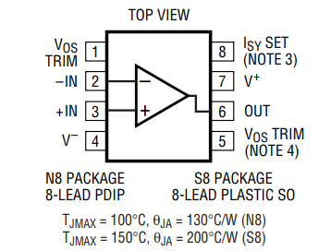
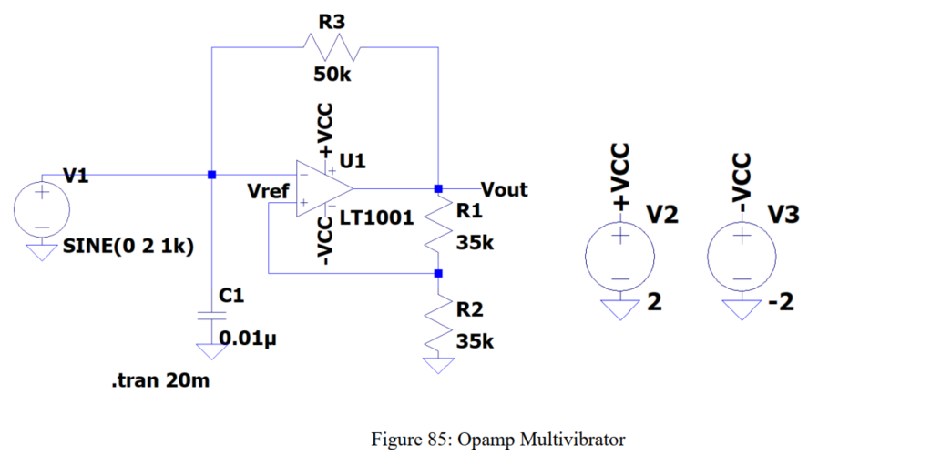
Opamp multivibrator circuit
Positive feedback here!

Slide 3
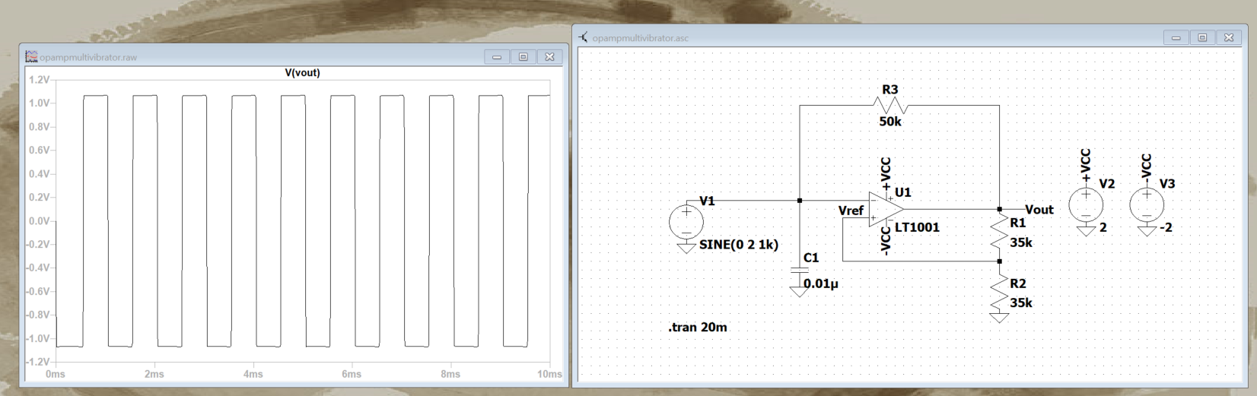
Input sine wave and output rectangular wave as shown below

Slide 4
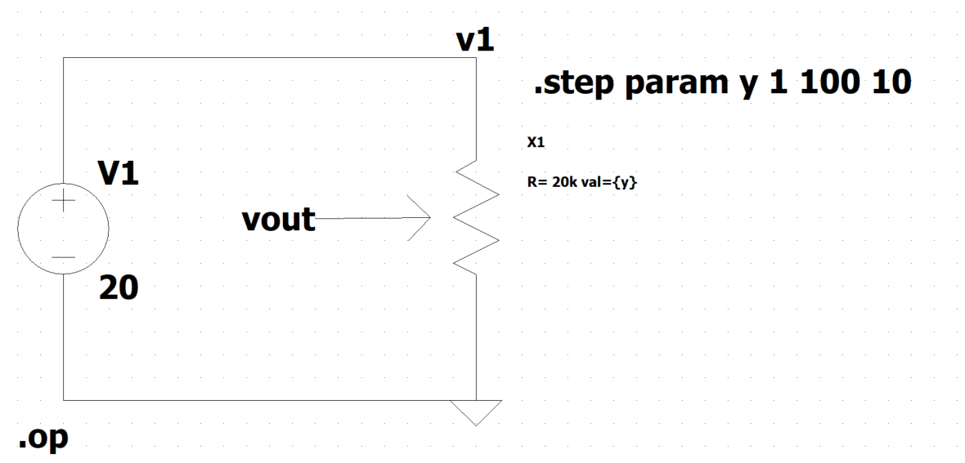
How to add a potentiometer
https://www.youtube.com/watch?v=e-Gp91AMQ80

Slide 5
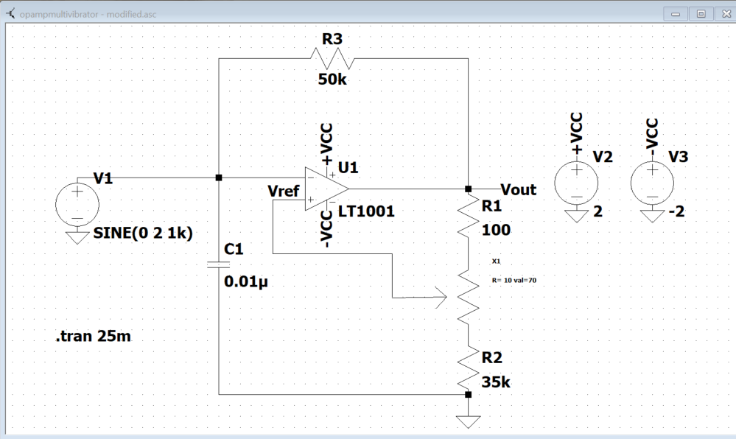
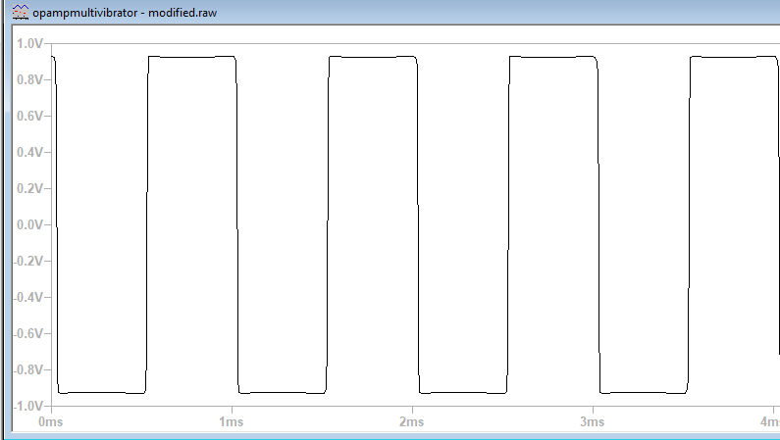
R and Val value
10ohm, 70V
35

Slide 6
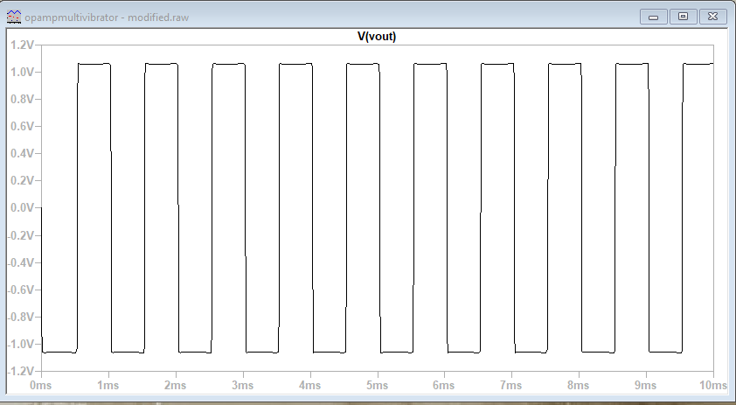
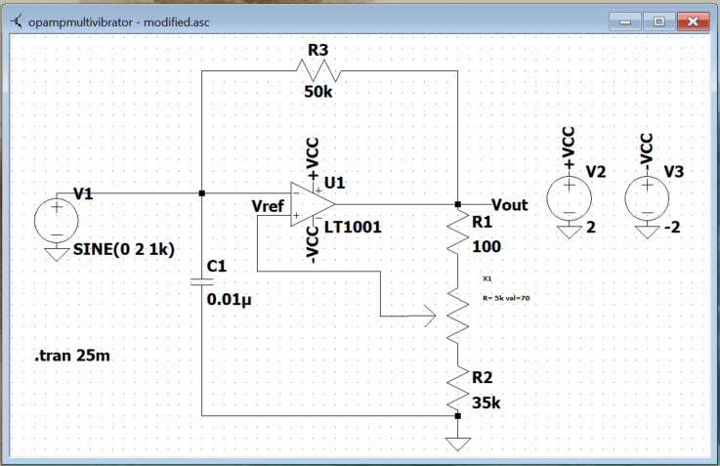
R and Val value
5kohm, 70V
35

Slide 7
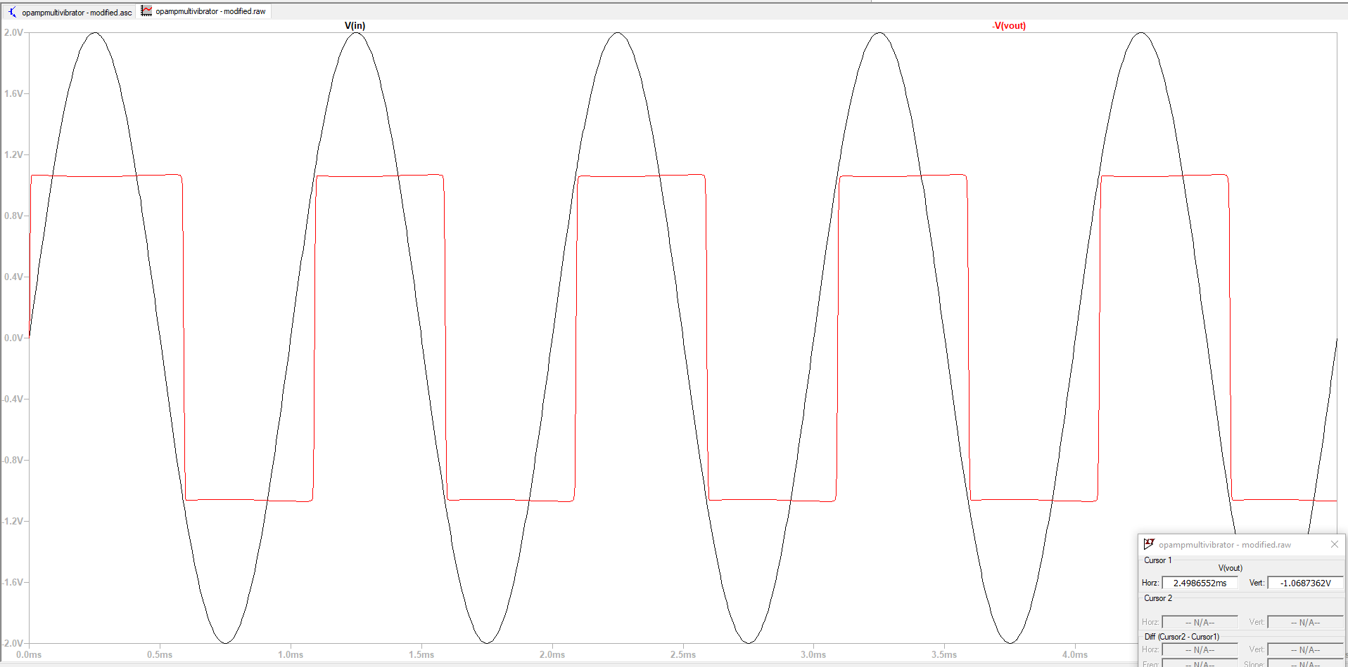
Show your calculation why square wave amplitude is this number (in your report)

Slide 8
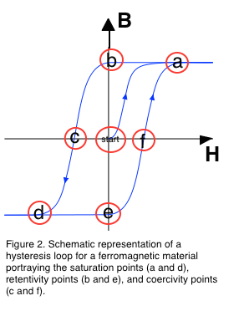
Test and fabricate Figure 85 onto the proto board/bread board. And check the output waveform in the oscilloscope.
Compare the waveform from LTspice with the one saved from oscilloscope. State the reason if they are not same.
This circuit is also called Op Amp based Schmitt Trigger circuits. If you are interested, you could read from this website or google it.
https://www.electronicshub.org/schmitt-trigger-basics/
It is also related to magnetic hysteresis, or known as Hysteresis loop structure.
https://eng.libretexts.org/Bookshelves/Materials_Science/Supplemental_Modules_(Materials_Science)/Magnetic_Properties/Magnetic_Hysteresis

Slide 9
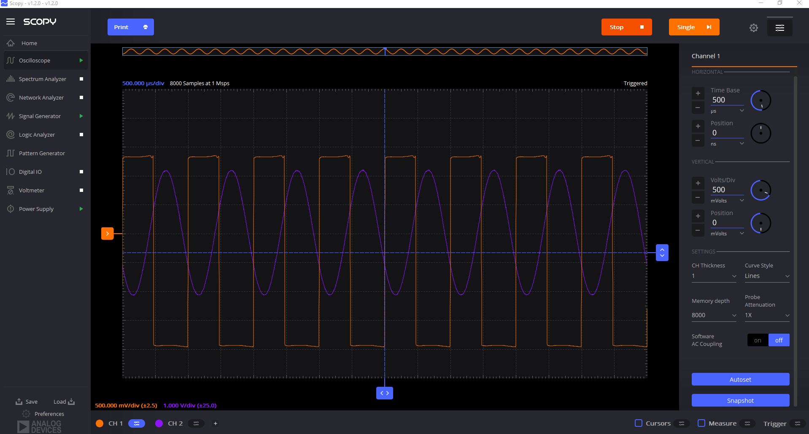
Example oscilloscope waveform with both Vin (purple) and Vout (in orange)

