Slide 1

GROUP 18 • IT PROJECT • NOVEMBER 2026
Hops
A campus safety network that works with
no internet, no mobile data and no signal.
PRESENTED BY
Victor · Hlonipha · Sade · Thrishen · Elijah · Nabihah · Jocelyn
PROJECT HOPS | GROUP 18
Notes:
COVER - 0:10 (Victor)
Good morning. We are Group 18, and this is Hops.
One line and move on: Hops is a campus safety network that works with no
internet, no mobile data and no signal. Do not explain how yet - the next
slide does that.

Slide 2
PROJECT HOPS • WHAT IT IS
Safety That Works With No Signal
Hops is a campus safety app that works with no internet, no data and no signal.
Phones talk straight to each other over Bluetooth.
Messages get passed along from phone to phone — so a call for help can travel further than any single phone can reach.
NO INTERNET
NO DATA
NO SIGNAL
Notes:
WHAT IT IS - 0:45 (Victor)
One click per line. Let each land before the next.
Line 1: it works with no internet, no data and no signal.
Line 2: phones talk straight to each other over Bluetooth - no pairing, no
router, no account needed between them.
Line 3: messages get passed from phone to phone, so a call for help travels
further than any single phone can reach.
Then the three pills: that is the whole promise - no internet, no data, no
signal.

Slide 3
HLONIPHA • WHY WE BUILT IT
Why We Built It
1
THE PROBLEM
Messaging apps and websites fail the moment data runs out or a dead zone blocks the signal.
One flare, relayed phone to phone
2
THE SAFETY CORE
In an emergency, “No internet connection” is the last thing anyone should see.
NO SERVER IN THE MIDDLE
Inspired by decentralised, peer-to-peer networks: messages exist only on the phones involved, never on a server.
3
direct range
SO WE BUILT A MESH
A call for help keeps travelling past the phones that heard it first — further than any one phone can reach.
4
Phones beyond direct range are still alerted
SOS
Notes:
WHY WE BUILT IT - 1:35 (Hlonipha)
Four clicks down the left, then the diagram.
1. The problem: apps and websites fail the moment data runs out or a dead
zone blocks the signal.
2. Why that matters: in an emergency, "No internet connection" is the last
thing anyone should see. That is the whole reason this exists.
3. The answer: decentralised, peer-to-peer. No server in the middle -
messages exist only on the phones involved.
4. So we built a mesh.
Then the diagram - this is the payoff, give it a beat. Someone sets off an
Emergency Flare. Every nearby phone sounds an alarm AND passes it on, so
phones outside the first phone's range still get alerted.
If there is time, the other half: the everyday features (crowd checks,
study finder, Watch Me, Hops Share, games) are what keep Hops installed, so
it is already on the phone on the day it matters. 8 optional features.

Slide 4








THE TECH STACK
Built to Work Offline First
Flutter & Dart
One codebase, two apps: student and staff
Kotlin
Android-specific code beside Flutter
Android Studio
Build, debug and test on real phones
Bluetooth Low Energy
The mesh: short broadcasts, no pairing
SQLite
Chats, tasks and vibe reports, kept on the phone
Supabase
Accounts and moderation only
PostgreSQL
Deny-all by default: no direct table access, ever
GitHub
Team collaboration and version control
Offline-first by design: only login and moderation ever touch the cloud.
Notes:
TECH STACK - 1:45 (Victor)
Three clicks: the top row, the bottom row, then the takeaway.
Flutter and Dart: one codebase builds both the student app and the staff
app.
Kotlin and Android Studio: the Android side, where we build, debug and test
on real phones.
Bluetooth Low Energy is the heart of the mesh: short coded broadcasts that
nearby phones read, with no pairing and no internet. 26 bytes per message,
which is the tightest constraint in the whole codebase.
SQLite stores chats, tasks and vibe reports on the phone itself (settings
live in the phone's own preferences store).
Supabase with PostgreSQL is the small cloud backend: accounts, passwords
(salted) and staff moderation. No direct table access at all - everything
goes through 65 locked-down commands.
GitHub is how seven of us worked on one codebase.
Close on the takeaway: only login and moderation ever touch the cloud.
Everything else stays on the phones - stay connected, informed and safe,
even in the dark.
HELD BACK FOR QUESTIONS - the three ways phones talk:
The megaphone (BLE): one phone reaches every phone in range at once. This
is behind almost every Hops feature.
The phone call (RFCOMM): a reliable two-way stream between two phones,
which a broadcast cannot give you. This is 1:1 chat.
The courier (Google Nearby Connections): a direct connection for
streaming files. This is Hops Share.
Also: one shared install serves the 5-tab Student App and the locked-down
Staff App.

Slide 5
NABIHAH • LIVE DEMONSTRATION
How We Will Demo It
STEP 1 — START AT THE WEBSITE
hopsapp.me
Everything starts here. Download the app from the site and install it — the only step in the whole demo that needs the internet.
1
2
3
PHONE 1 · STUDENT
PHONE 2 · STUDENT
PHONE 3 · ADMIN
Raises the flare
Hears it, relays it
The staff app
A Hops user sets off an Emergency Flare from the phone’s quick-settings tile.
A second user’s phone sounds the alarm and passes the flare on to anyone further out.
Sends a Community Alert and moderates accounts. Same APK as the student app, second entry point.
Then we switch Wi-Fi and mobile data off on all three. Everything after the download runs on Bluetooth alone.
Notes:
HOW WE WILL DEMO IT - 0:20 (Nabihah)
Three clicks. Set the room up before touching a phone.
Click 1 - the website. Everything starts at hopsapp.me/download.html.
That is where the app comes from, and it is the only step in the whole
demo that needs the internet. The QR on screen goes straight there if
anyone wants to follow along on their own phone.
Click 2 - the three phones. Two are ordinary Hops users. The third runs
the staff app. Worth saying out loud: it is the SAME APK - the admin app
is a second entry point into the same install, not a separate download.
Click 3 - then we switch Wi-Fi and mobile data off on all three, and
everything after that is Bluetooth alone.
Then run it: phone 1 raises a flare, phone 2 sounds and relays it, phone 3
sends a Community Alert back.
(The demo itself sits outside the five minutes.)

Slide 6
GROUP 18 • THANK YOU
Questions?
Hops is a campus safety network that needs no network.
DOWNLOAD THE APP
GROUP 18
hopsapp.me
Victor · Hlonipha · Sade · Thrishen · Elijah · Nabihah · Jocelyn
Notes:
QUESTIONS - 0:15, then Q&A (Q&A is outside the five minutes)
That is Hops. Happy to take questions.
Leave this slide up for the whole of Q&A - it holds the download link.
The app is at hopsapp.me.
Numbers anyone may quote: 3 ways phones talk, 26 bytes per Bluetooth
message, 8 optional features, 4.57/5 from 13 students.
The practice pack has the full question bank.
When questions are done, click once more for the sign-off.

Slide 7
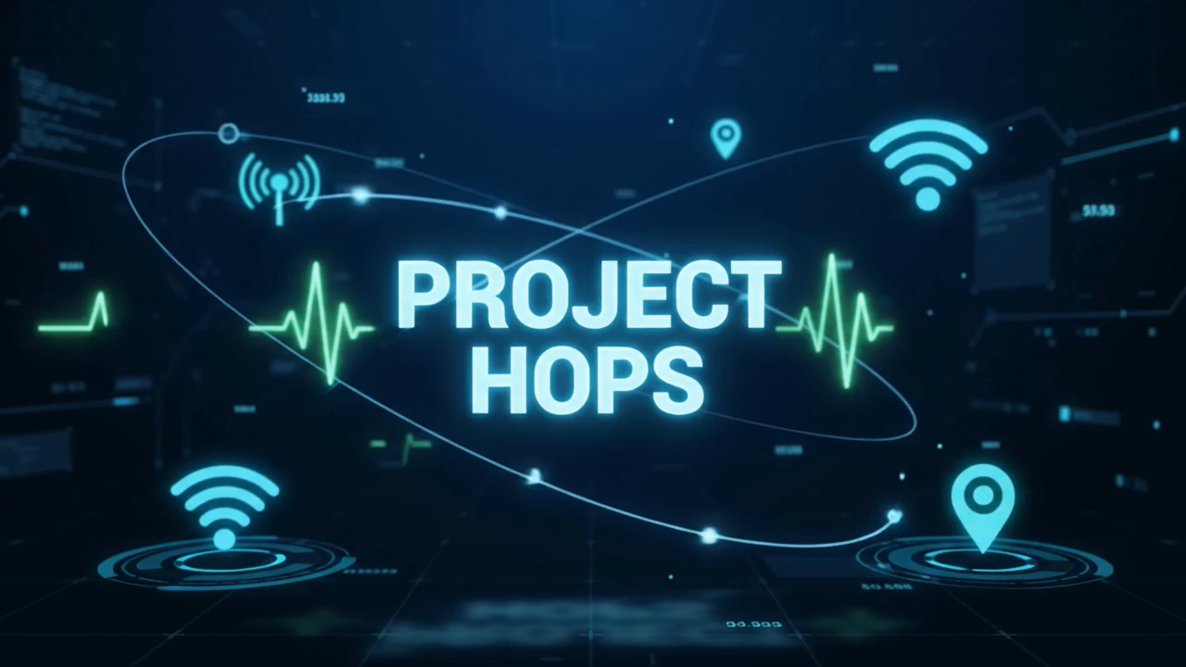
Notes:
SIGN-OFF - 0:10
A ten-second outro: the Hops bunny, "Thank You for Listening / Stay
Connected Offline".
Click once to play it. It is full screen and it has sound, so stop talking
over it and let it finish - this is the last thing the room sees.
If the sound does not come through on the day, say the line yourself:
thank you for listening, and stay connected offline.

