Slide 1
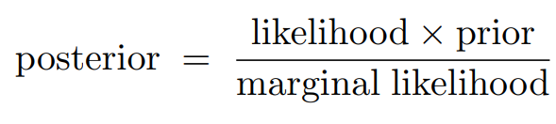







Gaussian Processes (GP) – An introduction
How does it work?
The same way one can generalize observed (continuous) data as a Gaussian distribution, one can generalize a function (such as a chemical process model) as a distribution of functions, called a Gaussian Process (GP)
Distribution of numbers
Distribution of functions
$$Σ(X)$$
$$Σ$$
Bayesian Inference
$$X_{1}$$
$$μ(X)$$
Uncertainty
$$μ$$
$$X_{2}$$
Mean prediction
Prediction
Data
Covariance function
$$GP≝\hat{Y}\left(X\right)=m\left(X\right)+k(X)$$
This concept has been extended to applications such as:
Computer Experiments^{[1]}, Flowsheet Optimization^{[2]}, Real-time Optimization^{[3]}
[1] Forrester A., Sobester A. and Keane A. (2008). John Wiley & Sons.
[2] Caballero, J. A. and Grossmann, I. E. (2008). AIChE Journal.
[3] Gomes, M.V.C (2007). PhD Thesis. UFRJ.

Slide 2
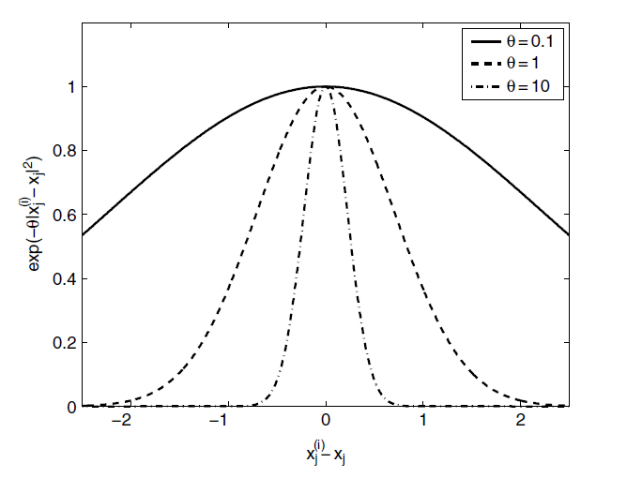
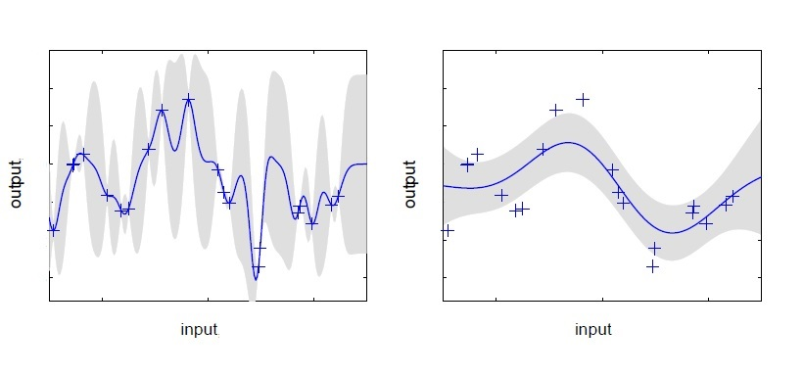
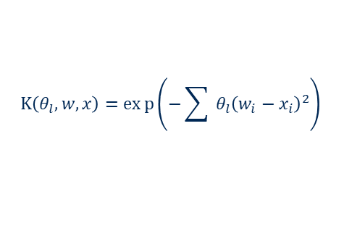


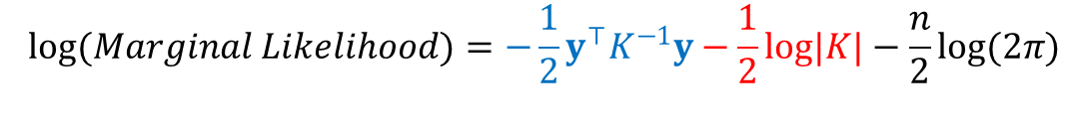

Gaussian Processes (GP) – An introduction
Gaussian Processes (GP) – An introduction
$$X_{1}$$
Uncertainty
Prediction
Data
Covariance function
$$X_{2}$$
Mean prediction
$$K\left(θ_{l},w,x\right)=exp\left(−\sum_{ }^{ }{ }θ_{l}{\left(w_{i}−x_{i}\right)}^{2}\right)$$
Squared exponential
$$GP≝\hat{Y}\left(X\right)=μ\left(X\right)+Σ(X)$$
[2]
Advantages
Flexible supervised machine-learning modeling of nonlinear processes
Non-parametric (differently from a nonlinear polynomial regression, for instance)
Hyperparameters interpretation (activity of length scale) is straightforward
Accurate statistical framework for predicting uncertainty
Disadvantages
It can scale poorly with extremely large datasets ( > 10,000)^{[4]} – Should not be prohibitive for Chemical Engineering applications
$$log(Marginal Likelihood)=−\frac{1}{2}y^{⊤}K^{−1}y−\frac{1}{2}log|K|−\frac{n}{2}log(2π)$$
GP estimation balances data fit and complexity of the predicted model^{[1]}: Occam’s Razor is automatic^{[3]}
[1]
[1] Rasmussen, C.E. and C.K.I. Williams. (2006). MIT Press.
[2] Forrester A., Sobester A. and Keane A. (2008). John Wiley & Sons.
[3] Moghaddan, B. Lectures notes from NASA’s JPL Machine Learning Group.
[4] Rasmussen, C.E. and C.K.I. Williams. (2006). MIT Press.
Notes:
This effect is called Occam’s razor after William of Occam 1285-1349, whose principle: “plurality should not be assumed without necessity” he used to encourage simplicity in explanations.

