Slide 1
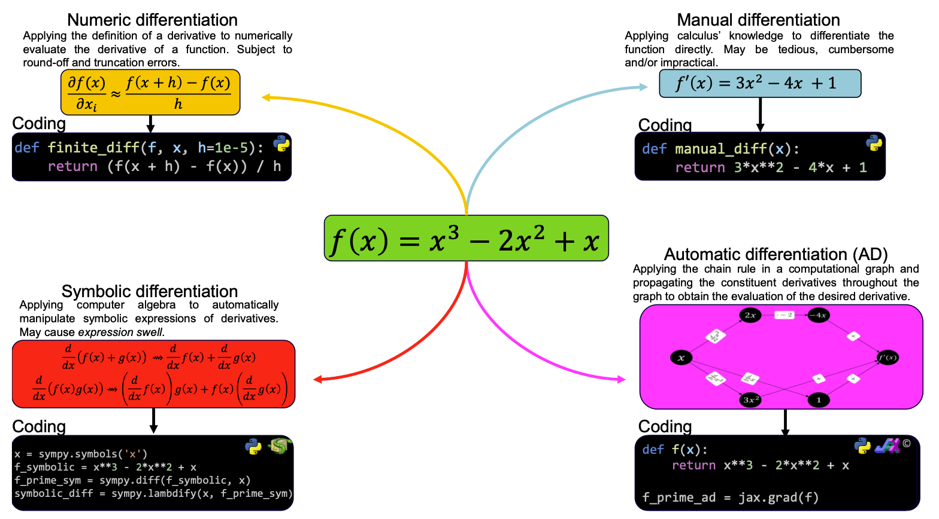
Differentiation techniques

Slide 2







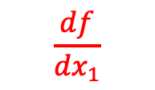



















Automatic differentiation (AD)
Effective way of accurately and timely evaluate high-order data, when compared against finite-differences and symbolic differentiation
AD in a nutshell: Intelligent use of the chain rule in computer code:
^{[2]}
$$f\left(x_{1},x_{2}\right)=\ln\left(x_{1}\right)+x_{1}x_{2}−\sin\left(x_{2}\right)$$
$$v_{4}=v_{1}+v_{2}$$
$${v_{−1},v}_{0}$$
$$v_{1}$$
$$v_{2}$$
$$v_{3}$$
$$v_{5}=v_{4}−v_{3}$$
$$\frac{df}{dx_{1}}$$
$$\frac{∂v_{1}}{∂x_{1}}=\frac{d\left(\ln\left(x_{1}\right)\right)}{dx_{1}}=\frac{1}{x_{1}}$$
$$\frac{∂v_{4}}{∂x_{1}}=\frac{∂v_{1}}{∂x_{1}}+\frac{∂v_{2}}{∂x_{1}}=\frac{1}{x_{1}}+x_{2}$$
$$\dot{x_{1}}$$
$$\dot{x_{1}}$$
$$\dot{v_{−1}}$$
$$\dot{v_{1}}$$
$$\dot{v_{4}}$$
$$\frac{∂x_{1}}{∂x_{1}}$$
$$\frac{∂v_{5}}{∂x_{1}}=\frac{1}{x_{1}}+x_{2}$$
$$\dot{v_{2}}$$
$$\dot{v_{5}}$$
$$\frac{1}{x_{1}}+x_{2}$$
$$\frac{∂v_{2}}{∂x_{1}}=\frac{d\left(x_{1}x_{2}\right)}{dx_{1}}=x_{2}$$
$$\dot{x_{2}}$$
$$\dot{x_{2}}$$
$$\dot{v_{0}}$$
$$\dot{v_{3}}$$
$$\frac{∂x_{2}}{∂x_{1}}$$
$$\frac{∂v_{3}}{∂x_{1}}=0$$
$$=$$

