Slide 1
L.A. restaurant research
NEW BUSINESS OPPORTUNITY
Viktor Akulinin, student
victor.akulinin@gmail.com
JULY, 2023
TripleTen

Slide 2
INTRO
We are a group of partners who decided to open a robot-run cafe in Los Angeles.
Using innovations - waiter robots, we plan to enter the market and take part of it.
Before launching the project, we studied the restaurant market in more detail. This presentation is the result of our research.
TripleTen

Slide 3
MARKET
In the study, we used data from more than 9,000 establishments in Los Angeles. The data includes information about the name of the institution, its type, the number of seats, its location, and belonging to a network institution.
Based on the data, we studied the existing patterns to determine the most appropriate size, and location, and whether it is worth becoming a chain establishment.
TripleTen

Slide 4
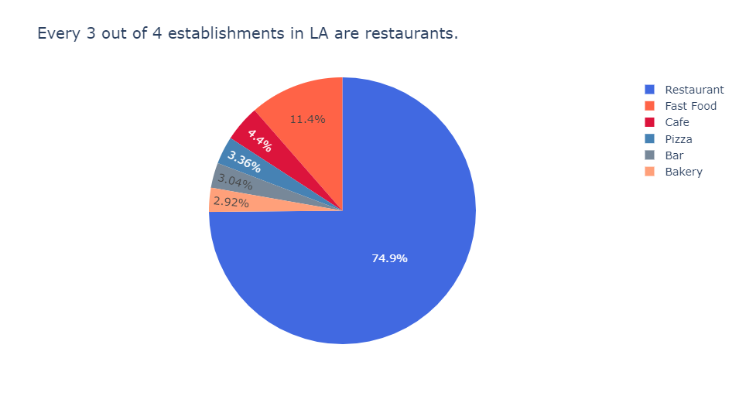
TYPES OF ESTABLISHMENTS
The most shareable type of establishments:
- 75% of establishments are occupied by restaurants
- 11.4% of establishments are occupied by fast-food
- 4.4% of establishments are occupied by a cafe
TripleTen

Slide 5
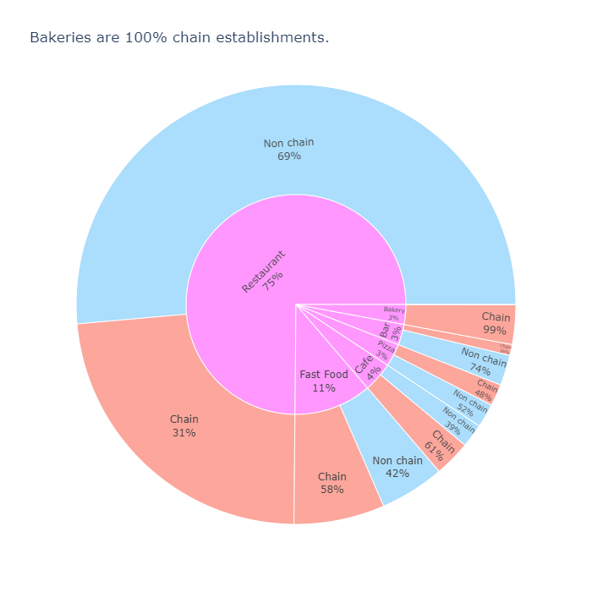
CHAINS
Extremes
The most common network establishments
- bakeries 99%
- cafe 61%
The most common non-chain establishments
- bar 74%
- restaurants - 68%
TripleTen

Slide 6
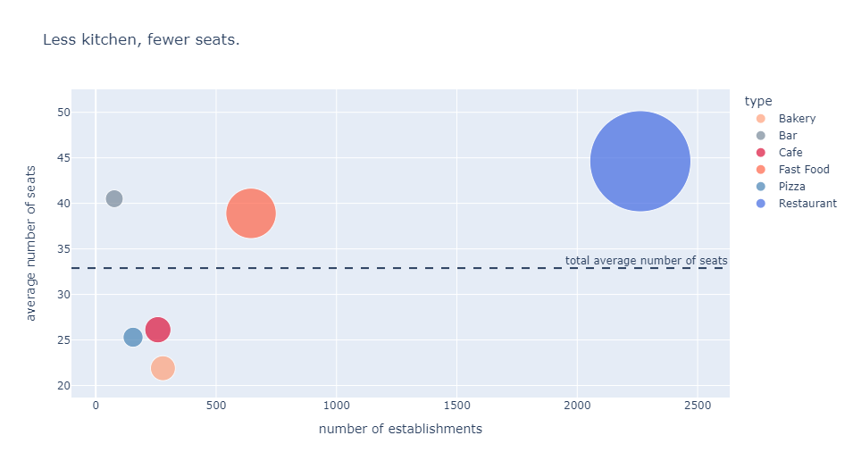
SEATS BY CHAINS
Сhain establishments are divided into two groups:
- Cafes, pizzerias, and bakeries mostly have few seats.
- Bars, fast food, and restaurants - on the contrary, are focused on many seats.
TripleTen

Slide 7
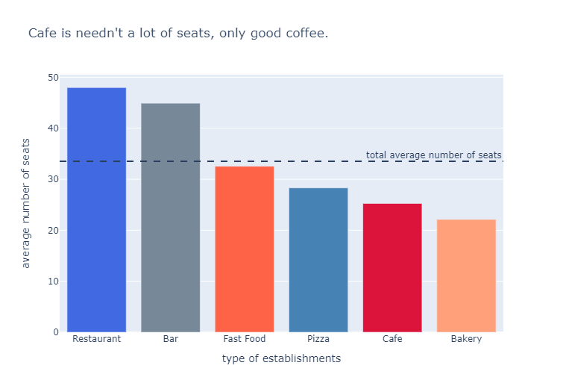
SEATS GENERAL
The average number of seats in restaurants and bars is the highest.
The average number of seats for cafes in chain establishments is higher than the same general indicator for chain and non-chain establishments.
Opening the first cafe, you should not chase after a large number of seats.
TripleTen

Slide 8
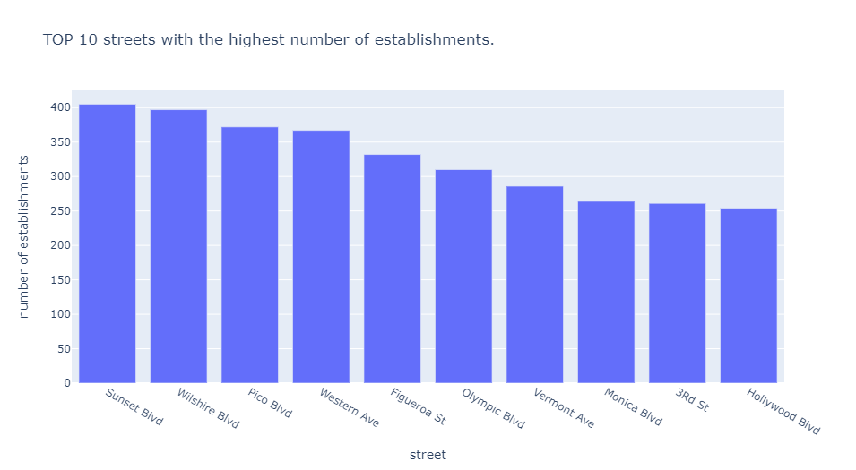
STREETS
The TOP 10 streets (2%) have between 250 and 405 establishments on each street, which is about 30% of the total number of establishments.
At the same time, 229 streets (44%) have no more than 1 establishment, which in total is 2.5% of the total number of establishments.
TripleTen

Slide 9
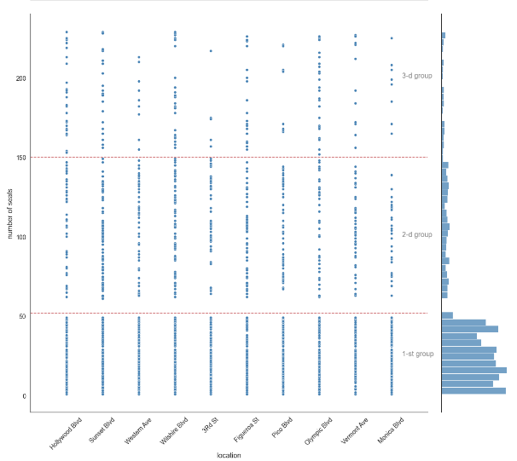
LOCATIONS
The schedule shows that most of the establishments work with a number of seats up to 50, with a larger number - the number of establishments decreases.
Most of all on these streets there are establishments with the number of seats in the range of 16 - 20.
TripleTen

Slide 10
FINAL RECOMMENDATION
We recommend opening a small cafe for up to 20 seats on a popular street in a passing place.
Robot service innovation will surely attract customers, and high traffic will create recognition. After increasing awareness, it will be possible to scale, which will undoubtedly improve financial performance.
TripleTen

Slide 11
Thank you!
NEW BUSINESS OPPORTUNITY
Viktor Akulinin, student
victor.akulinin@gmail.com
JULY, 2023
TripleTen

