Slide 1


The Last Thirty Days
By Victor Arjona
An analysis of the Data file provided by Anna Fisher using Python, Pandas, and Matplotlib.

Slide 2
Content
1. General information
  1.1 What columns do we have and what do they represent?
  1.2 What are the contents of each of these columns?
  1.3 What’s the frequency of applications throughout the month in total?
  1.4 What time span are we in here?
  1.5 What are some stats on the amounts requested?
  1.6 What’s the count for online/store channels? Percentage?
  1.7 How much revenue did we get?
  1.8 how much loss did we get?
  1.9 What are the counts for each decision code? Percentage?
  1.10 What are the counts for each decision? Percentage?

Slide 3
Content
2. Specific questions provided by email
  2.1 What is the bad rate, approval rate, and average loan amount by channel?
  2.2 What is the bad rate, approval rate, and average loan amount by risk?
  2.3 What do you think the different risk (N, J, B) likely represent?

Slide 4
Content
3. Further analysis
  3.1 What’s the frequency of Approve/Decline rate?
  3.2
  3.3

Slide 5
1. General information
1.1 What columns do we have and what do they represent?
1.2 What are the contents of each of these columns?
Original name | New label | Description
Application ID | id | Identifier for the person asking for a loan amount.
Application Date | date | The date at which the applicant made a loan request.
Channel | chnl | The channel the application was made.
Amount Requested | amt_req | The total amount requested.
Risk Class | risk | Risk awarded.
Decision | dec | Decision made.
Decision Code | dec_code | Decision code.
Outcome | out | FILL IN LATER
Revenue/(Loss) | rev_loss | Amount gained/lost.

Slide 6
1. General information
1.2 What are the contents of each of these columns?
1.2.1 What type of data is the content?
Renamed columns | Content | New content
id | An identifier string | LOOK MORE INTO IT
date | String timestamp | Pandas Timestamp
chnl | Two string options: Store, Online. | -
amt_req | String dollar amounts. | Float.
risk | Three string values: B, N, and J | -
dec | Strings: Decline and Approval | -
dec_code | Strings: U, S, and D | -
out | Strings: nan, Bad = Default, Good = Pay | Numpy nan (float); strings: bad, good
rev_loss | Strings of values in dollar amounts. Contained dollar signs and parentheses. | Turned into a floating point number.

Slide 7
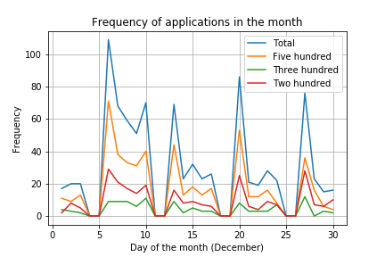
1. General information
1.3 What’s the frequency of applications in the month?
1.4 What time span are we in here?
The starting date is Wednesday 1 of December, 2010.
The last date is Friday 31 of December, 2010.
Total span of time: 30 days
The drops in frequency could be explained by business hours, hence the activity for five days.

Slide 8
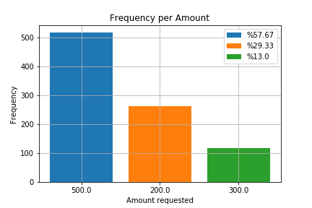
1. General information
1.5 What are some stats on the amounts requested?
There were three amounts requested: $500.00, $200.00, and $300.00.
$500.00 had %57.67 of the requests made this month.
$200.00 had %29.33 of the requests made this month.
$300.00 had %13.0 of the requests made this month.

Slide 9
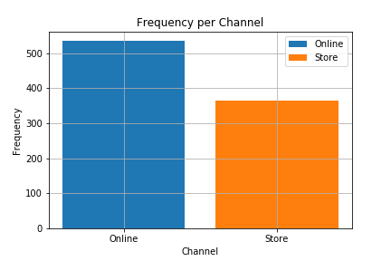
1. General information
1.6 What is the count for online/store channels? Percentage?
There were 2 channels: Online, and Store.
Online had %59.56 of the requests made this month.
Store had %40.44 of the requests made this month.

Slide 10
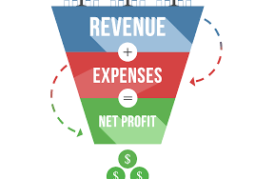
1. General information
1.7 How much revenue did we get?
1.8 How much did we lose?
There was a total of $11350.00 in revenue.
There was a total of $9400.00 in loss.
That gives us a total profit of $1950.00.

Slide 11
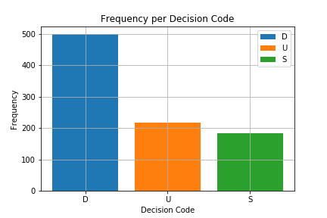
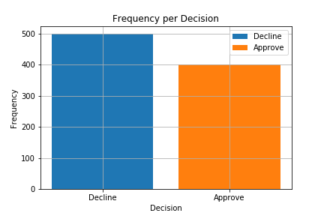
1. General information
1.9 What are the counts for each decision code? Percentage?
1.10 What are the counts for each decision? Percentage?
There were 3 decision codes: D, U, and S.
D had %55.56 of the requests made this month.
U had %24.11 of the requests made this month.
S had %20.33 of the requests made this month.
There were 2 different decisions: Decline, and Approve.
Decline had %55.56 of the requests made this month - 500/900.
Approve had %44.44 of the requests made this month - 400/900.

Slide 12
Total online pop = 536, 60%
Total store pop = 364, 40%

Slide 13

2. Specific questions provided by email
2.1 What is the bad rate, approval rate, and average loan amount by channel?
The Decline rate by channel is %78.54 for Online and %21.7 for Store.

Slide 14

Decline rates
The Decline rate by risk is %34.28 for B, %68.25 for N, and %87.19 for J.

Slide 15


Approve rates
The Approve rate by channel is %21.46 for Online and %78.3 for Store.
The Approve rate by risk is %65.72 for J, %31.75 for N, and %12.81 for B.

Slide 16

Average loan amounts per channel/risk
The average loan amount requested per channel is $394.03 for Online and $374.18 for Store.
The average loan amount requested per risk is $392.9 for B, $392.06 for J, and $371.17 for N.

