Slide 1
Chapter 1: Introduction to Switched Networks
Routing And Switching
Notes:
Cisco Networking Academy program
Routing & Switching
Chapter 1: Introduction to Switched Networks

Slide 2
Chapter 1
1.0 Introduction
1.1 LAN Design
1.2 The Switched Environment
1.3 Summary
Notes:
Chapter 1

Slide 3
Chapter 1: Objectives
Describe convergence of data, voice and video in the context of switched networks
Describe a switched network in a small to medium-sized business
Explain the process of frame forwarding in a switched network
Compare a collision domain to a broadcast domain
Notes:
1.

Slide 4
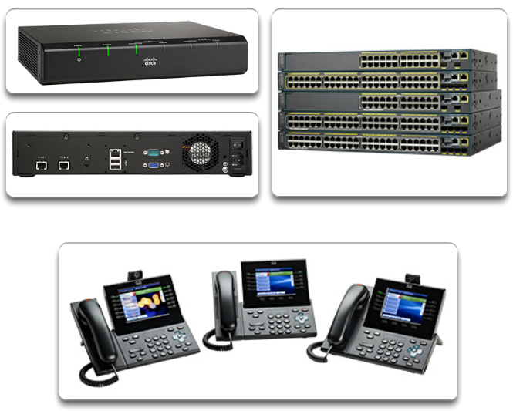
Converged Networks Growing Complexity of Networks
Our digital world is changing
Information must be accessed from anywhere in the world
Networks must be secure, reliable, and highly available
Notes:
1.1 LAN Design
1.1.1 Converged Networks
1.1.1.1 Growing Complexity of Networks

Slide 5
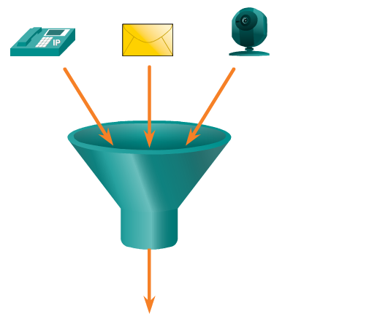
Converged Networks Elements Of A Converged Network
Collaboration is a requirement
To support collaboration, networks employ converged solutions
Data services such as voice systems, IP phones, voice gateways, video support, and video conferencing
Call control, voice messaging, mobility and automated attendant are also common features
Notes:
1.1 LAN Design
1.1.1 Converged Networks
1.1.1.2 Elements Of A Converged Network

Slide 6
Converged Networks Elements Of A Converged Network
Benefits of Converged Networks include:
Multiple types of traffic; Only one network to manage
Substantial savings over installation and management of separate voice, video and data networks
Integrates IT management
Notes:
1.1 LAN Design
1.1.1 Converged Networks
1.1.1.2 Elements Of A Converged Network

Slide 7
Converged Networks Borderless Switched Networks
Cisco Borderless Network is a network architecture that allow organizations to connect anyone, anywhere, anytime, and on any device securely, reliably, and seamlessly
It is designed to address IT and business challenges, such as supporting the converged network and changing work patterns
Notes:
1.1 LAN Design
1.1.1 Converged Networks
1.1.1.3 Borderless Switched Networks

Slide 8
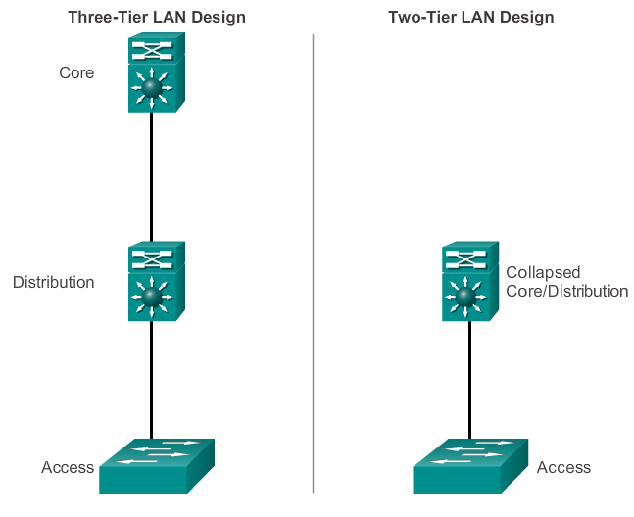
Converged Networks Hierarchy in the Borderless Switched Network
Borderless switched network design guidelines are built upon the following principles:
Hierarchical
Modularity
Resiliency
Flexibility
Notes:
1.1 LAN Design
1.1.1 Converged Networks
1.1.1.4 Hierarchy in the Borderless Switched Network

Slide 9
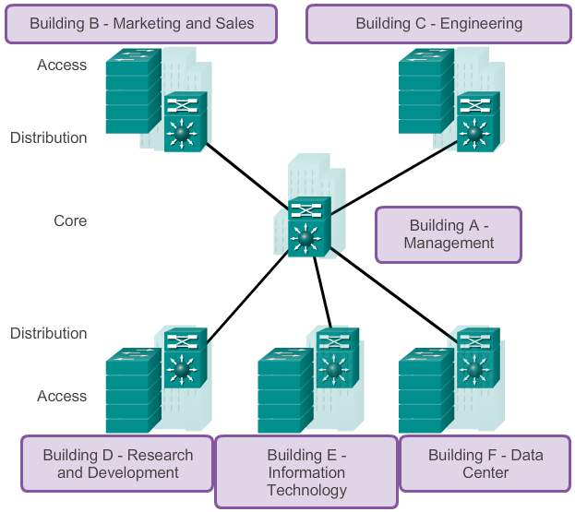
Converged Networks Core, Distribution, Access
Notes:
1.1 LAN Design
1.1.1 Converged Networks
1.1.1.5 Core, Distribution, Access

Slide 10
Switched Networks Role of Switched Networks
The role of switched networks has evolved
A switched LAN allows more flexibility, traffic management
It also support features such as quality of service, additional security, support for wireless, support for IP telephony and mobility services
Notes:
1.1 LAN Design
1.1.2 Switched Networks
1.1.2.1 Role of Switched Networks

Slide 11
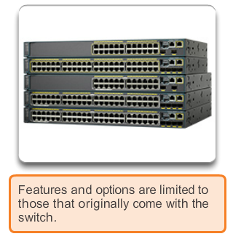
Switched Networks Form Factor
Fixed
Notes:
1.1 LAN Design
1.1.2 Switched Networks
1.1.2.2 Form Factor

Slide 12
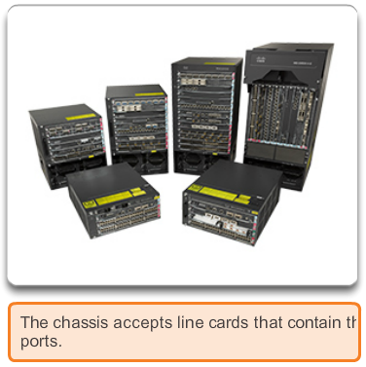
Switched Networks Form Factor
Modular
Notes:
1.1 LAN Design
1.1.2 Switched Networks
1.1.2.2 Form Factor

Slide 13
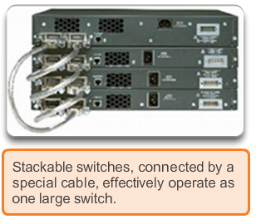
Switched Networks Form Factor
Stackable
Notes:
1.1 LAN Design
1.1.2 Switched Networks
1.1.2.2 Form Factor

Slide 14
Frame Forwarding Switching as a General Concept
A Switch makes a decision based on ingress and destination port
A LAN switch keeps a table that it uses to determine how to forward traffic through the switch
Cisco LAN switches forward Ethernet frames based on the destination MAC address of the frames.
Notes:
1.2 The Switched Environment
1.2.1 Frame Forwarding
1.2.1.1 Switching as a General Concept in Networking and Telecommunications

Slide 15
Frame Forwarding Dynamically Populating a Switch MAC Address Table
A switch must first learn which devices exist on each port before it can transmit a frame
It builds a table called a MAC address, or content addressable memory (CAM) table
The mapping device <-> port is stored in the CAM table
CAM is a special type of memory used in high-speed searching applications.
The information in the MAC address table I used to send frames
When a switch receives an incoming frame with a MAC address that is not found in the CAM table, it floods it to all ports but the one that received the frame.
Notes:
1.2 The Switched Environment
1.2.1 Frame Forwarding
1.2.1.2 Dynamically Populating a Switch MAC Address Table

Slide 16
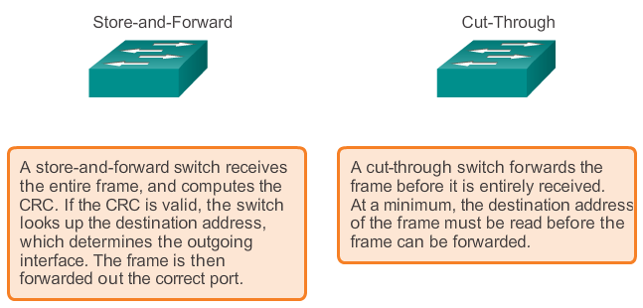
Frame Forwarding Switch Forwarding Methods
Notes:
1.2 The Switched Environment
1.2.1 Frame Forwarding
1.2.1.3 Switch Forwarding Methods

Slide 17
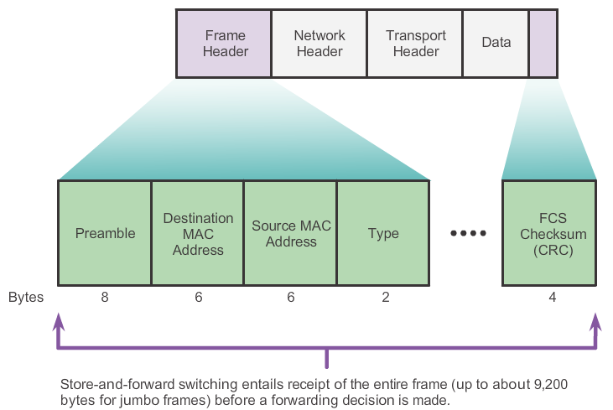
Frame Forwarding Store-and-Forward Switching
Store-and-Forwarding allows the switch to:
Check for errors (via FCS check)
Perform Automatic Buffering
Slower forwarding
Notes:
1.2 The Switched Environment
1.2.1 Frame Forwarding
1.2.1.4 Store-and-Forward Switching

Slide 18
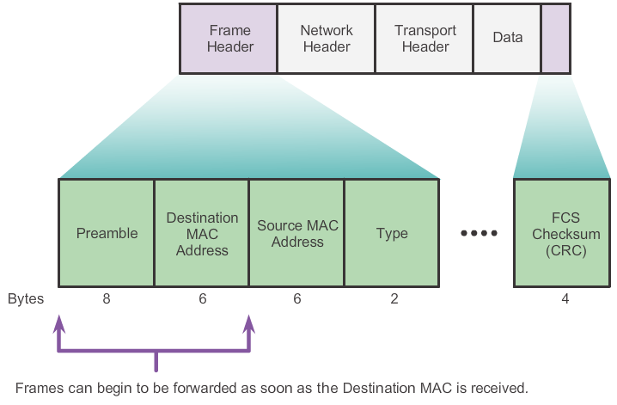
Frame Forwarding Cut-Through Switching
Cut-Through allows the switch to start forwarding in about 10 microseconds
No FCS check
No Automatic Buffering
Notes:
1.2 The Switched Environment
1.2.1 Frame Forwarding
1.2.1.5 Cut-Through Switching

Slide 19
Switching Domains Collision Domains
Collision domain is the segment where devices must compete to communicate
All ports of a hub belong to the same collision domain
Every port of a switch is a collision domain on its own
A switch break the segment into smaller collision domains, easing device competition.
Notes:
1.2 The Switched Environment
1.2.2 Switching Domains
1.2.2.1 Collision Domains

Slide 20
Switching Domains Broadcast Domains
Broadcast domain is the extend of the network where a broadcast frame can be heard.
Switches forward broadcast frames to all ports. Therefore switches don’t break broadcast domains.
All ports of a switch (with its default configuration) belong to the same broadcast domain
If two or more switches are connected, broadcasts will be forward to all ports of all switches (except for the port that originally received the broadcast)
Notes:
1.2 The Switched Environment
1.2.2 Switching Domains
1.2.2.2 Broadcast Domains

Slide 21
Switching Domains Alleviating Network Congestion
Switches help alleviating network congestion by:
facilitating the segmentation of a LAN into separate collision domains
providing full-duplex communication between devices
taking advantage of their high port density
buffering large frames
employing high speed ports
taking advantage of their fast internal switching process
having a low per-port cost
Notes:
1.2 The Switched Environment
1.2.2 Switching Domains
1.2.2.4 Alleviating Network Congestion

Slide 22
Chapter 1: Summary
This chapter showed that the trend in networks is towards convergence using a single set of wires and devices to handle voice, video, and data transmission.
In addition, there has been a dramatic shift in the way businesses operate.
No physical offices or geographic boundaries constraints. Resources must now be seamlessly available anytime and anywhere.
The Cisco Borderless Network architecture enables different elements, from access switches to wireless access points, to work together and allow users to access resources from any place at any time.
Notes:
Chapter 1 Summary

Slide 23
Chapter 1: Summary
The traditional three-layer hierarchical design model divides the network into core, distribution and access layers, and allows each portion of the network to be optimized for specific functionality.
It provides modularity, resiliency, and flexibility, which provides a foundation that allows network designers to overlay security, mobility, and unified communication features.
Switches use either store-and-forward or cut-through switching.
Every port on a switch forms a separate collision domain allowing for extremely high-speed full-duplex communication.
Notes:
Chapter 1 Summary

Slide 24
Chapter 1: Summary
Switch ports do not block broadcasts and connecting switches together can extend the size of the broadcast domain often resulting in degraded network performance
Notes:
Chapter 1 Summary

Slide 25


