Slide 1
Chapter 2: Introduction to Switched Networks
Routing And Switching
Notes:
Cisco Networking Academy program
Routing & Switching
Chapter 2: Introduction to Switched Networks

Slide 2
Chapter 2
2.0 Introduction
2.1 Basic Switch Configuration
2.2 Switch Security: Management and Implementation
Notes:
Chapter 2

Slide 3
Chapter 2: Objectives
Explain the advantages and disadvantages of static routing
Configure initial settings on a Cisco switch
Configure switch ports to meet network requirements
Configure the management switch virtual interface
Describe basic security attacks in a switched environment
Describe security best practices in a switched environment
Configure the port security feature to restrict network access
Notes:
2.

Slide 4
Basic Switch Configuration Switch Boot Sequence
POST
Run boot loader software
Boot loader does low-level CPU initialization
Boot loader initializes the flash filesystem
Boot loader locates and loads a default IOS operating system software image into memory and hands control of the switch over to the IOS.
Notes:
2.1 Basic Switch Configuration
2.1.1 Configure a Switch With Initial Settings
2.1.1.1 Switch Boot Sequence

Slide 5
Basic Switch Configuration Switch Boot Sequence
In order to find a suitable IOS image, the switch goes through the following steps:
It attempts to automatically boot by using information in the BOOT environment variable
If this variable is not set, the switch performs a top-to-bottom search through the flash file system. It will load and execute the first executable file, if it can.
The IOS operating system then initializes the interfaces using the Cisco IOS commands found in the configuration file, startup configuration, which is stored in NVRAM.
Note: the command boot system can be used to set the BOOT environment variable.
Notes:
2.1 Basic Switch Configuration
2.1.1 Configure a Switch With Initial Settings
2.1.1.1 Switch Boot Sequence
Note: the BOOT environment variable is set using the boot system global configuration mode command. Use the show bootvar command to see to what the current IOS boot file is set.

Slide 6
Basic Switch Configuration Recovering From a System Crash
The boot loader can also be used to manage the switch if the IOS can’t be loaded.
The boot loader can be accessed through a console connection by:
Connect a PC by console cable to the switch console port. Unplug the switch power cord.
Reconnect the power cord to the switch and press and hold down the Mode button.
The System LED turns briefly amber and then solid green. Release the Mode button.
The boot loader switch:prompt appears in the terminal emulation software on the PC.
Notes:
2.1 Basic Switch Configuration
2.1.1 Configure a Switch With Initial Settings
2.1.1.2 Recovering From a System Crash

Slide 7
Basic Switch Configuration Switch LED Indicators
Each port on Cisco Catalyst switches have status LED indicator lights.
By default these LED lights reflect port activity but they can also provide other information about the switch through the Mode button
The following modes are available on Cisco Catalyst 2960 switches:
System LED
Redundant Power System (RPS) LED
Port Status LED
Port Duplex LED
Port Speed LED
Power over Ethernet (PoE) Mode LED
Notes:
2.1 Basic Switch Configuration
2.1.1 Configure a Switch With Initial Settings
2.1.1.3 Switch LED Indicators

Slide 8
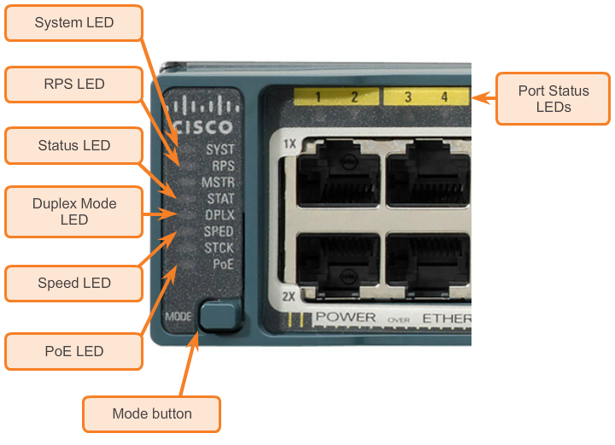
Basic Switch Configuration Switch LED Indicators
Cisco Catalyst 2960 switch modes
Notes:
2.1 Basic Switch Configuration
2.1.1 Configure a Switch With Initial Settings
2.1.1.3 Switch LED Indicators

Slide 9
Basic Switch Configuration Preparing for Basic Switch Management
In order to remotely manage a Cisco switch, it needs to be configured to access the network
An IP address and a subnet mask must be configured
If managing the switch from a remote network, a default gateway must also be configured
The IP information (address, subnet mask, gateway) is to be assigned to a switch SVI (switch virtual interface)
Although these IP settings allow remote management and remote access to the switch, they do not allow the switch to route Layer 3 packets.
Notes:
2.1 Basic Switch Configuration
2.1.1 Configure a Switch With Initial Settings
2.1.1.4 Preparing for Basic Switch Management

Slide 10
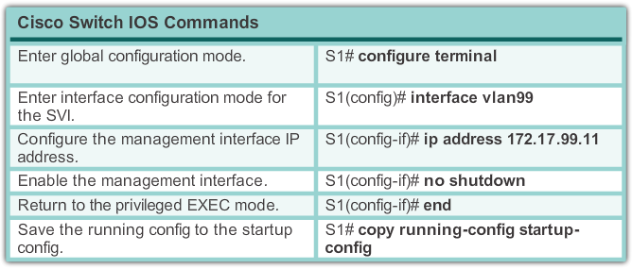
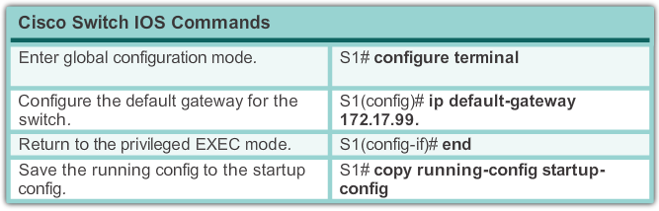
Basic Switch Configuration Preparing for Basic Switch Management
Notes:
2.1 Basic Switch Configuration
2.1.1 Configure a Switch With Initial Settings
2.1.1.4 Preparing for Basic Switch Management

Slide 11
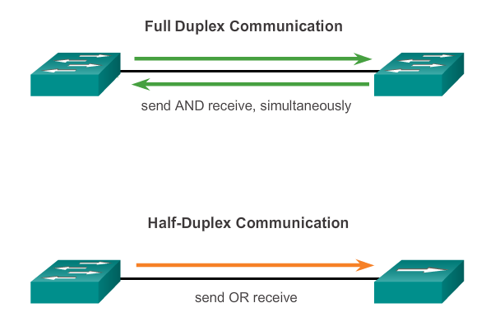
Configure Switch Ports Duplex Communication
Notes:
2.1 Basic Switch Configuration
2.1.2 Configure Switch Ports
2.1.2.1 Duplex Communication

Slide 12
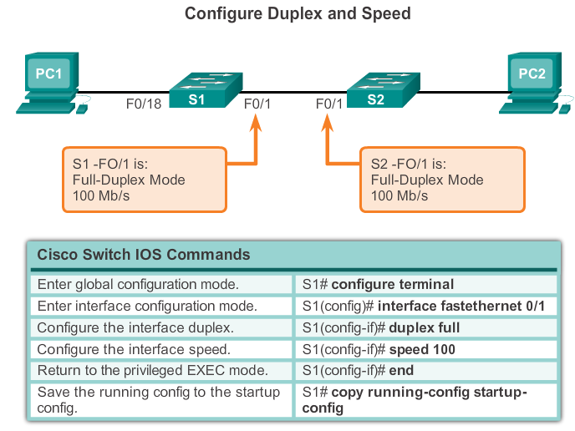
Configure Switch Ports Configure Switch Ports at the Physical Layer
Notes:
2.1 Basic Switch Configuration
2.1.2 Configure Switch Ports
2.1.2.2 Configure Switch Ports at the Physical Layer

Slide 13
Configure Switch Ports MDIX Auto Feature
Certain cable types (straight-through or crossover) were required when connecting devices
The automatic medium-dependent interface crossover (auto-MDIX) feature eliminates this problem
When auto-MDIX is enabled, the interface automatically detects and configures the connection appropriately
When using auto-MDIX on an interface, the interface speed and duplex must be set to auto
Notes:
2.1 Basic Switch Configuration
2.1.2 Configure Switch Ports
2.1.2.3 MDIX Auto Feature

Slide 14
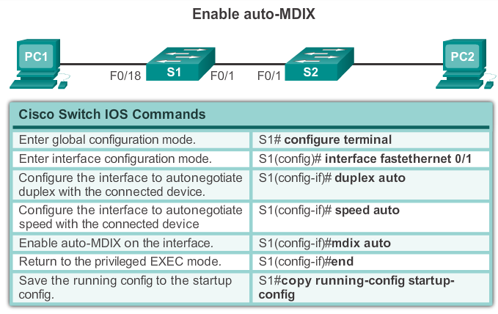
Configure Switch Ports MDIX Auto Feature
Notes:
2.1 Basic Switch Configuration
2.1.2 Configure Switch Ports
2.1.2.3 MDIX Auto Feature

Slide 15
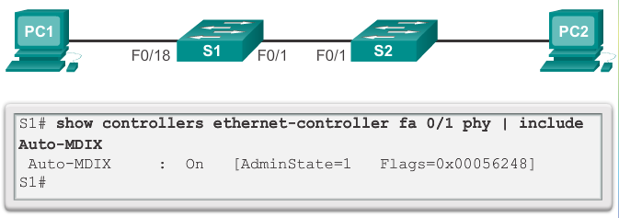
Configure Switch Ports MDIX Auto Feature
Notes:
2.1 Basic Switch Configuration
2.1.2 Configure Switch Ports
2.1.2.3 MDIX Auto Feature

Slide 16
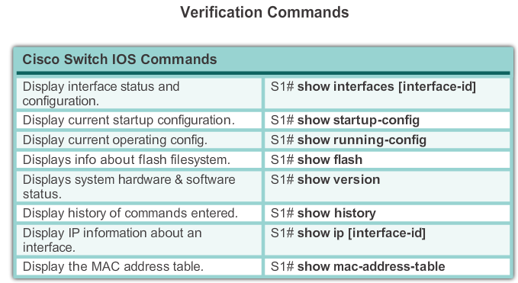
Configure Switch Ports Verifying Switch Port Configuration
Notes:
2.1 Basic Switch Configuration
2.1.2 Configure Switch Ports
2.1.2.4 Verifying Switch Port Configuration

Slide 17
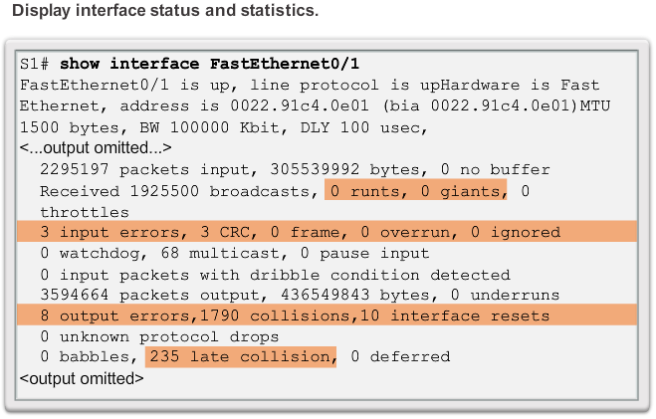
Configure Switch Ports Network Access Layer Issues
Notes:
2.1 Basic Switch Configuration
2.1.2 Configure Switch Ports
2.1.2.5 Network Access Layer Issues

Slide 18
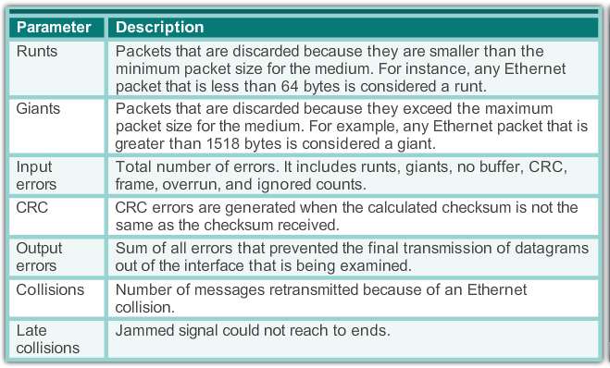
Configure Switch Ports Network Access Layer Issues
Notes:
2.1 Basic Switch Configuration
2.1.2 Configure Switch Ports
2.1.2.5 Network Access Layer Issues

Slide 19
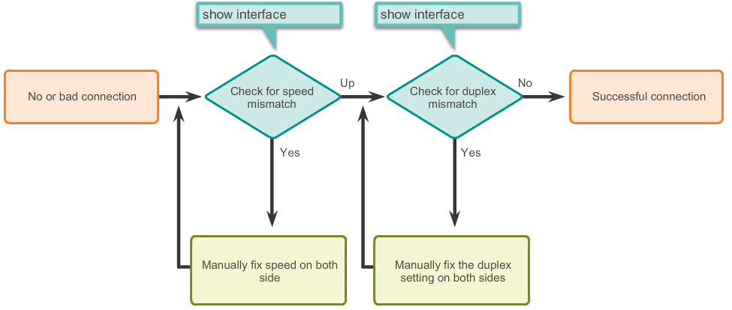
Configure Switch Ports Network Access Layer Issues
Troubleshooting Switch Media (connection) issues
Notes:
2.1 Basic Switch Configuration
2.1.2 Configure Switch Ports
2.1.2.6 Troubleshooting Network Access Layer Issues

Slide 20
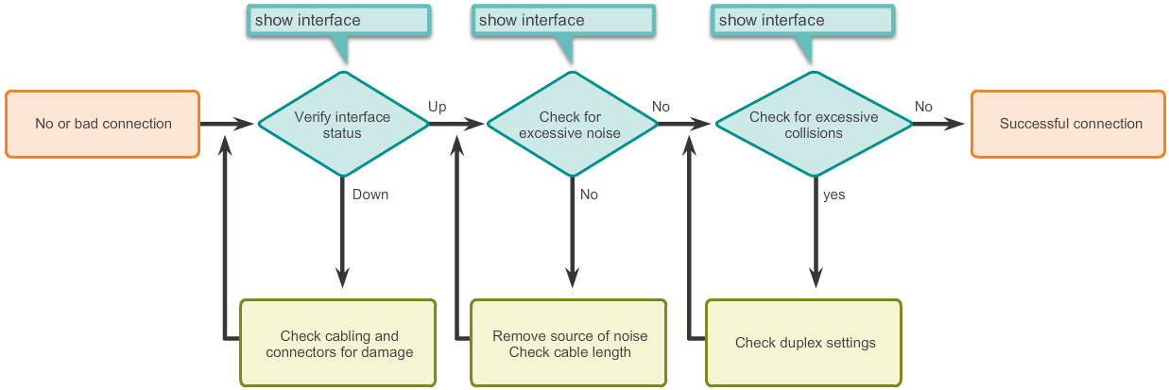
Configure Switch Ports Network Access Layer Issues
Troubleshooting Interface-related issues
Notes:
2.1 Basic Switch Configuration
2.1.2 Configure Switch Ports
2.1.2.6 Troubleshooting Network Access Layer Issues

Slide 21
Secure Remote Access SSH Operation
Secure Shell (SSH) is a protocol that provides a secure (encrypted) command-line based connection to a remote device
SSH is commonly used in UNIX-based systems
Cisco IOS also supports SSH
A version of the IOS software including cryptographic (encrypted) features and capabilities is required in order to enable SSH on Catalyst 2960 switches
Because its strong encryption features, SSH should replace Telnet for management connections
SSH uses TCP port 22 by default. Telnet uses TCP port 23
Notes:
2.2 Switch Security: Management and Implementation
2.2.1 Secure Remote Access
2.2.1.1 SSH Operation

Slide 22
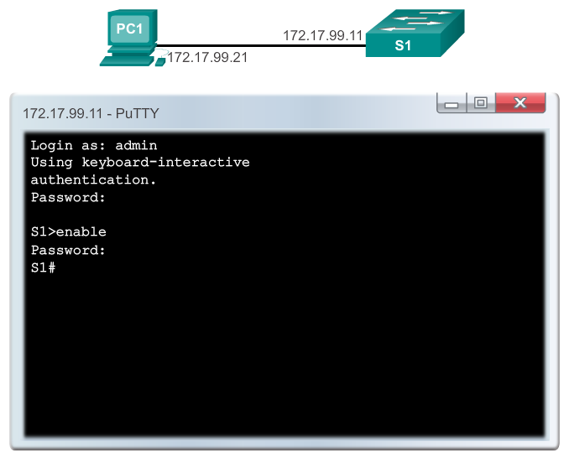
Secure Remote Access SSH Operation
Notes:
2.2 Switch Security: Management and Implementation
2.2.1 Secure Remote Access
2.2.1.1 SSH Operation

Slide 23
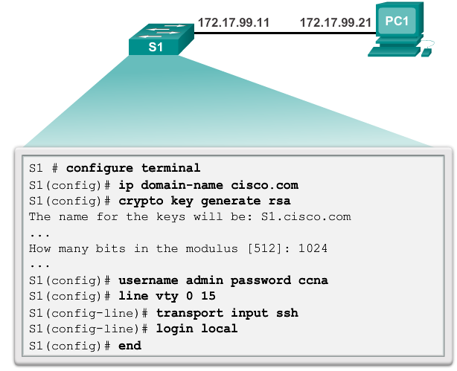
Secure Remote Access Configuring SSH
Notes:
2.2 Switch Security: Management and Implementation
2.2.1 Secure Remote Access
2.2.1.2 Configuring SSH

Slide 24
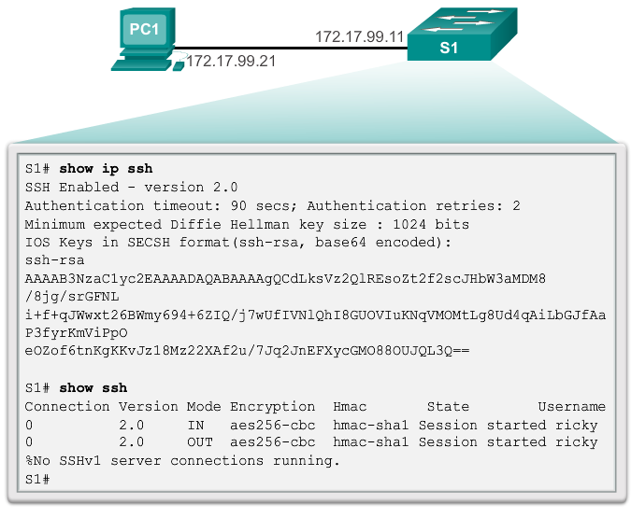
Secure Remote Access Verifying SSH
Notes:
2.2 Switch Security: Management and Implementation
2.2.1 Secure Remote Access
2.2.1.2 Verifying SSH

Slide 25
Security Concerns in LANs MAC Address Flooding
Switches automatically populate their CAM tables by watching traffic entering their ports
Switches will forward traffic trough all ports if it can’t find the destination MAC in its CAM table
Under such circumstances, the switch acts as a hub. Unicast traffic can be seen by all devices connected to the switch
An attacker could exploit this behavior to gain access to traffic normally controlled by the switch by using a PC to run a MAC flooding tool.
Notes:
2.2 Switch Security: Management and Implementation
2.2.2 Security Concerns In LANs
2.2.2.1 Common Security Attacks: MAC Address Flooding

Slide 26
Security Concerns in LANs MAC Address Flooding
Such tool is a program created to generate and send out frames with bogus source MAC addresses to the switch port
As these frames reach the switch, it adds the bogus MAC address to its CAM table, taking note of the port the frames arrived
Eventually the CAM table fills out with bogus MAC addresses
The CAM table now has no room for legit devices present in the network and therefore will never find their MAC addresses in the CAM table.
All frames are now forwarded to all ports, allowing the attacker to access traffic to other hosts
Notes:
2.2 Switch Security: Management and Implementation
2.2.2 Security Concerns In LANs
2.2.2.1 Common Security Attacks: MAC Address Flooding

Slide 27
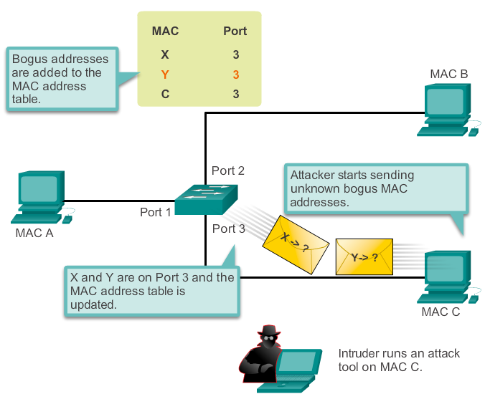
Security Concerns in LANs MAC Address Flooding
Attacker flooding the CAM table with bogus entries
Notes:
2.2 Switch Security: Management and Implementation
2.2.2 Security Concerns In LANs
2.2.2.1 Common Security Attacks: MAC Address Flooding

Slide 28
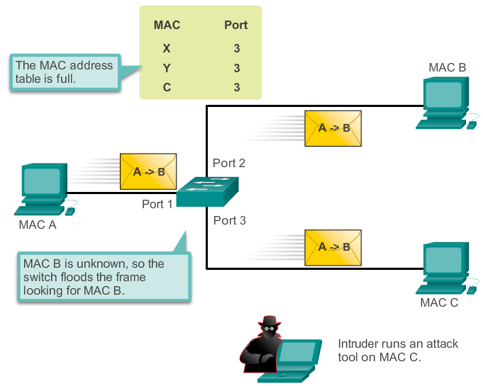
Security Concerns in LANs MAC Address Flooding
The switch now behaves as a hub
Notes:
2.2 Switch Security: Management and Implementation
2.2.2 Security Concerns In LANs
2.2.2.1 Common Security Attacks: MAC Address Flooding

Slide 29
Security Concerns in LANs DHCP Spoofing
DHCP is a network protocol used to assign IP info automatically
Two types of DHCP attacks are:
DHCP spoofing
DHCP starvation
In DHCP spoofing attacks, a fake DHCP server is placed in the network to issue DHCP addresses to clients.
DHCP starvation is often used before a DHCP spoofing attack to deny service to the legitimate DHCP server
Notes:
2.2 Switch Security: Management and Implementation
2.2.2 Security Concerns In LANs
2.2.2.2 Common Security Attacks: DHCP Spoofing

Slide 30
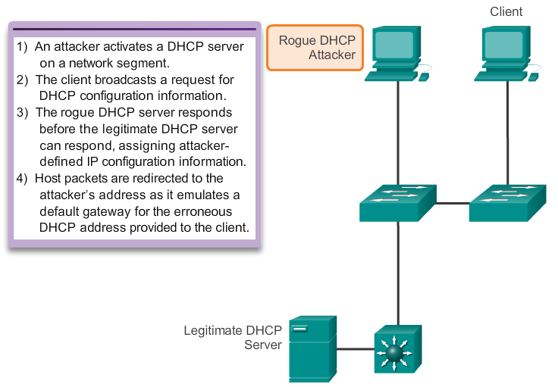
Security Concerns in LANs DHCP Spoofing
DHCP Spoof Attack
Notes:
2.2 Switch Security: Management and Implementation
2.2.2 Security Concerns In LANs
2.2.2.2 Common Security Attacks: DHCP Spoofing

Slide 31
Security Concerns in LANs Leveraging CDP
CDP is a layer 2 Cisco proprietary protocol used to discover other Cisco devices that are directly connected
It is designed to allow the devices to auto-configure their connections
If an attacker is listening to CDP messages, it could learn important information such as device model, version of software running
Cisco recommends disabling CDP when not in use
Notes:
2.2 Switch Security: Management and Implementation
2.2.2 Security Concerns In LANs
2.2.2.3 Common Security Attacks: Leveraging CDP

Slide 32
Security Concerns in LANs Leveraging Telnet
As mentioned the Telnet protocol is insecure and should be replaced by SSH.
Although, an attacker can use Telnet as part of other attacks
Two of these attacks are Brute Force Password Attack and Telnet DOS Attack
When passwords can’t be captured, attackers will try as many combinations of characters as possible. This attempt to guess the password is known as brute force password attack.
Telnet can be used to test the guessed password against the system.
Notes:
2.2 Switch Security: Management and Implementation
2.2.2 Security Concerns In LANs
2.2.2.4 Common Security Attacks: Leveraging Telnet

Slide 33
Security Concerns in LANs Leveraging Telnet
In a Telnet DoS attack, the attacker exploits a flaw in the Telnet server software running on the switch that renders the Telnet service unavailable.
This sort of attack prevents an administrator from remotely accessing switch management functions.
This can be combined with other direct attacks on the network as part of a coordinated attempt to prevent the network administrator from accessing core devices during the breach.
Vulnerabilities in the Telnet service that permit DoS attacks to occur are usually addressed in security patches that are included in newer Cisco IOS revisions.
Notes:
2.2 Switch Security: Management and Implementation
2.2.2 Security Concerns In LANs
2.2.2.4 Common Security Attacks: Leveraging Telnet

Slide 34
Security Best Practices 10 Best Practices
Develop a written security policy for the organization
Shut down unused services and ports
Use strong passwords and change them often
Control physical access to devices
Use HTTPS instead of HTTP
Perform backups operations on a regular basis.
Educate employees about social engineering attacks
Encrypt and password-protect sensitive data
Implement firewalls.
Keep software up-to-date
Notes:
2.2 Switch Security: Management and Implementation
2.2.3 Security Best Practices
2.2.3.1 10 Best Practices

Slide 35
Security Best Practices Network Security Tools: Options
Network Security Tools are very important to network administrators
Such tools allow an administrator to test the strength of the security measures implemented
An administrator can launch an attack against the network and analyze the results
This is also to determine how to adjust security policies to mitigate those types of attacks
Security auditing and penetration testing are two basic functions that network security tools perform
Notes:
2.2 Switch Security: Management and Implementation
2.2.3 Security Best Practices
2.2.3.2 Network Security Tools: Options

Slide 36
Security Best Practices Network Security Tools: Audits
Network Security Tools can be used to audit the network
By monitoring the network, an administrator can assess what type of information an attacker would be able to gather
For example, by attacking and flooding the CAM table of a switch, an administrator would learn which switch ports are vulnerable to MAC flooding and correct the issue
Network Security Tools can also be used as penetration test tools
Notes:
2.2 Switch Security: Management and Implementation
2.2.3 Security Best Practices
2.2.3.3 Network Security Tools: Audits

Slide 37
Security Best Practices Network Security Tools: Audits
Penetration testing is a simulated attack
It helps to determine how vulnerable the network is when under a real attack.
Weaknesses within the configuration of networking devices can be identified based on pen test results
Changes can be made to make the devices more resilient to attacks
Such tests can damage the network and should be carried out under very controlled conditions
An off-line test bed network that mimics the actual production network is the ideal.
Notes:
2.2 Switch Security: Management and Implementation
2.2.3 Security Best Practices
2.2.3.3 Network Security Tools: Audits

Slide 38
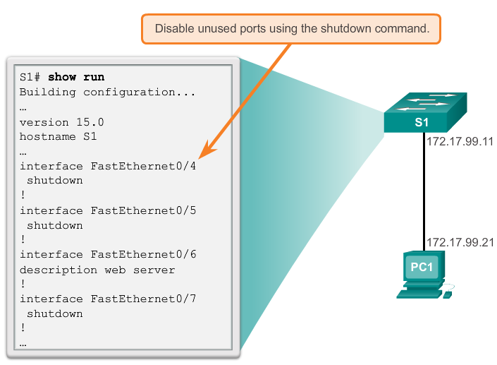
Switch Port Security Secure Unused Ports
Disable Unused Ports is a simple yet efficient security guideline
Notes:
2.2 Switch Security: Management and Implementation
2.2.4 Switch Port Security
2.2.4.1 Secure Unused Ports

Slide 39
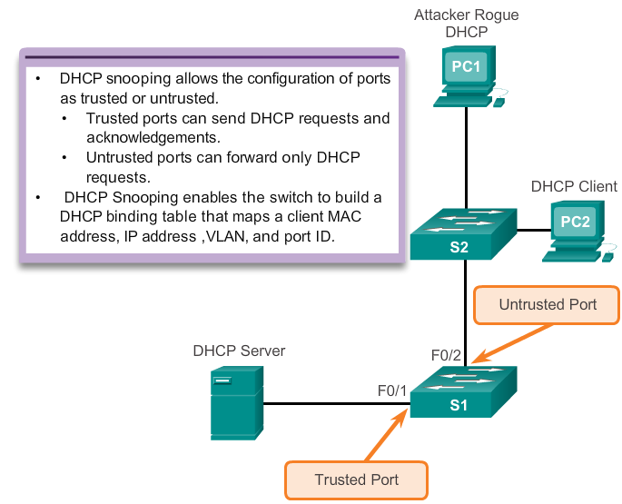
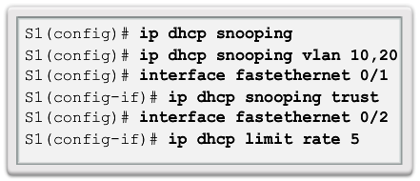
Switch Port Security DHCP Snooping
DHCP Snooping specifies which switch ports can respond to DHCP requests
Notes:
2.2 Switch Security: Management and Implementation
2.2.4 Switch Port Security
2.2.4.2 DHCP Snooping

Slide 40
Switch Port Security Port Security: Operation
Port security limits the number of valid MAC addresses allowed on a port
The MAC addresses of legitimate devices are allowed access, while other MAC addresses are denied
Any additional attempts to connect by unknown MAC addresses will generate a security violation
Secure MAC addresses can be configured in a number of ways:
Static secure MAC addresses
Dynamic secure MAC addresses
Sticky secure MAC addresses
Notes:
2.2 Switch Security: Management and Implementation
2.2.4 Switch Port Security
2.2.4.3 Port Security: Operation

Slide 41
Switch Port Security Port Security: Violation Modes
IOS considers a security violation when either of these situations occurs:
The maximum number of secure MAC addresses for that interface have been added to the CAM, and a station whose MAC address is not in the address table attempts to access the interface.
An address learned or configured on one secure interface is seen on another secure interface in the same VLAN.
There are three possible action to be taken when a violation is detected:
Protect
Restrict
Shutdown
Notes:
2.2 Switch Security: Management and Implementation
2.2.4 Switch Port Security
2.2.4.4 Port Security: Violation Modes

Slide 42
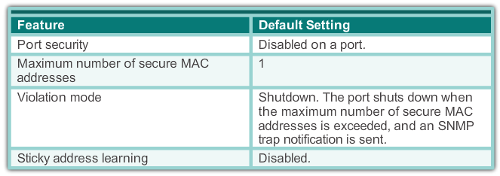
Switch Port Security Port Security: Configuring
Dynamic Port Security Defaults
Notes:
2.2 Switch Security: Management and Implementation
2.2.4 Switch Port Security
2.2.4.5 Port Security: Configuring

Slide 43
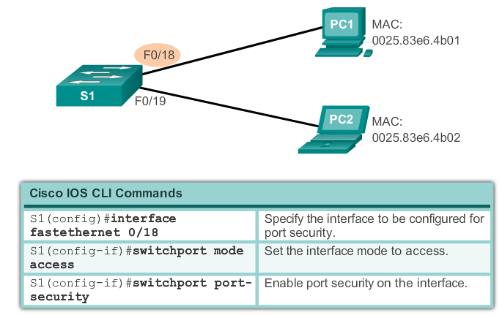
Switch Port Security Port Security: Configuring
Configuring Dynamic Port Security
Notes:
2.2 Switch Security: Management and Implementation
2.2.4 Switch Port Security
2.2.4.5 Port Security: Configuring

Slide 44
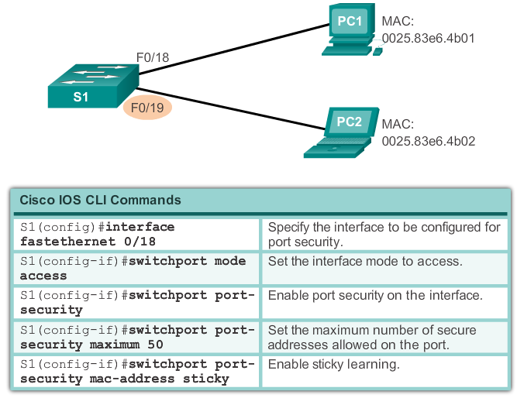
Switch Port Security Port Security: Configuring
Configuring Port Security Sticky
Notes:
2.2 Switch Security: Management and Implementation
2.2.4 Switch Port Security
2.2.4.5 Port Security: Configuring

Slide 45
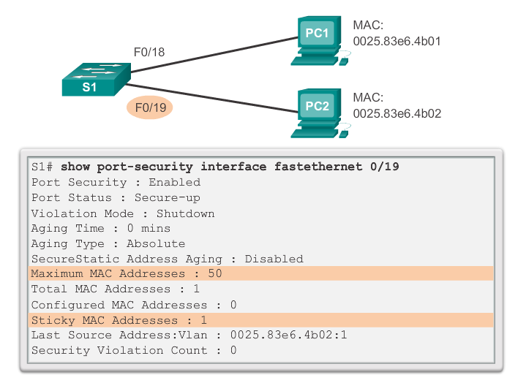
Switch Port Security Port Security: Verifying
Verifying Port Security Sticky
Notes:
2.2 Switch Security: Management and Implementation
2.2.4 Switch Port Security
2.2.4.6 Port Security: Verifying

Slide 46
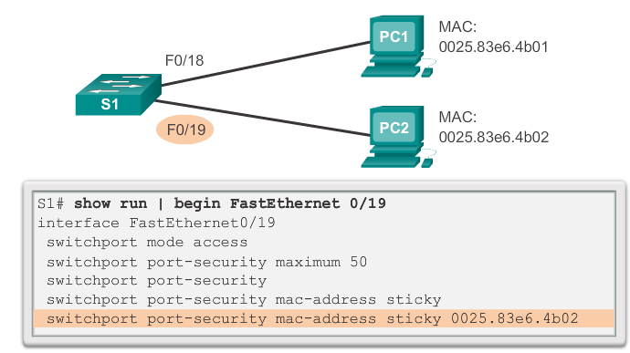
Switch Port Security Port Security: Verifying
Verifying Port Security Sticky – Running Config
Notes:
2.2 Switch Security: Management and Implementation
2.2.4 Switch Port Security
2.2.4.6 Port Security: Verifying

Slide 47
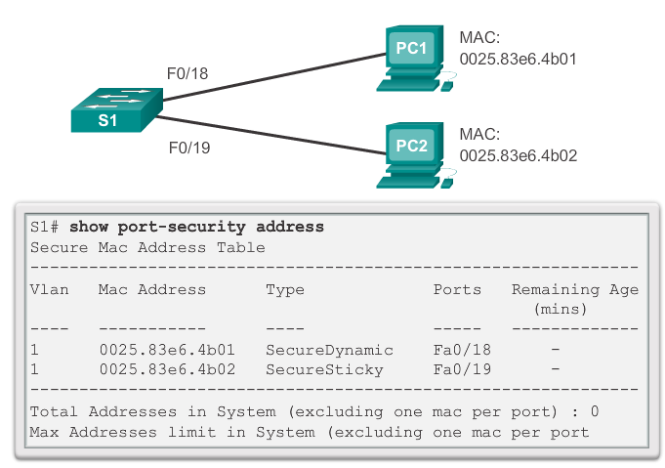
Switch Port Security Port Security: Verifying
Verifying Port Security Secure MAC Addresses
Notes:
2.2 Switch Security: Management and Implementation
2.2.4 Switch Port Security
2.2.4.6 Port Security: Verifying

Slide 48
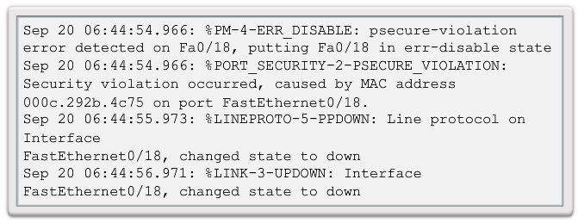
Switch Port Security Ports In Error Disabled State
A port security violation can put a switch in error disabled state
A port in error disabled is effectively shut down
The switch will communicate these events through console messages
Notes:
2.2 Switch Security: Management and Implementation
2.2.4 Switch Port Security
2.2.4.7 Ports In Error Disabled State

Slide 49
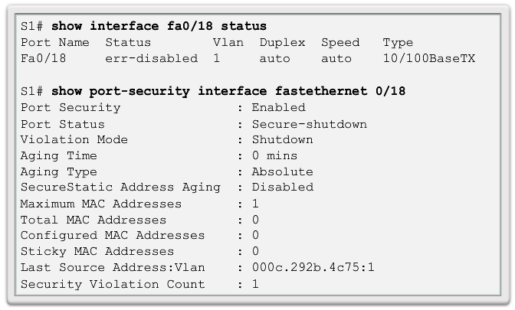
Switch Port Security Ports In Error Disabled State
The show interface command also reveals a switch port on error disabled state
Notes:
2.2 Switch Security: Management and Implementation
2.2.4 Switch Port Security
2.2.4.7 Ports In Error Disabled State

Slide 50
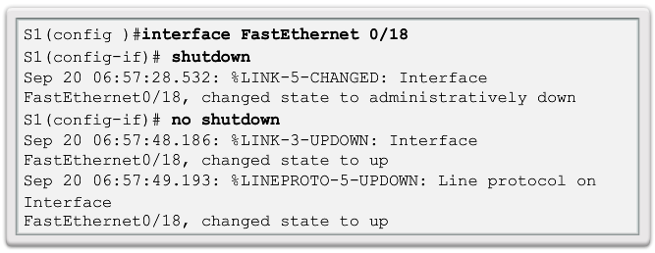
Switch Port Security Ports In Error Disabled State
A shutdown/no shutdown interface command must be issued to re-enable the port
Notes:
2.2 Switch Security: Management and Implementation
2.2.4 Switch Port Security
2.2.4.7 Ports In Error Disabled State

Slide 51
Switch Port Security Network Time Protocol (NTP)
NTP is a protocol used to synchronize the clocks of computer systems data networks
NTP can get the correct time from an internal or external time source
Time sources can be:
Local master clock
Master clock on the Internet
GPS or atomic clock
A network device can be configured as either an NTP server or an NTP client
See slide notes for more information on NTP
Notes:
2.2 Switch Security: Management and Implementation
2.2.4 Switch Port Security
2.2.4.8 Network Time Protocol (NTP)
More info can be found at:
http://tools.ietf.org/html/rfc5905
http://en.wikipedia.org/wiki/Network_Time_Protocol

Slide 52
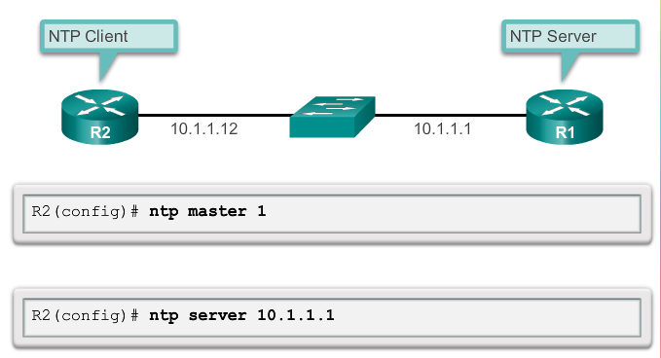
Switch Port Security Network Time Protocol (NTP)
Configuring NTP
Notes:
2.2 Switch Security: Management and Implementation
2.2.4 Switch Port Security
2.2.4.8 Network Time Protocol (NTP)
More info can be found at:
http://tools.ietf.org/html/rfc5905
http://en.wikipedia.org/wiki/Network_Time_Protocol

Slide 53
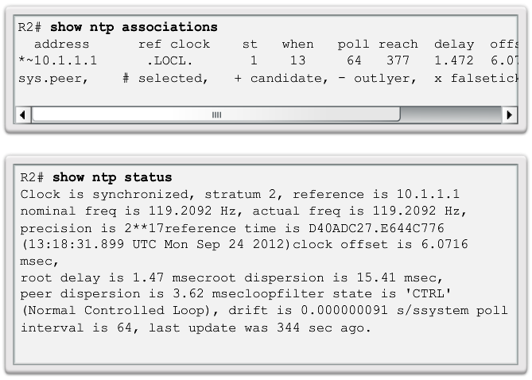
Switch Port Security Network Time Protocol (NTP)
Verifying NTP
Notes:
2.2 Switch Security: Management and Implementation
2.2.4 Switch Port Security
2.2.4.8 Network Time Protocol (NTP)
More info can be found at:
http://tools.ietf.org/html/rfc5905
http://en.wikipedia.org/wiki/Network_Time_Protocol

Slide 54
Chapter 2: Summary
This chapter covered:
Cisco LAN Switch Boot Sequence
Cisco LAN Switch LED modes
How to remotely access and manage a Cisco LAN Switch through a secure connection
Cisco LAN switch port duplex modes
Cisco LAN switch port security, violation modes and actions
Best practices for switched networks
Notes:
Chapter 2 Summary

Slide 55


