Slide 1
Chapter 3: Implementing VLAN Security
Routing And Switching
Notes:
Cisco Networking Academy program
Routing & Switching
Chapter 3: Implementing VLAN Security

Slide 2
Chapter 3
3.1 VLAN Segmentation
3.2 VLAN Implementation
3.3 VLAN Security and Design
3.4 Summary
Notes:
Chapter 3

Slide 3
Chapter 3: Objectives
Explain the purpose of VLAN in a switched network
Analyze how a switch forwards frames based VLAN configuration in a multi-switched environment
Configure a switch port to be assigned to a VLAN based on requirements
Configure a trunk port on a LAN switch
Configure Dynamic Trunk Protocol (DTP)
Troubleshoot VLAN and trunk configurations in a switched network
Configure security features to mitigate attacks in a VLAN-segmented environment
Explain security best practices for a VLAN-segmented environment
Notes:
1.

Slide 4
Overview Of VLANs VLAN Definitions
VLAN (virtual LAN) is a logical partition of a layer 2 network
Multiple partition can be created, allowing for multiple VLANs to co-exist
Each VLAN is a broadcast domain, usually with its own IP network
VLANS are mutually isolated and packets can only pass between them through a router
The partitioning of the layer 2 network takes inside a layer 2 device, usually a switch.
The hosts grouped within a VLAN are unaware of the VLAN’s existence
Notes:
3.1 VLAN Segmentation
3.1.1 Overview of VLANs
3.1.1.1 VLAN Definitions

Slide 5
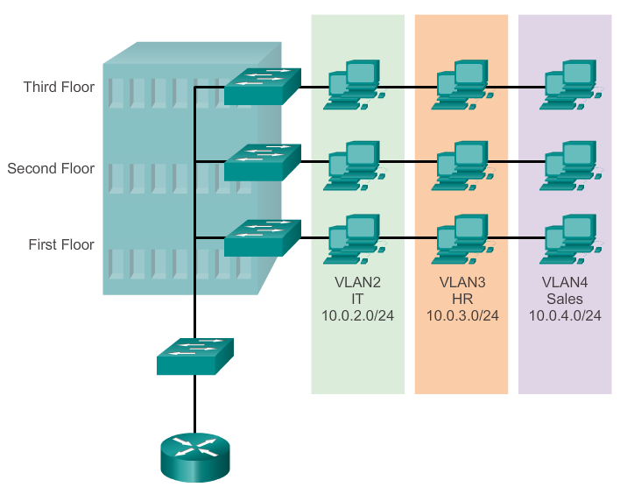
Overview Of VLANs VLAN Definitions
Notes:
3.1 VLAN Segmentation
3.1.1 Overview of VLANs
3.1.1.1 VLAN Definitions

Slide 6
Overview Of VLANs Benefits of VLANs
Security
Cost reduction
Better performance
Shrink broadcast domains
Improved IT staff efficiency
Simpler project and application management
Notes:
3.1 VLAN Segmentation
3.1.1 Overview of VLANs
3.1.1.2 Benefits of VLANs

Slide 7
Overview Of VLANs Types of VLANs
Data VLAN
Default VLAN
Native VLAN
Management VLAN
Notes:
3.1 VLAN Segmentation
3.1.1 Overview of VLANs
3.1.1.3 Types of VLANs

Slide 8
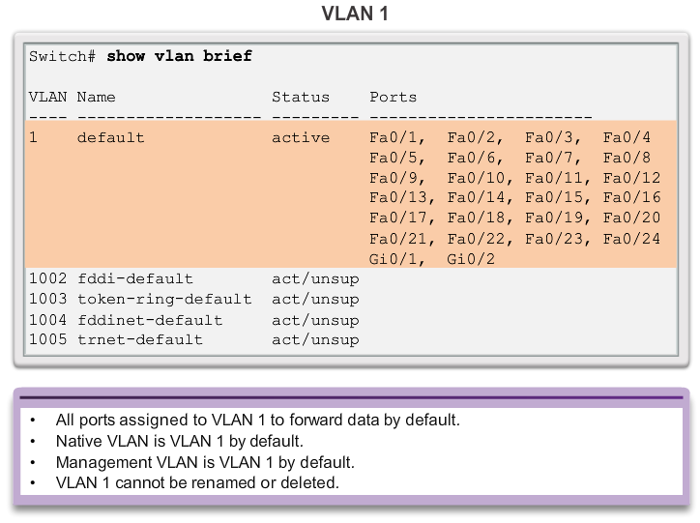
Overview Of VLANs Types of VLANs
Notes:
3.1 VLAN Segmentation
3.1.1 Overview of VLANs
3.1.1.3 Types of VLANs

Slide 9
Overview Of VLANs Voice VLANs
VoIP traffic is time-sensitive and requires:
Assured bandwidth to ensure voice quality
Transmission priority over other types of network traffic
Ability to be routed around congested areas on the network
Delay of less than 150 ms across the network
The voice VLAN feature enables access ports to carry IP voice traffic from an IP phone
The switch can connect to a Cisco 7960 IP Phone and carry IP voice traffic
Because the sound quality of an IP phone call can deteriorate if the data is unevenly sent, the switch supports quality of service (QoS)
Notes:
3.1 VLAN Segmentation
3.1.1 Overview of VLANs
3.1.1.4 Voice VLANs

Slide 10
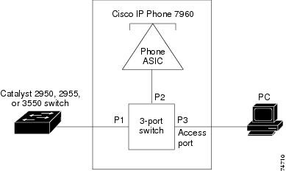
Overview Of VLANs Voice VLANs
The Cisco 7960 IP Phone contains an integrated three-port 10/100 switch:
Port 1 connects to the switch
Port 2 is an internal 10/100 interface that carries the IP phone traffic
Port 3 (access port) connects to a PC or other device.
Notes:
3.1 VLAN Segmentation
3.1.1 Overview of VLANs
3.1.1.4 Voice VLANs

Slide 11
VLANs in a Multi-Switched Environment VLAN Trunks
A VLAN trunk carries more than one VLAN
Usually established between switches so same-VLAN devices can communicate even if physically connected to different switches
A VLAN trunk is not associated to any VLANs. Neither is the trunk ports used to establish the trunk link
Cisco IOS supports IEEE802.1q, a popular VLAN trunk protocol
Notes:
3.1 VLAN Segmentation
3.1.2 VLANs in a Multi-Switched Environment
3.1.2.1 VLAN Trunks

Slide 12
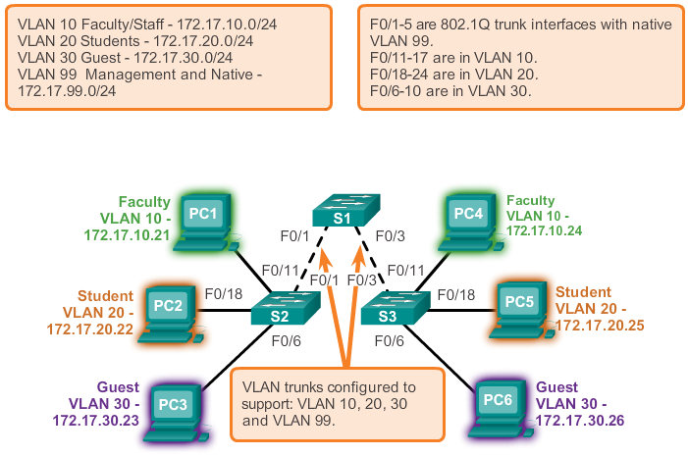
VLANs in a Multi-Switched Environment VLAN Trunks
Notes:
3.1 VLAN Segmentation
3.1.2 VLANs in a Multi-Switched Environment
3.1.2.1 VLAN Trunks

Slide 13
VLANs in a Multi-Switched Environment Controlling Broadcast Domains with VLANs
VLANs can be used to limit the reach of broadcast frames
A VLAN is a broadcast domain of its own
Therefore, a broadcast frame sent by a device in a specific VLAN is forwarded within that VLAN only.
This help controlling the reach of broadcast frames and their impact in the network
Unicast and multicast frames are forwarded within the originating VLAN as well
Notes:
3.1 VLAN Segmentation
3.1.2 VLANs in a Multi-Switched Environment
3.1.2.2 Controlling Broadcast Domains with VLANs

Slide 14
VLANs in a Multi-Switched Environment Tagging Ethernet Frames for VLAN Identification
Frame tagging is used to properly transmit multiple VLAN frames through a trunk link
Switches will tag frames to identify the VLAN they belong. Different tagging protocols exist, with IEEE 802.1q being a very popular one
The protocol defines the structure of the tagging header added to the frame
Switches will add VLAN tags to the frames before placing them into trunk links and remove the tags before forwarding frames through non-trunk ports
Once properly tagged, the frames can transverse any number of switches via trunk links and still be forward within the correct VLAN at the destination
Notes:
3.1 VLAN Segmentation
3.1.2 VLANs in a Multi-Switched Environment
3.1.2.3 Tagging Ethernet Frames for VLAN Identification

Slide 15
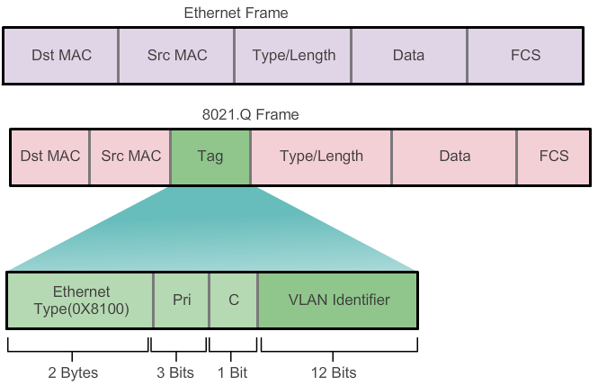
VLANs in a Multi-Switched Environment Tagging Ethernet Frames for VLAN Identification
Notes:
3.1 VLAN Segmentation
3.1.2 VLANs in a Multi-Switched Environment
3.1.2.3 Tagging Ethernet Frames for VLAN Identification

Slide 16
VLANs in a Multi-Switched Environment Native VLANs and 802.1q Tagging
A frame that belongs to the native VLAN will not be tagged
A frame that is received untagged will remain untagged and placed in the native VLAN when forwarded
If there are not ports associated to the native VLAN and no other trunk links, an untagged frame will be dropped
In Cisco switches, the native VLAN is VLAN 1 by default
Notes:
3.1 VLAN Segmentation
3.1.2 VLANs in a Multi-Switched Environment
3.1.2.4 Native VLANs and 802.1q Tagging

Slide 17
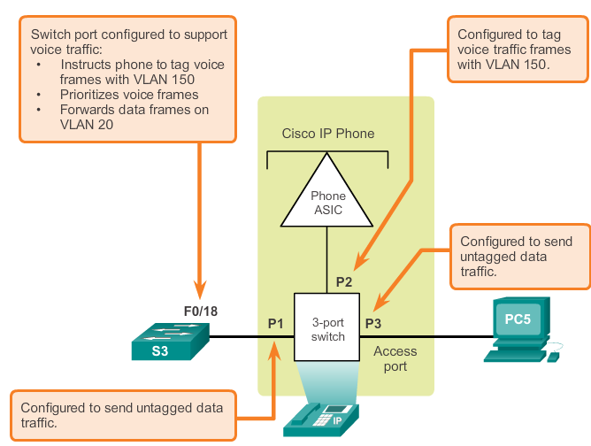
VLANs in a Multi-Switched Environment Voice VLAN Tagging
Notes:
3.1 VLAN Segmentation
3.1.2 VLANs in a Multi-Switched Environment
3.1.2.5 Voice VLAN Tagging

Slide 18
VLAN Assignment VLAN Ranges On Catalyst Switches
The Catalyst 2960 and 3560 Series switches support over 4,000 VLANs
These VLANs are split into 2 categories:
Normal Range VLANs
VLAN numbers from 1 through 1005
Configurations stored in the vlan.dat (in the flash)
VTP can only learn and store normal range VLANs
Extended Range VLANs
VLAN numbers from 1006 through 4096
Configurations stored in the running-config (in the NVRAM)
VTP does not learn extended range VLANs
Notes:
3.2 VLAN Implementations
3.2.1 VLAN Assignment
3.2.1.1 VLAN Ranges On Catalyst Switches

Slide 19
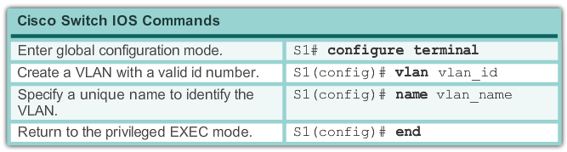
VLAN Assignment Creating a VLAN
Notes:
3.2 VLAN Implementations
3.2.1 VLAN Assignment
3.2.1.2 Creating a VLAN

Slide 20
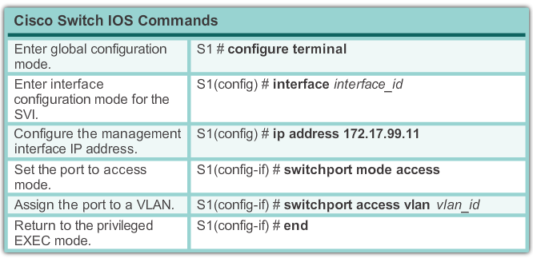
VLAN Assignment Assigning Ports To VLANs
Notes:
3.2 VLAN Implementations
3.2.1 VLAN Assignment
3.2.1.3 Assigning Ports To VLANs

Slide 21
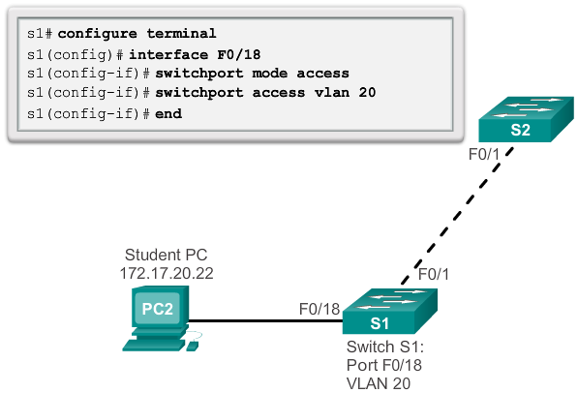
VLAN Assignment Assigning Ports To VLANs
Notes:
3.2 VLAN Implementations
3.2.1 VLAN Assignment
3.2.1.3 Assigning Ports To VLANs

Slide 22
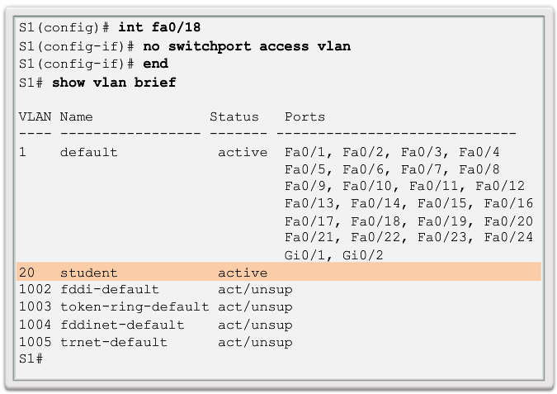
VLAN Assignment Changing VLAN Port Membership
Notes:
3.2 VLAN Implementations
3.2.1 VLAN Assignment
3.2.1.4 Changing VLAN Port Membership

Slide 23
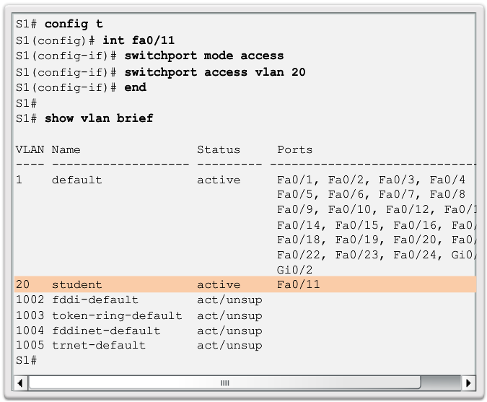
VLAN Assignment Changing VLAN Port Membership
Notes:
3.2 VLAN Implementations
3.2.1 VLAN Assignment
3.2.1.4 Changing VLAN Port Membership

Slide 24
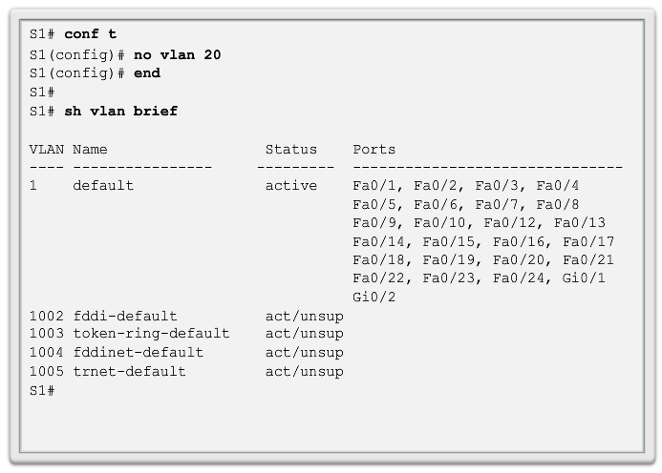
VLAN Assignment Deleting VLANs
Notes:
3.2 VLAN Implementations
3.2.1 VLAN Assignment
3.2.1.5 Deleting VLANs

Slide 25
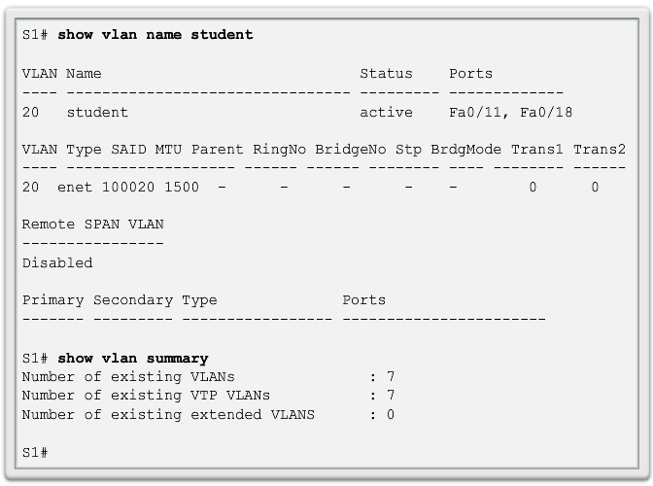
VLAN Assignment Verifying VLAN Information
Notes:
3.2 VLAN Implementations
3.2.1 VLAN Assignment
3.2.1.6 Verifying VLAN Information

Slide 26
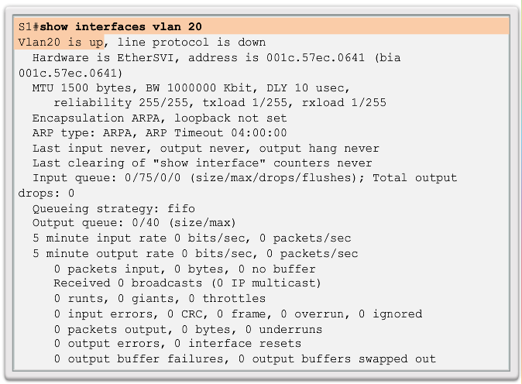
VLAN Assignment Verifying VLAN Information
Notes:
3.2 VLAN Implementations
3.2.1 VLAN Assignment
3.2.1.6 Verifying VLAN Information

Slide 27
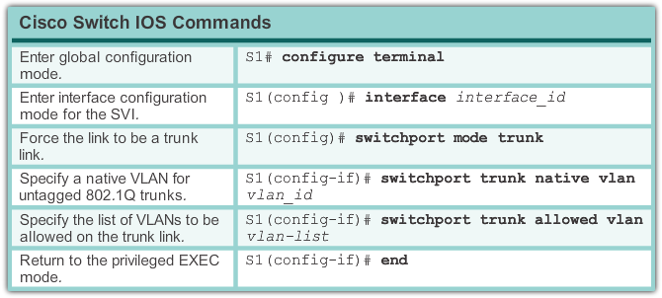
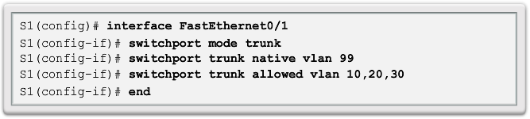
VLAN Assignment Configuring IEEE 802.1q Trunk Links
Notes:
3.2 VLAN Implementations
3.2.2 VLAN Trunks
3.2.2.1 Configuring IEEE 802.1q Trunk Links

Slide 28
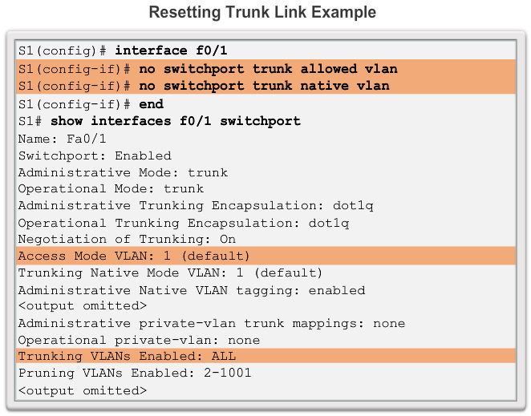
VLAN Assignment Resetting the Trunk To Default State
Notes:
3.2 VLAN Implementations
3.2.2 VLAN Trunks
3.2.2.2 Resetting the Trunk To Default State

Slide 29
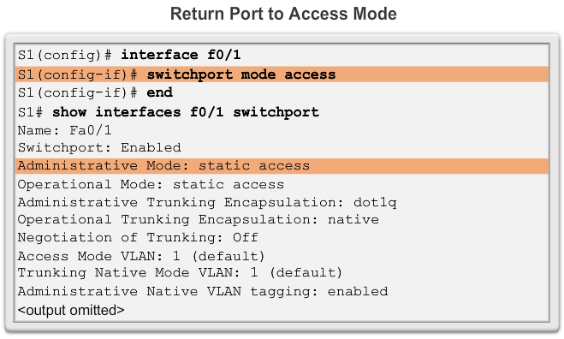
VLAN Assignment Resetting the Trunk To Default State
Notes:
3.2 VLAN Implementations
3.2.2 VLAN Trunks
3.2.2.2 Resetting the Trunk To Default State

Slide 30
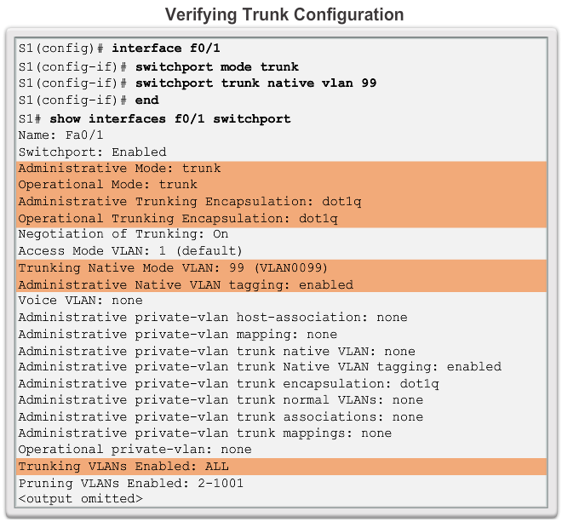
VLAN Assignment Verifying Trunk Configuration
Notes:
3.2 VLAN Implementations
3.2.2 VLAN Trunks
3.2.2.4 Verifying Trunk Configuration

Slide 31
Dynamic Trunking Protocol Introduction to DTP
Switch ports can be manually configured to form trunks
Switch ports can also be configured to negotiate and establish a trunk link with a connected peer
Dynamic Trunking Protocol (DTP) is a protocol to manage trunk negotiation
DTP is a Cisco proprietary protocol and is enabled by default in Cisco Catalyst 2960 and 3560 switches
If the port on the neighbor switch is configured in a trunk mode that supports DTP, it manages the negotiation
The default DTP configuration for Cisco Catalyst 2960 and 3560 switches is dynamic auto
Notes:
3.2 VLAN Implementations
3.2.3 Dynamic Trunking Protocol
3.2.3.1 Introduction to DTP

Slide 32
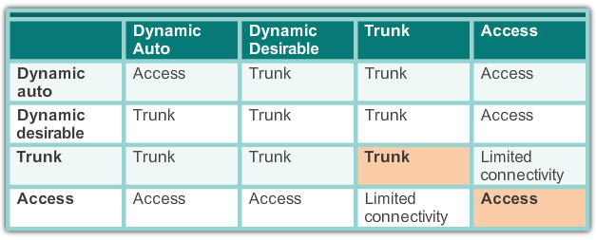
Dynamic Trunking Protocol Negotiated Interface Modes
Cisco Catalyst 2960 and 3560 support the following trunk modes:
switchport mode dynamic auto
switchport mode dynamic desirable
switchport mode trunk
switchport nonegotiate
Notes:
3.2 VLAN Implementations
3.2.3 Dynamic Trunking Protocol
3.2.3.2 Introduction to DTP

Slide 33
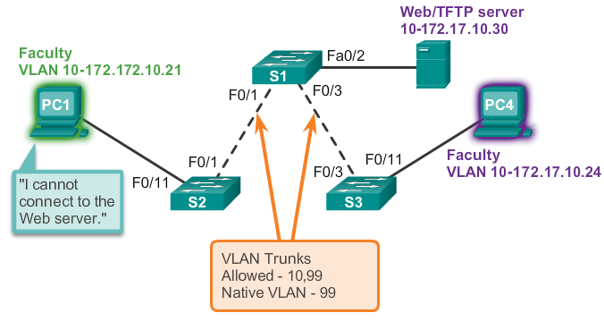
Troubleshooting VLANs and Trunks Addressing Issues with VLAN
It is very common practice to associate a VLAN with a IP network
Since different IP networks only communicate through a router, all devices within a VLAN must be part of the same IP network in order to communicate
In the picture below, PC1 can’t communicate to the server because it has a wrong IP address configured
Notes:
3.2 VLAN Implementations
3.2.4 Troubleshooting VLANs and Trunks
3.2.4.1 Addressing Issues with VLAN

Slide 34
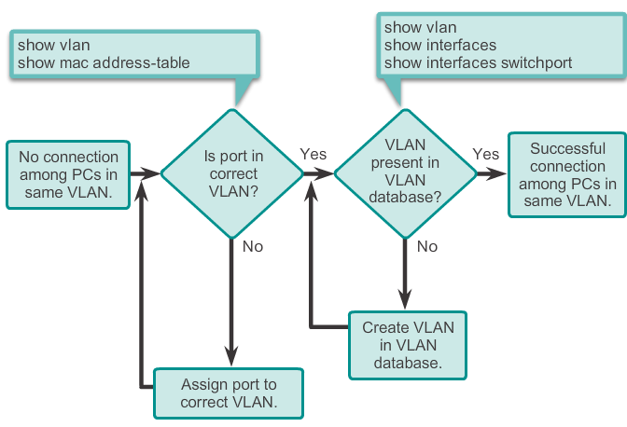
Troubleshooting VLANs and Trunks Missing VLANs
If all IP addresses mismatch have been solved but device still can’t connect, check if the VLAN exists in the switch.
Notes:
3.2 VLAN Implementations
3.2.4 Troubleshooting VLANs and Trunks
3.2.4.2 Missing VLANs

Slide 35
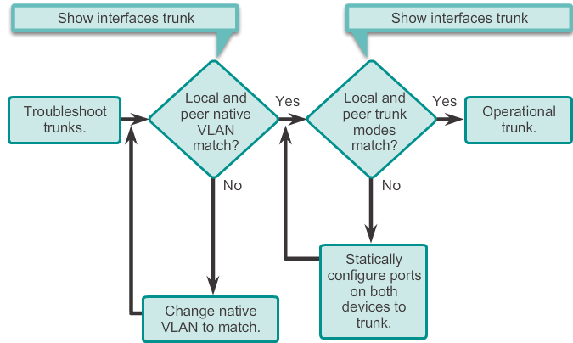
Troubleshooting VLANs and Trunks Introduction to Troubleshooting Trunks
Notes:
3.2 VLAN Implementations
3.2.4 Troubleshooting VLANs and Trunks
3.2.4.3 Introduction to Troubleshooting Trunks

Slide 36
Troubleshooting VLANs and Trunks Common Problems With Trunks
Trunking issues are usually associated with incorrect configurations.
The most common type of trunk configuration errors are:
Native VLAN mismatches
Trunk mode mismatches
Allowed VLANs on trunks
If a trunk problem is detected, the best practice guidelines recommend to troubleshoot in the order shown above.
Notes:
3.2 VLAN Implementations
3.2.4 Troubleshooting VLANs and Trunks
3.2.4.4 Common Problems With Trunks

Slide 37
Troubleshooting VLANs and Trunks Trunk Mode Mismatches
If a port on a trunk link is configured with a trunk mode that is incompatible with the neighboring trunk port, a trunk link fails to form between the two switches
Check the status of the trunk ports on the switches using the show interfaces trunk command
To fix the problem, configure the interfaces with proper trunk modes.
Notes:
3.2 VLAN Implementations
3.2.4 Troubleshooting VLANs and Trunks
3.2.4.5 Trunk Mode Mismatches

Slide 38
Troubleshooting VLANs and Trunks Incorrect VLAN List
VLANs must be allowed in the trunk before their frames can be transmitted across the link
Use the switchport trunk allowed vlan command to specifuy which VLANs are allowed in a trunk link
To ensure the correct VLANs are permitted in a trunk, used the show interfaces trunk command
Notes:
3.2 VLAN Implementations
3.2.4 Troubleshooting VLANs and Trunks
3.2.4.6 Incorrect VLAN List

Slide 39
Attacks on VLANs Switch spoofing Attack
There are a number of different types of VLAN attacks in modern switched networks. VLAN hopping is one them.
The default configuration of the switch port is dynamic auto
By configuring a host to act as a switch and form a trunk, an attacker could gain access to any VLAN in the network.
Because the attacker is now able to access other VLANs, this is called a VLAN hopping attack
To prevent a basic switch spoofing attack, turn off trunking on all ports, except the ones that specifically require trunking
Notes:
3.3 VLAN Implementations
3.3.1 Attacks on VLANs
3.3.1.1 Switch spoofing Attack

Slide 40
Attacks on VLANs Double-Tagging Attack
The double-tagging attack takes advantage of the way that hardware on most switches de-encapsulate 802.1Q tags
Most switches perform only one level of 802.1Q de-encapsulation, allowing an attacker to embed a second, unauthorized attack header in the frame
After removing the first and legit 802.1Q header, the switch forwards the frame to the VLAN specified in the unauthorized 802.1Q header
The best approach to mitigating double-tagging attacks is to ensure that the native VLAN of the trunk ports is different from the VLAN of any user ports
Notes:
3.3 VLAN Implementations
3.3.1 Attacks on VLANs
3.3.1.2 Double-Tagging Attack

Slide 41
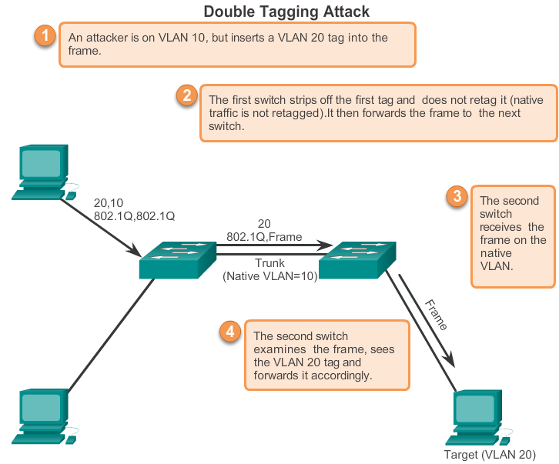
Attacks on VLANs Double-Tagging Attack
Notes:
3.3 VLAN Implementations
3.3.1 Attacks on VLANs
3.3.1.2 Double-Tagging Attack

Slide 42
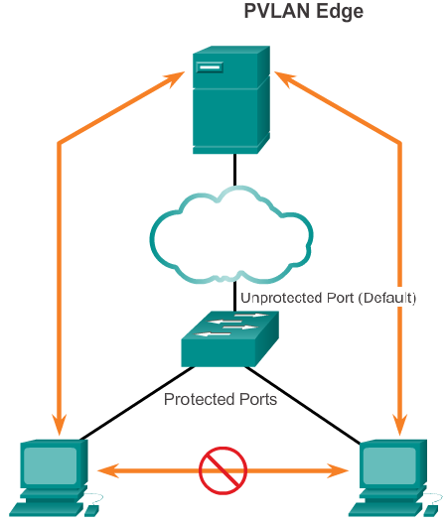
Attacks on VLANs PVLAN Edge
Private VLAN (PVLAN) Edge feature, also known as protected ports, ensures that there is no exchange of unicast, broadcast, or multicast traffic between protected ports on the switch
Local relevancy only
A protected port only exchanges traffic with un-protected ports
A protected port will not exchange traffic with another protected port
Notes:
3.3 VLAN Implementations
3.3.1 Attacks on VLANs
3.3.1.3 PVLAN Edge

Slide 43
Design Best Practices For VLANs VLAN Design Guideline
Move all ports from VLAN1 and assign them to a not-in-use VLAN
Shut down all unused switch ports
Separate management and user data traffic
Change the management VLAN to a VLAN other than VLAN1. The same goes to the native VLAN
Make sure that only devices in the management VLAN can connect to the switches
The switch should only accept SSH connections
Disable autonegotiation on trunk ports
Do not use the auto or desirable switch port modes
Notes:
3.3 VLAN Implementations
3.3.2 Design Best Practices For VLANs
3.3.2.1 VLAN Design Guideline

Slide 44
Chapter 3: Summary
This chapter introduced VLANS and their types.
It also covered the connection between VLANs and broadcast domain
The chapter also covers IEEE 802.1Q frame tagging and how it enables differentiation between Ethernet frames associated with distinct VLANs as they traverse common trunk links.
This chapter also examined the configuration, verification, and troubleshooting of VLANs and trunks using the Cisco IOS CL and explored basic security and design considerations in the context of VLANs.
Notes:
Chapter 3 Summary

Slide 45


