Slide 1
Chapter 5: Inter-VLAN Routing
Routing And Switching
Notes:
Cisco Networking Academy program
Routing & Switching
Chapter 5: : Inter-VLAN Routing

Slide 2
Chapter 5
5.1 Inter-VLAN Routing Configuration
5.2 Troubleshooting Inter-VLAN Routing
5.3 Layer 3 Switching
5.4 Summary
Notes:
Chapter 5

Slide 3
Chapter 5: Objectives
Describe the three primary options for enabling inter-VLAN routing
Configure legacy inter-VLAN routing
Configure router-on-a-stick inter-VLAN routing
Troubleshoot common inter-VLAN configuration issues
Troubleshoot common IP addressing issues in an inter-VLAN routed environment
Configure inter-VLAN routing using Layer 3 switching
Troubleshoot inter-VLAN routing in a Layer 3 switched environment
Notes:
5.

Slide 4
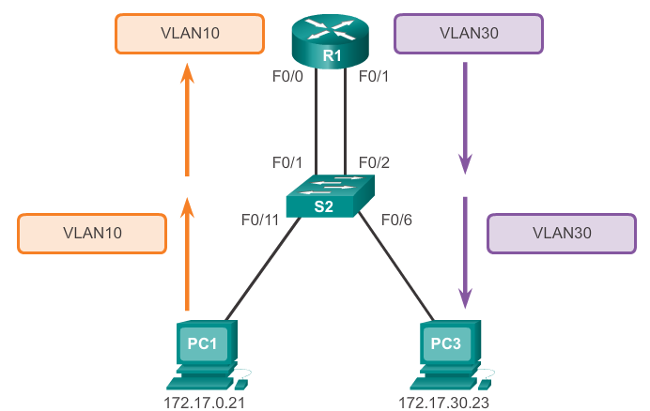
Inter-VLAN Routing Operation What is Inter-VLAN Routing?
Layer 2 switches can’t forward traffic between VLANs without the assistance of a router
Inter-VLAN routing is a process for forwarding network traffic from one VLAN to another using a router
Notes:
5.1 Inter-VLAN Routing Configuration
5.1.1 Inter-VLAN Routing Operation
5.1.1.1 What is Inter-VLAN Routing?

Slide 5
Inter-VLAN Routing Operation Legacy Inter-VLAN Routing
In the past, actual routers were used to route between VLAN
Each VLAN was connected to a different physical router interface
Packets would arrive on the router through one through interface, be routed and leave through another
Since the router interfaces were connected to VLANs and had IP addresses from that specific VLAN, routing between VLANs was achieved.
Simple solution but not scalable. Large networks with large number of VLANs would require lots of router interfaces
Notes:
5.1 Inter-VLAN Routing Configuration
5.1.1 Inter-VLAN Routing Operation
5.1.1.2 Legacy Inter-VLAN Routing

Slide 6
Inter-VLAN Routing Operation Router-On-A-Stick Inter-VLAN Routing
The so called router-on-a-stick approach uses a different path to route between VLANs
One of the router’s physical interfaces is configured as a 802.1Q trunk port. Now that interface can understand VLAN tags
Logical subinterfaces are then created. One subinterface per VLAN
Each subinterface is configured with an IP address from the VLAN it represents
VLAN members (hosts) are configured to use the subinterface address as a default gateway.
Only one of the router’s physical interface is used
Notes:
5.1 Inter-VLAN Routing Configuration
5.1.1 Inter-VLAN Routing Operation
5.1.1.3 Router-On-A-Stick Inter-VLAN Routing

Slide 7
Inter-VLAN Routing Operation Multilayer Switch Inter-VLAN Routing
Multilayer switches can perform Layer 2 and Layer 3 functions. Routers are not required anymore
Each VLAN existent in the switch is a SVI
SVI are seen as layer 3 interfaces
The switch understands network layer PDUs and therefore, it can route between its SVIs just as a router routes between its interfaces
With a multilayer switch, traffic is routed internal to the switch device
Very scalable solution
Notes:
5.1 Inter-VLAN Routing Configuration
5.1.1 Inter-VLAN Routing Operation
5.1.1.4 Multilayer Switch Inter-VLAN Routing

Slide 8
Configure Legacy Inter-VLAN Routing Preparation
Legacy inter-VLAN routing requires routers to have multiple physical interfaces
Each one of the router’s physical interfaces is connected to a unique VLAN
Each interface is also configured with an IP address for the subnet associated with the particular VLAN
Network devices use the router as a gateway to access the devices connected to the other VLANs
Notes:
5.1 Inter-VLAN Routing Configuration
5.1.2 Configure Legacy Inter-VLAN Routing
5.1.2.1 Configure Legacy Inter-VLAN Routing: Preparation

Slide 9
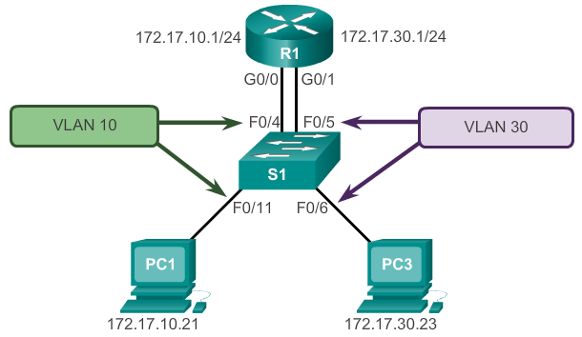
Configure Legacy Inter-VLAN Routing Preparation
Notes:
5.1 Inter-VLAN Routing Configuration
5.1.2 Configure Legacy Inter-VLAN Routing
5.1.2.1 Configure Legacy Inter-VLAN Routing: Preparation

Slide 10
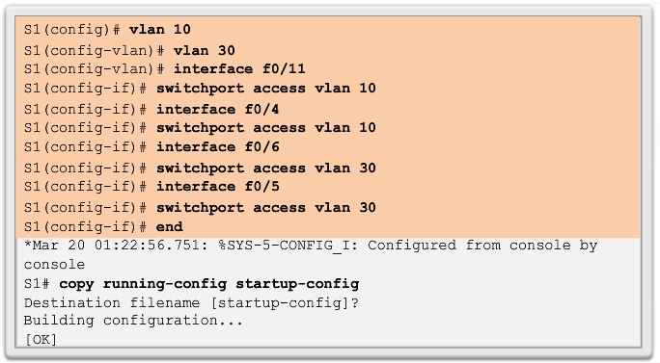
Configure Legacy Inter-VLAN Routing Switch Configuration
Notes:
5.1 Inter-VLAN Routing Configuration
5.1.2 Configure Legacy Inter-VLAN Routing
5.1.2.2 Configure Legacy Inter-VLAN Routing: Switch Configuration

Slide 11
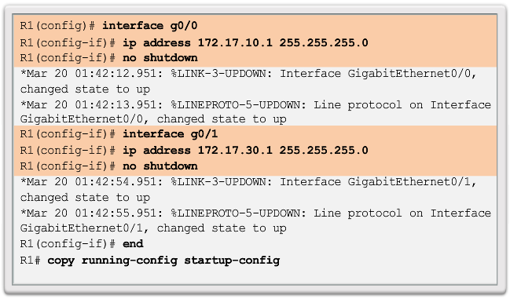
Configure Legacy Inter-VLAN Routing Router Interface Configuration
Notes:
5.1 Inter-VLAN Routing Configuration
5.1.2 Configure Legacy Inter-VLAN Routing
5.1.2.3 Configure Legacy Inter-VLAN Routing: Router Interface Configuration

Slide 12
Configure Router-On-A-Stick Preparation
An alternative to legacy inter-VLAN routing is to use VLAN trunking and subinterfaces
VLAN trunking allows a single physical router interface to route traffic for multiple VLANs
The physical interface of the router must be connected to a trunk link on the adjacent switch
On the router, subinterfaces are created for each unique VLAN on the networ
Each subinterface is assigned an IP address specific to its subnet/VLAN and is also configured to tag frames for that VLAN
Notes:
5.1 Inter-VLAN Routing Configuration
5.1.3 Configure Router-On-A-Stick Inter-VLAN Routing
5.1.3.1 Configure Router-On-A-Stick: Preparation

Slide 13
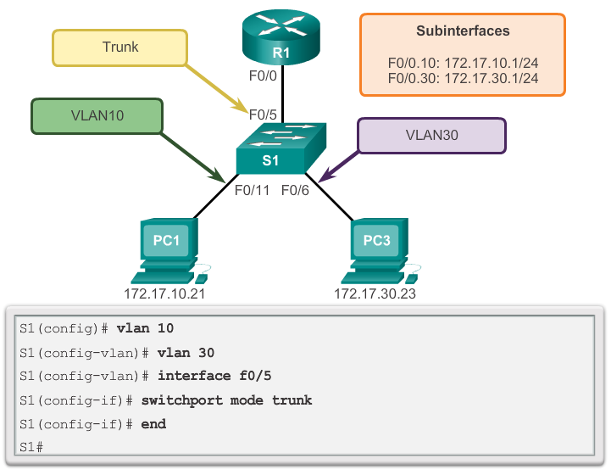
Configure Router-On-A-Stick Switch Configuration
Notes:
5.1 Inter-VLAN Routing Configuration
5.1.3 Configure Router-On-A-Stick Inter-VLAN Routing
5.1.3.2 Configure Router-On-A-Stick: Switch Configuration

Slide 14
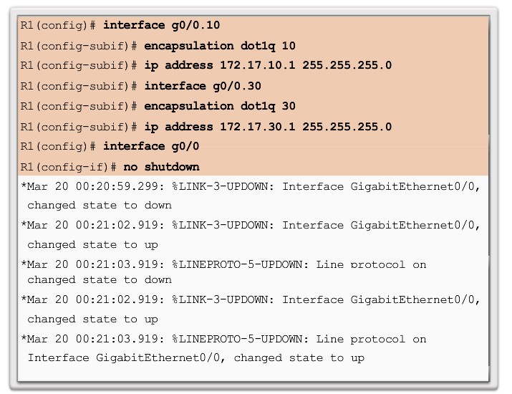
Configure Router-On-A-Stick Router Interface Configuration
Notes:
5.1 Inter-VLAN Routing Configuration
5.1.3 Configure Router-On-A-Stick Inter-VLAN Routing
5.1.3.3 Configure Router-On-A-Stick: Router Interface Configuration

Slide 15
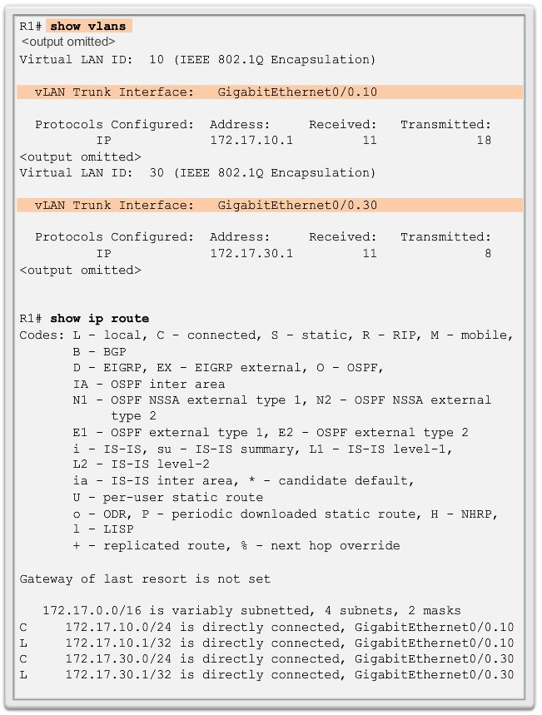
Configure Router-On-A-Stick Verifying Subinterfaces
Notes:
5.1 Inter-VLAN Routing Configuration
5.1.3 Configure Router-On-A-Stick Inter-VLAN Routing
5.1.3.4 Configure Router-On-A-Stick: Verifying Subinterfaces

Slide 16
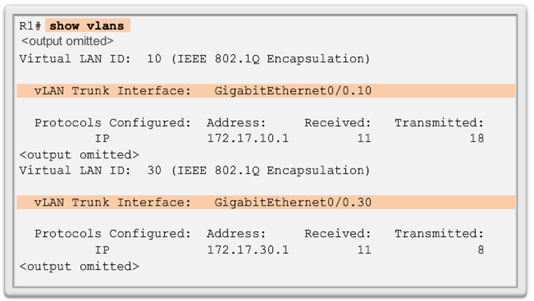
Configure Router-On-A-Stick Verifying Subinterfaces
Notes:
5.1 Inter-VLAN Routing Configuration
5.1.3 Configure Router-On-A-Stick Inter-VLAN Routing
5.1.3.4 Configure Router-On-A-Stick: Verifying Subinterfaces

Slide 17
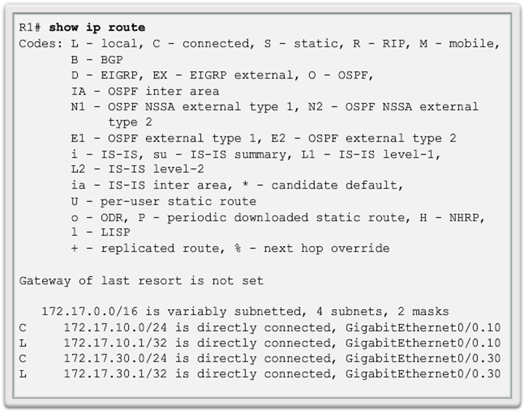
Configure Router-On-A-Stick Verifying Subinterfaces
Notes:
5.1 Inter-VLAN Routing Configuration
5.1.3 Configure Router-On-A-Stick Inter-VLAN Routing
5.1.3.4 Configure Router-On-A-Stick: Verifying Subinterfaces

Slide 18
Configure Router-On-A-Stick Verifying Routing
Access to devices on remote VLANs can be tested using the ping command.
The pingcommand sends an ICMP echo request to the destination address
When a host receives an ICMP echo request, it responds with an ICMP echo reply
Tracert is a useful utility for confirming the routed path taken between two devices
Notes:
5.1 Inter-VLAN Routing Configuration
5.1.3 Configure Router-On-A-Stick Inter-VLAN Routing
5.1.3.5 Configure Router-On-A-Stick: Verifying Routing

Slide 19
Inter-VLAN Configuration Issues Switch Port Issues
When using the legacy routing model, ensure that the switch ports that connect to the router interfaces are configured with the correct VLANs
Use the switchport access vlan 10 command to correct any errouneous VLAN port assignment
Also ensure the router is connected to the correct switch port
When using router-on-a-stick, ensure the switch port connected to the router is configured as a trunk link
The switchport mode trunk command can be used to solve this problem
Notes:
5.2 Troubleshooting Inter-VLAN Routing
5.2.1 Inter-VLAN Configuration Issues
5.2.1.1 Switch Port Issues

Slide 20
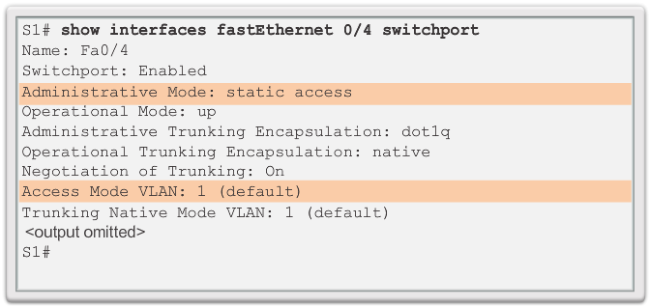
Inter-VLAN Configuration Issues Verify Switch Configuration
Notes:
5.2 Troubleshooting Inter-VLAN Routing
5.2.1 Inter-VLAN Configuration Issues
5.2.1.2 Verify Switch Configuration

Slide 21
Inter-VLAN Configuration Issues Verify Router Configuration
With router-on-a-stick configurations, a common problem is assigning the wrong VLAN ID to the subinterface
The show interface command can help detecting thi problem
If this is the case, use the encapsulation dot1q <vlan id> interface command to fix the problem
Notes:
5.2 Troubleshooting Inter-VLAN Routing
5.2.1 Inter-VLAN Configuration Issues
5.2.1.4 Verify Router Configuration

Slide 22
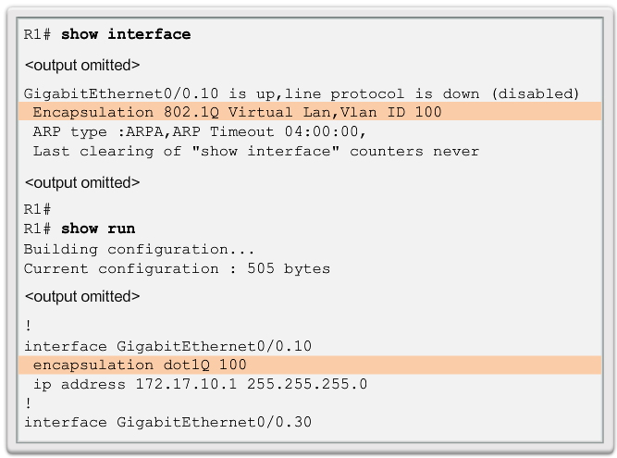
Inter-VLAN Configuration Issues Verify Router Configuration
Notes:
5.2 Troubleshooting Inter-VLAN Routing
5.2.1 Inter-VLAN Configuration Issues
5.2.1.4 Verify Router Configuration

Slide 23
IP Addressing Issues Errors With IP Address And Subnet Mask
When using legacy inter-VLAN routing, ensure the router has the correct IP address and mask on the interfaces connecting to the switch
Also ensure the network devices are configured with the correct IP address and mask
In the router, the ip address command can be used to fix any erroneous IP assignements
In the PCs, refer to the installed operating system documentation to properly change IP information
Notes:
5.2 Troubleshooting Inter-VLAN Routing
5.2.2 IP Addressing Issues
5.2.2.1 Errors With IP Address And Subnet Masks

Slide 24
IP Addressing Issues Verifying IP Address And Subnet Mask Configuration Issues
To verify if the correct IP address is configured in the router, use the show ip interface command
The show running-config can also be useful when troubleshooting router related problems
Although configuring subinterface IDs to match the VLAN number makes it easier to manage inter-VLAN configuration, it is not a requirement. When troubleshooting addressing issues, ensure that the subinterface is configured with the correct address for that VLAN.
Notes:
5.2 Troubleshooting Inter-VLAN Routing
5.2.2 IP Addressing Issues
5.2.2.2 Verifying IP Address And Subnet Mask Configuration Issues

Slide 25
Layer 3 Switching Operation And Configuration Introduction To Layer 3 Switching
Layer 3 switches usually have packet-switching throughputs in the millions of packets per second (pps)
All Catalyst switches support two types of Layer 3 interfaces:
Routed Port
SVI
High-performance switches, such as the Catalyst 6500 and Catalyst 4500, are able to perform most of the router’s functions
But several models of Catalyst switches require enhanced software for specific routing protocol feature
Notes:
5.3 Layer 3 switching
5.3.1 Layer 3 Switching Operation And Configuration
5.3.1.1 Introduction To Layer 3 Switching

Slide 26
Layer 3 Switching Operation And Configuration Inter-VLAN Routing with SVIs
Today routing has become faster and cheaper and can performed at hardware speed
It can be transferred to core and distribution devices with little to no impact on network performance
Many users are in separate VLANs, and each VLAN is usually a separate subnet
This implies that each distribution switch must have IP addresses matching each access switch VLAN
Layer 3 (routed) ports are normally implemented between the distribution and the core layer
This model is less dependent on spanning-tree as there are no loops in the Layer 2 portion of the topology
Notes:
5.3 Layer 3 switching
5.3.1 Layer 3 Switching Operation And Configuration
5.3.1.2 Inter-VLAN Routing with Switch Virtual Interfaces

Slide 27
Layer 3 Switching Operation And Configuration Inter-VLAN Routing with SVIs (cont)
By default, an SVI is created for the default VLAN (VLAN1). This allows for remote switch administration
Any additional SVIs must be created by the admin
SVIs are created the first time the VLAN interface configuration mode is entered for a particular VLAN SVI
The interface vlan 10 entered by the first time creates an SVI named VLAN 10
The VLAN number used corresponds to the VLAN tag associated with data frames on an 802.1Q encapsulated trunk
Whenever the SVI is created, ensure that particular VLAN is present in the VLAN database
Notes:
5.3 Layer 3 switching
5.3.1 Layer 3 Switching Operation And Configuration
5.3.1.3 Inter-VLAN Routing with Switch Virtual Interfaces (cont)

Slide 28
Layer 3 Switching Operation And Configuration Inter-VLAN Routing with SVIs (cont)
SVIs advantages include:
It is much faster than router-on-a-stick, because everything is hardware switched and routed.
No need for external links from the switch to the router for routing.
Not limited to one link. Layer 2 EtherChannels can be used between the switches to get more bandwidth.
Latency is much lower, because it does not need to leave the switch.
Notes:
5.3 Layer 3 switching
5.3.1 Layer 3 Switching Operation And Configuration
5.3.1.3 Inter-VLAN Routing with Switch Virtual Interfaces (cont)

Slide 29
Layer 3 Switching Operation And Configuration Inter-VLAN Routing with Routed Ports
A routed port is a physical port that acts similarly to an interface on a router
Routed ports are not associated with any VLANs
Layer 2 protocols, such as STP, do not function on a routed interfac
Routed ports on a Cisco IOS switch do not support subinterfaces
To configure routed ports, use the no switchport interface configuration mode command
Note: Routed ports are not supported on Catalyst 2960 Series switches.
Notes:
5.3 Layer 3 switching
5.3.1 Layer 3 Switching Operation And Configuration
5.3.1.4 Inter-VLAN Routing with with Routed Ports

Slide 30
Layer 3 Switching Operation And Configuration Configuring Static Routes on a Cat2960
The Cisco Switch Database Manager (SDM) provides multiple templates for the 2960 switch
The sdm lanbase-routingtemplate can be enabled to allow the switch to route between VLANs and to support static routing
Use the show sdm prefer command verify which template is in use
The SDM template can be changed in global configuration mode with the sdm prefer command
Notes:
5.3 Layer 3 switching
5.3.1 Layer 3 Switching Operation And Configuration
5.3.1.5 Configuring Static Routes on a Catalyst 2960

Slide 31
Troubleshooting Layer 3 Switching Layer 3 Switching Configuration Issues
To troubleshoot Layer 3 switching issues, check the following items for accuracy:
VLANs
VLANs must be defined across all the switches
VLANs must be enabled on the trunk ports
Ports must be in the right VLANs
SVIs
SVI must have the correct IP address or subnet mask
SVI must be up
SVI must match with the VLAN number
Notes:
5.3 Layer 3 switching
5.3.2 Troubleshooting Layer 3 Switching
5.3.2.1 Layer 3 Switching Configuration Issues

Slide 32
Troubleshooting Layer 3 Switching Layer 3 Switching Configuration Issues
To troubleshoot Layer 3 switching issues, check the following items for accuracy (cont):
Routing
Routing must be enabled
Each interface or network should be added to the routing protocol
Hosts
Hosts must have the correct IP address or subnet mask
Hosts must have a default gateway associated with an SVI or routed port
Notes:
5.3 Layer 3 switching
5.3.2 Troubleshooting Layer 3 Switching
5.3.2.1 Layer 3 Switching Configuration Issues

Slide 33
Chapter 5: Summary
This chapter covered Inter-VLAN routing, the process of routing traffic between different VLANs, using either a dedicated router or a multilayer switch.
It discussed Legacy, router-on-a-stick and multilayer swtiching inter-VLAN routing.
The chapter also covers Layer 3 switching, SVIs and routed ports.
Lastly, troubleshooting inter-VLAN routing with a router or a Layer 3 switch were discussed. Common errors involve VLAN, trunk, Layer 3 interface, and IP address configurations.
Notes:
Chapter 5 Summary

Slide 34


