Slide 1
Chapter 7: Routing Dynamically
Routing Protocols

Slide 2
Chapter 7
7.1 Dynamic Routing Protocols
7.2 Distance Vector Dynamic Routing
7.3 RIP and RIPng Routing
7.4 Link-State Dynamic Routing
7.5 The Routing Table
7.6 Summary

Slide 3
Chapter 7: Objectives
Explain the basic operation of dynamic routing protocols.
Compare and contrast dynamic and static routing.
Determine which networks are available during an initial network discovery phase.
Define the different categories of routing protocols.
Describe the process by which distance vector routing protocols learn about other networks.
Identify the types of distance-vector routing protocols.
Configure the RIP routing protocol.
Configure the RIPng routing protocol.
Explain the process by which link-state routing protocols learn about other networks.

Slide 4
Chapter 7: Objectives (continued)
Describe the information sent in a link-state update.
Describe advantages and disadvantages of using link-state routing protocols.
Identify protocols that use the link-state routing process. (OSPF, IS-IS)
Determine the route source, administrative distance, and metric for a given route.
Explain the concept of a parent/child relationship in a dynamically built routing table.
Compare the IPv4 classless route lookup process and the IPv6 lookup process.
Analyze a routing table to determine which route will be used to forward a packet.

Slide 5
Dynamic Routing Protocols
Notes:
7.1

Slide 6
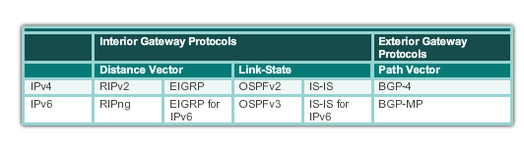
Dynamic Routing Protocol Operation The Evolution of Dynamic Routing Protocols
Dynamic routing protocols used in networks since the late 1980s
Newer versions support the communication based on IPv6
Routing Protocols Classification
Notes:
7.1.1.1

Slide 7
Dynamic Routing Protocol Operation Purpose of Dynamic Routing Protocols
Routing Protocols
Used to facilitate the exchange of routing information between routers
Purpose of dynamic routing protocols includes:
Discovery of remote networks
Maintaining up-to-date routing information
Choosing the best path to destination networks
Ability to find a new best path if the current path is no longer available
Notes:
7.1.1.2

Slide 8
Dynamic Routing Protocol Operation Purpose of Dynamic Routing Protocols
Main components of dynamic routing protocols include:
Data structures - Routing protocols typically use tables or databases for its operations. This information is kept in RAM.
Routing protocol messages - Routing protocols use various types of messages to discover neighboring routers, exchange routing information, and other tasks to learn and maintain accurate information about the network.
Algorithm - Routing protocols use algorithms for facilitating routing information for best path determination.
Notes:
7.1.1.2

Slide 9
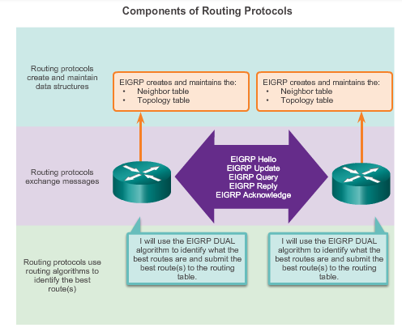
Dynamic Routing Protocol Operation Purpose of Dynamic Routing Protocols
Notes:
7.1.1.2

Slide 10
Dynamic Routing Protocol Operation The Role of Dynamic Routing Protocols
Advantages of dynamic routing
Automatically share information about remote networks
Determine the best path to each network and add this information to their routing tables
Compared to static routing, dynamic routing protocols require less administrative overhead
Help the network administrator manage the time-consuming process of configuring and maintaining static routes
Disadvantages of dynamic routing
Dedicate part of a routers resources for protocol operation, including CPU time and network link bandwidth
Times when static routing is more appropriate
Notes:
7.1.1.3

Slide 11
Dynamic verses Static Routing Using Static Routing
Networks typically use a combination of both static and dynamic routing
Static routing has several primary uses
Providing ease of routing table maintenance in smaller networks that are not expected to grow significantly
Routing to and from a stub network
a network with only one default route out and no knowledge of any remote networks
Accessing a single default router
used to represent a path to any network that does not have a match in the routing table
Notes:
7.1.2.1

Slide 12
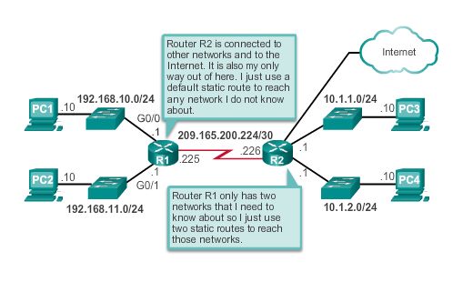
Dynamic verses Static Routing Using Static Routing
Notes:
7.1.2.1

Slide 13
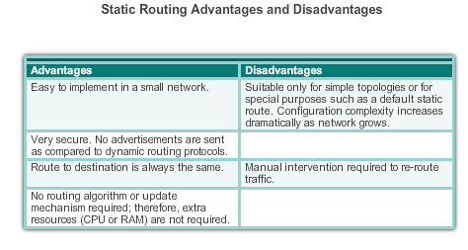
Dynamic verses Static Routing Static Routing Scorecard
Notes:
7.1.2.2

Slide 14
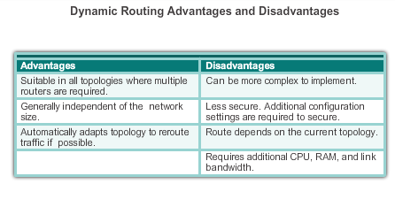
Dynamic verses Static Routing Dynamic Routing Scorecard
Notes:
7.1.2.4

Slide 15
Routing Protocol Operating Fundamentals Dynamic Routing Protocol Operation
In general, the operations of a dynamic routing protocol can be described as follows:
The router sends and receives routing messages on its interfaces.
The router shares routing messages and routing information with other routers that are using the same routing protocol.
Routers exchange routing information to learn about remote networks.
When a router detects a topology change the routing protocol can advertise this change to other routers.
Notes:
7.1.3.1

Slide 16
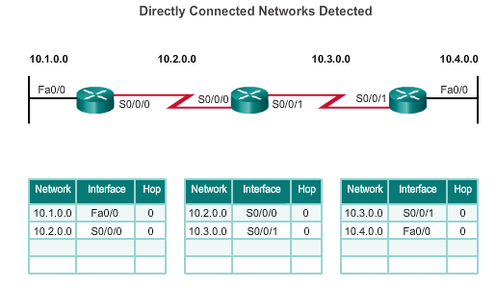
Routing Protocol Operating Fundamentals Cold Start
R1 adds the 10.1.0.0 network available through interface FastEthernet 0/0 and 10.2.0.0 is available through interface Serial 0/0/0.
R2 adds the 10.2.0.0 network available through interface Serial 0/0/0 and 10.3.0.0 is available through interface Serial 0/0/1.
R3 adds the 10.3.0.0 network available through interface Serial 0/0/1 and 10.4.0.0 is available through interface FastEthernet 0/0.
Routers running RIPv2
Notes:
7.1.3.2

Slide 17
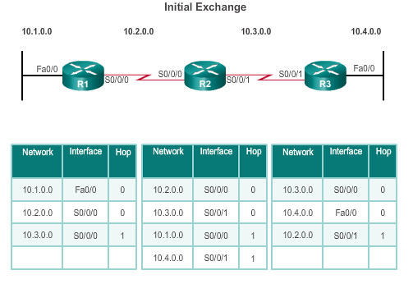
Routing Protocol Operating Fundamentals Network Discovery
R1:
Sends an update about network 10.1.0.0 out the Serial0/0/0 interface
Sends an update about network 10.2.0.0 out the FastEthernet0/0 interface
Receives update from R2 about network 10.3.0.0 with a metric of 1
Stores network 10.3.0.0 in the routing table with a metric of 1
Routers running RIPv2
Notes:
7.1.3.3

Slide 18
Routing Protocol Operating Fundamentals Network Discovery
R2:
Sends an update about network 10.3.0.0 out the Serial 0/0/0 interface
Sends an update about network 10.2.0.0 out the Serial 0/0/1 interface
Receives an update from R1 about network 10.1.0.0 with a metric of 1
Stores network 10.1.0.0 in the routing table with a metric of 1
Receives an update from R3 about network 10.4.0.0 with a metric of 1
Stores network 10.4.0.0 in the routing table with a metric of 1
Routers running RIPv2
Notes:
7.1.3.3

Slide 19
Routing Protocol Operating Fundamentals Network Discovery
R3:
Sends an update about network 10.4.0.0 out the Serial 0/0/1 interface
Sends an update about network 10.3.0.0 out the FastEthernet0/0
Receives an update from R2 about network 10.2.0.0 with a metric of 1
Stores network 10.2.0.0 in the routing table with a metric of 1
Routers running RIPv2
Notes:
7.1.3.3

Slide 20
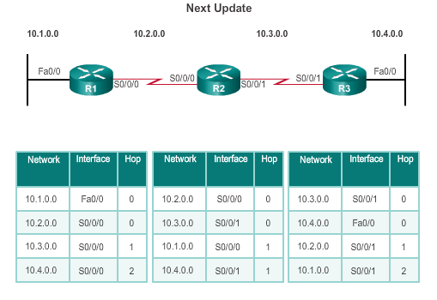
Routing Protocol Operating Fundamentals Exchanging the Routing Information
R1:
Sends an update about network 10. 1. 0. 0 out the Serial 0/0/0 interface
Sends an update about networks 10. 2. 0. 0 and 10. 3. 0. 0 out the FastEthernet0/0 interface
Receives an update from R2 about network 10. 4. 0. 0 with a metric of 2
Stores network 10. 4. 0. 0 in the routing table with a metric of 2
Same update from R2 contains information about network 10. 3. 0. 0 with a metric of 1. There is no change; therefore, the routing information remains the same
Routers running RIPv2
Notes:
7.1.3.4

Slide 21
Routing Protocol Operating Fundamentals Exchanging the Routing Information
R2:
Sends an update about networks 10. 3. 0. 0 and 10. 4. 0. 0 out of Serial 0/0/0 interface
Sends an update about networks 10. 1. 0. 0 and 10. 2. 0. 0 out of Serial 0/0/1 interface
Receives an update from R1 about network 10. 1. 0. 0. There is no change; therefore, the routing information remains the same.
Receives an update from R3 about network 10. 4. 0. 0. There is no change; therefore, the routing information remains the same.
Routers running RIPv2
Notes:
7.1.3.4

Slide 22
Routing Protocol Operating Fundamentals Exchanging the Routing Information
R3:
Sends an update about network 10. 4. 0. 0 out the Serial 0/0/1 interface
Sends an update about networks 10. 2. 0. 0 and 10. 3. 0. 0 out the FastEthernet0/0 interface
Receives an update from R2 about network 10. 1. 0. 0 with a metric of 2
Stores network 10. 1. 0. 0 in the routing table with a metric of 2
Same update from R2 contains information about network 10. 2. 0. 0 with a metric of 1. There is no change; therefore, the routing information remains the same.
Routers running RIPv2
Notes:
7.1.3.4

Slide 23
Routing Protocol Operating Fundamentals Achieving Convergence
Network converged when all routers have complete and accurate information about the entire network.
Convergence time is the time it takes routers to share information, calculate best paths, and update their routing tables.
A network is not completely operable until the network has converged.
Convergence properties include the speed of propagation of routing information and the calculation of optimal paths. The speed of propagation refers to the amount of time it takes for routers within the network to forward routing information.
Generally, older protocols, such as RIP, are slow to converge, whereas modern protocols, such as EIGRP and OSPF, converge more quickly.
Notes:
7.1.3.5

Slide 24
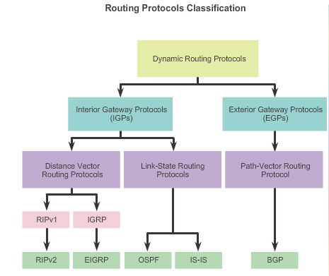
Types of Routing Protocols Classifying Routing Protocols
Notes:
7.1.4.1

Slide 25
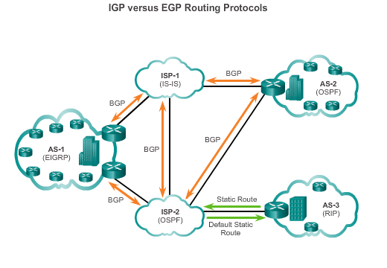
Types of Routing Protocols IGP and EGP Routing Protocols
Interior Gateway Protocols (IGP) -
Used for routing within an AS
Include RIP, EIGRP, OSPF, and IS-IS
Exterior Gateway Protocols (EGP) -
Used for routing between AS
Official routing protocol used by the Internet
Notes:
7.1.4.2

Slide 26
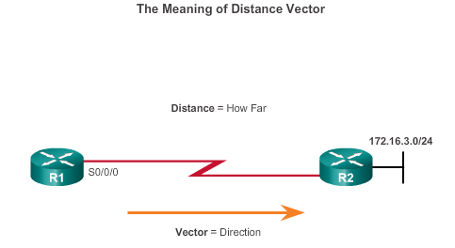
Types of Routing Protocols Distance Vector Routing Protocols
Distance vector IPv4 IGPs:
RIPv1 - First generation legacy protocol
RIPv2 - Simple distance vector routing protocol
IGRP - First generation Cisco proprietary protocol (obsolete)
EIGRP - Advanced version of distance vector routing
For R1, 172.16.3.0/24 is one hop away (distance) it can be reached through R2 (vector)
Notes:
7.1.4.3

Slide 27
Types of Routing Protocols Distance Vector or Link-State Routing Protocols
Distance vector protocols use routers as sign posts along the path to the final destination.
A link-state routing protocol is like having a complete map of the network topology. The sign posts along the way from source to destination are not necessary, because all link-state routers are using an identical map of the network. A link-state router uses the link-state information to create a topology map and to select the best path to all destination networks in the topology.
Notes:
7.1.4.3

Slide 28
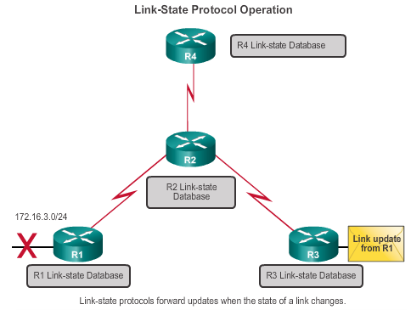
Types of Routing Protocols Link-State Routing Protocols
Link-state IPv4 IGPs:
OSPF - Popular standards based routing protocol
IS-IS - Popular in provider networks.
Notes:
7.1.4.4

Slide 29
Types of Routing Protocols Classful Routing Protocols
Classful routing protocols do not send subnet mask information in their routing updates
Only RIPv1 and IGRP are classful
Created when network addresses were allocated based on classes (class A, B, or C)
Cannot provide variable length subnet masks (VLSMs) and classless interdomain routing (CIDR)
Create problems in discontiguous networks
Notes:
7.1.4.5

Slide 30
Types of Routing Protocols Classless Routing Protocols
Classless routing protocols include subnet mask information in the routing updates
RIPv2, EIGRP, OSPF, and IS_IS
Support VLSM and CIDR
IPv6 routing protocols
Notes:
7.1.4.6

Slide 31
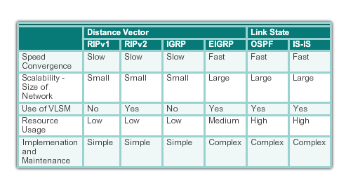
Types of Routing Protocols Routing Protocol Characteristics
Notes:
7.1.4.7

Slide 32
Types of Routing Protocols Routing Protocol Metrics
A metric is a measurable value that is assigned by the routing protocol to different routes based on the usefulness of that route
Used to determine the overall “cost” of a path from source to destination
Routing protocols determine the best path based on the route with the lowest cost
Notes:
7.1.4.8

Slide 33
Distance Vector Dynamic Routing
Notes:
7.2

Slide 34
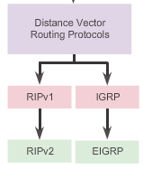
Distance Vector Routing Protocol Operation Distance Vector Technologies
Distance vector routing protocols
Share updates between neighbors
Not aware of the network topology
Some send periodic updates to broadcast IP 255.255.255.255 even if topology has not changed
Updates consume bandwidth and network device CPU resources
RIPv2 and EIGRP use multicast addresses
EIGRP will only send an update when topology has changed
Notes:
7.2.1.1

Slide 35
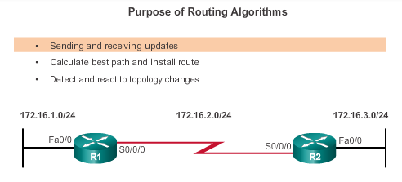
Distance Vector Routing Protocol Operation Distance Vector Algorithm
RIP uses the Bellman-Ford algorithm as its routing algorithm
IGRP and EIGRP use the Diffusing Update Algorithm (DUAL) routing algorithm developed by Cisco
Notes:
7.2.1.2

Slide 36
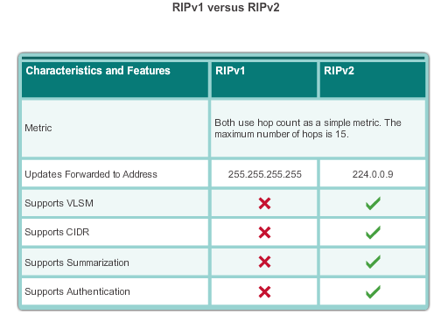
Types of Distance Vector Routing Protocols Routing Information Protocol
Routing updates broadcasted every 30 seconds
Updates use UDP port 520
RIPng is based on RIPv2 with a 15 hop limitation and the administrative distance of 120
Notes:
7.2.2.1

Slide 37
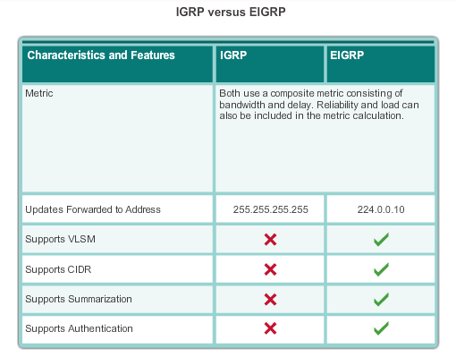
Types of Distance Vector Routing Protocols Enhanced Interior-Gateway Routing Protocol
EIGRP
Bounded triggered updates
Hello keepalives mechanism
Maintains a topology table
Rapid convergence
Multiple network layer protocol support
Notes:
7.2.2.2

Slide 38
RIP and RIPng Routing
Notes:
7.3

Slide 39
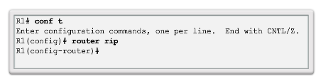
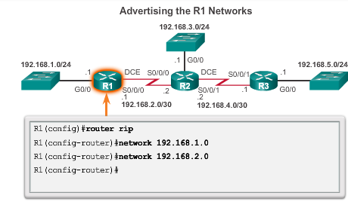
Configuring the RIP Protocol Router RIP Configuration Mode Advertising Networks
Notes:
7.3.1.1
7.3.1.2

Slide 40
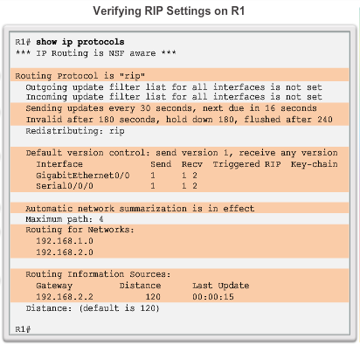
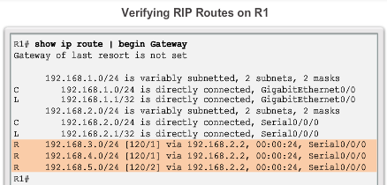
Configuring the RIP Protocol Examining Default RIP Settings
Notes:
7.3.1.3

Slide 41
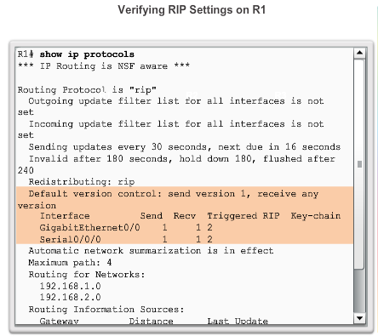
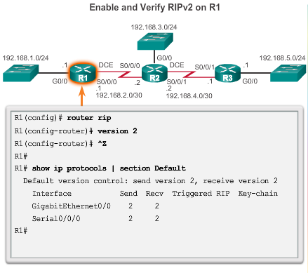
Configuring the RIP Protocol Enabling RIPv2
Notes:
7.3.1.4

Slide 42
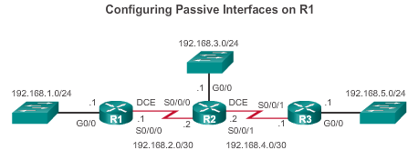
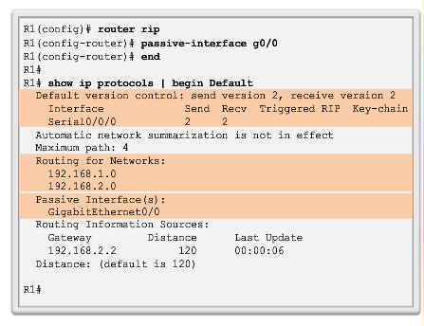
Configuring the RIP Protocol Configuring Passive Interfaces
Sending out unneeded updates on a LAN impacts the network in three ways:
Wasted Bandwidth
Wasted Resources
Security Risk
Notes:
7.3.1.6

Slide 43
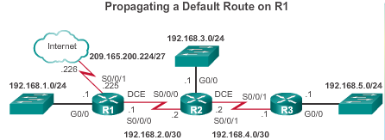
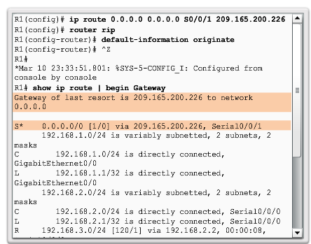
Configuring the RIP Protocol Propagating a Default Route
Notes:
7.3.1.7

Slide 44
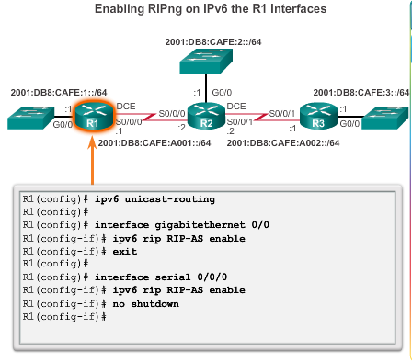
Configuring the RIPng Protocol Advertising IPv6 Networks
Notes:
7.3.2.1

Slide 45
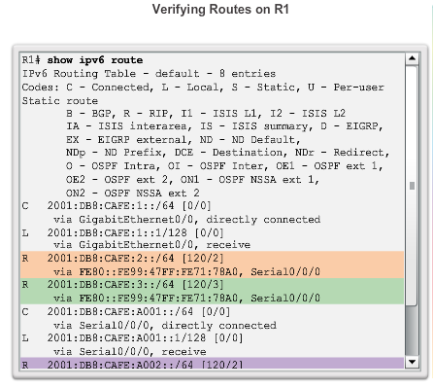
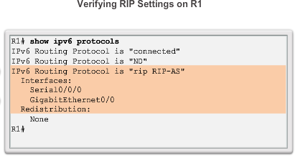
Configuring the RIPng Protocol Examining the RIPng Configuration
Notes:
7.3.2.2

Slide 46
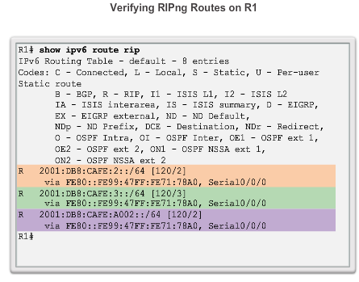
Configuring the RIPng Protocol Examining the RIPng Configuration
Notes:
7.3.2.2

Slide 47
Link-State Dynamic Routing
Notes:
7.4

Slide 48
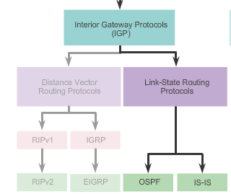
Link-State Routing Protocol Operation Shortest Path First Protocols
Notes:
7.4.1.1

Slide 49
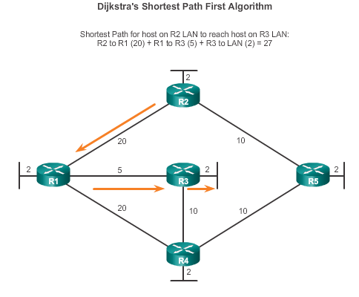
Link-State Routing Protocol Operation Dijkstra’s Algorithm
Notes:
7.4.1.2

Slide 50
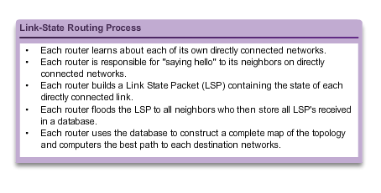
Link-State Updates Link-State Routing Process
Notes:
7.4.2.1

Slide 51
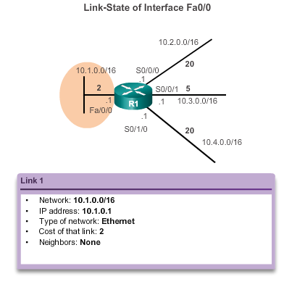
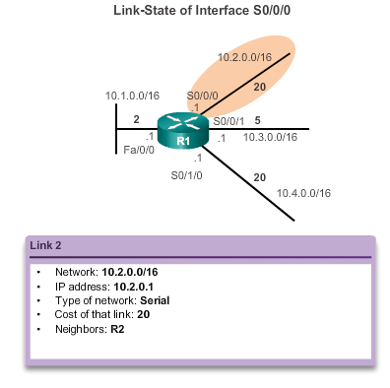
Link-State Updates Link and Link-State
The first step in the link-state routing process is that each router learns about its own links, its own directly connected networks.
Notes:
7.4.2.2

Slide 52
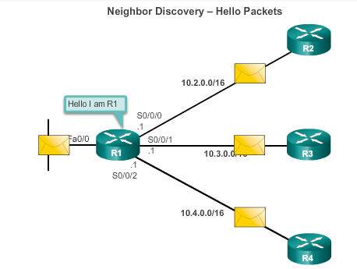
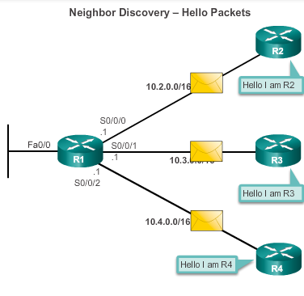
Link-State Updates Say Hello
The second step in the link-state routing process is that each router is responsible for meeting its neighbors on directly connected networks.
Notes:
7.4.2.3

Slide 53
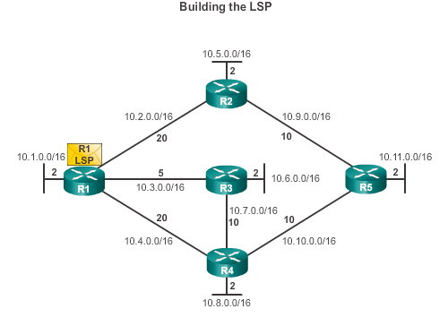
Link-State Updates Say Hello
The third step in the link-state routing process is that each router builds a link-state packet (LSP) containing the state of each directly connected link.
R1; Ethernet network 10.1.0.0/16; Cost 2
R1 -> R2; Serial point-to-point network; 10.2.0.0/16; Cost 20
R1 -> R3; Serial point-to-point network; 10.7.0.0/16; Cost 5
R1 -> R4; Serial point-to-point network; 10.4.0.0/16; Cost 20
Notes:
7.4.2.4

Slide 54
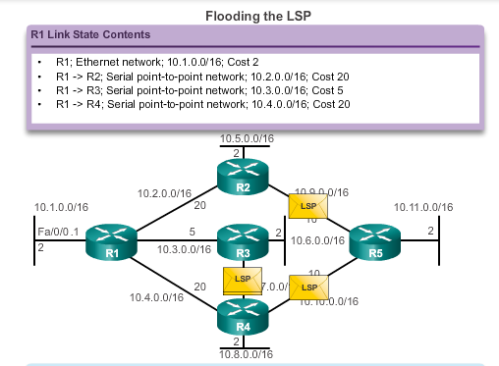
Link-State Updates Flooding the LSP
The fourth step in the link-state routing process is that each router floods the LSP to all neighbors, who then store all LSPs received in a database.
Notes:
7.4.2.5

Slide 55
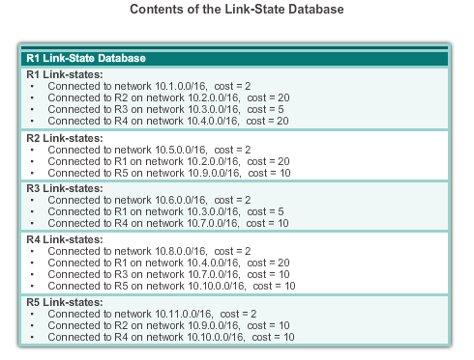
Link-State Updates Building the Link-State Database
The final step in the link-state routing process is that each router uses the database to construct a complete map of the topology and computes the best path to each destination network.
Notes:
7.4.2.6

Slide 56
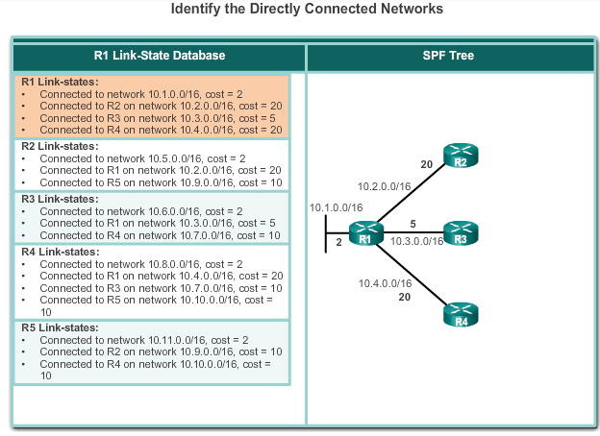
Link-State Updates Building the SPF Tree
Notes:
7.4.2.6

Slide 57
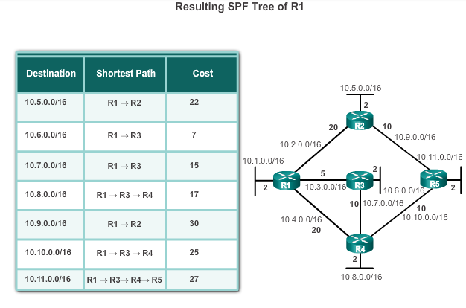
Link-State Updates Building the SPF Tree
Notes:
7.4.2.7

Slide 58
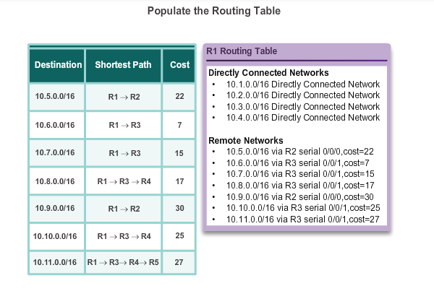
Link-State Updates Adding OSPF Routes to the Routing Table
Notes:
7.4.2.8

Slide 59
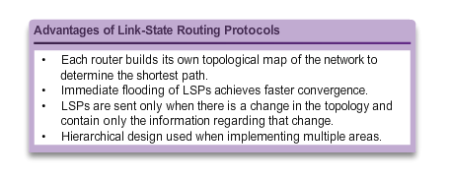
Why Use Link-State Routing Protocols Why Use Link-State Protocols?
Disadvantages compared to distance vector routing protocols:
Memory Requirements
Processing Requirements
Bandwidth Requirements
Notes:
7.4.3.1

Slide 60
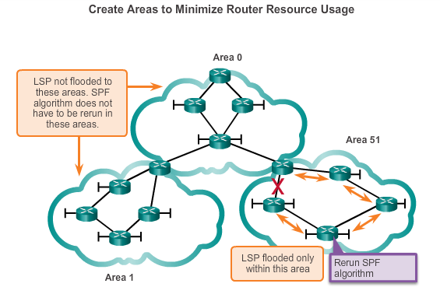
Why Use Link-State Routing Protocols Disadvantages of Link-State Protocols
Notes:
7.4.3.2

Slide 61
Why Use Link-State Routing Protocols Protocols that Use Link-State
Only two link-state routing protocols:
Open Shortest Path First (OSPF) most popular
began in 1987
two current versions
OSPFv2 - OSPF for IPv4 networks
OSPFv3 - OSPF for IPv6 networks
IS-IS was designed by International Organization for Standardization (ISO )
Notes:
7.4.3.3

Slide 62
The Routing Table
Notes:
7.4

Slide 63
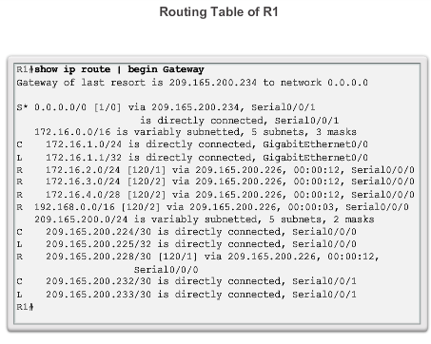
Parts of an IPv4 Route Entry Routing Table Entries
Notes:
7.5.1.1

Slide 64
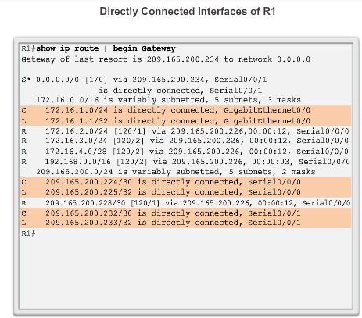
Parts of an IPv4 Route Entry Directly Connected Entries
Notes:
7.5.1.2

Slide 65
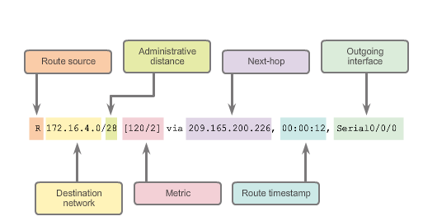
Parts of an IPv4 Route Entry Remote Network Entries
Notes:
7.5.1.3

Slide 66
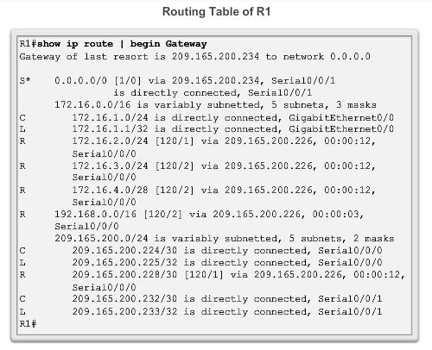
Dynamically Learned IPv4 Routes Routing Table Terms
Routes are discussed in terms of:
Ultimate route
Level 1 route
Level 1 parent route
Level 2 child routes
Notes:
7.5.2.1

Slide 67

Dynamically Learned IPv4 Routes Ultimate Route
An ultimate route is a routing table entry that contains either a next-hop IP address or an exit interface. Directly connected, dynamically learned, and link local routes are ultimate routes.
Notes:
7.5.2.2

Slide 68

Dynamically Learned IPv4 Routes Level 1 Route
Notes:
7.5.2.3

Slide 69

Dynamically Learned IPv4 Routes Level 1 Parent Route
Notes:
7.5.2.4

Slide 70

Dynamically Learned IPv4 Routes Level 2 Child Route
Notes:
7.5.2.5

Slide 71

The IPv4 Route Lookup Process Best Route = Longest Match
Notes:
7.5.3.2

Slide 72


Analyze an IPVv6 Routing Table Directly Connected Entries
Notes:
7.5.4.2

Slide 73


Analyze an IPVv6 Routing Table Remote IPv6 Network Entries
Notes:
7.5.4.3

Slide 74
Chapter 7: Summary
Dynamic routing protocols:
Used by routers to automatically learn about remote networks from other routers
Purpose includes: discovery of remote networks, maintaining up-to-date routing information, choosing the best path to destination networks, and ability to find a new best path if the current path is no longer available
Best choice for large networks but static routing is better for stub networks.
Function to inform other routers about changes
Can be classified as either classful or classless, distance-vector or link-state, and an interior or an exterior gateway protocol
Notes:
Chapter 7 Summary

Slide 75
Chapter 7: Summary
Dynamic routing protocols (continued):
A link-state routing protocol can create a complete view or topology of the network by gathering information from all of the other routers
Metrics are used to determine the best path or shortest path to reach a destination network
Different routing protocols may use different (hops, bandwidth, delay, reliability, and load)
Show ip protocols command displays the IPv4 routing protocol settings currently configured on the router, for IPv6, use show ipv6 protocols
Notes:
Chapter 7 Summary

Slide 76
Chapter 7: Summary
Dynamic routing protocols (continued):
Cisco routers use the administrative distance value to determine which routing source to use
Each dynamic routing protocol has a unique administrative value, along with static routes and directly connected networks, lower is preferred the route
Directly connected networks are preferred source, followed by static routes and then various dynamic routing protocols
An OSPF link is an interface on a router, information about the state of the links is known as link-states
Link-state routing protocols apply Dijkstra’s algorithm to calculate the best path route which uses accumulated costs along each path, from source to destination, to determine the total cost of a route
Notes:
Chapter 7 Summary

Slide 77


