Slide 1
Chapter 8: Single-Area OSPF
Routing Protocols
Notes:
Cisco Networking Academy program
Routing Protocols
Chapter 8

Slide 2
Chapter 8
8.1 Characteristics of OSPF
8.2 Configuring Single-area OSPFv2
8.3 Configure Single-area OSPFv3
Notes:
Chapter 8

Slide 3
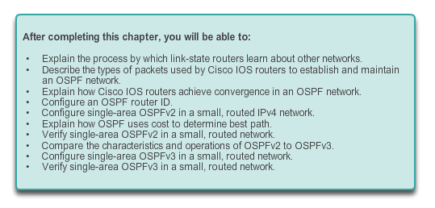
Chapter 8: Objectives

Slide 4
8.1 Characteristics of OSPF
Notes:
8.1.1.1

Slide 5
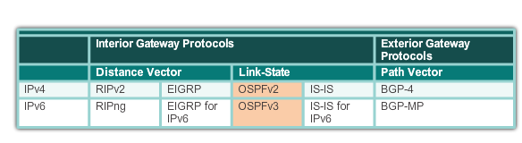
Open Shortest Path First Evolution of OSPF
Interior Gateway Protocols
1989
updated in 2008
1988
Notes:
8.1.1.1

Slide 6
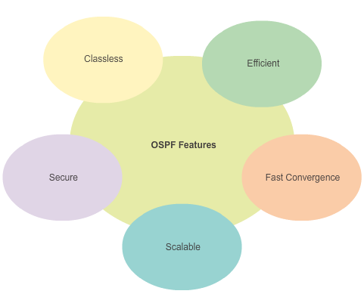
Open Shortest Path First Features of OSPF
Notes:
8.1.1.2

Slide 7
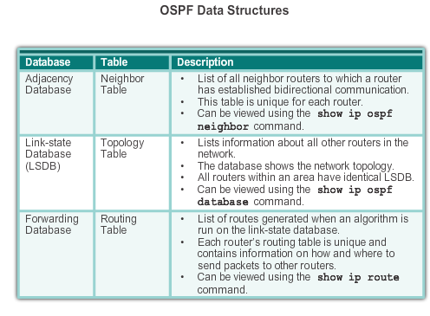
Open Shortest Path First Components of OSPF
Notes:
8.1.1.3

Slide 8
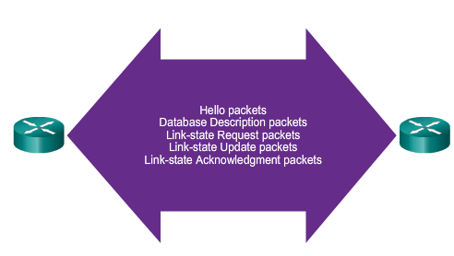
Open Shortest Path First Components of OSPF
OSPF Routers Exchange Packets - These packets are used to discover neighboring routers and also to exchange routing information to maintain accurate information about the network.
Notes:
8.1.1.3

Slide 9
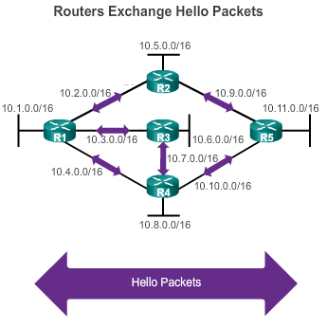
Open Shortest Path First Link-State Operation
If a neighbor is present, the OSPF-enabled router attempts to establish a neighbor adjacency with that neighbor
Notes:
8.1.1.4

Slide 10
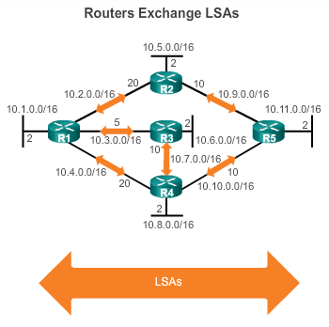
Open Shortest Path First Link-State Operation
LSAs contain the state and cost of each directly connected link.
Routers flood their LSAs to adjacent neighbors.
Adjacent neighbors receiving the LSA immediately flood the LSA to other directly connected neighbors, until all routers in the area have all LSAs.
Notes:
8.1.1.4

Slide 11
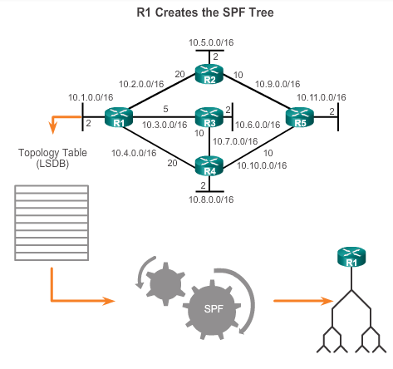
Open Shortest Path First Link-State Operation
Build the topology table based on the received LSAs.
This database eventually holds all the information about the topology of the network.
Execute the SPF Algorithm.
Notes:
8.1.1.4

Slide 12
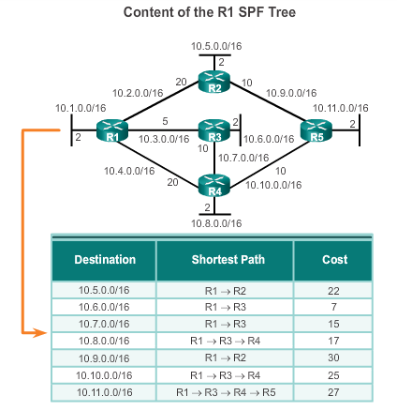
Open Shortest Path First Link-State Operation
From the SPF tree, the best paths are inserted into the routing table.
Notes:
8.1.1.4

Slide 13
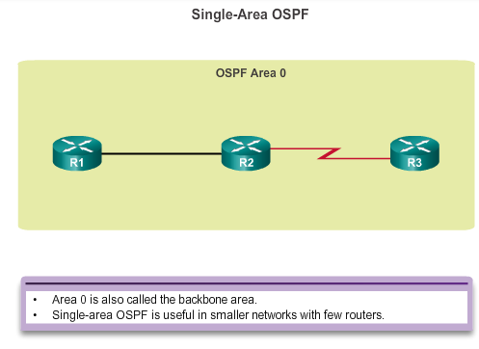
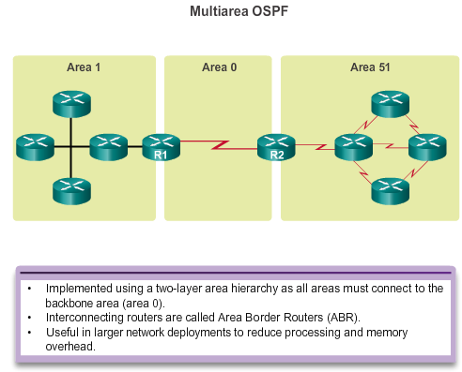
Open Shortest Path First Single-area and Multiarea OSPF
Notes:
8.1.1.5

Slide 14
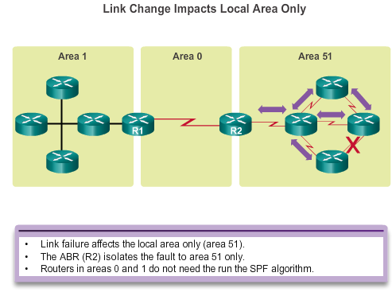
Open Shortest Path First Single-area and Multiarea OSPF
Notes:
8.1.1.5

Slide 15
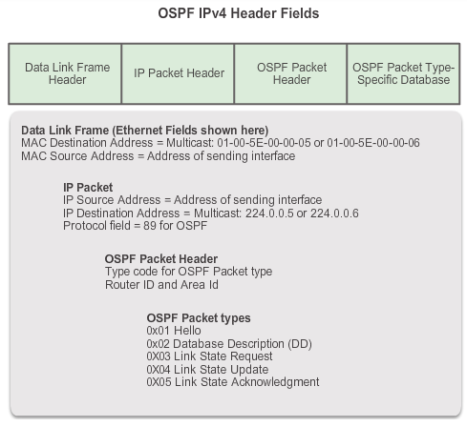
OSPF Messages Encapsulating OSPF Messages
Notes:
8.1.2.1

Slide 16
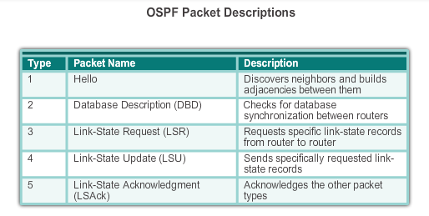
OSPF Messages Types of OSPF Packets
Notes:
8.1.2.2

Slide 17
OSPF Messages Hello Packet
OSPF Type 1 packet = Hello packet
Discover OSPF neighbors and establish neighbor adjacencies
Advertise parameters on which two routers must agree to become neighbors
Elect the Designated Router (DR) and Backup Designated Router (BDR) on multiaccess networks like Ethernet and Frame Relay
Notes:
8.1.2.3

Slide 18
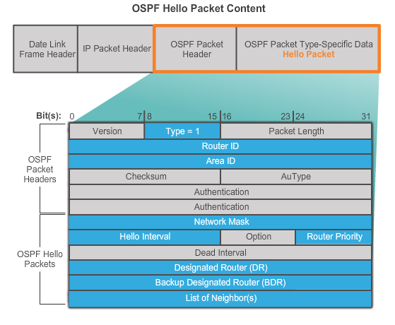
OSPF Messages Hello Packet
Notes:
8.1.2.3

Slide 19
OSPF Messages Hello Packet Intervals
OSPF Hello packets are transmitted
To 224.0.0.5 in IPv4 and FF02::5 in IPv6 (all OSPF routers)
Every 10 seconds (default on multiaccess and point-to-point networks)
Every 30 seconds (default on non-broadcast multiaccess [NBMA] networks)
Dead interval is the period that the router waits to receive a Hello packet before declaring the neighbor down
Router floods the LSDB with information about down neighbors out all OSPF enabled interfaces
Cisco’s default is 4 times the Hello interval
Notes:
8.1.2.4

Slide 20
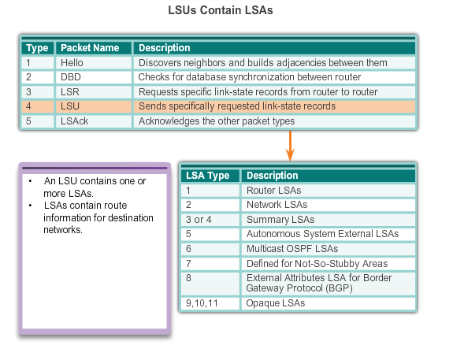
OSPF Messages Link-State Updates
Notes:
8.1.2.5

Slide 21
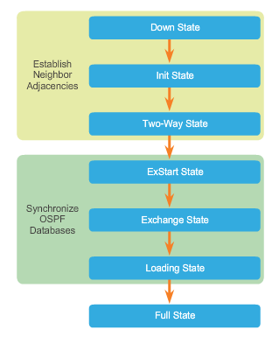
OSPF Operation OSPF Operational States
When an OSPF router is initially connected to a network, it attempts to:
Create adjacencies with neighbors
Exchange routing information
Calculate the best routes
Reach convergence
OSPF progresses through several states while attempting to reach convergence.
Notes:
8.1.3.1

Slide 22
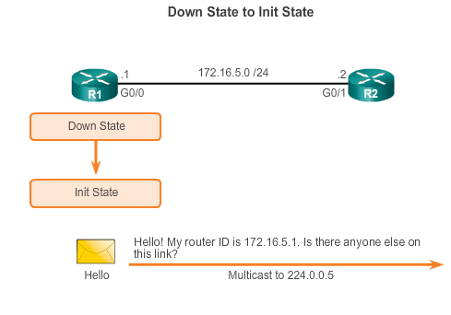
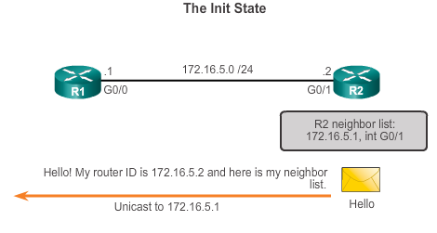
OSPF Operation Establish Neighbor Adjacencies
Notes:
8.1.3.2

Slide 23
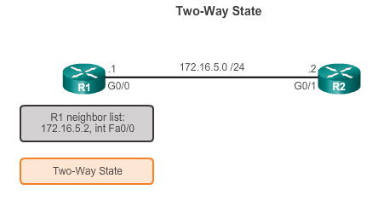
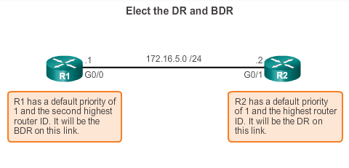
OSPF Operation Establish Neighbor Adjacencies
DR and BDR election only occurs on multi-access networks such as Ethernet LANs.
Notes:
8.1.3.2

Slide 24
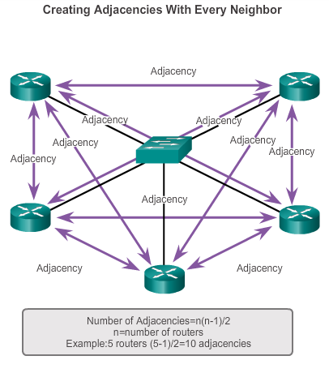
OSPF Operation OSPF DR and BDR
Notes:
8.1.3.3

Slide 25
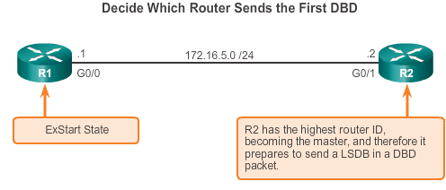
OSPF Operation Synchronizing OSPF Database
Notes:
8.1.3.4

Slide 26
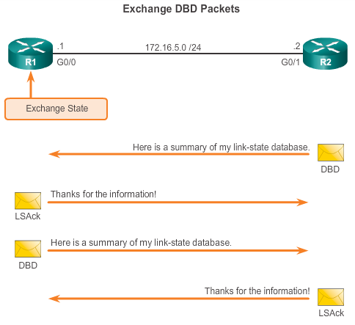
OSPF Operation Synchronizing OSPF Database
Notes:
8.1.3.4

Slide 27
8.2 Configuring Single-area OSPFv2
Notes:
8.2

Slide 28
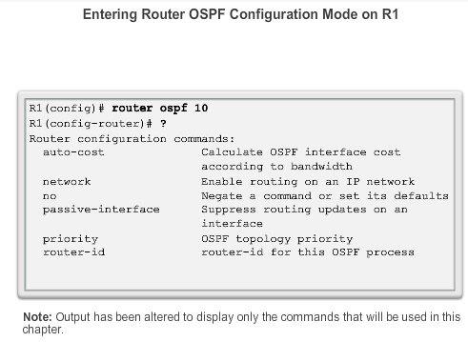
OSPF Router ID OSPF Network Topology
Notes:
8.2.1.2

Slide 29
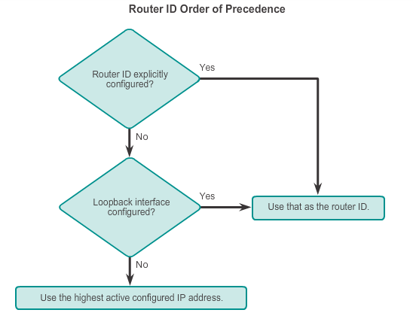
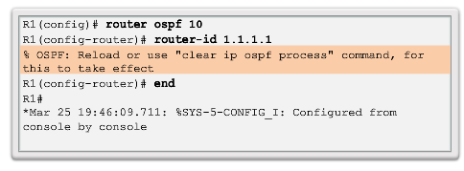
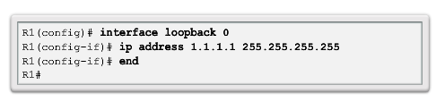
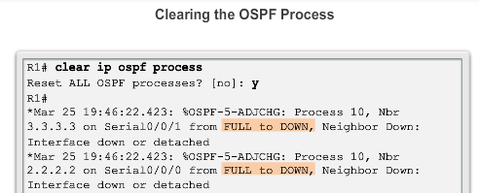
OSPF Router ID Router IDs
Notes:
8.2.1.3/4/5/6

Slide 30
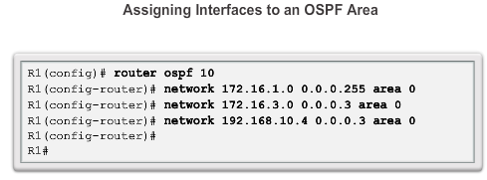
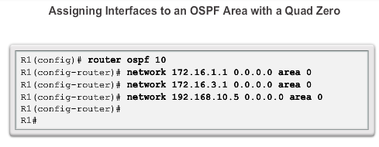
Configure Single-area OSPFv2 The network Command
Notes:
8.2.2.1/2/3

Slide 31
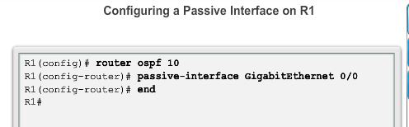
Configure Single-area OSPFv2 Configuring Passive Interfaces
Use the passive-interface router configuration mode command to prevent the transmission of routing messages through a router interface, but still allow that network to be advertised to other routers.
Notes:
8.2.2.5

Slide 32
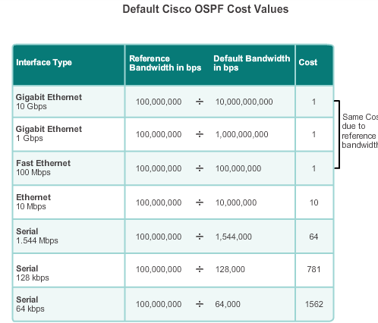
OSPF Cost OSPF Metric = Cost
Cost = reference bandwidth / interface bandwidth
(default reference bandwidth is 10^8)
Cost = 100,000,000 bps / interface bandwidth in bps
Notes:
8.2.3.1

Slide 33
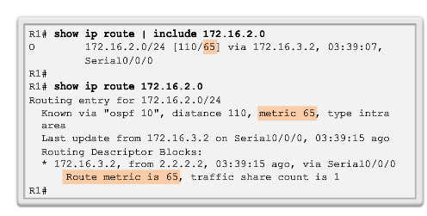
OSPF Cost OSPF Accumulates Costs
Cost of an OSPF route is the accumulated value from one router to the destination network
Notes:
8.2.3.2

Slide 34
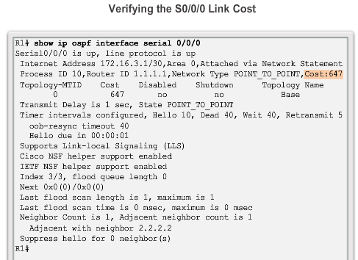
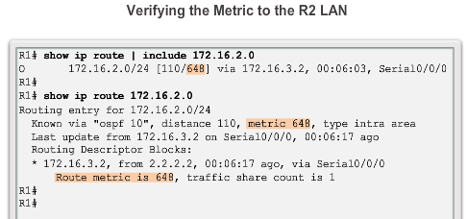
OSPF Cost Adjusting the Reference Bandwidth
Use the command - auto-cost reference-bandwidth
Must be configured on every router in the OSPF domain
Notice that the value is expressed in Mb/s:
Gigabit Ethernet - auto-cost reference-bandwidth 1000
10 Gigabit Ethernet - auto-cost reference-bandwidth 10000
Notes:
8.2.3.3

Slide 35
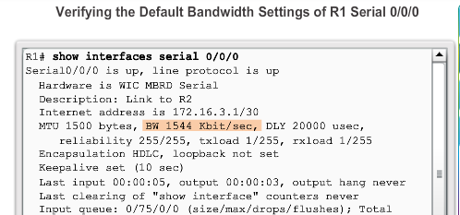
OSPF Cost Default Interface Bandwidths
On Cisco routers, the default bandwidth on most serial interfaces is set to 1.544 Mb/s
Notes:
8.2.3.4

Slide 36
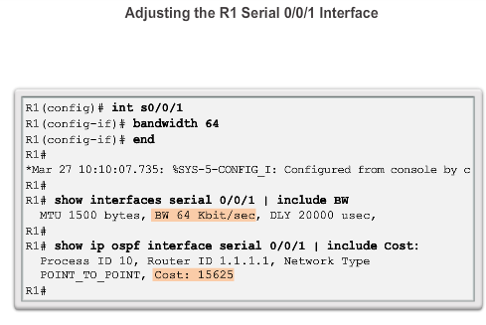
OSPF Cost Adjusting the Interface Bandwidths
Notes:
8.2.3.5

Slide 37
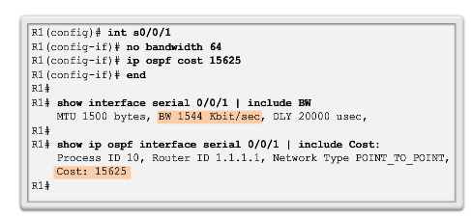
OSPF Cost Manually Setting the OSPF Cost
Both the bandwidth interface command and the ip ospf cost interface command achieve the same result, which is to provide an accurate value for use by OSPF in determining the best route.
Notes:
8.2.3.6

Slide 38
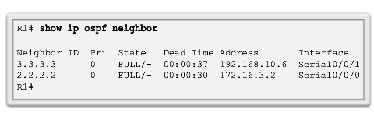
Verify OSPF Verify OSPF Neighbors
Verify that the router has formed an adjacency with its neighboring routers
Notes:
8.2.4.1

Slide 39
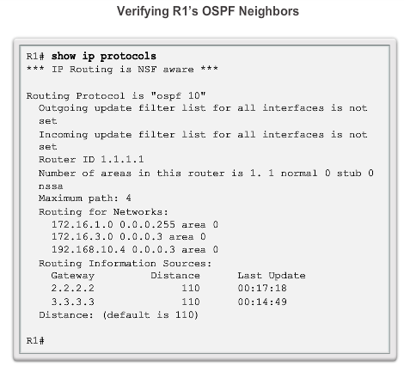
Verify OSPF Verify OSPF Protocol Settings
Notes:
8.2.4.2

Slide 40
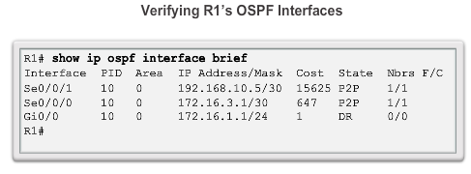
Verify OSPF Verify OSPF Interface Settings
Notes:
8.2.4.4

Slide 41
Configuring Single-area OSPFv3
Notes:
8.3

Slide 42
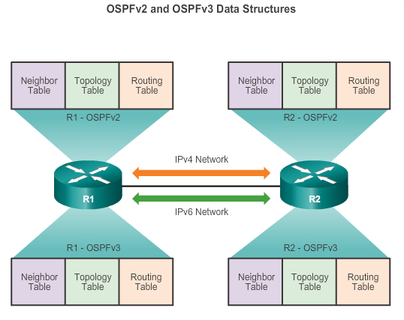
OSPFv2 vs. OSPFv3 OSPFv3
Notes:
8.3.1.1

Slide 43
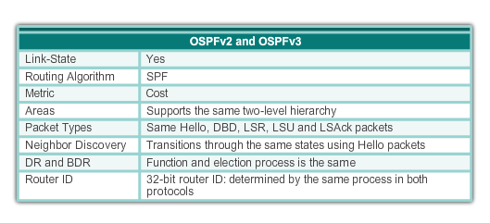
OSPFv2 vs. OSPFv3 Similarities Between OSPFv2 to OSPFv3
Notes:
8.3.1.2

Slide 44
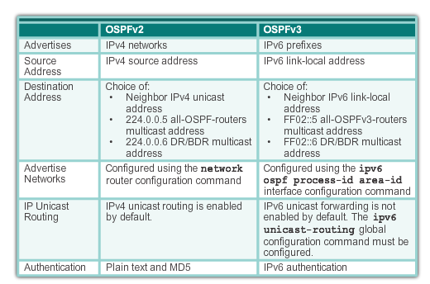
OSPFv2 vs. OSPFv3 Differences Between OSPFv2 to OSPFv3
Notes:
8.3.1.3

Slide 45
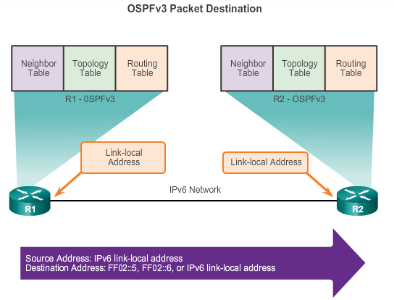
OSPFv2 vs. OSPFv3 Link-Local Addresses
FF02::5 address is the all OSPF router address
FF02::6 is the DR/BDR multicast address
Notes:
8.3.1.4

Slide 46
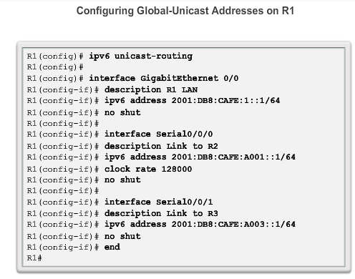
Configuring OSFPv3 OSPFv3 Network Topology
Notes:
8.3.2.1

Slide 47
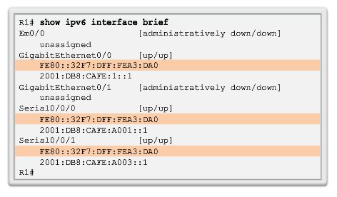
Configuring OSFPv3 Link-Local Addresses
Link-local addresses are automatically created when an IPv6 global unicast address is assigned to the interface (required).
Global unicast addresses are not required.
Cisco routers create the link-local address using FE80::/10 prefix and the EUI-64 process unless the router is configured manually,
EUI-64 involves using the 48-bit Ethernet MAC address, inserting FFFE in the middle and flipping the seventh bit. For serial interfaces, Cisco uses the MAC address of an Ethernet interface.
Notice in the figure that all three interfaces are using the same link-local address.
Notes:
8.3.2.2

Slide 48
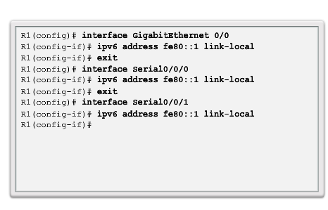
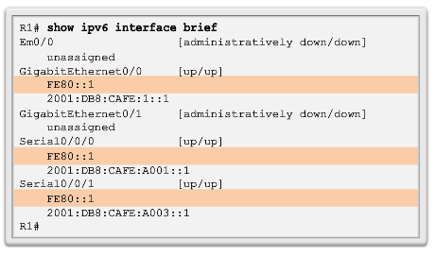
Configuring OSFPv3 Assigning Link-Local Addresses
Configuring the link-local address provides the ability to create an address that is recognizable and easier to remember
Notes:
8.3.2.3

Slide 49

Configuring OSFPv3 Configuring the OSPFv3 Router ID
Notes:
8.3.2.4

Slide 50

Configuring OSFPv3 Configuring the OSPFv3 Router ID
Notes:
8.3.2.4

Slide 51


Configuring OSFPv3 Modifying an OSPFv3 Router ID
Notes:
8.3.2.5

Slide 52

OSPF Configuring OSFPv3 Enabling OSPFv3 on Interfaces
Instead of using the network router configuration mode command to specify matching interface addresses, OSPFv3 is configured directly on the interface.
Notes:
8.3.2.6

Slide 53


Verify OSPFv3 Verify OSPFv3 Neighbors/Protocol Settings
Notes:
8.3.3.1/2

Slide 54

Verify OSPFv3 Verify OSPFv3 Interfaces
Notes:
8.3.3.3

Slide 55

Verify OSPFv3 Verify IPv6 Routing Table
Notes:
8.3.3.4

Slide 56
Chapter 8: Summary
OSPF:
For IPv4 is OSPFv2
For IPv6 is OSPFv3
Classless, link-state routing protocol with a default administrative distance of 110, and is denoted in the routing table with a route source code of O
OSPFv2 is enabled with the router ospf process-id global configuration mode command. The process-id value is locally significant, which means that it does not need to match other OSPF routers to establish adjacencies with those neighbors.
Network command uses the wildcard-mask value which is the inverse of the subnet mask, and the area-id value
Notes:
Chapter 8 Summary

Slide 57
Chapter 8: Summary
OSPF:
By default, OSPF Hello packets are sent every 10 seconds on multiaccess and point-to-point segments and every 30 seconds on NBMA segments (Frame Relay, X.25, ATM), and are used by OSPF to establish neighbor adjacencies. The Dead interval is four times the Hello interval, by default.
For routers to become adjacent, their Hello interval, Dead interval, network types, and subnet masks must match. Use the show ip ospf neighborscommand to verify OSPF adjacencies.
In a multiaccess network, OSPF elects a DR to act as collection and distribution point for LSAs sent and received. A BDR is elected to assume the role of the DR should the DR fail. All other routers are known as DROTHERs. All routers send their LSAs to the DR, which then floods the LSA to all other routers in the multiaccess network.
Notes:
Chapter 8 Summary

Slide 58
Chapter 8: Summary
OSPF:
In multiaccess networks, the router with the highest router ID is the DR, and the router with the second highest router ID is the BDR. This can be superseded by the ip ospf priority command on that interface. The router with the highest priority value is the DR, and next-highest the BDR.
The show ip protocols command is used to verify important OSPF configuration information, including the OSPF process ID, the router ID, and the networks the router is advertising.
OSPFv3 is enabled on an interface and not under router configuration mode. OSPFv3 needs link-local addresses to be configured. IPv6 Unicast routing must be enabled for OSPFv3. A 32-bit router-ID is required before an interface can be enabled for OSPFv3.
Notes:
Chapter 8 Summary

Slide 59
Chapter 8: Summary
OSPF:
The show ip protocols command is used to verify important OSPFv2 configuration information, including the OSPF process ID, the router ID, and the networks the router is advertising.
OSPFv3
Enabled on an interface and not under router configuration mode
Needs link-local addresses to be configured. IPv6
Unicast routing must be enabled for OSPFv3
32-bit router-ID is required before an interface can be enabled for OSPFv3
show ipv6 protocols command is a quick way to verify configuration information (OSPF process ID, the router ID, and the interfaces enabled for OSPFv3)
Notes:
Chapter 8 Summary

Slide 60


