Slide 1
Chapter 9: Access Control Lists
Routing & Switching
Notes:
Cisco Networking Academy program
Routing & Switching
Chapter 9: Access Control Lists

Slide 2
Chapter 9
9.1 IP ACL Operation
9.2 Standard IPv4 ACLs
9.3 Extended IPv4 ACLSs
9.4 Contextual Unit: Debug with ACLs
9.5 Troubleshoot ACLs
9.6 Contextual Unit: IPv6 ACLs
9.7 Summary
Notes:
Chapter 9

Slide 3
Chapter 9: Objectives
Explain how ACLs are used to filter traffic.
Compare standard and extended IPv4 ACLs.
Explain how ACLs use wildcard masks.
Explain the guidelines for creating ACLs.
Explain the guidelines for placement of ACLs.
Configure standard IPv4 ACLs to filter traffic according to networking requirements.
Modify a standard IPv4 ACL using sequence numbers.
Configure a standard ACL to secure vty access.

Slide 4
Chapter 9: Objectives (continued)
Explain the structure of an extended access control entry (ACE).
Configure extended IPv4 ACLs to filter traffic according to networking requirements.
Configure an ACL to limit debug output.
Explain how a router processes packets when an ACL is applied.
Troubleshoot common ACL errors using CLI commands.
Compare IPv4 and IPv6 ACL creation.
Configure IPv6 ACLs to filter traffic according to networking requirements.

Slide 5
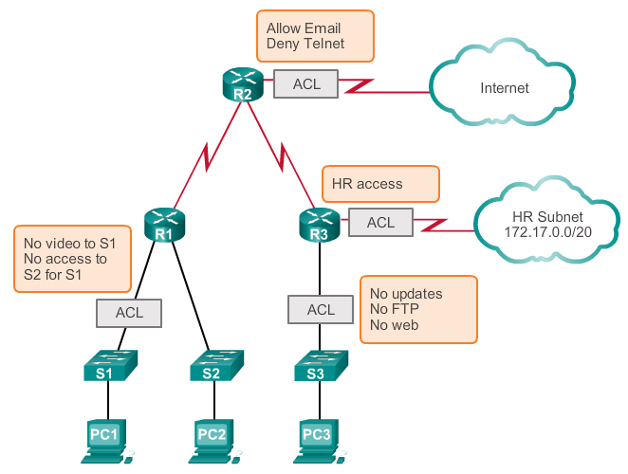
Purpose of ACLs What is an ACL?
Notes:
9.1.1.1

Slide 6
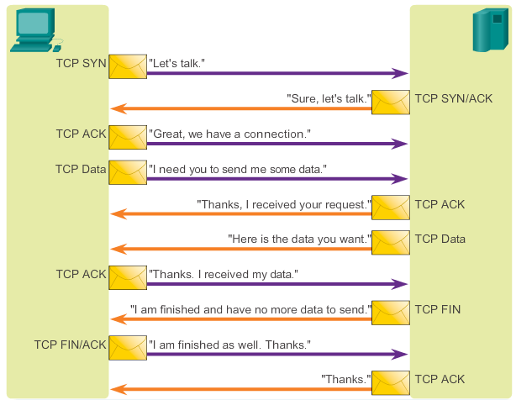
Purpose of ACLs A TCP Conversation
Notes:
9.1.1.2

Slide 7
Purpose of ACLs Packet Filtering
Packet filtering, sometimes called static packet filtering, controls access to a network by analyzing the incoming and outgoing packets and passing or dropping them based on given criteria, such as the source IP address, destination IP addresses, and the protocol carried within the packet.
A router acts as a packet filter when it forwards or denies packets according to filtering rules.
An ACL is a sequential list of permit or deny statements, known as access control entries (ACEs).
Notes:
9.1.1.3

Slide 8
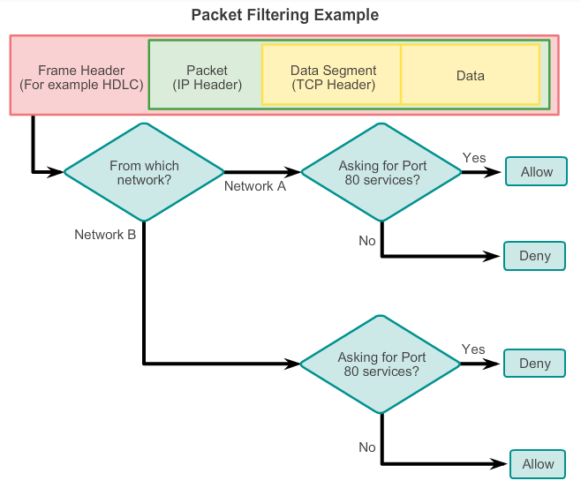
Purpose of ACLs Packet Filtering (Cont.)
Notes:
9.1.1.4

Slide 9
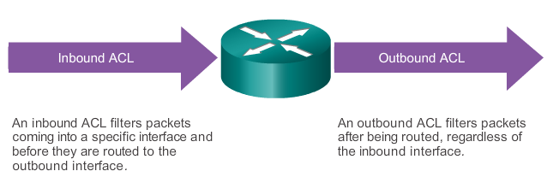
Purpose of ACLs ACL Operation
The last statement of an ACL is always an implicit deny. This statement is automatically inserted at the end of each ACL even though it is not physically present. The implicit deny blocks all traffic. Because of this implicit deny, an ACL that does not have at least one permit statement will block all traffic.
Notes:
9.1.1.5

Slide 10
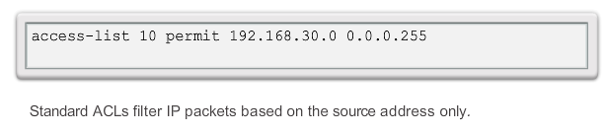
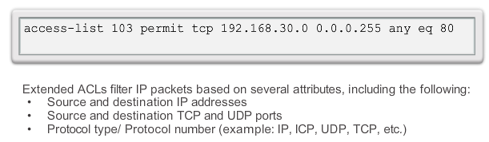
Standard versus Extended IPv4 ACLs Types of Cisco IPv4 ACLs
Standard ACLs
Extended ACLs
Notes:
9.1.2.1

Slide 11
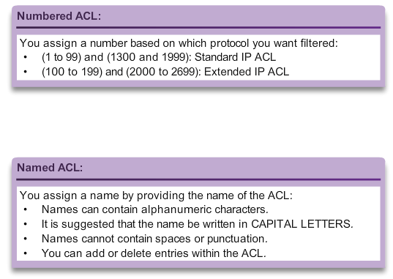
Standard versus Extended IPv4 ACLs Numbering and Naming ACLs
Notes:
9.1.2.2

Slide 12
Wildcard Masks in ACLs Introducing ACL Wildcard Masking
Wildcard masks and subnet masks differ in the way they match binary 1s and 0s. Wildcard masks use the following rules to match binary 1s and 0s:
Wildcard mask bit 0 - Match the corresponding bit value in the address.
Wildcard mask bit 1 - Ignore the corresponding bit value in the address.
Wildcard masks are often referred to as an inverse mask. The reason is that, unlike a subnet mask in which binary 1 is equal to a match and binary 0 is not a match, in a wildcard mask the reverse is true.
Notes:
9.1.3.1

Slide 13
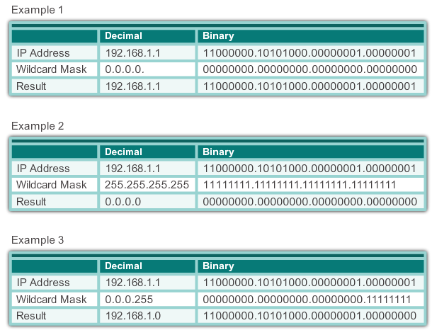
Wildcard Masks in ACLs Wildcard Mask Examples: Hosts / Subnets
Notes:
9.1.3.2

Slide 14
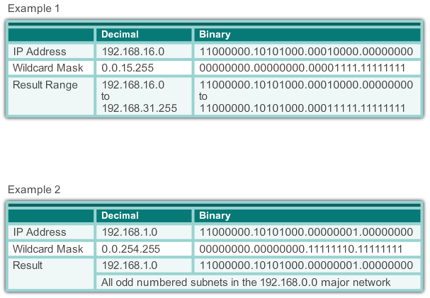
Wildcard Masks in ACLs Wildcard Mask Examples: Match Ranges
Notes:
9.1.3.2

Slide 15
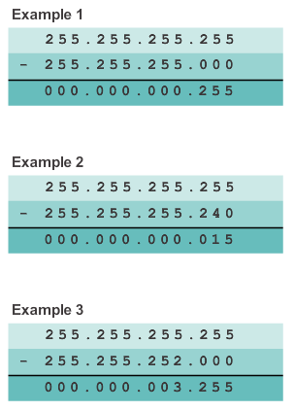
Wildcard Masks in ACLs Calculating the Wildcard Mask
Calculating wildcard masks can be challenging. One shortcut method is to subtract the subnet mask from 255.255.255.255.
Notes:
9.1.3.3

Slide 16
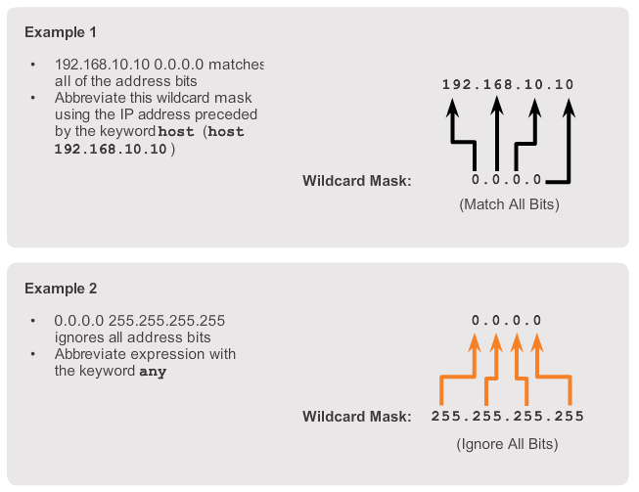
Wildcard Masks in ACLs Wildcard Mask Keywords
Notes:
9.1.3.4

Slide 17
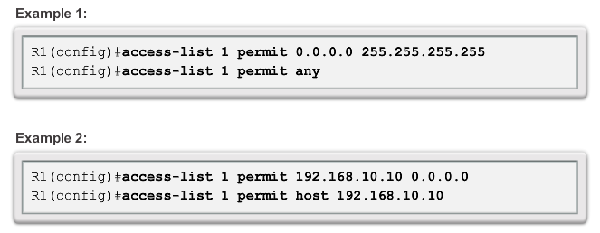
Wildcard Masks in ACLs Examples Wildcard Mask Keywords
Notes:
9.1.3.5

Slide 18
Guidelines for ACL creation General Guidelines for Creating ACLs
Use ACLs in firewall routers positioned between your internal network and an external network such as the Internet.
Use ACLs on a router positioned between two parts of your network to control traffic entering or exiting a specific part of your internal network.
Configure ACLs on border routers, that is routers situated at the edges of your networks.
Configure ACLs for each network protocol configured on the border router interfaces.
Notes:
9.1.4.1

Slide 19
Guidelines for ACL creation General Guidelines for Creating ACLs
The Three Ps
One ACL per protocol - To control traffic flow on an interface, an ACL must be defined for each protocol enabled on the interface.
One ACL per direction - ACLs control traffic in one direction at a time on an interface. Two separate ACLs must be created to control inbound and outbound traffic.
One ACL per interface - ACLs control traffic for an interface, for example, GigabitEthernet 0/0.
Notes:
9.1.4.1

Slide 20
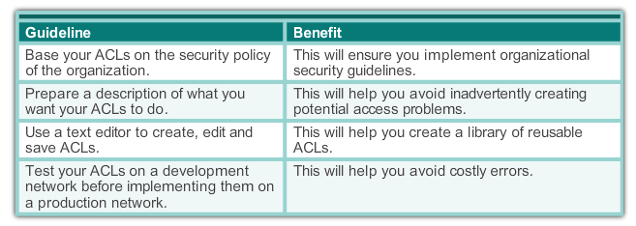
Guidelines for ACL creation ACL Best Practices
Notes:
9.1.4.2

Slide 21
Guidelines for ACL Placement Where to Place ACLs
Every ACL should be placed where it has the greatest impact on efficiency. The basic rules are:
Extended ACLs: Locate extended ACLs as close as possible to the source of the traffic to be filtered.
Standard ACLs: Because standard ACLs do not specify destination addresses, place them as close to the destination as possible.
Placement of the ACL and therefore the type of ACL used may also depend on: the extent of the network administrator’s control, bandwidth of the networks involved, and ease of configuration.
Notes:
9.1.5.1

Slide 22
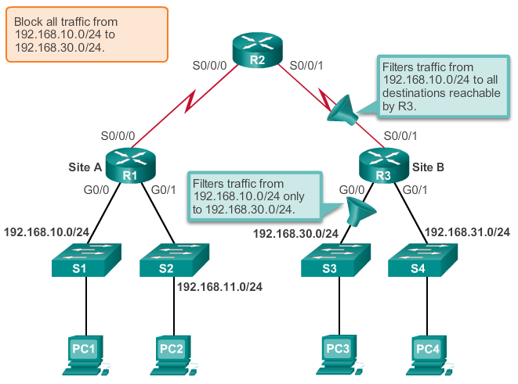
Guidelines for ACL Placement Standard ACL Placement
Notes:
9.1.5.2

Slide 23
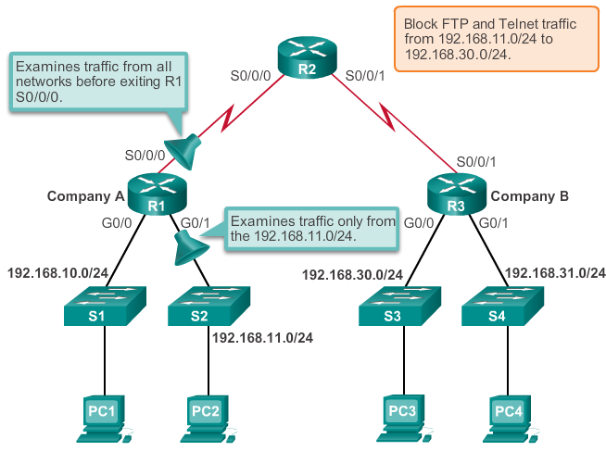
Guidelines for ACL Placement Extended ACL Placement
Notes:
9.1.5.3

Slide 24
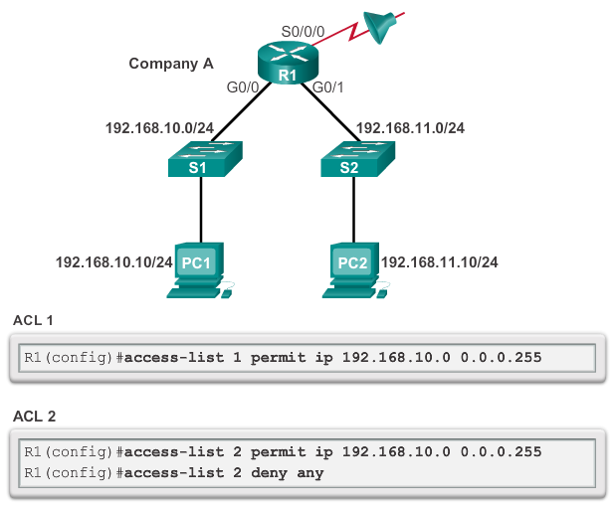
Configure Standard IPv4 ACLs Entering Criteria Statements
Notes:
9.2.1.1

Slide 25
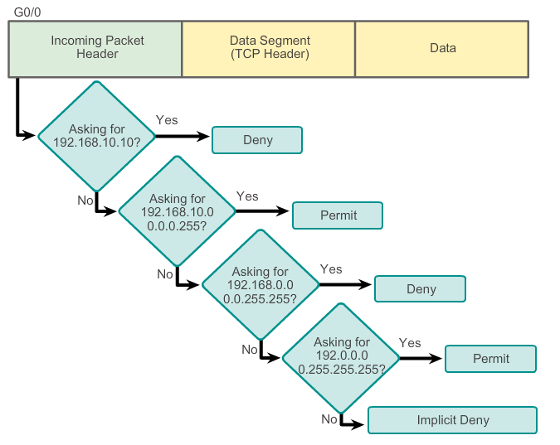
Configure Standard IPv4 ACLs Configuring a Standard ACL
Example ACL
access-list 2 deny host 192.168.10.10
access-list 2 permit 192.168.10.0 0.0.0.255
access-list 2 deny 192.168.0.0 0.0.255.255
access-list 2 permit 192.0.0.0 0.255.255.255
Notes:
9.2.1.2

Slide 26
Configure Standard IPv4 ACLs Configuring a Standard ACL (Cont.)
The full syntax of the standard ACL command is as follows:
Router(config)# access-list access-list-number deny permit remark source [ source-wildcard ] [ log ]
To remove the ACL, the global configuration no access-list command is used.
The remark keyword is used for documentation and makes access lists a great deal easier to understand.
Notes:
9.2.1.3

Slide 27
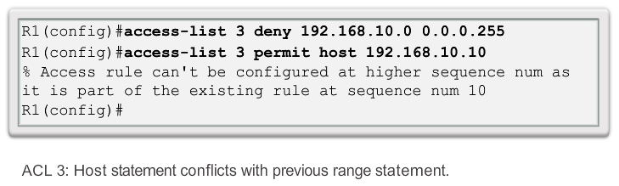
Configure Standard IPv4 ACLs Internal Logic
Cisco IOS applies an internal logic when accepting and processing standard access list statements. As discussed previously, access list statements are processed sequentially. Therefore, the order in which statements are entered is important.
Notes:
9.2.1.4

Slide 28
Configure Standard IPv4 ACLs Applying Standard ACLs to Interfaces
After a standard ACL is configured, it is linked to an interface using the ip access-group command in interface configuration mode:
Router(config-if)# ip access-group { access-list-number | access-list-name } { in | out }
To remove an ACL from an interface, first enter the no ip access-group command on the interface, and then enter the global no access-list command to remove the entire ACL.
Notes:
9.2.1.5

Slide 29
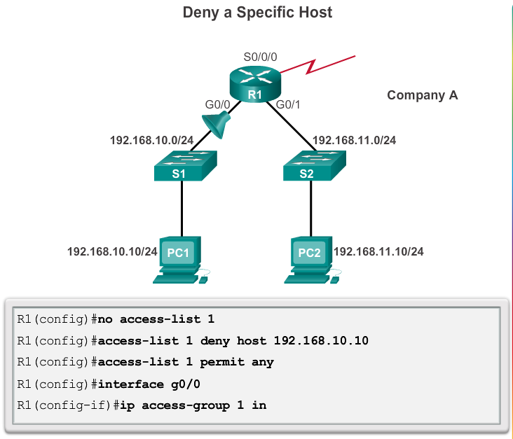
Configure Standard IPv4 ACLs Applying Standard ACLs to Interfaces (Cont.)
Notes:
9.2.1.6

Slide 30
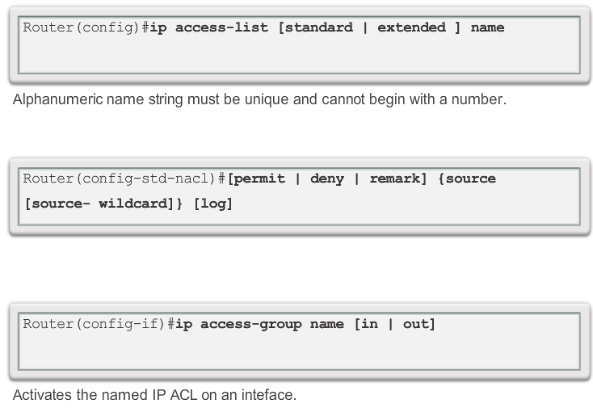
Configure Standard IPv4 ACLs Creating Named Standard ACLs
Notes:
9.2.1.7

Slide 31
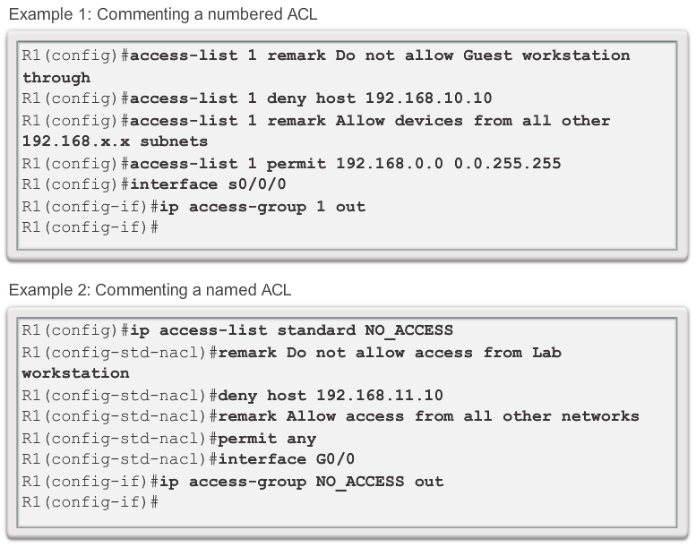
Configure Standard IPv4 ACLs Commenting ACLs
Notes:
9.2.1.8

Slide 32
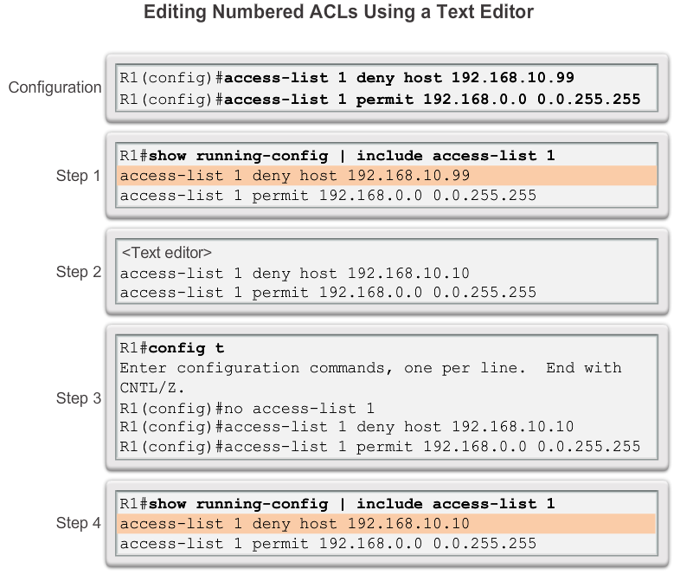
Modify IPv4 ACLs Editing Standard Numbered ACLs
Notes:
9.2.2.1

Slide 33
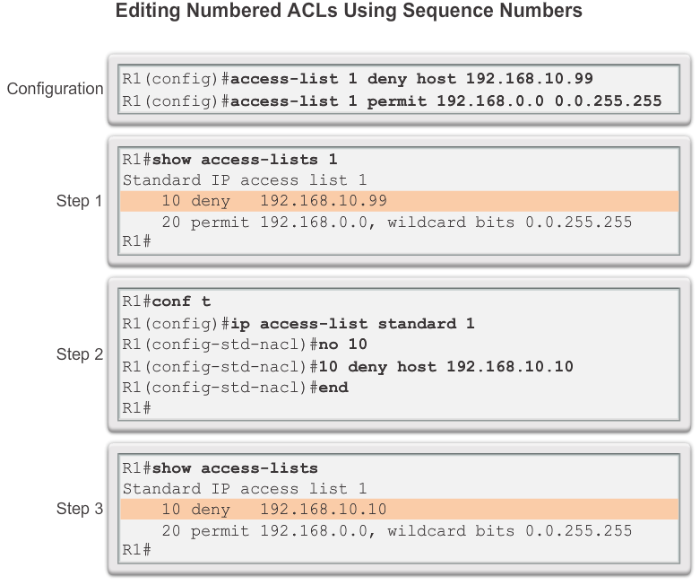
Modify IPv4 ACLs Editing Standard Numbered ACLs (Cont.)
Notes:
9.2.2.2

Slide 34
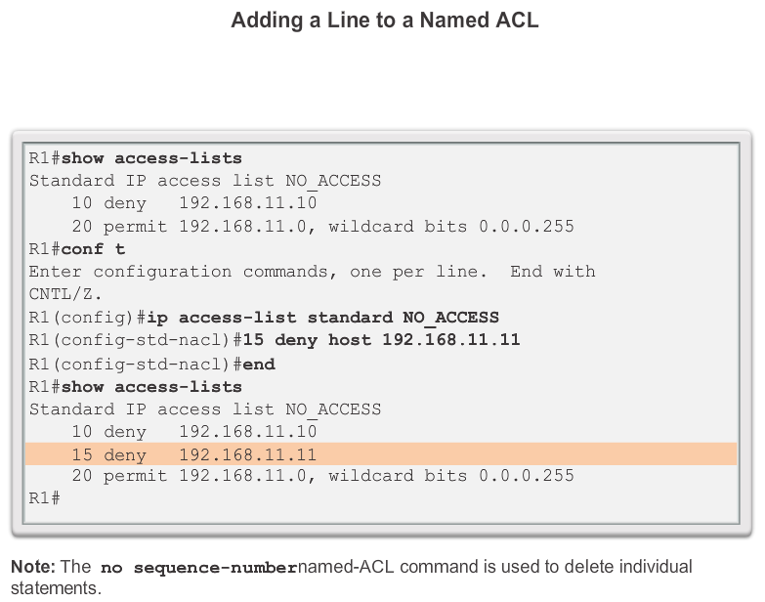
Modify IPv4 ACLs Editing Standard Named ACLs
Notes:
9.2.2.3

Slide 35
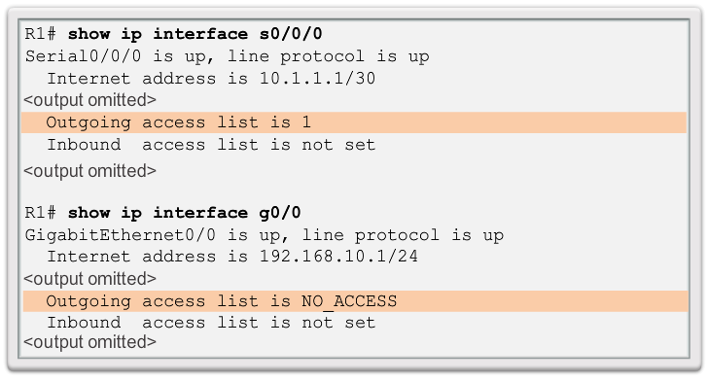
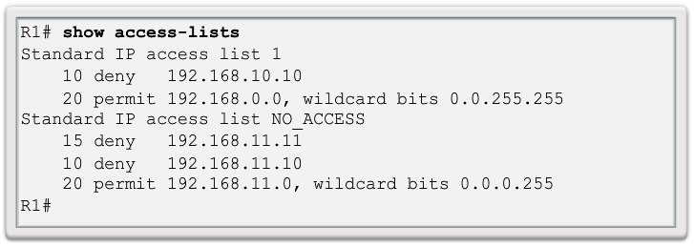
Modify IPv4 ACLs Verifying ACLs
Notes:
9.2.2.5

Slide 36
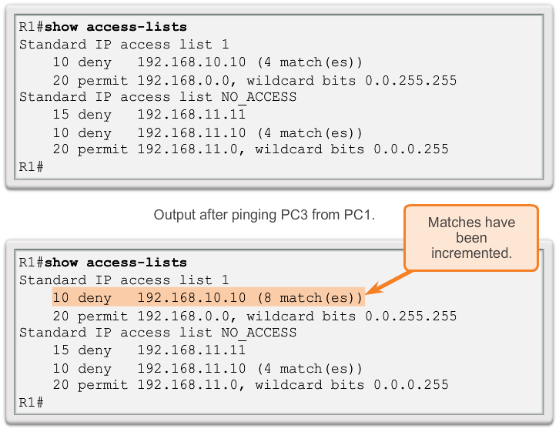
Modify IPv4 ACLs ACL Statistics
Notes:
9.2.2.6

Slide 37
Modify IPv4 ACLs Standard ACL Sequence Numbers
Another part of the IOS internal logic involves the internal sequencing of standard ACL statements. Range statements that deny three networks are configured first followed by five host statements. The host statements are all valid statements because their host IP addresses are not part of the previously entered range statements.
The host statements are listed first by the show command, but not necessarily in the order that they were entered. The IOS puts host statements in an order using a special hashing function. The resulting order optimizes the search for a host ACL entry.
Notes:
9.2.2.7

Slide 38
Securing VTY ports with a Standard IPv4 ACL Configuring a Standard ACL to Secure a VTY Port
Filtering Telnet or SSH traffic is typically considered an extended IP ACL function because it filters a higher level protocol. However, because the access-class command is used to filter incoming or outgoing Telnet/SSH sessions by source address, a standard ACL can be used.
Router(config-line)# access-class access-list-number { in [ vrf-also ] | out }
Notes:
9.2.3.1

Slide 39
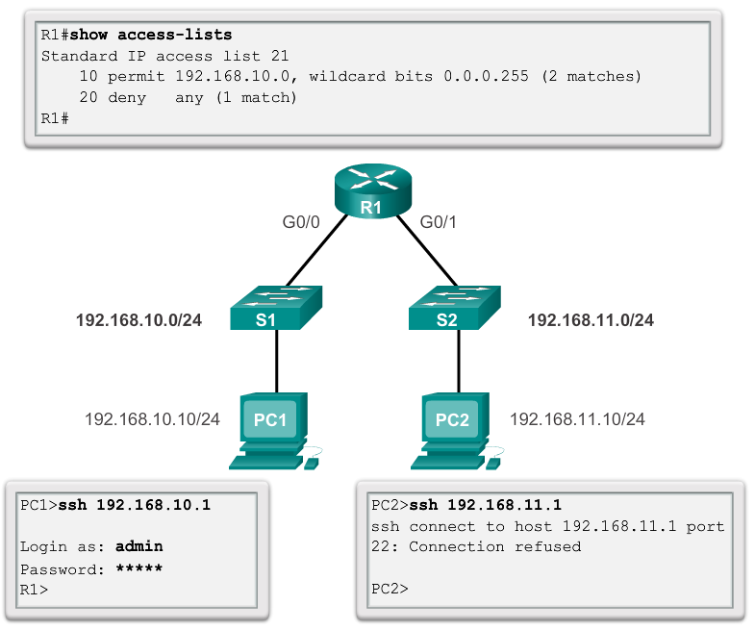
Securing VTY ports with a Standard IPv4 ACL Verifying a Standard ACL used to Secure a VTY Port
Notes:
9.2.3.2

Slide 40
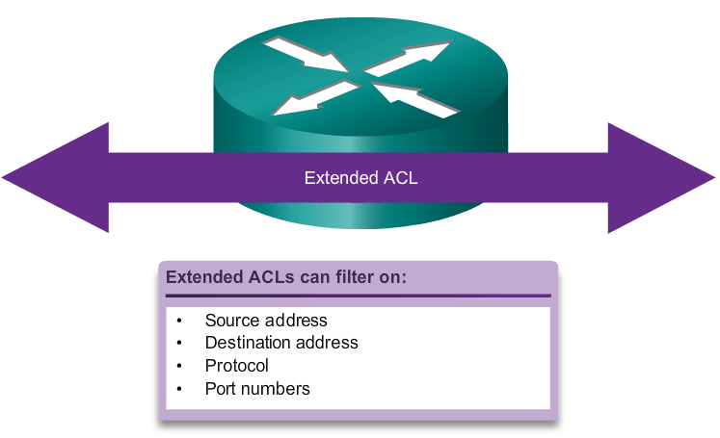
Structure of an Extended IPv4 ACL Extended ACLs
Notes:
9.3.1.1

Slide 41
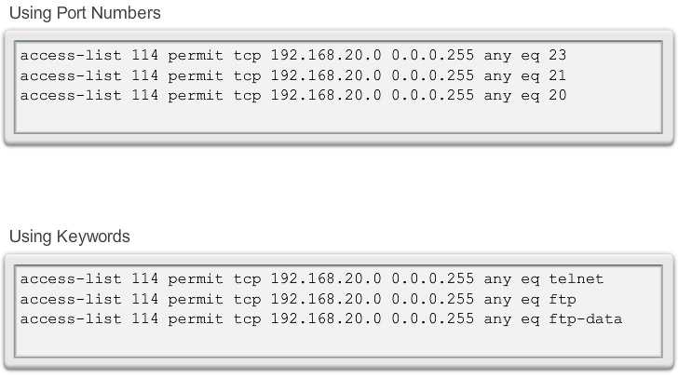
Structure of an Extended IPv4 ACL Extended ACLs (Cont.)
Notes:
9.3.1.2

Slide 42
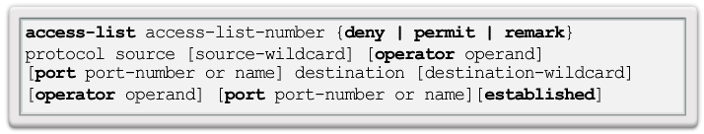
Configure Extended IPv4 ACLs Configuring Extended ACLs
The procedural steps for configuring extended ACLs are the same as for standard ACLs. The extended ACL is first configured, and then it is activated on an interface. However, the command syntax and parameters are more complex to support the additional features provided by extended ACLs.
Notes:
9.3.2.1

Slide 43
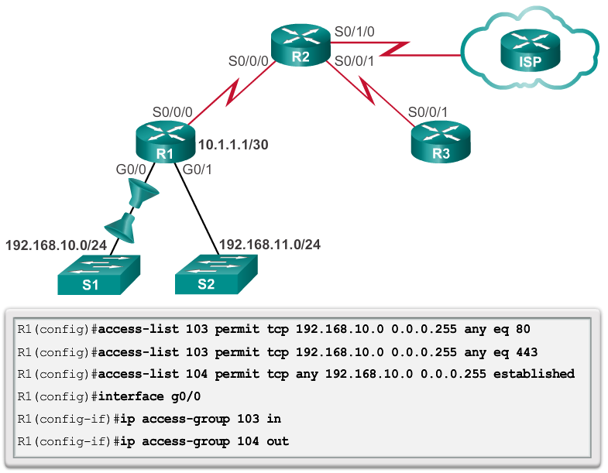
Configure Extended IPv4 ACLs Applying Extended ACLs to Interfaces
Notes:
9.3.2.2

Slide 44
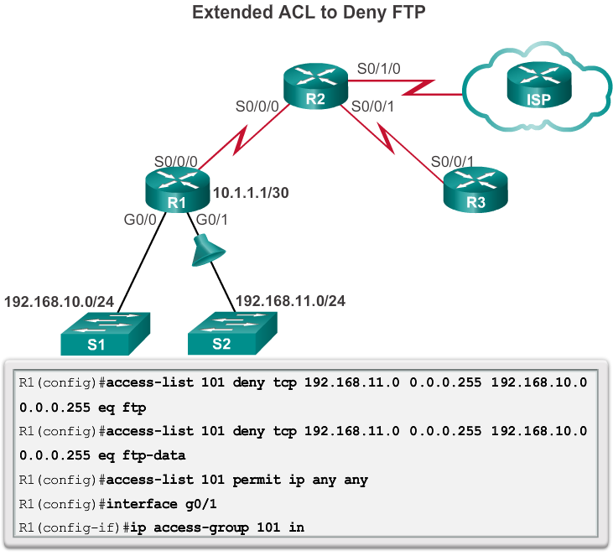
Configure Extended IPv4 ACLs Filtering Traffic with Extended ACLs
Notes:
9.3.2.3

Slide 45
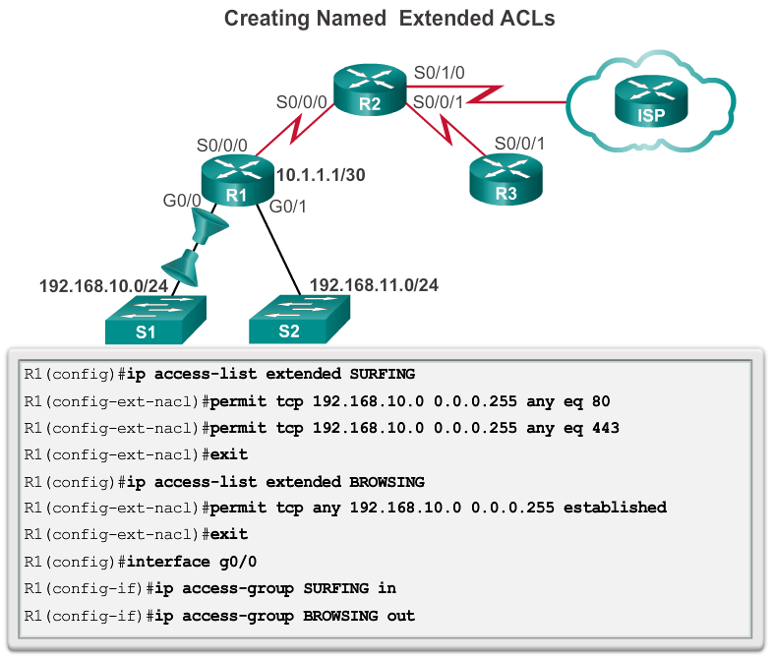
Configure Extended IPv4 ACLs Creating Named Extended ACLs
Notes:
9.3.2.4

Slide 46
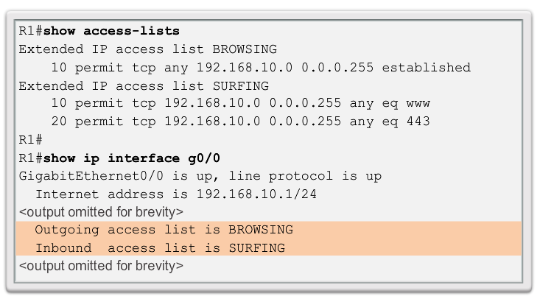
Configure Extended IPv4 ACLs Verifying Extended ACLs
Notes:
9.3.2.5

Slide 47
Configure Extended IPv4 ACLs Editing Extended ACLs
Editing an extended ACL can be accomplished using the same process as editing a standard. An extended ACL can be modified using:
Method 1 - Text editor
Method 2 – Sequence numbers
Notes:
9.3.2.6

Slide 48
Limiting Debug Output Purpose of Limiting debug Output with ACLs
Debug commands are tools used to help verify and troubleshoot network operations.
When using some debug options, the output may display much more information than is needed or can be easily viewed.
In a production network, the amount of information provided by debug commands can be overwhelming and can cause network interruptions.
Some debug commands can be combined with an access list to limit output so that only the information needed for verification or troubleshooting a specific issue is displayed.
Notes:
9.4.1.1

Slide 49
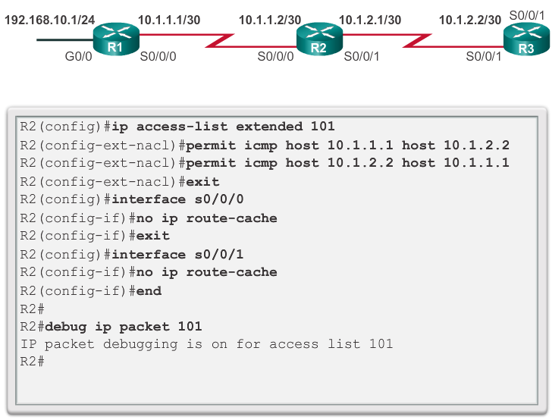
Limiting Debug Output Configuring ACLs to Limit debug Output
The administrator for R2 wants to verify that traffic is being routed correctly using debug ip packet. To limit the debug output to include only the ICMP traffic between R1 and R3, ACL 101 will be applied.
Notes:
9.4.1.2

Slide 50
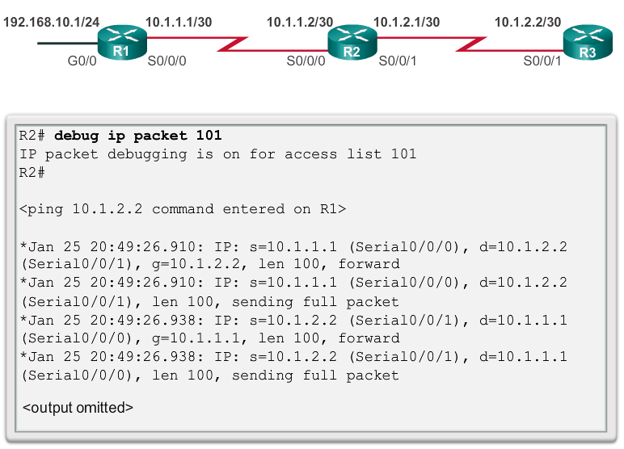
Limiting Debug Output Verifying ACLs that Limit debug Output
Notes:
9.4.1.3

Slide 51
Processing Packets with ACLs Inbound ACL Logic
Packets are tested against an inbound ACL, if one exists, before being routed.
If an inbound packet matches an ACL statement with a permit, it is sent to be routed.
If an inbound packet matches an ACL statement with a deny, it is dropped and not routed.
If an inbound packet does not meet any ACL statements, then it is “implicitly denied” and dropped without being routed.
Notes:
9.5.1.1

Slide 52
Processing Packets with ACLs Outbound ACL Logic
Packets are first checked for a route before being sent to an outbound interface. If there is no route, the packets are dropped.
If an outbound interface has no ACL, then the packets are sent directly to that interface.
If there is an ACL on the outbound interface, it is tested before being sent to that interface.
If an outbound packet matches an ACL statement with a permit, it is sent to the interface.
Notes:
9.5.1.1

Slide 53
Processing Packets with ACLs Outbound ACL Logic (continued)
If an outbound packet matches an ACL statement with a deny, it is dropped.
If an outbound packet does not meet any ACL statements, then it is “implicitly denied” and dropped.
Notes:
9.5.1.1

Slide 54
Processing Packets with ACLs ACL Logic Operations
When a packet arrives at a router interface, the router process is the same, whether ACLs are used or not. As a frame enters an interface, the router checks to see whether the destination Layer 2 address matches it’s the interface Layer 2 address or if the frame is a broadcast frame.
If the frame address is accepted, the frame information is stripped off and the router checks for an ACL on the inbound interface. If an ACL exists, the packet is tested against the statements in the list.
Notes:
9.5.1.2

Slide 55
Processing Packets with ACLs ACL Logic Operations (continued)
If the packet is accepted, it is then checked against routing table entries to determine the destination interface. If a routing table entry exists for the destination, the packet is then switched to the outgoing interface, otherwise the packet is dropped.
Next, the router checks whether the outgoing interface has an ACL. If an ACL exists, the packet is tested against the statements in the list.
If there is no ACL or the packet is permitted, the packet is encapsulated in the new Layer 2 protocol and forwarded out the interface to the next device.
Notes:
9.5.1.2

Slide 56
Processing Packets with ACLs Standard ACL Decision Process
Standard ACLs only examine the source IPv4 address. The destination of the packet and the ports involved are not considered.
Cisco IOS software tests addresses against the conditions in the ACL one by one. The first match determines whether the software accepts or rejects the address. Because the software stops testing conditions after the first match, the order of the conditions is critical. If no conditions match, the address is rejected.
Notes:
9.5.1.3

Slide 57
Processing Packets with ACLs Extended ACL Decision Process
The ACL first filters on the source address, then on the port and protocol of the source. It then filters on the destination address, then on the port and protocol of the destination, and makes a final permit or deny decision.
Notes:
9.5.1.4

Slide 58
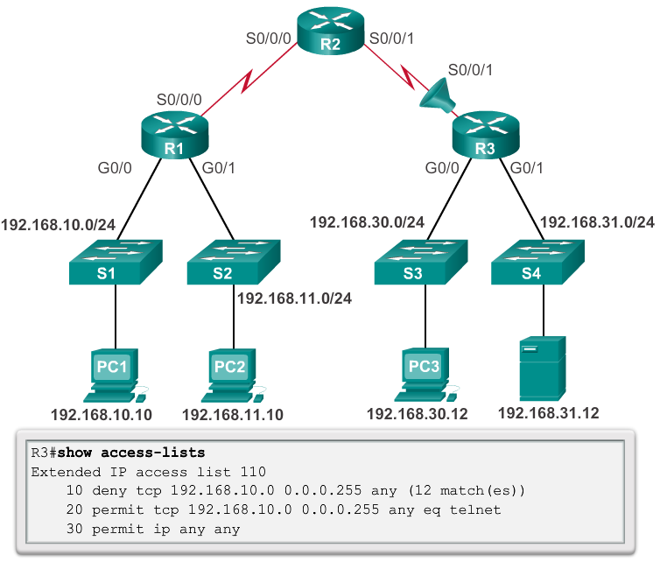
Common ACLs Errors Troubleshooting Common ACL Errors - Example 1
Host 192.168.10.10 has no connectivity with 192.168.30.12.
Notes:
9.5.2.1

Slide 59
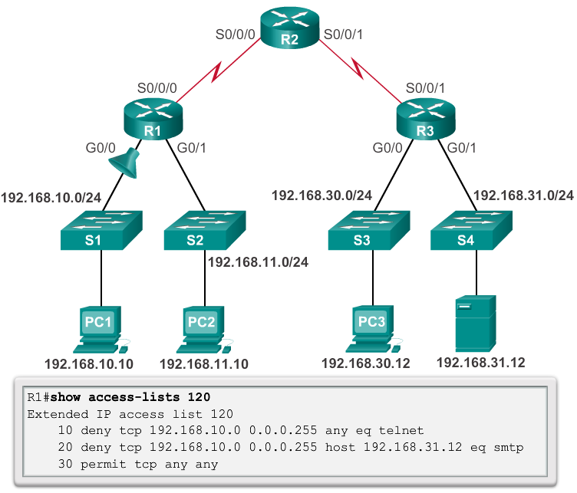
Common ACLs Errors Troubleshooting Common ACL Errors – Example 2
The 192.168.10.0 /24 network cannot use TFTP to connect to the 192.168.30.0 /24 network.
Notes:
9.5.2.2

Slide 60
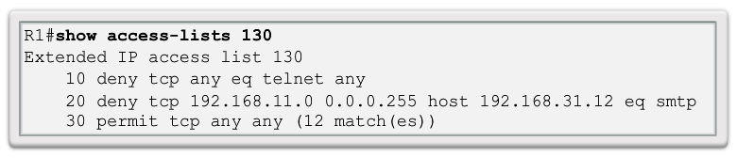
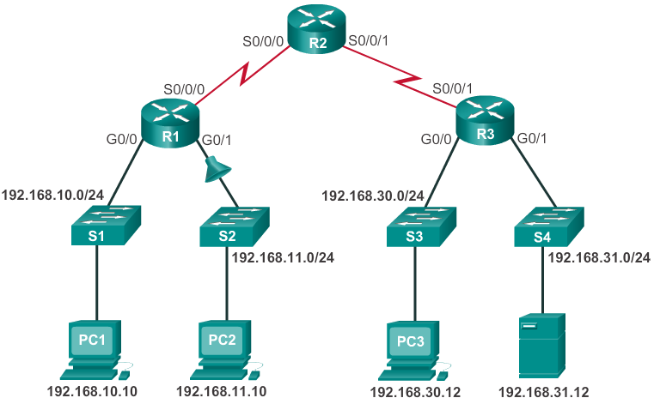
Common ACLs Errors Troubleshooting Common ACL Errors – Example 3
The 192.168.11.0 /24 network can use Telnet to connect to 192.168.30.0 /24, but according to company policy, this connection should not be allowed.
Notes:
9.5.2.3

Slide 61
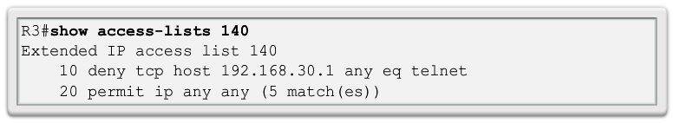
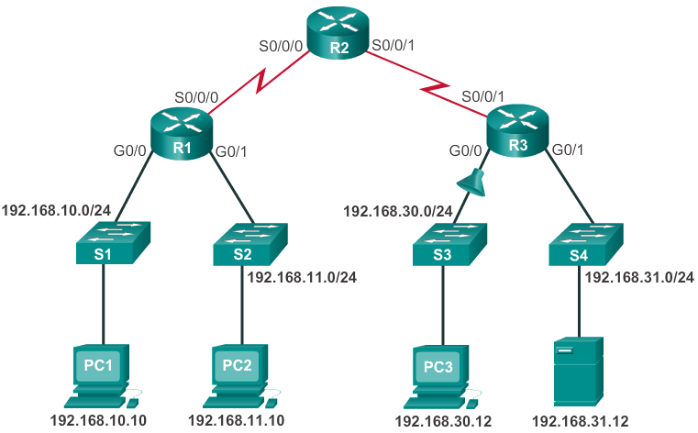
Common ACLs Errors Troubleshooting Common ACL Errors – Example 4
Host 192.168.30.12 is able to Telnet to connect to 192.168.31.12, but company policy states that this connection should not be allowed.
Notes:
9.5.2.4

Slide 62
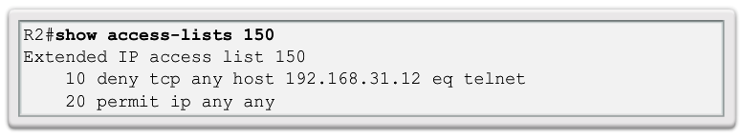
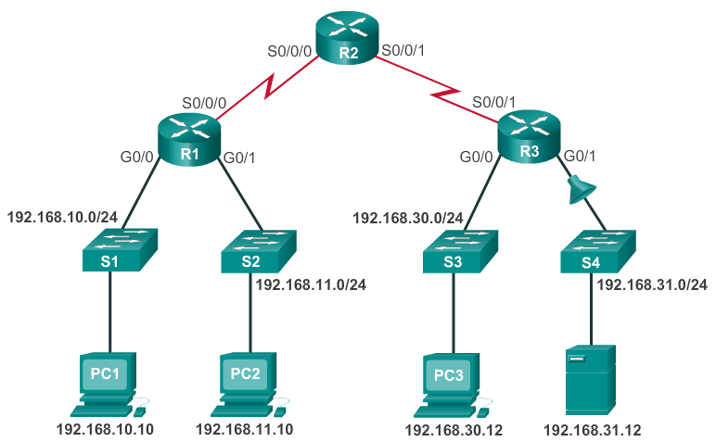
Common ACLs Errors Troubleshooting Common ACL Errors – Example 5
Host 192.168.30.12 can use Telnet to connect to 192.168.31.12, but according to the security policy, this connection should not be allowed.
Notes:
9.5.2.5

Slide 63
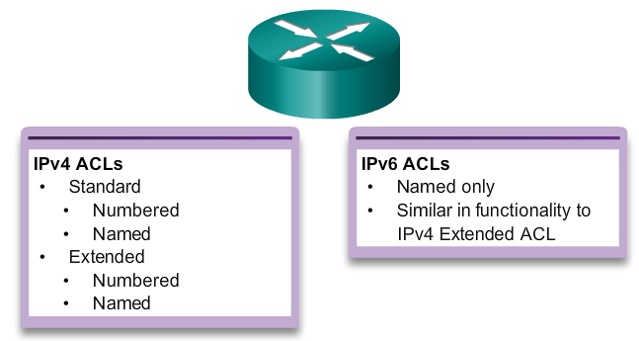
IPv6 ACL Creation Type of IPv6 ACLs
Notes:
9.6.1.1

Slide 64
IPv6 ACL Creation Comparing IPv4 and IPv6 ACLs
Although IPv4 and IPv6 ACLs are very similar, there are three significant differences between them.
Applying an IPv6 ACL
IPv6 uses the ipv6 traffic-filter command to perform the same function for IPv6 interfaces.
No Wildcard Masks
The prefix-length is used to indicate how much of an IPv6 source or destination address should be matched.
Additional Default Statements
permit icmp any any nd-na
permit icmp any any nd-ns
Notes:
9.6.1.2

Slide 65
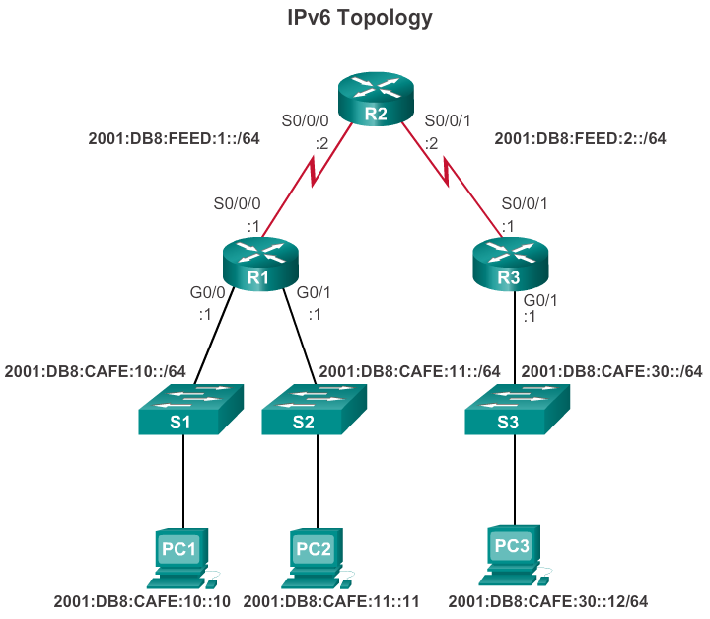
Configuring IPv6 ACLs Configuring IPv6 Topology
Notes:
9.6.2.1

Slide 66
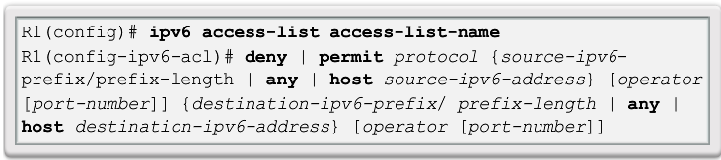
Configuring IPv6 ACLs Configuring IPv6 ACLs
There are three basic steps to configure an IPv6 ACL:
From global configuration mode, use the ipv6 access-listname command to create an IPv6 ACL.
From the named ACL configuration mode, use the permit or deny statements to specify one or more conditions to determine if a packet is forwarded or dropped.
Return to privileged EXEC mode with the end command.
Notes:
9.6.2.2

Slide 67
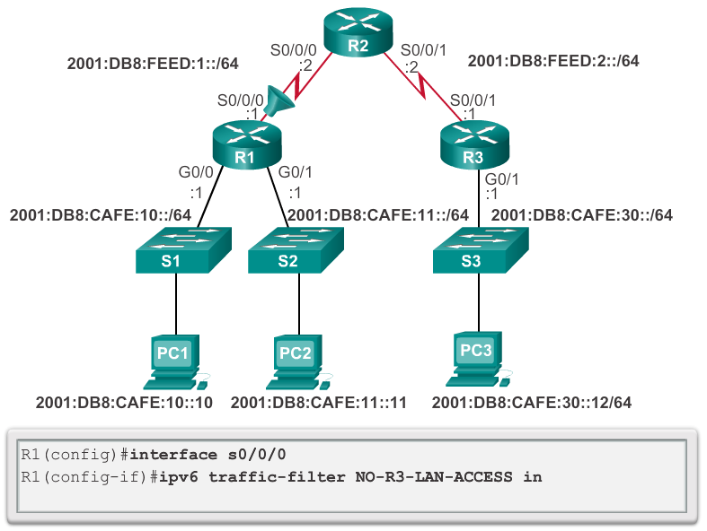
Configuring IPv6 ACLs Applying an IPv6 ACL to an Interface
Notes:
9.6.2.3

Slide 68
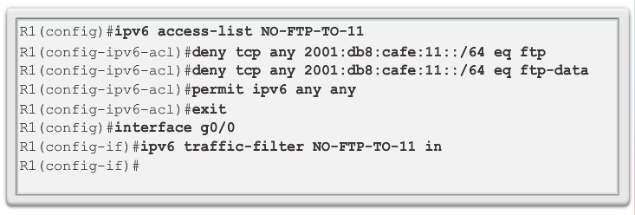

Configuring IPv6 ACLs IPv6 ACL Examples
Deny FTP
Restrict Access
Notes:
9.6.2.4

Slide 69


Configuring IPv6 ACLs Verifying IPv6 ACLs
Notes:
9.6.2.5

Slide 70
Chapter 9: Summary
By default a router does not filter traffic. Traffic that enters the router is routed solely based on information within the routing table.
Packet filtering, controls access to a network by analyzing the incoming and outgoing packets and passing or dropping them based on criteria such as the source IP address, destination IP addresses, and the protocol carried within the packet.
A packet-filtering router uses rules to determine whether to permit or deny traffic. A router can also perform packet filtering at Layer 4, the Transport layer.
An ACL is a sequential list of permit or deny statements.
Notes:
Chapter 9 Summary

Slide 71
Chapter 9: Summary (continued)
The last statement of an ACL is always an implicit deny which blocks all traffic. To prevent the implied deny any statement at the end of the ACL from blocking all traffic, the permit ip any any statement can be added.
When network traffic passes through an interface configured with an ACL, the router compares the information within the packet against each entry, in sequential order, to determine if the packet matches one of the statements. If a match is found, the packet is processed accordingly.
ACLs are configured to apply to inbound traffic or to apply to outbound traffic.
Notes:
Chapter 9 Summary

Slide 72
Chapter 9: Summary (continued)
Standard ACLs can be used to permit or deny traffic only from a source IPv4 addresses. The destination of the packet and the ports involved are not evaluated. The basic rule for placing a standard ACL is to place it close to the destination.
Extended ACLs filter packets based on several attributes: protocol type, source or destination IPv4 address, and source or destination ports. The basic rule for placing an extended ACL is to place it as close to the source as possible.
Notes:
Chapter 9 Summary

Slide 73
Chapter 9: Summary (continued)
The access-list global configuration command defines a standard ACL with a number in the range of 1 to 99 or an extended ACL with numbers in the range of 100 to 199 and 2000 to 2699. Both standard and extended ACLs can also be named.
The ip access-list standard name is used to create a standard named ACL, whereas the command ip access-list extended name is for an extended access list. IPv4 ACL statements include the use of wildcard masks.
After an ACL is configured, it is linked to an interface using the ip access-group command in interface configuration mode.
Notes:
Chapter 9 Summary

Slide 74
Chapter 9: Summary (continued)
Remember the three Ps, one ACL per protocol, per direction, per interface.
To remove an ACL from an interface, first enter the no ip access-group command on the interface, and then enter the global no access-list command to remove the entire ACL.
The show running-config and show access-lists commands are used to verify ACL configuration. The show ip interface command is used to verify the ACL on the interface and the direction in which it was applied.
Notes:
Chapter 9 Summary

Slide 75
Chapter 9: Summary (continued)
The access-class command configured in line configuration mode restricts incoming and outgoing connections between a particular VTY and the addresses in an access list.
Like IPv4 named ACLs, IPv6 names are alphanumeric, case sensitive and must be unique. Unlike IPv4, there is no need for a standard or extended option.
From global configuration mode, use the ipv6 access-list name command to create an IPv6 ACL. The prefix-length is used to indicate how much of an IPv6 source or destination address should be matched.
After an IPv6 ACL is configured, it is linked to an interface using the ipv6 traffic-filter command.
Notes:
Chapter 9 Summary

Slide 76


