Slide 1
Chapter 3: Link Aggregation
Scaling Networks
Notes:
Cisco Networking Academy program
Scaling Networks
Chapter 3: Link Aggregation

Slide 2
Chapter 3
3.1 Link Aggregation Concepts
3.2 Link Aggregation Configuration
3.3 Summary
Notes:
Chapter 3

Slide 3
Chapter 3: Objectives
Explain the operation of link aggregation in a switched LAN environment.
Describe EtherChannel technology.
Configure link aggregation to improve performance on high-traffic switch links.
Configure link aggregation with EtherChannel.
Verify and troubleshoot link aggregation with EtherChannel.
Notes:
Chapter 3 Objectives

Slide 4
3.1 Link Aggregation Concepts
Notes:
Cisco Networking Academy program
Scaling Networks
Chapter 3: Link Aggregation

Slide 5
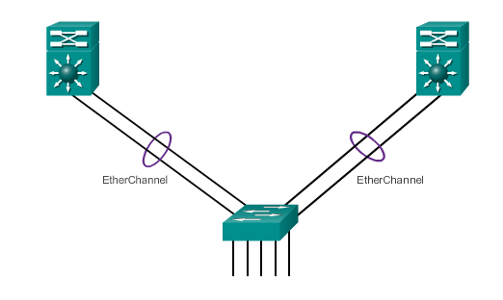
Link Aggregation Introduction to Link Aggregation
Link aggregation allows the creation of logical links made up of several physical links.
EtherChannel is a form of link aggregation used in switched networks.
Notes:
3.1.1.1 Introduction to Link Aggregation

Slide 6
Link Aggregation Advantages of EtherChannel
Most configurations are done on the EtherChannel interface ensuring consistency throughout links.
Relies on existing switch ports – no need for upgrades.
Load-balances between links on the same EtherChannnel.
Creates an aggregation viewed as one logical link by STP.
Provides redundancy because the overall link is viewed as one logical connection. If one physical link within channel goes down, this does not cause a change in the topology and does not require STP recalculation.
Notes:
3.1.1.2 Advantages of EtherChannel

Slide 7
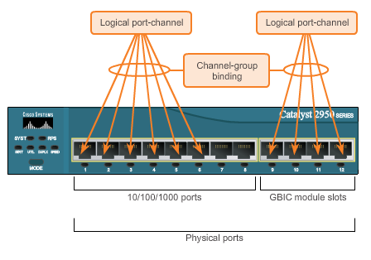
EtherChannel Operation Implementation Restrictions
EtherChannel implemented by grouping multiple physical ports into one or more logical EtherChannel links.
Interface types cannot be mixed.
EtherChannel provides full-duplex bandwidth up to 800 Mb/s (Fast EtherChannel) or 8 Gb/s (Gigabit EtherChannel).
EtherChannel can consist of up to 16 compatibly-configured Ethernet ports.
The Cisco IOS switch currently supports six EtherChannels.
Notes:
3.1.2.1 Implementation Restrictions

Slide 8
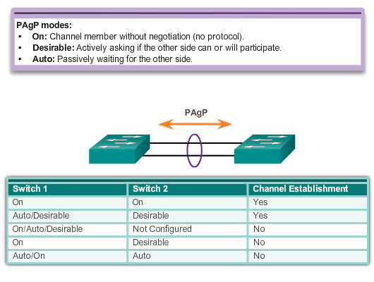
EtherChannel Operation Port Aggregation Protocol (PAgP)
Notes:
3.1.2.2 Port Aggregation Protocol

Slide 9
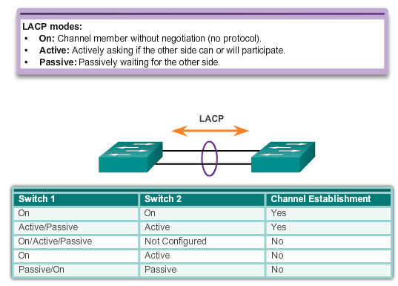
EtherChannel Operation Link Aggregation Control Protocol (LACP)
Notes:
3.1.2.3 Link Aggregation Control Protocol

Slide 10
3.2 Link Aggregation Configuration
Notes:
Cisco Networking Academy program
Scaling Networks
Chapter 3: Link Aggregation

Slide 11
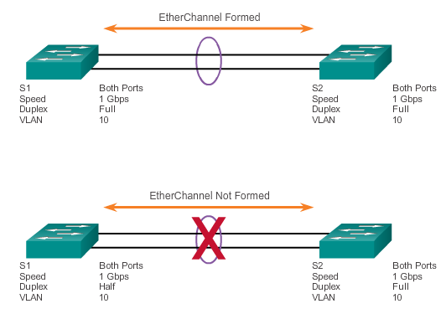
Configuring EtherChannel Configuration Guidelines
EtherChannel must be supported.
Speed and duplex must match.
VLAN match – All interfaces are in the same VLAN.
Range of VLAN – Same range on all interfaces.
Notes:
3.2.1.1 Configuration Guidelines

Slide 12
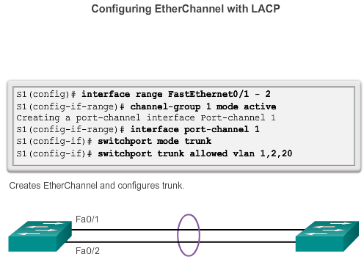
Configuring EtherChannel Configuring Interfaces
Notes:
3.2.1.2 Configuring Interfaces

Slide 13
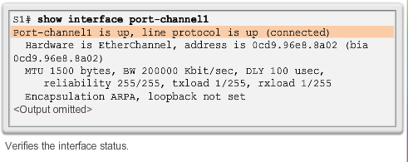
Verifying and Troubleshooting EtherChannel Verifying EtherChannel
show interface Port-channel – Displays the general status of the EtherChannel interface.
show etherchannel summary – Displays one line of information per port channel.
show etherchannel port-channel – Displays information about a specific port channel interface.
show interfaces etherchannel – Provides information about the role of the interface in the EtherChannel.
Notes:
3.2.2.1 Verifying EtherChannel

Slide 14
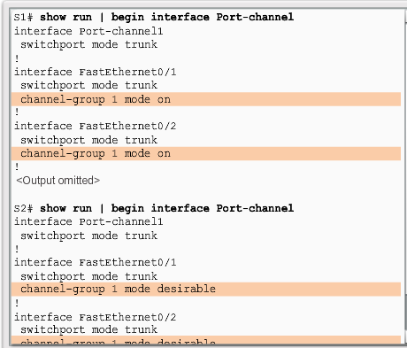
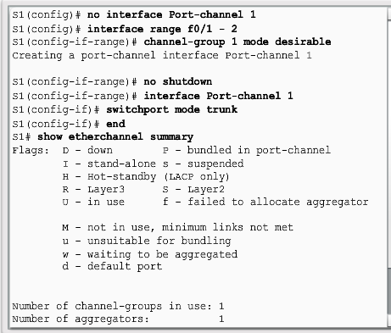
Verifying and Troubleshooting EtherChannel Troubleshooting EtherChannel
Notes:
3.2.2.2 Troubleshooting EtherChannel

Slide 15
Chapter 3: Summary
This chapter described:
EtherChannel and how to encompass both the PAgP-based and the LACP-based link aggregation methods
EtherChannel technologies and the various means available to implement them
The configuration, verification, and troubleshooting of EtherChannel
Notes:
Chapter 3 Summary

Slide 16


