Slide 1
Chapter 7: Enhanced Interior Gateway Protocol (EIGRP)
Scaling Networks
Notes:
Cisco Networking Academy program
Scaling Networks
Chapter 7: Enhanced Interior Gateway Protocol (EIGRP)

Slide 2
Chapter 7
7.0 Introduction
7.1 Characteristics of EIGRP
7.2 Configuring EIGRP for IPv4
7.3 Operation of EIGRP
7.4 Configuration of EIGRP for IPv6
7.5 Summary
Notes:
Chapter 7

Slide 3
Chapter 7: Objectives
Describe the features and operation of EIGRP.
Examine the different EIGRP packet formats.
Calculate the composite metric used by the Diffusing Update Algorithm (DUAL).
Describe the concepts and operation of DUAL.
Examine the commands to configure and verify basic EIGRP operations for IPv4 and IPv6.
Notes:
Chapter 7 Objectives

Slide 4
7.1 Characteristics of EIGRP
Notes:
Cisco Networking Academy program
Scaling Networks
Chapter 7: Enhanced Interior Gateway Protocol (EIGRP)

Slide 5
Basic Features of EIGRP Features of EIGRP
Released in 1992 as a Cisco proprietary protocol.
2013 basic functionality of EIGRP released as an open standard.
Advanced Distance Vector routing protocol.
Uses the Diffusing Update Algorithm (DUAL) to calculate paths and back-up paths.
Establishes Neighbor Adjacencies.
Uses the Reliable Transport Protocol to provide delivery of EIGRP packets to neighbors.
Partial and Bounded Updates. Send updates only when there is a change and only to the routers that need the information.
Supports Equal and Unequal Cost Load Balancing.
Notes:
7.1.1.1 Features of EIGRP

Slide 6
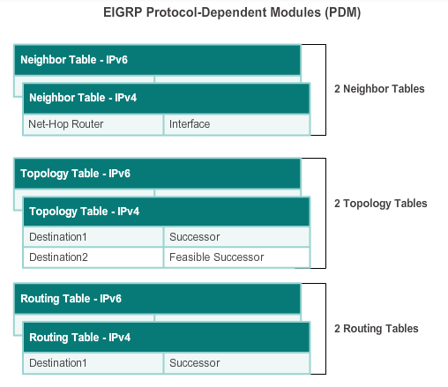
Basic Features of EIGRP Protocol Dependent Modules
Notes:
7.1.1.2 Features of EIGRP

Slide 7
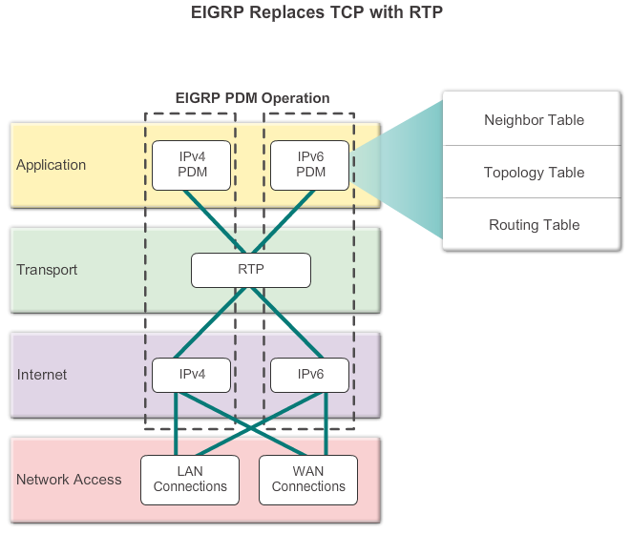
Basic Features of EIGRP Reliable Transport Protocol
Notes:
7.1.1.3 Reliable Transport Protocol

Slide 8
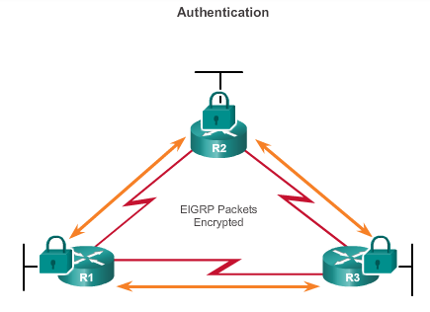
Basic Features of EIGRP Authentication
EIGRP can be configured to authenticate routing information.
Ensures routers only accept updates from routers that have been configured with the correct authentication information.
Notes:
7.1.1.4 Authentication

Slide 9
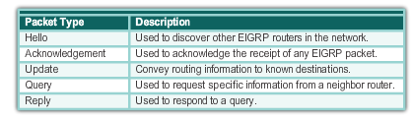
Types of EIGRP Packets EIGRP Packet Types
Notes:
7.1.2.1 EIGRP Packet Types

Slide 10
Types of EIGRP Packets EIGRP Hello Packets
Used to discover EIGRP neighbors.
Used to form and maintain EIGRP neighbor adjacencies.
Sent as IPv4 or IPv6 multicasts.
IPv4 multicast address 224.0.0.10.
IPv6 multicast address FF02::A.
Unreliable delivery.
Sent every 5 seconds (every 60 seconds on low-speed NBMA networks).
EIGRP uses a default Hold timer of three times the Hello interval before declaring neighbor unreachable.
Notes:
7.1.2.2 EIGRP Hello Packets

Slide 11
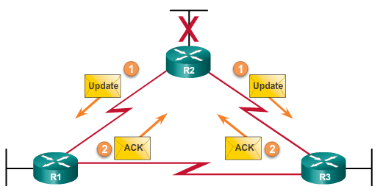
Types of EIGRP Packets EIGRP Update & Acknowledgement Packets
Update packets are sent to propagate routing information, only when necessary.
Sends Partial updates – only contains information about route changes.
Sends Bounded updates-sent only to routers affected by the change.
Updates use reliable delivery, therefore, require an acknowledgement.
Notes:
7.1.2.3 EIGRP Update & Acknowledgement Packets

Slide 12
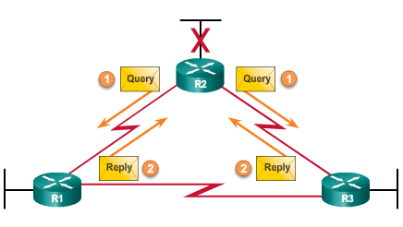
Types of EIGRP Packets EIGRP Query and Reply Packets
Used when searching for networks.
Queries use reliable delivery, which can be multicast or unicast.
Replies use reliable delivery.
Notes:
7.1.2.4 EIGRP Query and Reply Packets

Slide 13
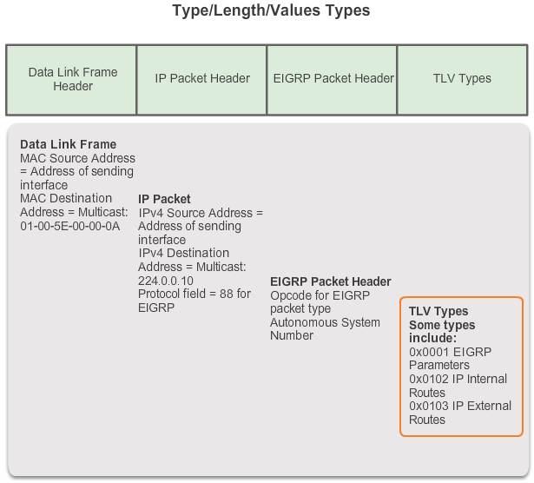
EIGRP Messages Encapsulating EIGRP Messages
Notes:
7.1.3.1 Encapsulating EIGRP Messages

Slide 14
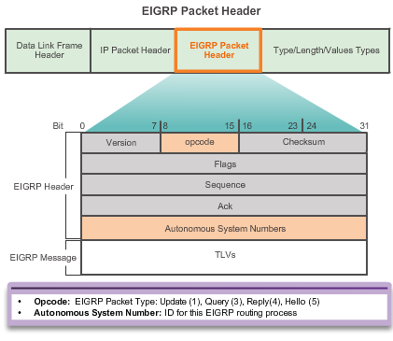
EIGRP Messages EIGRP Packet Header and TLV
Notes:
7.1.3.2 EIGRP Packet Header and TLV

Slide 15
7.2 Configuring EIGRP for IPv4
Notes:
Cisco Networking Academy program
Scaling Networks
Chapter 7: Enhanced Interior Gateway Protocol (EIGRP)

Slide 16
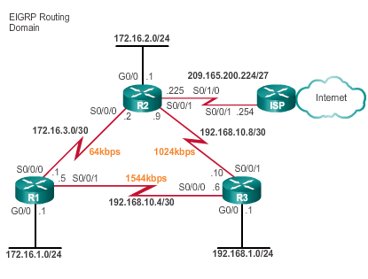
Configuring EIGRP with IPv4 EIGRP Network Topology
This course uses the topology that configures EIGRP with IPv4.
Notes:
7.2.1.1 EIGRP Network Topology

Slide 17
Configuring EIGRP with IPv4 Autonomous System Numbers
The router eigrp autonomous-system command enables the EIGRP process.
The autonomous system number is only significant to the EIGRP routing domain.
The EIGRP autonomous system number is not associated with the Internet Assigned Numbers Authority (IANA) globally assigned autonomous system numbers used by external routing protocols.
Internet Service Providers (ISPs) require an autonomous system number from IANA.
ISPs often use the Border Gateway Protocol (BGP), which does use the IANA autonomous system number in its configuration.
Notes:
7.2.1.2 Autonomous System Numbers

Slide 18

Configuring EIGRP with IPv4 Router EIGRP Command
Router(config)# router eigrp autonomous-system
To completely remove the EIGRP routing process from a device, use the no router eigrp autonomous-system command.
Notes:
7.2.1.3 The Router EIGRP Command

Slide 19
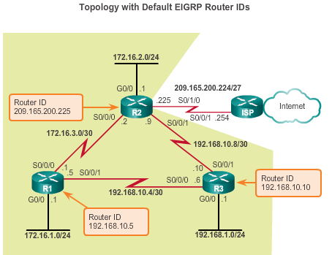
Configuring EIGRP with IPv4 EIGRP Router ID
Used in both EIGRP and OSPF routing protocols, the router ID’s role is more significant in OSPF.
Notes:
7.2.1.4 EIGRP Router ID

Slide 20
Configuring EIGRP with IPv4 Configuring the EIGRP Router ID
Configuring the EIGRP router ID
Router(config)# router eigrp autonomous-system
Router(config-router)# eigrp router-id ipv4-address
The IPv4 loopback address can be used as the router ID.
If the eigrp router-id value is not configured, the highest loopback address is selected as the router ID.
Configuring a loopback interface
Router(config)# interface loopback number
Router(config-if)# ip addressipv4-address subnet-mask
Notes:
7.2.1.5 Configuring the EIGRP Router ID

Slide 21
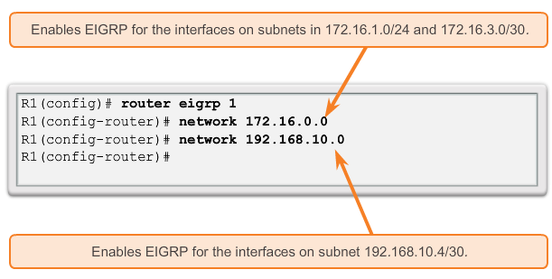
Configuring EIGRP with IPv4 Network Command
Enables any interface on this router that matches the network address in the network router configuration mode command to send and receive EIGRP updates.
These networks are included in EIGRP routing updates.
Notes:
7.2.1.6 The Network Command

Slide 22
Configuring EIGRP with IPv4 Network Command
The eigrp log-neighbor-changes router configuration mode
On by default
Displays changes in neighbor adjacencies
Verifies neighbor adjacencies during configuration
Indicates when any adjacencies have been removed
Notes:
7.2.1.6 The Network Command

Slide 23
Configuring EIGRP with IPv4 The Network Command and Wildcard Mask
To configure EIGRP to advertise specific subnets only, use the wildcard-mask option with the network command.
Router(config-router)# network network address [wildcard-mask]
The wildcard mask is the inverse of the subnet mask.
To calculate the wildcard mask, subtract the subnet mask from 255.255.255.255:
255.255.255.255
-- 255.255.255.252
0. 0. 0. 3 wildcard mask
Note: Some IOS versions also let you enter the subnet mask instead of a wildcard mask.
Notes:
7.2.1.7 The Network Command and Wildcard Mask

Slide 24
Configuring EIGRP with IPv4 Passive Interface
Use the passive-interface command to:
Prevent neighbor adjacencies
Suppress unnecessary update traffic
Increase security controls, such as preventing unknown rogue routing devices from receiving EIGRP updates
To configure:
Router(config)# router eigrp as-number
Router(config-router)# passive-interface interface-type interface-number
To verify:
Router# show ip protocols
Notes:
7.2.1.8 Passive Interface

Slide 25
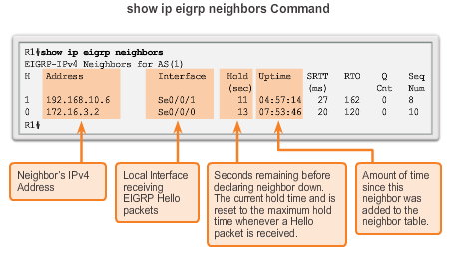
Configuring EIGRP with IPv4 Verifying EIGRP: Examining Neighbors
Notes:
7.2.2.1 Verifying EIGRP: Examining Neighbors

Slide 26
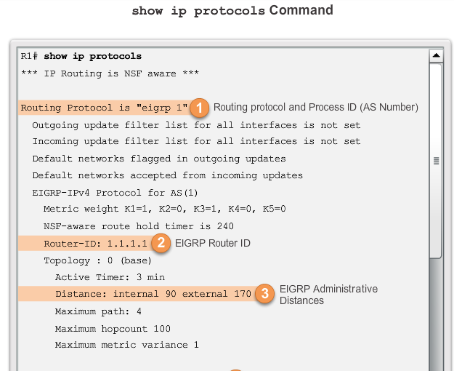
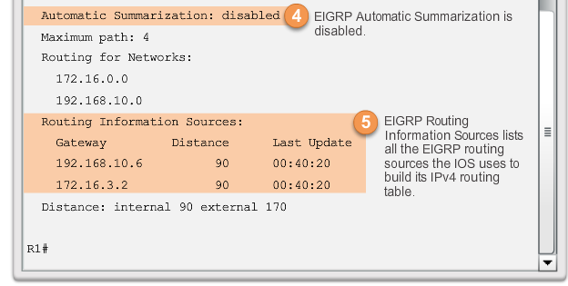
Configuring EIGRP with IPv4 Verifying EIGRP: show ip protocols Command
Notes:
7.2.2.2 Verifying EIGRP: Show ip protocols command

Slide 27
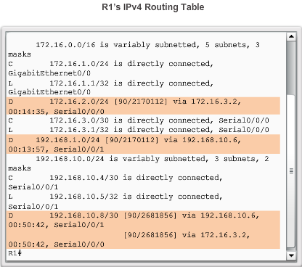
Configuring EIGRP with IPv4 Verifying EIGRP: Examine the IPv4 Routing Table
Notes:
7.2.2.3 Verifying EIGRP: Examine the IPv4 routing table

Slide 28
7.3 Operation of EIGRP
Notes:
Cisco Networking Academy program
Scaling Networks
Chapter 7: Enhanced Interior Gateway Protocol (EIGRP)

Slide 29
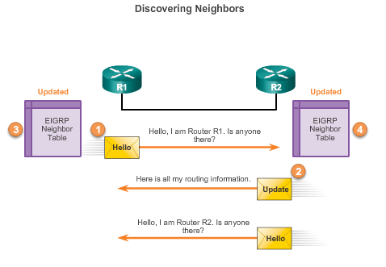
EIGRP Initial Route Discovery EIGRP Neighbor Adjacency
Notes:
7.3.1.1 EIGRP Neighbor Adjacency

Slide 30
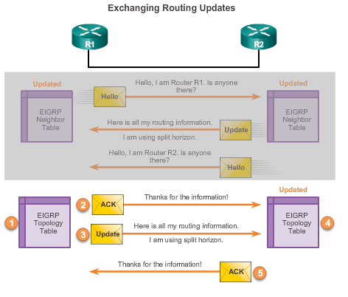
EIGRP Initial Route Discovery EIGRP Topology Table
Notes:
7.3.1.2 EIGRP Topology Table

Slide 31
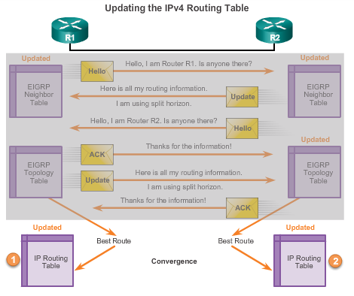
EIGRP Initial Route Discovery EIGRP Convergence
Convergence – All routers have the correct, most up-to-date information about the network.
Notes:
7.3.1.3 EIGRP Convergence

Slide 32
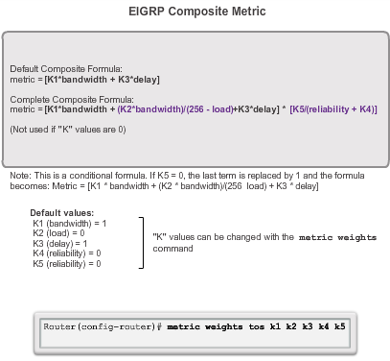
Metrics EIGRP Composite Metric
Notes:
7.3.2.1 EIGRP Composite Metric

Slide 33
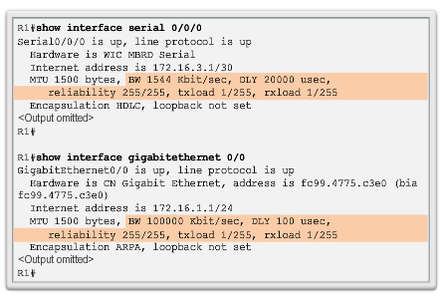
Metrics Examining Interface Values
BW – Bandwidth of the interface (in Kilobits per second).
DLY – Delay of the interface (microseconds).
Reliability – Reliability of interface; by default, the value is not included in the computing metric.
Txload, Rxload – By default, the value is not included in the computing metric.
Notes:
7.3.2.2 Examining Interface Values

Slide 34

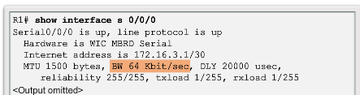
Metrics Bandwidth Metric
Use the show interfaces command to verify bandwidth.
Most serial bandwidths are set to 1,544 kb/s (default).
A correct value for bandwidth is very important in order to calculate the correct metric (both sides of link must have same bandwidth).
Notes:
7.3.2.3 Bandwidth Metric

Slide 35
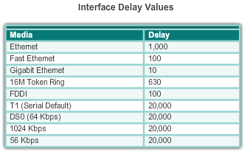
Metrics Delay Metric
Notes:
7.3.2.4 Delay Metric

Slide 36

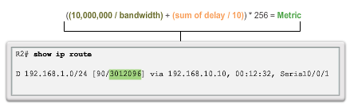
Metrics Calculating the EIGRP Metric
Step 1. Determine the link with the slowest bandwidth. Use that value to calculate bandwidth (10,000,000/bandwidth).
Step 2. Determine the delay value for each outgoing interface on the way to the destination. Add the delay values and divide by 10 (sum of delay/10).
Step 3. Add the computed values for bandwidth and delay, and multiply the sum by 256 to obtain the EIGRP metric.
Notes:
7.3.2.5 Calculating the EIGRP Metric

Slide 37
DUAL and the Topology Table DUAL Concepts
Diffusing Update ALgorithm (DUAL) provides the following:
Loop-free paths and loop-free backup paths
Fast convergence
Minimum bandwidth usage with bounded updates
The decision process for all route computations is done by the DUAL Finite State Machine (FSM)
DUAL FSM tracks all routes.
Uses EIGRP metrics to select efficient, loop-free paths.
Identifies the routes with the least-cost path to be inserted into the routing table.
EIGRP maintains a list of backup routes that DUAL has already determined that can be used immediately if the primary path fails.
Notes:
7.3.3.2 Introduction to DUAL

Slide 38
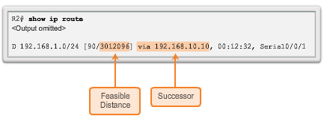

DUAL and the Topology Table Successor and Feasible Distance
The Successor is the least-cost route to the destination network.
The Feasible Distance (FD) is the lowest calculated metric to reach the destination network.
Notes:
7.3.3.3 Successor and Feasible Distance

Slide 39
Feasible Successors, Feasibility Condition, and Reported Distance
Feasible Successor (FS) is a neighbor that has a loop-free backup path to the same network as the successor, and it satisfies the Feasibility Condition (FC).
Feasibility Condition (FC) is met when a neighbor’s Reported Distance (RD) to a network is less than the local router’s feasible distance to the same destination network.
Reported Distance (RD) is an EIGRP neighbor’s feasible distance to the same destination network.
Notes:
7.3.3.4 Feasible Successors, Feasibility Condition and Reported Distance

Slide 40
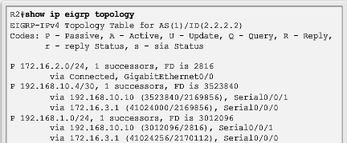
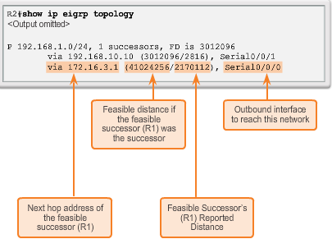
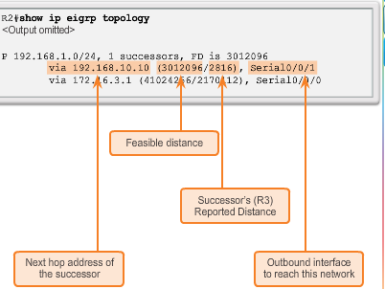
DUAL and the Topology Table Topology Table: show ip eigrp Command
Notes:
7.3.3.5-6 Topology Table: Show ip eigrp Command

Slide 41
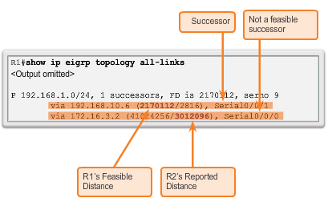
DUAL and the Topology Table Topology Table: No Feasible Successor
Notes:
7.3.3.7 Topology Table: No Feasible Successor

Slide 42
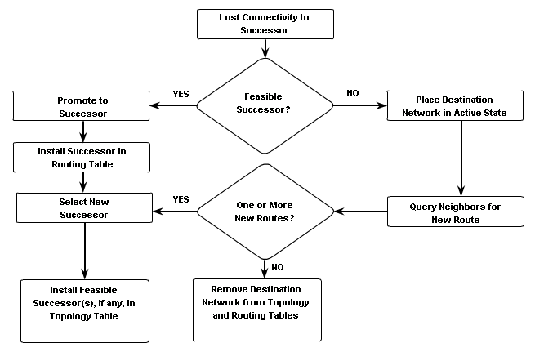
DUAL and Convergence DUAL Finite State Machine (FSM)
Notes:
7.3.4.1 DUAL Finite State Machine (FSM)

Slide 43
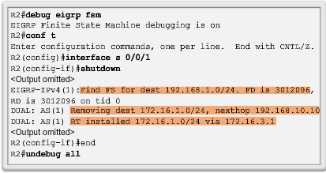
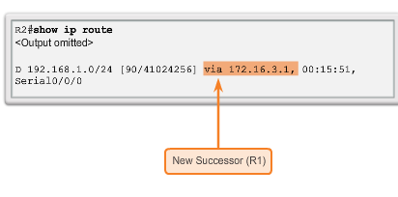
DUAL and Convergence DUAL: Feasible Successor
Notes:
7.3.4.2 DUAL: Feasible Successor

Slide 44
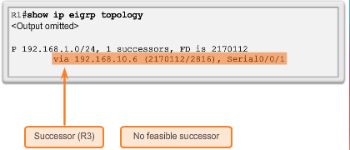
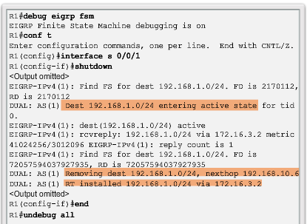
DUAL and Convergence DUAL: No Feasible Successor
Notes:
7.3.4.3 DUAL: No Feasible Successor

Slide 45
7.4 Configuration of EIGRP for IPv6
Notes:
Cisco Networking Academy program
Scaling Networks
Chapter 7: Enhanced Interior Gateway Protocol (EIGRP)

Slide 46
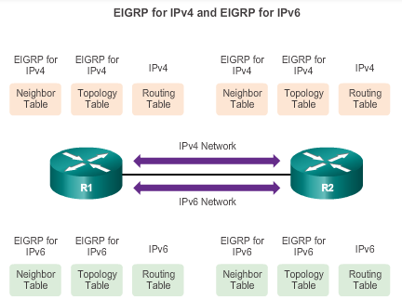
EIGRP for IPv4 vs. IPv6 EIGRP for IPv6
Notes:
7.4.1.1 EIGRP for IPv6

Slide 47
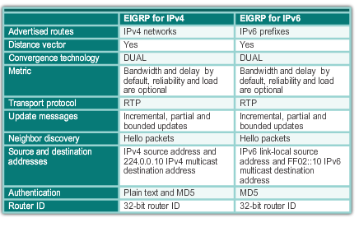
EIGRP for IPv4 vs. IPv6 Comparing EIGRP for IPv4 and IPv6
Notes:
7.4.1.2 Comparing EIGRP for IPv4 and IPv6

Slide 48
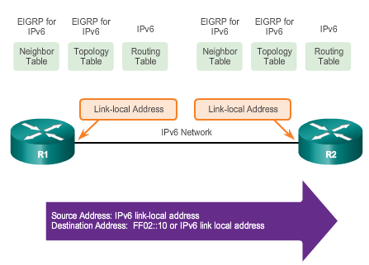
EIGRP for IPv4 vs. IPv6 IPv6 Link-local Addresses
Notes:
7.4.1.3 IPv6 Link-local Addresses

Slide 49
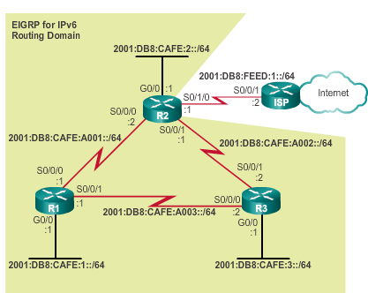
Configuring EIGRP for IPv6 EIGRP for IPv6 Network Topology
Notes:
7.4.2.1 EIGRP for IPv6 Network Topology

Slide 50
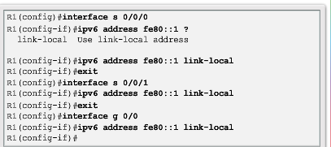
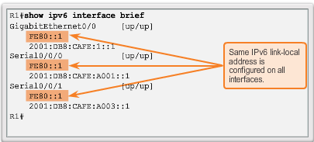
Configuring EIGRP for IPv6 Configuring IPv6 Link-Local Addresses
Manually configuring link-local addresses
Verifying link-local addresses
Notes:
7.4.2.2 Configuring IPv6 Link-local Addresses

Slide 51
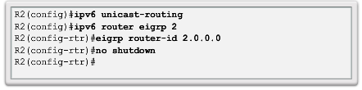
Configuring EIGRP for IPv6 Configuring EIGRP for the IPv6 Routing Process
The ipv6 unicast-routing global configuration mode command is required to enable any IPv6 routing protocol.
Configuring EIGRP for IPv6
The no shutdown command and a router ID are required for the router to form neighbor adjacencies.
Notes:
7.4.2.3 Configuring EIGRP for IPv6 Routing Process

Slide 52
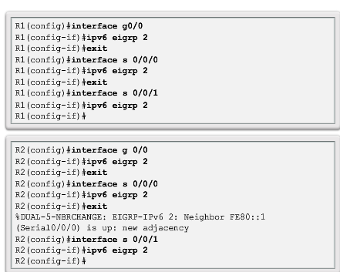
Configuring EIGRP for IPv6 ipv6 eigrp interface Command
Enabling EIGRP of IPv6 on an Interface
Notes:
7.4.2.4 ipv6 eigrp Interface Command

Slide 53
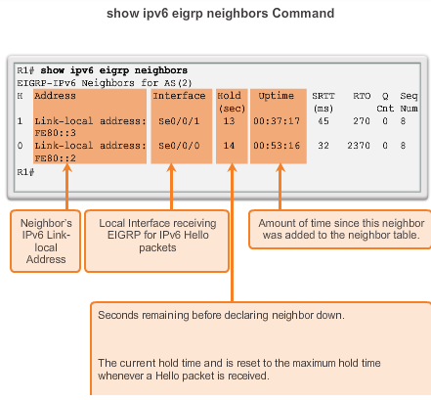
Verifying EIGRP for IPv6 Verifying EIGRP for IPv6: Examining Neighbors
Notes:
7.4.3.1 Verifying EIGRP for IPv6:Examining Neighbors

Slide 54
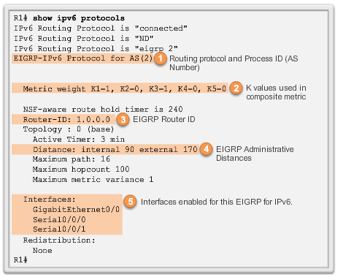
Verifying EIGRP for IPv6 Verifying EIGRP for IPv6: show ip protocols Command
Notes:
7.4.3.2 Verifying EIGRP for IPv6: show ip protocols command

Slide 55
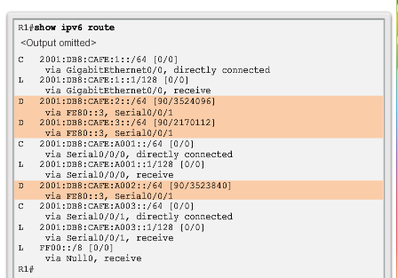
Verifying EIGRP for IPv6 Verifying EIGRP for IPv6: Examine the Routing Table
Use the show ipv6 route command to examine the IPv6 routing table.
Notes:
7.4.3.3 Verifying EIGRP for IPv6: Examine the Routing Table

Slide 56
Chapter 7: Summary
EIGRP is a classless, advanced distance vector routing protocol.
EIGRP uses the source code of “D” for DUAL in the routing table.
The default administrative distance of 90 is used for internal routes and 170 for routes imported from an external source.
Advanced features include DUAL, establishing neighbor adjacencies, RTP, partial and bounded updates, and equal and unequal cost load balancing.
PDMs give EIGRP the capability to support different Layer 3 protocols.
EIGRP Hello packets are used to discover neighbors.
The show ip eigrp neighbors command is used to view neighbor table and verify adjacencies.
Notes:
7.5 Summary

Slide 57
Chapter 7: Summary (cont.)
EIGRP sends partial bounded updates when a change occurs on network.
EIGRP composite metric uses bandwidth, delay, reliability and load to determine the best path (by default, only bandwidth and delay are used).
DUAL FSM is used to determine best path; Successor and potential backup path, FS to every destination network.
Notes:
7.5 Summary (cont.)

Slide 58


