Slide 1
Chapter 8: EIGRP Advanced Configurations and Troubleshooting
Scaling Networks
Notes:
Cisco Networking Academy program
Scaling Networks
Chapter 8: EIGRP Advanced Configurations and Troubleshooting

Slide 2
Chapter 8
8.1 Advanced EIGRP Configurations
8.2 Troubleshooting EIGRP
8.3 Summary
Notes:
Chapter 8

Slide 3
Chapter 8: Objectives
After completing this chapter, you will be able to:
Configure EIGRP automatic summarization.
Configure EIGRP manual summarization.
Configure a router to propagate a default route in an EIGRP network.
Modify EIGRP interface settings to improve network performance.
Configure EIGRP authentication to ensure secure routing updates.
Explain the process and tools used to troubleshoot an EIGRP network.
Troubleshoot neighbor adjacency issues in an EIGRP network.
Troubleshoot missing route entries in an EIGRP routing table.

Slide 4
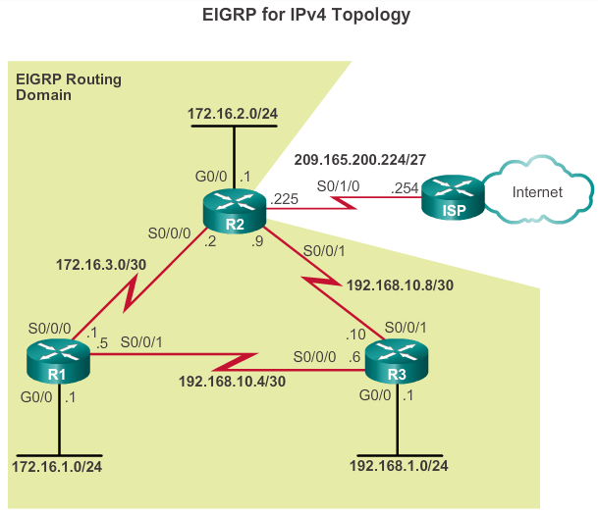
Automatic Summarization Network Technology
Notes:
8.1.1.1 Network Topology

Slide 5
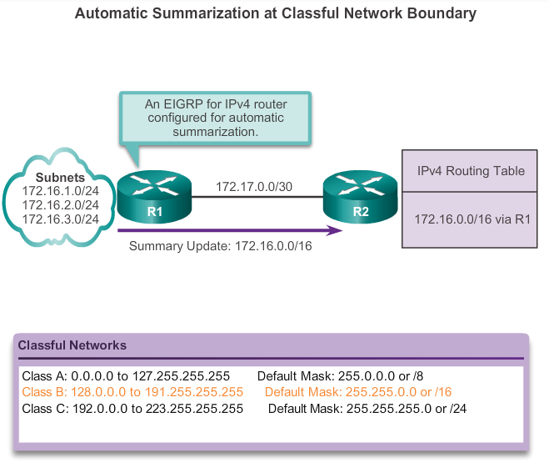
Automatic Summarization EIGRP Automatic Summarization
Notes:
8.1.1.2 EIGRP Autosummarization

Slide 6
Automatic Summarization Configuring EIGRP Automatic Summarization
EIGRP for IPv4 automatic summarization is disabled, by default, beginning with Cisco IOS Release 15.0(1)M and 12.2(33). Prior to this, automatic summarization was enabled, by default.
To enable automatic summarization for EIGRP, use the auto-summary command in router configuration mode.
R1(config)# router eigrp autonomous-system
R1(config-router)# auto-summary
Use the no form of this command to disable autosummarization.
R1(config)# router eigrp autonomous-system
R1(config-router)# no auto-summary
Notes:
8.1.1.3 Configuring EIGRP Summarization

Slide 7
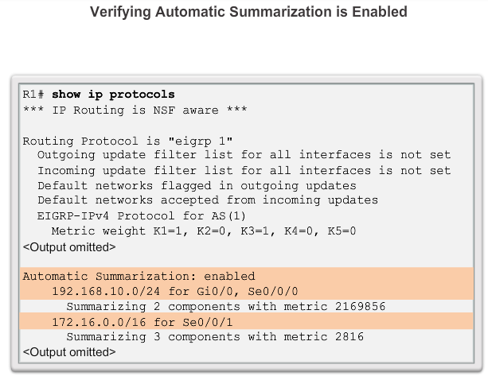
Autosummarization Verifying Autosummarization: show ip protocols
Notes:
8.1.1.4 Verifying Autosummarization: show ip protocols

Slide 8
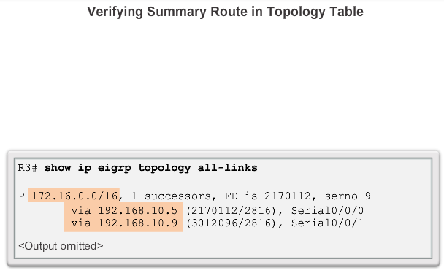
Autosummarization Verifying Autosummarization: Topology Table
Notes:
8.1.1.5 Verifying Autosummarization: Topology Table

Slide 9
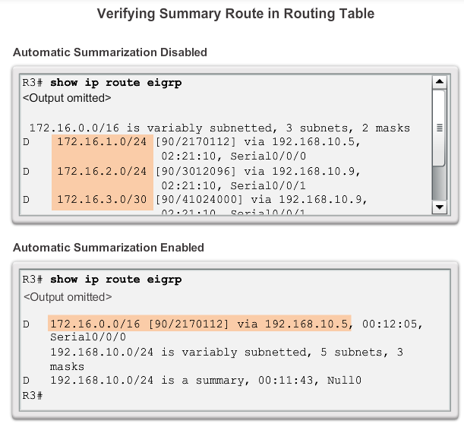
Autosummarization Verifying Autosummarization: Routing Table
Notes:
8.1.1.6 Verifying Auto-Summary: Routing Table

Slide 10
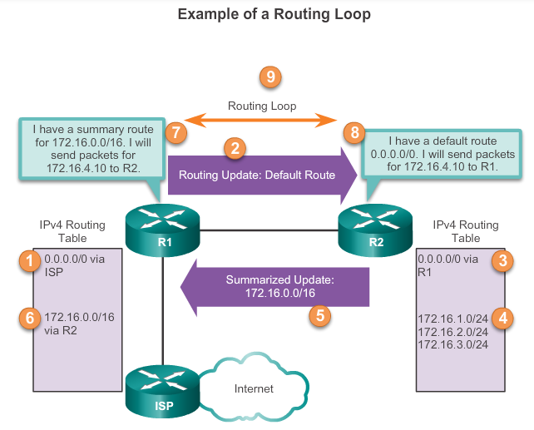
Autosummarization Summary Route
Notes:
8.1.1.7 Summary Route

Slide 11
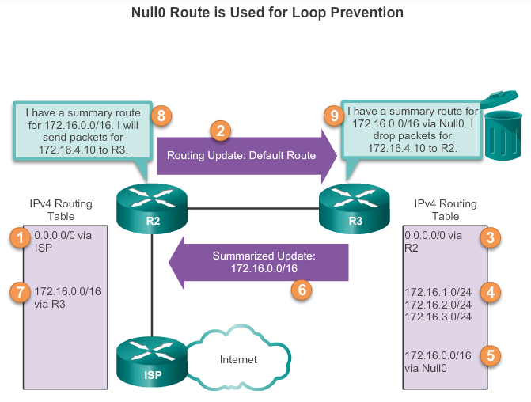
Autosummarization Summary Route (cont.)
Notes:
8.1.1.8 Summary Route (Cont.)

Slide 12
Manual Summarization Manual Summary Routes
EIGRP can be configured to summarize routes, whether or not autosummarization is enabled.
Because EIGRP is a classless routing protocol and includes the subnet mask in the routing updates, manual summarization can include supernet routes.
A supernet is an aggregation of multiple major classful network addresses.
Notes:
8.1.2.1 Manual Summary Routes

Slide 13
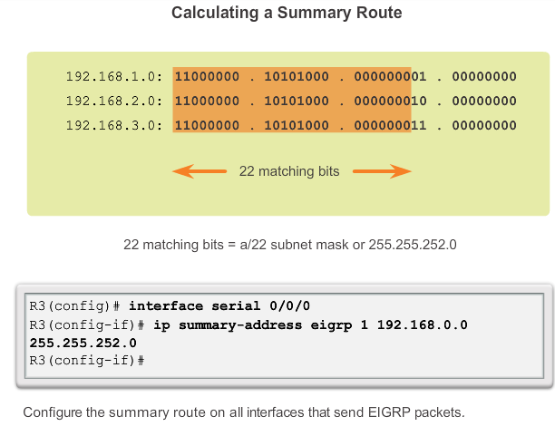
Manual Summarization Configuring EIGRP Manual Summary Routes
Notes:
8.1.2.2 Configuring EIGRP Manual Summary Routes

Slide 14
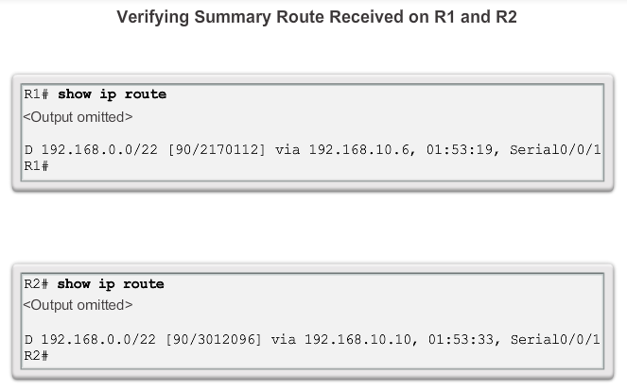
Manual Summarization Verifying Manual Summary Routes
Notes:
8.1.2.3 Verifying Manual Summary Routes

Slide 15
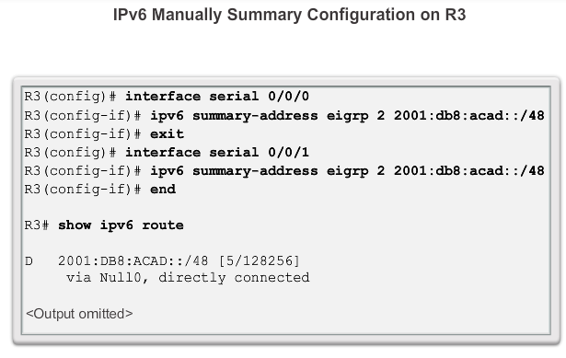
Manual Summarization EIGRP for IPv6: Manual Summary Routes
Notes:
8.1.2.4 EIGRP for IPv6: Manual Summary Routes

Slide 16
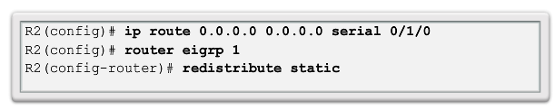
Default Route Propagation Propagating a Default Static Route
Using a static route to 0.0.0.0/0 as a default route is not routing protocol-dependent.
The quad zero static default route can be used with any currently supported routing protocols.
The static default route is usually configured on the router that has a connection to a network outside the EIGRP routing domain, for example, to an ISP.
Notes:
8.1.3.1 Propagating a Default Static Route

Slide 17
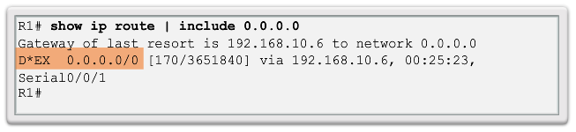
Default Route Propagation Verifying the Propagated Default Route
The entry for the EIGRP-learned default route is identified by the following:
D – This route was learned from an EIGRP routing update.
* – The route is a candidate for a default route.
EX – The route is an external EIGRP route; in this case, a static route outside of the EIGRP routing domain.
170 – This is the administrative distance of an external EIGRP route.
Notes:
8.1.3.2 Verifying the Propagated Default Route

Slide 18
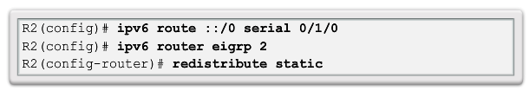
Default Route Propagation EIGRP for IPv6- Default Route
Note: Some IOSs may require that the redistribute static command include the EIGRP metric parameters and maximum transmission unit (MTU) before the static route can be redistributed. These parameters may vary, but an example for this scenario would be:
R2(config)# ipv6 router eigrp 2
R2(config-router)# redistribute static metric 64 2000 255 1 1500
Notes:
8.1.3.3 EIGRP for IPv6: Default Route

Slide 19
Fine-tuning EIGRP Interfaces EIGRP Bandwidth Utilization
EIGRP Bandwidth for IPv4
By default, EIGRP uses only up to 50% of an interface’s bandwidth for EIGRP information, which prevents the EIGRP process from overutilizing a link and not allowing enough bandwidth for the routing of normal traffic.
The ip bandwidth-percent eigrp command can be used to configure the percentage of bandwidth that may be used by EIGRP on an interface.
Router(config-if)# ip bandwidth-percent eigrp as-number percent
Notes:
8.1.4.1 EIGRP Bandwidth Utilization

Slide 20
Fine-tuning EIGRP Interfaces EIGRP Bandwidth Utilization (cont.)
EIGRP Bandwidth for IPv6
To configure the percentage of bandwidth that may be used by EIGRP for IPv6 on an interface, use the ipv6 bandwidth-percent eigrp command in interface configuration mode. To restore the default value, use the no form of this command.
Router(config-if)# ipv6 bandwidth-percent eigrp as-number percent
Notes:
8.1.4.1 EIGRP Bandwidth Utilization

Slide 21
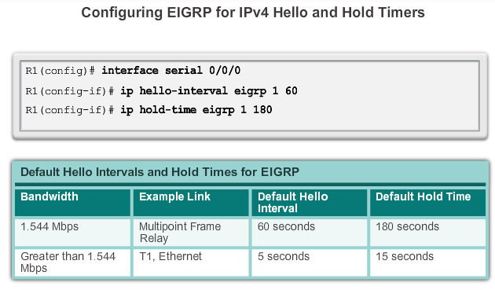
Fine-tuning EIGRP Interfaces Hello and Hold Timers
Notes:
8.1.4.2 Hello and Hold Timers

Slide 22
Fine-tuning EIGRP Interfaces Load Balancing IPv4
Equal-cost load balancing is the ability of a router to distribute outbound traffic using all interfaces that have the same metric from the destination address.
The Cisco IOS will, by default, allow load balancing using up to four equal-cost paths; however, this can be modified. Using the maximum-paths router configuration mode command, up to 32 equal-cost routes can be kept in the routing table.
Router(config-router)# maximum-paths value
If the value is set to 1, load balancing is disabled.
Notes:
8.1.4.3 Load Balancing IPv4

Slide 23
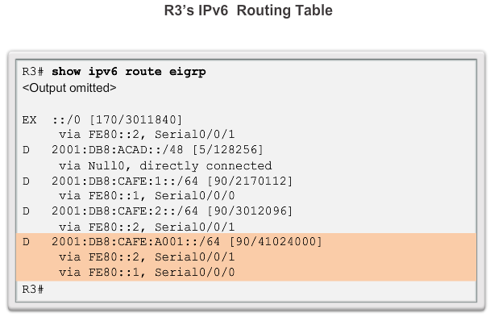
Fine-tuning EIGRP Interfaces Load Balancing IPv6
Notes:
8.1.4.4 Load Balancing IPv6

Slide 24
Secure EIGRP Routing Protocol Authentication Overview
Network administrators must be aware that routers are at risk from attack just as much as end-user devices. Anyone with a packet sniffer, such as Wireshark, can read information propagating between routers.
A method to protect routing information on the network is to authenticate routing protocol packets using the Message Digest 5 (MD5) algorithm.
Routing protocols, such as RIPv2, EIGRP, OSPF, IS-IS, and BGP all support various forms of MD5 authentication.
Notes:
8.1.5.1 Routing Protocol Authentication Overview

Slide 25
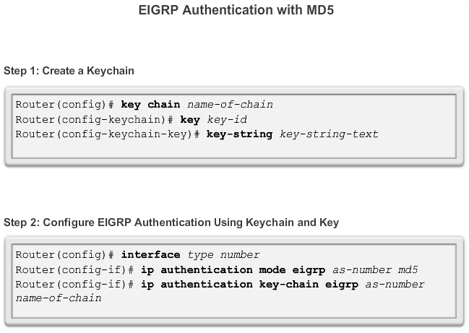
Secure EIGRP Configuring EIGRP with MD5 Authentication
Notes:
8.1.5.2 Configuring EIGRP with MD5 Authentication

Slide 26
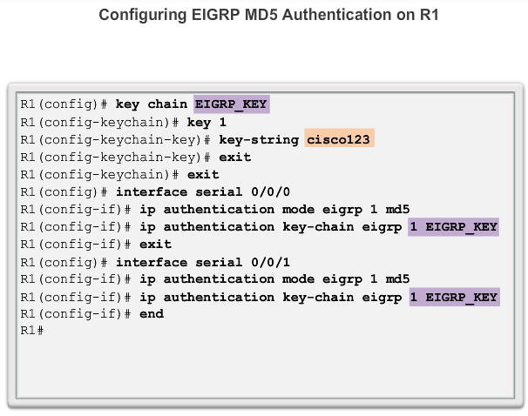
Secure EIGRP EIGRP Authentication Example
Notes:
8.1.5.3 EIGRP Authentication Example

Slide 27
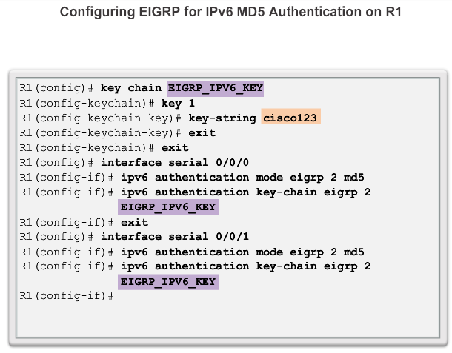
Secure EIGRP EIGRP Authentication Example (cont.)
Notes:
8.1.5.3 EIGRP Authentication Example

Slide 28
Secure EIGRP Verifying Authentication
Adjacencies are only formed when both connecting devices have authentication configured.
To verify that the correct EIGRP adjacencies were formed after being configured for authentication, use the show ip eigrp neighbors command on each router.
To verify the neighbor adjacencies EIGRP for IPv6, use the show ipv6 eigrp neighbors command.
Notes:
8.1.5.4 Verifying Authentication

Slide 29
8.2 Troubleshooting EIGRP
Scaling Networks
Notes:
8.2 Troubleshooting EIGRP

Slide 30
Components of Troubleshooting EIGRP Basic EIGRP Troubleshooting Commands
EIGRP for IPv4
Router# show ip eigrp neighbors
Router# show ip route
Router# show ip protocols
EIGRP for IPv6
Router# show ipv6 eigrp neighbors
Router# show ipv6 route
Router# show ipv6 protocols
Notes:
8.2.1.1 Basic EIGRP Troubleshooting Commands

Slide 31
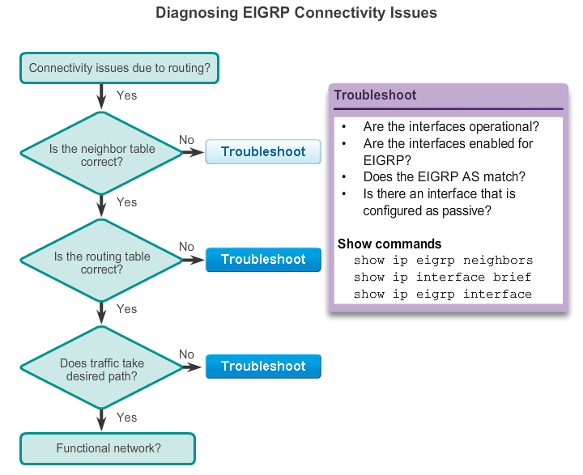
Components of Troubleshooting EIGRP Components
Notes:
8.2.1.2 Components

Slide 32
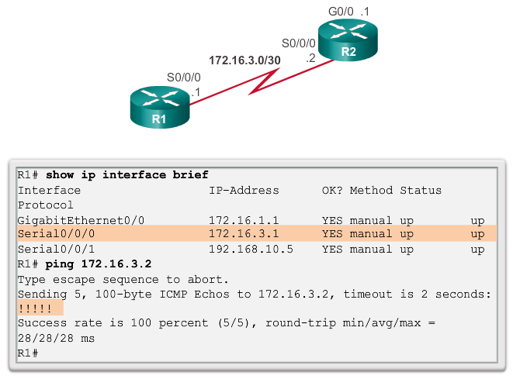
Troubleshoot EIGRP Neighbor Issues Layer 3 Connectivity
A prerequisite for a neighbor adjacency to form between two directly connected routers is Layer 3 connectivity.
Notes:
8.2.2.1 Layer 3 Connectivity

Slide 33
Troubleshoot EIGRP Neighbor Issues EIGRP Parameters
When troubleshooting an EIGRP network, one of the first things to verify is that all routers that are participating in the EIGRP network are configured with the same autonomous system number. EIGRP for IPv4
Router# show ip protocols
EIGRP for IPv6
Router# show ipv6 protocols
Notes:
8.2.2.2 EIGRP Parameters

Slide 34
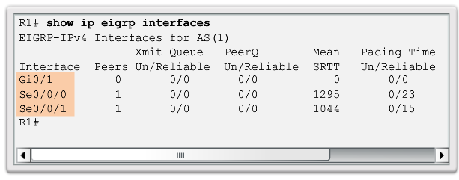
Troubleshoot EIGRP Neighbor Issues EIGRP Interfaces
In addition to verifying the autonomous system number, it is necessary to verify that all interfaces are participating in the EIGRP network.
The network command that is configured under the EIGRP routing process indicates which router interfaces participate in EIGRP.
Notes:
8.2.2.3 EIGRP Interfaces

Slide 35
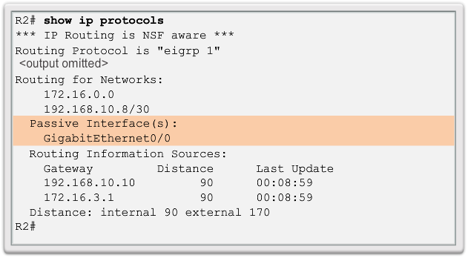
Troubleshoot EIGRP Routing Table Issues Passive Interface
One reason that route tables may not reflect the correct routes is due to the passive-interface command.
The show ip protocols can be used to check if an interface is configured as passive.
Notes:
8.2.3.1 Passive Interface

Slide 36
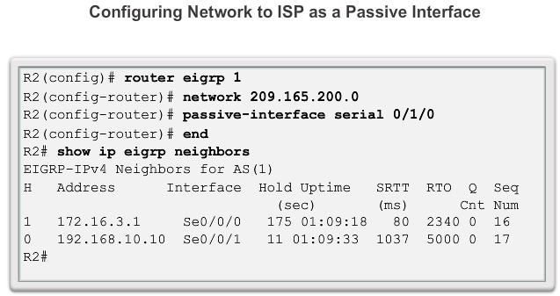
Troubleshoot EIGRP Routing Table Issues Passive Interface
With EIGRP running on a network, the passive-interface command stops both outgoing and incoming routing updates. For this reason, routers do not become neighbors.
Notes:
8.2.3.1 Passive Interface

Slide 37
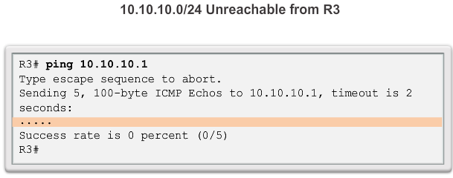
Troubleshoot EIGRP Routing Table Issues Missing Network Statement
Notes:
8.2.3.1 Missing Network Statement

Slide 38
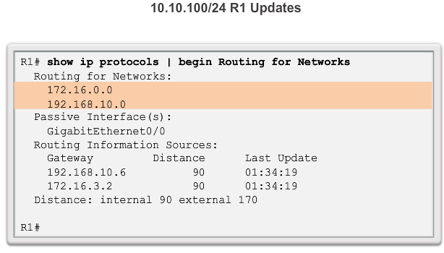
Troubleshoot EIGRP Routing Table Issues Missing Network Statement (cont.)
10.10.10.0/24 R1 Updates
Notes:
8.2.3.1 Missing Network Statement

Slide 39
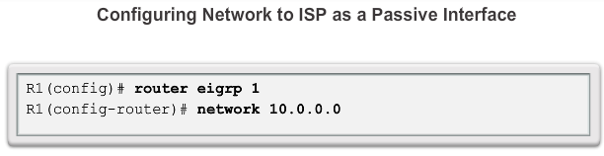
Troubleshoot EIGRP Routing Table Issues Missing Network Statement (cont.)
Add Missing Network Statement
Notes:
8.2.3.1 Missing Network Statement

Slide 40
Troubleshooting EIGRP Routing Table Issues Autosummarization
Another issue that may create problems for the network administrator is EIGRP autosummarization.
EIGRP for IPv4 can be configured to automatically summarize routes at classful boundaries. If there are discontiguous networks, autosummarization causes inconsistent routing.
Classful networks do not exist in IPv6; therefore, EIGRP for IPv6 does not support autosummarization. All summarization must be accomplished using EIGRP manual summary routes.
Notes:
8.2.3.3 Autosummarization

Slide 41
Chapter 8: Summary
EIGRP is one of the routing protocols commonly used in large enterprise networks.
Modifying EIGRP features and troubleshooting problems is one of the most essential skills for a network engineer involved in the implementation and maintenance of large, routed enterprise networks that use EIGRP.
Summarization decreases the number of entries in routing updates and lowers the number of entries in local routing tables. It also reduces bandwidth utilization for routing updates and results in faster routing table lookups.
EIGRP for IPv4 autosummarization is disabled, by default, beginning with Cisco IOS Release 15.0(1)M and 12.2(33). Prior to this, autosummarization was enabled, by default.
Notes:
Chapter 8 Summary

Slide 42


