Slide 1
Chapter 1: Hierarchical Network Design
Connecting Networks
Notes:
Cisco Networking Academy program
Connecting Networks
Chapter 1: Hierarchical Network Design

Slide 2
Chapter 1
1.0 Introduction
1.1 Hierarchical Network Design Overview
1.2 Cisco Enterprise Architecture
1.3 Evolving Network Architectures
1.4 Summary
Notes:
Chapter 1

Slide 3
Chapter 1: Objectives
Describe how a hierarchical network model is used to design networks.
Explain the structured engineering principles for network design: Hierarchy, Modularity, Resiliency, Flexibility.
Describe the three layers of a hierarchical network and how they are used in network design.
Identify the benefits of a hierarchical design.
Describe the Cisco Enterprise Architecture model.
Describe the three new business network architectures: borderless network architecture, collaboration network architecture, and the data center or virtualization network architecture.
Notes:
Chapter 1 Objectives

Slide 4
1.1 Hierarchical Network Design Overview
Notes:
1.1 Hierarchical Network Design Overview

Slide 5
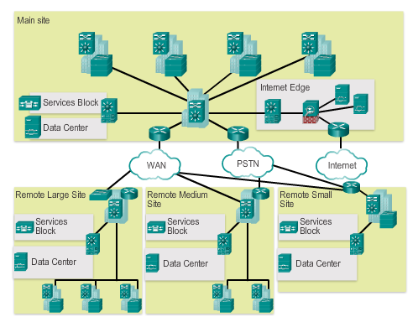
Enterprise Network Campus Design Network Requirements
Small network – Provides services for 1 to 200 devices.
Medium-sized network – Provides services for 200 to 1,000 devices.
Large network – Provides services for 1,000+ devices.
Notes:
1.1.1.1 Network Requirements

Slide 6
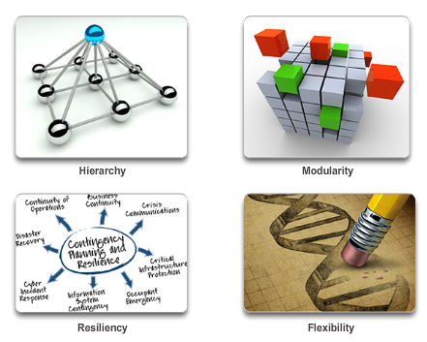
Enterprise Network Campus Design Structured Engineering Principles
Notes:
1.1.1.2 Structured Engineering Principles

Slide 7
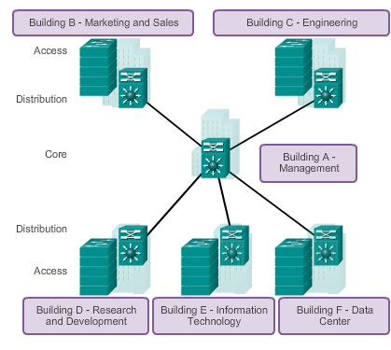
Hierarchical Network Design Network Hierarchy
Access layer – Provides workgroup or user access to the network.
Distribution layer – Provides policy-based connectivity.
Core layer – Provides fast transport between distribution switches.
Notes:
1.1.2.1 Network Hierarchy

Slide 8
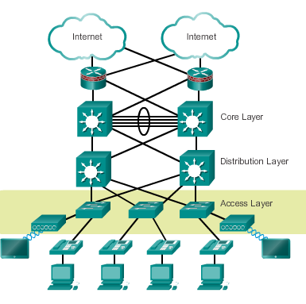
Hierarchical Network Design Access Layer
Layer 2 switching
High availability
Port security
QoS classification and marking and trust boundaries
Address Resolution Protocol (ARP) inspection
Virtual access control lists (VACLs)
Spanning tree
Power over Ethernet (PoE) and auxiliary VLANs for VoIP
Notes:
1.1.2.2 The Access Layer

Slide 9
Hierarchical Network Design Distribution Layer
Aggregation of LAN or WAN links
Policy-based security in the form of access control lists (ACLs) and filtering
Routing services between LANs and VLANs and between routing domains (e.g., EIGRP to OSPF)
Redundancy and load balancing
A boundary for route aggregation and summarization configured on interfaces toward the core layer
Notes:
1.1.2.3 The Distribution Layer

Slide 10
Hierarchical Network Design Core Layer
Provides high-speed switching (i.e., fast transport)
Provides reliability and fault tolerance
Scales by using faster, and not more, equipment
Avoids CPU-intensive packet manipulation caused by security, inspection, quality of service (QoS) classification, or other processes
Notes:
1.1.2.4 The Core Layer

Slide 11
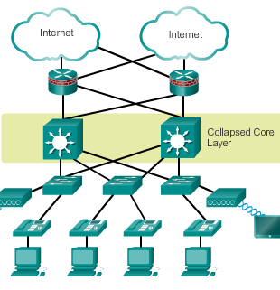
Hierarchical Network Design Two-Tier Collapsed Core Design
A two-tier hierarchical “collapsed core” is when the distribution layer and core layer functions are implemented by a single device.
Used by smaller businesses to reduce network cost while maintaining most of the benefits of the three-tier hierarchical model.
Notes:
1.1.2.5 Two-Tier Collapsed Core Design

Slide 12
1.2 Cisco Enterprise Architecture
Notes:
1.2 Cisco Enterprise Architecture

Slide 13
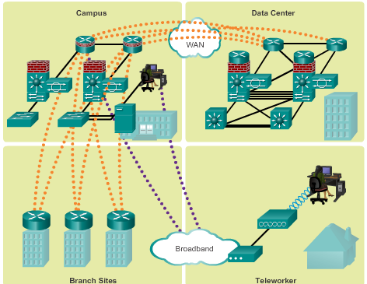
Modular Network Design Modular Design
As the complexity of networks increased, a modular network design has been implemented.
Modular design separates the network into various functional network modules.
Notes:
1.2.1.1 Modular Design

Slide 14
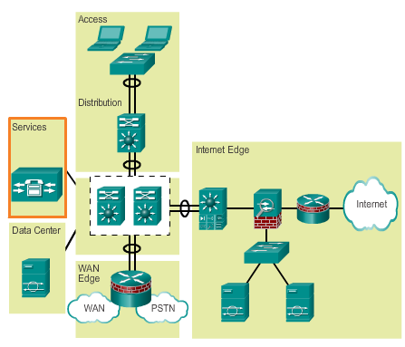
Modular Network Design Modules in the Enterprise Architecture
Access-distribution module – Also called the distribution block.
Services module – A generic block used to identify services, such as centralized Lightweight Access Point Protocol (LWAPP).
Data center module – Originally called the server farm.
Enterprise Edge module – Consists of the Internet Edge and the WAN Edge.
Notes:
1.2.1.2 Modules in the Enterprise Architecture

Slide 15
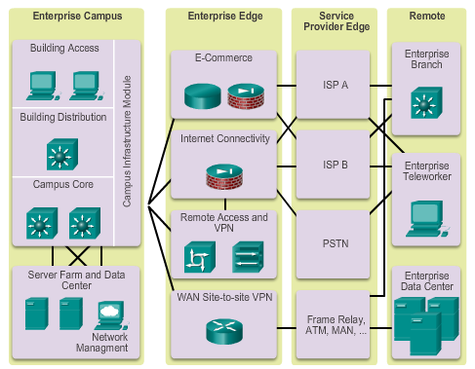
Cisco Enterprise Architecture Model Cisco Enterprise Architecture Model
Notes:
1.2.2.1 Cisco Enterprise Architecture Model

Slide 16
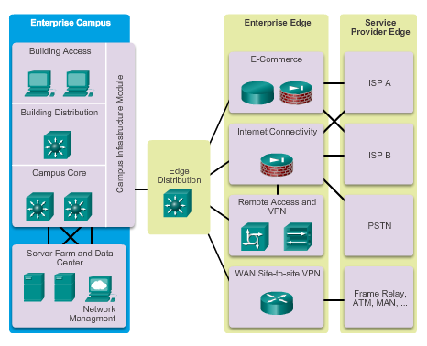
Cisco Enterprise Architecture Model Cisco Enterprise Campus
Notes:
1.2.2.2 Cisco Enterprise Campus

Slide 17
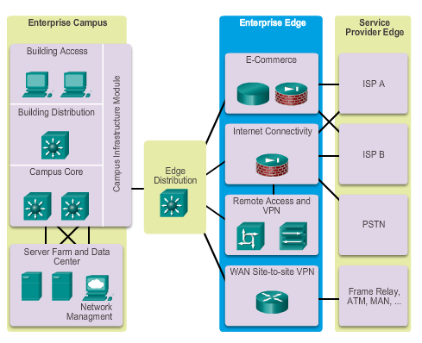
Cisco Enterprise Architecture Model Cisco Enterprise Edge
Notes:
1.2.2.3 Cisco Enterprise Edge

Slide 18
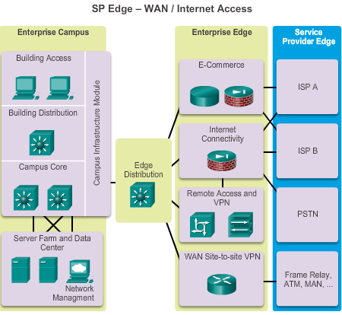
Cisco Enterprise Architecture Model Service Provider Edge
Notes:
1.2.2.4 Service Provider Edge

Slide 19
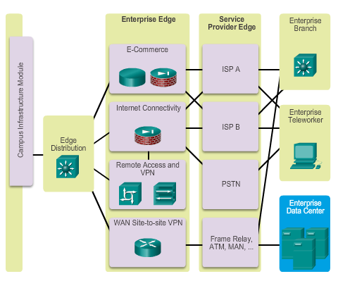
Cisco Enterprise Architecture Model Cisco Enterprise Data Center
Notes:
1.2.2.5 Cisco Enterprise Data Center

Slide 20
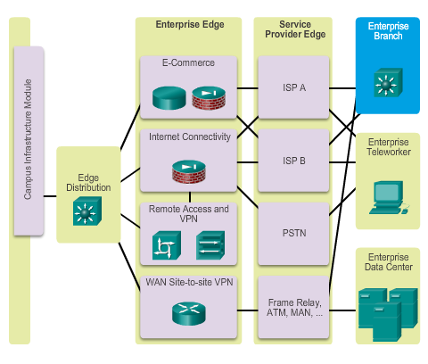
Cisco Enterprise Architecture Model Cisco Enterprise Branch
Notes:
1.2.2.6 Cisco Enterprise Branch

Slide 21
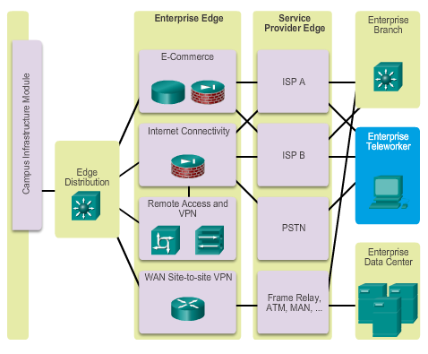
Cisco Enterprise Architecture Model Cisco Enterprise Teleworker
Notes:
1.2.2.7 Cisco Enterprise Teleworker

Slide 22
1.3 Evolving Network Architectures
Notes:
1.3 Evolving Network Architectures

Slide 23

Cisco Enterprise Architectures IT Challenges
Some of the top trends include:
Bring Your Own Device (BYOD)
Online collaboration
Video communication
Cloud computing
Notes:
1.3.1.1 IT Challenges

Slide 24
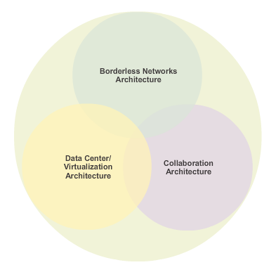
Cisco Enterprise Architectures Emerging Enterprise Architectures
Notes:
1.3.1.2 Emerging Enterprise Architectures

Slide 25
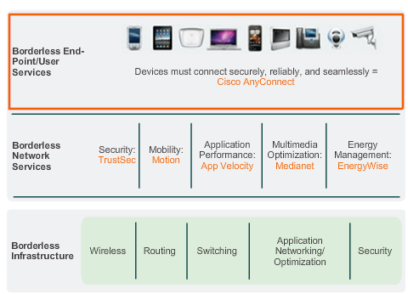
Emerging Network Architectures Cisco Borderless Networks
Notes:
1.3.2.1 Cisco Borderless Networks

Slide 26
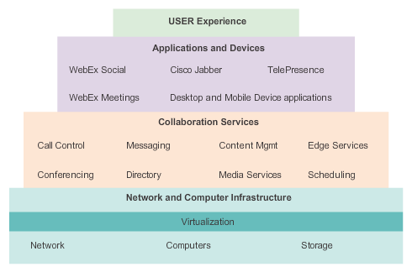
Emerging Network Architectures Collaboration Architecture
Cisco’s collaboration architecture is composed of three layers:
Application and Devices –Unified communications and conference applications, such as Cisco WebEx Meetings, WebEx Social, Cisco Jabber, and TelePresence.
Collaboration Services –Supports collaboration applications.
Network and Computer Infrastructure – Allows collaboration anytime, from anywhere, on any device.
Notes:
1.3.2.2 Collaboration Architecture

Slide 27
Emerging Network Architectures Data Center and Virtualization
The data center architecture consists of three components:
Cisco Unified Management Solutions – Simplifies and automates the process of deploying IT infrastructure and services with speed and enterprise reliability.
Unified Fabric Solutions – Delivers network services to servers, storage, and applications, providing transparent convergence, and scalability.
Unified Computing Solutions – Cisco’s next-generation data center system unites computing, network, storage access, and virtualization into a cohesive system designed to reduce total cost of ownership (TCO).
Notes:
1.3.2.3 Data Center and Virtualization

Slide 28
1.4 Summary
Notes:
1.4 Summary

Slide 29
Chapter 1: Summary
This chapter:
Introduced the structured engineering principles of good network design that include hierarchy, modularity, resiliency, and flexibility.
Explained that the typical enterprise hierarchical LAN campus network design incorporates the access layer, distribution layer, and the core layer.
Identified that smaller enterprise networks may use a “collapsed core” hierarchy, whereas the distribution and core layer functions are implemented in a single device.
Described the benefits of a hierarchical network as scalability, redundancy, performance, and ease of maintenance.
Notes:
Chapter 1 Summary

Slide 30
Chapter 1: Summary (cont.)
Explained that a modular design, which separates the functions of a network, enables flexibility and facilitates implementation and management.
Discussed that the Cisco Enterprise Architecture modules are used to facilitate the design of large, scalable networks.
Identified the primary modules, including the Enterprise Campus, Enterprise Edge, Service Provider Edge, Enterprise Data Center, Enterprise Branch, and Enterprise Teleworker.
Notes:
Chapter 1 Summary (continued)

Slide 31


