Slide 1
Chapter 2: Connecting to the WAN
Connecting Networks
Notes:
Cisco Networking Academy program
Connecting Networks
Chapter 2: Connecting to the WAN

Slide 2
Chapter 2
2.0 Introduction
2.1 WAN Technologies Overview
2.2 Selecting a WAN Technology
2.3 Summary
Notes:
Chapter 2

Slide 3
Chapter 2: Objectives
Describe the purpose of a WAN.
Describe WAN operations.
Describe WAN services available.
Compare various private WAN technologies.
Compare various public WAN technologies.
Select the appropriate WAN protocol and service for a specific network requirement.

Slide 4
2.1 WAN Technologies Overview
Notes:
2.1 WAN Technologies Overview

Slide 5
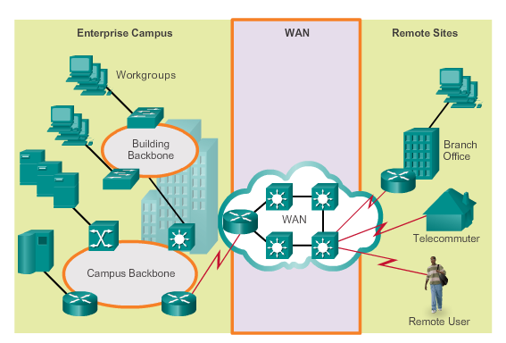
Purpose of WANs Why Choose a WAN?
Operates beyond the geographic scope of a LAN
Used to interconnect the enterprise LAN to remote LANs in branch sites and telecommuter sites
Owned by a service provider
Organization must pay a fee to use the provider’s services to connect sites
Notes:
2.1.1.1 Why a WAN?

Slide 6
Purpose of WANs Are WANs Necessary?
Businesses require communication among geographically separated sites. Examples include:
Regional or branch offices must be able to communicate and share data.
Organizations must share information with other customer organizations.
Mobile workers must access information that resides on corporate networks.
Home computer users must send and receive data across increasingly larger distances. Examples include:
Consumers communicate over the Internet with banks, stores, and a variety of providers of goods and services.
Students do research by accessing library indexes and publications located in other parts of the country and in other parts of the world.
Notes:
2.1.1.2 Are WANs Necessary?

Slide 7
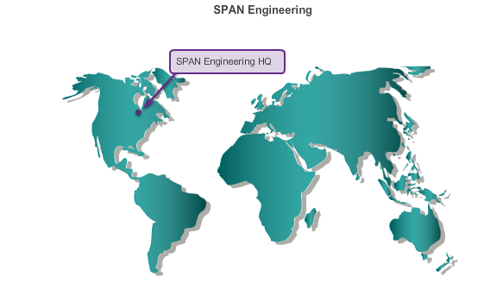
Purpose of WANs Evolving Networks
Companies expect their networks to perform optimally and to be able to deliver an ever increasing array of services and applications to support productivity and profitability.
SPAN Engineering – example used in the curriculum
Notes:
2.1.1.3 Evolving Networks

Slide 8
Purpose of WANs Small Office
SPAN Engineering – Environmental Consulting Firm
Been in business for four years, has grown to include 15 employees: six engineers, four computer-aided drawing (CAD) designers, a receptionist, two senior partners, and two office assistants
Uses a single LAN to share information between computers, and to share peripherals, such as a printer, a large-scale plotter, and fax equipment
Upgraded LAN to provide inexpensive VoIP service to save on the costs of separate phone lines for their employees
Connection to the Internet is through a common broadband service called DSL
Uses support services purchased from the DSL provider
Uses a hosting service rather than purchasing and operating its own FTP and email servers
Notes:
2.1.1.4 Small Office

Slide 9
Purpose of WANs Campus Network
SPAN Engineering – Environmental Consulting Firm
Five years later has grown rapidly.
Contracted to design and implement a full-sized waste conversion facility.
Won other projects in neighboring municipalities and in other parts of the country.
Hired more staff and leased more office space with several hundred employees, organized itself into functional departments.
Network now consists of several subnetworks, each devoted to a different department.
Multiple LANs are joined to create a company-wide network or campus, which spans several floors of the building.
Notes:
2.1.1.5 Campus Network

Slide 10
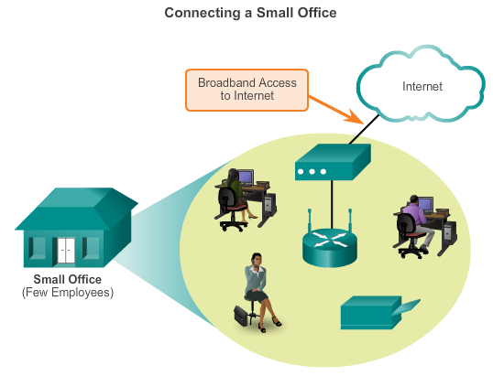
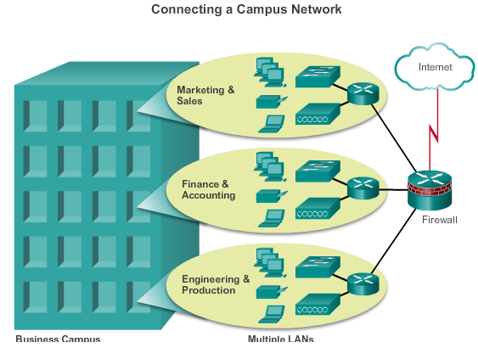
Purpose of WANs Small Office – Campus Network
Notes:
2.1.1.5 Campus Network

Slide 11
Purpose of WANs Branch Networks
Another six years later, SPAN Engineering demand for its services has skyrocketed.
To manage those projects, the company has opened small branch offices closer to the project sites.
SPAN Engineering now has a data center, which houses the various databases and servers of the company. They must now implement a WAN.
For its branch offices that are in nearby cities, the company decides to use private dedicated lines through their local service provider.
For those offices that are located in other countries, the Internet is an attractive WAN connection option.
Although connecting offices through the Internet is economical, it introduces security and privacy issues that the IT team must address.
Notes:
2.1.1.6 Branch Networks

Slide 12
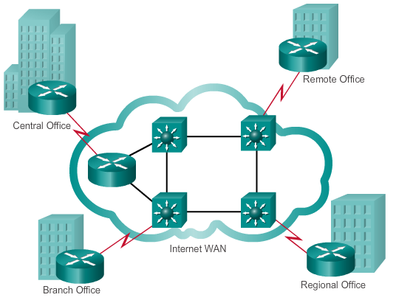
Purpose of WANs Branch Networks (cont.)
Notes:
2.1.1.6 Branch Networks

Slide 13
Purpose of WANs Distributed Networks
SPAN Engineering has now been in business for 20 years and has grown to thousands of employees distributed in offices worldwide.
Cost of the network and its related services is a big expense.
Looking to provide the best network services at the lowest cost.
Encouraging teleworking and virtual teams, web-based applications are being used to increase productivity and reduce costs.
Site-to-site and remote access Virtual Private Networks (VPNs) enable the company to use the Internet to connect easily and securely with employees and facilities around the world.
Notes:
2.1.1.7 Distributed Network

Slide 14
Purpose of WANs Distributed Networks (cont.)
Network requirements can change dramatically as the company grows.
Distributing employees saves costs in many ways, but it puts increased demands on the network.
Network must be able to adapt and grow as the company changes.
Network designers and administrators meet these challenges by carefully choosing network technologies, protocols, and service providers, and by optimizing their networks.
Notes:
2.1.1.7 Distributed Network

Slide 15
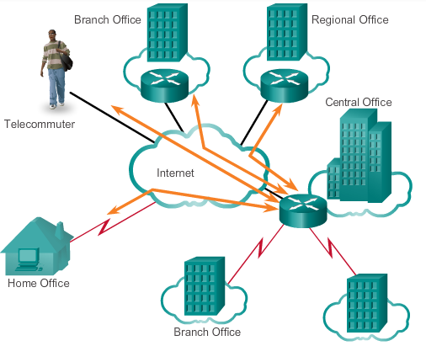
Purpose of WANs Distributed Networks (cont.)
Notes:
2.1.1.7 Distributed Network

Slide 16
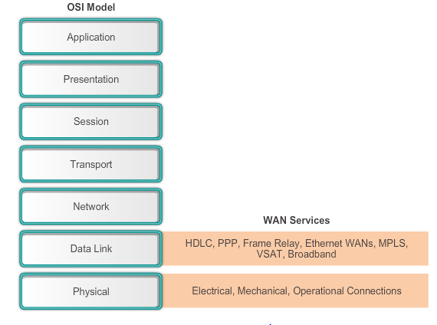
WAN Operations WANs in the OSI Model
WAN access standards typically describe both physical layer delivery methods and data link layer requirements, including physical addressing, flow control, and encapsulation.
Notes:
2.1.2.1 WANs in the OSI Model

Slide 17
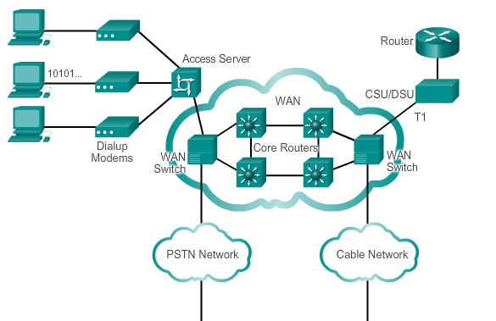
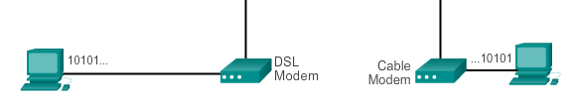
WAN Operations WAN Devices
Notes:
2.1.2.3 Common WAN Terminology

Slide 18
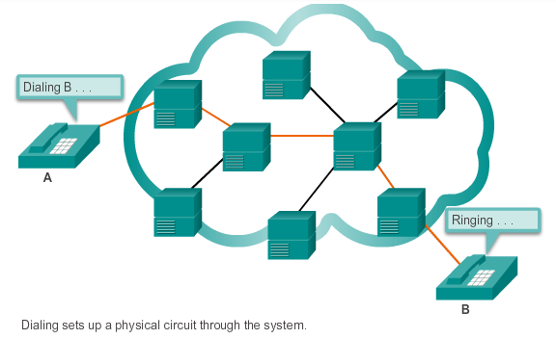
WAN Operations Circuit Switching
The two most common types of circuit-switched WAN technologies are the public switched telephone network (PSTN) and the Integrated Services Digital Network (ISDN).
Notes:
2.1.2.4 Circuit Switching

Slide 19
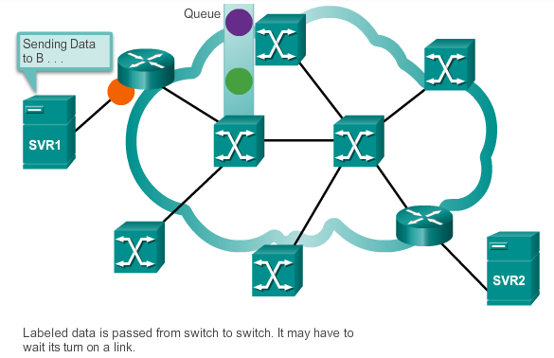
WAN Operations Packet Switching
Splits traffic data into packets that are routed over a shared network. Packet-switching allow many pairs of nodes to communicate over the same channel.
Notes:
2.1.2.5 Packet Switching

Slide 20
2.2 Selecting a WAN Technology
Notes:
2.2 Selecting a WAN Technology

Slide 21

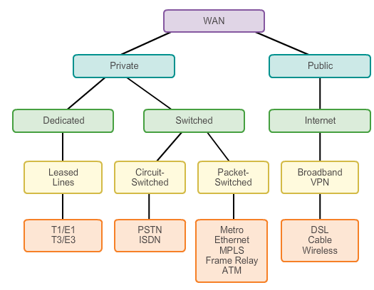
WAN Services WAN Link Connection Options
Notes:
2.2.1.1 WAN Link Connection Options

Slide 22
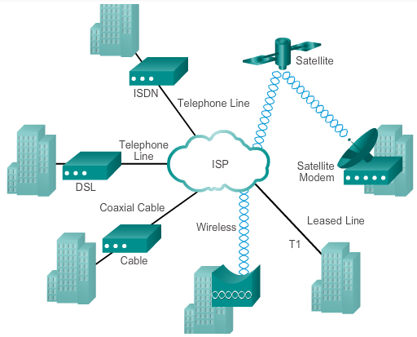
WAN Services Service-Provided Network Infrastructure
Notes:
2.2.1.2 Service Provider Network Infrastructure

Slide 23
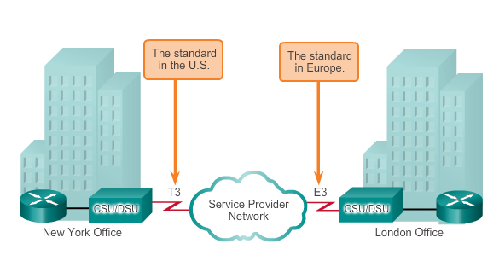
Private WAN Infrastructures Leased Lines
Advantages:
Simplicity
Quality
Availability
Disadvantages:
Cost
Limited flexibility
Notes:
2.2.2.1 Leased Lines

Slide 24
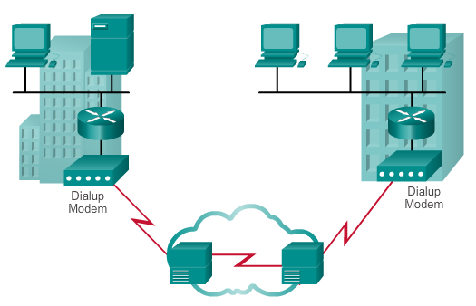
Private WAN Infrastructures Dialup
Advantages:
Simplicity
Availability
Low implementation cost
Disadvantages:
Low data rates
Relatively long connection time
Notes:
2.2.2.2 Dialup

Slide 25
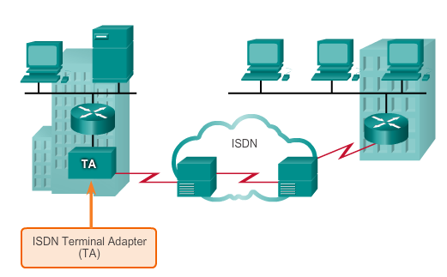
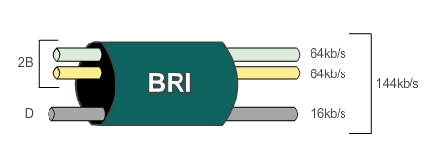
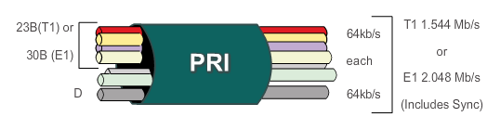
Private WAN Infrastructures ISDN
Sample ISDN Topology
ISDN BRI
ISDN PRI
Notes:
2.2.2.3 ISDN

Slide 26
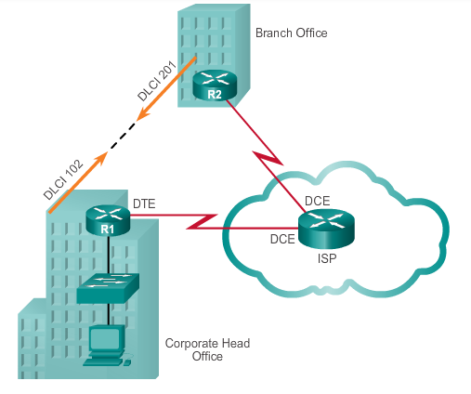
Private WAN Infrastructures Frame Relay
PVCs carry both voice and data traffic.
PVCs are uniquely identified by a data-link connection identifier (DLCI).
PVCs and DLCIs ensure bidirectional communication from one DTE device to another.
R1 uses DLCI 102 to reach R2 while R2 uses DLCI 201 to reach R1.
Notes:
2.2.2.4 Frame Relay

Slide 27
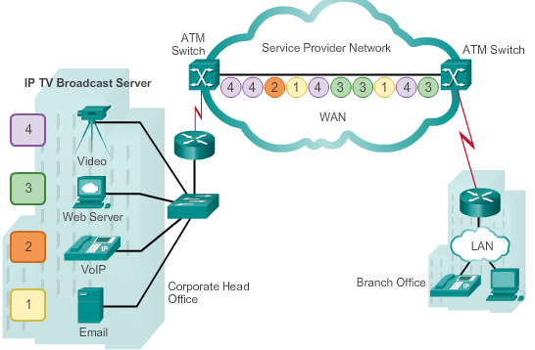
Private WAN Infrastructures ATM
Built on a cell-based architecture, rather than on a frame-based architecture. ATM cells are always a fixed length of 53 bytes.
Notes:
2.2.2.5 ATM

Slide 28
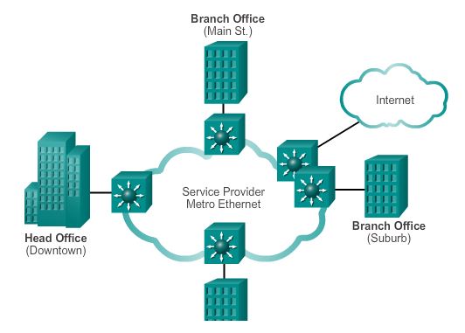
Private WAN Infrastructures Ethernet WAN
Features and Benefits of Ethernet WAN include:
Reduced expenses and administration
Easy integration with existing networks
Enhanced business productivity
Service providers now offer Ethernet WAN service using fiber-optic cabling.
Known as Metropolitan Ethernet (MetroE), Ethernet over MPLS (EoMPLS), and Virtual Private LAN Service (VPLS).
Note: Commonly used to replace the traditional Frame Relay and ATM WAN links.
Notes:
2.2.2.6 Ethernet WAN

Slide 29
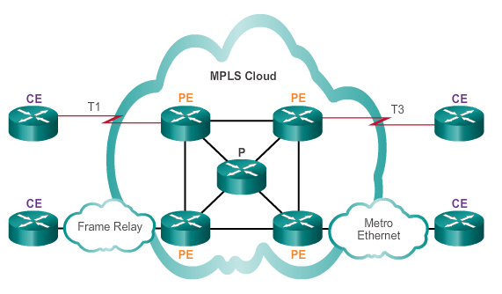
Private WAN Infrastructures MPLS
Multiprotocol Label Switching (MPLS) is a multiprotocol high-performance WAN technology that directs data from one router to the next, based on short path labels rather than IP network addresses.
Notes:
2.2.2.7 MPLS

Slide 30
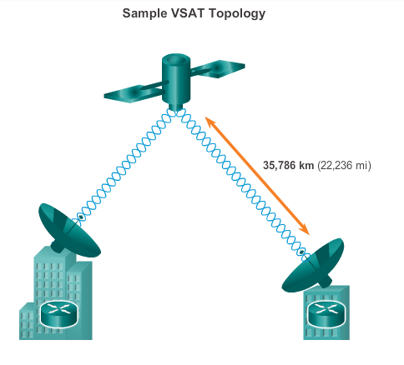
Private WAN Infrastructures VSAT
Very small aperture terminal (VSAT) - a solution that creates a private WAN using satellite communications.
Notes:
2.2.2.8 VSAT

Slide 31
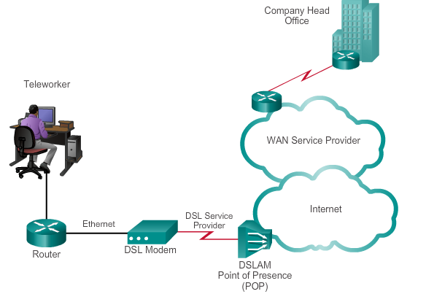
Private WAN Infrastructures DSL
Always-on connection technology that uses existing twisted-pair telephone lines to transport high-bandwidth data, and provides IP services to subscribers.
A DSL modem converts an Ethernet signal from the user device to a DSL signal, which is transmitted to the central office.
Notes:
2.2.3.1 DSL

Slide 32
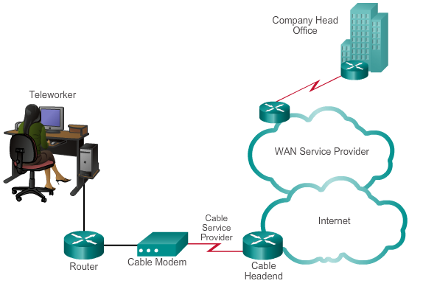
Private WAN Infrastructures Cable
Network access is available from some cable television networks.
Cable modems provide an always-on connection and a simple installation.
Notes:
2.2.3.2 Cable

Slide 33
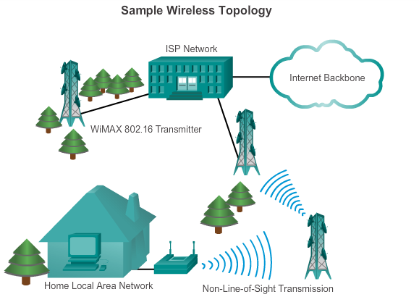
Private WAN Infrastructures Wireless
New developments in broadband wireless technology:
Municipal Wi-Fi – Many cities have begun setting up municipal wireless
WiMAX – Worldwide Interoperability for Microwave Access (WiMAX) is a new technology that is just beginning to come into use.
Satellite Internet
Notes:
2.2.3.3 Wireless

Slide 34
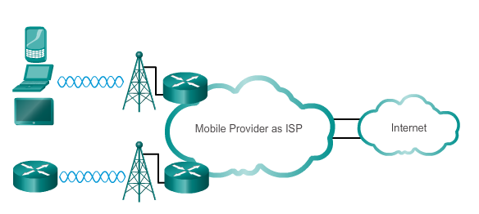
Private WAN Infrastructures 3G/4G Cellular
Common cellular industry terms include:
3G/4G Wireless – Abbreviation for 3rd generation and 4th generation cellular access. These technologies support wireless Internet access.
Long-Term Evolution (LTE) – A newer and faster technology, considered to be part of the 4th generation (4G) technology.
Notes:
2.2.3.4 3G/4G Cellular

Slide 35

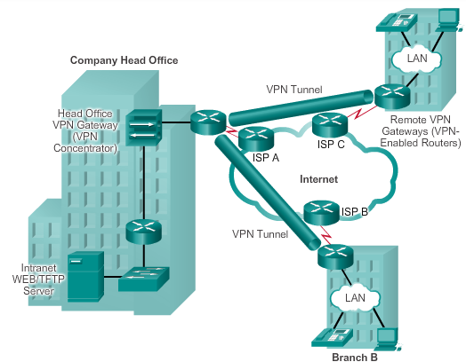
Private WAN Infrastructures VPN Technology
VPN is an encrypted connection between private networks over a public network.
Benefits:
Cost savings
Security
Scalability
Compatibility with broadband technology
Two types of VPN:
Site-to-site VPNs
Remote-access VPNs
Notes:
2.2.3.5 VPN Technology

Slide 36
Selecting WAN Services Choosing a WAN Link Connection
Answer the following questions when choosing a WAN Connection:
What is the purpose of the WAN?
What is the geographic scope?
What are the traffic requirements?
Notes:
2.2.4.1 Choosing a WAN Link Connection

Slide 37
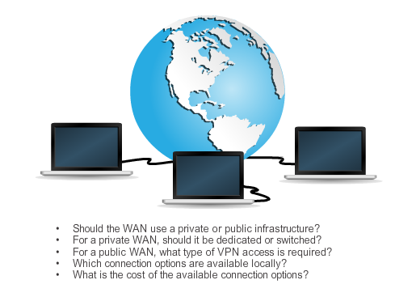
Selecting WAN Services Choosing a WAN Link Connection
Notes:
2.2.4.2 Choosing a WAN Link Connection

Slide 38
2.3 Summary
Notes:
2.3 Summary

Slide 39
Chapter 2: Summary
A business can use private lines or the public network infrastructure for WAN connections.
WAN access standards operate at layers 1 and 2 of the OSI model, and are defined and managed by the TIA/EIA, ISO, and IEEE.
A WAN may be circuit-switched or packet-switched.
There is common terminology used to identify the physical components of WAN connections and who, the service provider or the customer, is responsible for which components.
Service provider networks are complex and the service provider’s backbone networks consist primarily of high-bandwidth fiber optic media.
Notes:
Chapter 2 Summary

Slide 40
Chapter 2: Summary (cont.)
Permanent, dedicated point-to-point connections are provided by using leased lines.
Public infrastructure connections include DSL, cable, wireless, and 3G/4G cellular.
Security over public infrastructure connections can be provided by using remote-access or site-to-site VPNs.
Notes:
Chapter 2 Summary

Slide 41


