Slide 1
Chapter 3: Point-to-Point Connections
Connecting Networks
Notes:
Cisco Networking Academy program
Connecting Networks
Chapter 3: Point-to-Point Connections

Slide 2
Chapter 3
3.1 Serial Point-to-Point Overview
3.2 PPP Operation
3.3 Configuring PPP
3.4 Troubleshooting WAN Connectivity
3.5 Summary
Notes:
Chapter 5

Slide 3
Chapter 3: Objectives
In this chapter, you will be able to:
Explain the fundamentals of point-to-point serial communication across a WAN.
Configure HDLC encapsulation on a point-to-point serial link.
Describe the benefits of using PPP over HDLC in a WAN.
Describe the PPP layered architecture and the functions of LCP and NCP.
Explain how a PPP session is established.
Configure PPP encapsulation on a point-to-point serial link.
Configure PPP authentication protocols.
Use show and debug commands to troubleshoot PPP.
Notes:
Chapter 3 Objectives

Slide 4
3.1 Serial Point-to-Point Overview
Notes:
3.1 Serial Point-to-Point Overview

Slide 5
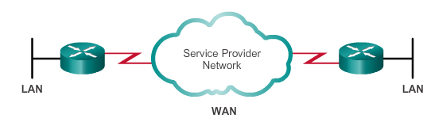
Serial Communications Serial and Parallel Ports
Point-to-point connections are used to connect LANs to service provider WANs.
Also referred to as a serial connection or leased-line connection.
Communications across a serial connection is a method of data transmissions in which the bits are transmitted sequentially over a single channel.
In parallel communications, bits can be transmitted simultaneously over multiple wires.
Notes:
3.1.1.1 Serial and Parallel Ports

Slide 6
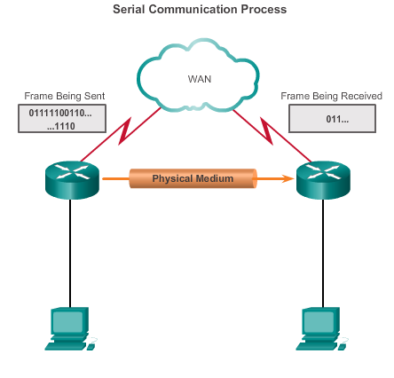
Serial Communications Serial Communication
On the WAN link, data is encapsulated by the protocol used by the sending router.
Encapsulated frame is sent on a physical medium to the WAN.
Receiving router uses the same communications protocol to de-encapsulate the frame when it arrives.
Three serial communication standards for LAN-to-WAN connections: RS-232, V.35, HSSI
Notes:
3.1.1.2 Serial Communication

Slide 7
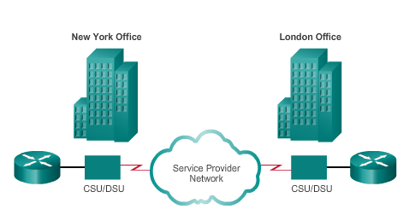
Serial Communications Point-to-Point Communication Links
Point-to-point links can connect two geographically distant sites.
Carrier dedicates specific resources for a line leased by the customer (leased-line).
Point-to-point links are usually more expensive than shared services.
Notes:
3.1.1.3 Point-to-Point Communication Links

Slide 8
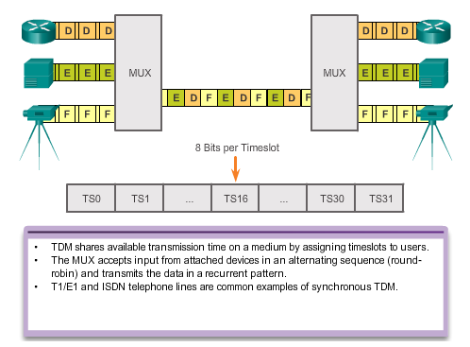
Serial Communications Time-Division Multiplexing
Multiplexing – A scheme that allows multiple logical signals to share a single physical channel.
Notes:
3.1.1.4 Time-Division Multiplexing

Slide 9
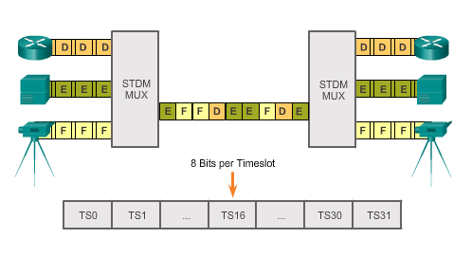
Serial Communications Statistical Time-Division Multiplexing
STDM uses a variable time-slot length, allowing channels to compete for any free slot space.
STDM does not waste high-speed line time with inactive channels using this scheme.
Notes:
3.1.1.5 Statistical Time-Division Multiplexing

Slide 10
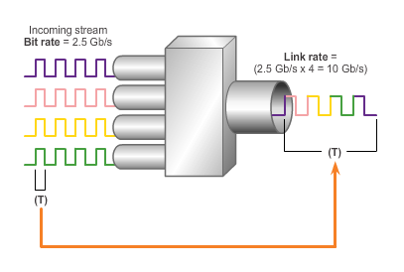
Serial Communications TDM Examples
The industry uses the Synchronous Optical Networking (SONET) or Synchronous Digital Hierarchy (SDH) standard for optical transport of TDM data.
Traffic arriving at the SONET multiplexer from four places at 2.5 Gb/s goes out as a single stream at 4 x 2.5 Gb/s or 10 Gb/s.
Example: TDM SONET
Notes:
3.1.1.6 TDM Examples

Slide 11
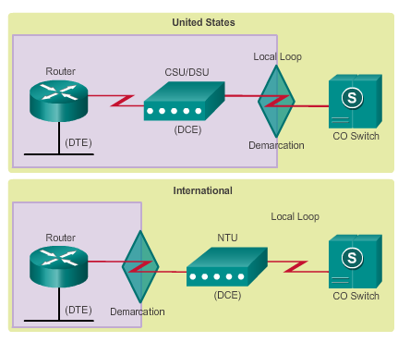
Serial Communications Demarcation Point
Marks the point where your network interfaces with a network that is owned by another organization
Interface between CPE and network service provider equipment
Point in the network where the responsibility of the service provider ends
Notes:
3.1.1.7 Demarcation Point

Slide 12
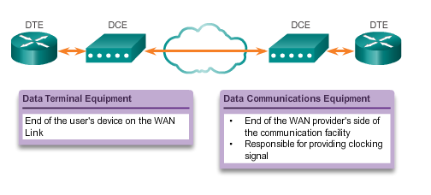
Serial Communications DTE-DCE
DTE – Commonly CPE, generally a router, could also be a terminal, computer, printer, or fax machine if they connect directly to the service provider network.
DCE – Commonly a modem or CSU/DSU, it is a device used to convert the user data from the DTE into a form acceptable to the WAN service provider transmission link. The signal is received at the remote DCE, which decodes the signal back into a sequence of bits; the remote DCE then signals this sequence to the remote DTE.
Notes:
3.1.1.8 DTE-DCE

Slide 13
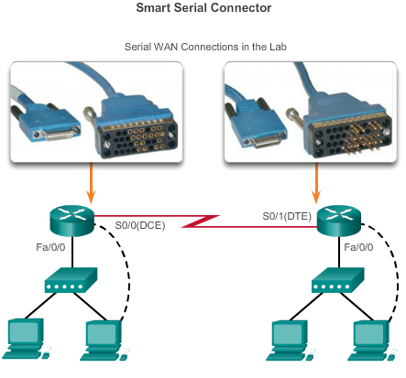
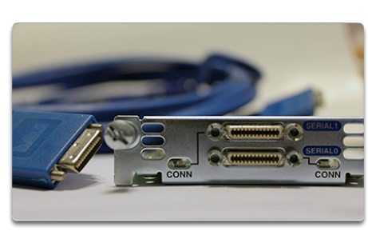
Serial Communications Serial Cables
Notes:
3.1.1.9 Serial Cables

Slide 14
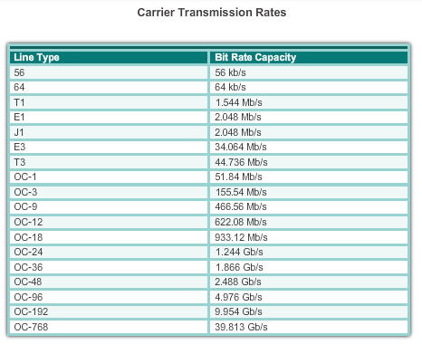
Serial Communications Serial Bandwidth
Bandwidth refers to the rate at which data is transferred over the communication link.
Notes:
3.1.1.10 Serial Bandwidth

Slide 15
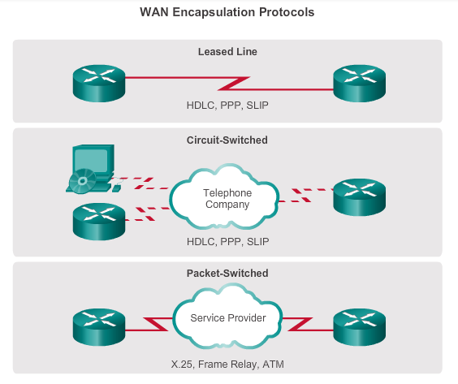
HDLC Encapsulation WAN Encapsulation Protocols
Data is encapsulated into frames before crossing the WAN link; an appropriate Layer 2 encapsulation type must be configured.
Notes:
3.1.2.1 WAN Encapsulation Protocols

Slide 16
HDLC Encapsulation HDLC Encapsulation
Bit-oriented, synchronous data link layer protocol developed by the International Organization for Standardization (ISO).
Uses synchronous serial transmission to provide error-free communication between two points.
Defines a Layer 2 framing structure that allows for flow control and error control through the use of acknowledgments.
Cisco has developed an extension to the HLDC protocol to solve the inability to provide multiprotocol support (Cisco HLDC also referred to as cHDLC).
Notes:
3.1.2.2 HDLC Encapsulation

Slide 17
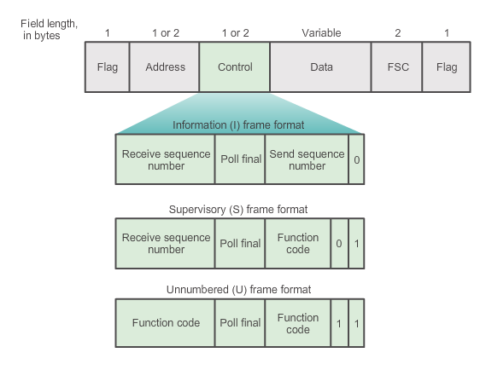
HDLC Encapsulation HDLC Frame Types
The Flag field initiates and terminates error checking, and the frame always starts and ends with an 8-bit flag field, 01111110.
I-frames carry upper layer information and some control information; sends and receives sequence numbers, and the poll final (P/F) bit performs flow and error control.
S-frames provide control information – Request and suspend transmission, report on status, and acknowledge receipt of I-frame.
U-frames support control purposes and are not sequenced.
Notes:
3.1.2.3 HDLC Frame Types

Slide 18
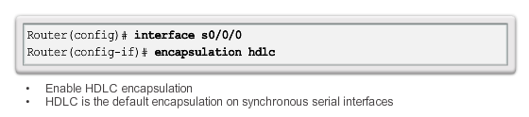
HDLC Encapsulation Configuring HDLC Encapsulation
Default encapsulation method used by Cisco devices on synchronous serial lines
Point-to-point protocol on leased lines between two Cisco devices
Connecting to a non-Cisco device, use synchronous PPP
Notes:
3.1.2.4 Configuring HDLC Encapsulation

Slide 19
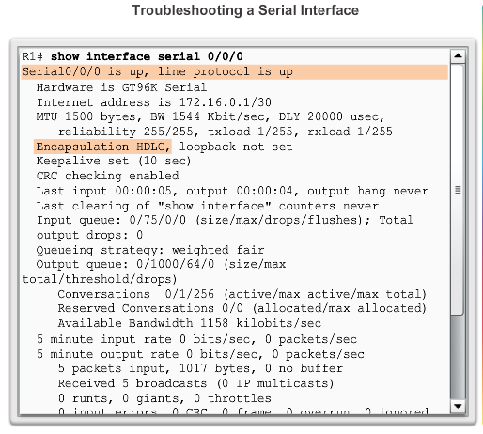
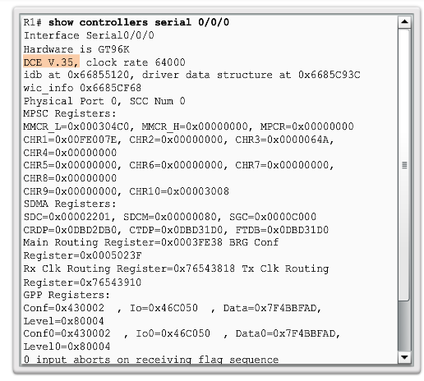
HDLC Encapsulation Troubleshooting a Serial Interface
Notes:
3.1.2.5 Troubleshooting a Serial Interface

Slide 20

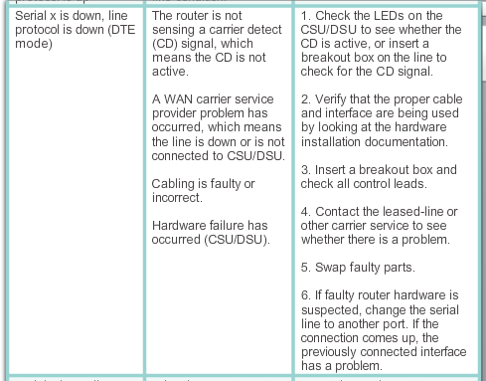
HDLC Encapsulation Troubleshooting a Serial Interface (cont.)
Notes:
3.1.2.5 Troubleshooting a Serial Interface

Slide 21

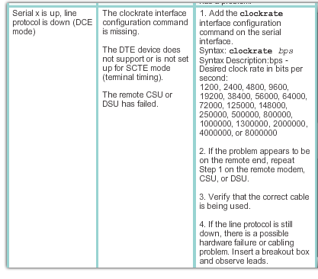
HDLC Encapsulation Troubleshooting a Serial Interface (cont.)
Notes:
3.1.2.5 Troubleshooting a Serial Interface

Slide 22
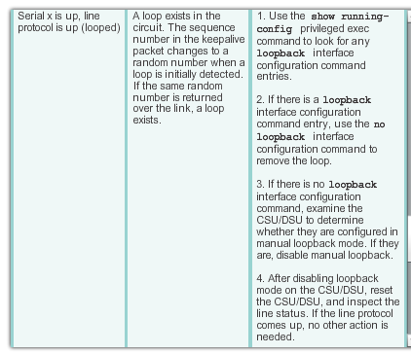

HDLC Encapsulation Troubleshooting a Serial Interface (cont.)
Notes:
3.1.2.5 Troubleshooting a Serial Interface

Slide 23
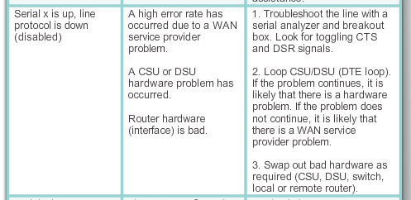
HDLC Encapsulation Troubleshooting a Serial Interface (cont.)
Notes:
3.1.2.5 Troubleshooting a Serial Interface

Slide 24
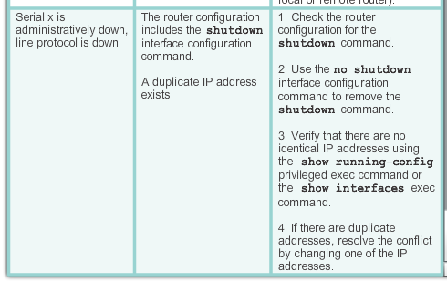
HDLC Encapsulation Troubleshooting a Serial Interface (cont.)
Notes:
3.1.2.5 Troubleshooting a Serial Interface

Slide 25
3.2 PPP Operation
Notes:
3.2 PPP Operation

Slide 26
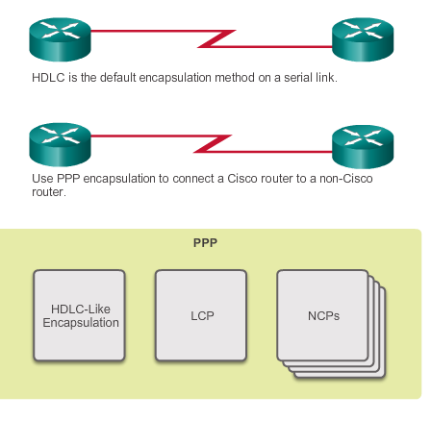
Benefits of PPP Introducing PPP
PPP contains three main components:
HDLC protocol for encapsulating datagrams over point-to-point links
Extensible Link Control Protocol (LCP) to establish, configure, and test the data link connection
Family of Network Control Protocols (NCPs) to establish and configure different network layer protocols (IPv4, IPv6, AppleTalk, Novell IPX, and SNA Control Protocol)
Notes:
3.2.1.1 Introducing PPP

Slide 27
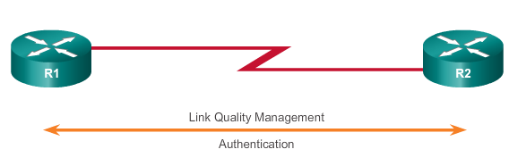
Benefits of PPP Advantages of PPP
PPP not proprietary
PPP includes many features not available in HDLC
Link quality management feature monitors the quality of the link. If too many errors are detected, PPP takes down the link
Supports PAP and CHAP authentication
Notes:
3.2.1.2 Advantages of PPP

Slide 28
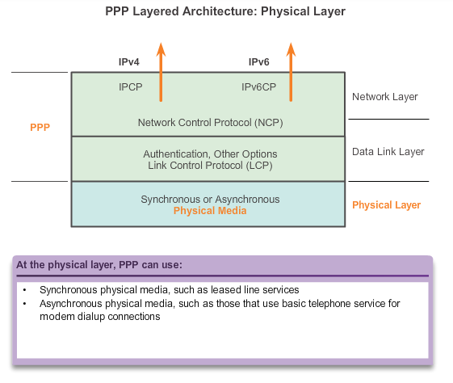
LCP and NCP PPP Layered Architecture
LCP sets up the PPP connection and its parameters
NCPs handle higher layer protocol configurations
LCP terminates the PPP connection
Notes:
3.2.2.1 PPP Layered Architecture

Slide 29
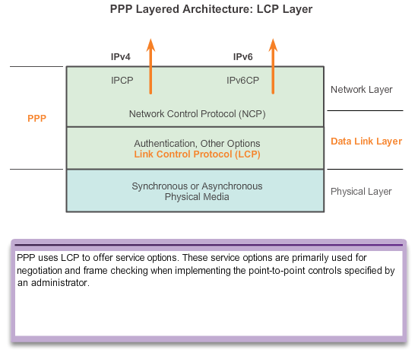
LCP and NCP PPP Control Protocol (LCP)
LCP provides automatic configuration of the interfaces at each end, including:
Handling varying limits on packet size.
Detecting common misconfiguration errors.
Terminating the link.
Determining when a link is functioning properly or when it is failing.
Notes:
3.2.2.2 PPP – Link Control Protocol (LCP)

Slide 30
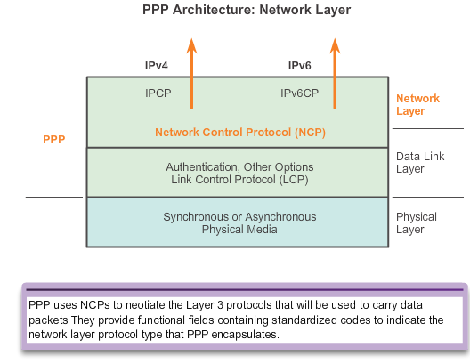
LCP and NCP PPP Network Control Protocol (NCP)
PPP permits multiple network layer protocols to operate on the same communications link.
For every network layer protocol used, PPP uses a separate NCP.
Notes:
3.2.2.3 PPP – Network Control Protocol (NCP)

Slide 31
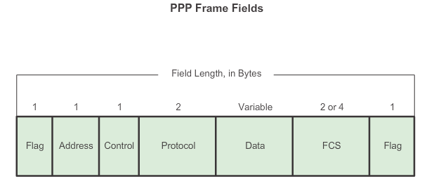
LCP and NCP PPP Frame Structure
Notes:
3.2.2.4 PPP Frame Structure

Slide 32
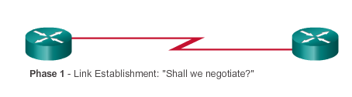
PPP Sessions Establishing a PPP Session
Phase 1 – LCP must first open the connection and negotiate configuration options; it completes when the receiving router sends a configuration-acknowledgment frame back to the router initiating the connection.
Notes:
3.2.3.1 Establishing a PPP Session

Slide 33
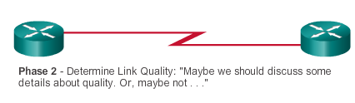
PPP Sessions Establishing a PPP Session (cont.)
Phase 2 – LCP tests the link to determine whether the link quality is sufficient to bring up network layer protocols.
Notes:
3.2.3.1 Establishing a PPP Session

Slide 34
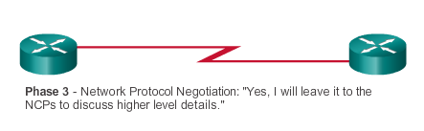
PPP Sessions Establishing a PPP Session (cont.)
Phase 3 – After the LCP has finished the link quality determination phase, the appropriate NCP can separately configure the network layer protocols, and bring them up and take them down at any time.
Notes:
3.2.3.1 Establishing a PPP Session

Slide 35
PPP Sessions LCP Operation
LCP operation includes provisions for link establishment, link maintenance, and link termination.
LCP operation uses three classes of LCP frames to accomplish the work of each of the LCP phases:
Link-establishment frames establish and configure a link.
Configure-Request, Configure-Ack, Configure-Nak, and Configure-Reject
Link-maintenance frames manage and debug a link.
Code-Reject, Protocol-Reject, Echo-Request, Echo-Reply, and Discard-Request
Link-termination frames terminate a link.
Terminate-Request and Terminate-Ack
Notes:
3.2.3.2 LCP Operation

Slide 36
PPP Sessions LCP Operation (cont.)
During link maintenance, LCP can use messages to provide feedback and test the link.
Echo-Request, Echo-Reply, and Discard-Request can be used to test the link.
Code-Reject and Protocol-Reject provides feedback when one device receives an invalid frame due to either an unrecognized LCP code (LCP frame type) or a bad protocol identifier.
Notes:
3.2.3.2 LCP Operation

Slide 37
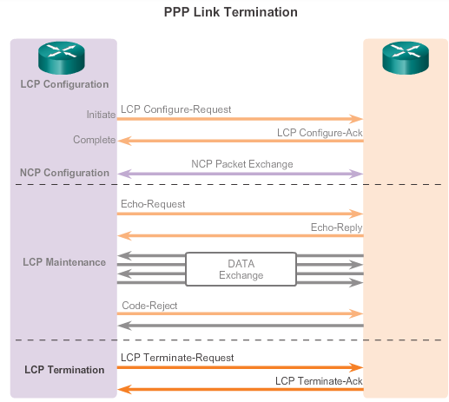
PPP Sessions LCP Operation (cont.)
Notes:
3.2.3.2 LCP Operation

Slide 38
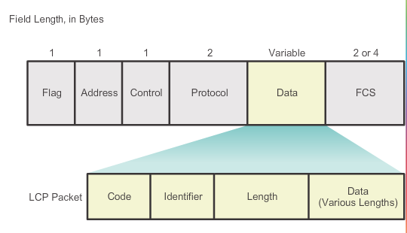
PPP Sessions LCP Packet
Notes:
3.2.3.3 LCP Packet

Slide 39
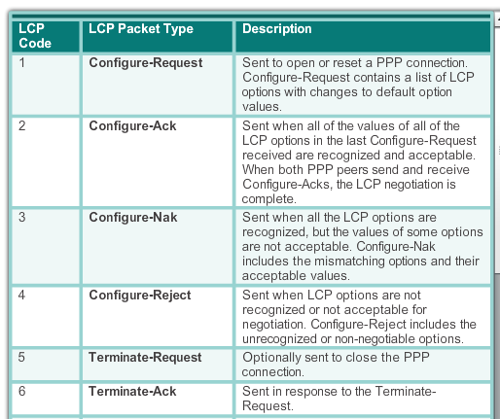
PPP Sessions LCP Packet
Notes:
3.2.3.3 LCP Packet

Slide 40

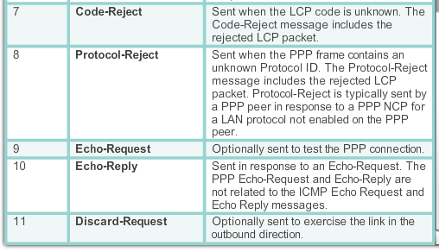
PPP Sessions LCP Packet (cont.)
Notes:
3.2.3.3 LCP Packet

Slide 41
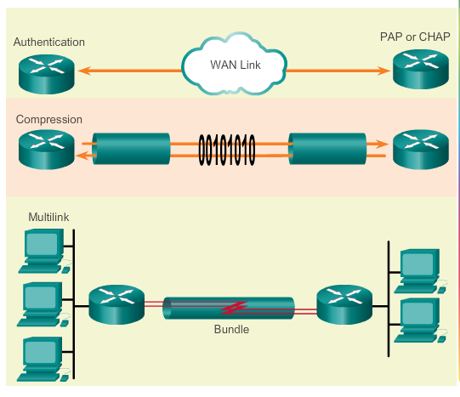
PPP Sessions PPP Configuration Options
Optional functions include:
Authentication using either PAP or CHAP
Compression using either Stacker or Predictor
Multilink that combines two or more channels to increase the WAN bandwidth
Notes:
3.2.3.4 PPP Configuration Options

Slide 42
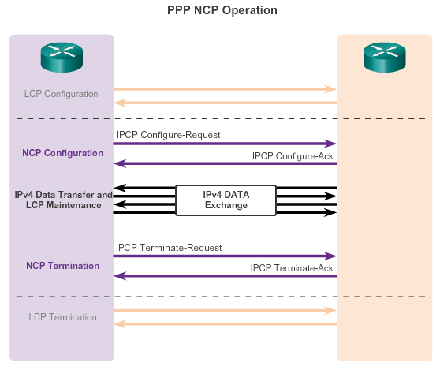
PPP Sessions NCP Explained
Notes:
3.2.3.5 NCP Explained

Slide 43
3.3 Configuring PPP
Notes:
3.3 Configuring PPP

Slide 44
Configure PPP PPP Configuration Options
Authentication – Two authentication choices are Password Authentication Protocol (PAP) and Challenge Handshake Authentication Protocol (CHAP).
Compression – Increases the effective throughput on PPP connections by reducing the amount of data in the frame that must travel across the link. The protocol decompresses the frame at its destination. Two compression protocols available in Cisco routers are Stacker and Predictor.
Error detection – Identifies fault conditions. The Quality and Magic Number options help ensure a reliable, loop-free data link. The Magic Number field helps in detecting links that are in a looped-back condition. Magic numbers are generated randomly at each end of the connection.
Notes:
3.3.1.1 PPP Configuration Options

Slide 45
Configure PPP PPP Configuration Options
PPP Callback – PPP callback is used to enhance security. With this LCP option, a Cisco router can act as a callback client or a callback server. The client makes the initial call, requests that the server call it back, and terminates its initial call. The callback router answers the initial call and makes the return call to the client based on its configuration statements. The command is ppp callback [accept | request].
Multilink – This alternative provides load balancing over the router interfaces that PPP uses. Multilink PPP provides a method for spreading traffic across multiple physical WAN links while providing packet fragmentation and reassembly, proper sequencing, multivendor interoperability, and load balancing on inbound and outbound traffic.
Notes:
3.3.1.1 PPP Configuration Options

Slide 46
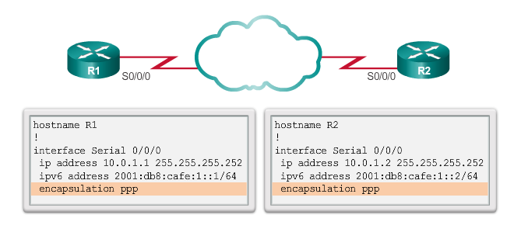
Configure PPP PPP Basic Configuration Command
Notes:
3.3.1.2 PPP Basic Configuration Command

Slide 47
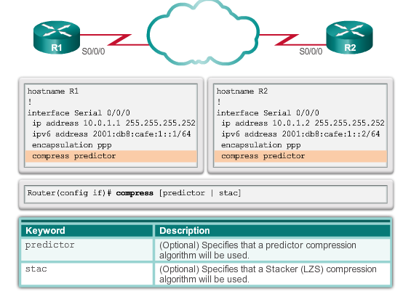
Configure PPP PPP Compression Commands
Notes:
3.3.1.3 PPP Compression Commands

Slide 48
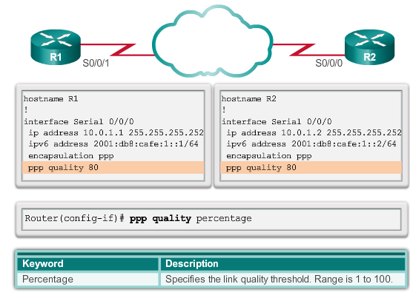
Configure PPP PPP Link Quality Monitoring Command
The ppp quality percentage command ensures that the link meets the quality requirement set; otherwise, the link closes down.
Notes:
3.3.1.4 PPP Link Quality Monitoring Command

Slide 49

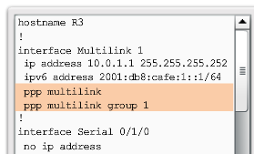
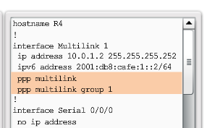
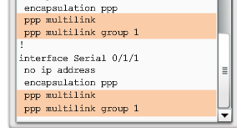
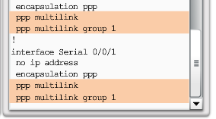
Configure PPP PPP Multilink Commands
Notes:
3.3.1.5 PPP Multilink Commands

Slide 50
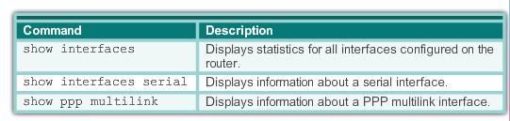
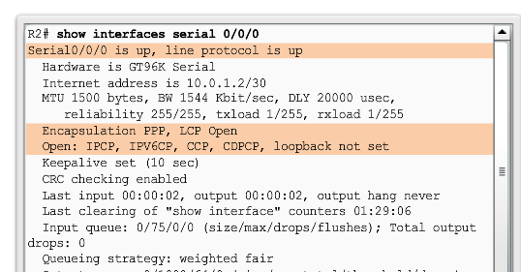
Configure PPP Verifying PPP Configuration
Notes:
3.3.1.6 Verifying PPP Configuration

Slide 51
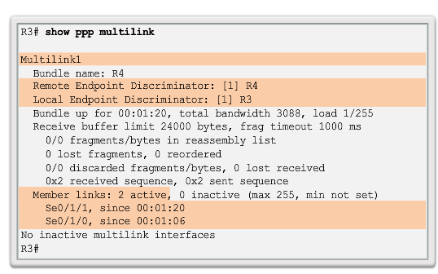
Configure PPP Verifying PPP Configuration (cont.)
The output indicates the interface Multilink 1, the hostnames of both the local and remote endpoints, and the serial interfaces assigned to the multilink bundle.
Notes:
3.3.1.6 Verifying PPP Configuration

Slide 52
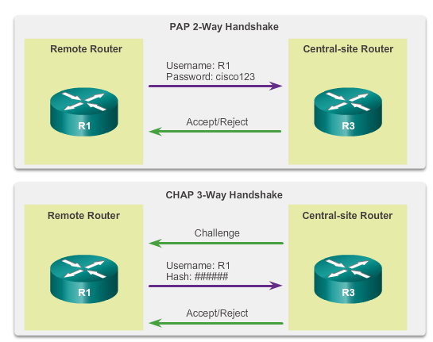
PPP Authentication PPP Authentication Protocols
Notes:
3.3.2.1 PPP Authentication Protocols

Slide 53
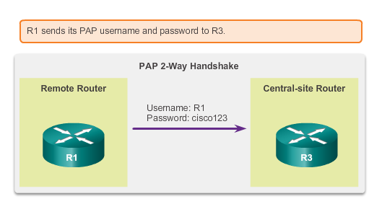
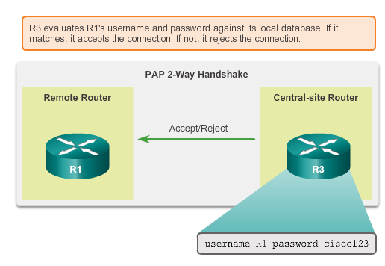
PPP Authentication Password Authentication Protocol (PAP)
Initiating PAP
Completing PAP
Notes:
3.3.2.2 Password Authentication Protocol (PAP)

Slide 54
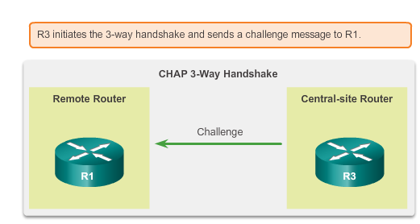

PPP Authentication Challenge Handshake Authentication Protocol
Initiating CHAP
Responding CHAP
Notes:
3.3.2.3 Challenge Handshake Authentication Protocol (CHAP)

Slide 55

PPP Authentication CHAP (cont.)
Completing CHAP
Notes:
3.3.2.3 Challenge Handshake Authentication Protocol (CHAP)

Slide 56

PPP Authentication PPP Encapsulation and Authentication Process
Notes:
3.3.2.4 PPP Encapsulation and Authentication Process

Slide 57

PPP Authentication Configuring PPP Authentication
Notes:
3.3.2.5 Configuring PPP Authentication

Slide 58

PPP Authentication Configuring PPP Authentication (cont.)
Notes:
3.3.2.6 Configuring PPP with Authentication

Slide 59

PPP Authentication Configuring PPP Authentication (cont.)
Notes:
3.3.2.6 Configuring PPP with Authentication

Slide 60
3.4 Troubleshooting WAN Connectivity
Notes:
3.4 Troubleshooting WAN Connectivity

Slide 61


Troubleshoot PPP Troubleshooting PPP Serial Encapsulation
Notes:
3.4.1.1 Troubleshooting PPP Serial Encapsulation

Slide 62

Troubleshoot PPP Troubleshooting a PPP Configuration with Authentication
Notes:
3.4.1.2/.3 Debug PPP/Troubleshooting a PPP Configuration with Authentication

Slide 63
Chapter 3: Summary
Point-to-Point links are usually more expensive than shared services; however, the benefits may outweigh the costs. Constant availability is important for some protocols, such as VoIP.
SONET is an optical network standard that uses STDM for efficient use of bandwidth.
The demarcation point is the point in the network where the responsibility of the service provider ends and the responsibility of the customer begins. The CPE, usually a router, is the DTE device. The DCE is usually a modem or CSU/DSU.
Cisco HDLC is a bit-oriented synchronous data link layer protocol extension of HDLC and is used by many vendors to provide multiprotocol support. This is the default encapsulation method used on Cisco synchronous serial lines.
Synchronous PPP is used to connect to non-Cisco devices, to monitor link quality, provide authentication, or bundle links for shared use
LCP is the PPP protocol used to establish, configure, test and terminate the data link connection. LCP can optionally authenticate a peer using PAP or CHAP.
Notes:
Chapter 3 Summary

Slide 64


