Slide 1
Chapter 4: Frame Relay
Connecting Networks
Notes:
Cisco Networking Academy program
Connecting Networks
Chapter 4: Frame Relay

Slide 2
Chapter 4
4.0 Introduction
4.1 Introduction to Frame Relay
4.2 Configuring Frame Relay
4.3 Troubleshooting Connectivity
4.4 Summary
Notes:
Chapter 4

Slide 3
Chapter 4: Objectives
Describe the fundamental concepts of Frame Relay technology, including operation, implementation requirements, maps, and Local Management Interface (LMI) operation.
Configure a basic Frame Relay permanent virtual circuit (PVC), including configuring and troubleshooting Frame Relay on a router serial interface and configuring a static Frame Relay map.
Describe advanced concepts of Frame Relay technology, including subinterfaces, bandwidth, and flow control.
Configure an advanced Frame Relay PVC, including solving reachability issues, configuring subinterfaces, and verifying and troubleshooting a Frame Relay configuration.
Notes:
Chapter 4: Objectives

Slide 4
4.1 Introduction to Frame Relay
Notes:
Cisco Networking Academy program
Connecting Networks
Chapter 4: Frame Relay

Slide 5
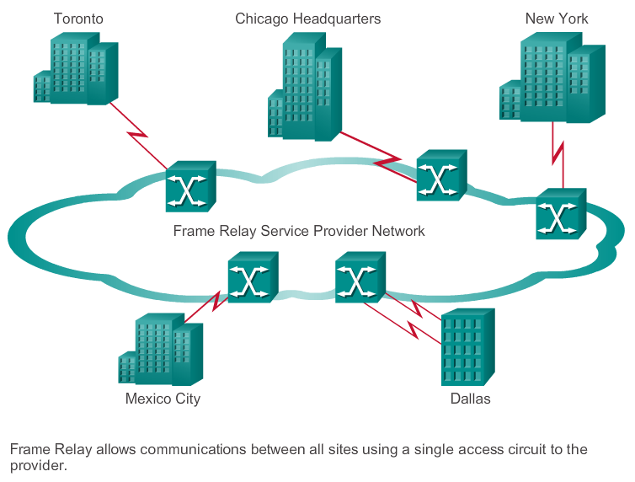
Benefits of Frame Relay Introducing Frame Relay
Notes:
4.1.1.1 Introducing Frame Relay

Slide 6
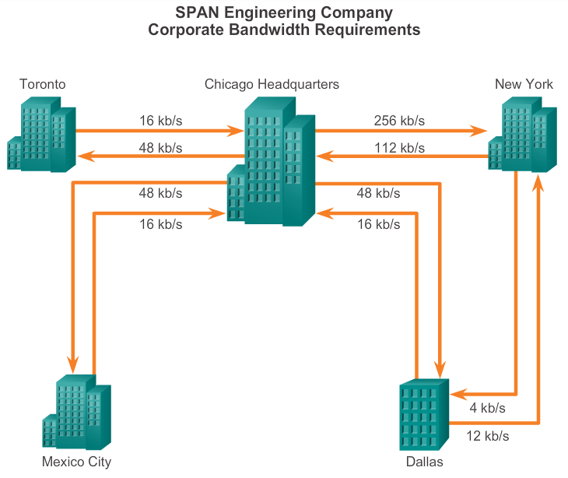
Benefits of Frame Relay Benefits of Frame Relay WAN Technology
Notes:
4.1.1.2 Benefits of Frame Relay WAN Technology

Slide 7
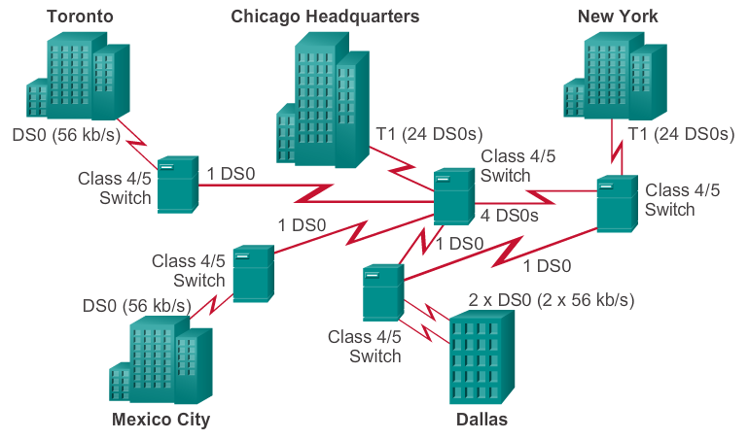
Benefits of Frame Relay Dedicated Line Requirements
Notes:
4.1.1.3 Dedicated Line Requirements

Slide 8
Benefits of Frame Relay Frame Relay Cost Effectiveness and Flexibility
With dedicated lines, customers pay for an end-to-end connection, which includes the local loop and the network link. With Frame Relay, customers only pay for the local loop, and for the bandwidth, they purchase from the network provider.
Frame Relay shares bandwidth across a larger base of customers. Typically, a network provider can service 40 or more 56 kb/s customers over one T1 circuit. Using dedicated lines would require more CSU/DSUs (one for each line) and more complicated routing and switching.
Notes:
4.1.1.4 Cost Effectiveness and Flexibility of Frame Relay

Slide 9
Frame Relay Operation Virtual Circuits
Switched virtual circuits (SVC) – Established dynamically by sending signaling messages to the network.
Permanent virtual circuits (PVCs) – Preconfigured by the carrier, and after they are set up, only operate in DATA TRANSFER and IDLE modes.
VCs are identified by DLCIs. Frame Relay DLCIs have local significance, which means that the values are not unique in the Frame Relay WAN. A DLCI identifies a VC to the equipment at an endpoint.
A DLCI has no significance beyond the single link.
Notes:
4.1.2.1 Virtual Circuits

Slide 10
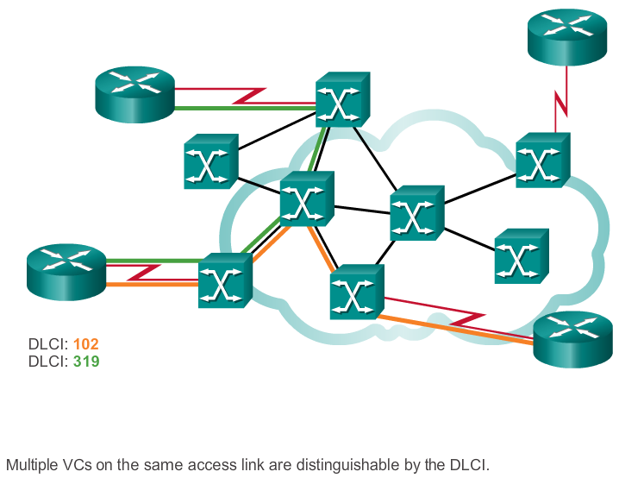
Frame Relay Operation Multiple Virtual Circuits
Notes:
4.1.2.2 Multiple Virtual Circuits

Slide 11
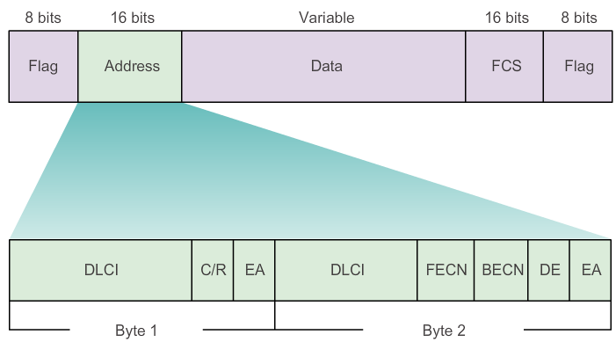
Frame Relay Operation Frame Relay Encapsulation
Notes:
4.1.2.3 Frame Relay Encapsulation

Slide 12
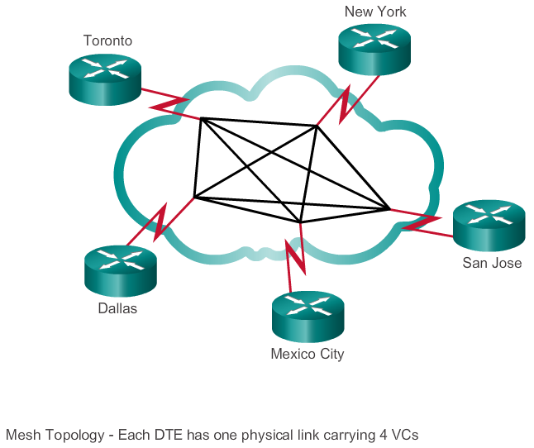
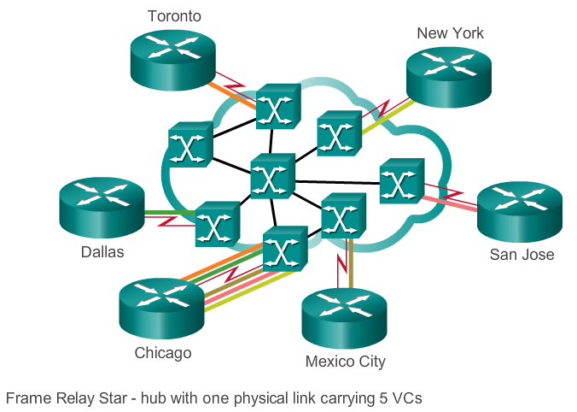
Frame Relay Operation Frame Relay Topologies
Notes:
4.1.2.4 Frame Relay Topologies
4.1.2.5 Frame Relay Topologies (Cont.)

Slide 13
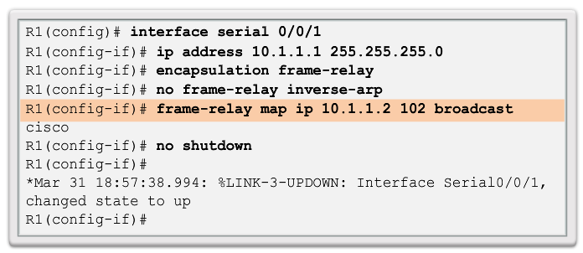
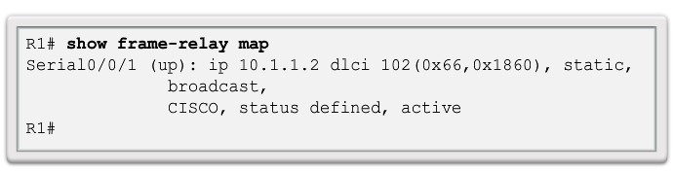
Frame Relay Operation Frame Relay Address Mapping
Notes:
4.1.2.6 Frame Relay Address Mapping

Slide 14
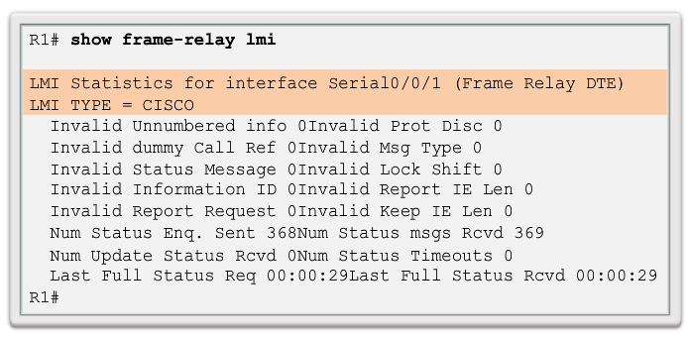
Frame Relay Operation Local Management Interface (LMI)
Notes:
4.1.2.7 Local Management Interface (LMI)

Slide 15
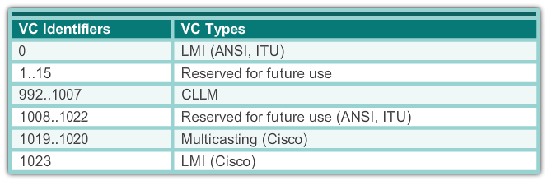
Frame Relay Operation LMI Extensions
VC status messages
Multicasting
Global addressing
Simple flow control
Notes:
4.1.2.8 LMI Extensions

Slide 16
Frame Relay Operation Using LMI and Inverse ARP to Map Addresses
The Inverse ARP request includes the source hardware, source Layer 3 protocol address, and the known target hardware address.
The Inverse ARP request fills the target Layer 3 protocol address field with all zeroes. It encapsulates the packet for the specific network and sends it directly to the destination device using the VC.
Upon receiving an Inverse ARP request, the destination device uses the source device’s address to create its own DLCI-to-Layer 3 map.
It then sends an Inverse ARP response that includes its Layer 3 address information.
When the source device receives the Inverse ARP response, it completes the DLCI-to-Layer 3 map using the provided information.
Notes:
4.1.2.9 Using LMI and Inverse ARP to Map Addresses

Slide 17
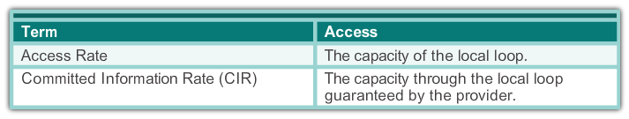
Advanced Frame Relay Concepts Access Rate and Committed Information Rate
Notes:
4.1.3.1 Access Rate and Committed Information Rate

Slide 18
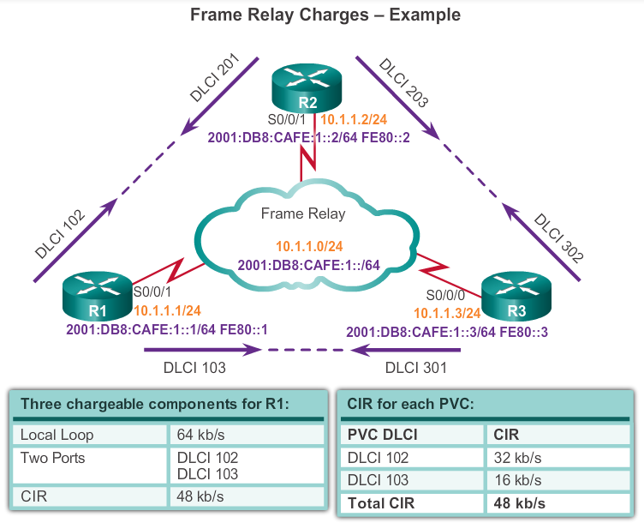
Advanced Frame Relay Concepts Frame Relay Example
Notes:
4.1.3.2 Frame Relay Example

Slide 19
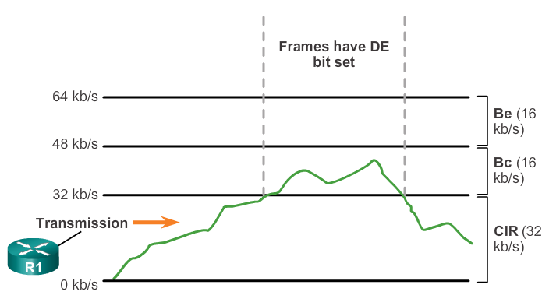
Advanced Frame Relay Concepts Bursting
Notes:
4.1.3.3 Bursting

Slide 20
Advanced Frame Relay Concepts Frame Relay Flow Control
When the DCE sets the BECN bit to 1, it notifies devices in the direction of the source (upstream) that there is congestion on the network.
When the DCE sets the FECN bit to 1, it notifies devices in the direction of the destination (downstream) that there is congestion on the network.
DTE devices can set the value of the DE bit to 1 to indicate that the frame has lower importance than other frames. When the network becomes congested, DCE devices discard the frames with the DE bit set to 1 before discarding those that do not.
Notes:
4.1.3.4 Frame Relay Flow Control

Slide 21
4.2 Configuring Frame Relay
Notes:
Cisco Networking Academy program
Connecting Networks
Chapter 4: Frame Relay

Slide 22
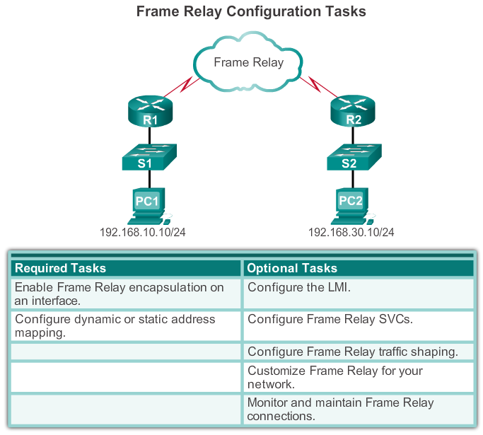
Configure Basic Frame Relay Basic Frame Relay Configuration Steps
Notes:
4.2.1.1 Basic Frame Relay Configuration Commands

Slide 23
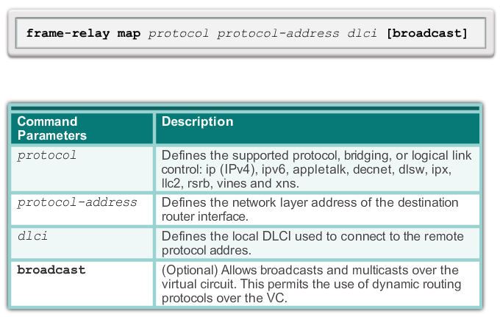
Configure Basic Frame Relay Configuring a Static Frame Relay Map
Notes:
4.2.1.2 Configuring a Static Frame Relay Map

Slide 24
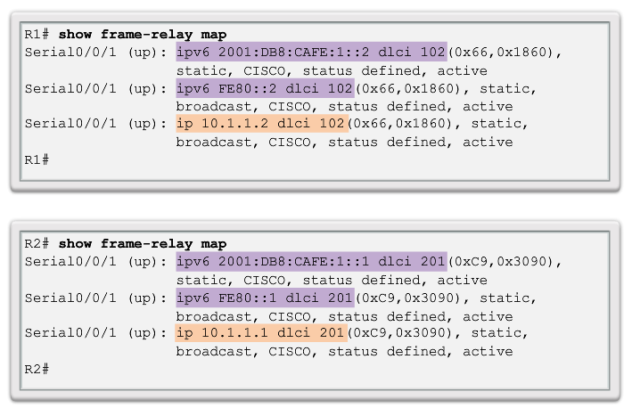
Configure Basic Frame Relay Verifying a Static Frame Relay Map
Notes:
4.2.1.3 Verify a Static Frame Relay Map

Slide 25
Configure Subinterfaces Reachability Issues
Frame Relay networks provide NBMA connectivity, using a hub-and-spoke topology, between remote sites. In an NBMA Frame Relay topology, when a single multipoint interface must be used to interconnect multiple sites, routing update reachability issues may result.
Reachability Issues:
Split horizon
Broadcast/multicast replication
Neighbor Discovery: DR and BDR
Notes:
4.2.2.1 Reachability Issues

Slide 26
Configure Subinterfaces Solving Reachability Issues
Disable split horizon – One method for solving the reachability issues that are produced by split horizon may be to turn off split horizon; however, disabling split horizon increases the chances of routing loops in your network.
Full-meshed topology – Another method is to use a full-meshed topology; however, this topology increases costs.
Subinterfaces – In a hub-and-spoke Frame Relay topology, the hub router can be configured with logically assigned interfaces called subinterfaces.
Notes:
4.2.2.2 Solving Reachability Issues

Slide 27
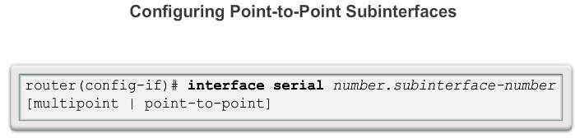
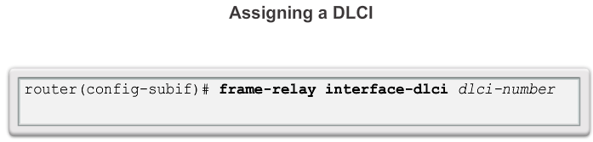
Configure Subinterfaces Configuring Point-to-Point Subinterfaces
Notes:
4.2.2.3 Configuring Point-to-Point Subinterfaces

Slide 28
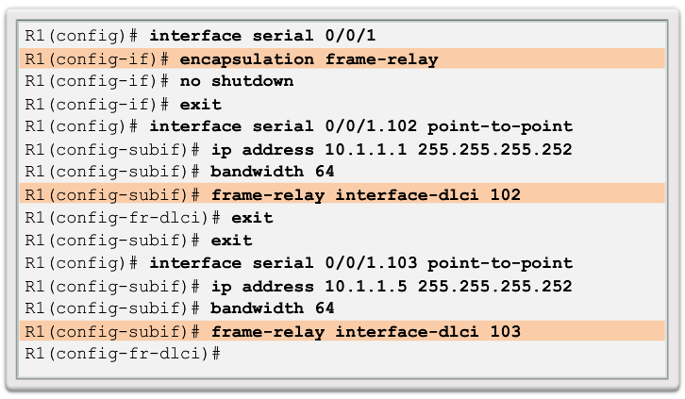
Configure Subinterfaces Example: Configuring Point-to-Point Subinterfaces
Notes:
4.2.2.4 Example: Configuring Point-to-Point Subinterfaces

Slide 29
4.3 Troubleshooting Connectivity
Notes:
Cisco Networking Academy program
Connecting Networks
Chapter 4: Frame Relay

Slide 30
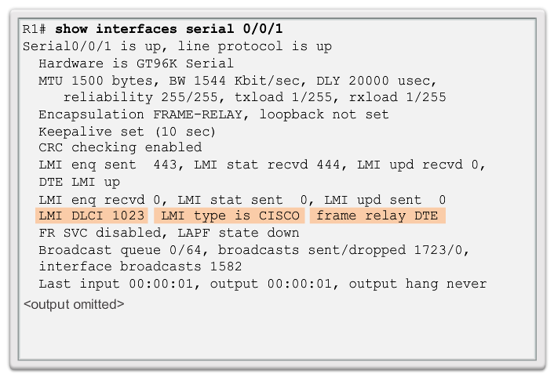
Troubleshoot Frame Relay Verifying Frame Relay Operation: Frame Relay Interface
Notes:
4.3.1.1 Verifying Frame Relay Operation: Frame Relay Interface

Slide 31
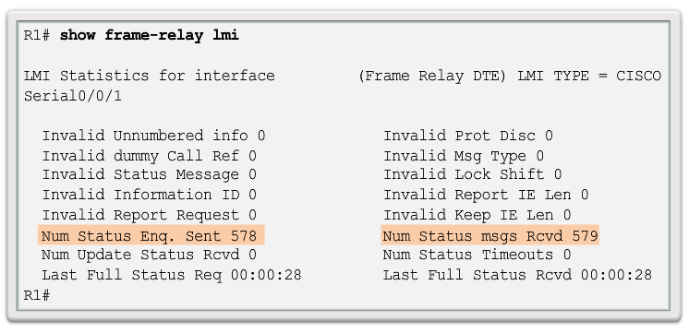
Troubleshoot Frame Relay Verifying Frame Relay Operation: LMI Operations
Notes:
4.3.1.2 Verifying Frame Relay Operation: LMI Operations

Slide 32
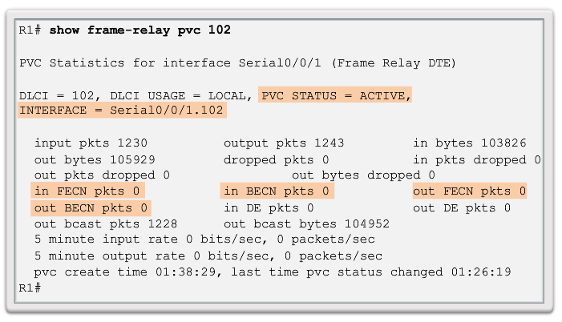
Troubleshoot Frame Relay Verifying Frame Relay Operation: PVC Status
Notes:
4.3.1.3 Verifying Frame Relay Operation: PVC Status

Slide 33
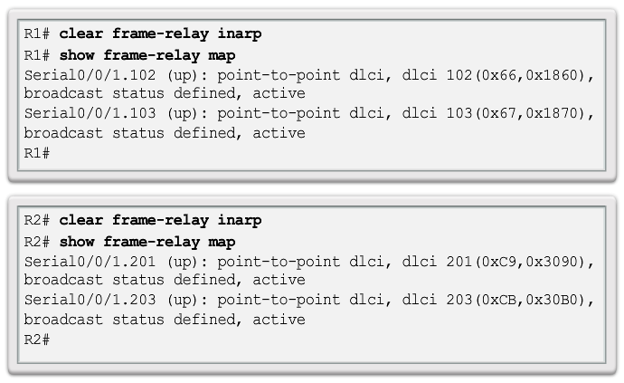
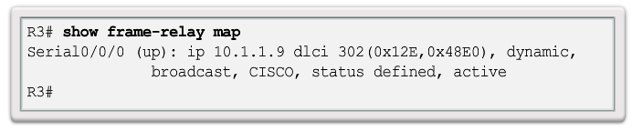
Troubleshoot Frame Relay Verifying Frame Relay Operation: Inverse ARP
Notes:
4.3.1.4 Verifying Frame Relay Operation: Inverse ARP

Slide 34
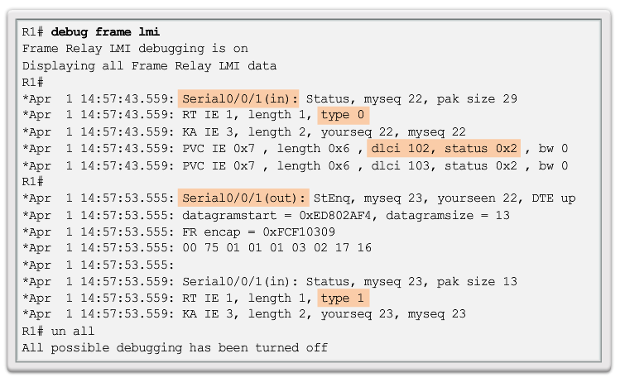
Troubleshoot Frame Relay Troubleshooting Frame Relay Operation
Notes:
4.3.1.5 Troubleshooting Frame Relay Operation

Slide 35
Chapter 4: Summary
This chapter described:
The fundamental concepts of Frame Relay technology, including operation, implementation requirements, maps, and Local Management Interface (LMI) operation.
How to configure a basic Frame Relay permanent virtual circuit (PVC), including configuring and troubleshooting Frame Relay on a router serial interface and configuring a static Frame Relay map.
Advanced concepts of Frame Relay technology including subinterfaces, bandwidth and flow control.
Advanced Frame Relay PVCs, including solving reachability issues, configuring subinterfaces, and verifying and troubleshooting a Frame Relay configuration.
Notes:
Chapter 4 Summary

Slide 36


