Slide 1
Chapter 6: Broadband Solutions
Connecting Networks
Notes:
Cisco Networking Academy program
Connecting Networks
Chapter 6: Broadband Solutions

Slide 2
Chapter 6
6.0 Introduction
6.1 Teleworking
6.2 Comparing Broadband Solutions
6.3 Configuring xDSL
6.4 Summary
Notes:
Chapter 6

Slide 3
Chapter 6: Objectives
Determine how to select broadband solutions to support remote connectivity in a small-to-medium-sized business network.
Explain the benefits of teleworking solutions.
Describe the business requirements of teleworking.
Describe a cable system and cable broadband access.
Describe a DSL system and DSL broadband access.
Describe broadband wireless options.
Compare broadband solutions.
Configure and verify a basic Point-to-Point Protocol (PPP) over Ethernet connection on a client router.
Notes:
Chapter 6 Objectives

Slide 4
6.1 Teleworking
Notes:
6.1 Teleworking

Slide 5
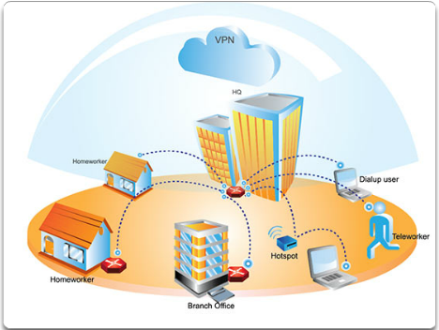
Benefits of Teleworking Introduction to Teleworking
Teleworking is conducting work by connecting to a workplace from a remote location, using telecommunications.
Efficient teleworking uses broadband Internet connections, a Virtual Private Network (VPN), VoIP, and videoconferencing.
Notes:
6.1.1.1 Introduction to Teleworking

Slide 6
Benefits of Teleworking Employer Benefits of Teleworking
Improved employee productivity – Teleworking staff is between 8 and 40% more productive than office working staff.
Reduced costs and expenses – Savings in real estate cost equaling anywhere from 10 to 80%.
Easier recruitment and retention – Being able to offer flexibility can reduce staff turnover by up to 20%.
Reduced absenteeism
Improved morale
Improved corporate citizenship
Improved customer service
Notes:
6.1.1.2 Employer Benefits of Teleworking

Slide 7
Benefits of Teleworking Government Benefits of Teleworking
Helps build a sustainable economy
Helps reduce contemporary problems, such as traffic
Increases productivity
Alleviates symptoms of the digital divide
Reduces costs and expenses
Improves flexibility
Attracts growth and development
Notes:
6.1.1.3 Government Benefits of Teleworking

Slide 8
Benefits of Teleworking Individual Benefits of Teleworking
Productivity – Over 70% of teleworkers claim they are significantly more productive.
Time savings – Less time commuting.
Cost savings – Saving money on lunch, clothing, commuting.
Better health – Less exposure to ‘sick' buildings, traffic accidents, stress.
Home and family – Able to spend more time with the family.
Taking control – The teleworker can take control over when and where work is performed, and also over the myriad of other details of modern life.
Flexibility – Telework can make it easier to have a more flexible schedule.
Notes:
6.1.1.4 Individual Benefits of Teleworking

Slide 9
Benefits of Teleworking Community Benefits of Teleworking
Helps build a sustainable economy – Telework is a critical component to building a truly sustainable local economy.
Increases value of real estate – Less traffic, less smog, and lower demands for urban office space means existing green spaces and heritage buildings can be preserved.
Helps reduce contemporary problems, such as traffic, infrastructure needs, urban drift.
Increases productivity.
Alleviates symptoms of the digital divide.
Reduces costs and expenses.
Attracts growth and development.
Notes:
6.1.1.5 Community Benefits of Teleworking

Slide 10
Benefits of Teleworking Detriments to Telework
For the organization:
More difficult to track employee progress
Necessary to implement a new management style
For the individual:
Feeling of isolation
Slower connections
Distractions
Notes:
6.1.1.6 Detriments to Teleworking

Slide 11
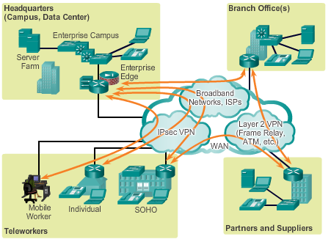
Business Requirements for Teleworker Services Teleworker Solution
Broadband connections
IPsec VPNs
Traditional private WAN Layer 2 technologies
Notes:
6.1.2.1 The Teleworker Solution

Slide 12
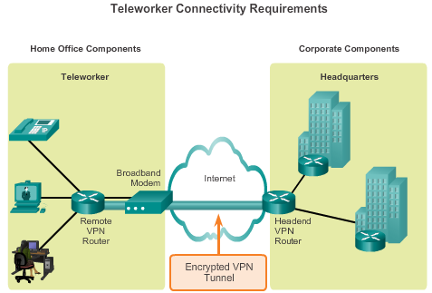
Business Requirements for Teleworker Services Teleworker Connectivity Requirements
Notes:
6.1.2.2 Teleworker Connectivity Requirements

Slide 13
6.2 Comparing Broadband Solutions
Notes:
6.2 Comparing Broadband Solutions

Slide 14
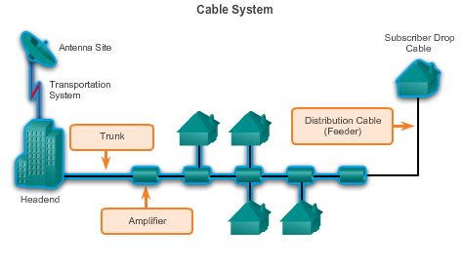
Cable What is a Cable System?
Notes:
6.2.1.1 What is a Cable System?

Slide 15
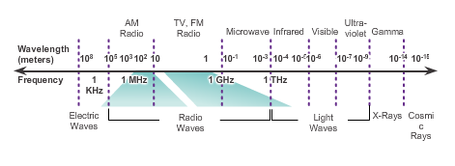
Cable Cable and the Electromagnetic Spectrum
Notes:
6.2.1.2 Cable and the Electromagnetic Spectrum

Slide 16
Cable DOCSIS
Data-over-Cable Service Interface Specification (DOCSIS) is an international standard developed by CableLabs.
Tests and certifies cable equipment vendor devices.
Defines the communications and operation support interface requirements for a data-over-cable system.
Specifies the OSI Layer 1 and Layer 2 requirements.
Notes:
6.2.1.3 Data-over-Cable Service Interface Specification (DOCSIS)

Slide 17
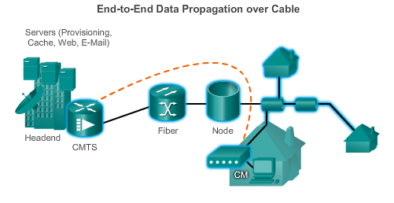
Cable Cable Components
Two types of equipment required to send digital modem signals upstream and downstream on a cable system:
Cable Modem Termination System (CMTS) at the headend of the cable operator.
Cable modem (CM) on the subscriber end.
Notes:
6.2.1.4 Cable Components

Slide 18
DSL DSL
DSL provides high-speed connections over installed copper wire system.
Two basic types of DSL technologies are asymmetric (ADSL) and symmetric (SDSL).
ADSL uses a frequency range from approximately 20 kHz to 1 MHz.
ADSL provides higher downstream bandwidth to the user than upload bandwidth.
SDSL provides the same capacity in both directions.
Local loop must be less than approximately 3.39 mi. (5.46 km) for ADSL.
Notes:
6.2.2.1 What is DSL?

Slide 19
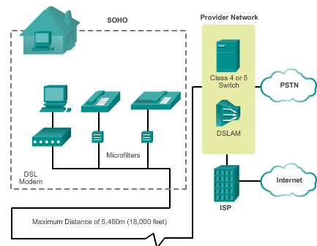
DSL DSL Connections
Two key components required to provide a DSL connection:
Transceiver – Connects the computer of the teleworker to the DSL.
DSL access multiplexer (DSLAM) – Located at the carrier’s central office, it combines individual DSL connections from users into one high-capacity link to an ISP.
Notes:
6.2.2.2 DSL Connections

Slide 20
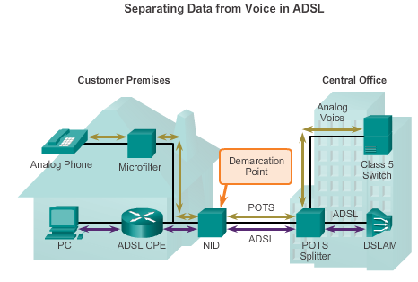
DSL Separating Voice and Data in ADSL
Notes:
6.2.2.3 Separating Voice and Data in ADSL

Slide 21
Broadband Wireless Broadband Wireless Technology Types
Municipal Wi-Fi (Mesh)
Worldwide Interoperability for Microwave Access (WiMAX)
A single WiMAX tower can provide coverage to an area as large as 3,000 square miles.
A WiMAX receiver similar in size and shape to a PCMCIA card, or built into a laptop or other wireless device.
Notes:
6.2.3.1 Types of Broadband Wireless Technologies

Slide 22
Broadband Wireless Broadband Wireless Technology Types
Cellular/mobile implementations wireless Internet:
3G/4G Wireless: Third generation and fourth generation wireless.
Long-Term Evolution (LTE): A newer and faster technology considered to be part of the 4G technology.
Satellite Implementations
one-way multicast
one-way terrestrial return
two-way satellite Internet
Notes:
6.2.3.2 Types of Broadband Wireless Technologies (cont)

Slide 23
Selecting Broadband Solutions Comparing Broadband Solutions
Cable – Bandwidth is shared by many users.
DSL – Limited bandwidth that is distance-sensitive.
Fiber-to-the-Home – Requires fiber-access network overlay.
Cellular/Mobile – Coverage is often an issue, bandwidth relatively limited.
Wi-Fi Mesh – Many municipalities do not have a mesh network deployed.
WiMAX – Bit rate is limited to 2 Mb/s per subscriber; cell size is 1.25 miles (1 to 2 km.)
Satellite – Expensive; limited capacity per subscriber.
Notes:
6.2.4.1 Comparing Broadband Solutions

Slide 24
6.3 Configuring xDSL
Notes:
6.3 Configuring xDSL

Slide 25
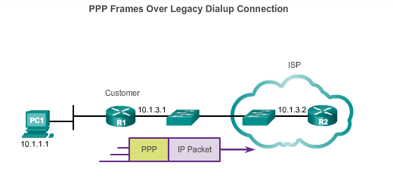
PPPoE Overview PPPoE Motivation
Most commonly used data link layer protocol by ISPs is PPP.
The PPP over Ethernet (PPPoE) protocol allows the transmission of PPP frames encapsulated inside Ethernet frames.
Notes:
6.3.1.1 PPPoE Motivation

Slide 26
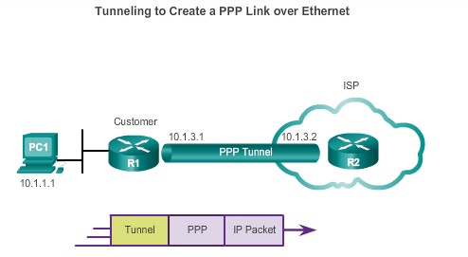
PPPoE Overview PPPoE Concepts
.
Notes:
6.3.1.2 PPPoE Concepts

Slide 27
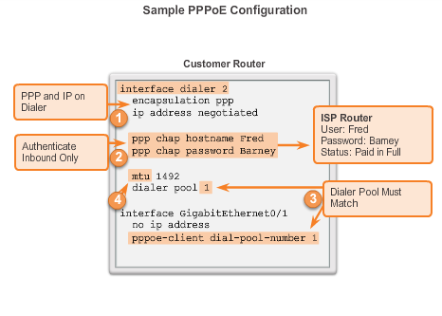
Configuring PPP0E PPPoE Configuration
Notes:
6.3.2.1 PPPoE Configuration

Slide 28
6.4 Summary
Notes:
6.4 Summary

Slide 29
Chapter 6: Summary
This chapter:
Explored the various broadband solutions used by telecommuters and branch office workers.
Outlined the features and basic infrastructure behind each broadband technology, which enables a network manager to make an informed selection.
Identified DSL, cable, and broadband wireless options as the various broadband solutions.
Described basic DSL configuration.
Notes:
Chapter 6 Summary

Slide 30


