Slide 1
Chapter 8: Monitoring the Network
Connecting Networks
Notes:
Cisco Networking Academy program
Connecting Networks
Chapter 8: Monitoring the Network

Slide 2
Chapter 8
8.0 Introduction
8.1 Syslog
8.2 SNMP
8.3 NetFlow
8.4 Summary
Notes:
Chapter 8

Slide 3
Chapter 8: Objectives
Explain syslog operation in a small-to-medium-sized business network.
Configure syslog to compile messages on a small-to-medium-sized business network management device.
Explain syslog operation in small-to-medium-sized business network.
Configure SNMP to compile messages on a small-to-medium-sized business network.
Describe NetFlow operation in a small-to-medium-sized business network.
Configure NetFlow data export on a router.
Examine sample NetFlow data to determine traffic patterns.

Slide 4
8.1 Syslog
Notes:
Cisco Networking Academy program
Connecting Networks
Chapter 8: Monitoring the Network

Slide 5
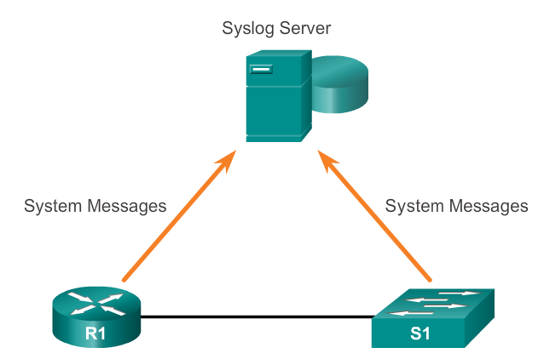
Syslog Operation Introduction to Syslog
Notes:
8.1.1.1 Introduction to Syslog

Slide 6
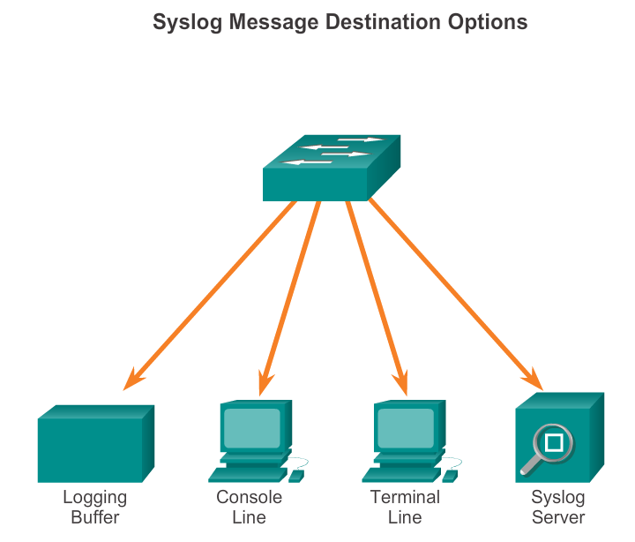
Syslog Operation Syslog Operation
Notes:
8.1.1.2 Syslog Operation

Slide 7
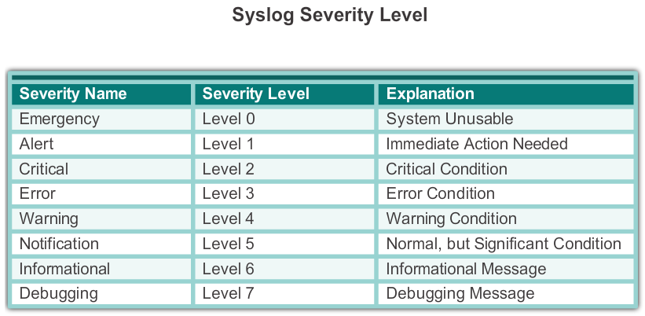
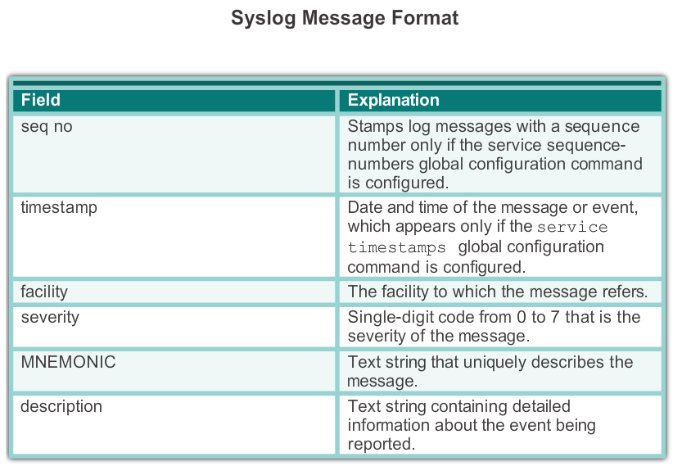
Syslog Operation Syslog Message Format
Notes:
8.1.1.3 Syslog Message Format

Slide 8
Syslog Operation Service Timestamp
Log messages can be time-stamped and the source address of syslog messages can be set. This enhances real-time debugging and management.
The service timestamps log datetime command entered in global configuration mode should be entered on the device.
In this chapter, it is assumed that the clock has been set and the service timestamps log datetime command has been configured on all devices.
Notes:
8.1.1.4 Service Timestamp

Slide 9
Configuring Syslog Syslog Server
The syslog server provides a relatively user-friendly interface for viewing syslog output.
The server parses the output and places the messages into pre-defined columns for easy interpretation. If timestamps are configured on the networking device sourcing the syslog messages, then the date and time of each message displays in the syslog server output.
Network administrators can easily navigate the large amount of data compiled on a syslog server.
Notes:
8.1.2.1 Syslog Server

Slide 10
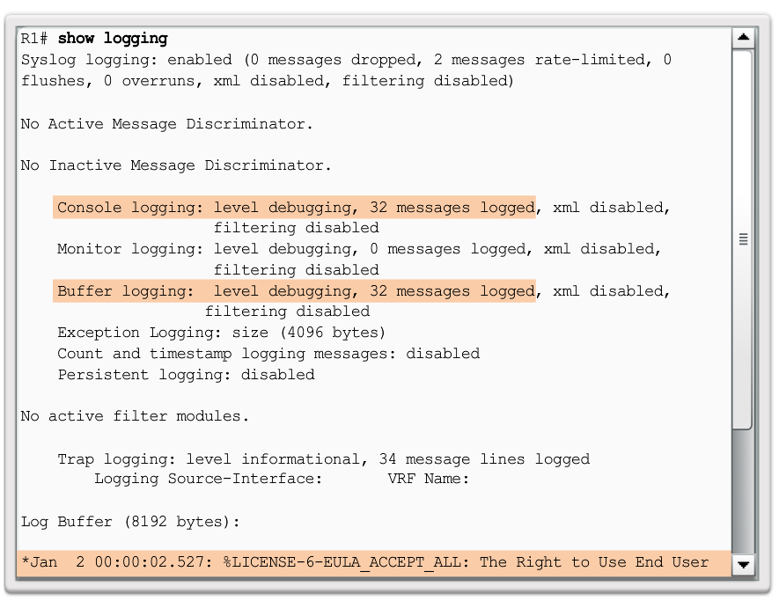
Configuring Syslog Default Logging
Notes:
8.1.2.2 Default Logging

Slide 11
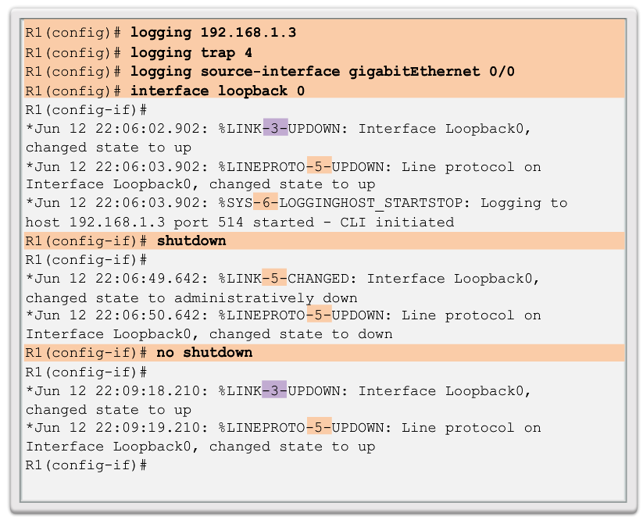
Configuring Syslog Router and Switch Commands for Syslog Clients
Notes:
8.1.2.3 Router and Switch Commands for Syslog Clients

Slide 12
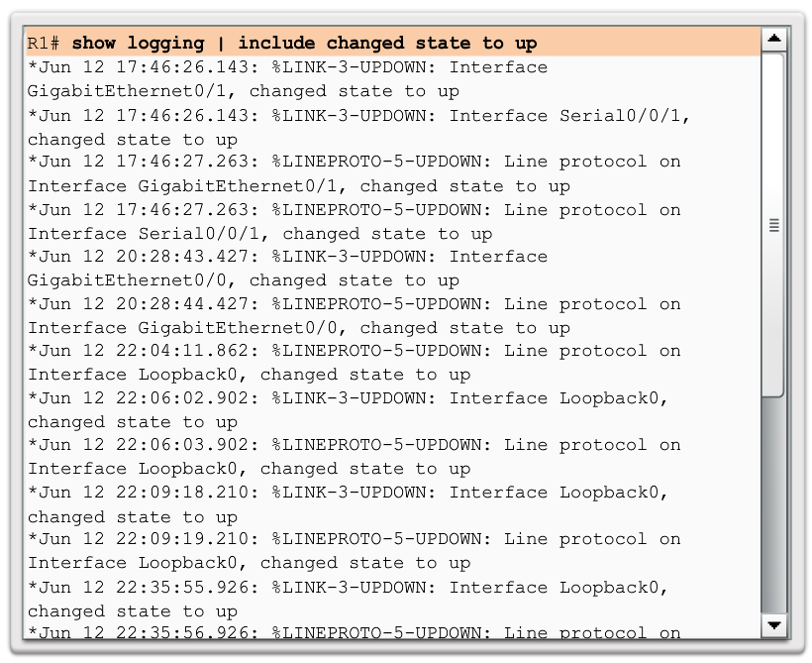
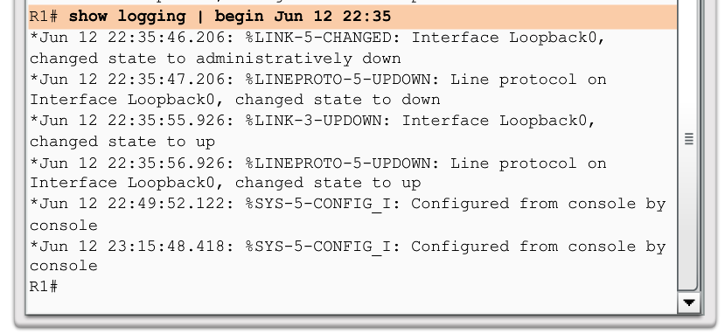
Configuring Syslog Verifying Syslog
Notes:
8.1.2.4 Verifying Syslog

Slide 13
8.2 SNMP
Notes:
Cisco Networking Academy program
Connecting Networks
Chapter 8: Monitoring the Network

Slide 14
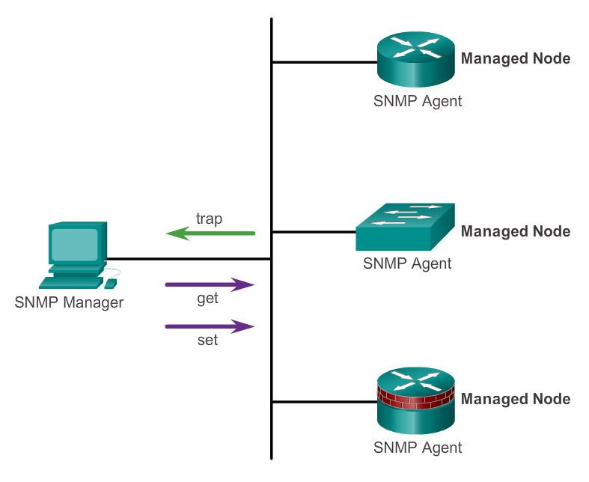
SNMP Operation Introduction to SNMP
Notes:
8.2.1.1 Introduction to SNMP

Slide 15
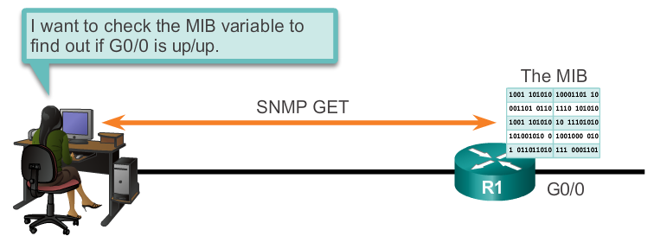
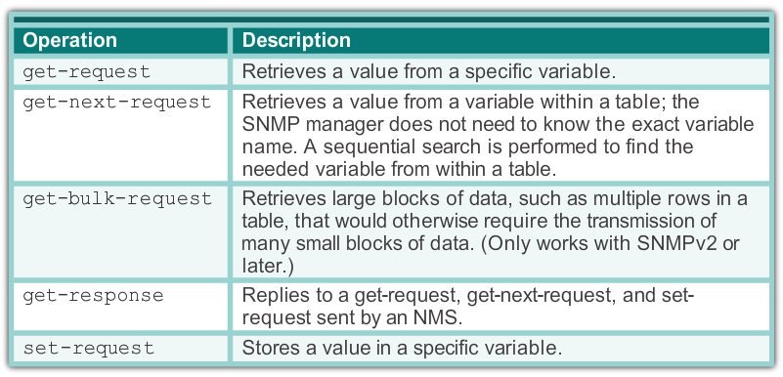
SNMP Operation SNMP Operation
Notes:
8.2.1.2 SNMP Operation

Slide 16
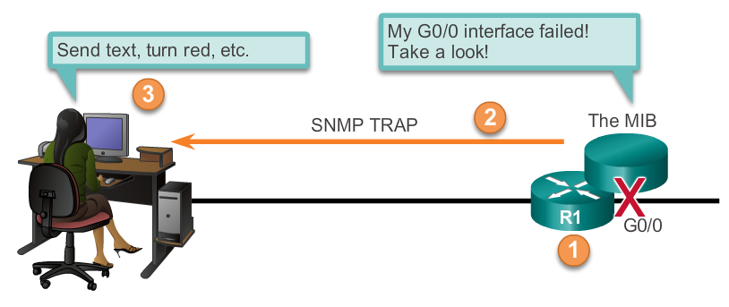
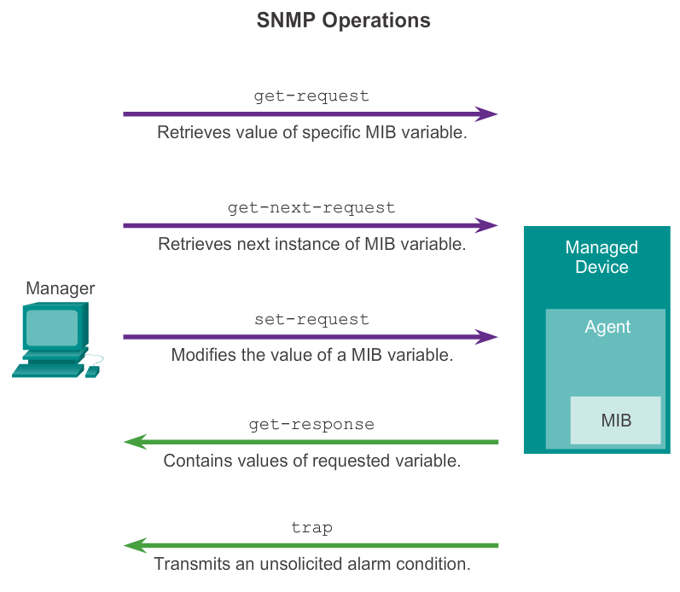
SNMP Operation SNMP Agent Traps
Notes:
8.2.1.3 SNMP Agent Traps

Slide 17
SNMP Operation SNMP Versions
There are several versions of SNMP, including:
SNMPv1 - The Simple Network Management Protocol, a Full Internet Standard, defined in RFC 1157.
SNMPv2c - Defined in RFCs 1901 to 1908; utilizes community-string-based Administrative Framework.
SNMPv3 - Interoperable standards-based protocol originally defined in RFCs 2273 to 2275; provides secure access to devices by authenticating and encrypting packets over the network. It includes these security features: message integrity to ensure that a packet was not tampered with in transit; authentication to determine that the message is from a valid source, and encryption to prevent the contents of a message from being read by an unauthorized source.
Notes:
8.2.1.4 SNMP Versions

Slide 18
SNMP Operation Community Strings
There are two types of community strings:
Read-only (ro) – Provides access to the MIB variables, but does not allow these variables to be changed, only read. Because security is so weak in version 2c, many organizations use SNMPv2c in read-only mode.
Read-write (rw) – Provides read and write access to all objects in the MIB.
Notes:
8.2.1.5 Community Strings

Slide 19
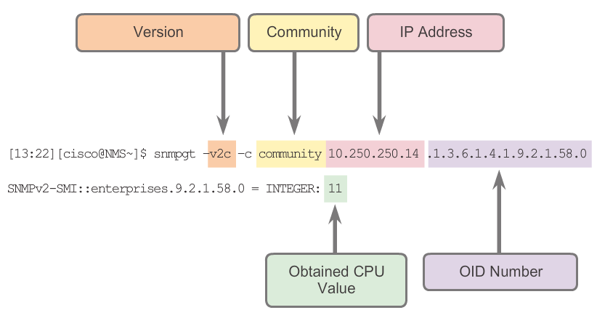
SNMP Operation Management Information Base Object ID
Notes:
8.2.1.6 Management Information Base Object ID

Slide 20
Configuring SNMP Steps for Configuring SNMP
Step 1. (Required) Configure the community string and access level (read-only or read-write) with the snmp-server community string ro | rw command.
Step 2. (Optional) Document the location of the device using the snmp-server location text command.
Step 3. (Optional) Document the system contact using the snmp-server contact text command.
Notes:
8.2.2.1 Steps for Configuring SNMP

Slide 21
Configuring SNMP Steps for Configuring SNMP (cont.)
Step 4. (Optional) Restrict SNMP access to NMS hosts (SNMP managers) that are permitted by an ACL. Define the ACL and then reference the ACL with the snmp-server community string access-list-number-or-name command.
Step 5. (Optional) Specify the recipient of the SNMP trap operations with the snmp-server host host-id [version {1 | 2c | 3 [auth | noauth | priv]}] community-string command. By default, no trap manager is defined.
Step 6. (Optional) Enable traps on an SNMP agent with the snmp-server enable traps notification-types command.
Notes:
8.2.2.1 Steps for Configuring SNMP (cont.)

Slide 22
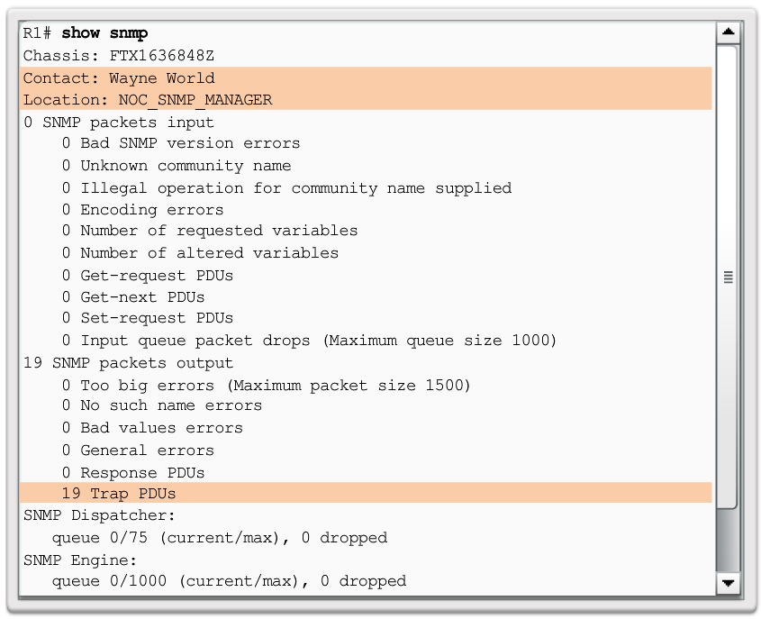
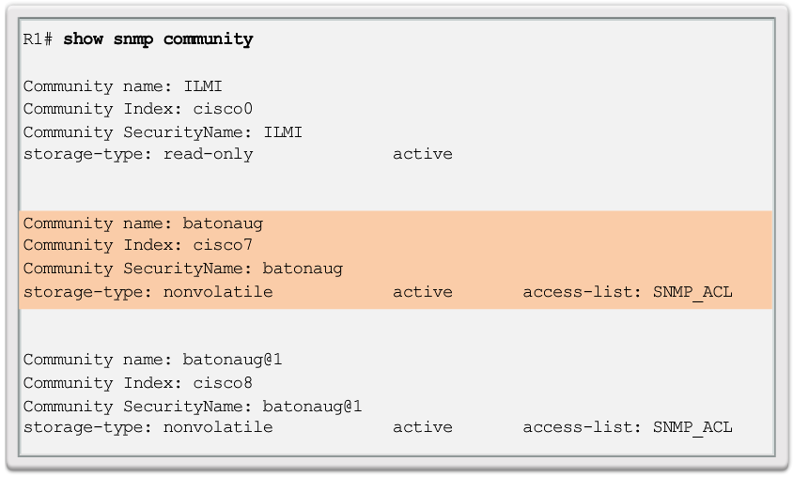
Configuring SNMP Verifying SNMP Configuration
Notes:
8.2.2.2 Verifying SNMP Configuration

Slide 23
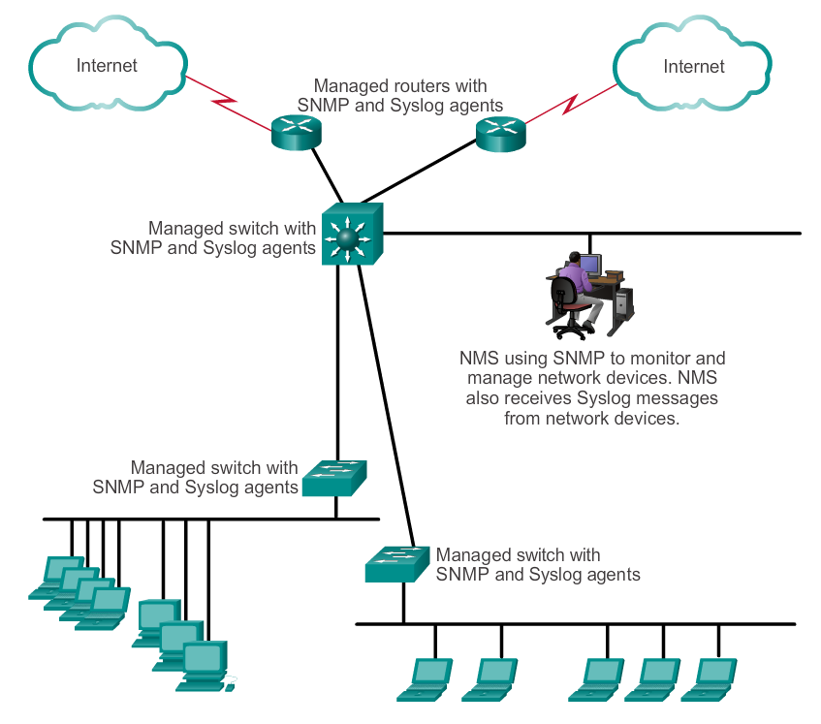
Configuring SNMP Security Best Practices
Notes:
8.2.2.3 Security Best Practices

Slide 24
8.3 NetFlow
Notes:
Cisco Networking Academy program
Connecting Networks
Chapter 8: Monitoring the Network

Slide 25
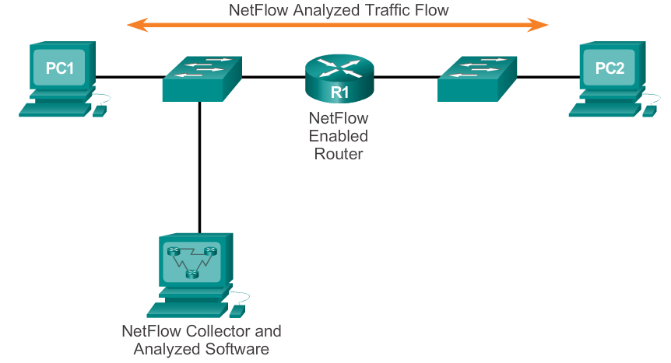
NetFlow Operation Introduction to NetFlow
Notes:
8.3.1.1 Introduction to NetFlow

Slide 26
NetFlow Operation Purpose of NetFlow
Most organizations use NetFlow for some or all of the following key data collection purposes:
Efficiently measuring who is using what network resources for what purpose.
Accounting and charging back according to the resource utilization level.
Using the measured information to do more effective network planning so that resource allocation and deployment is well-aligned with customer requirements.
Using the information to better structure and customize the set of available applications and services to meet user needs and customer service requirements.
Notes:
8.3.1.2 Purpose of NetFlow

Slide 27
NetFlow Operation Network Flows
NetFlow technology has seen several generations that provide more sophistication in defining traffic flows, but “original NetFlow” distinguished flows using a combination of seven key fields.
Source and destination IP address
Source and destination port number
Layer 3 protocol type
Type of service (ToS) marking
Input logical interface
Notes:
8.3.1.3 Network Flows

Slide 28
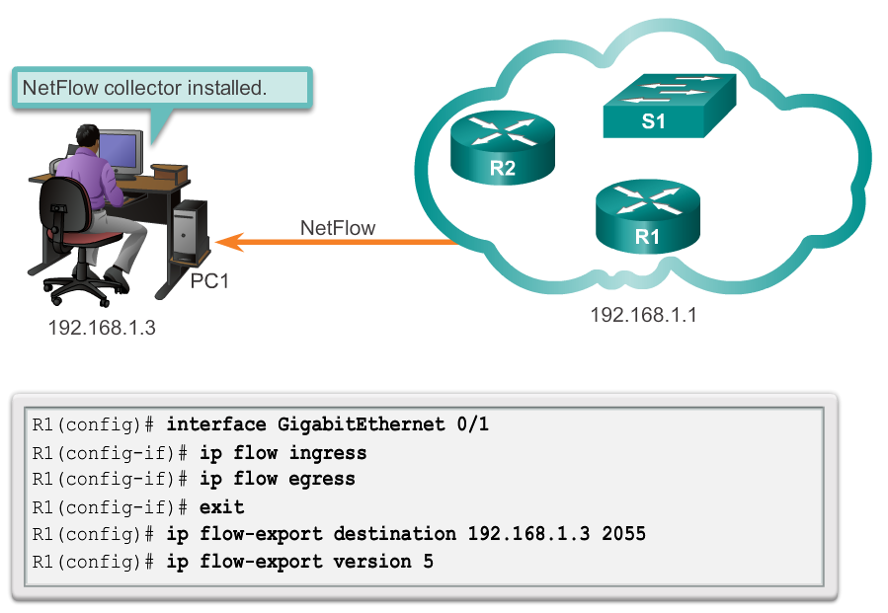
Configuring NetFlow NetFlow Configuration Tasks
Notes:
8.3.2.1 NetFlow Configuration Tasks

Slide 29
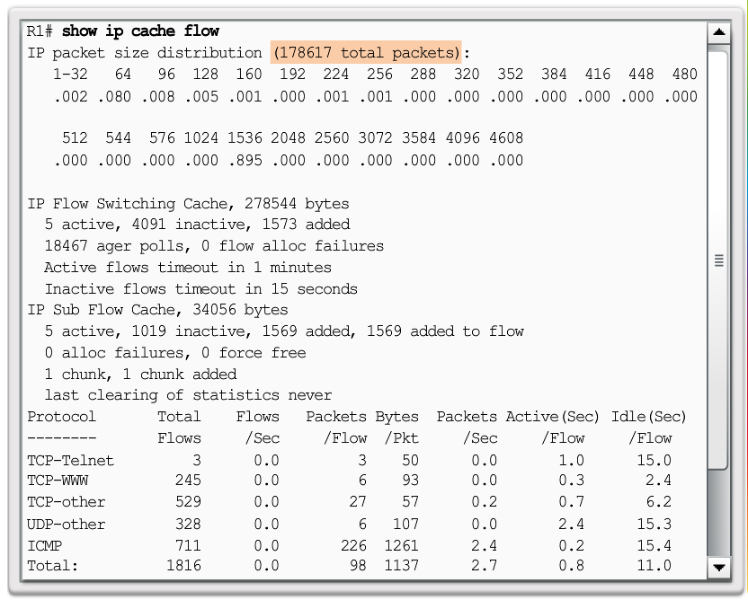
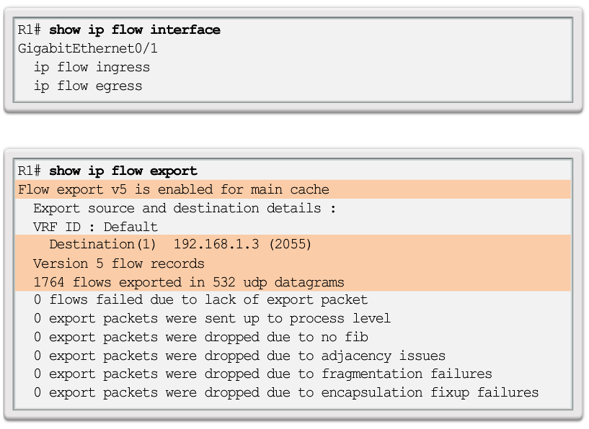
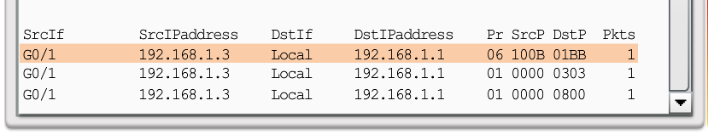
Examining Traffic Patterns Verifying NetFlow
Notes:
8.3.2.2 Verifying NetFlow

Slide 30
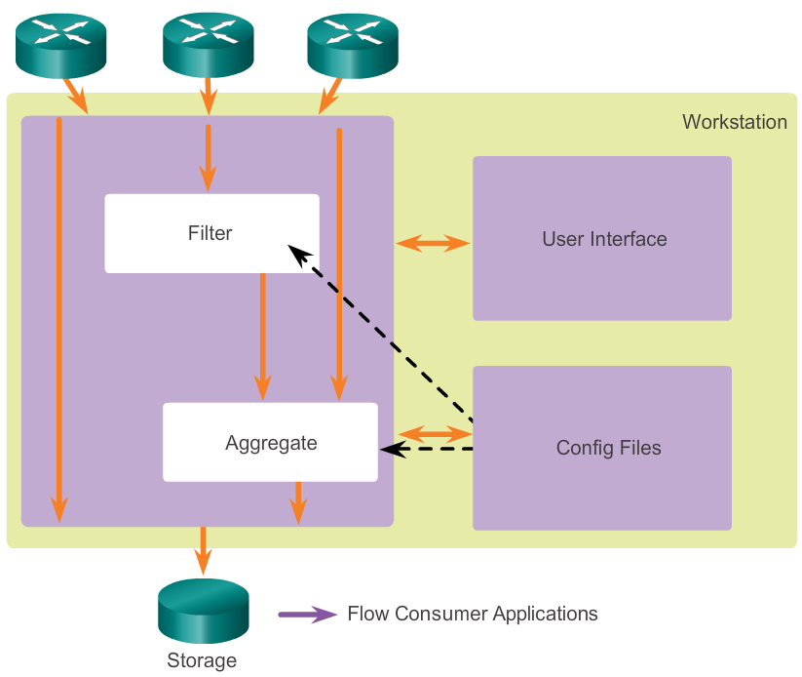
Examining Traffic Patterns NetFlow Collector Functions
Notes:
8.3.3.1 NetFlow Collector Functions

Slide 31
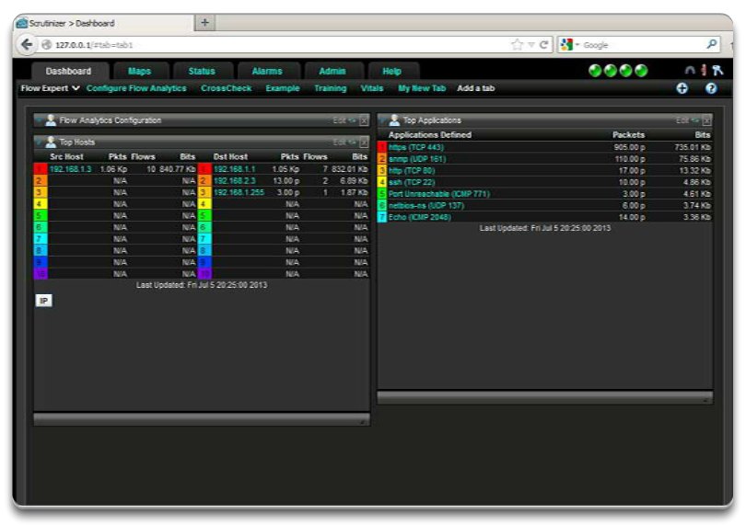
Examining Traffic Patterns NetFlow Analysis with a NetFlow Collector
Notes:
8.3.3.2 NetFlow Analysis with a NetFlow Collector

Slide 32
Chapter 8: Summary
Syslog, SNMP, and NetFlow are the tools a network administrator uses in a modern network to manage the collection, display, and analysis of events associated with the networking devices.
Syslog provides a rudimentary tool for collecting and displaying messages as they appear on a Cisco device console display.
SNMP has a very rich set of data records and data trees to both set and get information from networking devices.
NetFlow and its most recent iteration, Flexible NetFlow, provides a means of collecting IP operational data from IP networks.
NetFlow provides data to enable network and security monitoring, network planning, traffic analysis, and IP accounting.
NetFlow collectors provide sophisticated analysis options for NetFlow data.
Notes:
Chapter 8 Summary

Slide 33


