Slide 1
Chapter 9: Troubleshooting the Network
Connecting Networks
Notes:
Cisco Networking Academy program
Connecting Networks
Chapter 9: Troubleshooting the Network

Slide 2
Chapter 9
9.0 Introduction
9.1 Troubleshooting with a Systematic Approach
9.2 Network Troubleshooting
9.3 Summary
Notes:
Chapter 9

Slide 3
9.1 Troubleshooting with a Systematic Approach
Notes:
Cisco Networking Academy program
Connecting Networks
Chapter 9: Troubleshooting the Network

Slide 4
Chapter 9: Objectives
Explain how network documentation is developed and used to troubleshoot network issues.
Describe the general troubleshooting process.
Compare troubleshooting methods that use a systematic, layered approach.
Describe troubleshooting tools used to gather and analyze symptoms of network problems.
Determine the symptoms and causes of network problems using a layered model.
Troubleshoot a network using the layered model.

Slide 5
Network Documentation Documenting the Network
Network documentation is a complete set of accurate and current network documentation. This documentation includes:
Configuration files, including network configuration files and end-system configuration files
Physical and logical topology diagrams
A baseline performance level
Notes:
9.1.1.1 Documenting the Network

Slide 6
Network Documentation Network Topology Diagrams
Physical Topology
Device type Model and manufacturer
Operating system version Cable type and identifier
Cable specification Connector type
Cabling endpoints
Logical Topology
Device identifiers IP address and prefix lengths
Interface identifiers Connection type
DLCI for virtual circuits Site-to-site VPNs
Routing protocols Static routes
Data-link protocols WAN technologies used
Notes:
9.1.1.2 Network Topology Diagrams

Slide 7
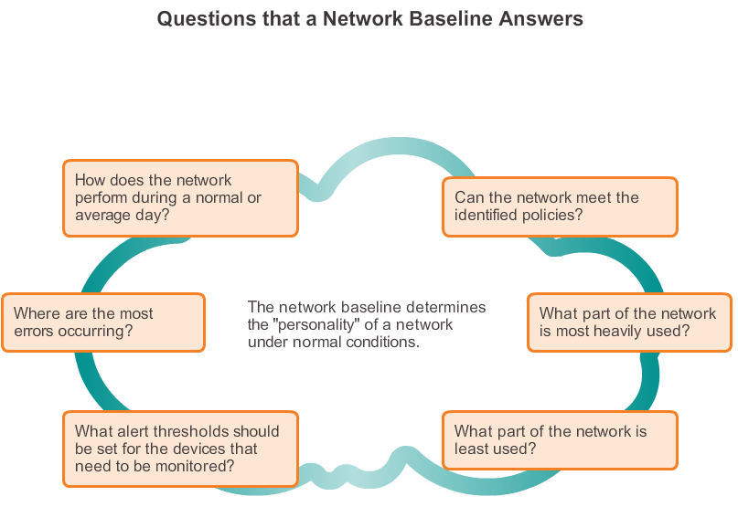
Network Documentation Establishing a Network Baseline
Notes:
9.1.1.2 Network Topology Diagrams

Slide 8
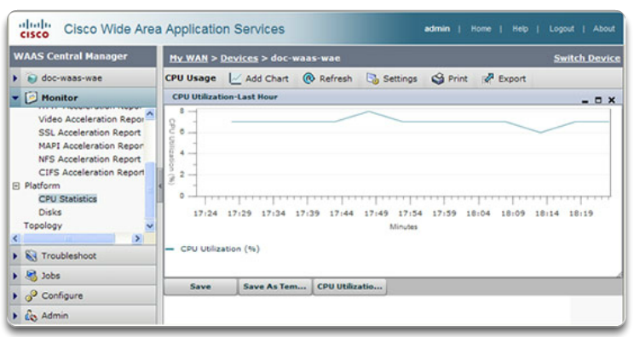
Network Documentation Establishing a Network Baseline (cont.)
Step 1. Determine what types of data to collect.
Step 2. Identify devices and ports of interest.
Step 3. Determine the baseline duration.
Notes:
9.1.1.4 Establishing a Network Baseline, Cont.

Slide 9
Network Documentation Measuring Data
Commands that are useful to the network documentation process include:
ping
telnet
show ip interface brief
show ipv6 interface brief
show ip route
show ipv6 route
show cdp neighbor detail
Notes:
9.1.1.5 Measuring Data

Slide 10
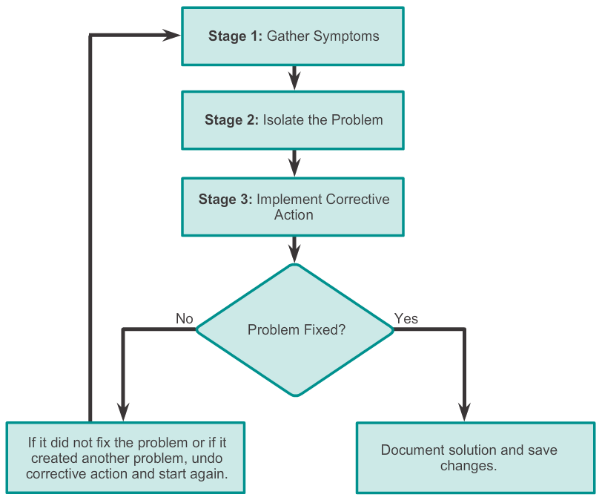
Troubleshooting Process General Troubleshooting Procedures
Notes:
9.1.2.1 General Troubleshooting Procedures

Slide 11
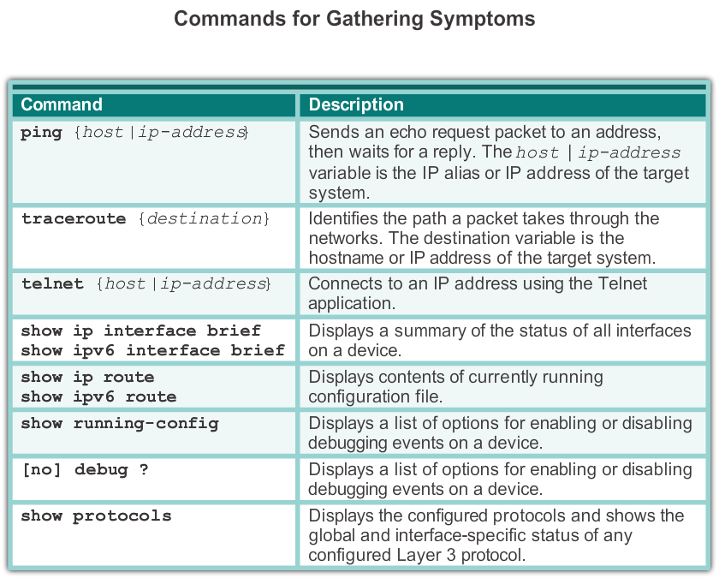
Troubleshooting Process Gathering Symptoms
Notes:
9.1.2.2 Gathering Symptoms

Slide 12
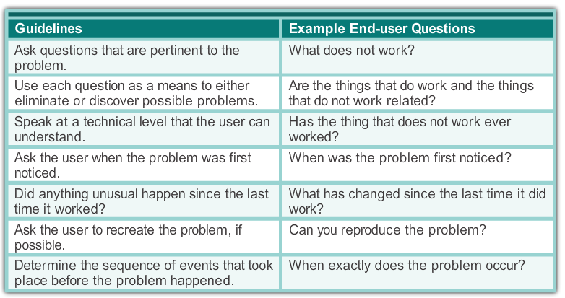
Troubleshooting Process Questioning End Users
Notes:
9.1.2.3 Questioning End Users

Slide 13
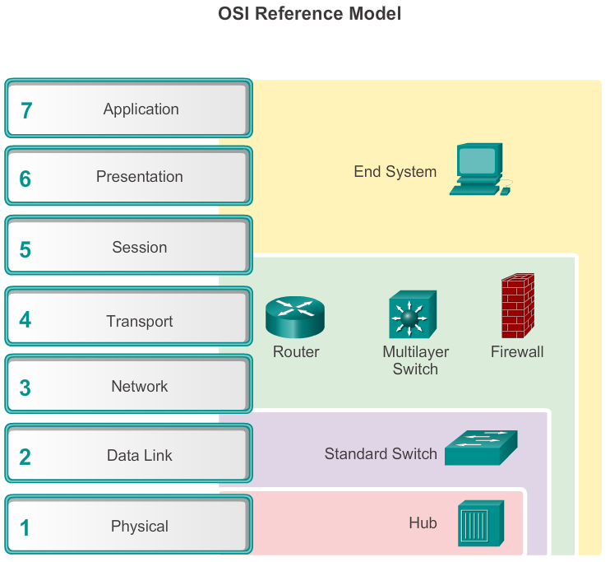
Isolating the Issue Using Layered Models Using Layered Models for Troubleshooting
Notes:
9.1.3.1 Using Layered Models for Troubleshooting

Slide 14
Isolating the Issue Using Layered Models Troubleshooting Methods
Using the layered models, there are three primary methods for troubleshooting networks:
Bottom-up
Top-down
Divide-and-conquer
Notes:
9.1.3.2 Troubleshooting Methods

Slide 15
Isolating the Issue Using Layered Models Troubleshooting Methods (cont.)
In addition to the systematic, layered approach to troubleshooting, there are also, less-structured troubleshooting approaches:
One troubleshooting approach is based on an educated guess by the network administrator, based on the symptoms of the problem.
Another approach involves comparing a working and nonworking situation, and spotting significant differences.
Swapping the problematic device with a known, working one is a quick way to troubleshoot.
Notes:
9.1.3.3 Troubleshooting Methods, Cont.

Slide 16
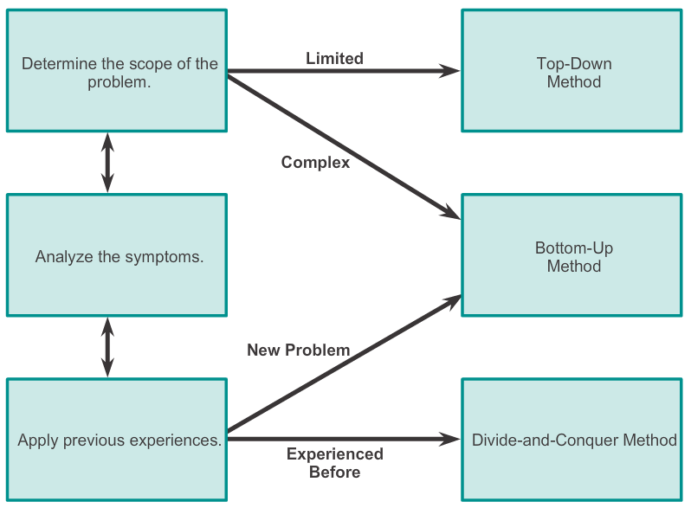
Isolating the Issue Using Layered Models Guidelines for Selecting a Troubleshooting Method
Notes:
9.1.3.4 Guidelines for Selecting a Troubleshooting Method

Slide 17
9.2 Network Troubleshooting
Notes:
Cisco Networking Academy program
Connecting Networks
Chapter 9: Troubleshooting the Network

Slide 18
Troubleshooting Tools Software Troubleshooting Tools
Common software troubleshooting tools include:
NMS tools
Knowledge bases
Baselining tools
Host-based protocol analyzers
Cisco IOS EPC
Notes:
9.2.1.1 Software Troubleshooting Tools
9.2.1.2 Software Troubleshooting Tools, Cont.

Slide 19
Troubleshooting Tools Hardware Troubleshooting Tools
Common hardware troubleshooting tools include:
Network analysis module
Digital multimeters
Cable testers
Cable analyzers
Portable network analyzers
Notes:
9.2.1.3 Hardware Troubleshooting Tools

Slide 20
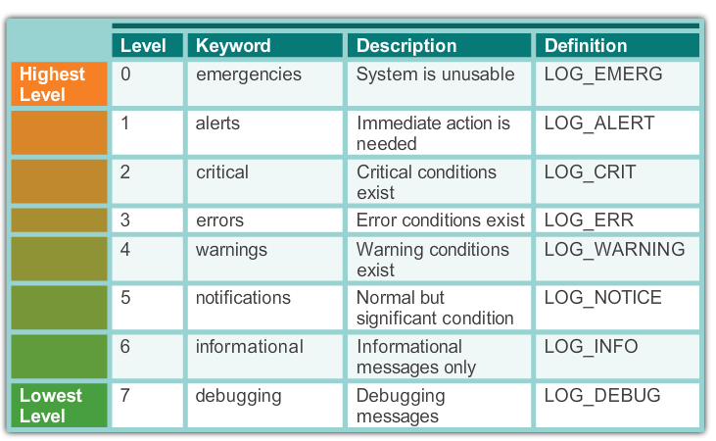
Troubleshooting Tools Using a Syslog Server for Troubleshooting
Severity Level
Notes:
9.2.1.4 Using a Syslog Server for Troubleshooting

Slide 21
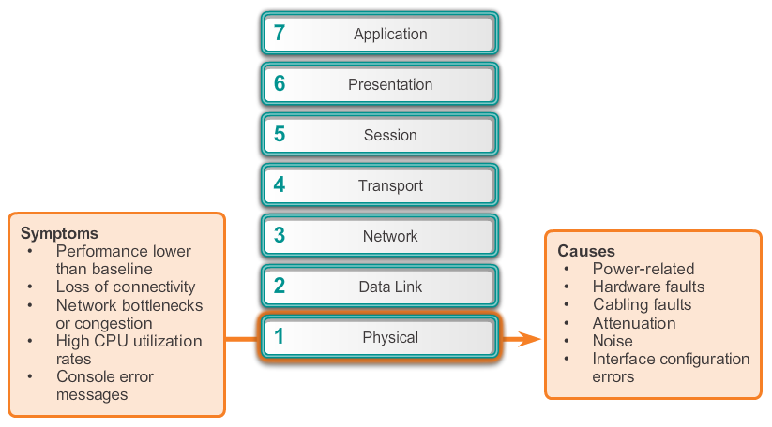
Symptoms and Causes of Network Troubleshooting Physical Layer Troubleshooting
Notes:
9.2.2.1 Physical Layer Troubleshooting

Slide 22
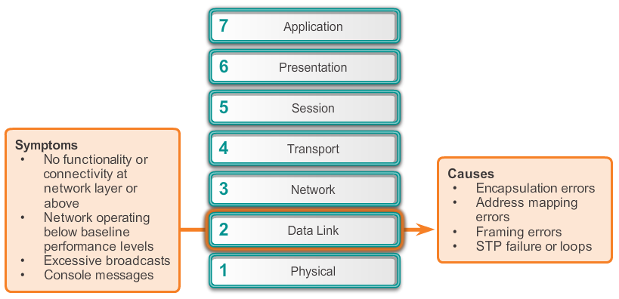
Symptoms and Causes of Network Troubleshooting Data Link Layer Troubleshooting
Notes:
9.2.2.2 Data Link Layer Troubleshooting

Slide 23
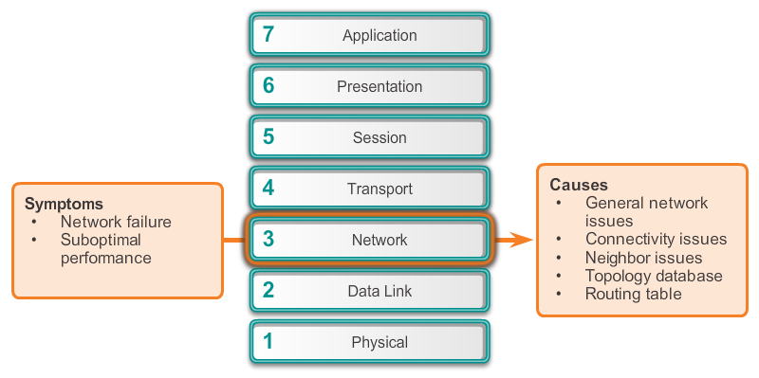
Symptoms and Causes of Network Troubleshooting Network Layer Troubleshooting
Notes:
9.2.2.3 Network Layer Troubleshooting

Slide 24
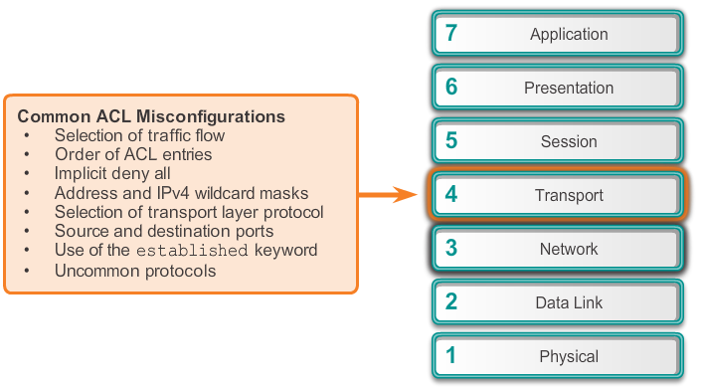
Symptoms and Causes of Network Troubleshooting Transport Layer Troubleshooting – ACLs
Notes:
9.2.2.4 Transport Layer Troubleshooting - ACLs

Slide 25
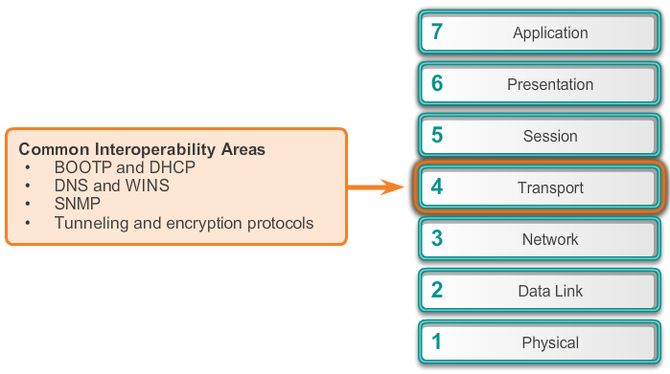
Symptoms and Causes of Network Troubleshooting Transport Layer Troubleshooting – NAT for IPv4
Notes:
9.2.2.5 Transport Layer Troubleshooting – NAT for IPv4

Slide 26
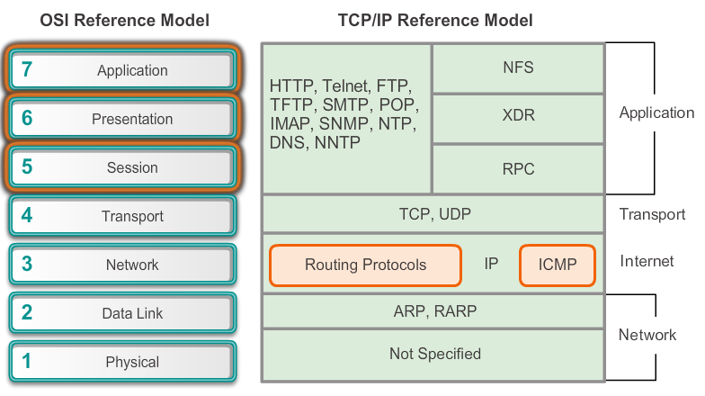
Symptoms and Causes of Network Troubleshooting Application Layer Troubleshooting
Notes:
9.2.2.6 Application Layer Troubleshooting

Slide 27
Troubleshooting IP Connectivity Components of Troubleshooting End-to-End Connectivity
When there is no end-to-end connectivity, and the administrator chooses to troubleshoot with a bottom-up approach, these are common steps the administrator can take:
Step 1. Check physical connectivity at the point where network communication stops, including cables and hardware. The problem might be with a faulty cable or interface, or involve misconfigured or faulty hardware.
Step 2. Check for duplex mismatches.
Step 3. Check data link and network layer addressing on the local network. This includes IPv4 ARP tables, IPv6 neighbor tables, MAC address tables, and VLAN assignments.
Notes:
9.2.3.1 Components of Troubleshooting End-to-End Connectivity

Slide 28
Troubleshooting IP Connectivity Components of Troubleshooting End-to-End Connectivity (cont.)
Step 4. Verify that the default gateway is correct.
Step 5. Ensure that devices are determining the correct path from the source to the destination. Manipulate the routing information if necessary.
Step 6. Verify that the transport layer is functioning properly. Telnet can also be used to test transport layer connections from the command line.
Step 7. Verify that there are no ACLs blocking traffic.
Step 8. Ensure that DNS settings are correct. There should be an accessible DNS server.
Notes:
9.2.3.1 Components of Troubleshooting End-to-End Connectivity (cont.)

Slide 29
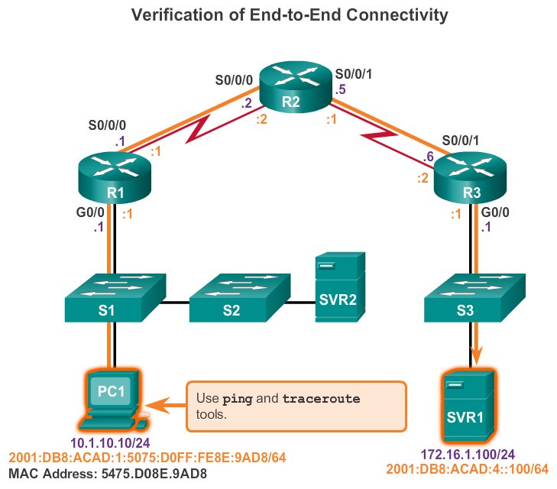
Troubleshooting IP Connectivity End-to-End Connectivity Problem Initiates Troubleshooting
Notes:
9.2.3.2 End-to-End Connectivity Problem Initiates Troubleshooting

Slide 30
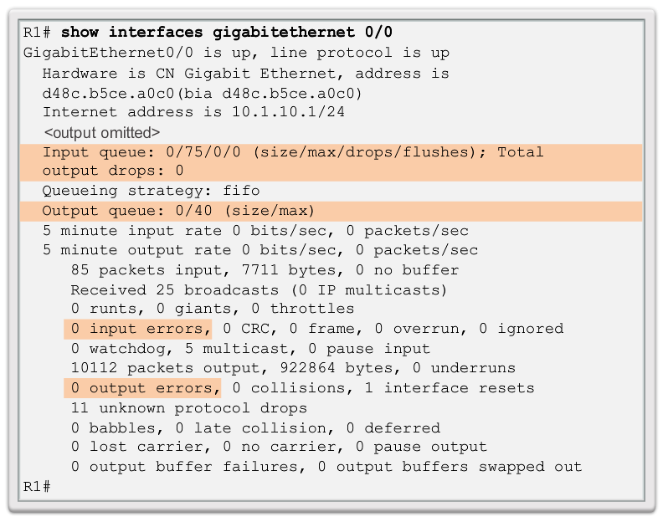
Troubleshooting IP Connectivity Step 1. Verify the Physical Layer
Notes:
9.2.3.3 Step 1 - Verify the Physical Layer

Slide 31
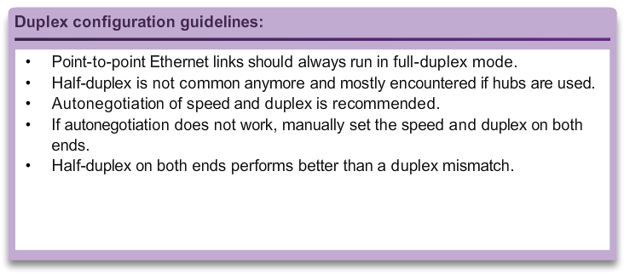
Troubleshooting IP Connectivity Step 2. Check for Duplex Mismatches
Notes:
9.2.3.4 Step 2 - Check for Duplex Mismatches

Slide 32
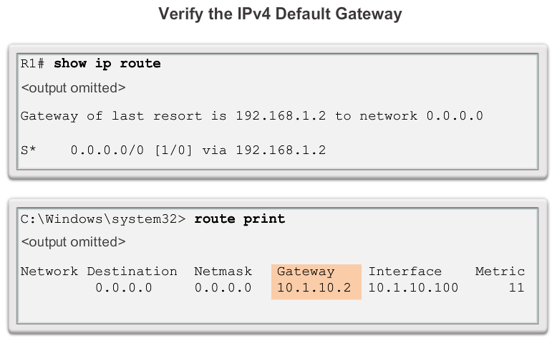
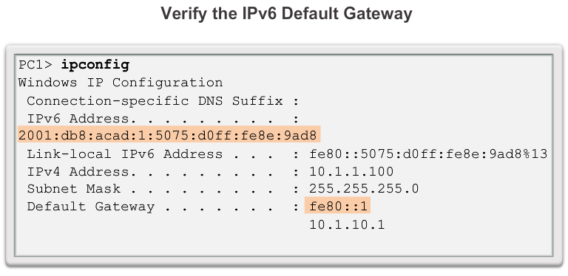
Troubleshooting IP Connectivity Step 3. Verify Layer 2 and Layer 3 Addressing on the Local Network
IPv4:
arp command (PC)
show mac address-table command (router)
IPv6:
netsh interface ipv6 show neighbor command (PC)
show ipv6 neighbors (router)
Notes:
9.2.3.5 Step 3 - Verify Layer 2 and Layer 3 Addressing on the Local Network

Slide 33
Troubleshooting IP Connectivity Step 4. Verify Default Gateway
Notes:
9.2.3.6 Step 4 - Verify Default Gateway

Slide 34
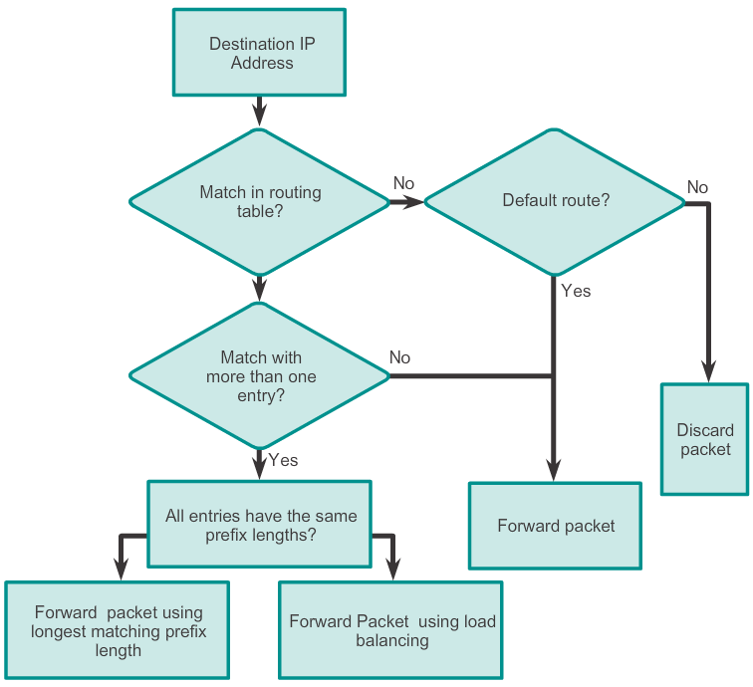
Troubleshooting IP Connectivity Step 5. Verify Correct Path
Notes:
9.2.3.7 Step 5 - Verify Correct Path

Slide 35
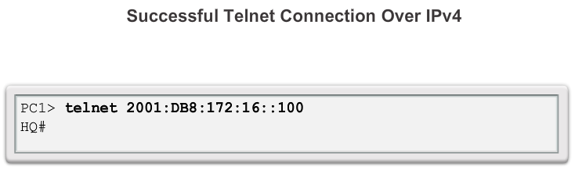
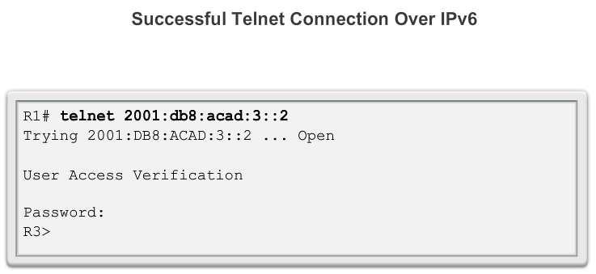
Troubleshooting IP Connectivity Step 6. Verify the Transport Layer
Notes:
9.2.3.8 Step 6 - Verify the Transport Layer

Slide 36
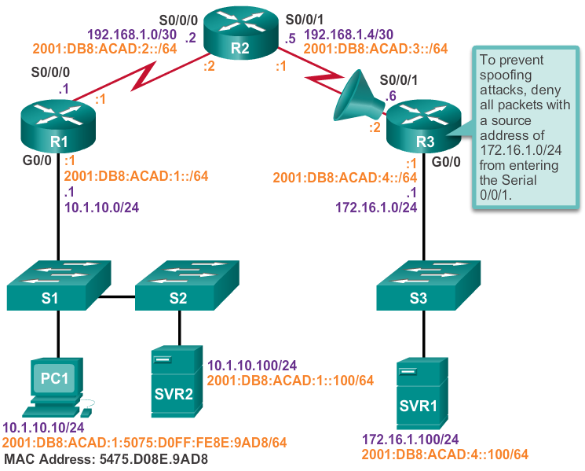
Troubleshooting IP Connectivity Step 7. Verify ACLs
Notes:
9.2.3.9 Step 7 - Verify ACLs

Slide 37
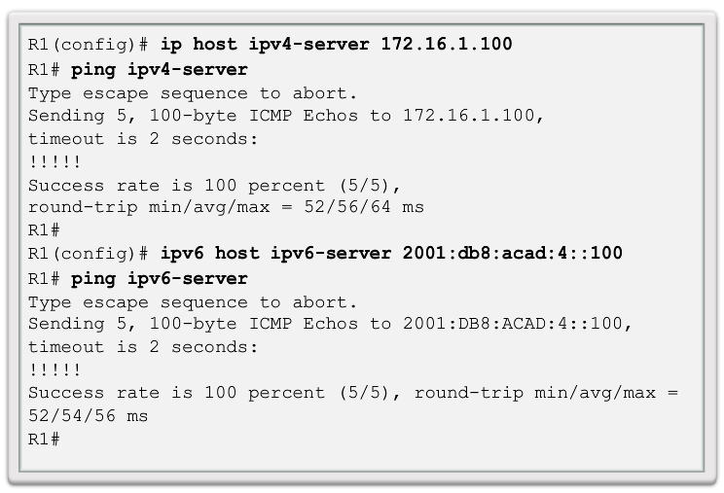
Troubleshooting IP Connectivity Step 8. Verify DNS
Notes:
9.2.3.10 Step 8 - Verify DNS

Slide 38
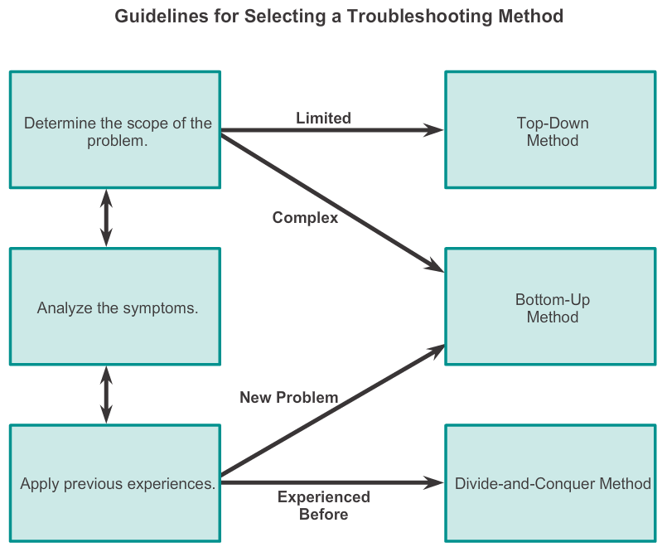
Chapter 9: Summary
Notes:
Chapter 9 Summary

Slide 39


