Slide 1

Applied Orbital Mechanics: Project 1
Victor Branea
vb8773

Slide 2

MICE code validation

Slide 3
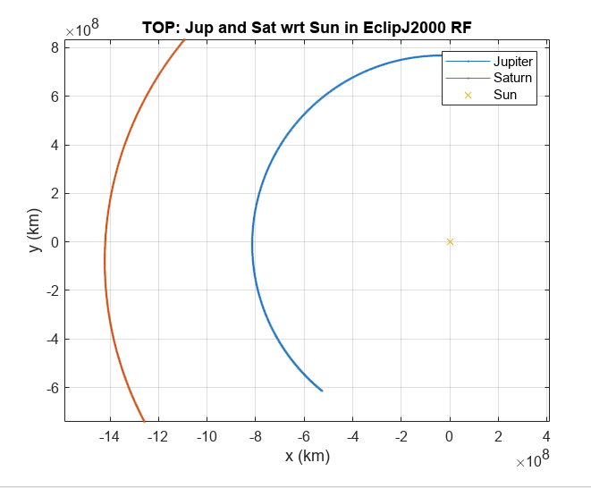
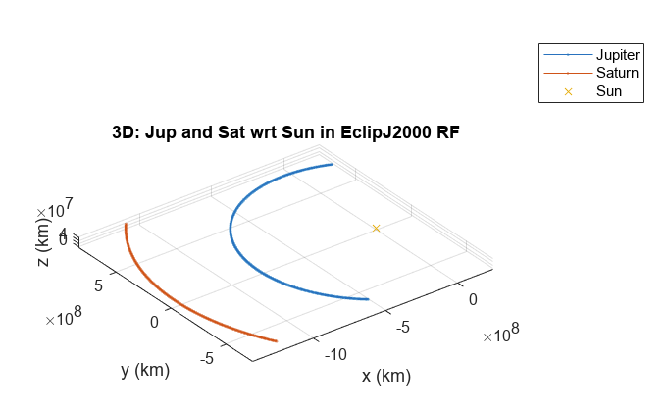

Slide 4
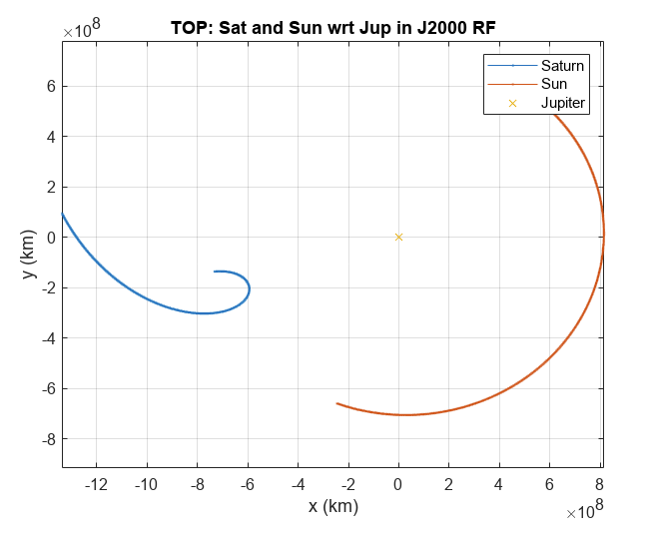
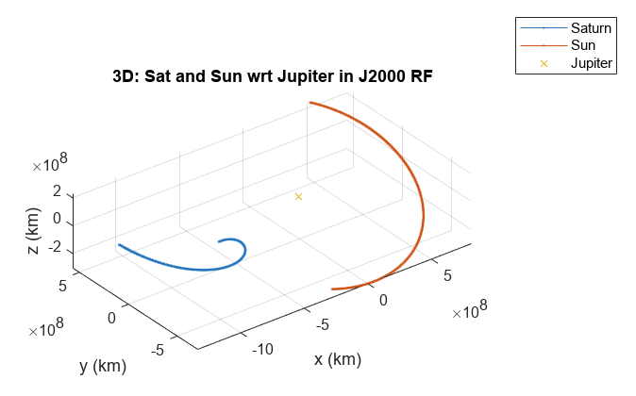

Slide 5
Lambert code validation

Slide 6
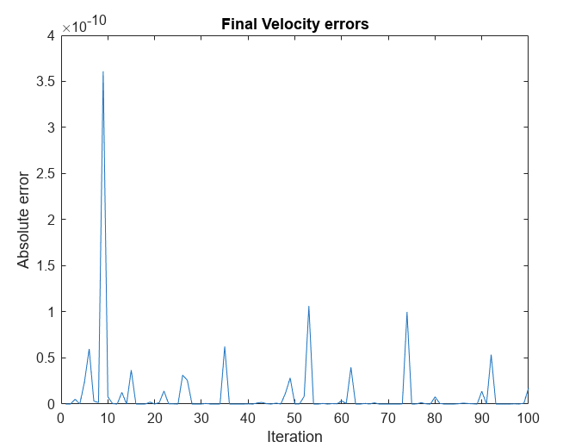
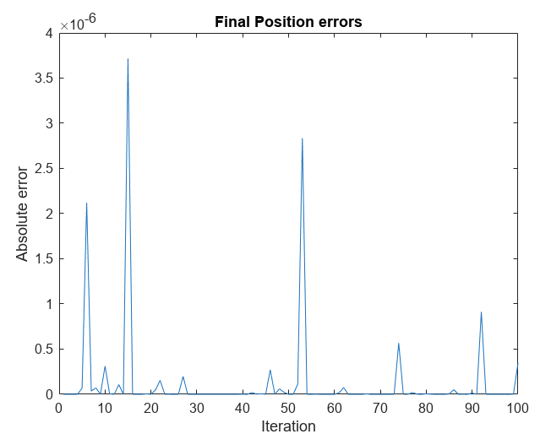

Slide 7

Reproducing example plot
ET_J: 1231145109.18405
ET_S: 1317287349.18235
Turn angle: 2.18508513087382 rad
Flyby altitude: 391177.910076721 km
Final s/c position: [-1306119904.60811; -639446477.360583; 63088993.7114965]
Final s/c velocity: [-3.75319148577208; -12.5441384798416; 0.430517334130783]
Arrival V infinity vector: [-7.48919935288359; -3.84027486889454; 0.428378600046949]

Slide 8
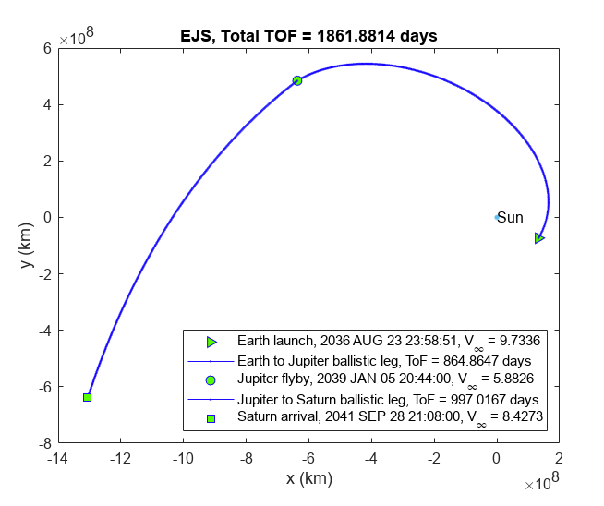

Slide 9
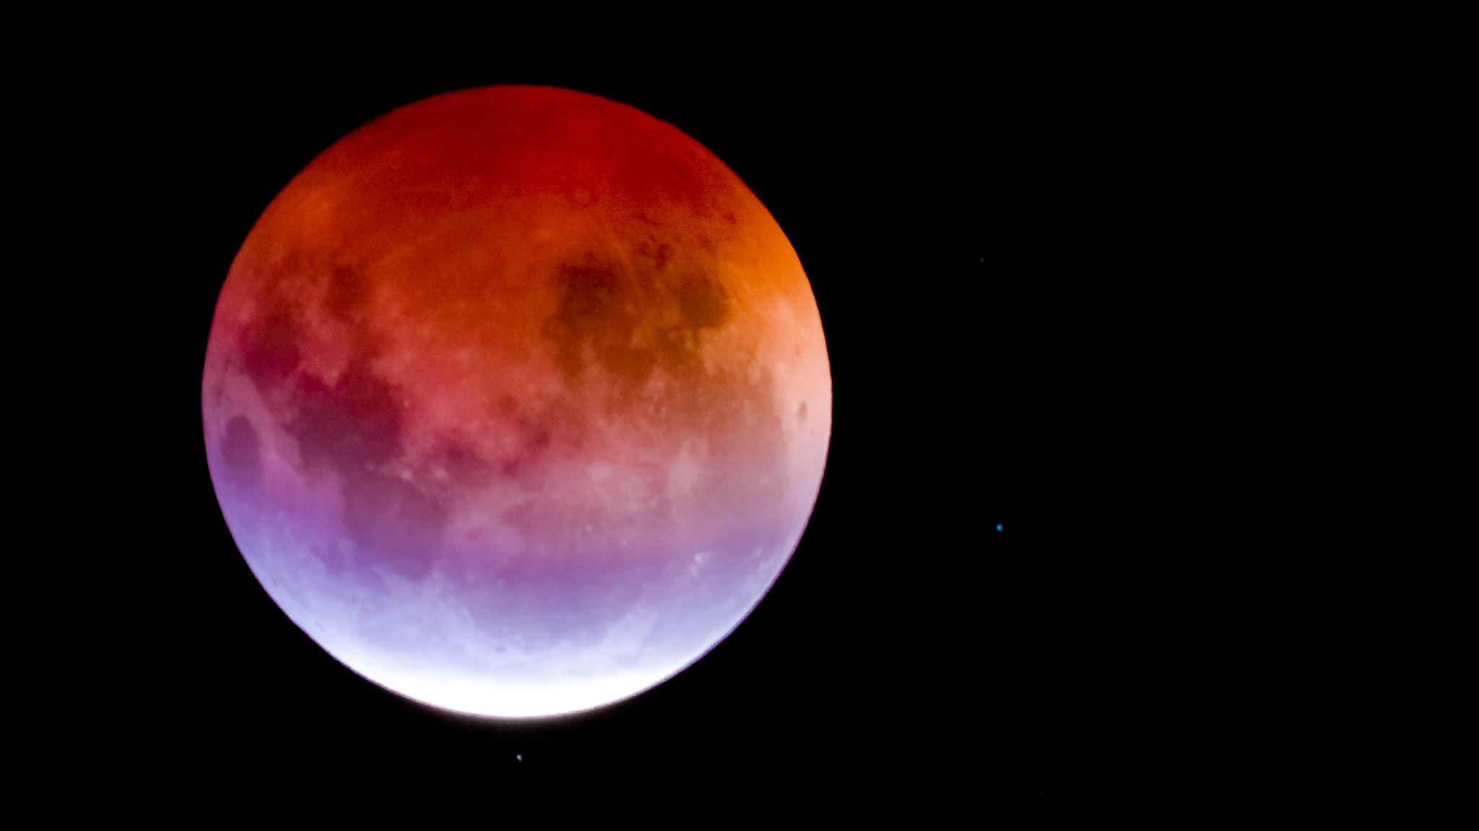
Family of feasible Jupiter flyby solutions

Slide 10

Solving the problem
In order to find the solutions, a nested for loop was used.
The first for loop iterated once a day for 2000 days through all the paths from Earth to Jupiter, checking if the value for C3 was small enough.
The second loop iterated through every path from Jupiter to Saturn from the day that the flyby at Jupiter occurs to 2000 days from launch, for each of the days that were acceptable in the first loop.
The results were then assessed for maximum acceptable V infinity error and for turning angle being smaller than the maximum delta angle.
The path from Jupiter to Saturn that had the smallest V infinity error was then chosen for each Jupiter flyby date.

Slide 11

Interesting results
Total number of Lambert calls: 767652
Total number of solutions: 530
Approx 1448.4 Lambert calls per solution
Flyby date range: 2037 SEP 30 23:58:51 to 2039 MAR 13 23:58:51
Arrival date range: 2039 APR 04 23:58:51 to 2041 NOV 05 23:58:51

Slide 12
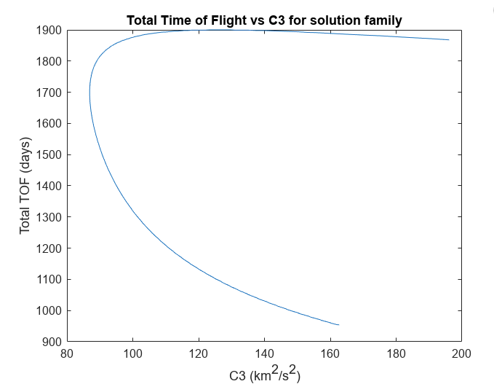

Slide 13
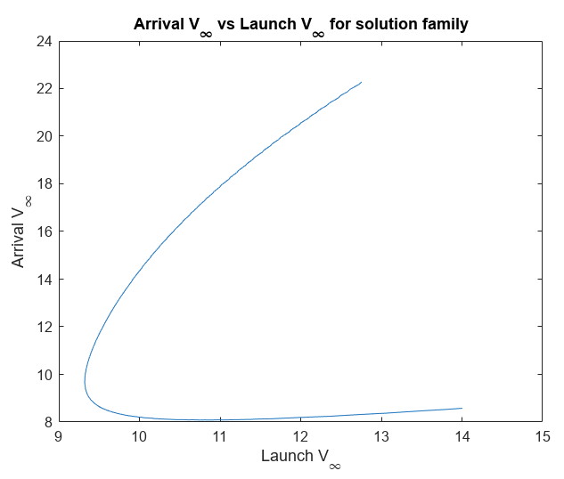

Slide 14
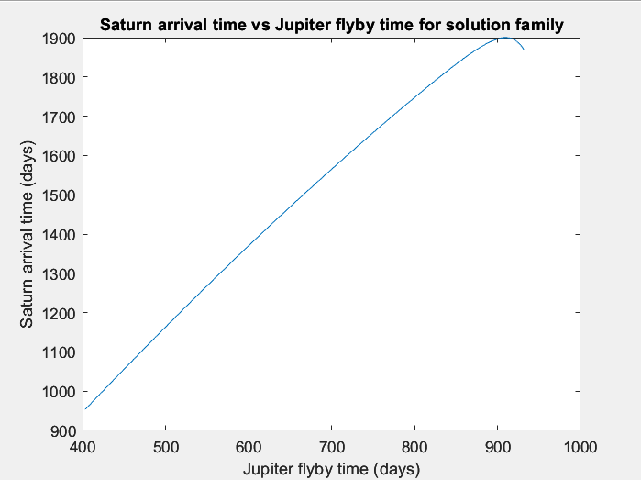

Slide 15
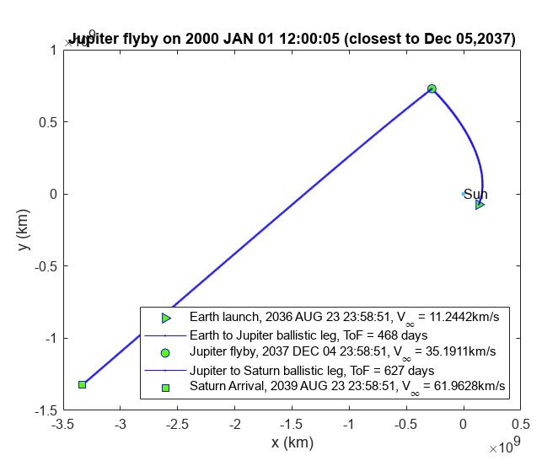

Slide 16
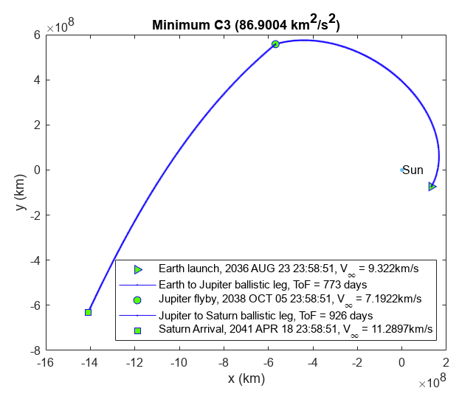

Slide 17
