Slide 1
SCHEMA THEORY
SCHEMA
SCHEMA INSTANCE
FUNCTIONAL LINK
ASSEMBLAGE
LTM
WM

Slide 2
PERCEPTUAL SCHEMA
SCHEMA
PERCEPTUAL SCHEMA
OBJECT
ACTION
QUALITY
RELATIONS
ACTION REL
SPATIAL REL
QUALITY REL
TEMP REL

Slide 3
BRAIN SYSTEM
SYSTEM
MODULE
CONNECT

Slide 4
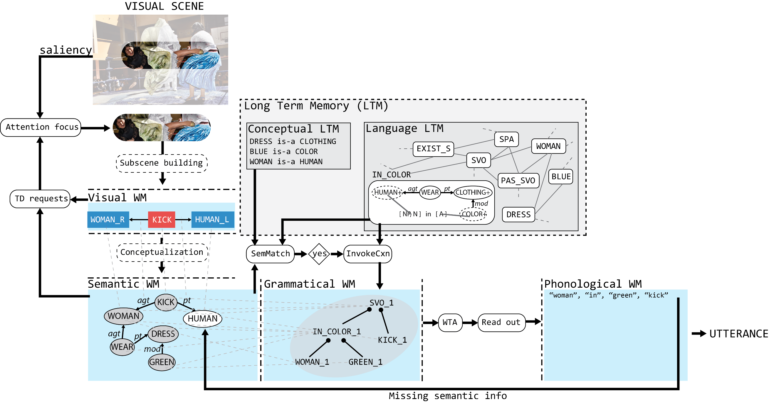
Modular architecture

Slide 5
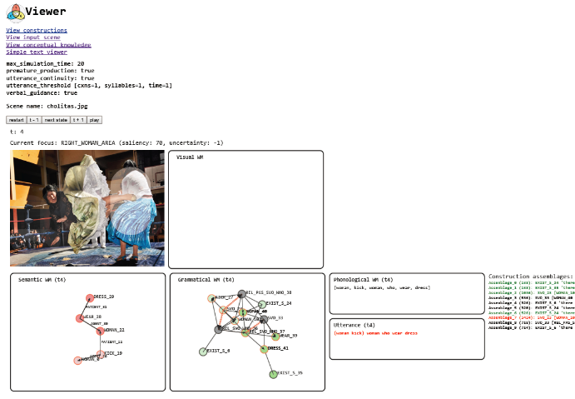
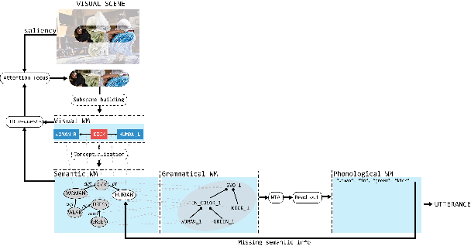

Implementation, analysis of algorithms, and comparison with existing computational CxG frameworks.
Inputs
(JSON files)
Output
Visualization
Simulation
parameters
(JSON file)
(JavaScript)
Grammatical
knowledge
Construction set
time
Long Term Memories
TCG
modular processes
Modules states
Conceptual
knowledge
Online demo!
Visual scenes
(attentional
regions + perceptual
schemas)
Perceptual
input

