Slide 1


Domain Driven Design and Command Query Responsibility Segregation
Notes:
Picture with background removed
(Intermediate)
To reproduce the picture effects on this slide, do the following:
On the Home tab, in the Slides group, click Layout, and then click Blank.
On the Insert tab, in the Images group, click Picture.
In the Insert Picture dialog box, select a picture and then click Insert.
Select the picture. Under Picture Tools, on the Format tab, in the Size group, click the Size and Position dialog box launcher. In the Format Picture dialog box, resize or crop the image so that the height is set to 7.5” and the width is set to 10”. To crop the picture, click Crop in the left pane, and in the right pane, under Crop position, enter values into the Height, Width, Left, and Top boxes. To resize the picture, click Size in the left pane, and in the right pane, under Size and rotate, enter values into the Height and Width boxes.
Also under Picture Tools, on the Format tab, in the Adjust group, click Color, and then under Recolor click Grayscale.
Also in the Adjust group, click Corrections, and then under Brightness and Contrast, click Brightness: -40% Contrast: +20%.
On the Home tab, in the Clipboard group, click the arrow to the right of Copy, and then click Duplicate.
Select the second picture. On the Home tab, in the Drawing group, click Arrange, point to Align, and then do the following:
Click Align to Slide.
Click Align Middle.
Click Align Center.
Under Picture Tools, on the Format tab, in the Adjust group, click Reset Picture.
Also under Picture Tools, on the Format tab, in the Size group, click the Size and Position dialog box launcher.. In the Format Picture dialog box, resize or crop the image to focus on the main subject in the picture. (Example picture is set to 3.54” height and 3.24” width). To crop the picture, click Crop in the left pane, and in the right pane, under Crop position, enter values into the Height, Width, Left, and Top boxes. To resize the picture, click Size in the left pane, and in the right pane, under Size and rotate, enter values into the Height and Width boxes.
Also under Picture Tools, on the Format tab, in the Adjust group, click Remove Background, and then do the following:
To remove additional background areas from the picture, on the Background Removal tab, in the Refine group, click Mark Areas to Remove. Select all of the additional areas to be removed.
To keep additional areas of the picture that have been removed, on the Background Removal tab, in the Refine group, click Mark Areas to Keep. Select all of the additional areas to be kept.
Click Keep Changes in the Close group when finished.
To reproduce the shape effects on this slide, do the following:
On the Home tab, in the Drawing group, select Rectangle.
On the slide, drag to draw a rectangle.
Select the rectangle. Also on the Home tab, in the Drawing group, click the Format Shape dialog box launcher.
In the Format Shape dialog box, in the Size tab, enter 7.5” into the Height box and enter 4” into the Width box.
Also in the Format Shape dialog box, in the Fill tab, select Gradient fill, and then do the following:
In the Type list, select Linear.
In the Angle box, enter 90°.
Under Gradient stops, click Add gradient stops or Remove gradient stops until three stops appear in the slider.
Also under Gradient stops, customize the gradient stops as follows:
Select the first stop from the left in the slider, and then do the following:
In the Position box, enter 0%.
Click the button next to Color, and then under Theme Colors click Black, Text 1 (first row, second option from the left).
In the Transparency box, enter 100%.
Select the second stop from the left in the slider, and then do the following:
In the Position box, enter 40%.
Click the button next to Color, click More Colors, and then in the Colors dialog box, on the Custom tab, enter values for Red: 47, Green: 91, and Blue: 77.
In the Transparency box, enter 0%.
Select the third stop from the left in the slider, and then do the following:
In the Position box, enter 100%.
Click the button next to Color, and then under Theme Colors click Black, Text 1 (first row, second option from the left).
In the Transparency box, enter 90%.
Also in the Format Shape dialog box, in the Line Color tab, select No Line.
Select the second picture. On the Home tab, in the Drawing group, click Arrange, and then click Bring to Front.
To reproduce the text effects on this slide, do the following:
On the Insert tab, in the Text group, click Text Box, and then on the slide drag to draw your text box.
Enter text in the text box, and then select the text. On the Home tab, in the Font group, do the following:
In the Font list, click Calisto MT.
In the Font Size list, click 36 pt.
Click Font Color, and then under Theme Colors click White, Background 1 (first row, first option from the left).
Position text over the least transparent part of the gradient.

Slide 2
Ultimate goals
Tradeoff between just to do things and to do things right
Tackling complexity in the Heart of software
Remove misunderstanding of business logic
Increase quality of communication between various actors

Slide 3
DDD discipline
Capture known elements of design process
Organize them into a set of principles
Make domain modeling the focus of development
Enjoy the different approach of business logic building

Slide 4
Main concepts
Context / Bounded context
Domain
Model
Ubiquitous Language
Notes:
Context - The setting in which a word or statement appears that determines its meaning;
Domain - A sphere of knowledge (ontology), influence, or activity. The subject area to which the user applies a program is the domain of the software;
Model - A system of abstractions that describes selected aspects of a domain and can be used to solve problems related to that domain;
Ubiquitous Language - A language structured around the domain model and used by all team members to connect all the activities of the team with the software.

Slide 5
Ubiquitous language
Vocabulary of domain specific terms
Shared by all parties involved in the project
Used in all forms of spoken and written communication
Notes:
Nouns, verbs, adjectives, idiomatic expressions and even adverbs
Primary goal of avoiding misunderstandings
Universal language of the business as done in the organization

Slide 6
Ubiquitous == Used everywhere
User stories
Meetings
Emails/Slack/Communicator
Technical documentation
Schedule
Source code

Slide 7

Ubiquitous == Comprehensive
Set state of the game => Start/Pause the game
Submit the order => Checkout
Update the job order => Extend the job order
No ambiguity, no synonyms

Slide 8
Bounded Context
Delimited space where an element has a well-defined meaning
Beyond the boundaries of the context, the language changes
Business domain split in a web of interconnected contexts
Notes:
Any elements of the ubiquitous language
Each bounded context has its own ubiquitous language
Each context has its own architecture and implementation
Motivations
Remove ambiguity and duplication
Simplify design of software modules
Integration of external components

Slide 9
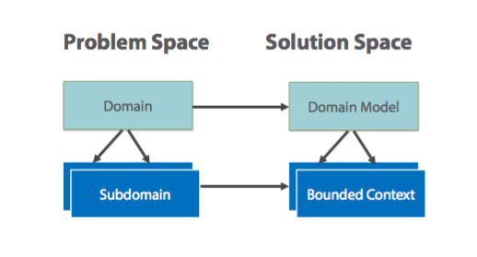
Bounded Context

Slide 10
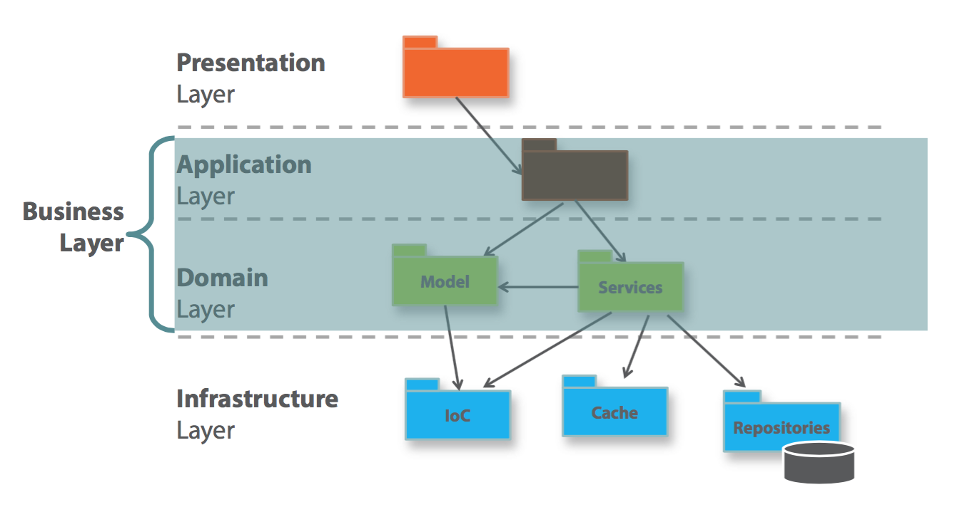
Spaghetti vs Lasagna

Slide 11
Business Logic - Definitions
Application Logic – Depends of use-cases
Application entities
Application workflow components
Domain Logic – Invariant to use-cases
Business entities
Business workflow components
Application Logic - Depends of use-cases
Data transfer objects
Application Services
Domain Logic – Invariant to use-cases
Domain model
Domain services
Abstract definition
DDD definition

Slide 12
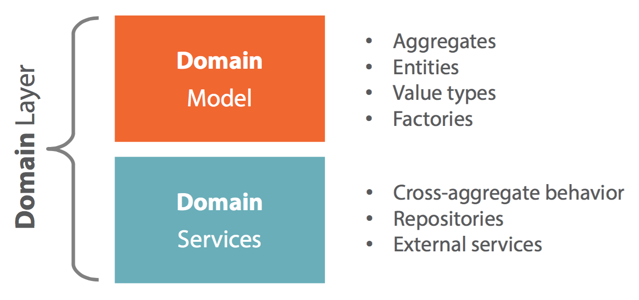
Domain Model Supporting Architecture

Slide 13
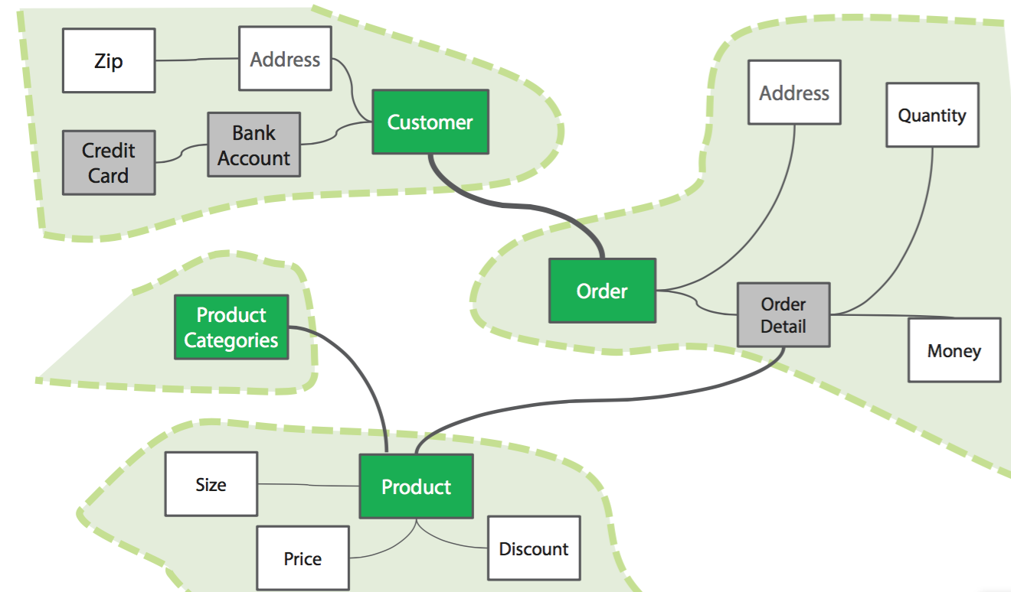
Domain Models and Bounded Contextes

Slide 14
Persistence vs. Domain Model
Persistence Model
Object-oriented model 1:1 with underlying relational data
Reliable and familiar to most developers
Doesn’t include business logic (except validation)
Domain Model
Object-oriented model for business logic
Persistable model
No persistence logic inside

Slide 15
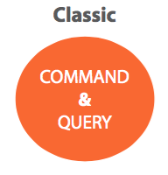
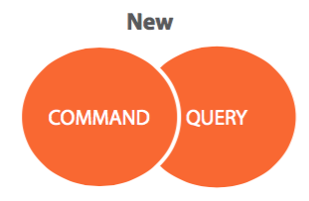
Command Query Responsibility Segregation
Benefits
Distinct optimization
Potential scalability
Side effects
Simplified design
Hassle-free stacks enhancement

Slide 16
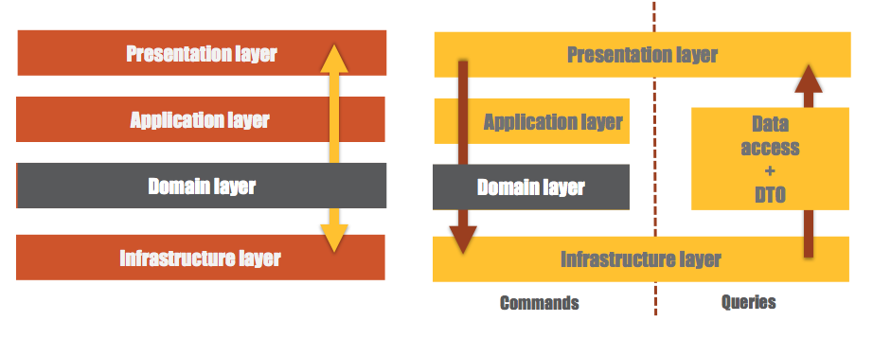
Command Query Responsibility Segregation
Canonical Layered Architecture
CQRS

Slide 17
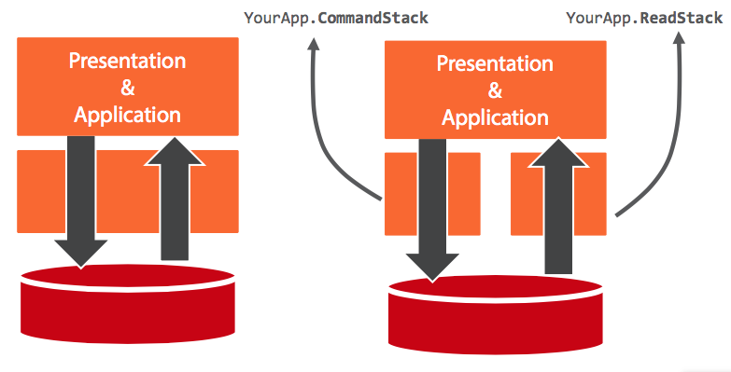
CQRS for plain CRUD Applications

Slide 18
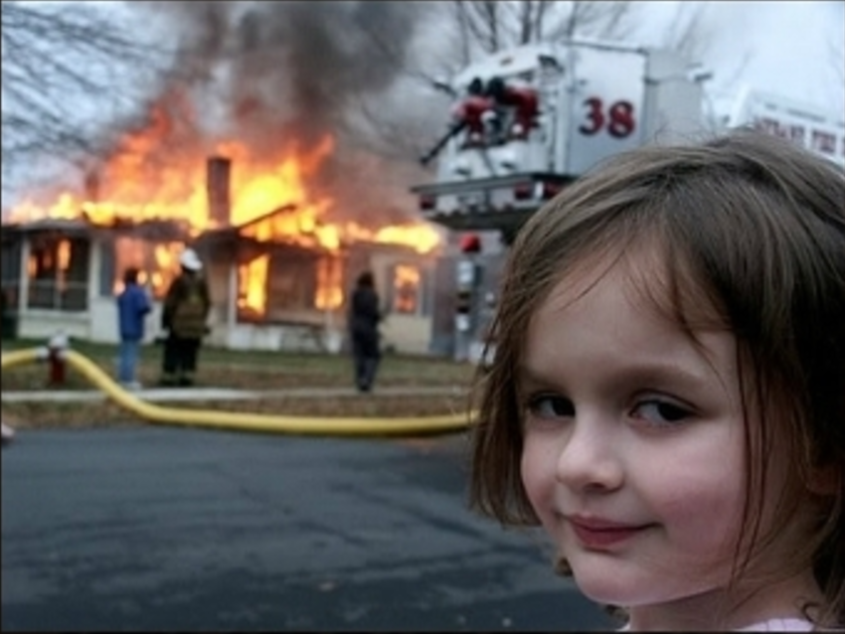
Practical aspects
Let’s see some code

