Slide 1
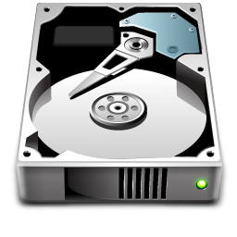
VDEV
VDEV
ZPOOL
Dataset
Dataset
Dataset
Dataset
ZVOL

Slide 2
RAID-10 (1+0)
Stripe of mirrors
Single
Mirror
RAIDZ-1
VDEV
VDEV
VDEV
VDEV - Mirror-0
VDEV - Mirror-1
VDEV - Mirror-2
ZPOOL
RAID | Minimum Drives | Parity | Acceptable Drive Failure
Dynamic Stripe
Mirror
RAIDZ
RAIDZ-2
RAIDZ-3

Slide 3
Data Changes (C)
Snapshot 2
Snapshot 2
Data Changes (B)
Data Changes (B)
Snapshot 1
Snapshot 1
Snapshot 1
Data (A)
Data (A)
Data (A)
Delete Changes B
Result: Files are shown as deleted to the OS, however they are not really deleted from the storage. You could recover with a rollback of snapshot 2 (which will delete changes C).
Delete Snapshot 2
Result: Snapthot 2 is deleted. Files in data changes B are fully marked deleted
Delete Snapshot 1
Result: Snapshot 1 is deleted. Files are not touched
Data Changes (C)
Snapshot 2
Data Changes (B)
Data Changes (C)
Snapshot 1
Snapshot 1
Data Changes (C)
Data (A)
Data (A)
Data (A)

Slide 4
Data Changes (C)
Snapshot 2
Data Changes (B)
Snapshot 1
Snapshot 2
- Data changes (B)
- Data (A)
Data (A)
Snapshot 1
- Data (A)

