Slide 1
Helicopter Ground Transportation
Market Analysis
Complete Analysis: Data to Strategic Recommendations
7 Cities • 197 Premium ZIPs • 21 Clusters • 3.1M Flights

Slide 2
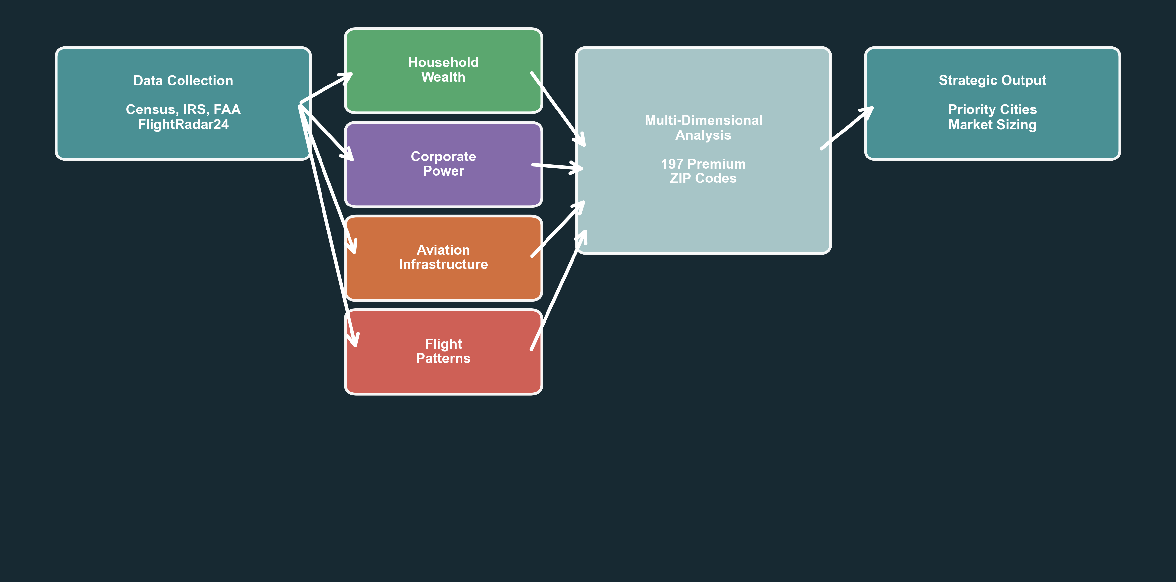
Project Scope & Methodology
2

