Slide 1
Helicopter Ground Transportation
Market Analysis
Data-Driven Site Selection for Premium Air Mobility Services
7 Cities Analyzed • 197 Premium ZIP Codes • 3.1M Premium Flights

Slide 2
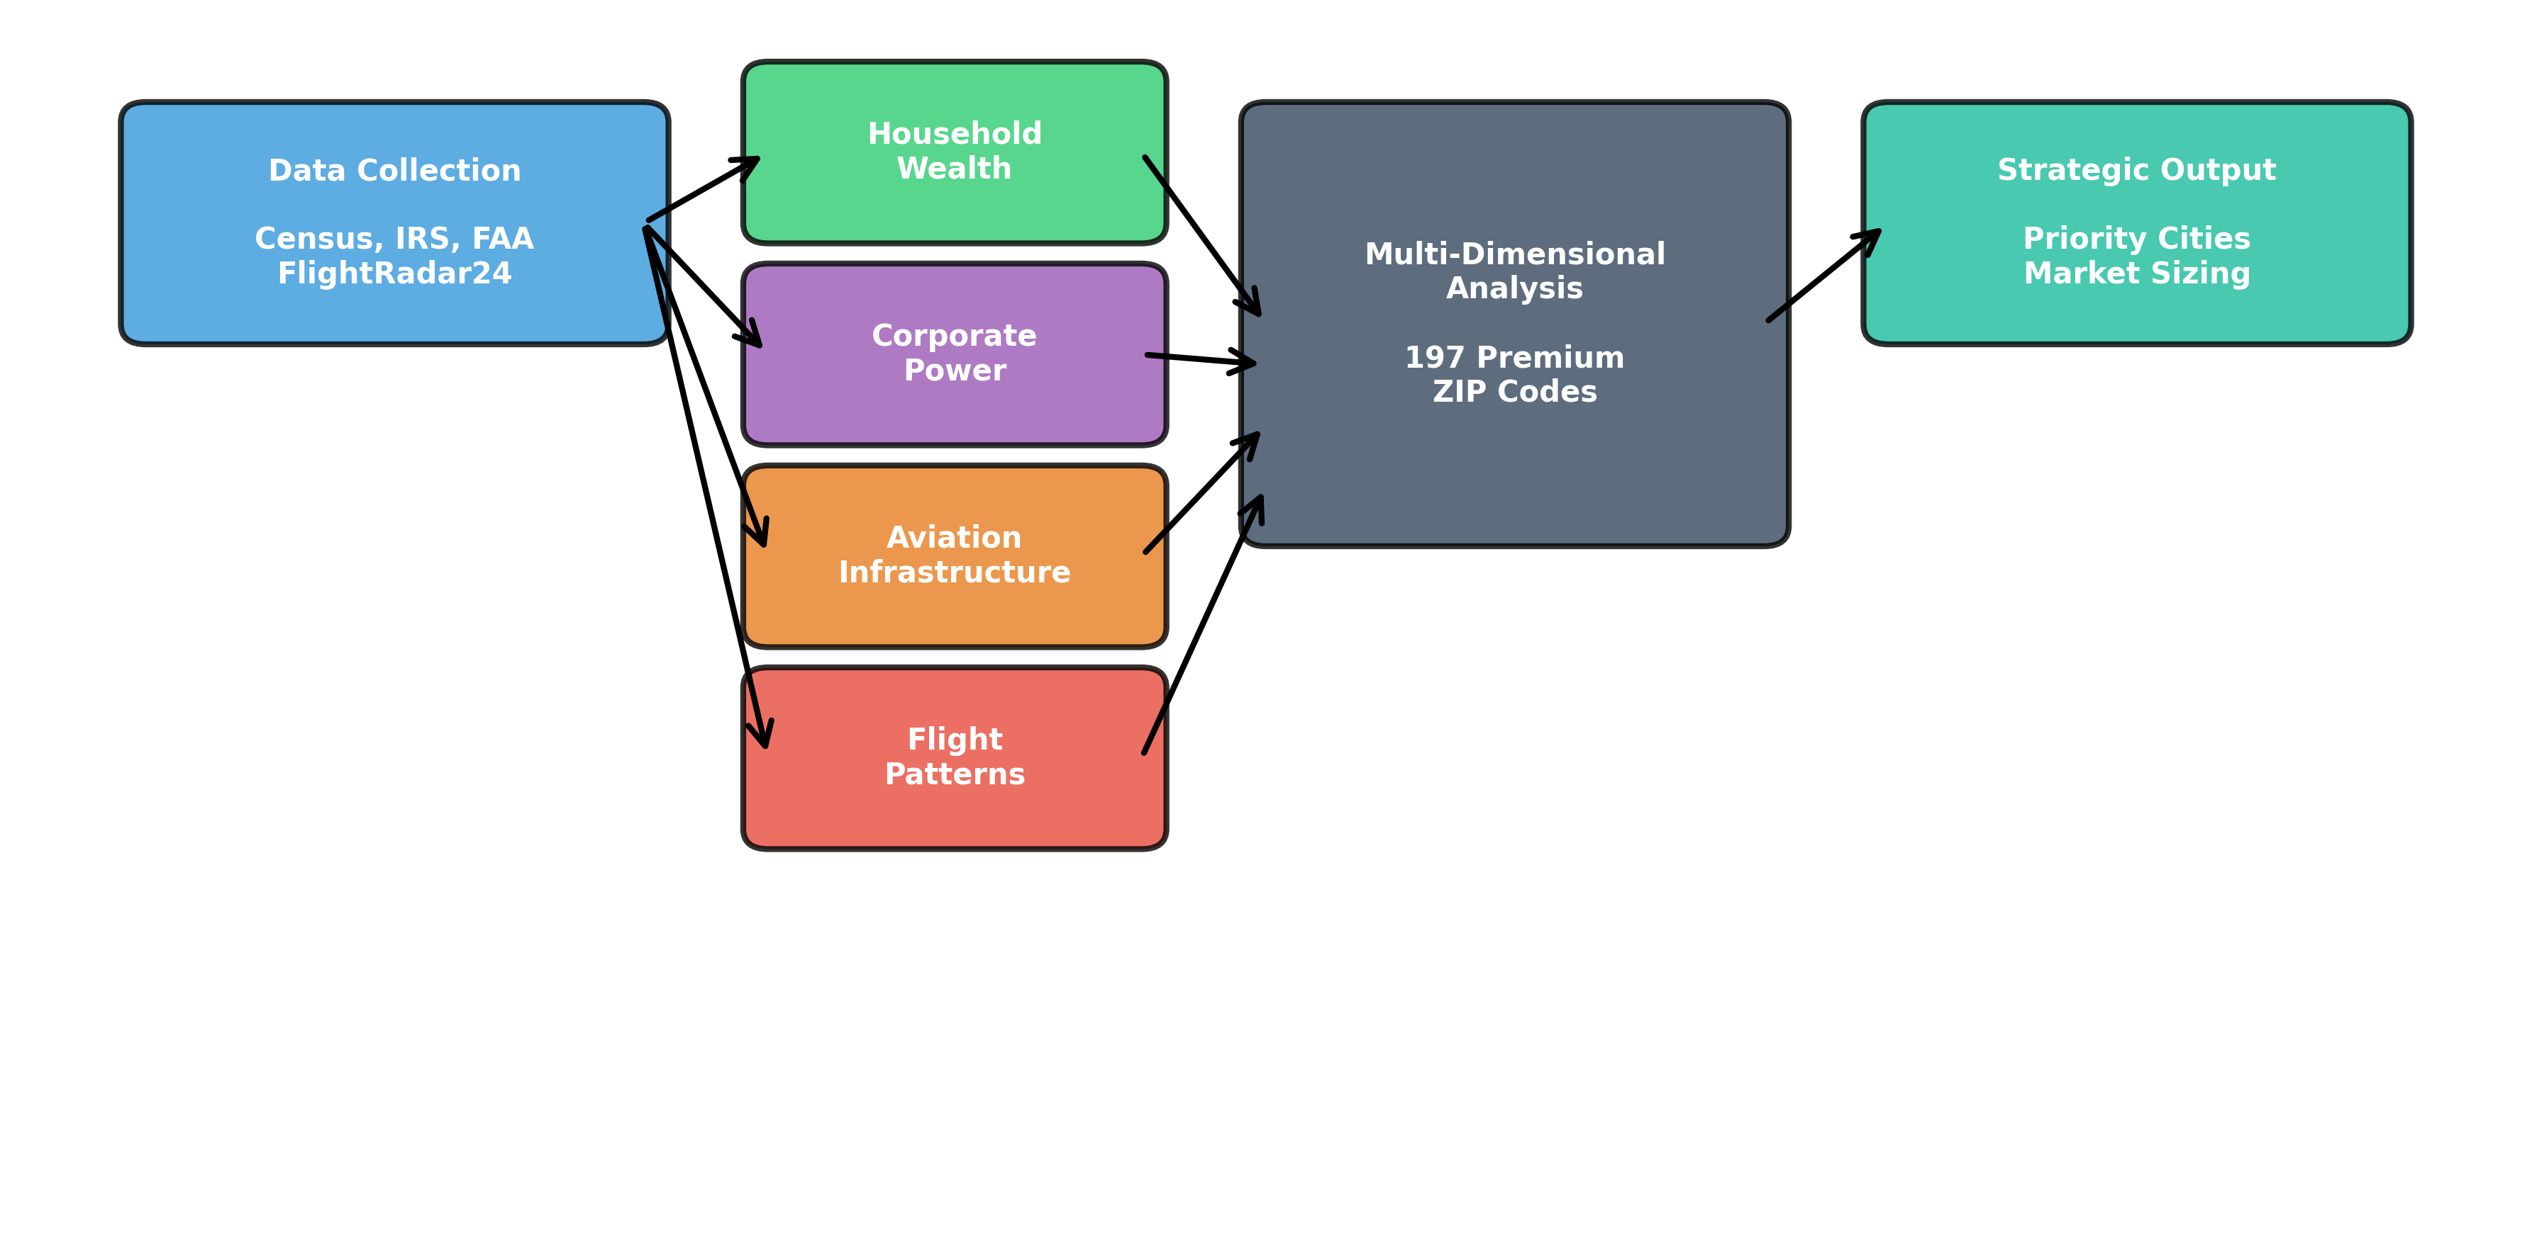
Project Scope & Methodology
Key Question: "Where should REVO expand helicopter services?"

Slide 3
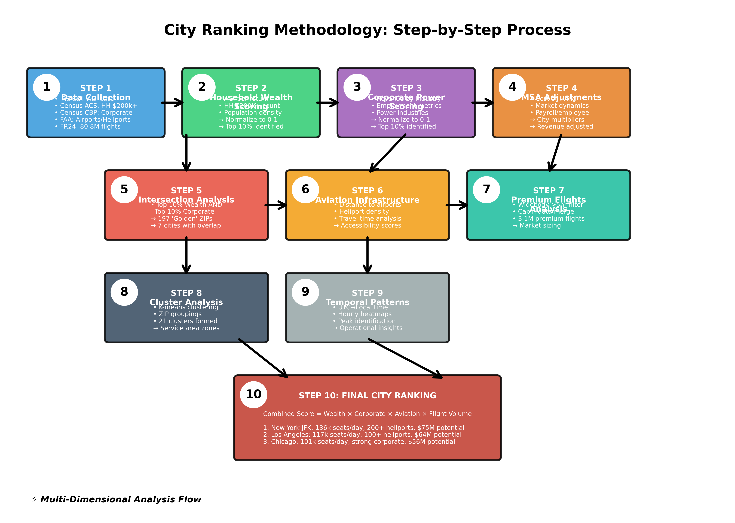
City Ranking Methodology: 10-Step Process

Slide 4
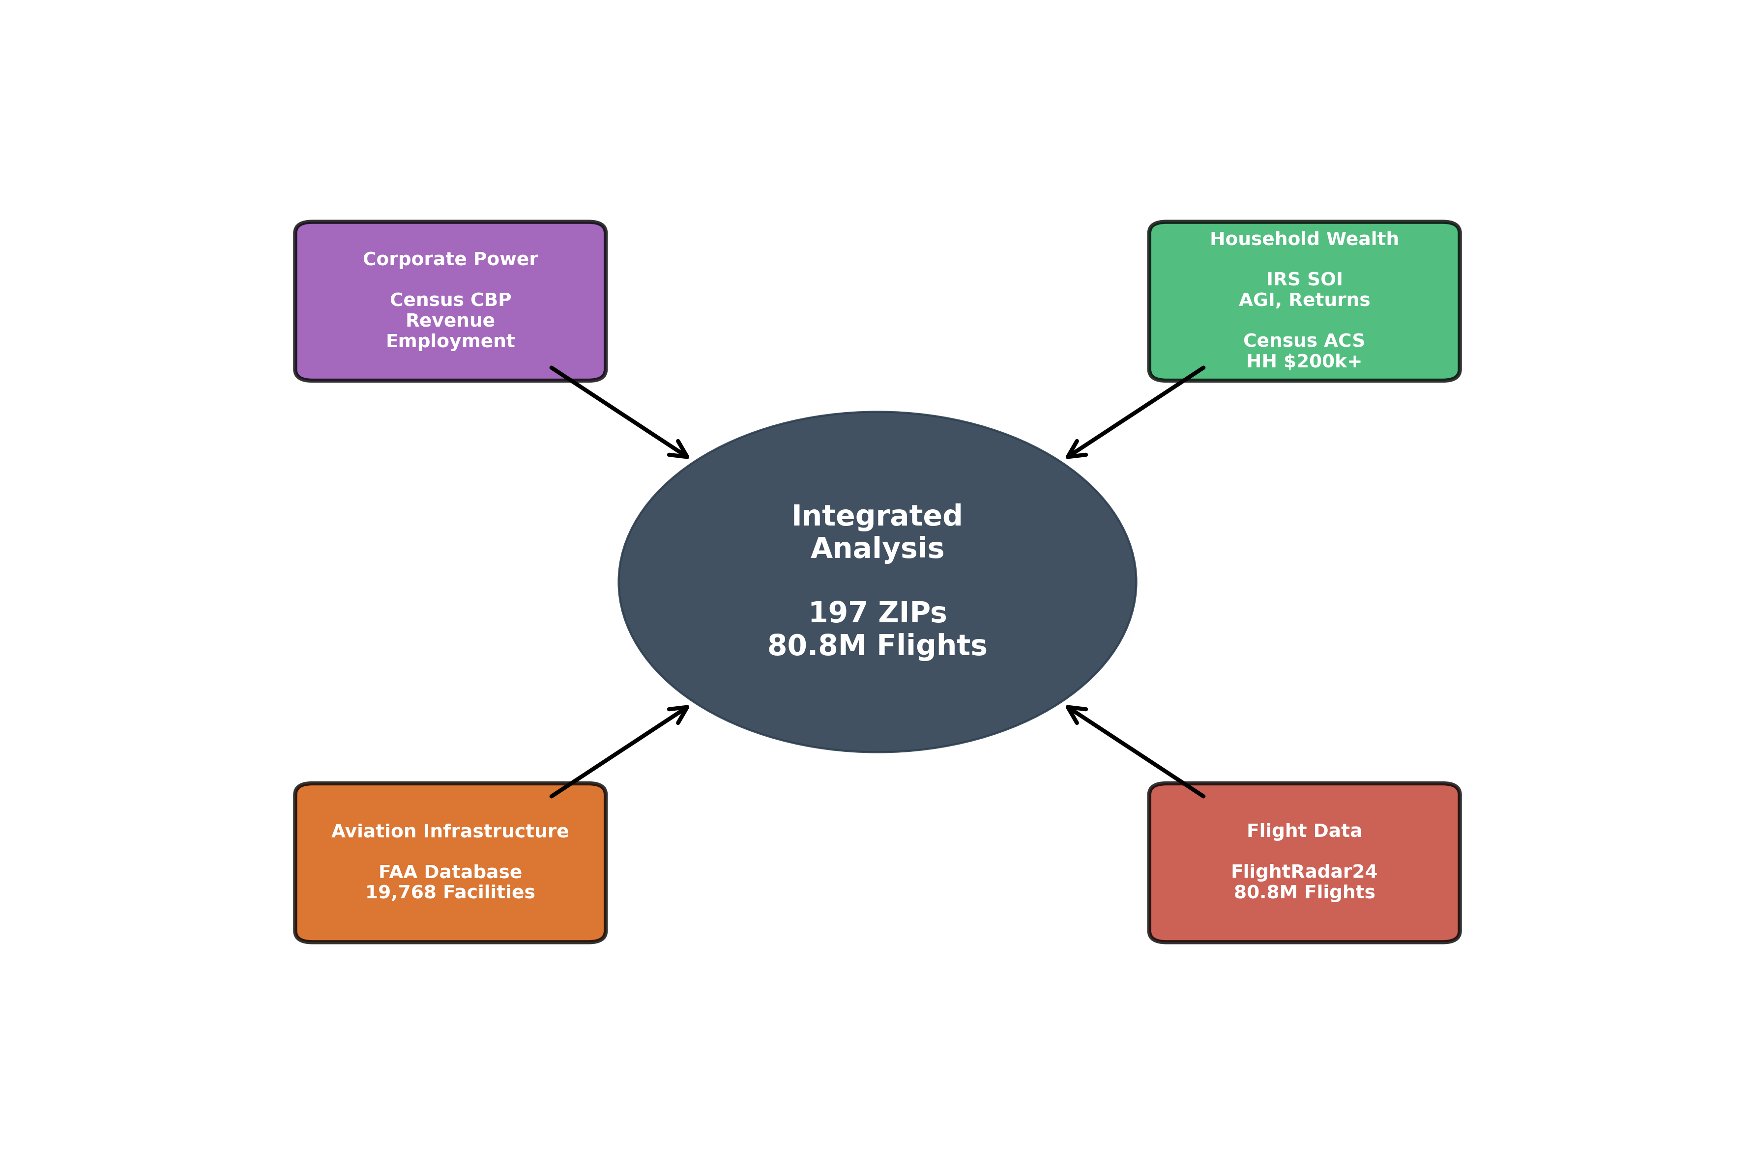
Data Sources & Integration
Data Volume: 80.8M Flights Analyzed • 197 Premium ZIPs Identified • 6 Major Airports

Slide 5
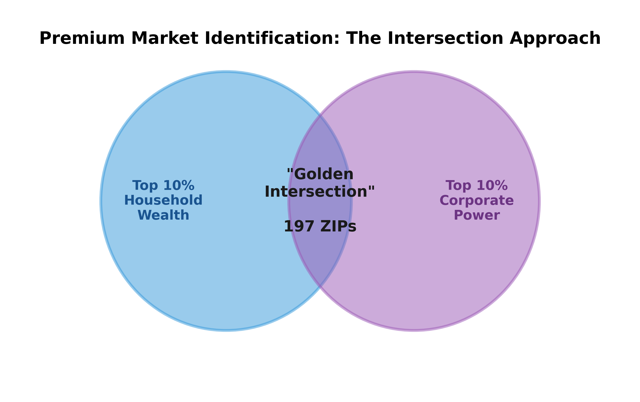
City Selection: Top 10% Intersection Analysis
City | Intersection ZIPs | HH $200k+
New York | 68 | 476,000
Los Angeles | 45 | 170,000
San Francisco | 31 | 140,000
Dallas | 22 | 95,000
Chicago | 19 | 120,000
Houston | 8 | 65,000
Miami | 4 | 55,000
197 Premium ZIP Codes identified across 7 cities combining high household wealth and strong corporate presence

Slide 6
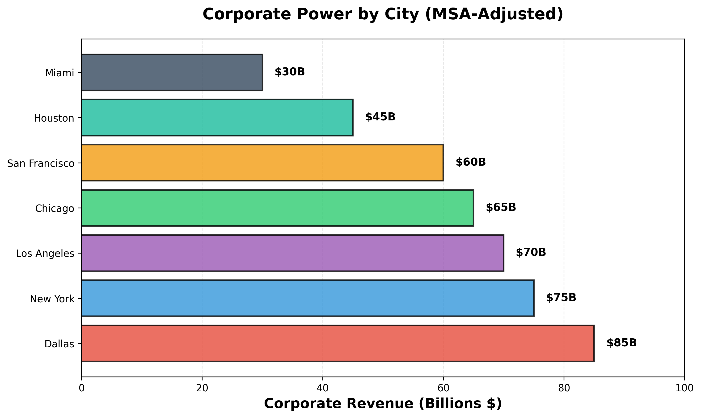
Corporate Power Analysis
• Dallas: Largest corporate base after MSA cost-of-living adjustments
• San Francisco: Highest revenue per employee ($450k avg) - tech dominance
• New York: Most diverse industry mix (Finance, Legal, Media, Real Estate)
• Key Industries: Finance, Technology, Professional Services, Healthcare

Slide 7
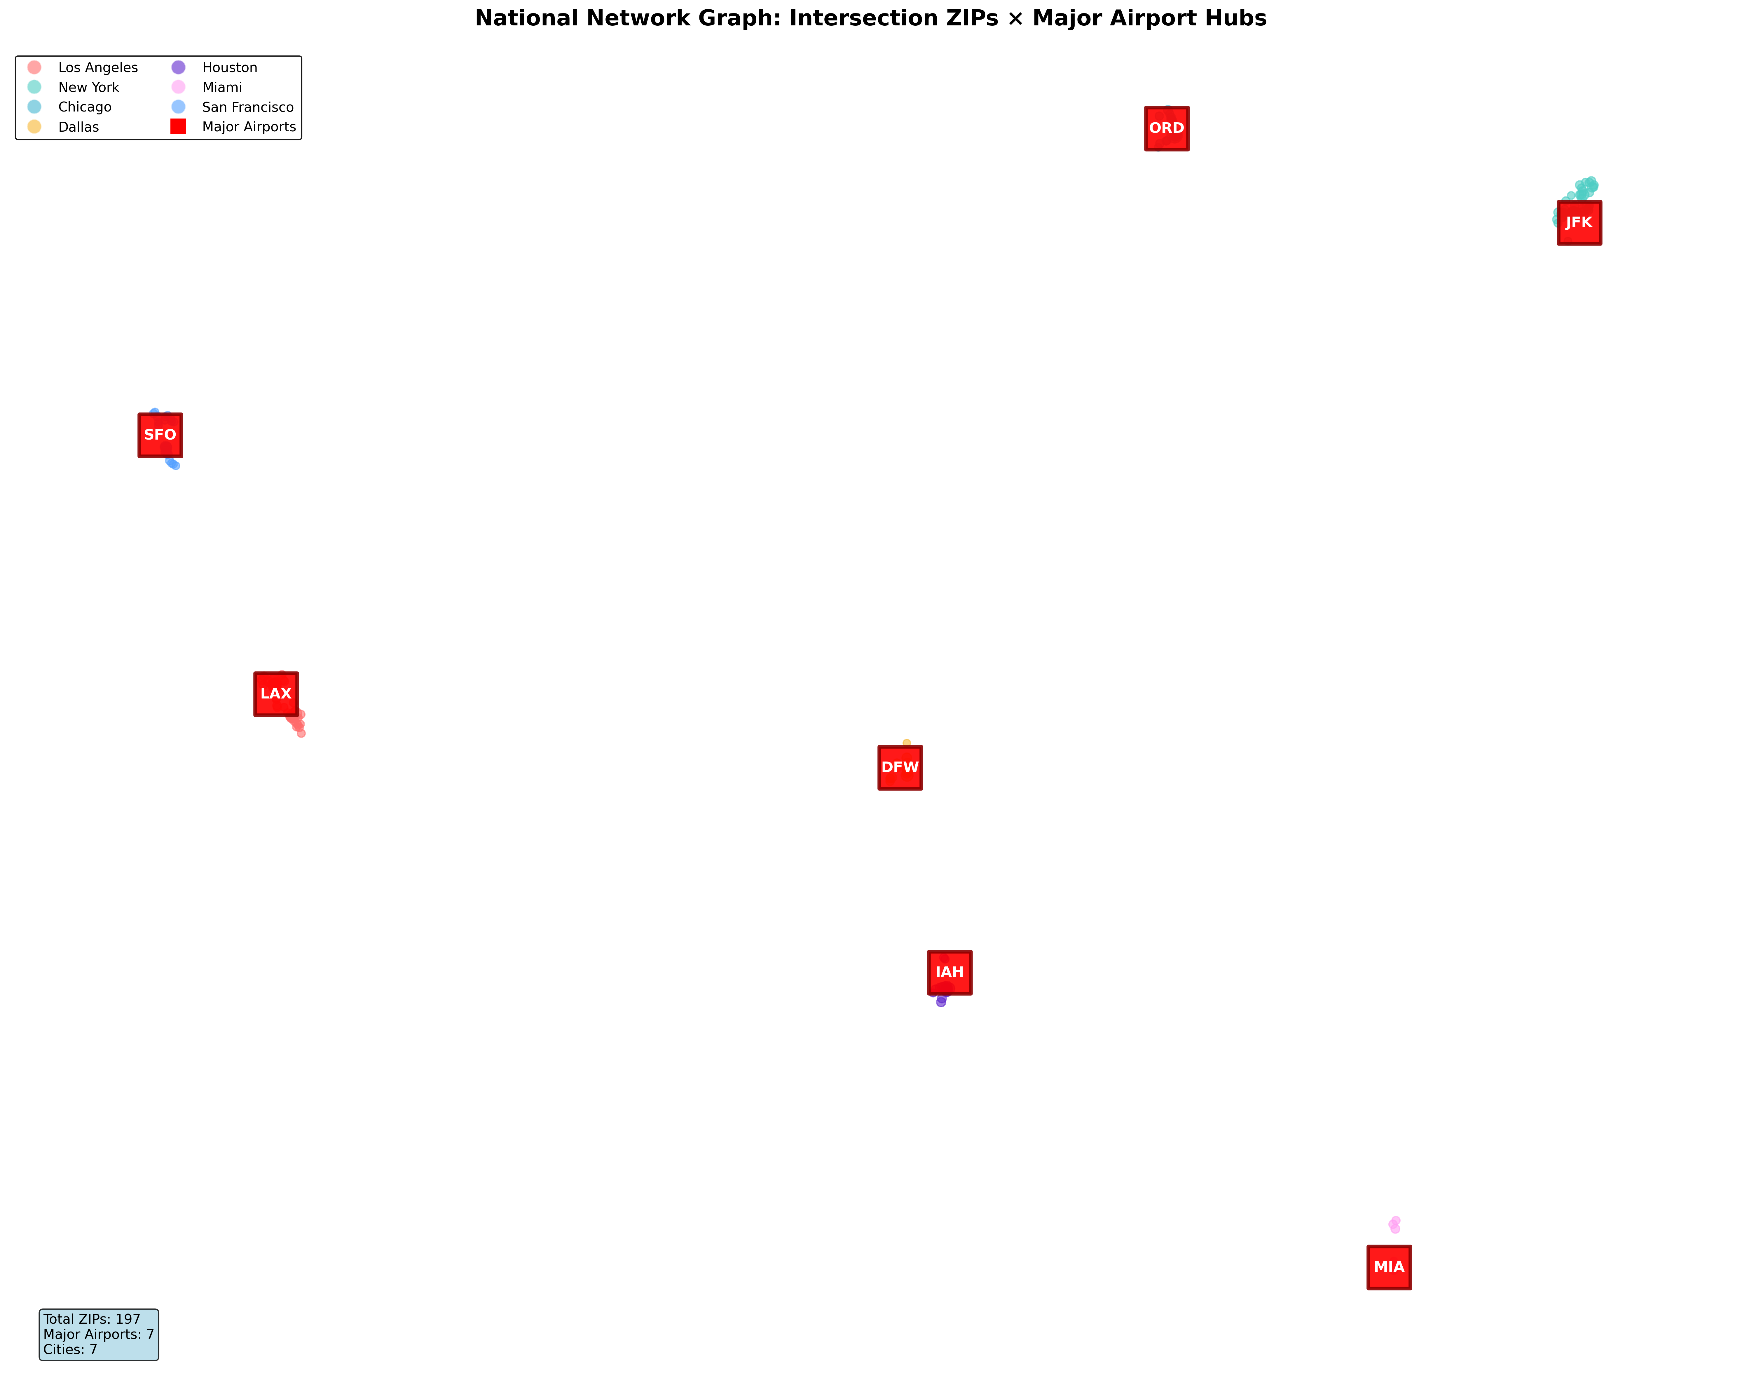
Airport & Heliport Infrastructure + Cluster Analysis
• 197 premium ZIPs clustered into 21 groups around major aviation hubs
• 30% of ZIPs have heliport within 5km • 60% within 10km
• NYC: 200+ heliports • LA: 100+ heliports • Strong existing infrastructure

Slide 8
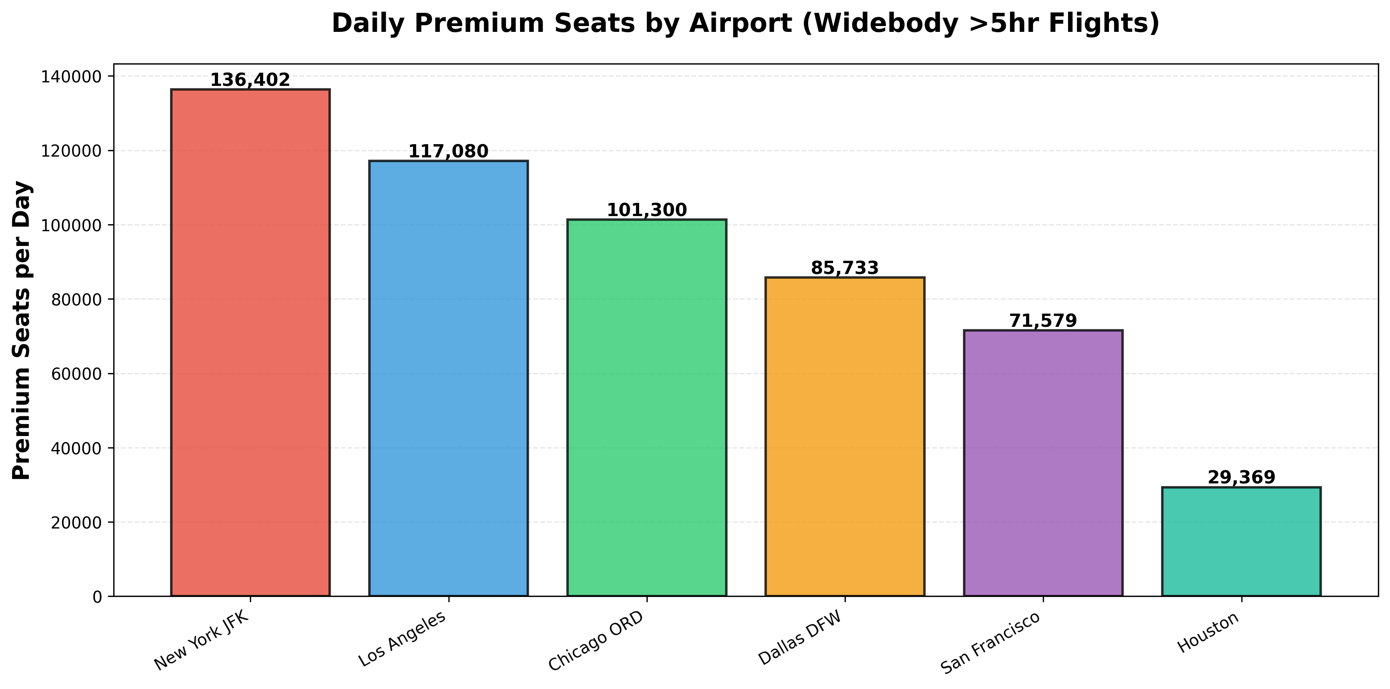
Premium Flights Market Analysis
Focus: Widebody aircraft only (B787, B777, A330, A350) with flights >5 hours
Boeing 787 dominance: 40% of all premium flights (1.25M flights/year)
B787-10 most luxurious: 142 premium seats average (First + Business + Premium Economy)
Total Market: 541,464 premium seats/day across 6 airports

Slide 9
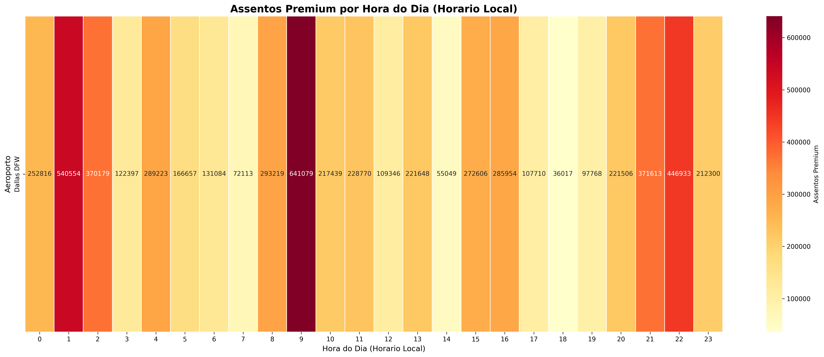
Peak Hours for Premium Passengers (Local Time)
Morning Peak (9-11am): Highest arrivals
Evening Peak (5-7pm): Secondary rush
Operational Insight: Helicopter fleet must be positioned pre-9am for morning peak

Slide 10
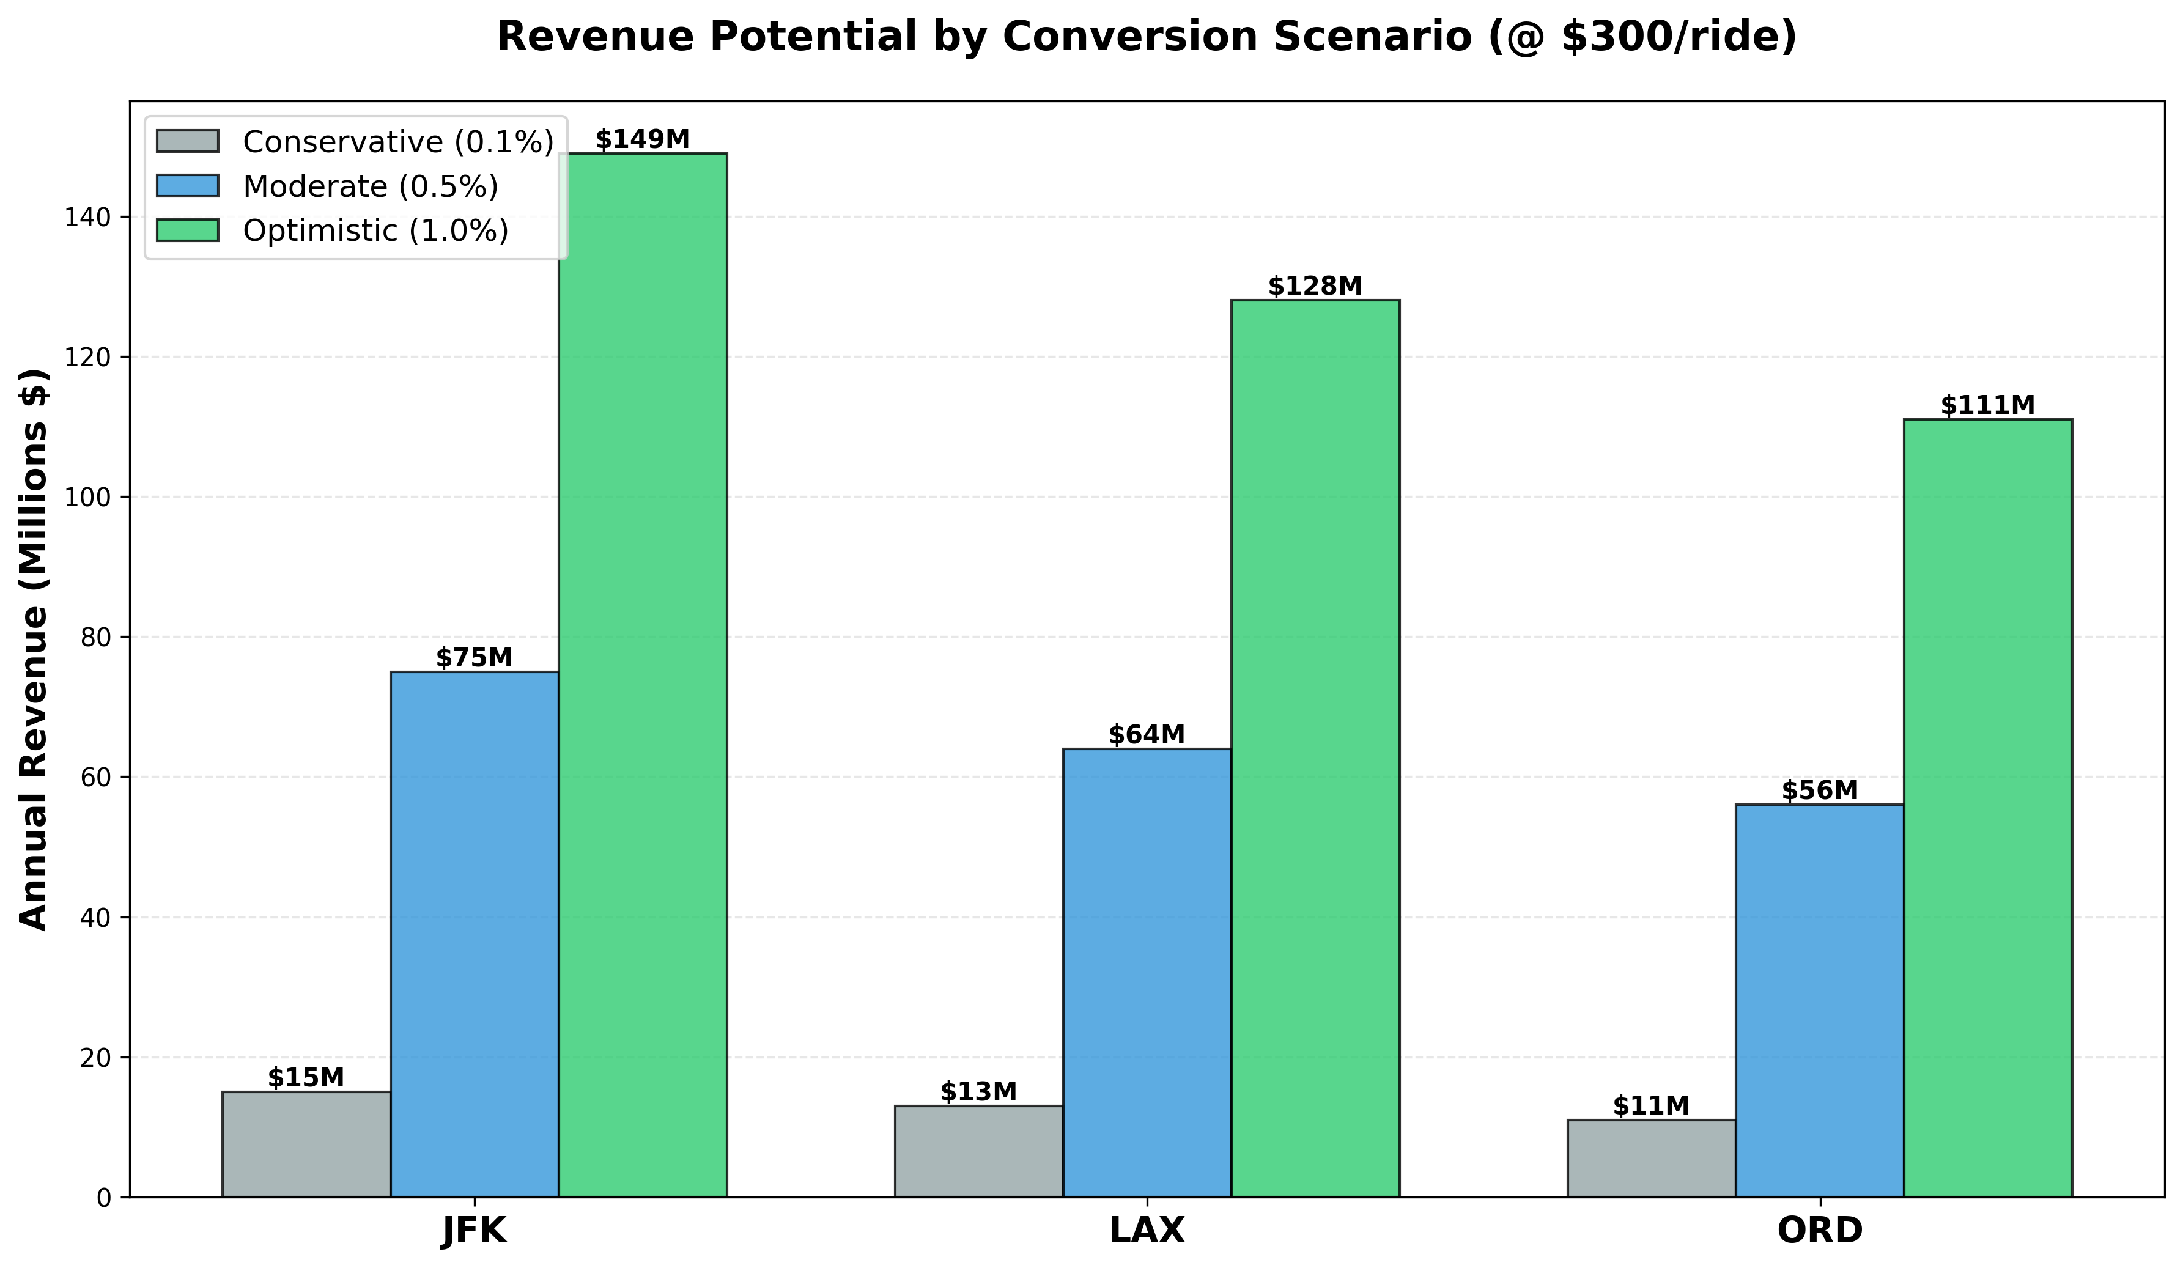
Market Potential & Revenue Scenarios
Scenario | JFK | LAX | ORD | Total
Conservative (0.1%) | $15M | $13M | $11M | $39M
Moderate (0.5%) | $75M | $64M | $56M | $194M
Optimistic (1.0%) | $149M | $128M | $111M | $389M

Slide 11
Strategic Recommendations & Next Steps
Priority 1: New York JFK
• Largest market: 136k premium seats/day
• Established heliport infrastructure (200+ facilities)
• Severe traffic congestion = high value proposition
Priority 2: Los Angeles LAX
• Second largest: 117k premium seats/day
• Existing helicopter culture and acceptance
• Geographic spread favors aerial transport
Priority 3: Chicago ORD
• Third largest: 101k premium seats/day
• Highest avg seats/flight (90.8) = larger aircraft, more passengers
• Central US hub with strong corporate base
Implementation Timeline:
Phase 1 (Q1): Detailed route analysis + pricing strategy development
Phase 2 (Q2): Partnership discussions with FBOs and heliport operators
Phase 3 (Q3): Pilot launch in Priority 1 market (New York JFK)

