Slide 1
Helicopter Ground Transportation
Market Analysis
Complete Analysis: Data to Strategic Recommendations
7 Cities • 197 Premium ZIPs • 21 Clusters • 3.1M Flights • 541k Premium Seats/Day

Slide 2
Presentation Roadmap
PART 1: METHODOLOGY (Slides 3-5)
Ranking process, data sources, integration
PART 2: MARKET IDENTIFICATION (Slides 6-9)
Household wealth, corporate power, intersection
PART 3: CLUSTER ANALYSIS (Slides 10-14)
What, why, how - Deep dive with diagrams
PART 4: PREMIUM FLIGHTS (Slides 15-18)
Market sizing, aircraft analysis, temporal patterns
PART 5: CITY DEEP DIVES (Slides 19-23)
New York, Los Angeles, Chicago, Dallas, San Francisco
PART 6: STRATEGIC RECOMMENDATIONS (Slides 24-27)
Priorities, revenue scenarios, roadmap
2

Slide 3
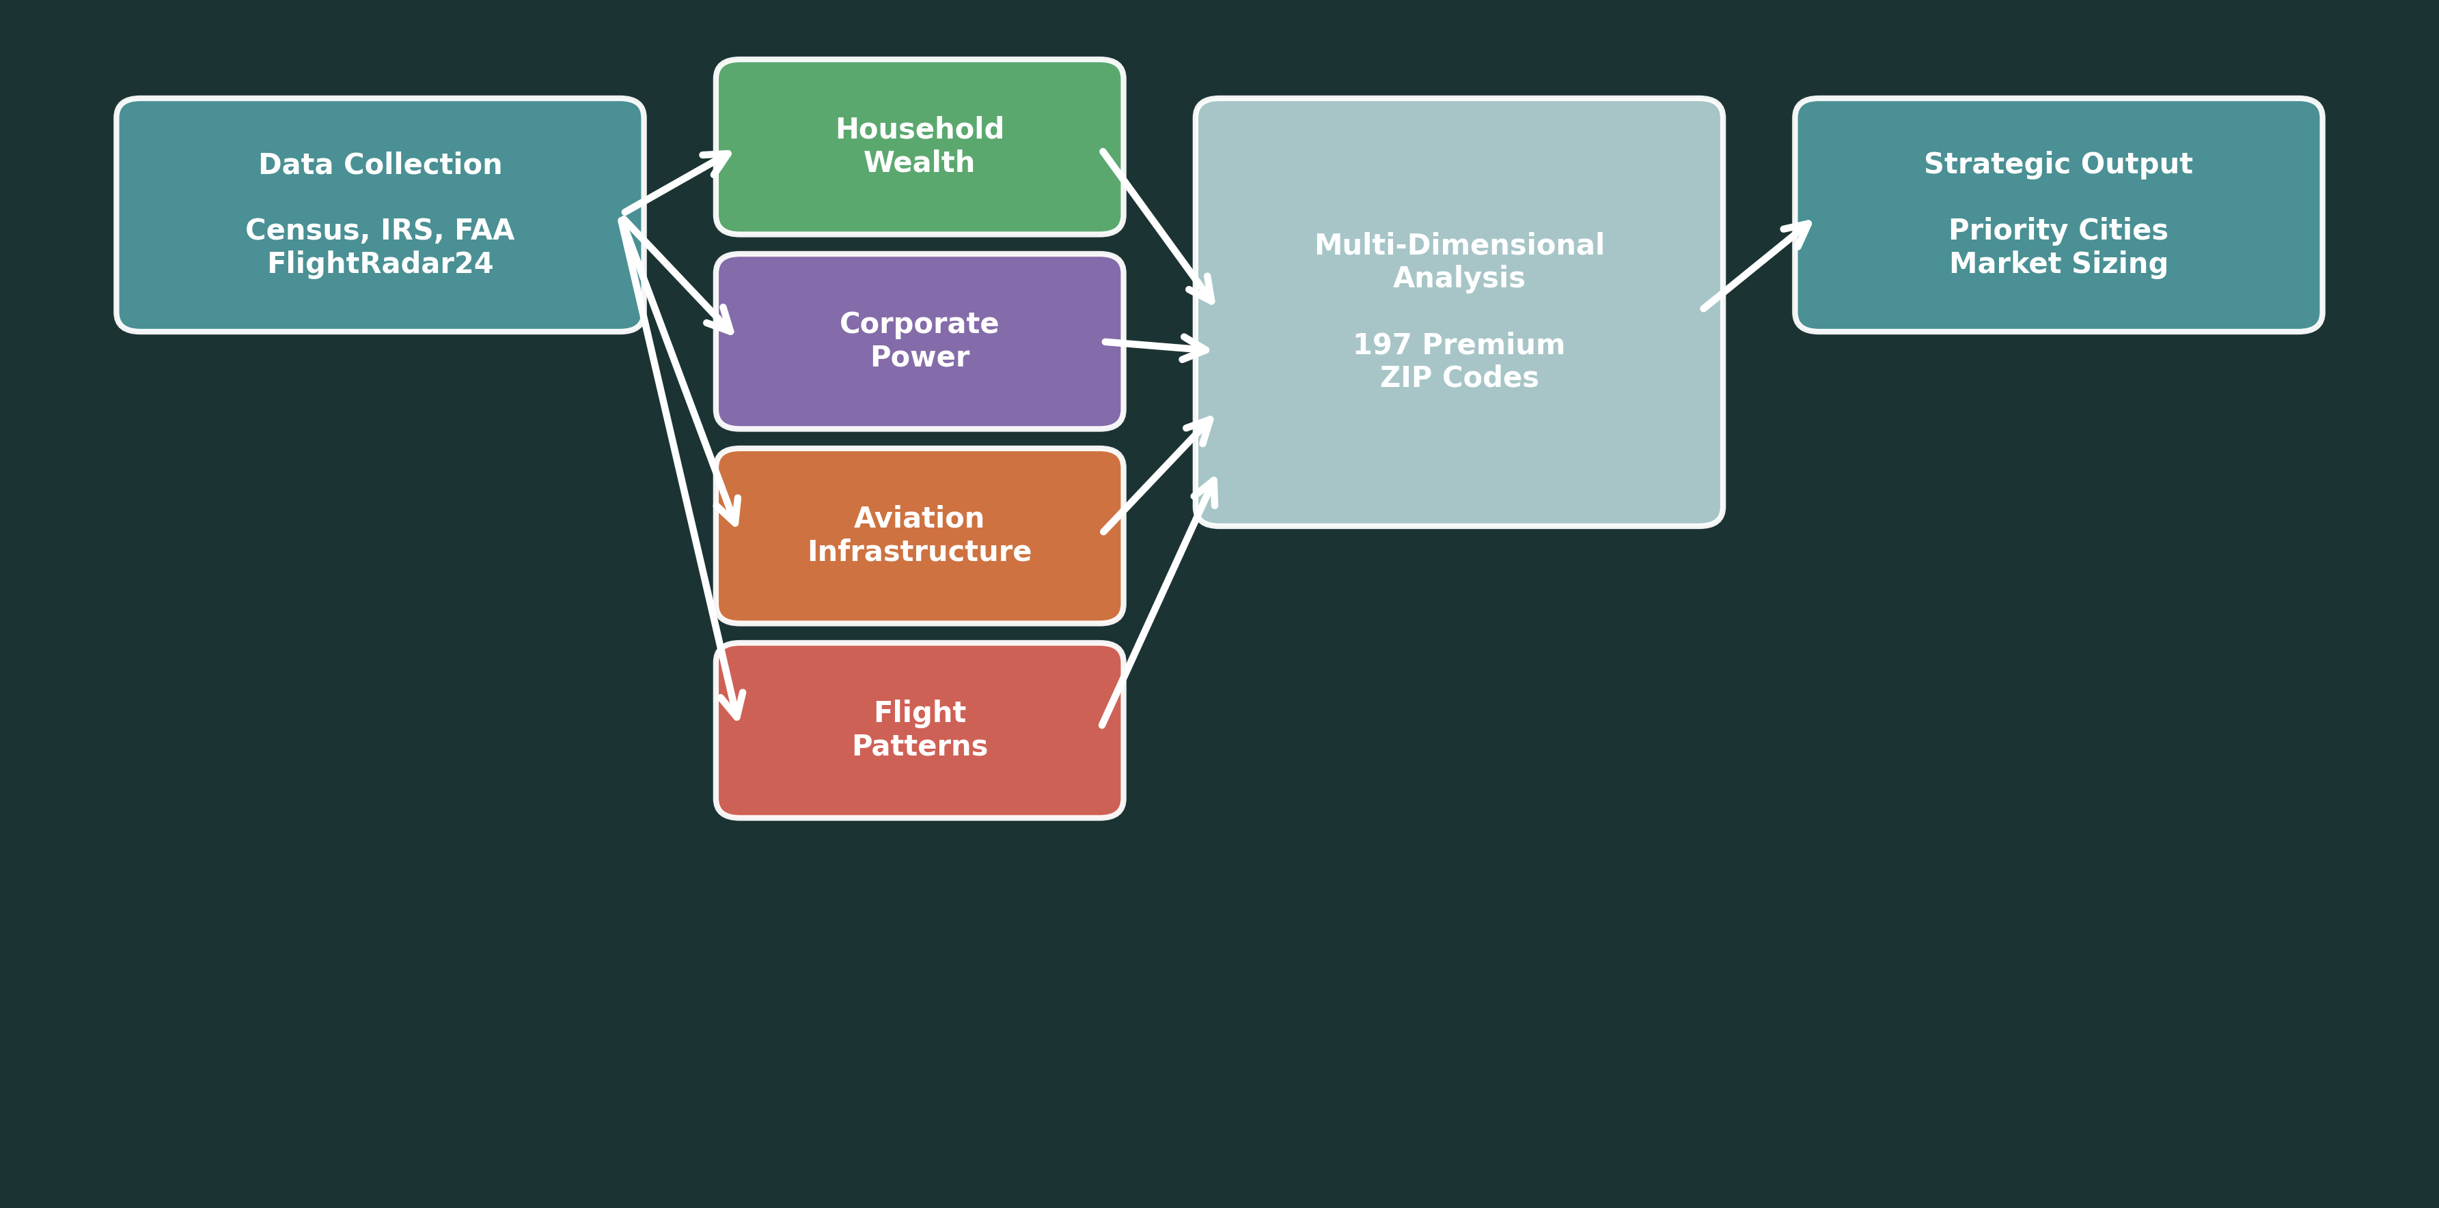
Project Scope & Methodology
Key Question: "Where should REVO expand helicopter services?"
3

Slide 4
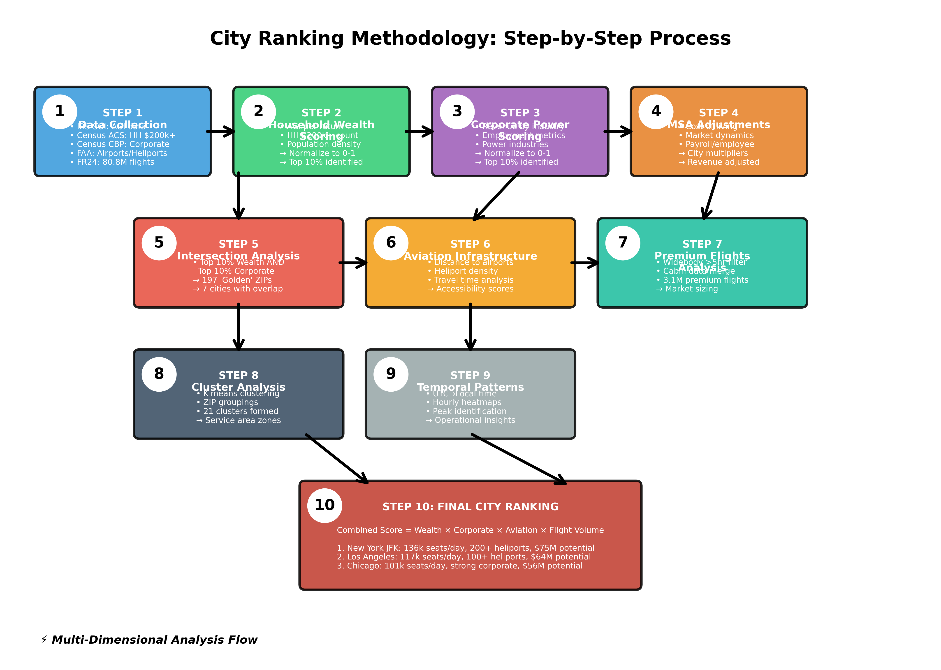
City Ranking Methodology: 10-Step Process
4

Slide 5
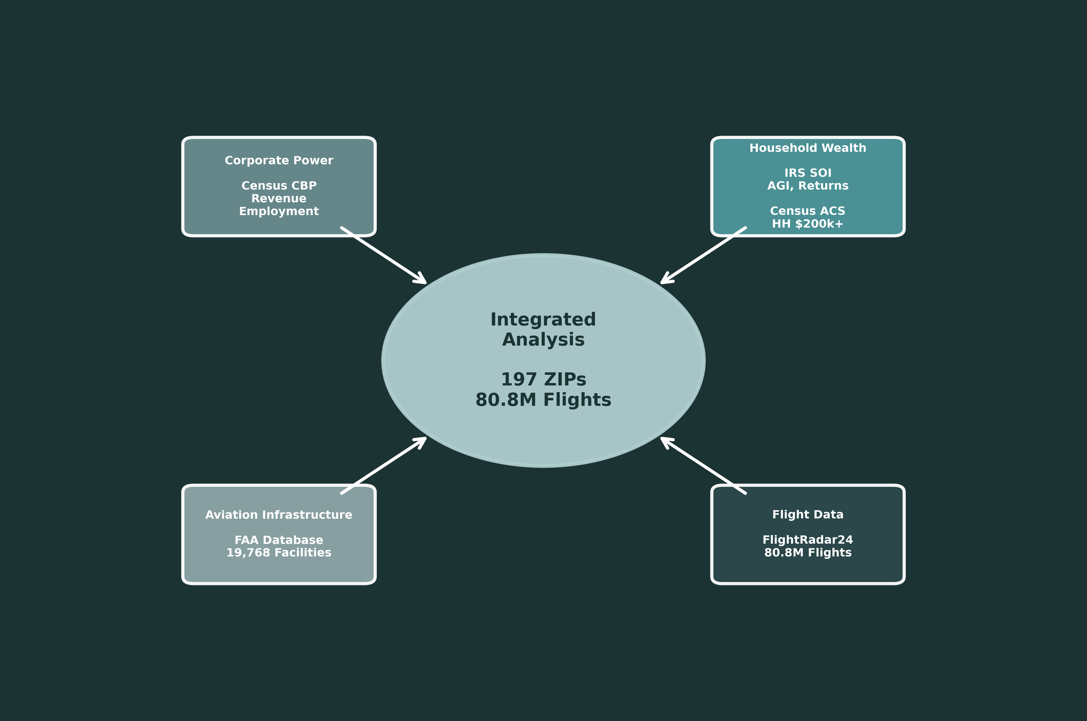
Data Sources & Integration
Data Volume: 80.8M Flights • 197 Premium ZIPs • 6 Major Airports
5

Slide 6
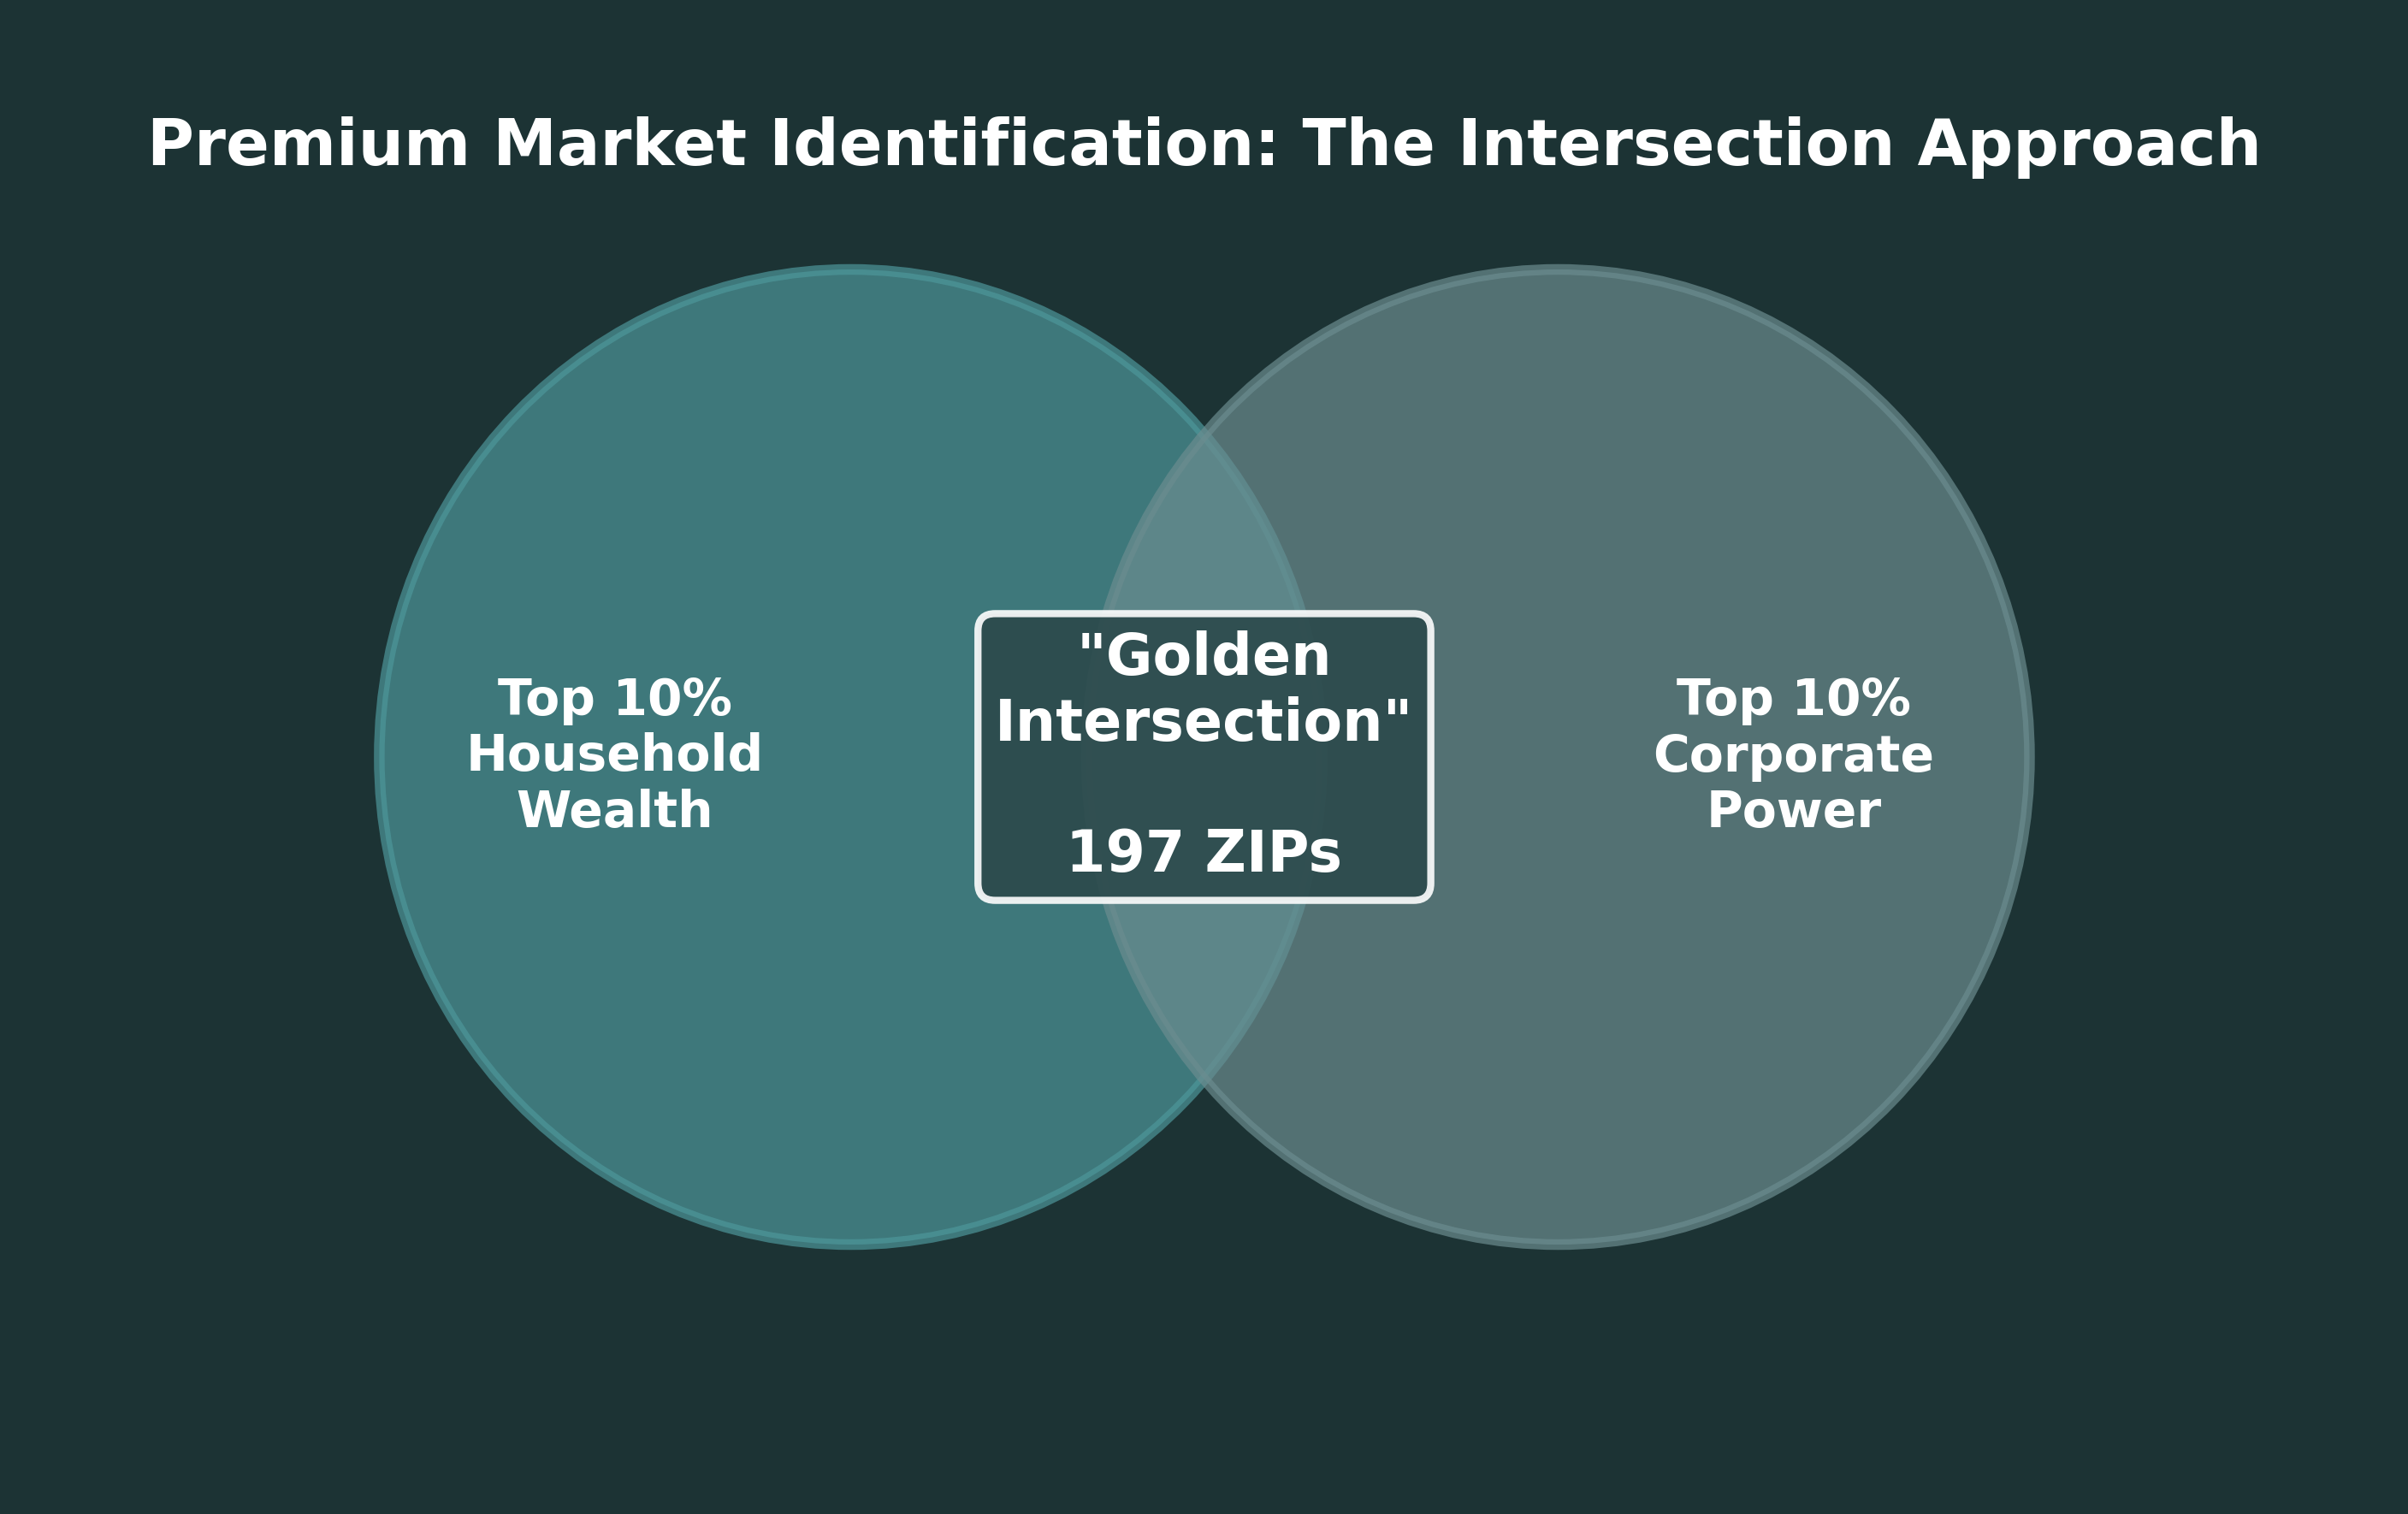
The 'Golden Intersection' Approach
City | Intersection ZIPs | HH $200k+
New York | 68 | 476,000
Los Angeles | 45 | 170,000
San Francisco | 31 | 140,000
Dallas | 22 | 95,000
Chicago | 19 | 120,000
Houston | 8 | 65,000
Miami | 4 | 55,000
6

Slide 7
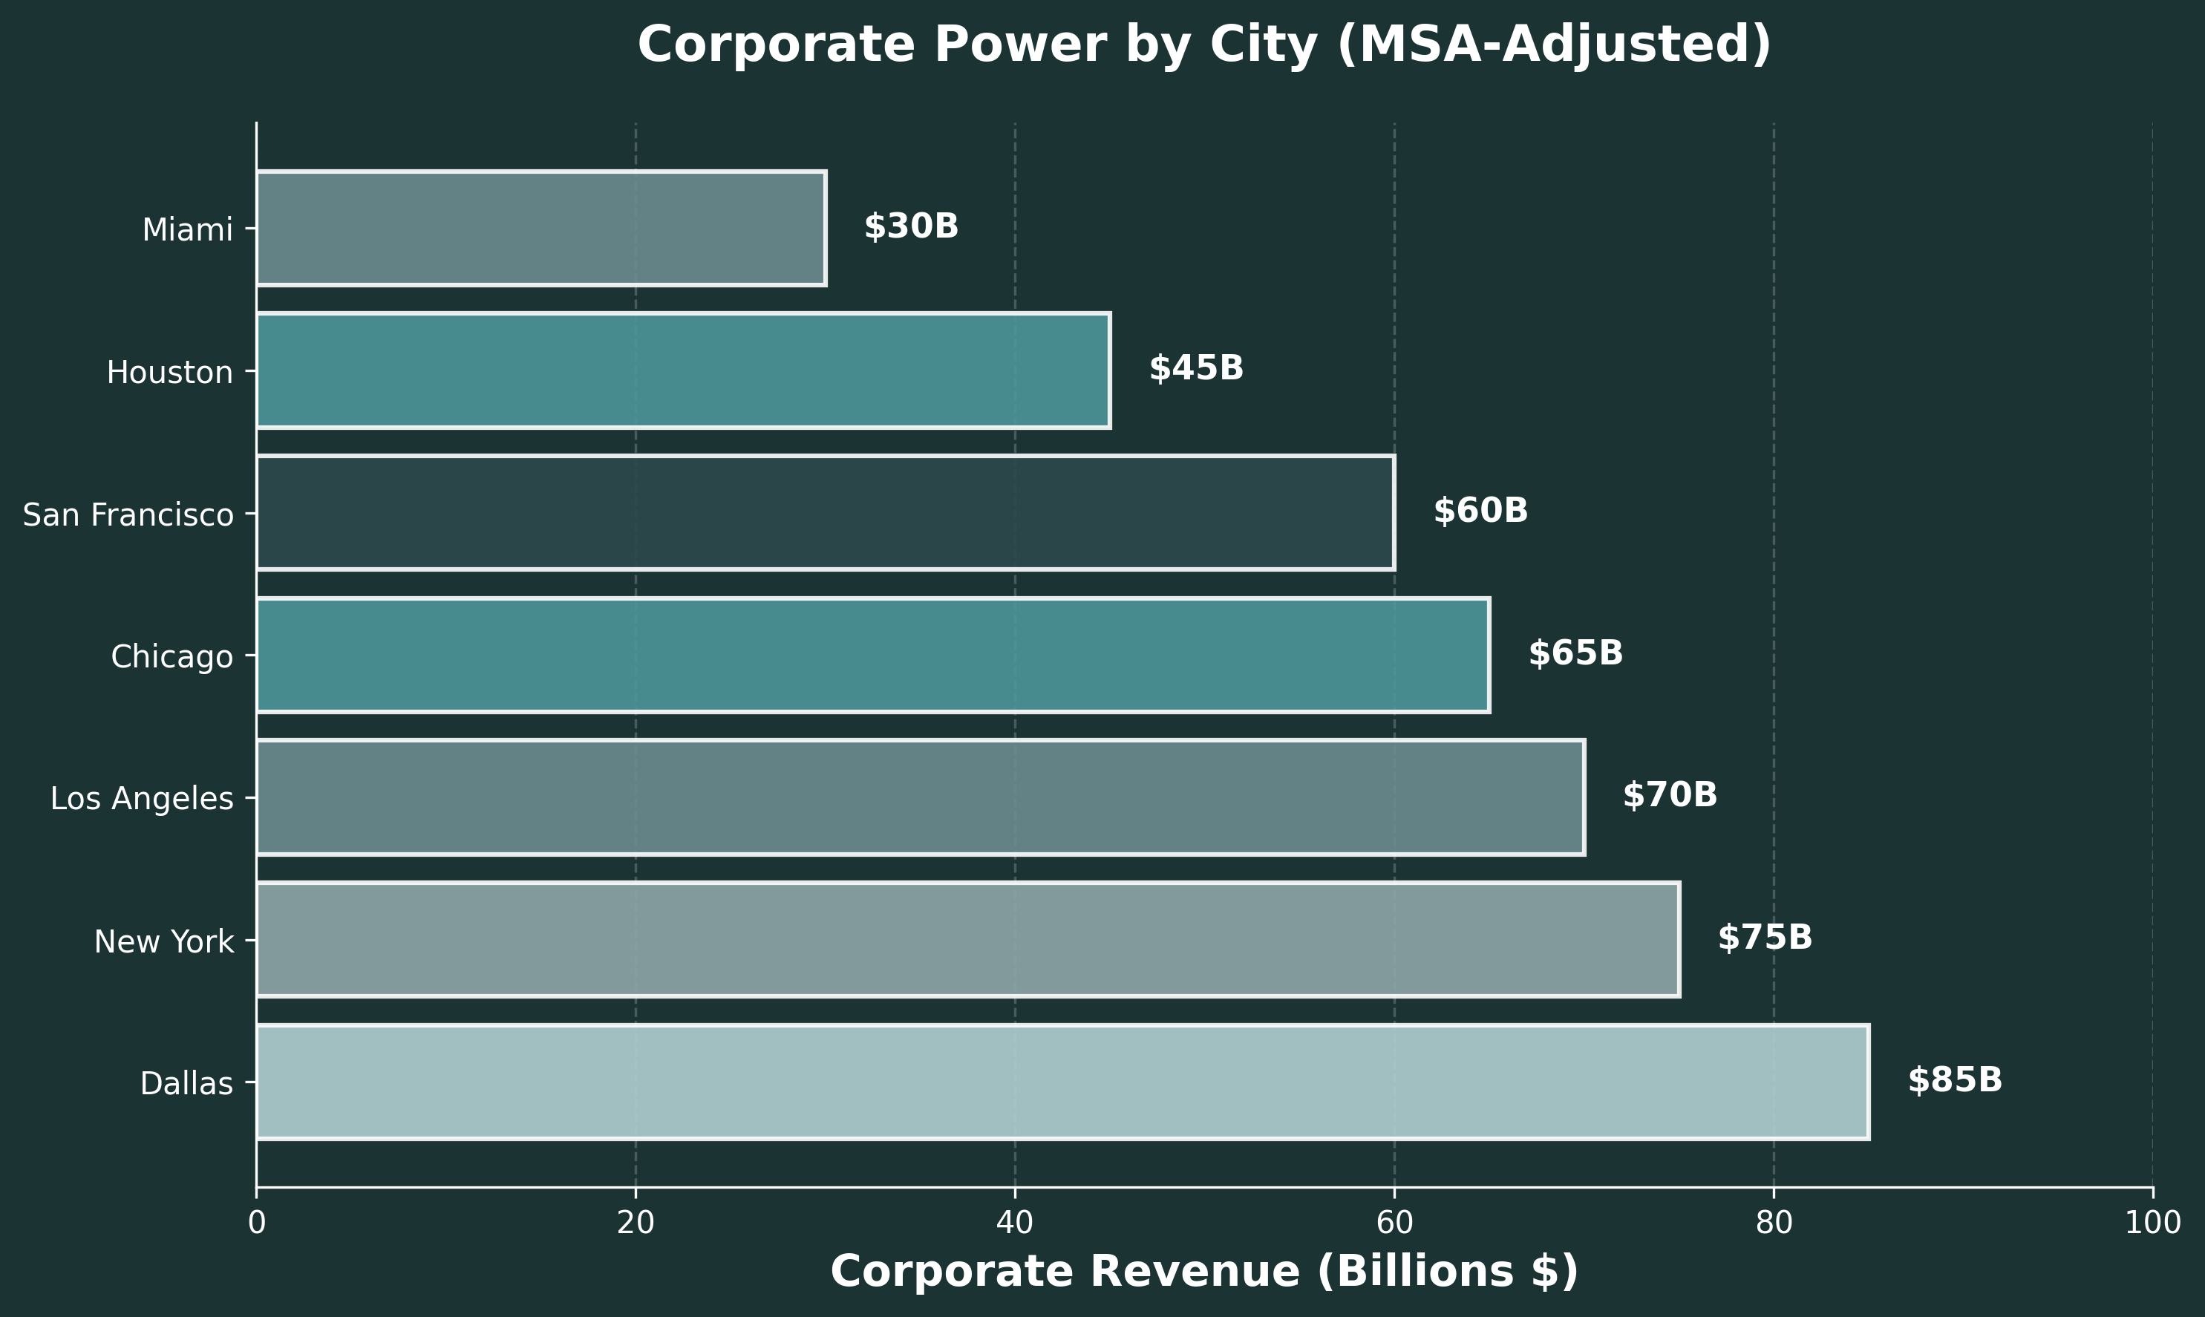
Corporate Power Analysis
7

Slide 8
Cluster Analysis: Deep Dive
Why did we cluster 197 premium ZIP codes?
1. Operational Efficiency: Group nearby ZIPs for optimized helicopter routes
2. Service Area Design: Define coverage zones and identify gaps
3. Market Segmentation: Tailor services and pricing by cluster characteristics
4. Resource Allocation: Position fleet and staff based on cluster demand
8

Slide 9
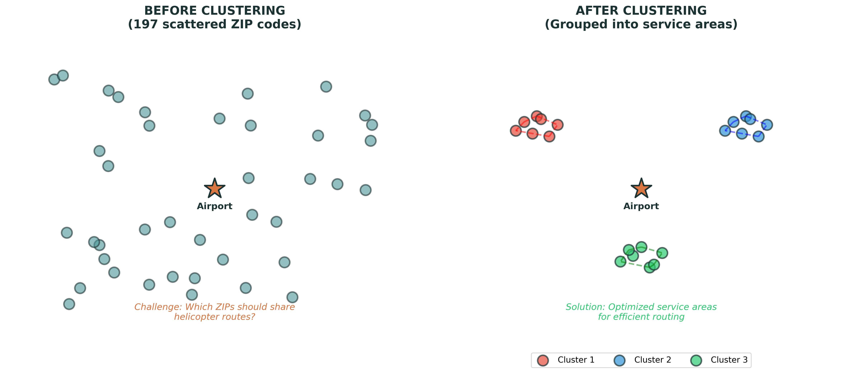
Clustering: Before & After
9

Slide 10
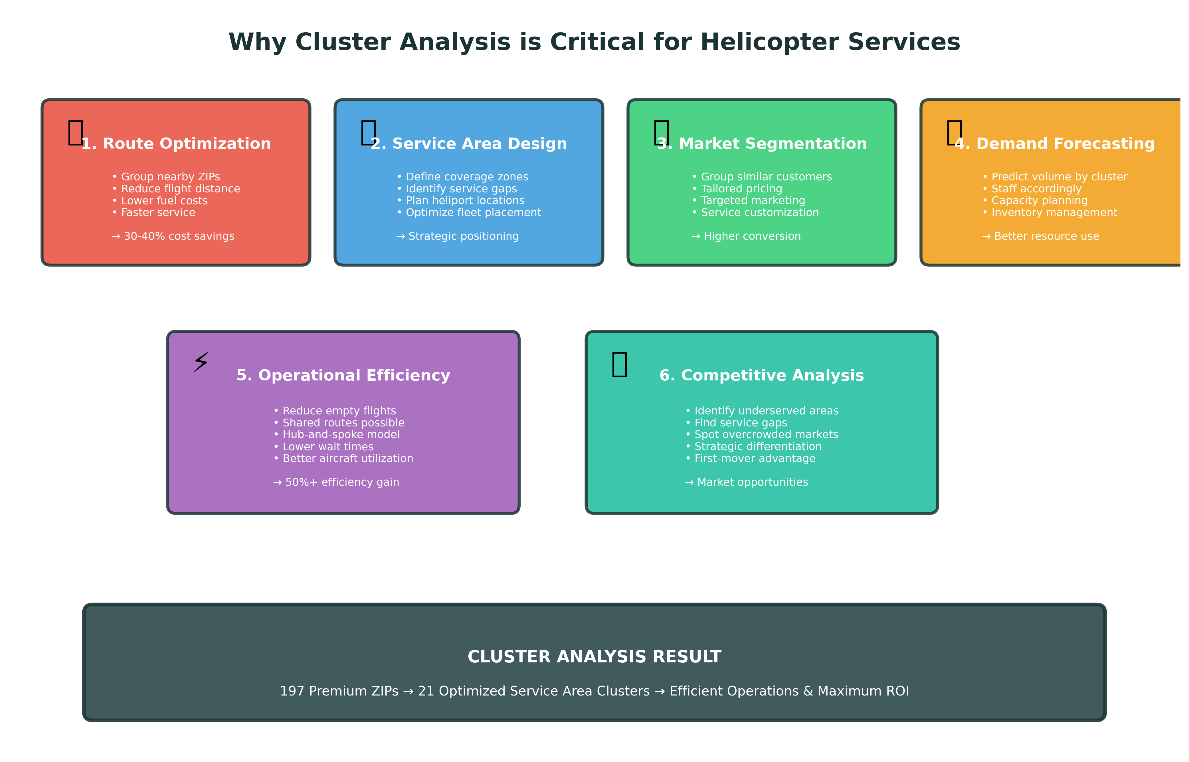
Why Cluster Analysis is Critical
10

Slide 11
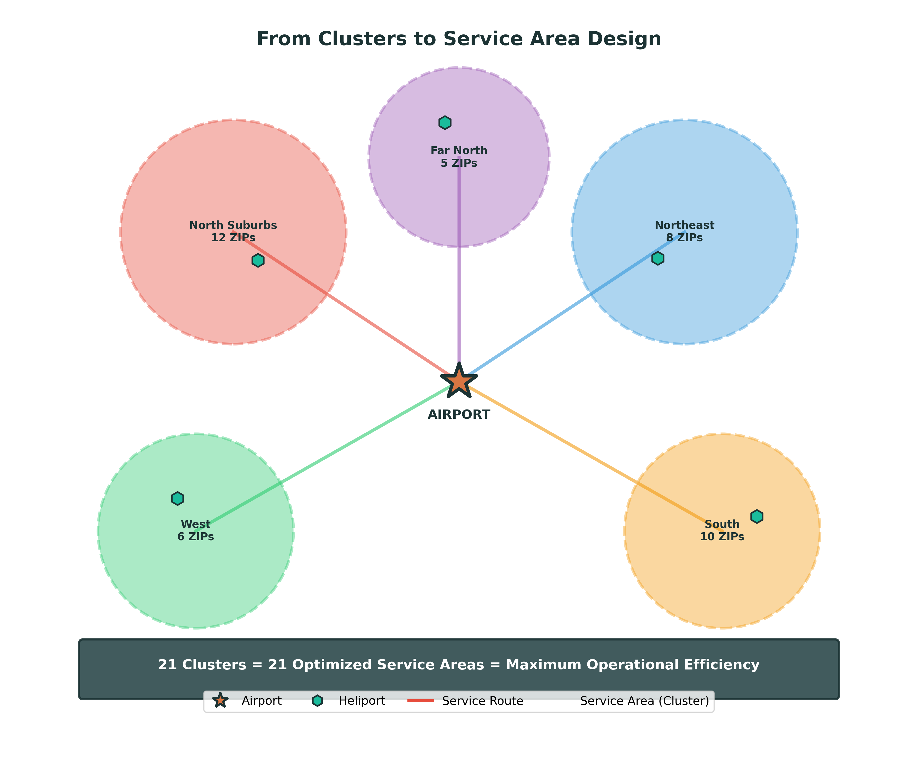
From Clusters to Service Area Design
11

Slide 12
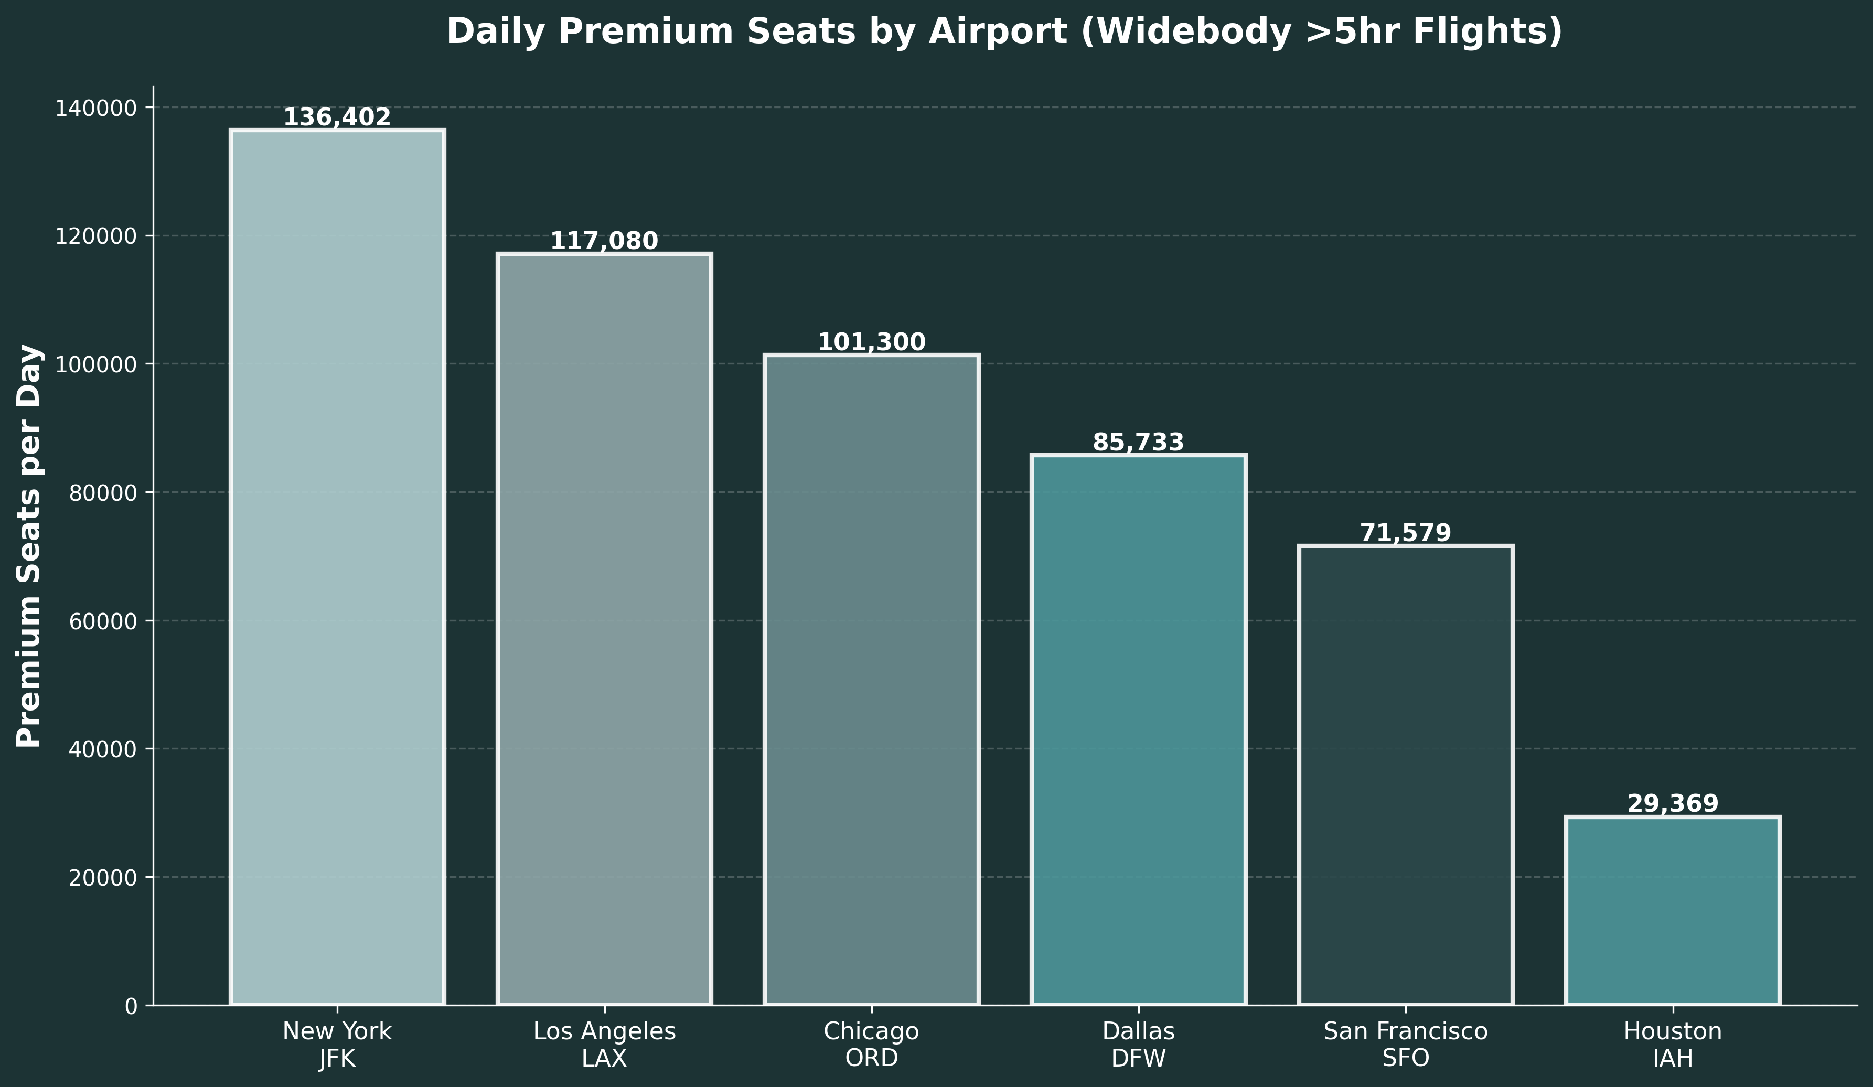
Premium Flights Market Sizing
12

Slide 13
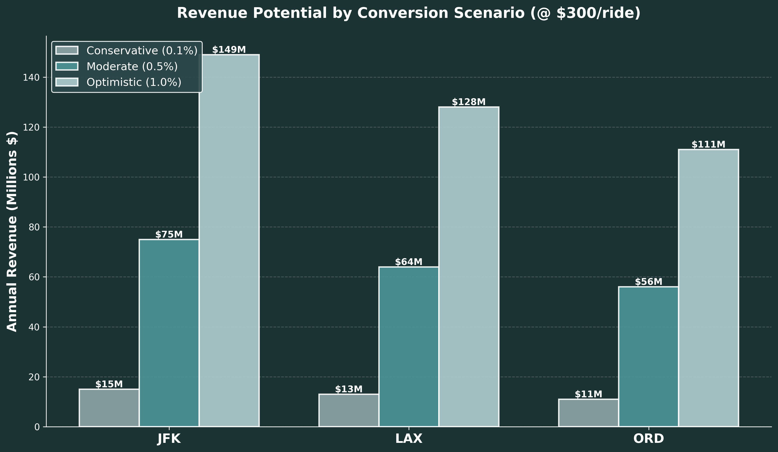
Market Potential & Revenue Scenarios
13

Slide 14
Strategic Recommendations
Priority 1: New York JFK
• Largest market: 136k premium seats/day
• 200+ heliports, established infrastructure
• Potential: $75M/year (moderate scenario)
Priority 2: Los Angeles LAX
• Second largest: 117k premium seats/day
• Existing helicopter culture
• Potential: $64M/year (moderate scenario)
Priority 3: Chicago ORD
• Third largest: 101k premium seats/day
• Highest avg seats/flight (90.8)
• Potential: $56M/year (moderate scenario)
Implementation: Q1 Route Analysis → Q2 Partnerships → Q3 NYC Launch
14

