Slide 1
18.S096 January 2017: Memory and Matrices
Steven G. Johnson, MIT Applied Math
performance experiments (circa 2008):
Hardware: 2.66GHz Intel Core 2 Duo
64-bit mode, double precision, gcc 4.1.2
optimized BLAS dgemm: ATLAS 3.6.0
http://math-atlas.sourceforge.net/

Slide 2
A trivial problem? C = A B
m×p
m×n
n×p
the “obvious” C code (rows ⋅ columns):
/* C = A B, where A is m x n, B is n x p,
and C is m x p, in row-major order */
void matmul(const double *A, const double *B,
double *C, int m, int n, int p)
{
int i, j, k;
for (i = 0; i < m; ++i)
for (j = 0; j < p; ++j) {
double sum = 0;
for (k = 0; k < n; ++k)
sum += A[i*n + k] * B[k*p + j];
C[i*p + j] = sum;
}
}
for i = 1 to m
for j = 1 to p
2mnp flops
(adds+mults)
“floating-point
operations”
just three loops, how complicated can it get?

Slide 3
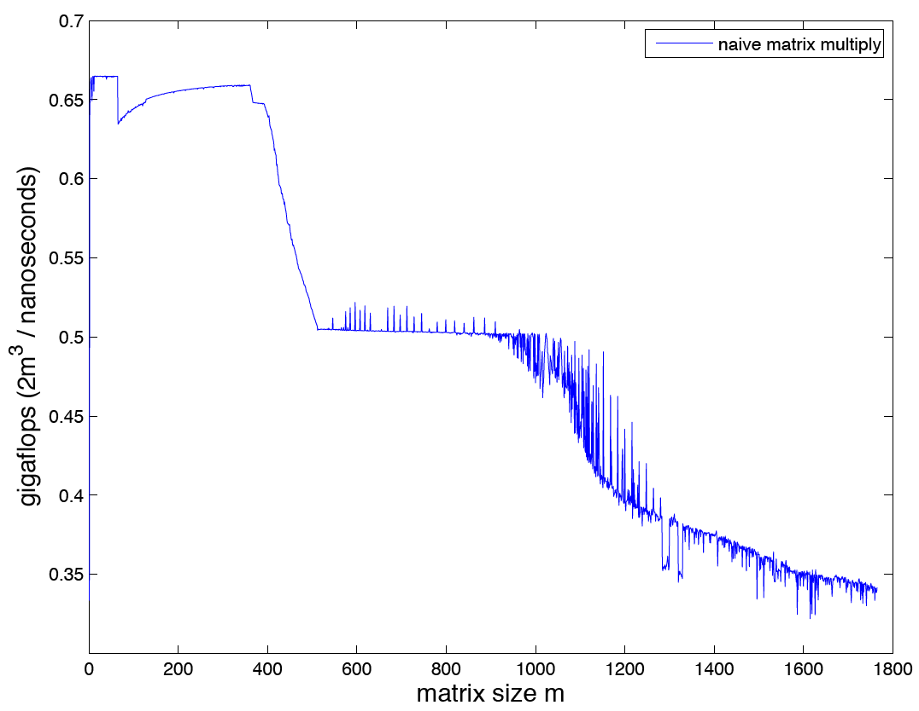
flops/time is not constant! (square matrices, m=n=p)
L1 cache
exceeded?
(2.66GHz processor?
why < 1 gigaflops?)
L2 cache
exceeded?
L1 cache
exceeded
for single row?

Slide 4
Speed is limited by access to the memory hierarchy ^{[not to scale!]}
L1 cache
(~10 kB)
L2 cache
(~100 kB)
L3 cache
(~10 MB)
CPU
(~100 registers)
smaller = faster
main memory (RAM)
(~10 GB)
[ network,
& disk
≳ TB ]

Slide 5
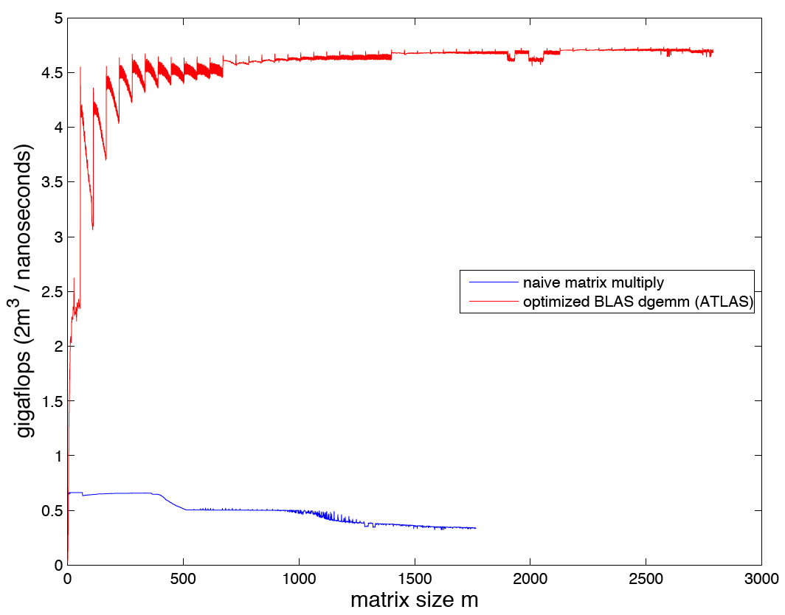
All flops are not created equal
nearly peak
theoretical flop rate
(2 flops/cycle via SSE2 instructions)
same #operations
same abstract algorithm
factor of 10 in speed

Slide 6
Things to remember
We often cannot understand performance without understanding memory efficiency (caches).
often ~10 times more important than arithmetic count when working with lots of data
Computers are more complicated than you think.
Even a trivial algorithm is nontrivial to implement well.
matrix multiplication: 10 lines of code ⟶ 130,000+ (ATLAS)
getting the last factor of 2 in speed often requires wizardry (and is usually not worth it)
but factors of 10 are often worthwhile and not too hard…

Slide 7
Ideal Cache Model
[ Frigo, Leiserson, Prokop, and
Ramachandran (1999) ]
simplified model of cache to help us understand/design algorithms
when CPU needs an item, either:
• cache hit: already in cache (fast)
• cache miss: load into cache (slow)
goal: analyze # of cache misses
(define “item” as
whatever is convenient)
Simplification: cache is “ideal”
— fully associative: any item in memory can replace any item in cache
— optimal replacement: cache miss replaces “best” item
(= item not needed for longest time in the future)
… within a ~constant factor of more realistic caches
Cache complexity: for problem with n items, cache size Z,
want # misses for large n in “big O” or “big Θ” notation
(ignoring constant factors), e.g. Θ(n/Z)

Slide 8
Strategy for efficient cache utilization: Maximize temporal locality
Once we read an item from memory, we want as much computation as possible before reading the next item…
Re-arrange our algorithm so that computations on the same data occur at close to the same time.

Slide 9
(optimal) Blocked Matrix Multiply
=
C
n×n
A
n×n
B
n×n
divide matrices into b×b blocks of b=√Z/3 numbers
load 3 b×b blocks into cache and multiply blocks in-cache
(provably optimal) cache misses: Θ(n³/b³) × Θ(b²) = Θ(n³/√Z)
# block × block
multiplications
# cache misses
per block

Slide 10
Challenges with blocking
Programmer/code needs to know the size Z of the cache — different code for every CPU?
Multiple levels of cache = nested blocking
Many complications to get near-optimal “constant factor” in Θ
optimal block size is non-square to balance load/store cost.
lowest level (cache=registers) requires unrolling, SIMD optimizations, lots of tricks…

Slide 11
(optimal) Cache-Oblivious Matrix Multiply
=
C
n×n
A
n×n
B
n×n
divide and conquer:
divide C into 4 blocks
compute block multiply recursively
achieves optimal Θ(n³/√Z) cache complexity
without knowing the Z, works for nested caches too

Slide 12
A little C implementation (~25 lines)
/* C = C + AB, where A is m x n, B is n x p, and C is m x p, in
row-major order. Actually, the physical size of A, B, and C
are m x fdA, n x fdB, and m x fdC, but only the first n/p/p
columns are used, respectively. */
void add_matmul_rec(const double *A, const double *B, double *C,
int m, int n, int p, int fdA, int fdB, int fdC)
{
if (m+n+p <= 48) { /* <= 16x16 matrices "on average" */
int i, j, k;
for (i = 0; i < m; ++i)
for (k = 0; k < p; ++k) {
double sum = 0;
for (j = 0; j < n; ++j)
sum += A[i*fdA +j] * B[j*fdB + k];
C[i*fdC + k] += sum;
}
}
else { /* divide and conquer */
int m2 = m/2, n2 = n/2, p2 = p/2;
add_matmul_rec(A, B, C, m2, n2, p2, fdA, fdB, fdC);
add_matmul_rec(A+n2, B+n2*fdB, C, m2, n-n2, p2, fdA, fdB, fdC);
add_matmul_rec(A, B+p2, C+p2, m2, n2, p-p2, fdA, fdB, fdC);
add_matmul_rec(A+n2, B+p2+n2*fdB, C+p2, m2, n-n2, p-p2, fdA, fdB, fdC);
add_matmul_rec(A+m2*fdA, B, C+m2*fdC, m-m2, n2, p2, fdA, fdB, fdC);
add_matmul_rec(A+m2*fdA+n2, B+n2*fdB, C+m2*fdC, m-m2, n-n2, p2, fdA, fdB, fdC);
add_matmul_rec(A+m2*fdA, B+p2, C+m2*fdC+p2, m-m2, n2, p-p2, fdA, fdB, fdC);
add_matmul_rec(A+m2*fdA+n2, B+p2+n2*fdB, C+m2*fdC+p2, m-m2, n-n2, p-p2, fdA, fdB, fdC);
}
}
void matmul_rec(const double *A, const double *B, double *C,
int m, int n, int p)
{
memset(C, 0, sizeof(double) * m*p);
add_matmul_rec(A, B, C, m, n, p, n, p, p);
}
note: base case is ~16×16
recursing down to 1×1
would kill performance
(1 function call per element,
no register re-use)
dividing C into 4
— note that, instead, for
very non-square matrices,
we might want to divide
C in 2 along longest axis

Slide 13
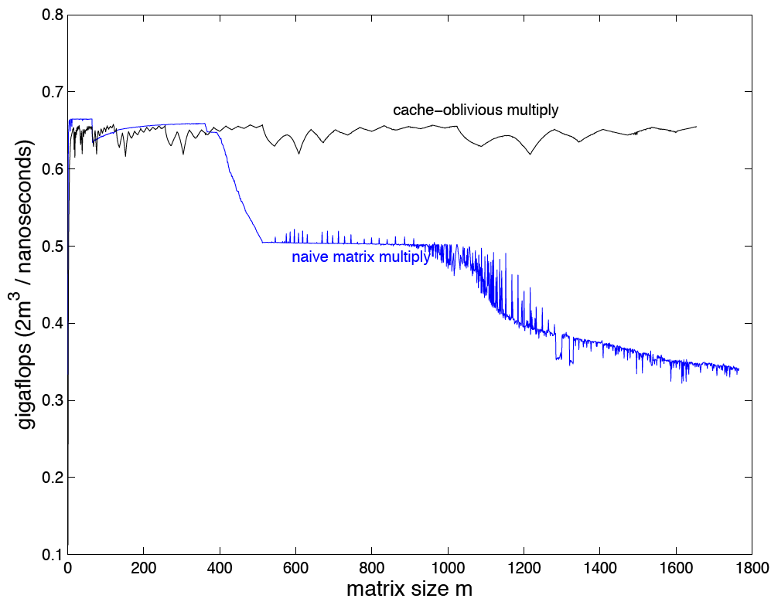
No Cache-based Performance Drops!

Slide 14
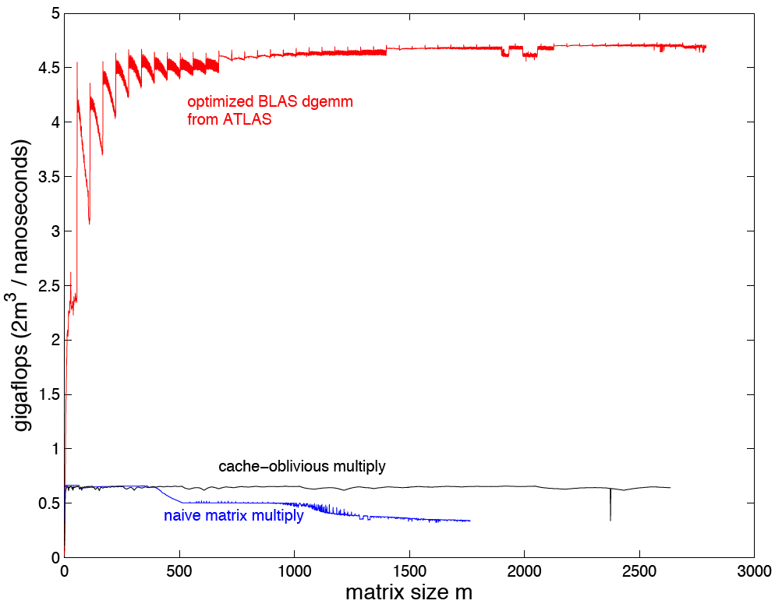
…but absolute performance still sucks
(of course, there are lots
of little optimizations,
but there must be something big…?)
÷ “unfair” factor of 2
from using SSE2 instructions
if this difference
is not L1/L2 cache,
what is it?
?

Slide 15
Registers == Cache
The registers (~100) form a very small, almost ideal cache
Three nested loops is not the right way to use this “cache” for the same reason as with other caches
Need long blocks of unrolled code: load blocks of matrix into local variables (= registers), do matrix multiply, write results
Loop-free blocks = many optimized hard-coded base cases of recursion for different-sized blocks … often automatically generated (ATLAS)
Unrolled n×n multiply has (n³)! possible code orderings — compiler cannot find optimal schedule (NP hard) — cache-oblivious scheduling can help (c.f. FFTW), but ultimately requires some experimentation/wizardry (automated in ATLAS)
Optimal blocks are non-square to balance load/store cost, and details (e.g. scheduling) turn out to depend on the CPU.

Slide 16
No data re-use = no possibility of temporal locality … what then?
Suppose we are computing the dot product x*y of two vectors:
Each element of x and y is used exactly once.
Does this mean we get no benefit from the caches?

Slide 17
Cache lines and spatial locality
To speed up algorithms with little or no data re-use, caches
exploit the fact that memory access is often consecutive
by reading in a whole cache line of L items on a miss
[ typically, L ~ 64 bytes ]
ideal cache
main memory
Ζ items
organized
in Z/L lines
of L items
L items
load whole line
into cache on a miss
L items
typically assume
“tall cache:” Z/L > L
Cache-optimization strategy:
when you access data in memory, try to access nearby data
soon afterwards … maximize “spatial locality”

Slide 18
Example: Matrix addition
=
+
C
m×n
A
m×n
B
m×n
two possible algorithms:
for i = 1 to m
for j = 1 to n
C_{ij} = A_{ij} + B_{ij}
for j = 1 to n
for i = 1 to m
C_{ij} = A_{ij} + B_{ij}
or
which one to use? depends on how matrices are stored!

Slide 19
Column-major storage used by Fortran, Matlab, Julia, …
= store columns of A consecutively in memory
0
5
10
1
6
11
memory
2
7
12
3
8
13
4
9
14
0
1
2
3
4
5
6
7
8
9
10
11
12
13
14
A
5×3
access rows consecutively:
access columns consecutively:
for i = 1 to m
for j = 1 to n
C_{ij} = A_{ij} + B_{ij}
for j = 1 to n
for i = 1 to m
C_{ij} = A_{ij} + B_{ij}
= Θ(mn) misses
= Θ(mn/L) misses

