Slide 1
Photon Mapping
Theory and Practice

Slide 2
Photon Mapping
Theory and Practice
Slides partly from:
Wojciech Jarosz

Slide 3



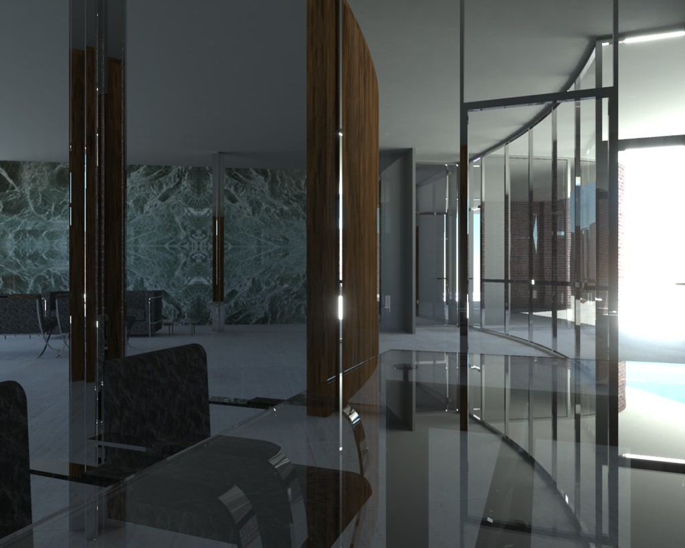
Motivation - Global Illumination
Henrik Wann Jensen
2

Slide 4


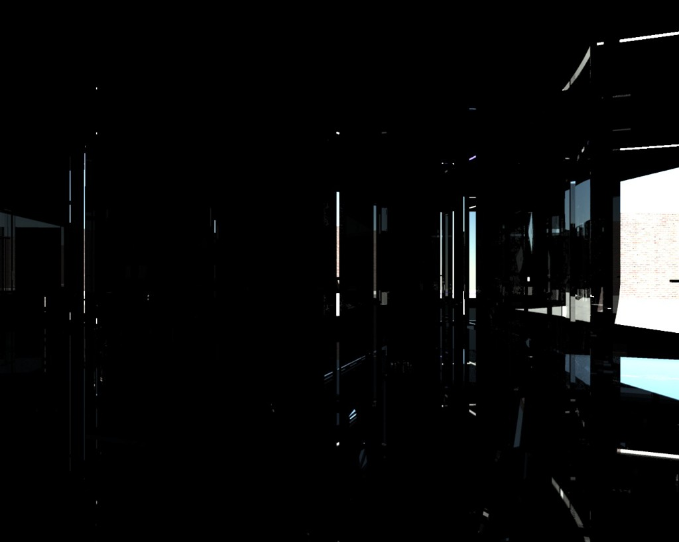
Motivation - Direct Illumination
Henrik Wann Jensen
3

Slide 5
Bunch of methods out there…
Radiosity – ewh, too 80’s…
(Bidirectional) path tracing
Radiance Caching
Photon Mapping
Metropolis Light Transport
VPLs – Many lights methods
Combinations: VCM/UPS, MCPM…

Slide 6


Photon Mapping
A two-pass algorithm:
Pass 1: Trace virtual photons from the light source, scatter at surfaces, and cache
Pass 2: Ray trace the scene and use the photons to compute indirect illumination
Same as light tracing, but different way of storing/caching photons
15

Slide 7


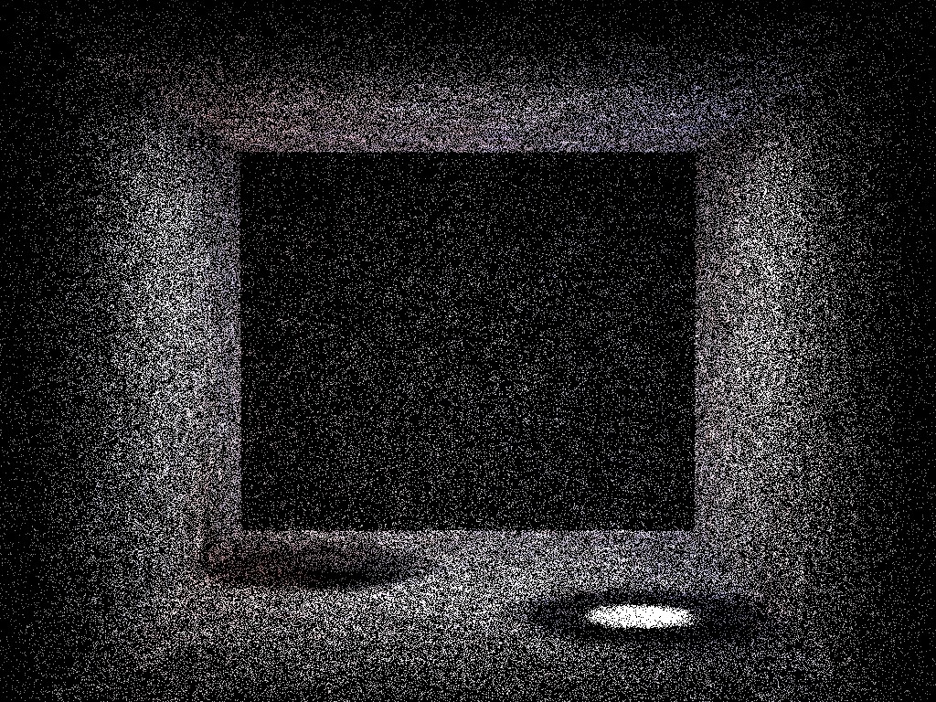
The Photon Map
Henrik Wann Jensen
16

Slide 8










Photon Mapping (Photon Tracing)
Emit photons
Scatter photons
Store photons
17

Slide 9

















Photon Mapping (Photon Tracing)
Emit photons
Scatter photons
Store photons
17

Slide 10






Photon Mapping (Photon Tracing)
Emit photons
Scatter photons
Store photons
18

Slide 11









Photon Mapping (Photon Tracing)
Emit photons
Scatter photons
Store photons
19

Slide 12
Photon Mapping
A two-pass algorithm:
Pass 1: Trace virtual photons from the light source, scatter at surfaces, and cache
Pass 2: Ray trace the scene and use the photons to compute indirect illumination
25

Slide 13





Photon Mapping (Rendering)
For each shading point:
Find the k closest photons
Approx. radiance using density of photons
26

Slide 14
The Photon Map
Henrik Wann Jensen
16

Slide 15
Photon Mapping (Rendering)
For each shading point:
Find the k closest photons
Approx. radiance using density of photons
26

Slide 16

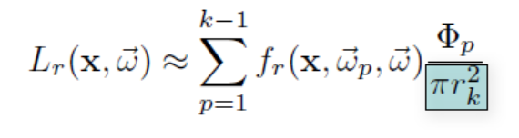


The Radiance Estimate
29

Slide 17

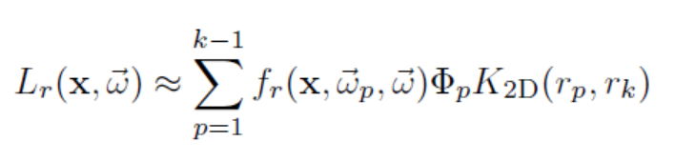

The Radiance Estimate
30

Slide 18
Why Photon Mapping?
Currently, the most robust light transport algorithm out there.
Nowadays can handle ANY kind of light path.

Slide 19


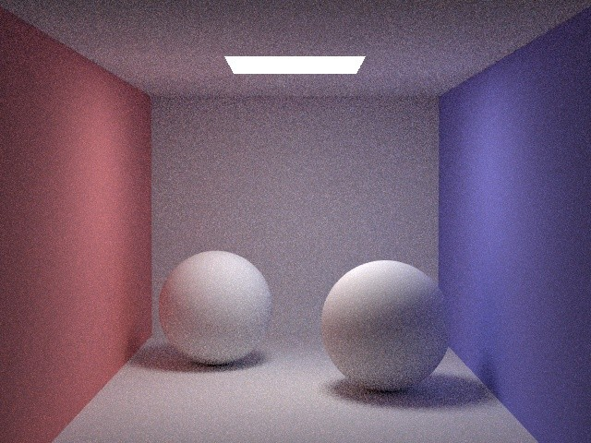
Path Tracing
Henrik Wann Jensen
10 paths/pixel
5

Slide 20

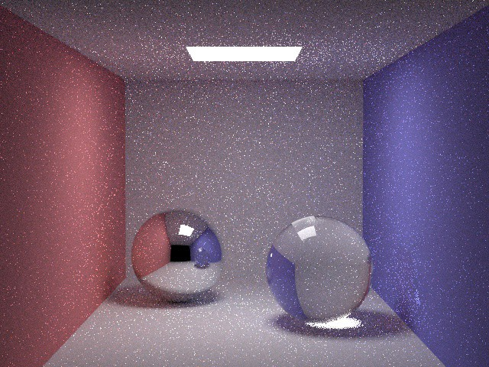
Path Tracing Caustics
Henrik Wann Jensen
10 paths/pixel
6

Slide 21


Path Tracing Caustics
7

Slide 22

Path Tracing Caustics
8

Slide 23

Path Tracing Caustics
9

Slide 24
Why Photon Mapping?
Currently, the most robust light transport algorithm out there.
Nowadays can handle ANY kind of light path.
Biased, but consistent.
Well known behaviour!
Bias doesn’t mean more error! If we have time, we’ll talk about that later…

Slide 25
The Work
Two required exercises – 70%
One for each part of the algorithm
Optional extensions – 30%
Will talk about them later…

Slide 26
Mandatory Part
The two parts of the algorithm…
1 Photon Map Generation
2 Radiance Estimation

Slide 27
Before entering in details…
If you want to use the provided code:
The scenes are defined in main.cpp
You are expected to include, at least, one or two more!
Most implementation should go to photon_mapping.cpp
Three main functions:
preprocess(), trace_ray() and shade().
trace_ray() is already implemented…

Slide 28
Mandatory Part
The two parts of the algorithm…
1 Photon Map Generation
preprocess()
2 Radiance Estimation
shade()

Slide 29
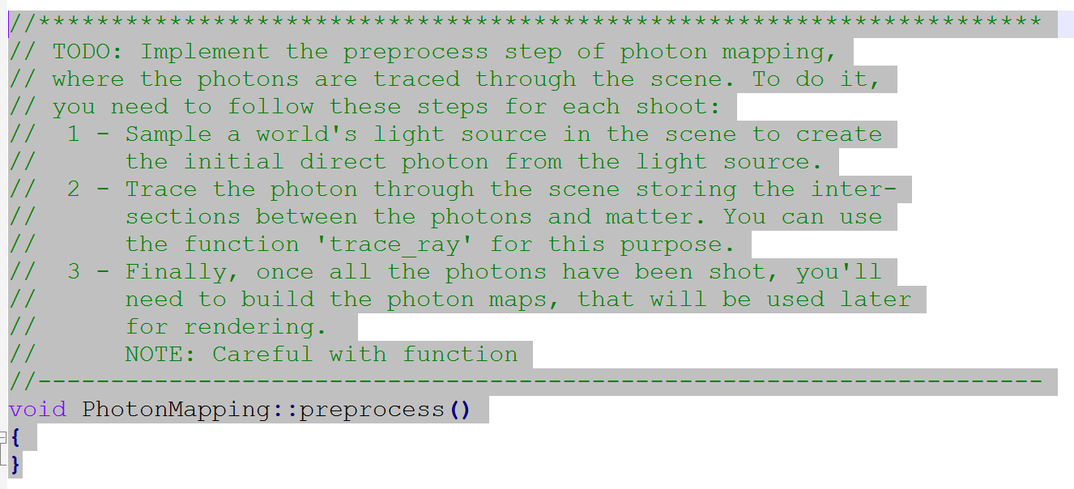
Photon Map Generation

Slide 30
Photon Mapping (Photon Tracing)
Emit photons
Scatter photons
Store photons
17

Slide 31
Photon Mapping (Photon Tracing)
Emit photons
Scatter photons
Store photons
17

Slide 32
Photon Mapping (Photon Tracing)
Emit photons
Scatter photons
Store photons
18

Slide 33
Photon Mapping (Photon Tracing)
Emit photons
Scatter photons
Store photons
19

Slide 34
Photon Map Generation
The random walk is already implemented in trace_ray()
So you just need to sample the light source, trace the path using the function, and store photons in the acceleration structure.

Slide 35
Photon Map Generation
Let’s remember how to…
Sample the (point) light source:
Just need to sample uniformly the sphere of directions, with solid angle 4*pi
Rejection sampling.
Sampling phi and theta
Probability
C’mon, it’s not that difficult!

Slide 36
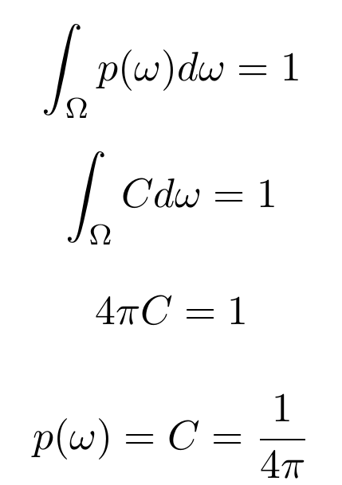
Photon Map Generation
Let’s remember how to…
Sample the (point) light source:

Slide 37
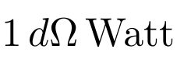
So… Test Question!
What is the energy stored by each photon*?
Assume we have:
An omnidirectional light source emitting
Monochromatic scene
Perfect russian roulette
Constant energy of the photon through the walk
Tracing 1000 photons

Slide 38
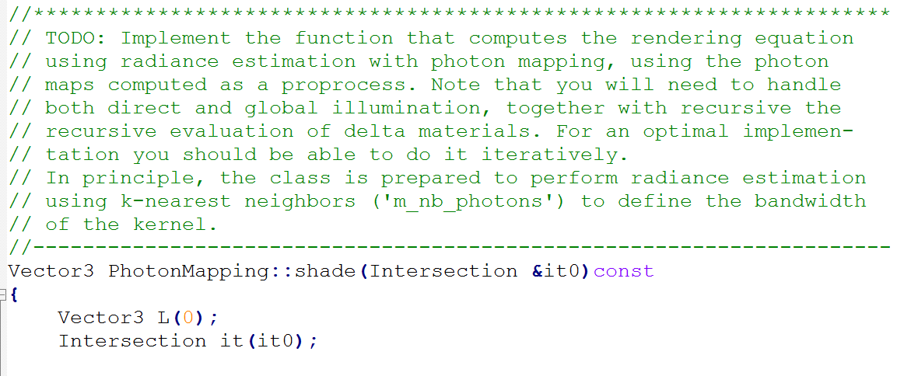
Radiance Estimation
Right now, displays some scene properties as a “hello World” code…

Slide 39
The Radiance Estimate
29

Slide 40
The Photon Map
Henrik Wann Jensen
16

Slide 41
The Photon Map
Henrik Wann Jensen
16

Slide 42
The Photon Map
Henrik Wann Jensen
16

Slide 43
So… Test Question!
Why is photon mapping biased, and what does it mean?

Slide 44
So… Test Question!
Why is photon mapping biased, and what does it mean?
Radiance

Slide 45
So… Test Question!
Why is photon mapping biased, and what does it mean?
Radiance

Slide 46
So… Test Question!
Why is photon mapping biased, and what does it mean?
Radiance

Slide 47
So… Test Question!
Why is photon mapping biased, and what does it mean?
Radiance

Slide 48
So… Test Question!
Why is photon mapping biased, and what does it mean?
Radiance

Slide 49
Radiance Estimation
You‘ll need to:
Render direct and indirect illumination
DI using both explicit ray tracing and PM
Indirect illumination using PM

Slide 50
Motivation - Direct Illumination
Henrik Wann Jensen
3

Slide 51
Motivation - Global Illumination
Henrik Wann Jensen
2

Slide 52
So… Test Question!
Assuming that all our scene has a albedo of 0.5 (i.e. absorbs half of the light), indirect illumination should be higher, or lower that direct illumination?

Slide 53
Mandatory Part
The two parts of the algorithm…
1 Photon Map Generation
2 Radiance Estimation
There are some questions you must answer

Slide 54
The Work
Two required exercises – 70%
One for each part of the algorithm
Optional extensions – 30%
Will talk about them later…

Slide 55
Optional Exercises
Participating Media
VPLs
Progressive Photon Mapping
Adaptive Kernel bandwidth
Transient Light Transport
Analysis of Kernels
…

Slide 56
Optional Exercises
These are sugestions.
You can also propose things.
Ask us first.

Slide 57
Deliverables
A report with description, Q&A, implementation details, tests, renders…
You’ll be evaluated based on it!
Your implementation
MUST compile, though we won’t evaluate the quality of coding
Check details…

Slide 58
Evaluation
Mandatory exercises – 7
Optional exercises – 3
Quality on the report matters, poor writting will be penalized…
Careful with energy conservation and kernel normalization.
Analyze things: # photons, k-NN…
For Christ’s sake, we do graphics; nice pics, please!

Slide 59
Questions
Diego: diegog@unizar.es
Julio: juliom@unizar.es
Lab 2.06
E-mail to make an appointment.
Don’t drop by unannounced!

