Slide 1
Problems:
No feedback control channel
No control chain
Model:
RIS controller does not know the geometry
Use-Case:
Complete low cost autonomous and compact system to enhance connectivity

Slide 2


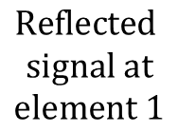



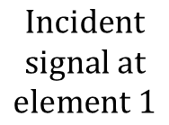










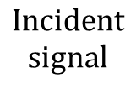
$$Incident$$
$$signal at$$
$$element 1$$
$$Reflected$$
$$signal at$$
$$element 1$$
$$θ_{1}$$
$$η$$
$$HRIS$$
$$θ_{1}$$
$$1−η$$
$$θ_{2}$$
$$η$$
$$θ_{2}$$
RF-power
detector
$$1−η$$
$$Directional$$
$$coupler$$
⁞
$$Incident$$
$$signal$$
$$Reflected$$
$$signal$$
$$θ_{N}$$
$$η$$
$$θ_{N}$$
$$1−η$$

Slide 3





Precoder optimization
$$BS−RIS Control channel$$
$$BS$$
Sensed power profile
$$BS$$
$$HRIS$$
Absorbed power
$$UE$$
Pointing direction
$$BS−UE Control channel$$
RIS optimization
Probing configuration sweep
$$UE$$

Slide 4















$$u_{k}={\left(u_{k,x},u_{k,y},u_{k,z}\right)}^{T}$$
$$z$$
$$r={\left(r_{x},r_{y},r_{z}\right)}^{T}$$
$$h_{k}$$
$$UE$$
$$HRIS$$
$$h_{k}^{H}$$
$$h_{D,k}$$
$$y$$
$$x$$
$$G^{H}$$
$$G$$
$$h_{D,k}^{H}$$
$$b={\left(b_{x},b_{y},b_{z}\right)}^{T}$$
$$BS$$

Slide 5




$$u_{k}={\left(u_{k,x},u_{k,y},u_{k,z}\right)}^{T}$$
$$z$$
$$r={\left(r_{x},r_{y},r_{z}\right)}^{T}$$
$$h_{k}$$
$$UE$$
$$HRIS$$
$$h_{k}^{H}$$
$$h_{D,k}$$
$$y$$
$$x$$
$$G^{H}$$
$$G$$
$$h_{D,k}^{H}$$
$$b={\left(b_{x},b_{y},b_{z}\right)}^{T}$$
$$BS$$

Slide 6
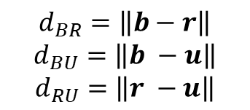
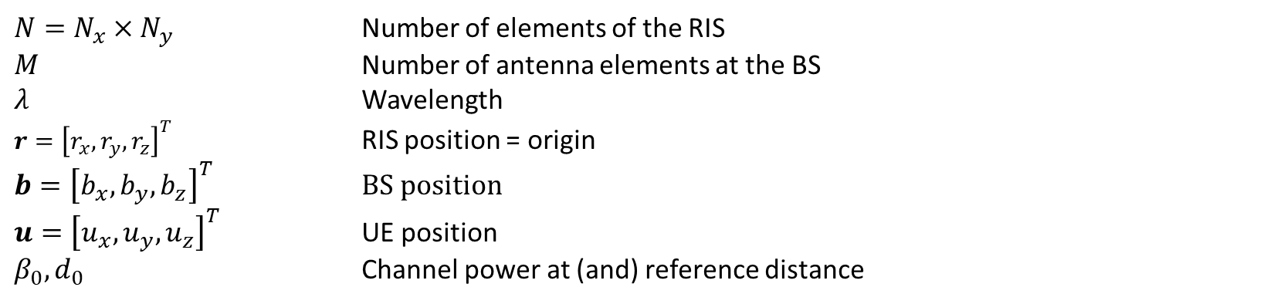
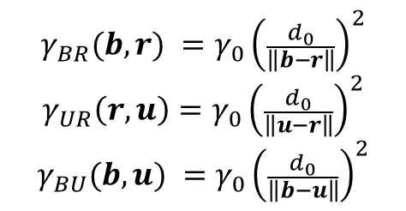
Parameters
$N=N_{x}×N_{y}$ Number of elements of the RIS
$M$ Number of antenna elements at the BS
$λ$ Wavelength
$r={\left[r_{x},r_{y},r_{z}\right]}^{T}$ RIS position = origin
$b={\left[b_{x},b_{y},b_{z}\right]}^{T}$ BS position
$u={\left[u_{x},u_{y},u_{z}\right]}^{T}$ UE position
$β_{0},d_{0}$ Channel power at (and) reference distance
Distances
Channel power gain
$$d_{BR}=\left\|b−r\right\|$$
$$d_{BU}=\left\|b −u\right\|$$
$$d_{RU}=\left\|r −u\right\|$$
$$γ_{BR}(b,r) =γ_{0}{\left(\frac{d_{0}}{\left\|b−r\right\|}\right)}^{2}$$
$$γ_{UR}\left(r,u\right)=γ_{0}{\left(\frac{d_{0}}{\left\|u−r\right\|}\right)}^{2}$$
$$γ_{BU}(b,u) =γ_{0}{\left(\frac{d_{0}}{\left\|b−u\right\|}\right)}^{2}$$

Slide 7
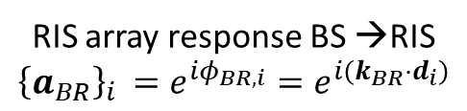

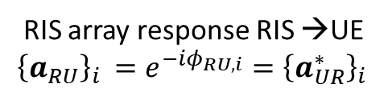
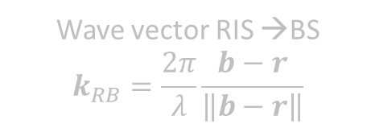


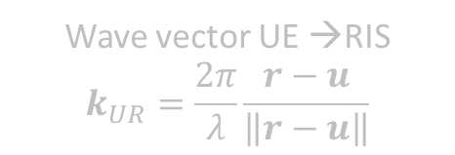
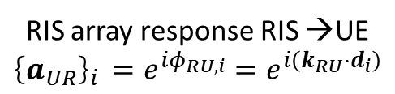
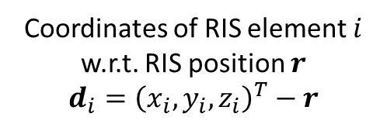
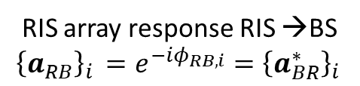

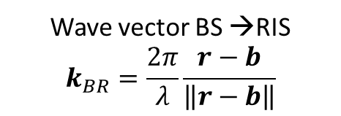
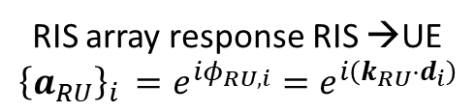
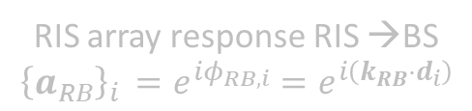
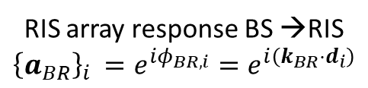



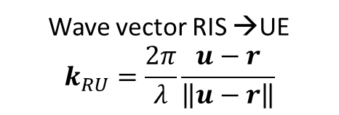
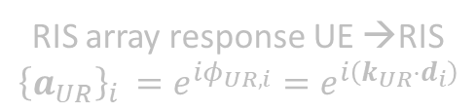

Phase shifts for incoming and departing waves on the RIS
We refer to the BS->RIS->UE link for vectors definitions
Coordinates of RIS element $i$ w.r.t. RIS position $r$
$$d_{i}={\left(x_{i},y_{i},z_{i}\right)}^{T}−r$$
Wave vector BS →RIS
$$k_{BR}=\frac{2π}{λ}\frac{r−b}{\left\|r−b\right\|}$$
Wave vector RIS →BS
$$k_{RB}=\frac{2π}{λ}\frac{b−r}{\left\|b−r\right\|}$$
Wave vector RIS →UE
$$k_{RU}=\frac{2π}{λ}\frac{u−r}{\left\|u−r\right\|}$$
Wave vector UE →RIS
$$k_{UR}=\frac{2π}{λ}\frac{r−u}{\left\|r−u\right\|}$$
Phase shift BS →RIS
$$φ_{BR,i}=k_{br}⋅d_{i}$$
Phase shift RIS →BS
$$φ_{RB,i}=k_{rb}⋅d_{i}$$
Phase shift RIS →UE
$$φ_{RU,i}=k_{RU}⋅d_{i}$$
Phase shift UE →RIS
$$φ_{UR,i}=k_{UR}⋅d_{i}$$
RIS array response RIS →BS
$${\left\{a_{RB}\right\}}_{i }=e^{iφ_{RB,i}}=e^{i\left(k_{RB}⋅d_{i}\right)}$$
RIS array response RIS →UE
$${\left\{a_{RU}\right\}}_{i }=e^{iφ_{RU,i}}=e^{i\left(k_{RU}⋅d_{i}\right)}$$
RIS array response UE →RIS
$${\left\{a_{UR}\right\}}_{i }=e^{iφ_{UR,i}}=e^{i\left(k_{UR}⋅d_{i}\right)}$$
RIS array response BS →RIS
$${\left\{a_{BR}\right\}}_{i }=e^{iφ_{BR,i}}=e^{i\left(k_{BR}⋅d_{i}\right)}$$
Reference direction: from BS to RIS and from UE to RIS according to the sensed signal
RIS array response BS →RIS
$${\left\{a_{BR}\right\}}_{i }=e^{iφ_{BR,i}}=e^{i\left(k_{BR}⋅d_{i}\right)}$$
RIS array response RIS →BS
$${\left\{a_{RB}\right\}}_{i }=e^{−iφ_{RB,i}}={\left\{a_{BR}^{∗}\right\}}_{i }$$
RIS array response RIS →UE
$${\left\{a_{UR}\right\}}_{i }=e^{iφ_{RU,i}}=e^{i\left(k_{RU}⋅d_{i}\right)}$$
RIS array response RIS →UE
$${\left\{a_{RU}\right\}}_{i }=e^{−iφ_{RU,i}}={\left\{a_{UR}^{∗}\right\}}_{i }$$
RIS array response BS →RIS
$$a_{B}(b,r)$$
RIS array response RIS →BS
$$a_{B}^{∗}(b,r)$$
RIS array response RIS →UE
$$a_{U}^{∗}(u,r)$$
RIS array response UE →RIS
$$a_{U}(u,r)$$
MATLAB confirms

Slide 8
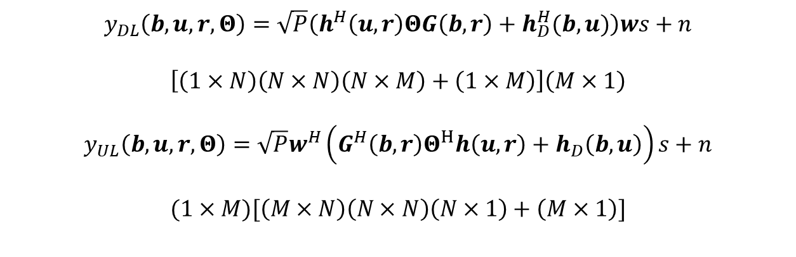


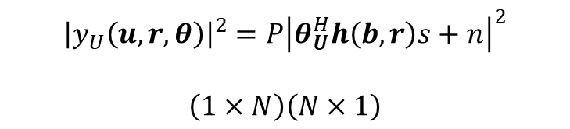
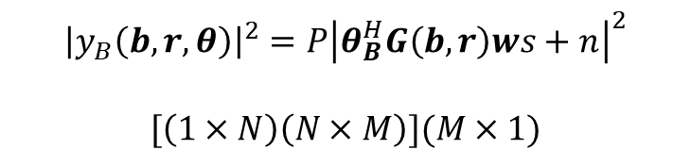
Channel
Absolute phase shift due to the path?
$$G\left(b,r\right)=\sqrt{β_{BR}\left(b,r\right)}a_{B}\left(b,r\right)a_{BS}^{H}\left(b,r\right)∈ℂ^{N×M}$$
$$h\left(u,r\right)=\sqrt{β_{UR}\left(u,r\right)}a_{UR}\left(u,r\right)∈ℂ^{N×1}$$
$$h_{D}\left(b,u\right)=\sqrt{β_{BU}\left(b,u\right)}a_{BU}\left(b,u\right)∈ℂ^{M×1}$$
Received signal (With this we can say that once we have the \theta for the uplink we have the theta for the downlink as well)
$$y_{DL}\left(b,u,r,Θ\right)=\sqrt{P}\left(h^{H}\left(u, r\right)ΘG\left(b,r\right)+h_{D}^{H}(b,u)\right)ws+n$$
$$\left[\left(1×N\right)\left(N×N\right)\left(N×M\right)+\left(1×M\right)\right]\left(M×1\right)$$
$$y_{UL}\left(b,u,r,Θ\right)=\sqrt{P}w^{H}\left(G^{H}\left(b,r\right)Θ^{H}h\left(u, r\right)+h_{D}\left(b,u\right)\right)s+n$$
$$(1×M)[\left(M×N\right)\left(N×N\right)\left(N×1\right)+\left(M×1\right)]$$
Sensed signal
$$θ=diag(Θ)$$
$${\left|y_{B}\left(b, r,θ\right)\right|}^{2}={P\left|θ_{B}^{H}G\left(b,r\right)ws+n\right|}^{2}$$
$$[\left(1×N\right)\left(N×M\right)](M×1)$$
$${\left|y_{U}\left(u,r,θ\right)\right|}^{2}={P\left|θ_{U}^{H}h\left(b,r\right)s+n\right|}^{2}$$
$$\left(1×N\right)\left(N×1\right)$$

Slide 9
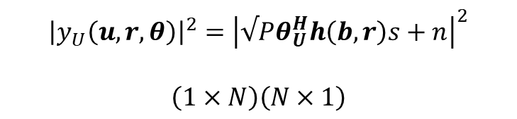
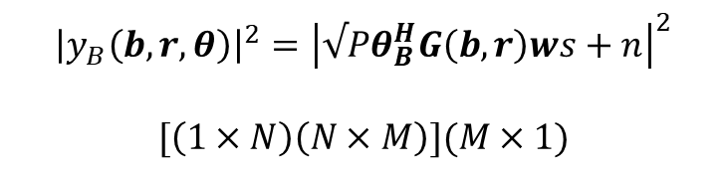

Sensed signal
$${\left|y_{B}\left(b, r,θ\right)\right|}^{2}={\left|√Pθ_{B}^{H}G\left(b,r\right)ws+n\right|}^{2}$$
$$[\left(1×N\right)\left(N×M\right)](M×1)$$
$${\left|y_{U}\left(u,r,θ\right)\right|}^{2}={\left|√Pθ_{U}^{H}h\left(b,r\right)s+n\right|}^{2}$$
$$\left(1×N\right)\left(N×1\right)$$
$$𝔼\left[{\left|y_{B}\left(b,r,θ\right)\right|}^{2}\right]=𝔼\left[{\left|\sqrt{P}θ_{B}^{H}G\left(b,r\right)ws+n\right|}^{2} \right]=P{\left|θ_{B}^{H}G\left(b,r\right)w\right|}^{2}σ_{s}^{2}+σ_{n}^{2}$$
$$𝔼\left[{\left|y_{U}\left(u,r,θ\right)\right|}^{2}\right]=𝔼\left[{\left|√Pθ_{U}^{H}h\left(u,r\right)s+n\right|}^{2}\right]=P{\left|θ_{U}^{H}h\left(u,r\right)\right|}^{2}σ_{s}^{2}+σ_{n}^{2}$$
$$\left|θ_{i}\right|≤1∀i=1…N$$
$$\max_{θ_{U}}{θ_{U}^{H}h\left(u,r\right)}h^{H}\left(u,r\right)θ_{U}=\max_{θ_{U}}{θ_{U}^{H}H_{U}\left(u,r\right)}θ_{U}→θ_{U}=\sqrt{N}\frac{h\left(u,r\right)}{\left\|h\left(u,r\right)\right\|}$$
← MATLAB confirms
$$\max_{θ_{B}}{θ_{B}^{H}G\left(b,r\right)ww^{H}G^{H}\left(b,r\right)θ_{B}}=\max_{θ_{B}}{θ_{B}^{H}H_{B}\left(b,r\right)}θ_{B}→θ_{B}=\sqrt{N}\frac{G\left(b,r\right)w}{\left\|G\left(b,r\right)w\right\|}$$
← MATLAB confirms

Slide 10

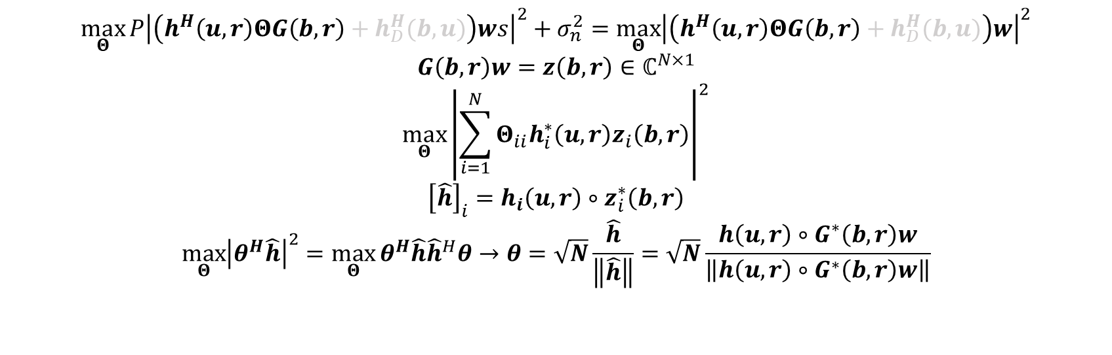

$$\max_{Θ}{P{\left|\left(h^{H}\left(u, r\right)ΘG\left(b,r\right)+h_{D}^{H}(b,u)\right)ws\right|}^{2}+σ_{n}^{2}}=\max_{Θ}{{\left|\left(h^{H}\left(u, r\right)ΘG\left(b,r\right)+h_{D}^{H}(b,u)\right)w\right|}^{2}}$$
$$\max_{Θ}{h^{H}\left(u, r\right)ΘG\left(b,r\right)ww^{H}G^{H}\left(b,r\right)Θh\left(u, r\right)}$$
$$\max_{Θ}{P{\left|\left(h^{H}\left(u, r\right)ΘG\left(b,r\right)+h_{D}^{H}(b,u)\right)ws\right|}^{2}+σ_{n}^{2}}=\max_{Θ}{{\left|\left(h^{H}\left(u, r\right)ΘG\left(b,r\right)+h_{D}^{H}(b,u)\right)w\right|}^{2}}$$
$$G\left(b,r\right)w=z\left(b,r\right)∈ℂ^{N×1}$$
$$\max_{Θ}{{\left|\sum_{i=1}^{N}{Θ_{ii}h_{i}^{∗}\left(u, r\right)z_{i}\left(b,r\right)}\right|}^{2}}$$
$${\left[\hat{h}\right]}_{i}=h_{i}\left(u, r\right)∘z_{i}^{∗}\left(b,r\right)$$
$$\max_{Θ}{{\left|θ^{H}\hat{h}\right|}^{2}}=\max_{Θ}{θ^{H}\hat{h}{\hat{h}}^{H}θ}→θ=\sqrt{N}\frac{\hat{h}}{\left\|\hat{h}\right\|}=\sqrt{N}\frac{h\left(u, r\right)∘G^{∗}\left(b,r\right)w}{\left\|h\left(u, r\right)∘G^{∗}\left(b,r\right)w\right\|}$$
$∘$ denotes the Hadamard product, i.e., elementwise product
Given that each element of theta has absolute value equal to 1
$θ=θ_{U}∘θ_{B}^{∗}$
← MATLAB confirms

Slide 11

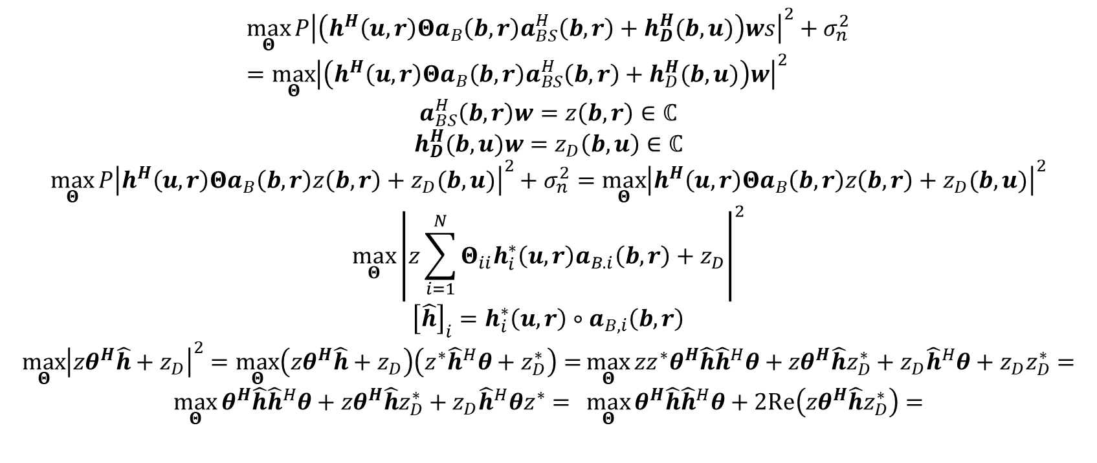
$∘$ denotes the Hadamard product, i.e., elementwise product
$$\max_{Θ}{P{\left|\left(h^{H}\left(u, r\right)Θa_{B}\left(b,r\right)a_{BS}^{H}\left(b,r\right)+h_{D}^{H}(b,u)\right)ws\right|}^{2}+σ_{n}^{2}}=\max_{Θ}{{\left|\left(h^{H}\left(u, r\right)Θa_{B}\left(b,r\right)a_{BS}^{H}\left(b,r\right)+h_{D}^{H}(b,u)\right)w\right|}^{2}}$$
$$\max_{Θ}{P{\left|\left(h^{H}\left(u, r\right)Θa_{B}\left(b,r\right)a_{BS}^{H}\left(b,r\right)+h_{D}^{H}(b,u)\right)ws\right|}^{2}+σ_{n}^{2}}=\max_{Θ}{{\left|\left(h^{H}\left(u, r\right)Θa_{B}\left(b,r\right)a_{BS}^{H}\left(b,r\right)+h_{D}^{H}(b,u)\right)w\right|}^{2}}$$
$$a_{BS}^{H}\left(b,r\right)w=z\left(b,r\right)∈ℂ$$
$$h_{D}^{H}(b,u)w=z_{D}\left(b,u\right)∈ℂ$$
$$\max_{Θ}{P{\left|h^{H}\left(u, r\right)Θa_{B}\left(b,r\right)z\left(b,r\right)+z_{D}(b,u)\right|}^{2}+σ_{n}^{2}}=\max_{Θ}{{\left|h^{H}\left(u, r\right)Θa_{B}\left(b,r\right)z\left(b,r\right)+z_{D}(b,u)\right|}^{2}}$$
$$\max_{Θ}{{\left|z\sum_{i=1}^{N}{Θ_{ii}h_{i}^{∗}\left(u, r\right)a_{B.i}\left(b,r\right)}+z_{D}\right|}^{2}}$$
$${\left[\hat{h}\right]}_{i}=h_{i}^{∗}\left(u, r\right)∘a_{B,i}\left(b,r\right)$$
$$\max_{Θ}{{\left|{zθ}^{H}\hat{h}+z_{D}\right|}^{2}}=\max_{Θ}\left(zθ^{H}\hat{h}+z_{D}\right)\left(z^{∗}{\hat{h}}^{H}θ+z_{D}^{∗}\right)=\max_{Θ}{zz^{∗}{θ^{H}\hat{h}\hat{h}}^{H}θ+{zθ}^{H}\hat{h}z_{D}^{∗}+{z_{D}\hat{h}}^{H}θ+z_{D}z_{D}^{∗}=}$$
$$\max_{Θ}{{θ^{H}\hat{h}\hat{h}}^{H}θ+{zθ}^{H}\hat{h}z_{D}^{∗}+{z_{D}\hat{h}}^{H}θz^{∗}= \max_{Θ}{{θ^{H}\hat{h}\hat{h}}^{H}θ+2Re\left({zθ}^{H}\hat{h}z_{D}^{∗}\right)=}}$$

Slide 12

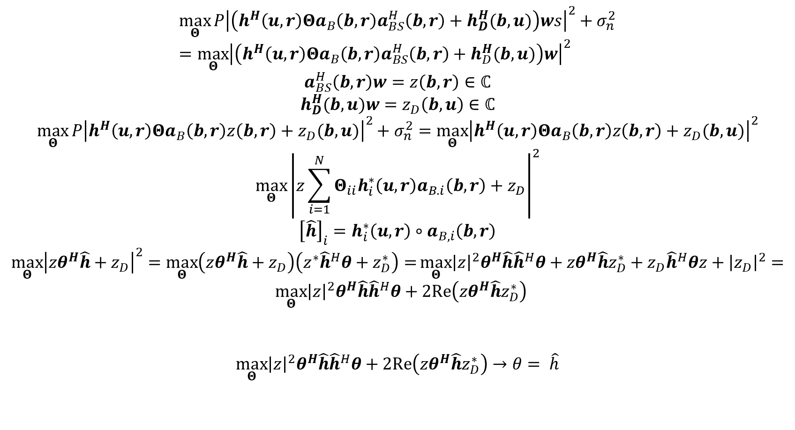
$$\max_{Θ}{P{\left|\left(h^{H}\left(u, r\right)Θa_{B}\left(b,r\right)a_{BS}^{H}\left(b,r\right)+h_{D}^{H}(b,u)\right)ws\right|}^{2}+σ_{n}^{2}}=\max_{Θ}{{\left|\left(h^{H}\left(u, r\right)Θa_{B}\left(b,r\right)a_{BS}^{H}\left(b,r\right)+h_{D}^{H}(b,u)\right)w\right|}^{2}}$$
$$a_{BS}^{H}\left(b,r\right)w=z\left(b,r\right)∈ℂ$$
$$h_{D}^{H}(b,u)w=z_{D}\left(b,u\right)∈ℂ$$
$$\max_{Θ}{P{\left|h^{H}\left(u, r\right)Θa_{B}\left(b,r\right)z\left(b,r\right)+z_{D}(b,u)\right|}^{2}+σ_{n}^{2}}=\max_{Θ}{{\left|h^{H}\left(u, r\right)Θa_{B}\left(b,r\right)z\left(b,r\right)+z_{D}(b,u)\right|}^{2}}$$
$$\max_{Θ}{{\left|z\sum_{i=1}^{N}{Θ_{ii}h_{i}^{∗}\left(u, r\right)a_{B.i}\left(b,r\right)}+z_{D}\right|}^{2}}$$
$${\left[\hat{h}\right]}_{i}=h_{i}^{∗}\left(u, r\right)∘a_{B,i}\left(b,r\right)$$
$$\max_{Θ}{{\left|{zθ}^{H}\hat{h}+z_{D}\right|}^{2}}=\max_{Θ}\left(zθ^{H}\hat{h}+z_{D}\right)\left(z^{∗}{\hat{h}}^{H}θ+z_{D}^{∗}\right)=\max_{Θ}{{\left|z\right|}^{2}{θ^{H}\hat{h}\hat{h}}^{H}θ+{zθ}^{H}\hat{h}z_{D}^{∗}+{z_{D}\hat{h}}^{H}θz+{\left|z_{D}\right|}^{2}=}$$
$$\max_{Θ}{{{{\left|z\right|}^{2}θ}^{H}\hat{h}\hat{h}}^{H}θ+2Re\left(zθ^{H}\hat{h}z_{D}^{∗}\right)}$$
$$\max_{Θ}{{{{\left|z\right|}^{2}θ}^{H}\hat{h}\hat{h}}^{H}θ+2Re\left(zθ^{H}\hat{h}z_{D}^{∗}\right)→θ= \hat{h}}$$
Mazimized if $z$ and $z_{D}^{∗}$ are
In phase with $θ^{H}\hat{h}$

Slide 13

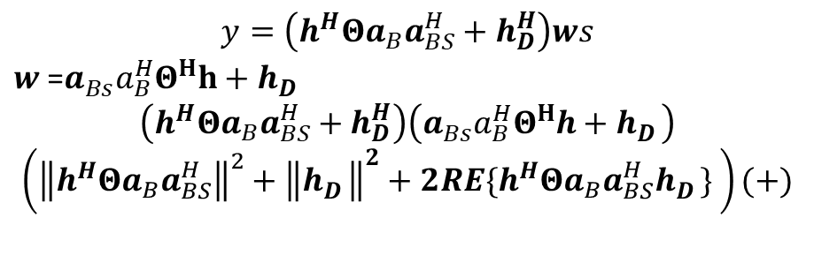
Mazimized if $z$ and $z_{D}^{∗}$ are
In phase with $θ^{H}\hat{h}$
$$\max_{Θ}{{θ^{H}\hat{h}\hat{h}}^{H}θ+2Re\left(zθ^{H}\hat{h}z_{D}^{∗}\right)}$$
RIS configuration is optimized ONLY based on the BS-RIS-UE channel as in the previous formulation
$$y=\left(h^{H}Θa_{B}a_{BS}^{H}+h_{D}^{H}\right)ws$$
$w$ =$a_{Bs}^{}a_{B}^{H}Θ^{H}h+h_{D}^{}$
$$\left(h^{H}Θa_{B}a_{BS}^{H}+h_{D}^{H}\right)\left(a_{Bs}^{}a_{B}^{H}Θ^{H}h+h_{D}^{}\right)$$
$$\left({\left\|h^{H}Θa_{B}a_{BS}^{H}\right\|}^{2}+{\left\|h_{D}^{}\right\|}^{2}+{2RE\{h}^{H}Θa_{B}a_{BS}^{H}h_{D}^{}\} \right)(+)$$

Slide 15
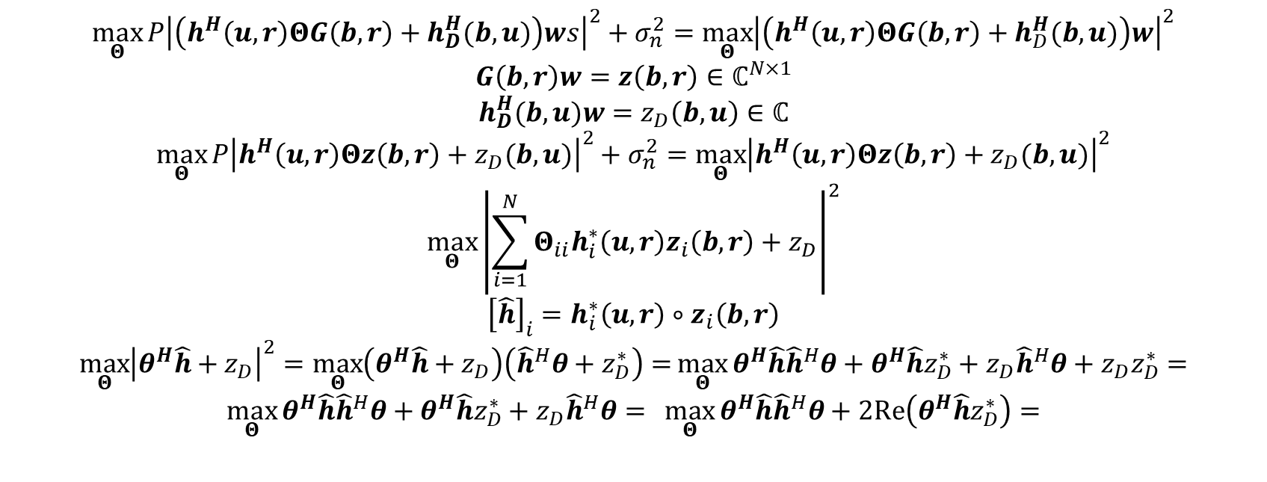

$∘$ denotes the Hadamard product, i.e., elementwise product
$$\max_{Θ}{P{\left|\left(h^{H}\left(u, r\right)ΘG\left(b,r\right)+h_{D}^{H}(b,u)\right)ws\right|}^{2}+σ_{n}^{2}}=\max_{Θ}{{\left|\left(h^{H}\left(u, r\right)ΘG\left(b,r\right)+h_{D}^{H}(b,u)\right)w\right|}^{2}}$$
$$\max_{Θ}{h^{H}\left(u, r\right)ΘG\left(b,r\right)ww^{H}G^{H}\left(b,r\right)Θh\left(u, r\right)}$$
$$\max_{Θ}{P{\left|\left(h^{H}\left(u, r\right)ΘG\left(b,r\right)+h_{D}^{H}(b,u)\right)ws\right|}^{2}+σ_{n}^{2}}=\max_{Θ}{{\left|\left(h^{H}\left(u, r\right)ΘG\left(b,r\right)+h_{D}^{H}(b,u)\right)w\right|}^{2}}$$
$$G\left(b,r\right)w=z\left(b,r\right)∈ℂ^{N×1}$$
$$h_{D}^{H}(b,u)w=z_{D}\left(b,u\right)∈ℂ$$
$$\max_{Θ}{P{\left|h^{H}\left(u, r\right)Θz\left(b,r\right)+z_{D}(b,u)\right|}^{2}+σ_{n}^{2}}=\max_{Θ}{{\left|h^{H}\left(u, r\right)Θz\left(b,r\right)+z_{D}(b,u)\right|}^{2}}$$
$$\max_{Θ}{{\left|\sum_{i=1}^{N}{Θ_{ii}h_{i}^{∗}\left(u, r\right)z_{i}\left(b,r\right)}+z_{D}\right|}^{2}}$$
$${\left[\hat{h}\right]}_{i}=h_{i}^{∗}\left(u, r\right)∘z_{i}\left(b,r\right)$$
$$\max_{Θ}{{\left|θ^{H}\hat{h}+z_{D}\right|}^{2}}=\max_{Θ}\left(θ^{H}\hat{h}+z_{D}\right)\left({\hat{h}}^{H}θ+z_{D}^{∗}\right)=\max_{Θ}{{θ^{H}\hat{h}\hat{h}}^{H}θ+θ^{H}\hat{h}z_{D}^{∗}+{z_{D}\hat{h}}^{H}θ+z_{D}z_{D}^{∗}=}$$
$$\max_{Θ}{{θ^{H}\hat{h}\hat{h}}^{H}θ+θ^{H}\hat{h}z_{D}^{∗}+{z_{D}\hat{h}}^{H}θ= \max_{Θ}{{θ^{H}\hat{h}\hat{h}}^{H}θ+2Re\left(θ^{H}\hat{h}z_{D}^{∗}\right)=}}$$

Slide 16

$$w_{MRT}=√P\frac{G^{H}Θ^{H}h+h_{d}}{\left\|G^{H}Θ^{H}h+h_{d}\right\|}$$
$$w_{MRT}=√P\frac{G^{H}Θ^{H}h+h_{d}}{\left\|G^{H}Θ^{H}h+h_{d}\right\|}$$

