Slide 1

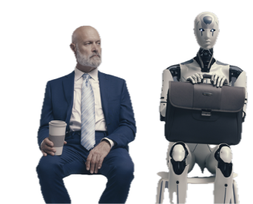
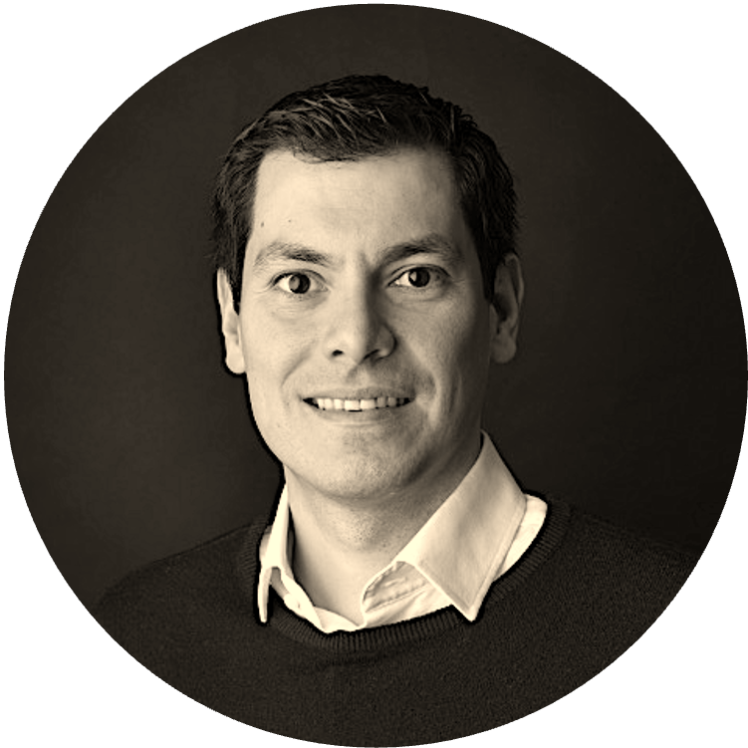
AI BADGE
Victor del Rosal

Slide 2
Thinking Partner

Slide 3
The Hook
Most people use AI
as a search box.
Practitioners use it as a thinking partner.
SEARCH BOX
THINKING PARTNER
One question. One answer. You take it or leave it.
A conversation that builds a calibrated, evidence-based view you could not have reached alone.
Seven moves turn any vague question into a view you can act on.

Slide 4
A real conversation
One real question, worked end to end.
Not a toy prompt. A question with real stakes pulls a better answer out of the model.
FORGETTABLE
"Tell me about software jobs."
REAL STAKES
"Set the record straight about software jobs. There is a lot of talk about redundancies and about more work than ever. What is a genuinely useful way to think about it?"

Slide 5
The seven moves
Seven moves. Three of them change everything.
The three marked with a key are the moves almost no one thinks to make.
1
Ask a real question
5
KEY Force calibration
Real stakes pull better answers.
Confidence and assumptions, per claim.
2
Drill deeper
6
Compress to a reusable prompt
Push for evidence, then the time horizon.
Then cross-validate elsewhere.
3
KEY Ask the AI for the questions
7
The retrospective
It surfaces the angles you missed.
What should I have asked from the start?
4
KEY Surface the hypotheses
Make the model's reasoning explicit.

Slide 6
Key move: ask the AI for the questions
Turn the AI from answerer to question-designer.
The single biggest unlock. The questions you did not know to ask are usually the valuable ones.
What comes back
THE PROMPT
Which roles actually shrink, and which just change shape?
"If you could ask any questions and explore every angle of this, what would you be most curious to ask?"
What does the data say versus the headlines?
How fast is the shift, in years not decades?
Why it works
You stop limiting the conversation to your own framing. The model maps the territory you cannot see yet.
What skills compound, and what becomes a commodity?
Where does judgement still beat automation?
Most people would never have thought of half of these.

Slide 7
Key moves: hypotheses + calibration
Make the reasoning visible. Then make it honest.
SURFACE THE HYPOTHESES
FORCE CALIBRATION
"What working theories or hypotheses are we entertaining here?"
"State your confidence on each claim, and name the assumptions behind it."
Now you see the structure of the answer, not just the answer. You can test each theory on its own.
This is bet-weights in chat form. The model splits what it is sure of from what it is guessing.
Example theories surfaced:
HIGH
Software demand grows long-term.
• Demand for software rises as it gets cheaper to build.
MEDIUM
Mid-level roles compress first.
• Routine coding commoditises; system judgement does not.
LOW
Exact timing of the shift.

Slide 8
The retrospective
The most underrated prompt in AI.
"What prompt should I have used from the very start, and what would have been the most useful questions to ask?"
Why it is the punchline
It compresses the whole conversation
The model hands back the single master question that would have unlocked it in one move.
It teaches you, not just answers you
Run it after any hard conversation and your next first prompt gets sharper.
It is reusable
Save the master question. It becomes the opening move next time you face the topic.

Slide 9
What you do next
You stop being a user.
You become a collaborator.
Today
Take one real question you are sitting with and run all seven moves.
This week
Use the three key moves on demand: ask-for-questions, hypotheses, calibration.
Next month
End every hard chat with the retrospective. Keep the master questions.
Beyond
Carry this into every other lesson. It changes how you use all of them.
Keep the seven-moves card beside you. AI is a thinking partner if you let it design the questions.

