Slide 1

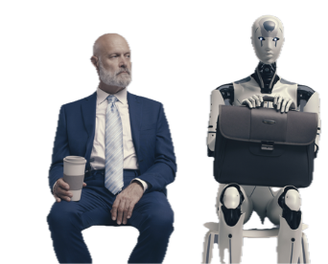

AI BADGE
Victor del Rosal

Slide 2
AI Interviews You

Slide 3
Let AI interview you and create a page for you
Open ChatGPT, Claude, or Gemini on the web
Paste the Interview Prompt (copy-paste from screen)
Answer 4 quick questions (mostly multiple choice)
Shortcut on Q3: drop in your CV or LinkedIn PDF
The AI returns an index.html with your page
Copy the index.html code block it returns
Save it as an .html file and open it in a browser
Push to GitHub Pages using the Deploy to GitHub steps

