Slide 1

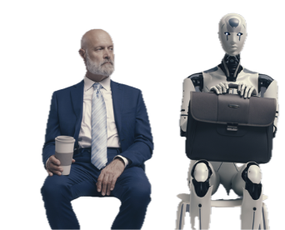
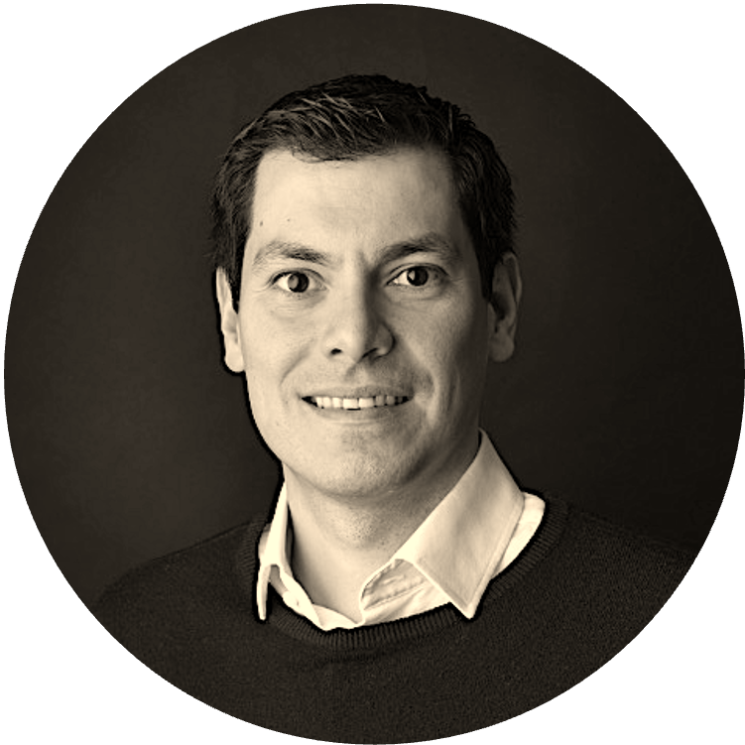
AI BADGE
Victor del Rosal

Slide 2
Hello World 2

Slide 3
What you will need for this exercise
Free ChatGPT account (www.chatgpt.com)
Download and Install Sublime Text (https://www.sublimetext.com/download)
Create an ai-projects folder in your computer

Slide 4
Individual Exercise
Ask ChatGPT (or your LLM of choice):
Make changes to my Hello World page: add a button that will change background color and make the ‘Hello World’ bounce around the page. Keep as a single-file HTML, JavaScript, CSS.

