Slide 1

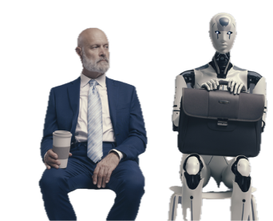
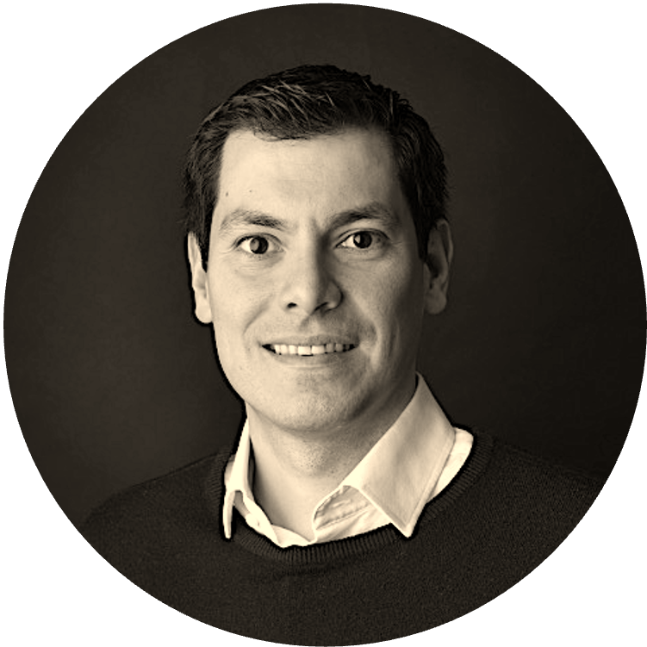
AI BADGE
Welcome!
Victor del Rosal

Slide 2
Coding with AI

Slide 3
What you will need for this exercise
Free ChatGPT account (www.chatgpt.com)
Download and Install Sublime Text (https://www.sublimetext.com/download)
Create an ai-projects folder in your computer

Slide 4
Individual Exercise
Ask ChatGPT (or your LLM of choice):
Code my very first Hello World page in under 50 lines of code that includes a button and some movement. Output as a single-file HTML, JavaScript, CSS.

