Slide 1
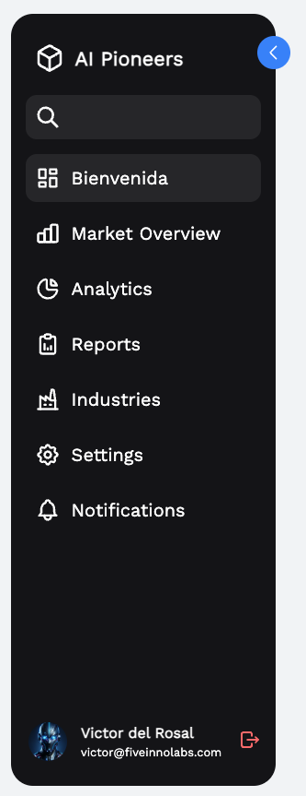
Exclusive Invitation
Join us for a special webinar on the impact of AI in modern industries, featuring expert speakers from around the world.
✅ Correct view

Slide 2
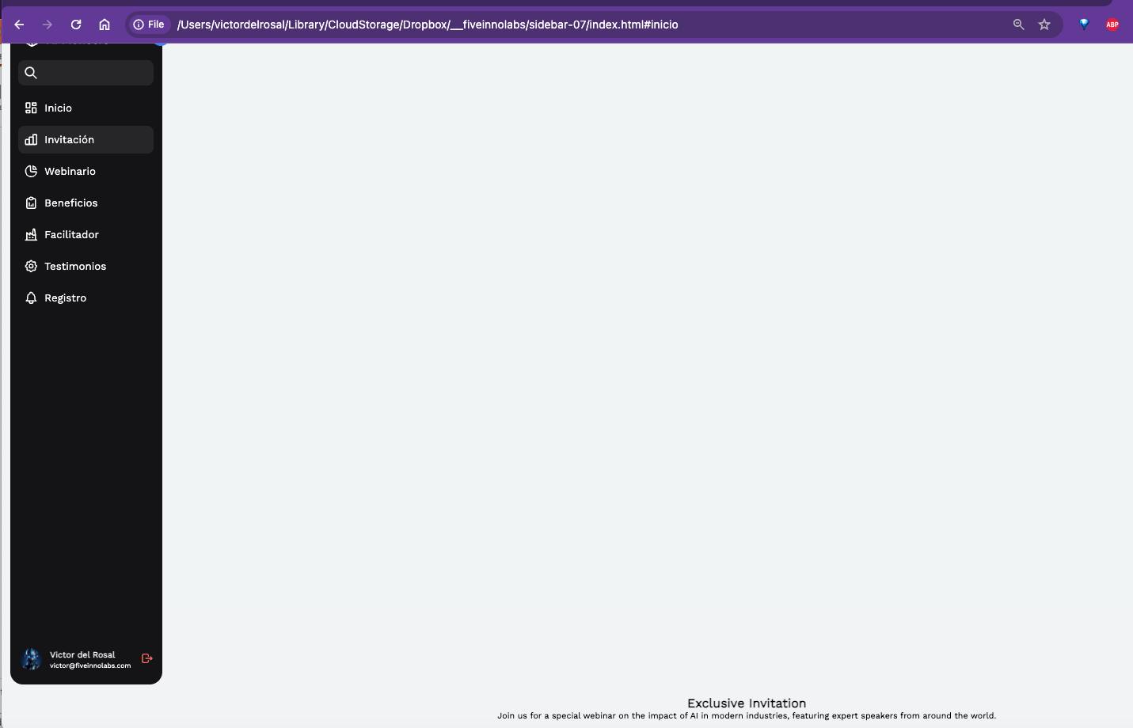
❌ Incorrect view

Slide 3
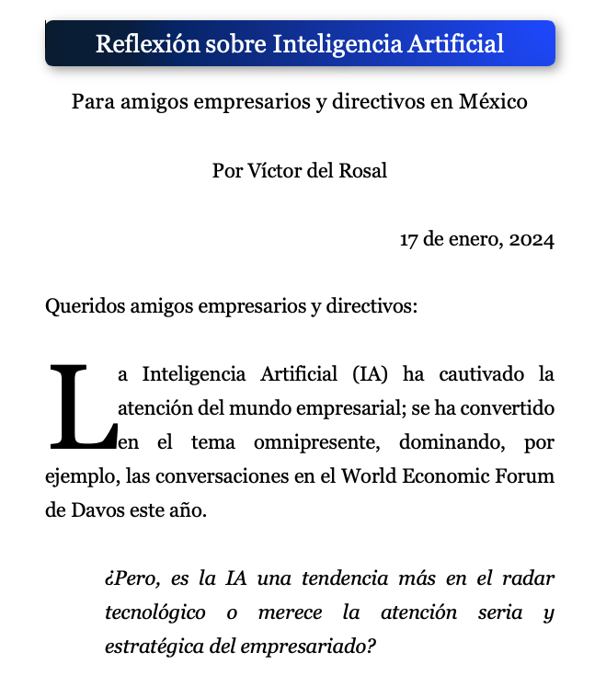


Inicio
Invitación
Webinario
Constancia
Facilitador
Testimonios
fiveinnolabs
Contacto
Registro

