Slide 1
Digital System Design Final Project
第六組
電機三 黃文璁
電機三 許耀中
電機三 陳博彥

Slide 2
Outline
Architecture
Jump instructions
Branch
Forwarding
Stall
Cache
Critical path optimization
Extension
Branch Prediction
L2 Cache
Multiplier, Divider
Experiments

Slide 3
Architecture

Slide 4
Jump Instructions
Handle jump instructions (J,JR,JAL,JALR) in ID stage
Pros: only 1 bubbled cycle needed
Cons: longer critical path

Slide 5
Jump Instructions
Details
J: can be done in IF, but handle in ID for convenience
JR/JALR: need correct values of regs, forwarding is needed
JAL/JALR: need additional controls LinkRA and LinkRD

Slide 6
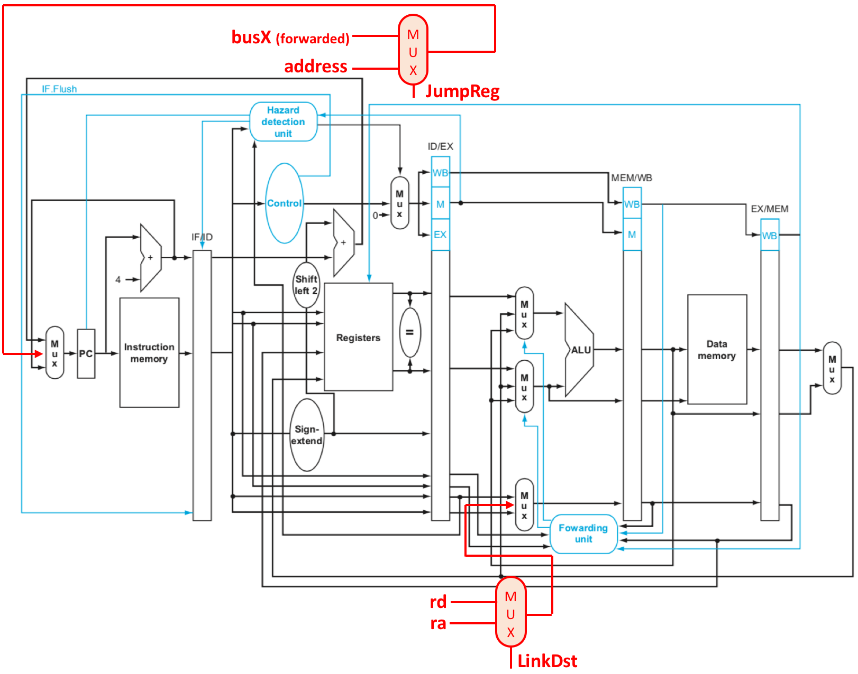
Jump datapath

Slide 7
Branch
Handle BEQ in ID stage (baseline)
Also need to use forwarded busX and busY
In BrPred, we have to handle BEQ in IF and ID

Slide 8
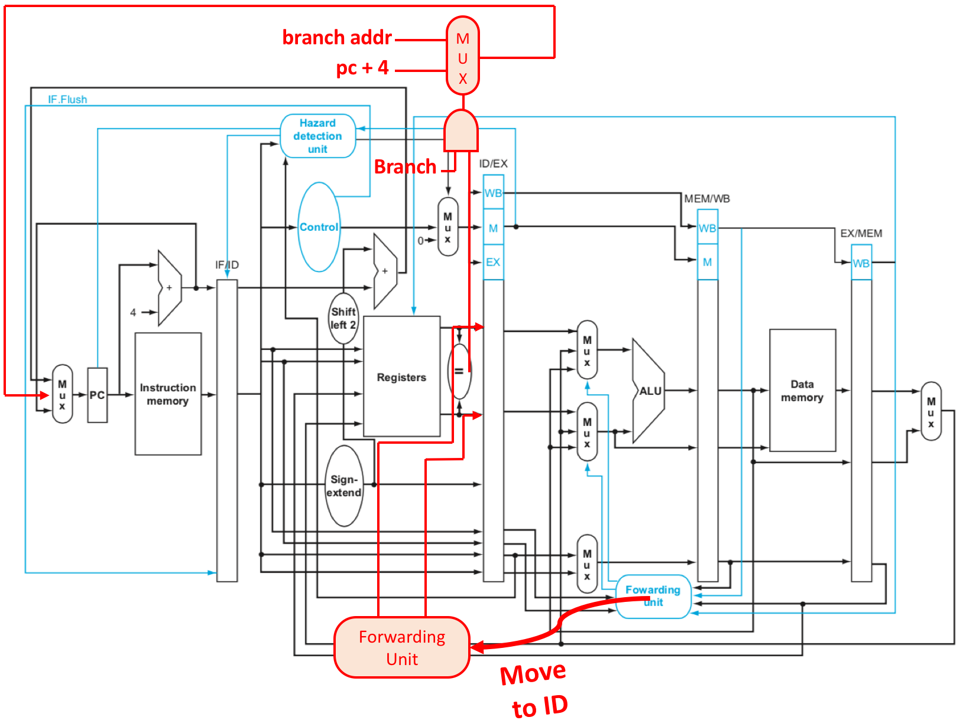
Branching (no BrPred)

Slide 9
Forwarding
Forward to ID
Similar to textbook, with additional ForwardEX conditions
ForwardEX_X = EX_RegWrite & (EX_RW!=0) & (EX_RW==ID_RX);
ForwardEX_Y = EX_RegWrite & (EX_RW!=0) & (EX_RW==ID_RY);
ForwardMEM_X = MEM_RegWrite & (MEM_RW!=0) & (MEM_RW==ID_RX);
ForwardMEM_Y = MEM_RegWrite & (MEM_RW!=0) & (MEM_RW==ID_RY);
ForwardWB_X = WB_RegWrite & (WB_RW!=0) & (WB_RW==ID_RX);
ForwardWB_Y = WB_RegWrite & (WB_RW!=0) & (WB_RW==ID_RY);

Slide 10
Stall
Stall aggregator
Inputs
I_stall: instruction cache stall
lw_hazard: load-use hazard
D_stall: data cache stall
Outputs
stall_IF: stall IF stage
flush_IF: bubble IF stage
stall_ID: stall ID stage
flush_ID: bubble ID stage
stall_EX: stall EX stage

Slide 11
Stall
Stall conditions
if D_stall:
stall IF/ID/EX
if lw_hazard:
stall IF/ID, flush ID
if I_stall:
flush IF

Slide 12
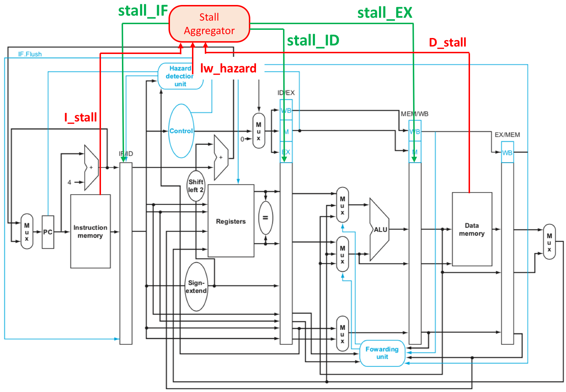

Slide 13
Cache
Separate implementation of ICACHE and DCACHE
ICACHE: read-only, 32 words, direct mapped
DCACHE: read/write, 32 words, direct mapped, write back + write buffer

Slide 14
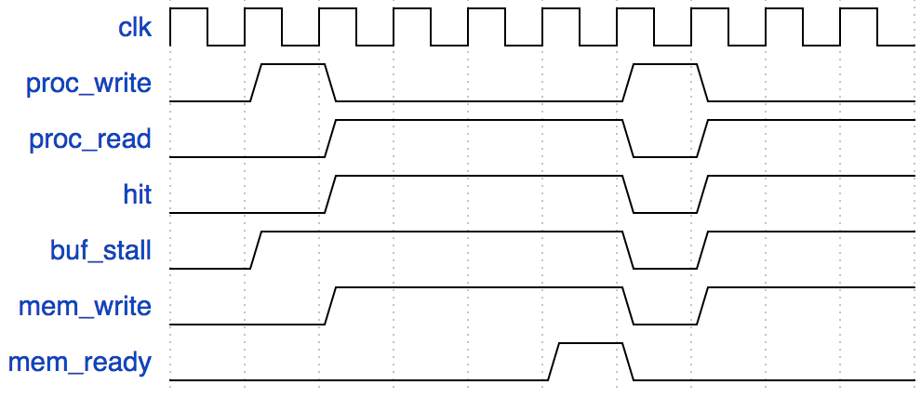
Cache
Write back + write buffer
Write buffer can hide write latency if no continuous miss
write miss
Can still read
after write miss

Slide 15
Cache
Read preloader
Continuous address for k read, preload next address

Slide 16
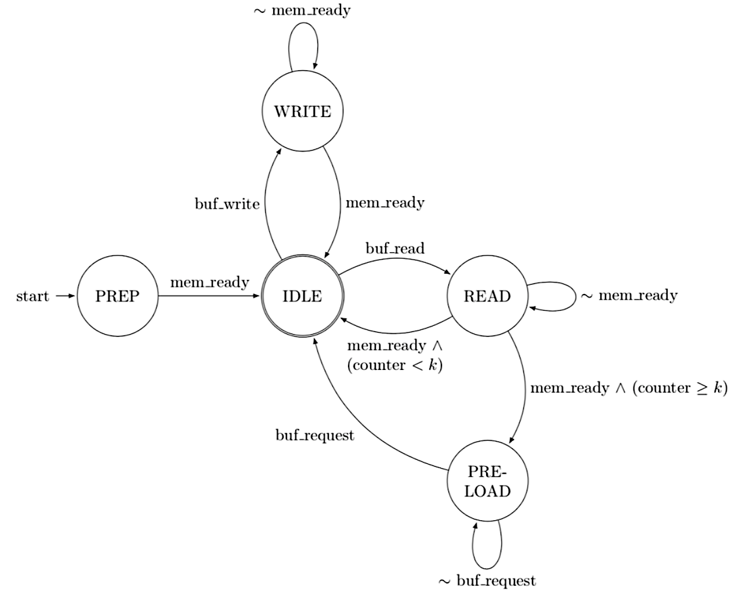
Cache
Read preloader FSM

Slide 17
Cache
Read preloader
NOT used in final design
In HW4:
Without RP: 6164 cycles, read miss penalty: ~4 cycles
With RP: 4172 cycles (-32.3%), read miss penalty: ~0.2 cycles
In Final (baseline):
Without RP: 2065 cycles
With RP: 2074 cycles (+0.4%)

Slide 18
Cache
Read preloader
Why?
In HW4, we can hide memory.v read latency
In Final, we can’t fully hide slow_memory.v read latency
Comparison
Using memory.v in HW4 tb: 4182 cycles
Using slow_memory.v in HW4 tb: 8811 cycles
Also, ICACHE read miss rate in baseline is low (0.9%)

Slide 19
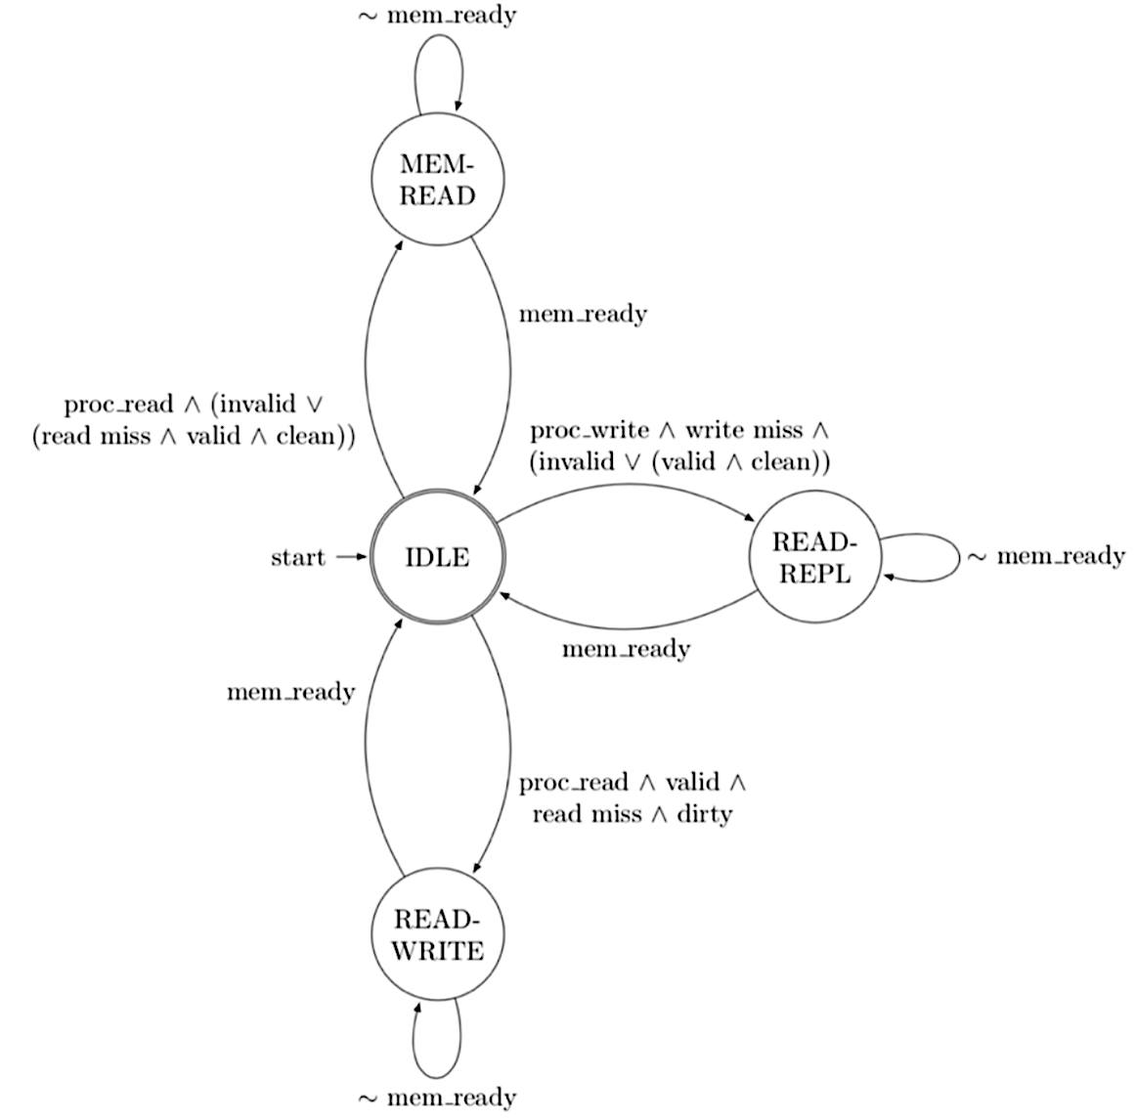
Cache
Cache FSM

Slide 20
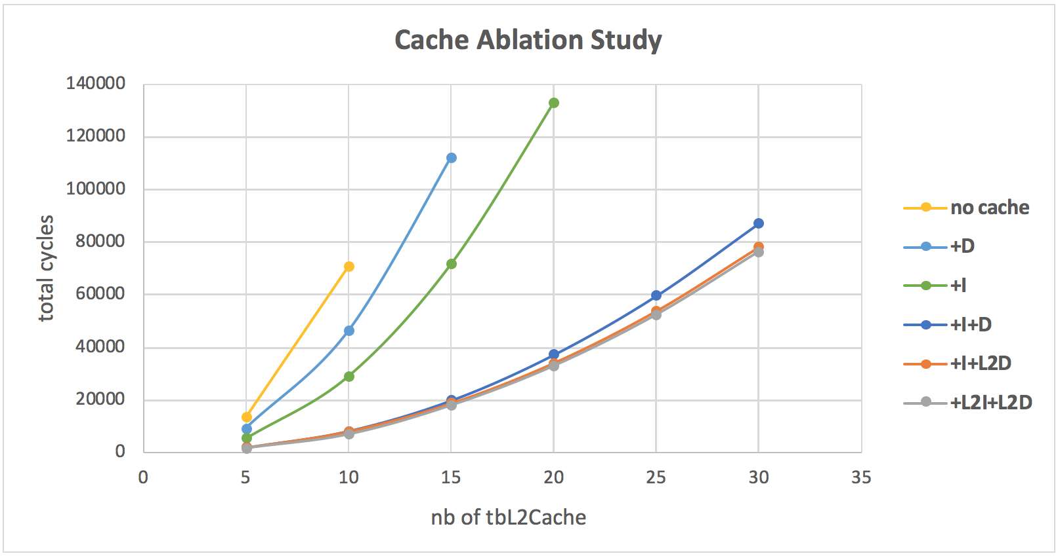
Experiment: Cache Ablation Study
Ablation study
+I: ICACHE, +D: DCACHE
+L2I: L2 ICACHE, +L2D: L2 DCACHE

Slide 21
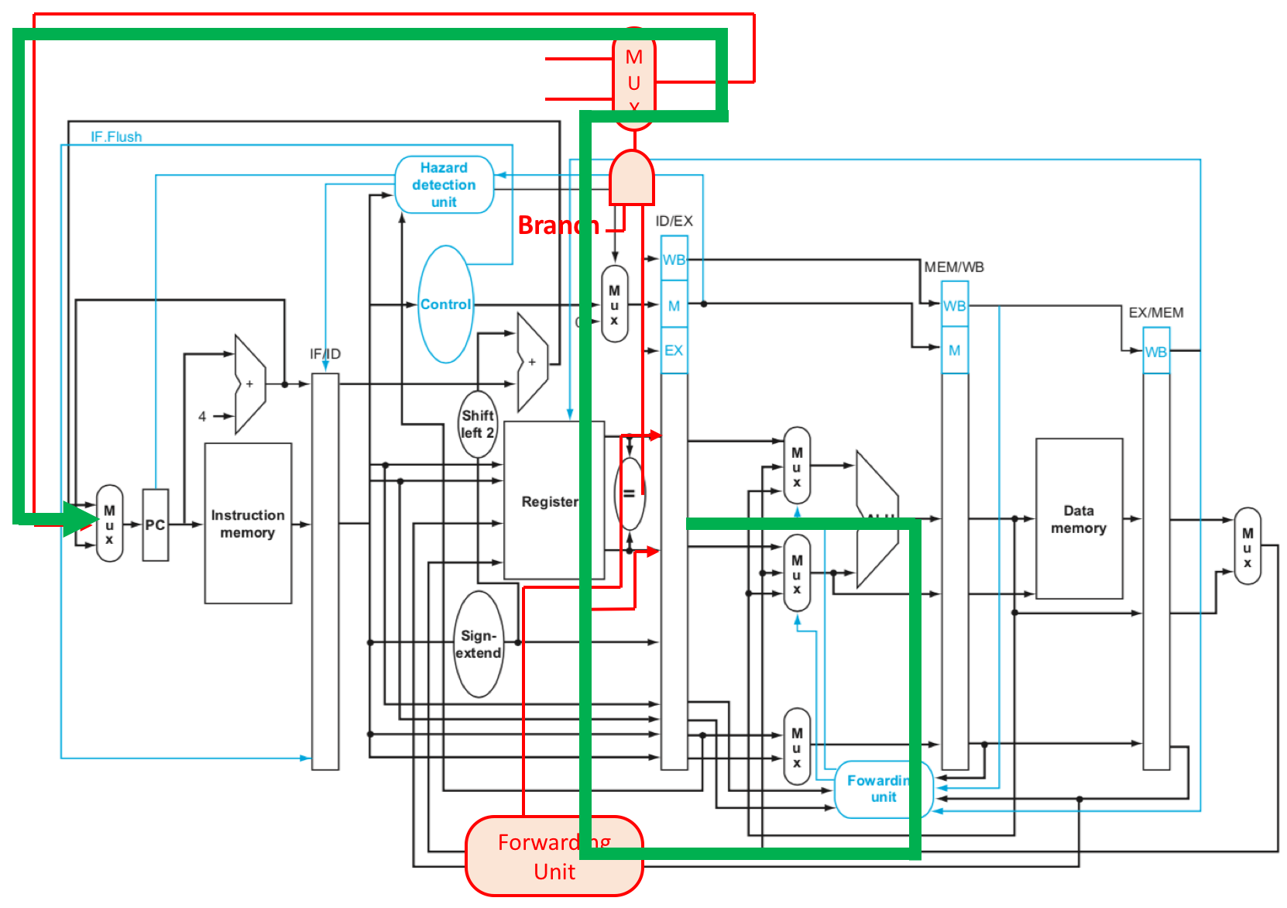
Critical Path Optimization
Observation: critical path
EX – forwarding – program counter

Slide 22
Critical Path Optimization
Break the critical path
Gate the forwarding unit and forwarded value by registers
If forwarding happens, stall IF and ID, flush ID

Slide 23
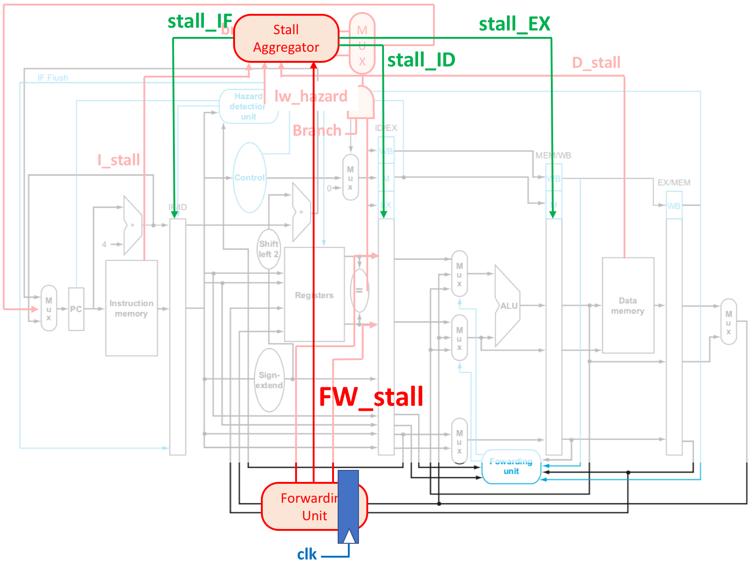

Slide 24
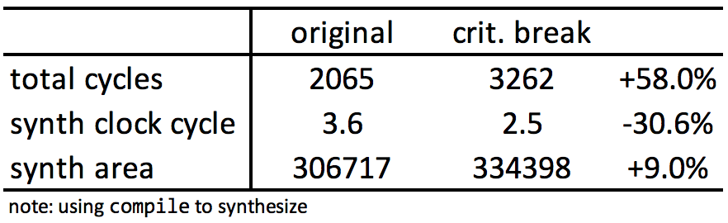
Experiment: Critical Path Optimization
Results
No gain in terms of AT
Clock speed can be faster, but total cycles also grows

Slide 25
Experiment: AT
Area: 290387 (um²)
Total cycles: 2143 (baseline hasHazard)
Clock cycle: 4.08 (ns)
A x T: ~2.538 x 10⁹

Slide 26
Extensions

Slide 27
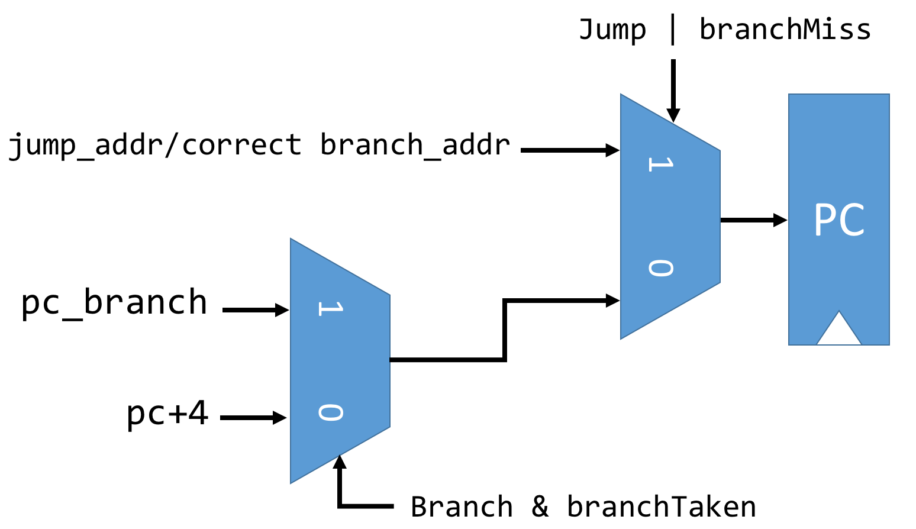
Branch Prediction
Data Path

Slide 28
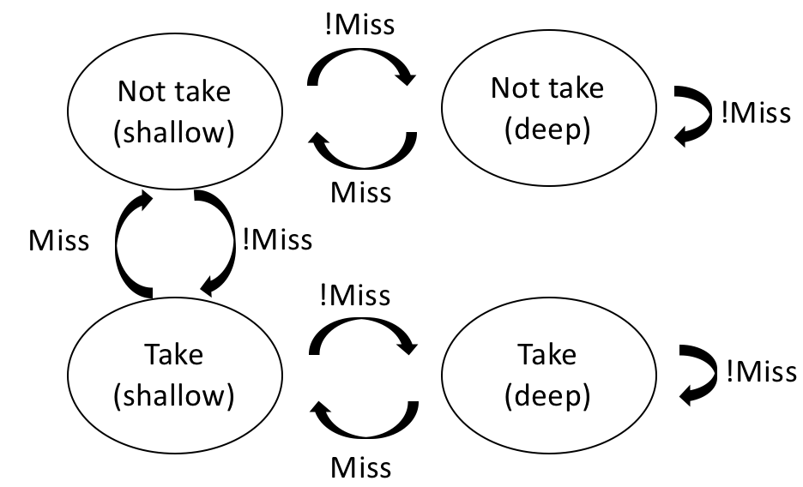
Branch Prediction
FSM: 2-bit saturating counter

Slide 29
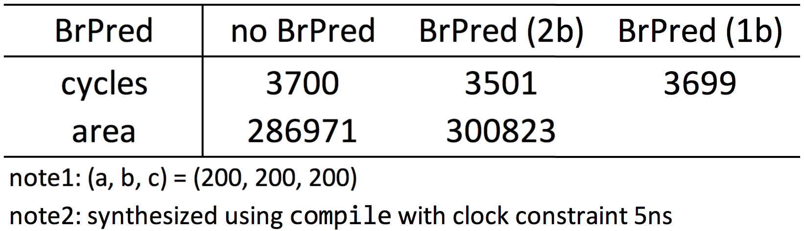
Experiment: Branch Prediction
Comparison
Also comparing 2-bit and 1-bit saturating counter

Slide 30
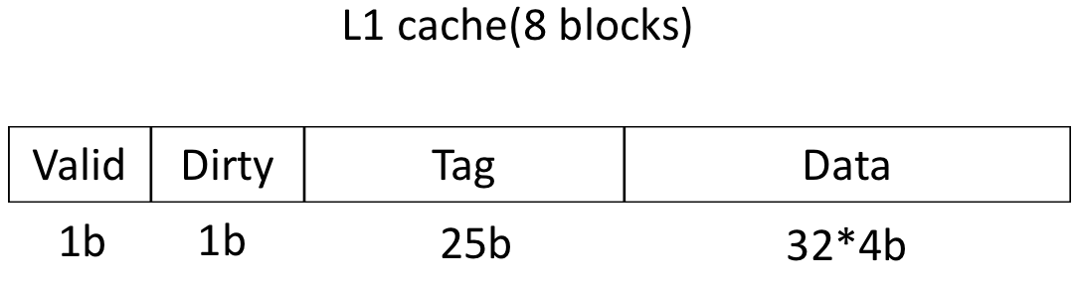
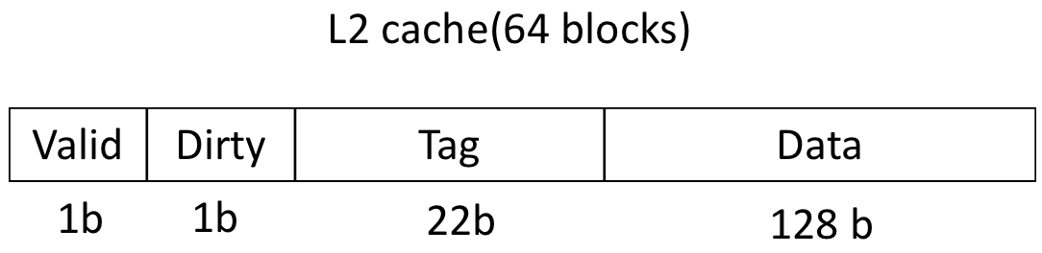
L2 Cache
Implementation
16~128 blocks, 128 bits/block
Direct mapped

Slide 31
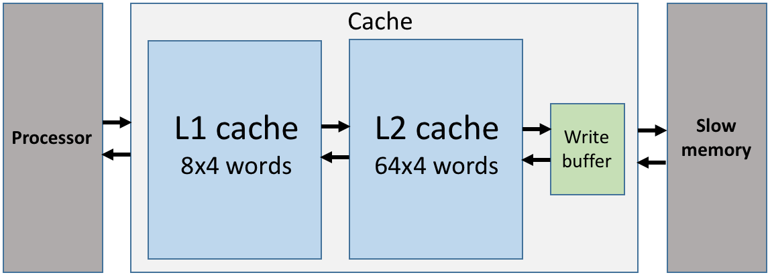
L2 Cache
Block diagram

Slide 32
Experiment: L2 Cache Ablation Study
Ablation study
+I: ICACHE, +D: DCACHE
+L2I: L2 ICACHE, +L2D: L2 DCACHE

Slide 33
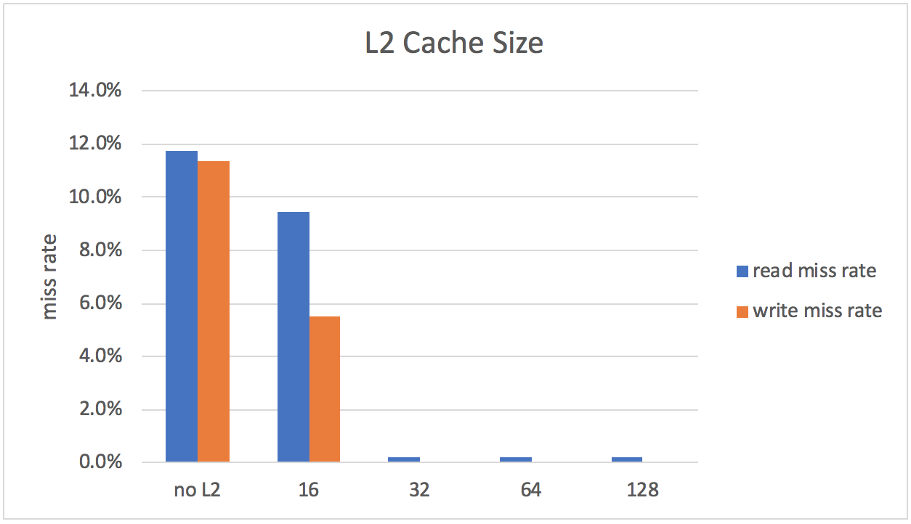
Experiment: L2 Cache Size
Different L2 cache size

Slide 34
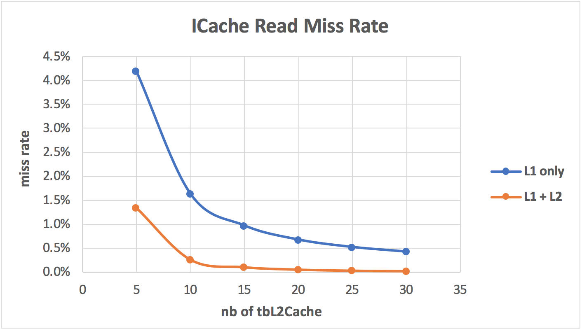
Experiment: L2 Cache Miss Rates
Miss rates
Instruction cache, read miss rate

Slide 35
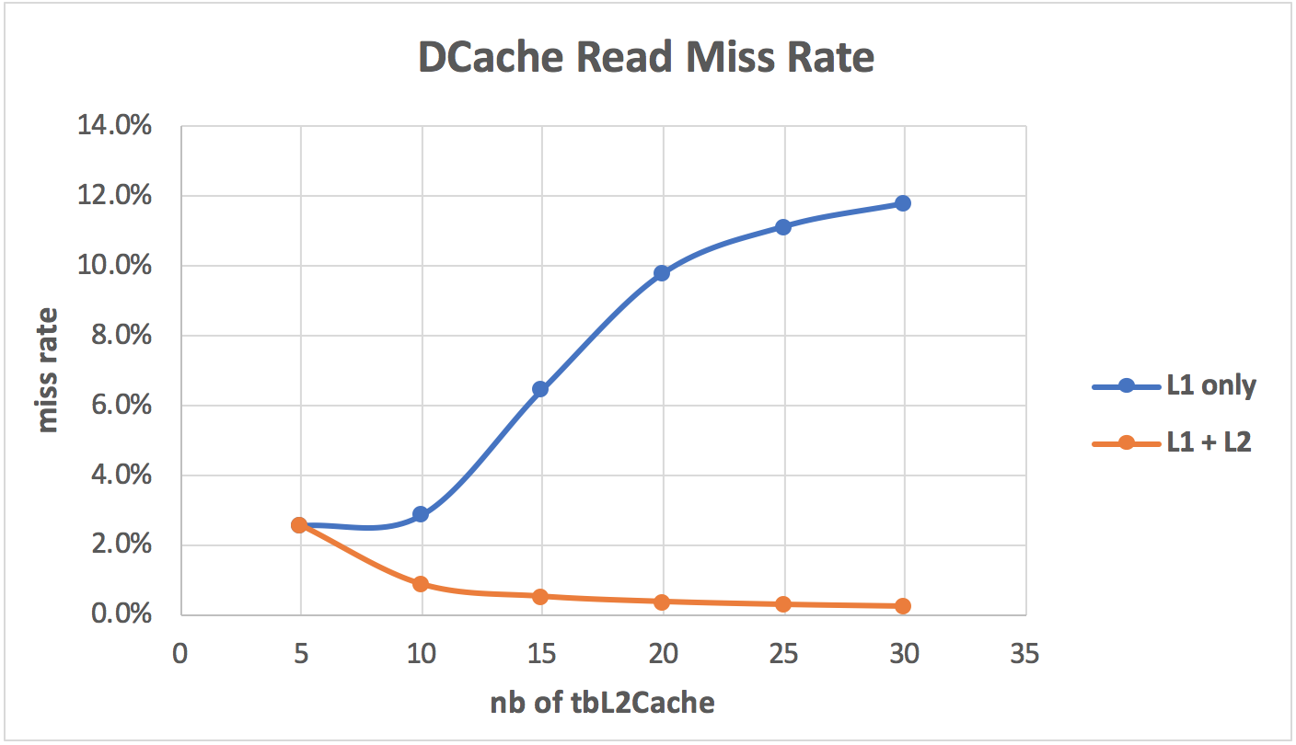
Experiment: L2 Cache Miss Rates
Miss rates
Data cache, read miss rate

Slide 36
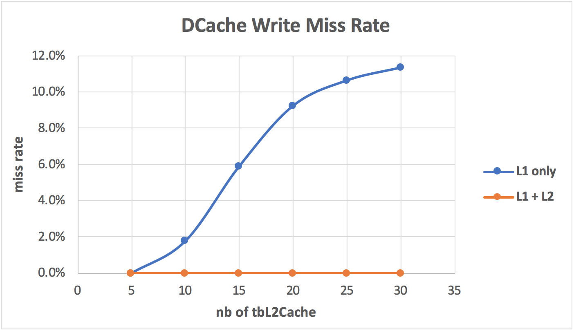
Experiment: L2 Cache Miss Rates
Miss rates
Data cache, write miss rate

Slide 37
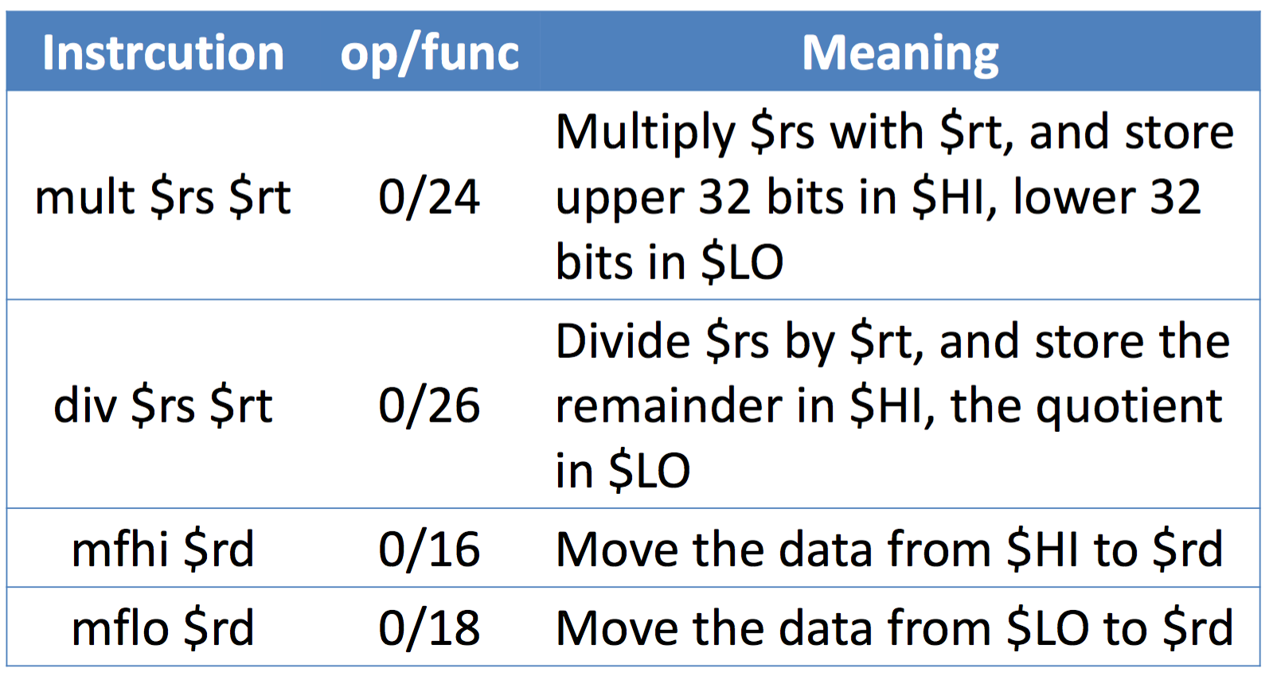
Multiplier, Divider
Implemented Instructions
(signed)
(signed)

Slide 38
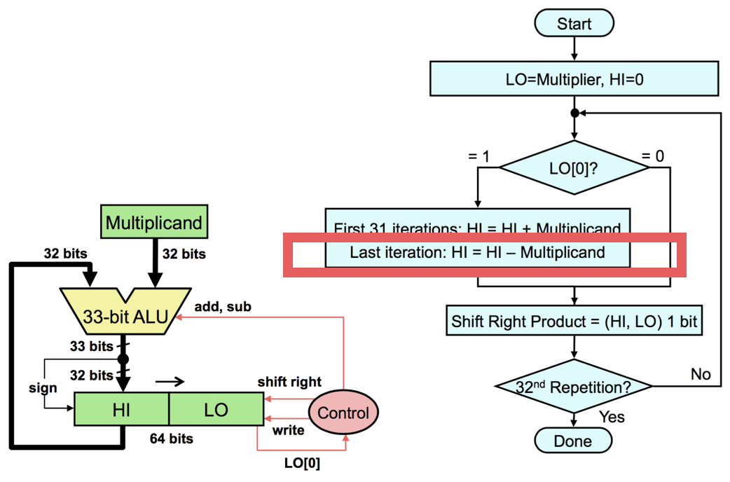
Multiplier, Divider
Multiplier architecture

Slide 39
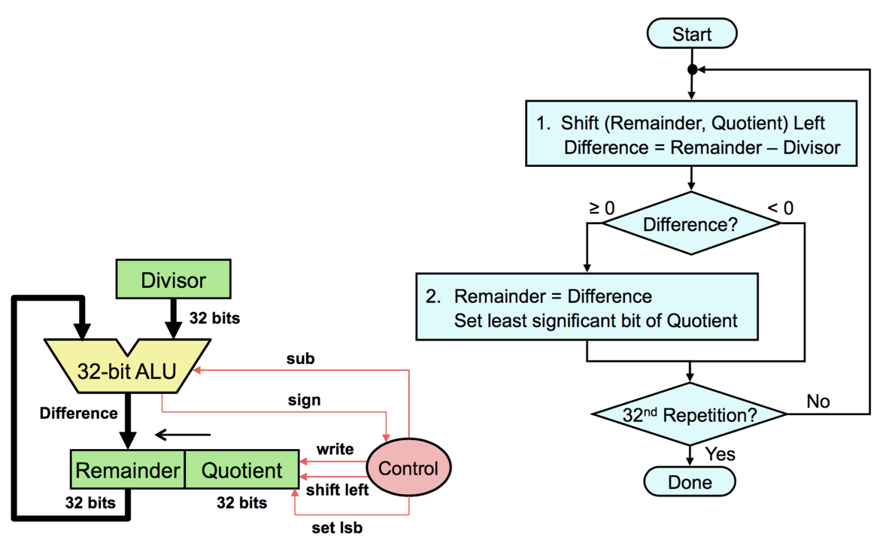
Multiplier, Divider
Divider architecture

Slide 40
Multiplier, Divider
Signed division
Convert the dividend and divisor to positive
Do unsigned division
Compute the signs of the quotient and remainder
(Quotient sign) = (Dividend sign) XOR (Divisor sign)
(Remainder sign) = (Dividend sign)

Slide 41
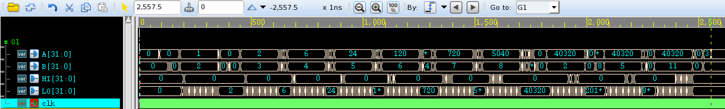
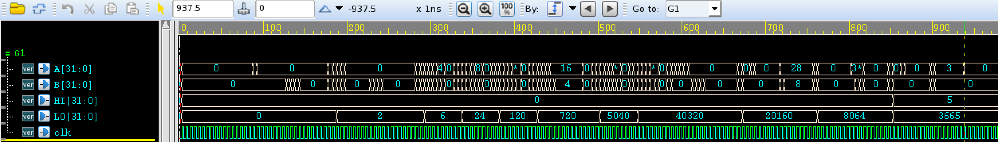

Multiplier, Divider
Comparison
Iterative (512 cycles)
RTL (188 cycles)

Slide 42
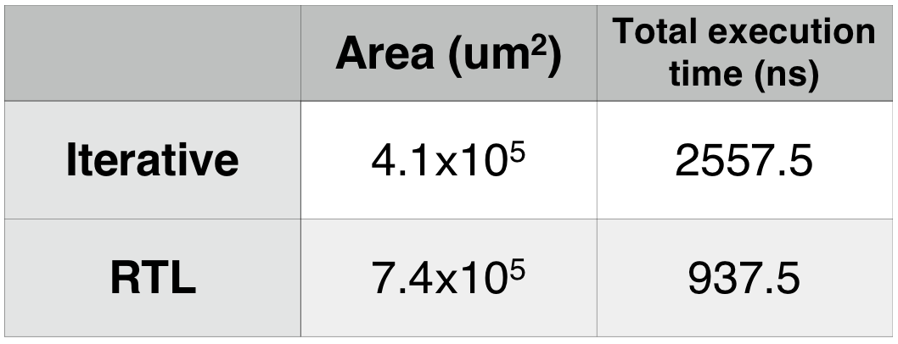

Experiment: Multiplier, Divider
Comparison
Area-speed tradeoff

