Slide 1
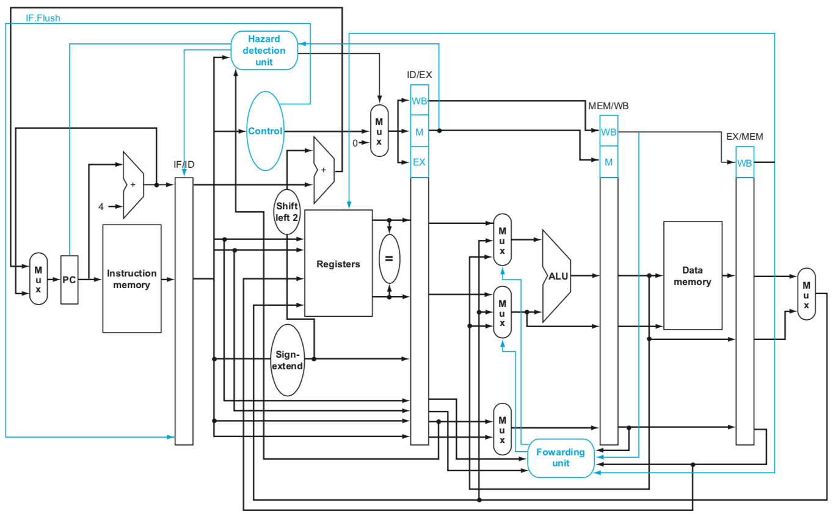
busX (forwarded)
M
U
X
address
JumpReg
rd
M
U
X
ra
LinkDst

Slide 2
branch addr
M
U
X
pc + 4
Branch
Forwarding
Unit
Move
to ID

Slide 3
stall_IF
Stall
Aggregator
stall_EX
stall_ID
D_stall
lw_hazard
I_stall

Slide 4
M
U
X
Branch
Forwarding
Unit

Slide 5
stall_IF
Stall
Aggregator
stall_EX
branch addr
M
U
X
pc + 4
stall_ID
D_stall
lw_hazard
Branch
I_stall
FW_stall
Forwarding
Unit
clk

