Slide 1
Final Project Update
General Deep Learning Inference Engine
VLSI Signal Processing
傅子興 , 黃文璁

Slide 2
Motivation
Recent researches focus on accelerating common deep learning operations, such as optimizing data flow or reducing bandwidth for accessing data
However, these accelerators require large effort to handle the control and data input to assist full model inference and lack of flexibility
We aim to design a instruction-based, general purpose deep learning inference engine
VLSI Signal Processing

Slide 3
Design Description
General deep learning inference engine
  Supporting different configurations of DNN/CNN layers
Porting existing model to our engine
  Custom instructions and model memory layout
Automatic model porting flow in Python
  Instruction generation, memory layout generation, …
VLSI Signal Processing

Slide 4
Prior Work
Chen, Yu-Hsin, et al. "Eyeriss: An energy-efficient reconfigurable accelerator for deep convolutional neural networks." IEEE Journal of Solid-State Circuits 52.1 (2016): 127-138.
Lee, Jinmook, et al. "UNPU: A 50.6 TOPS/W unified deep neural network accelerator with 1b-to-16b fully-variable weight bit-precision." 2018 IEEE International Solid-State Circuits Conference (ISSCC). IEEE, 2018.
Shin, Dongjoo, et al. "14.2 DNPU: An 8.1 TOPS/W reconfigurable CNN-RNN processor for general-purpose deep neural networks." 2017 IEEE International Solid-State Circuits Conference (ISSCC). IEEE, 2017.
Cheng-Hsun Lu et al., "A Fully-Programmable Deep Learning Processor with Adaptable Intelligence"
VLSI Signal Processing

Slide 5
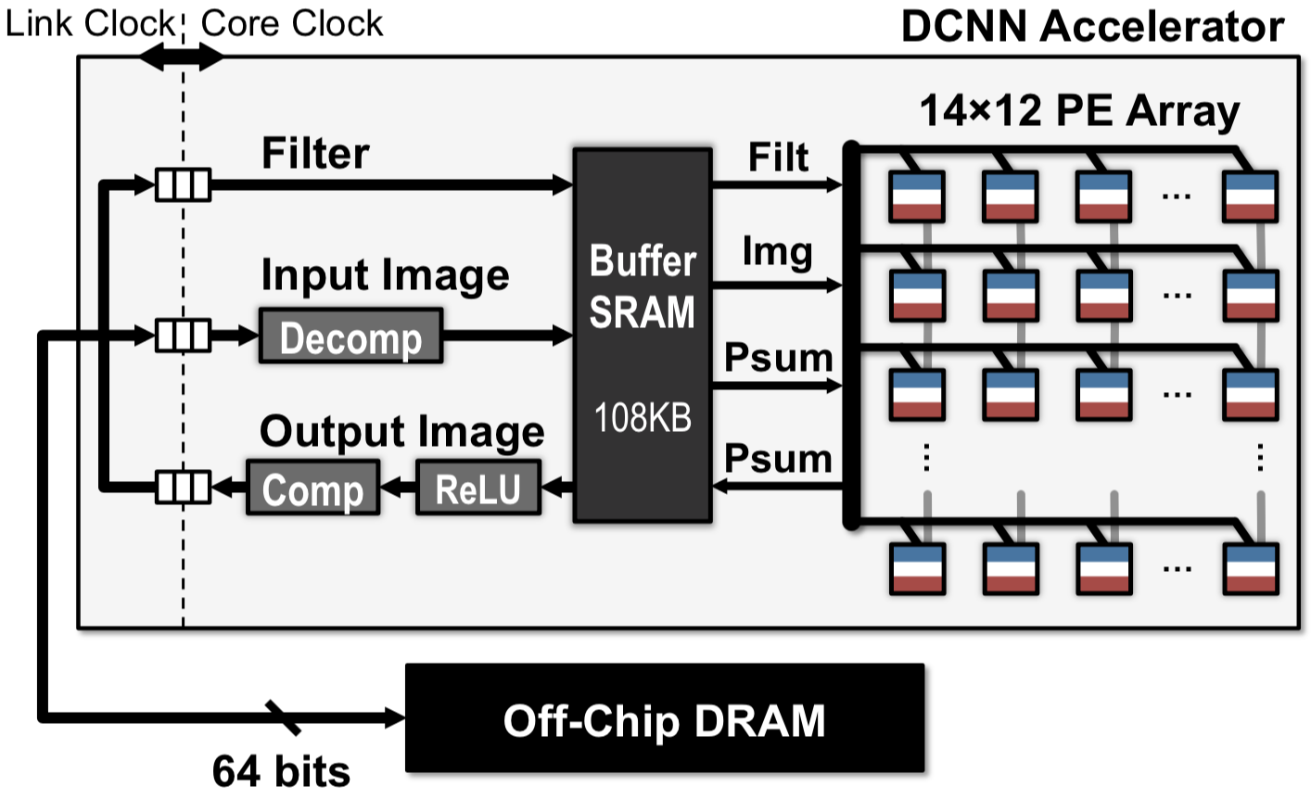
Eyeriss CNN Accelerator Design
VLSI Signal Processing

Slide 6
Design Challenges
Software
  Instruction design for model porting
  Hardware constraint-driven instruction generation
  Instructions should support different hardware configuration
Hardware
  Minimizing external memory access
  Parameterized hardware implementation
  Supporting fixed point and floating point inference
VLSI Signal Processing

Slide 7
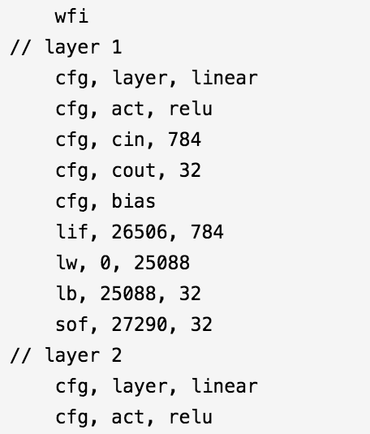
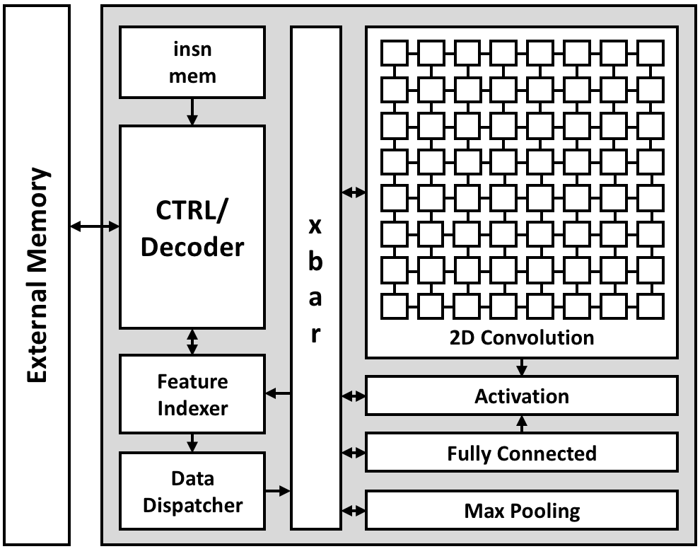

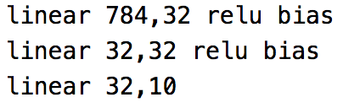
Possible Solutions
Training model in Python (e.g., PyTorch)
Generating instructions and memory layout
Run model inference on our engine
Model
Description
Generating
Instructions
Hardware
Inferencing
VLSI Signal Processing

Slide 8
Design Flow
Determine supported NN operations
Implement DNN/CNN core and other submodules
Top level instruction decoder and controller design
Conversion from high level model description
to low level instructions and layout
VLSI Signal Processing

Slide 9
Design Specifications
VLSI Signal Processing

Slide 10
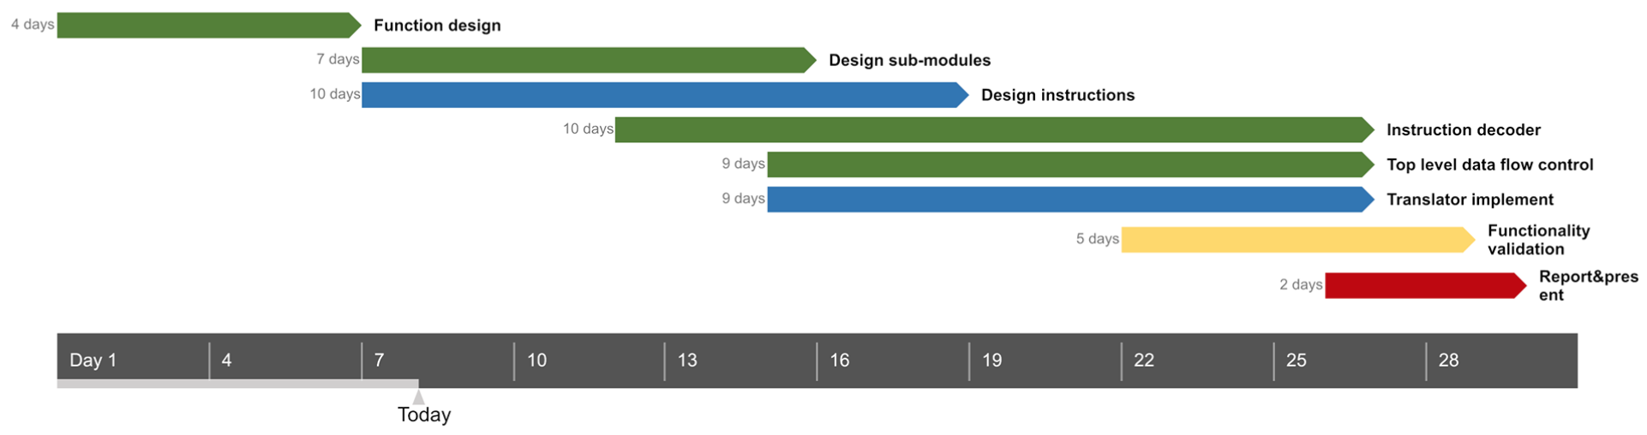
Design Schedule
VLSI Signal Processing

Slide 11
References
Chen, Yu-Hsin, et al. "Eyeriss: An energy-efficient reconfigurable accelerator for deep convolutional neural networks." IEEE Journal of Solid-State Circuits 52.1 (2016): 127-138.
Lee, Jinmook, et al. "UNPU: A 50.6 TOPS/W unified deep neural network accelerator with 1b-to-16b fully-variable weight bit-precision." 2018 IEEE International Solid-State Circuits Conference-(ISSCC). IEEE, 2018.
Shin, Dongjoo, et al. "14.2 DNPU: An 8.1 TOPS/W reconfigurable CNN-RNN processor for general-purpose deep neural networks." 2017 IEEE International Solid-State Circuits Conference (ISSCC). IEEE, 2017.
Cheng-Hsun Lu et al., "A Fully-Programmable Deep Learning Processor with Adaptable Intelligence"
VLSI Signal Processing

