Slide 1
MongoDB Connector for Apache Kafka Quick Start Sandbox 介紹
Victor Huang
2022/4/11

Slide 2
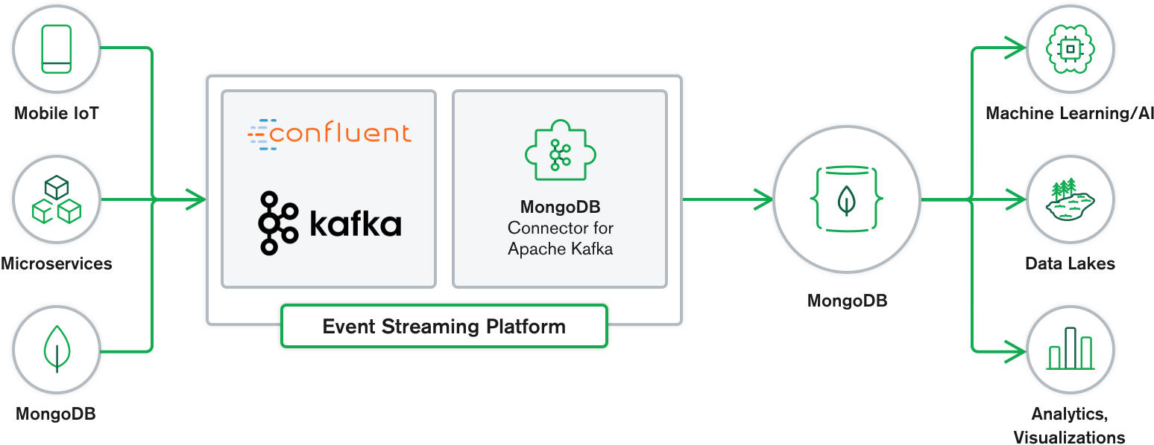
MongoDB & Kafka Integration Use Case
Source: https://www.mongodb.com/blog/post/getting-started-with-the-mongodb-connector-for-apache-kafka-and-mongodb-atlas

Slide 3
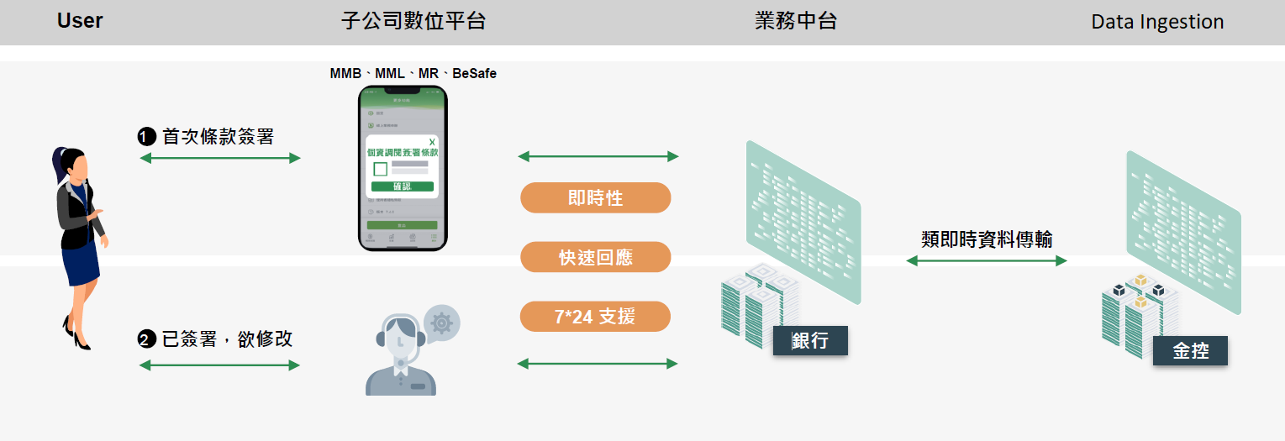
個資調閱註記 High Level Design

Slide 4
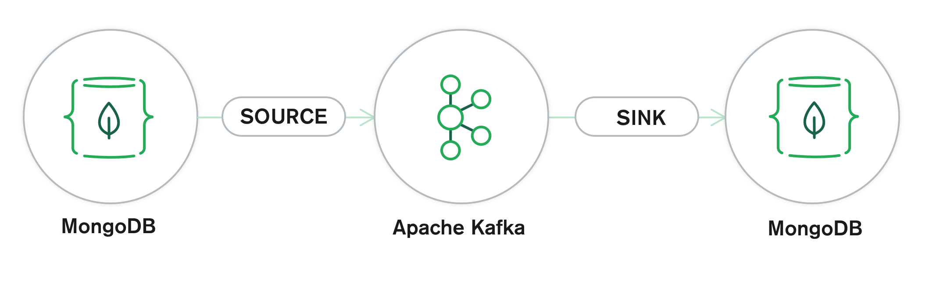
MongoDB Connector for Apache Kafka
Quick Start Example Blueprint
mongo-source
mongo-sink
quickstart.sampleData
topic: quickstart.sampleData
quickstart.topicData

Slide 5
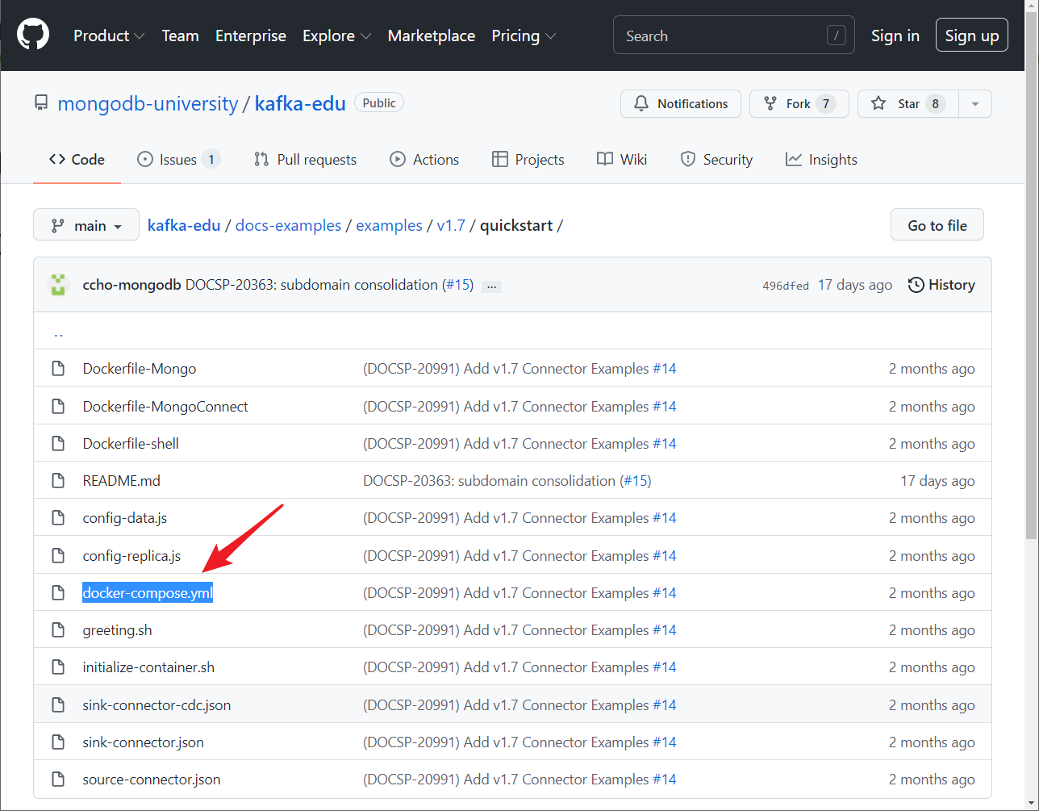
Download docker-compose.yml & Start the Sandbox
下載： https://github.com/mongodb-university/kafka-edu/tree/main/docs-examples/examples/v1.7/quickstart/docker-compose.yml
$ docker-compose -p quickstart up -d
安裝成功的訊息如下：
Creating mongo1 ... done
Creating zookeeper ... done
Creating mongo1-setup ... done
Creating broker ... done
Creating connect ... done
Creating shell ... done
Source:
https://github.com/mongodb-university/kafka-edu

Slide 6
確認是否啟動成功
[centos@ec2-54-248-82-150 ~]$ docker images
REPOSITORY TAG IMAGE ID CREATED SIZE
quickstart-shell 1.0 1c7e62c5764e 13 hours ago 360MB
quickstart-mongod 1.0 a829edb3b3dd 13 hours ago 699MB
quickstart-connect-1.7.0 1.0 6f6dc2e0f639 13 hours ago 1.46GB
mongo latest 532c84506200 3 days ago 699MB
confluentinc/cp-kafka-connect latest 636808fa6198 3 days ago 1.45GB
confluentinc/cp-kafka latest 5c24320a9696 3 days ago 783MB
confluentinc/cp-zookeeper latest 874b3b14eb0d 3 days ago 783MB
[centos@ec2-54-248-82-150 ~]$ docker ps
CONTAINER ID IMAGE COMMAND CREATED STATUS PORTS NAMES
66c4230552c1 quickstart-shell:1.0 "tail -f /dev/null" 13 hours ago Up 13 hours shell
5a0698acc0cb quickstart-connect-1.7.0:1.0 "/etc/confluent/dock…" 13 hours ago Up 13 hours (healthy) 8083/tcp, 9092/tcp connect
37d08b4240aa confluentinc/cp-kafka:latest "/etc/confluent/dock…" 13 hours ago Up 13 hours 9092/tcp broker
0c967cc7da4f confluentinc/cp-zookeeper:latest "/etc/confluent/dock…" 13 hours ago Up 13 hours 2181/tcp, 2888/tcp, 3888/tcp zookeeper
8fab6091117c quickstart-mongod:1.0 "docker-entrypoint.s…" 13 hours ago Up 13 hours 27017/tcp mongo1

Slide 7
連進shell
[centos@ec2-54-248-82-150 temp]$ docker exec -it shell /bin/bash
Version 1.0
Tools installed:
Kafkacat - Apache Kafka command line producer and consumer tool for Kafka
MongoSH - MongoDB command line shell
[MongoDB Kafka Connector Quick Start] :
Learn how to use Kafkacat – the most versatile Kafka CLI client:
https://dev.to/de_maric/learn-how-to-use-kafkacat-the-most-versatile-kafka-cli-client-1kb4
MongoDB Shell (mongosh) 使用方式:
https://www.mongodb.com/docs/mongodb-shell/

Slide 8
Check Connector Plugins
[MongoDB Kafka Connector Quick Start] : curl http://connect:8083/connector-plugins
[
{
"class": "com.mongodb.kafka.connect.MongoSinkConnector",
"type": "sink",
"version": "1.7.0"
},
{
"class": "com.mongodb.kafka.connect.MongoSourceConnector",
"type": "source",
"version": "1.7.0"
},
{
"class": "org.apache.kafka.connect.mirror.MirrorCheckpointConnector",
"type": "source",
"version": "1"
},
{
"class": "org.apache.kafka.connect.mirror.MirrorHeartbeatConnector",
"type": "source",
"version": "1"
},
{
"class": "org.apache.kafka.connect.mirror.MirrorSourceConnector",
"type": "source",
"version": "1"
}
]

Slide 9
新增 Source Connector
[MongoDB Kafka Connector Quick Start] : curl -X POST \
> -H "Content-Type: application/json" \
> --data '
> {"name": "mongo-source",
> "config": {
> "connector.class":"com.mongodb.kafka.connect.MongoSourceConnector",
> "connection.uri":"mongodb://mongo1:27017/?replicaSet=rs0",
> "database":"quickstart",
> "collection":"sampleData",
> "pipeline":"[{\"$match\": {\"operationType\": \"insert\"}}, {$addFields : {\"fullDocument.travel\":\"MongoDB Kafka Connector\"}}]"
> }
> }
> ' \
> http://connect:8083/connectors -w "\n"
{"name":"mongo-source","config":{"connector.class":"com.mongodb.kafka.connect.MongoSourceConnector","connection.uri":"mongodb://mongo1:27017/?replicaSet=rs0","database":"quickstart","collection":"sampleData","pipeline":"[{\"$match\": {\"operationType\": \"insert\"}}, {$addFields : {\"fullDocument.travel\":\"MongoDB Kafka Connector\"}}]","name":"mongo-source"},"tasks":[],"type":"source"}
To learn more about how to process and move data from MongoDB to Apache Kafka, see the Source Connector guide:
https://www.mongodb.com/docs/kafka-connector/current/source-connector/#std-label-kafka-source-overview

Slide 10
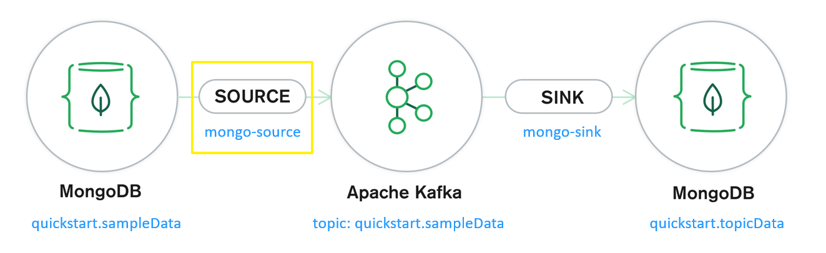
確認已加好source connector
[MongoDB Kafka Connector Quick Start] : curl -X GET http://connect:8083/connectors
["mongo-source"]

Slide 11
新增 Sink Connector
[MongoDB Kafka Connector Quick Start] : curl -X POST \
> -H "Content-Type: application/json" \
> --data '
> {"name": "mongo-sink",
> "config": {
> "connector.class":"com.mongodb.kafka.connect.MongoSinkConnector",
> "connection.uri":"mongodb://mongo1:27017/?replicaSet=rs0",
> "database":"quickstart",
> "collection":"topicData",
> "topics":"quickstart.sampleData",
> "change.data.capture.handler": "com.mongodb.kafka.connect.sink.cdc.mongodb.ChangeStreamHandler"
> }
> }
> ' \
> http://connect:8083/connectors -w "\n"
{"name":"mongo-sink","config":{"connector.class":"com.mongodb.kafka.connect.MongoSinkConnector","connection.uri":"mongodb://mongo1:27017/?replicaSet=rs0","database":"quickstart","collection":"topicData","topics":"quickstart.sampleData","change.data.capture.handler":"com.mongodb.kafka.connect.sink.cdc.mongodb.ChangeStreamHandler","name":"mongo-sink"},"tasks":[],"type":"sink"}
To learn more about how to process and move data from Apache Kafka to MongoDB, see the Sink Connector guide:
https://www.mongodb.com/docs/kafka-connector/current/sink-connector/#std-label-kafka-sink-overview

Slide 12
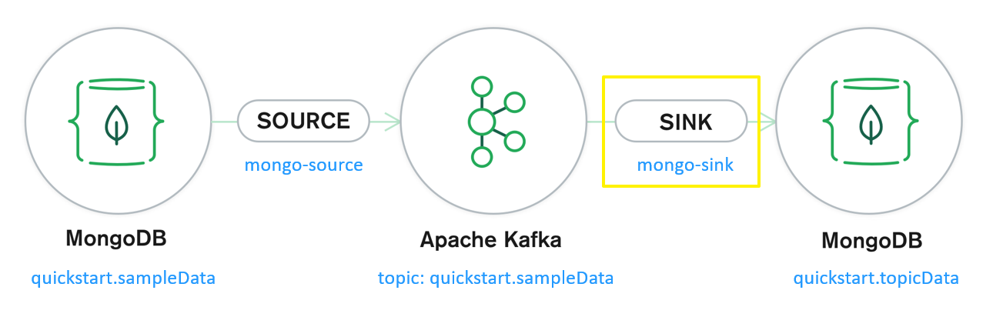
確認已加好sink connector
[MongoDB Kafka Connector Quick Start] : curl -X GET http://connect:8083/connectors
["mongo-sink","mongo-source"]

Slide 13
以 MongoSH 連接 MongoDB
[MongoDB Kafka Connector Quick Start] : mongosh mongodb://mongo1:27017/?replicaSet=rs0
Current Mongosh Log ID: 6251aa276c039ca73f206f04
Connecting to: mongodb://mongo1:27017/?replicaSet=rs0
Using MongoDB: 5.0.6
Using Mongosh: 1.0.0
For mongosh info see: https://docs.mongodb.com/mongodb-shell/
To help improve our products, anonymous usage data is collected and sent to MongoDB periodically (https://www.mongodb.com/legal/privacy-policy).
You can opt-out by running the disableTelemetry() command.
--------------------
The server generated these startup warnings when booting:
2022-04-08T15:26:07.494+00:00: Access control is not enabled for the database. Read and write access to data and configuration is unrestricted
2022-04-08T15:26:07.494+00:00: /sys/kernel/mm/transparent_hugepage/enabled is 'always'. We suggest setting it to 'never'
2022-04-08T15:26:07.494+00:00: /sys/kernel/mm/transparent_hugepage/defrag is 'always'. We suggest setting it to 'never'
--------------------
rs0 [primary] test>

Slide 14
在 MongoDB quickstart.sampleData 輸入一筆資料
rs0 [primary] test> use quickstart
switched to db quickstart
rs0 [primary] quickstart> db.sampleData.insertOne({"hello":"world"})
{
acknowledged: true,
insertedId: ObjectId("6251aa860c3e8045319de5ee")
}
rs0 [primary] quickstart> db.topicData.find()
[
{
_id: ObjectId("6251aa860c3e8045319de5ee"),
hello: 'world',
travel: 'MongoDB Kafka Connector'
}
]
rs0 [primary] test> exit
[MongoDB Kafka Connector Quick Start] : kafkacat -b broker:9092 -L -J|jq '.topics[].topic'|sort
"__consumer_offsets"
"docker-connect-configs"
"docker-connect-offsets"
"docker-connect-status"
"quickstart.sampleData"

Slide 15
在 MongoDB quickstart.sampleData 再輸入一筆資料
rs0 [primary] quickstart> db.sampleData.insertOne({"哈囉":"世界"})
{
acknowledged: true,
insertedId: ObjectId("6251ac790c3e8045319de5ef")
}
rs0 [primary] quickstart> db.topicData.find()
[
{
_id: ObjectId("6251aa860c3e8045319de5ee"),
hello: 'world',
travel: 'MongoDB Kafka Connector'
},
{
_id: ObjectId("6251ac790c3e8045319de5ef"),
'哈囉': '世界',
travel: 'MongoDB Kafka Connector'
}
]

Slide 16
比對 sampleData 與 topicData
rs0 [primary] quickstart> db.sampleData.find()
[
{ _id: ObjectId("6251aa860c3e8045319de5ee"), hello: 'world' },
{ _id: ObjectId("6251ac790c3e8045319de5ef"), '哈囉': '世界' }
]
rs0 [primary] quickstart> db.topicData.find()
[
{
_id: ObjectId("6251aa860c3e8045319de5ee"),
hello: 'world',
travel: 'MongoDB Kafka Connector'
},
{
_id: ObjectId("6251ac790c3e8045319de5ef"),
'哈囉': '世界',
travel: 'MongoDB Kafka Connector'
}
]

Slide 17
Summary of Kafka Connect Benefits
Kafka Connect Features
A common framework for Kafka connectors
Distributed and standalone modes
REST interface
Automatic offset management
Distributed and scalable by default
Streaming/batch integration
Why Kafka Connect
Auto-recovery after Failure
Auto-failover
Simple Parallelism
For more information: https://data-flair.training/blogs/kafka-connect/

Slide 18

End

