Slide 1
Cloud Data Platform AWS vs Azure vs GCP
Victor
2022/11/1

Slide 2
Data Platform - High Level Architecture
Exploration, data science experiments
Ingest
Storage
Processing
Serving
Cloud Data Warehouse
APIs
Data Export
Stream

Slide 3
Data Platform - Logical View
Orchestration
Fast storage
Streaming data
Ingestion
Real-time processing and analytics
Data consumers
Operational Metadata
Data warehouse
Data consumers
Batch data
Batch processing and analytics
Slow storage / Direct data lake access
Data consumers
ETL tools

Slide 4
Data Platform - AWS Implementation
AWS Glue, AWS Step Function Orchestration
AWS Kinesis Fast storage
Streaming data
AWS Kinesis, AWS Kinesis Firehose
Ingestion AWS Glue, AWS DMS, AWS Lambda
AWS Kinesis Data Analytics Real-time processing and analytics
DynamoDB + API Data consumers
AWS Glue Data Catalog Operational Metadata
AWS Redshift Data warehouse
SQL, JDBC Data consumers
Batch data
AWS EMR Batch processing and analytics
AWS S3 & AWS Athena Slow storage / Direct data lake access
SQL, JDBC Data consumers
AWS Glue ETL tools

Slide 5
Data Platform - Azure Implementation
Azure Data Factory Orchestration
Azure Event Hubs Fast storage
Streaming data
Azure Event Hubs
Ingestion Azure Data Factory, Azure Functions
Azure Stream Analytics Real-time processing and analytics
CosmosDB + API Data consumers
Azure Data Factory, Azure Data Catalog Operational Metadata
Azure Synapse Data warehouse
SQL, JDBC Data consumers
Batch data
Azure Databricks Batch processing and analytics
Azure Data Lake Storage Slow storage / Direct data lake access
SQL, JDBC Data consumers
Azure Data Factory ETL tools

Slide 6
Data Platform - GCP Implementation
Cloud Composer Orchestration
Cloud Pub/Sub Fast storage
Streaming data
Cloud Pub/Sub, Dataflow
Ingestion Cloud Data Fusion, Cloud Functions, Big Query Data Transfer Services
Cloud Dataflow Real-time processing and analytics
Cloud Bigtable + API Data consumers
Data Fusion, Data Catalog Operational Metadata
Big Query Data warehouse
SQL, JDBC Data consumers
Batch data
Dataproc Batch processing and analytics
Google Cloud Storage Slow storage / Direct data lake access
SQL, JDBC Data consumers
Cloud Data Fusion ETL tools

Slide 7

End

Slide 8
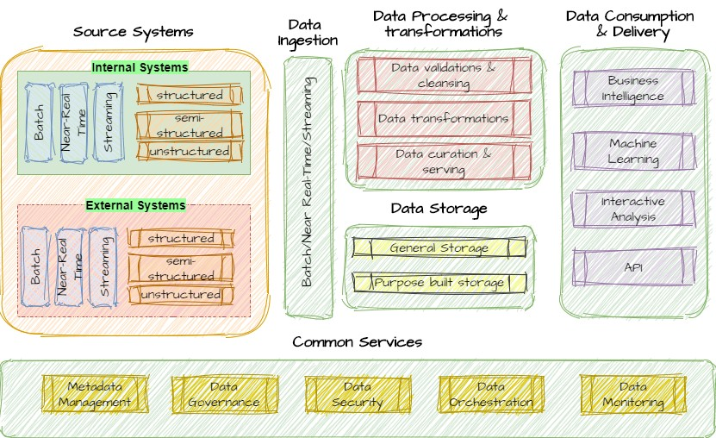
Core components of a data platform

Slide 9
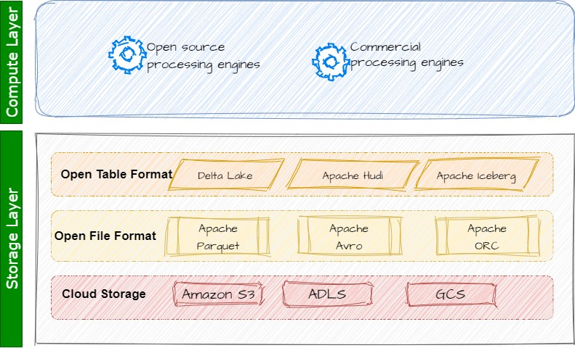
Lakehouse Architecture

