Slide 1

ГБПОУ МО «Орехово-Зуевский железнодорожный техникум имени В.И. Бондаренко»
«Искусство как часть жизни»
Выполнил: студент 3 курса
группы П-31
«Программирование в компьютерных системах»
Шувалов В.В.
Руководитель проекта:
Дерягина В.А.

Slide 2
The Plan of Presentation:
Art:
Graphic arts
Music
Mixture of music and graphic

Slide 3
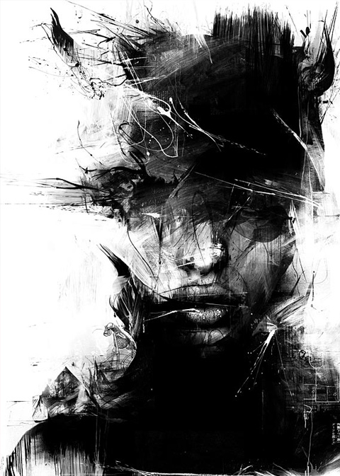
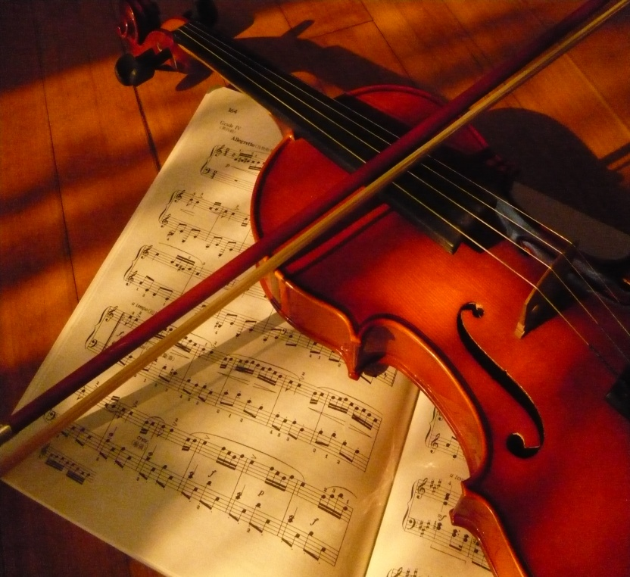
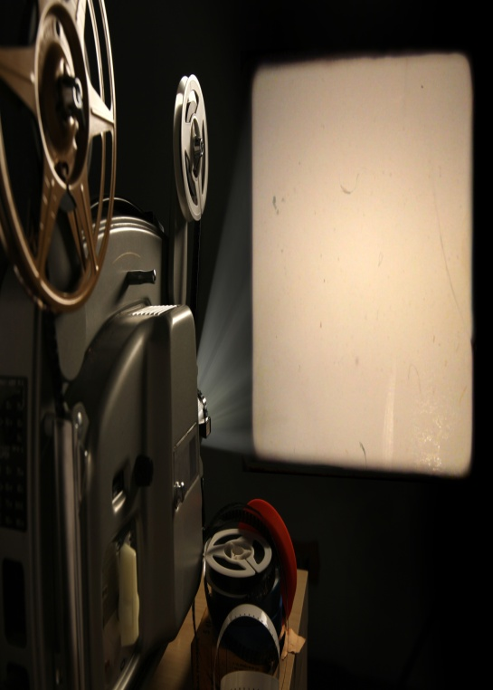
Art is a skill of transmitting a special information to viewer or listener. In order to learn art you must know some kinds of it:
Graphic arts
Music
Mixture of Music and Graphic

Slide 4
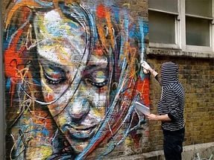
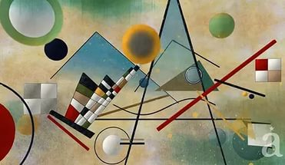
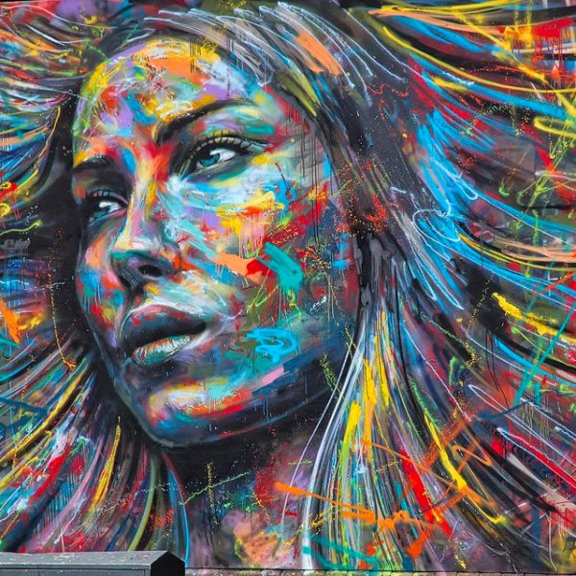
Art is the most important thing in our life, because without it humanity can’t exist. If art is destroyed, people will stop progressing and even degrade.
Art has a lot of purposes, but one of the most important is communication, because you can exchange information with not only your nation, but with all of them.

Slide 5
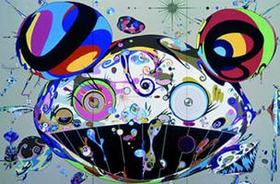
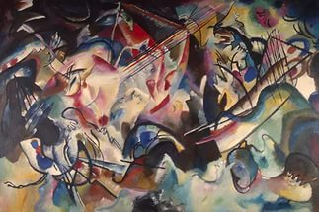
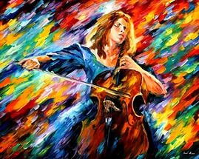
Art is used in every sphere of life: politic (Avant-garde), entertainment, etc. Even if you walk and see an awesome painting on the wall, it’s also an art.
The main target of art is dual: for creator it is a self-expression and for viewers or listeners it is to enjoy beauty. Beauty is very closely connected with art, like property and morality.

Slide 6
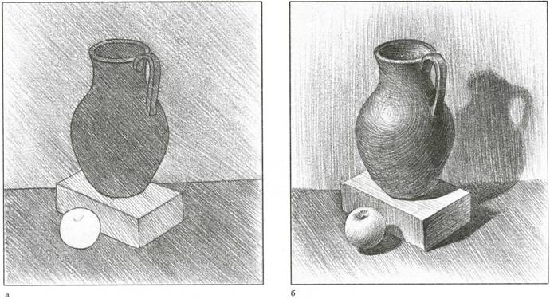
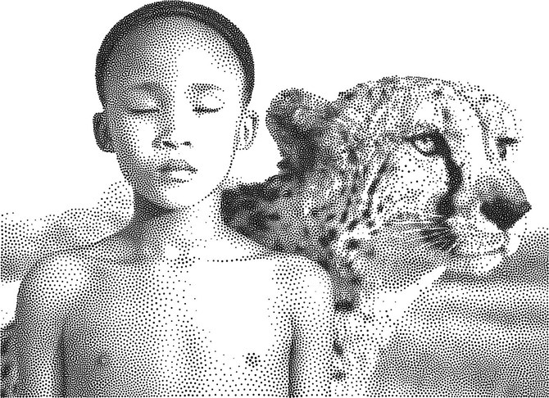
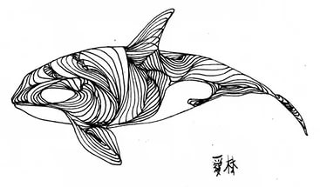
Graphic arts
This kind of art uses lines, strokes, spots and points as way to express the feelings of author. Also colour, but it is used only in pictorial art.

Slide 7
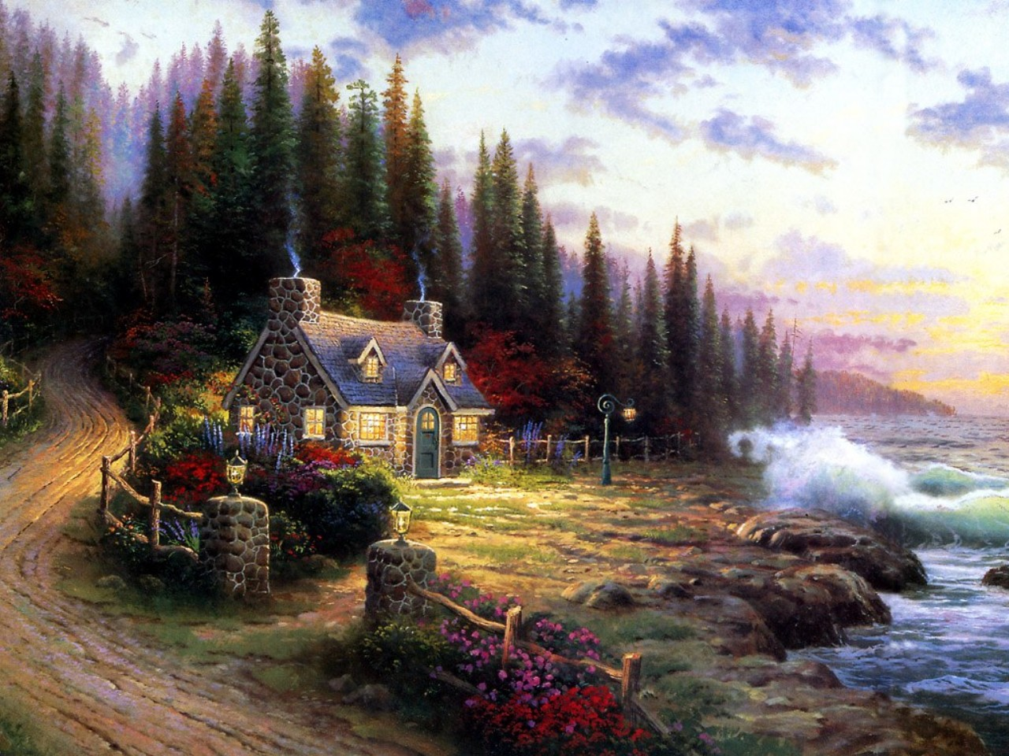
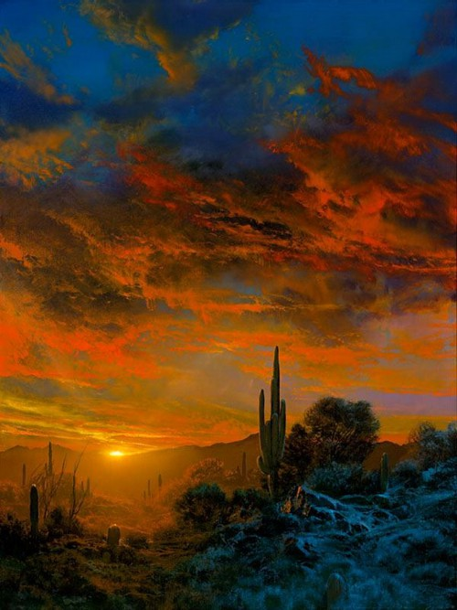
There are a lot of famous painters in the USA. For example: Thomas Kinkade, Dale Terbush, Cao Yong. They are modern painters, so we can say that now all of them build new story of art. There are some examples for you:

Slide 8
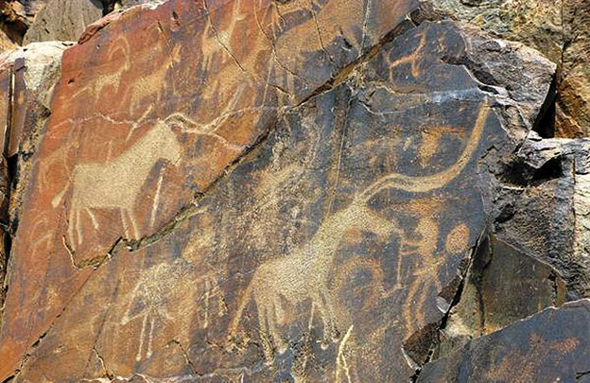
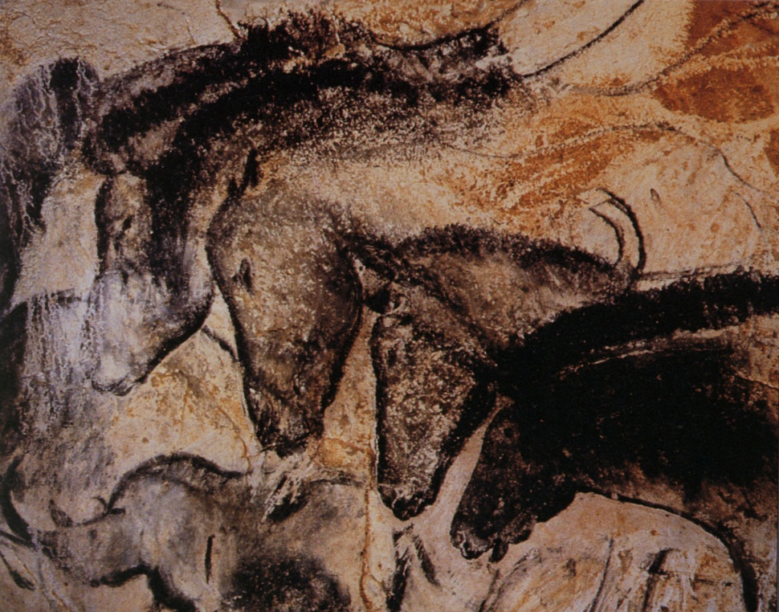
I think that’s the oldest kind of art, because, if you remember, even cave people tried to make some graphic arts in their caves when they couldn’t even talk!

Slide 9
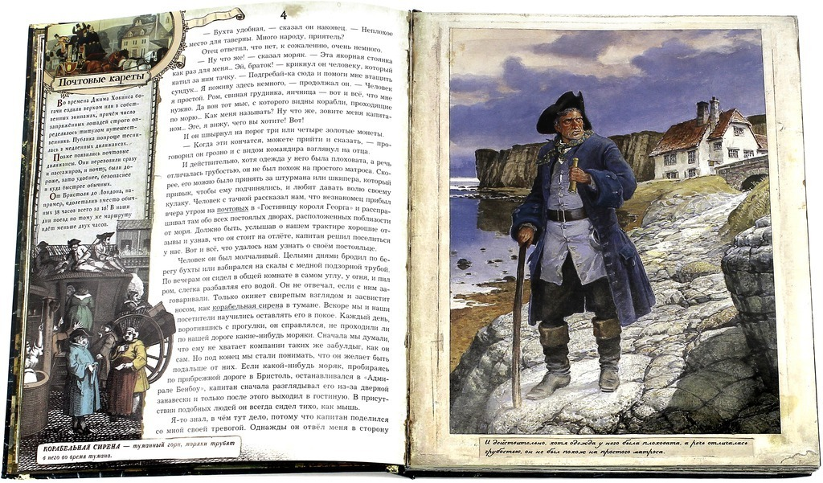
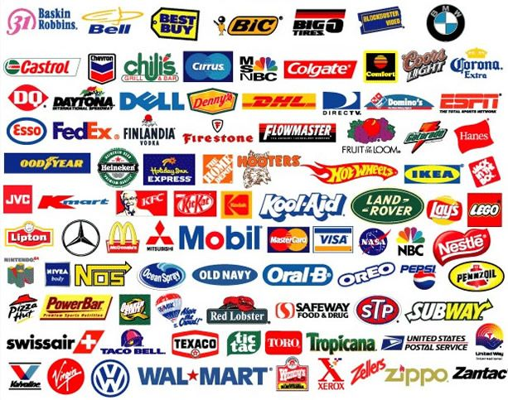
There are a lot of kinds of Graphic arts:
Book’s graphic
Industrial graphics

Slide 10
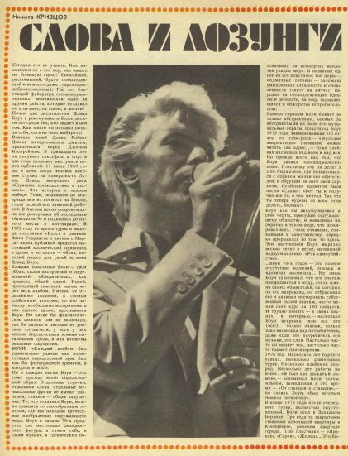
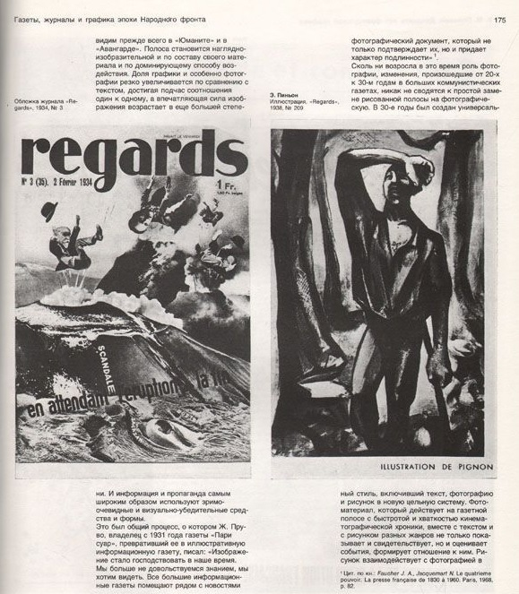
Magazine and newspaper’s graphic

Slide 11
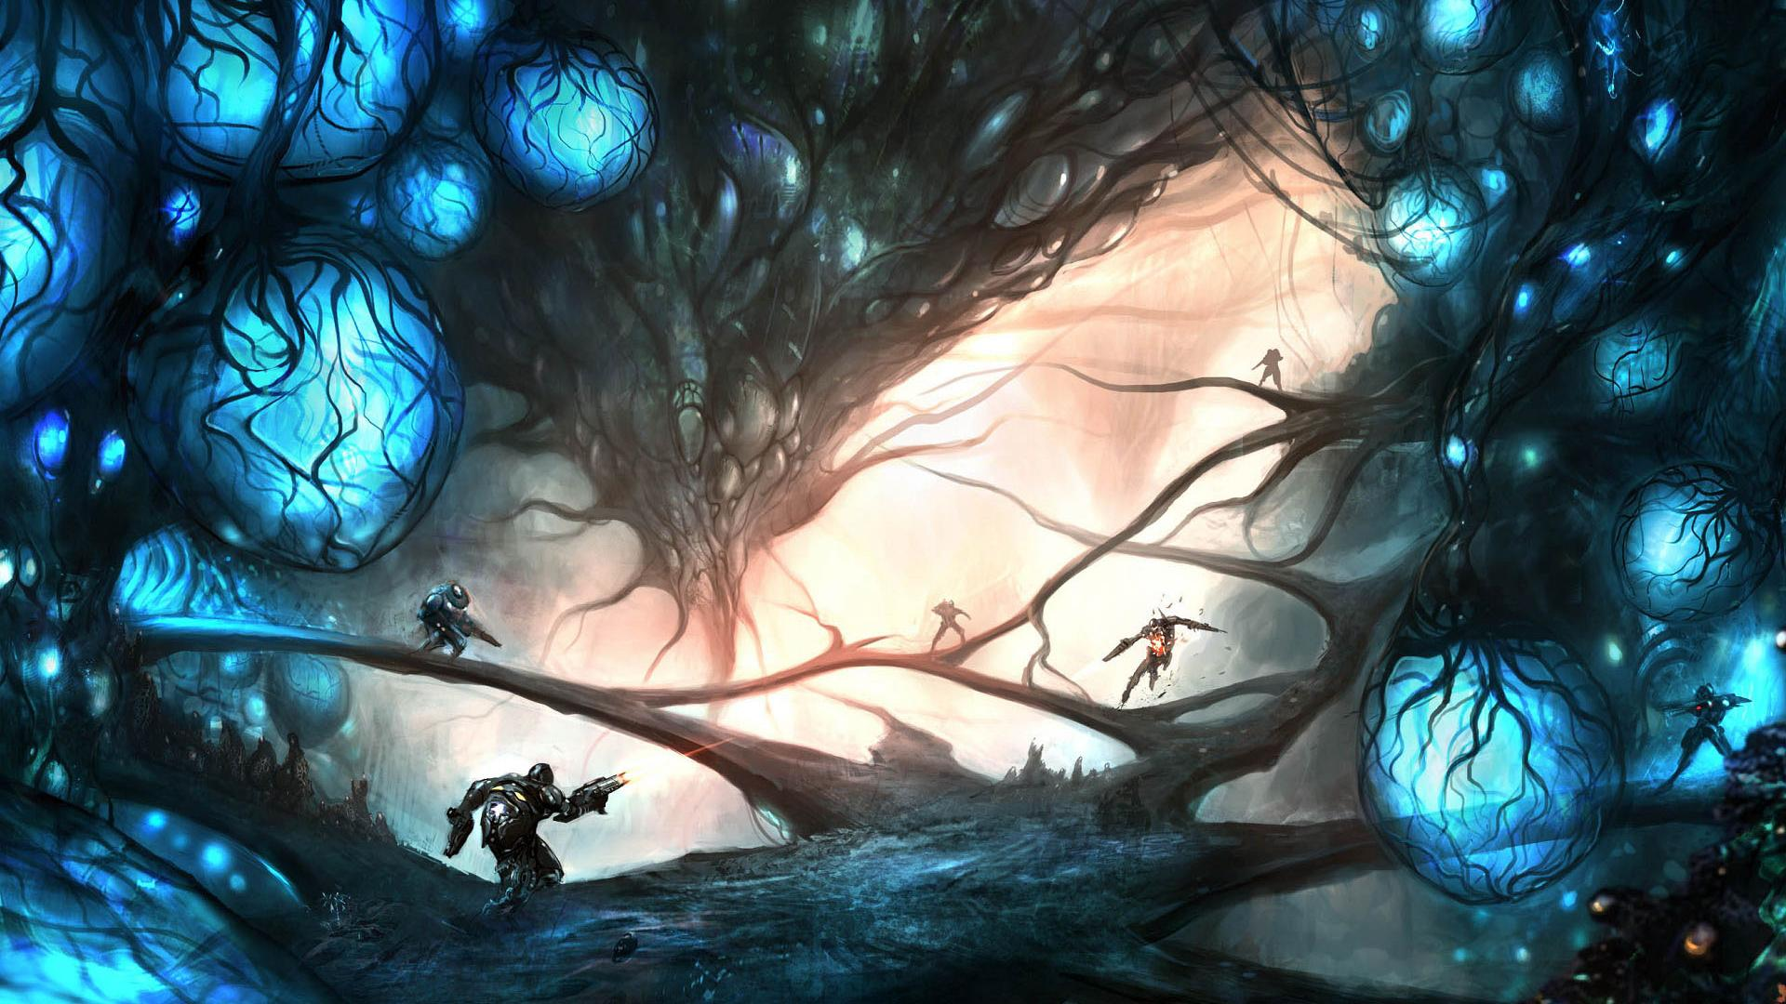
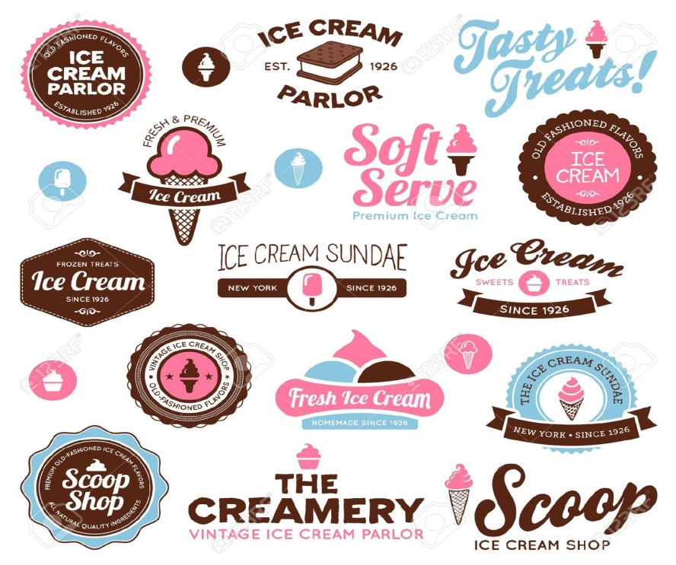
Computer’s graphic
Applied graphics

Slide 12
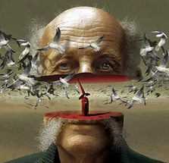
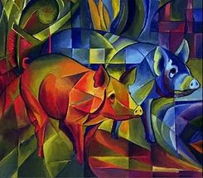
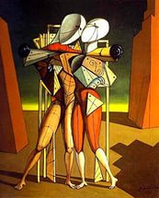
Now there are a lot of kinds of art:
Metaphysical painting
Abstract
Cubism
Surrealism
Modernism
Visual art
All of them have special difference, which you can find in
the internet, if you want.

Slide 13



Music
I think music is one of the most famous kinds of art nowadays in America, England etc. The whole world listens different types of music like rock, hip-hop, Jazz, and even Dubstep.
Music is life for the most people. They wake up with it, walk, and even when they take a shower they sing.

Slide 14
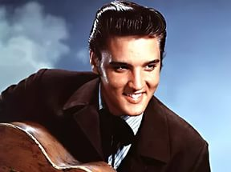
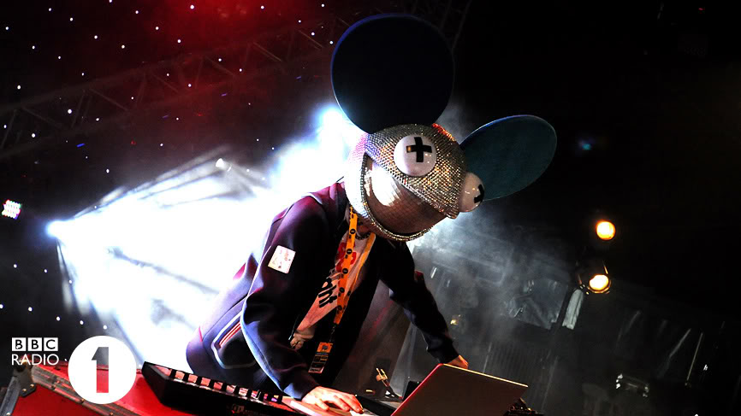
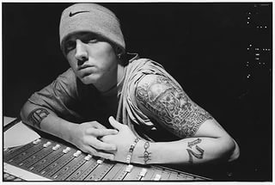
As I said above there are different types of music:
Rock'n'roll (Elvis Presley, Chuck Berry)
Dubstep (Deadmau5, Skrillex)
Rap (Eminem, Icecube, Snoop Dog)
About music, as art in general, we can speak forever. But we should remember that art is developing. So something can be forgotten, but something new will appear, because that's how evolution works.

Slide 15
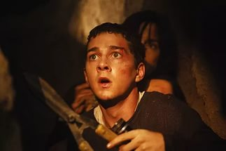
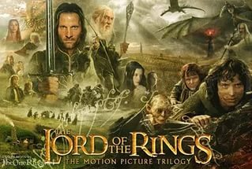

Mixture of Music and Graphic
This is one of the newest type in the world. It contains a lot of different kinds, but I suggest to choose movies.
First of all, let’s remember the most famous genres of movies:
Thriller
Drama
Comedy
Action
Fantasy

Slide 16
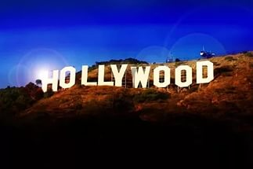
I think we don’t need examples, because everyone knows these genres. But if you think deeper, you will understand that all films that you remember are made in America. That’s really interesting, but this is fact. Now almost all films are from Hollywood, and they earn a lot of money in the whole world, because Americans have learnt how to make films correctly.

Slide 17


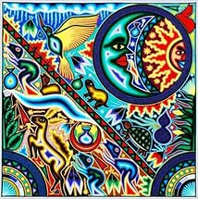
Nowadays there is an international art because of the globalization. English-speaking countries and language in general have the main role like you or not. On the one hand this is bad because some countries should forget their own art, but on the other it is great connection with every country by art.

Slide 18
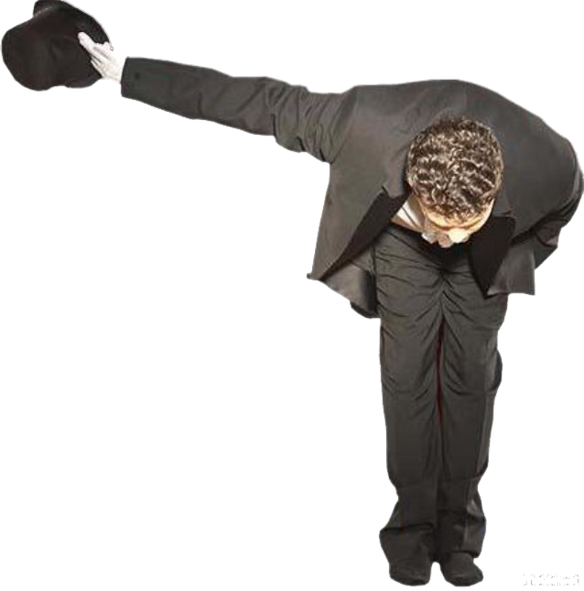
Thank you for attention!

Slide 19
Список использованных источников информации:
Искусство [Электронный ресурс] // Википедия –
свободная энциклопедия. – Режим доступа:
https://ru.wikipedia.org/wiki/Искусство
2. Музыка [Электронный ресурс] // Википедия –
свободная энциклопедия. – Режим доступа:
https://ru.wikipedia.org/wiki/Музыка
3. Кинематограф [Электронный ресурс] // Википедия –
свободная энциклопедия. – Режим доступа:
https://ru.wikipedia.org/wiki/Кинематограф
4. Живопись [Электронный ресурс] // Википедия –
свободная энциклопедия. – Режим доступа:
https://ru.wikipedia.org/wiki/Живопись

