Slide 1
Columbia River Basin Water Supply Forecasting
Cameron Bracken, Stefan Rose, Amanda Lawter,
Matt Sturtevant, Jana Simo

Slide 2
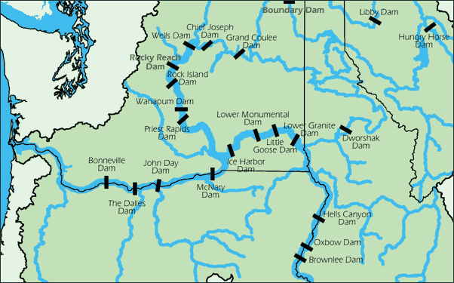
The Problem
Goal: Predict April–September naturalized streamflow volume at The Dalles, OR
Columbia Basin snowmelt drives hydropower, agriculture, and municipal water across the PNW
April 1 forecasts inform summer reservoir operations
Can ML improve on existing NRCS/NWRFC statistical forecasts?
Metric | Target
NSE | > 0 (beat mean)
RMSE | < 8,488 kcfs-days
Skill score | > 0 vs climatology
Notes:
The Dalles is the primary control point on the Columbia. Naturalized flow removes reservoir regulation so we’re modeling actual basin water supply. Success bar: beat the historical average on held-out test years.

Slide 3
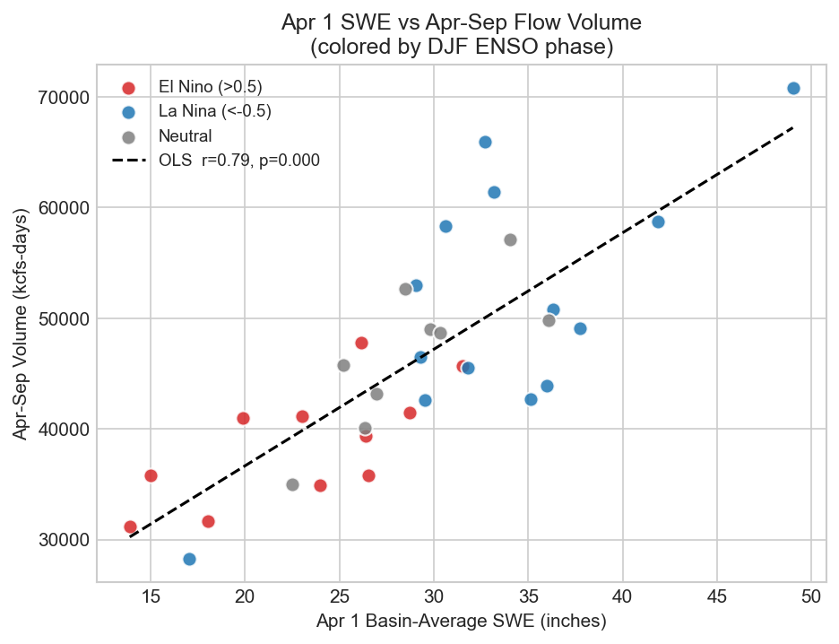
Data & Key Predictors
7 features, 34 water years (WY 1985–2018)
Feature | r
Apr 1 SWE anomaly (%) | 0.79
Jan–Mar mean flow | 0.56
Oct–Mar volume | 0.55
DJF Nino3.4 | −0.46
DJF PDO | −0.45
DJF PNA | −0.40
La Niña years (blue) produce higher runoff than El Niño (red) at the same SWE.
Notes:
Snowpack dominates (r = 0.79) but ENSO phase modulates the SWE–runoff relationship. La Niña enhances PNW precip; El Niño suppresses it. This scatter plot drove our feature selection.

Slide 4
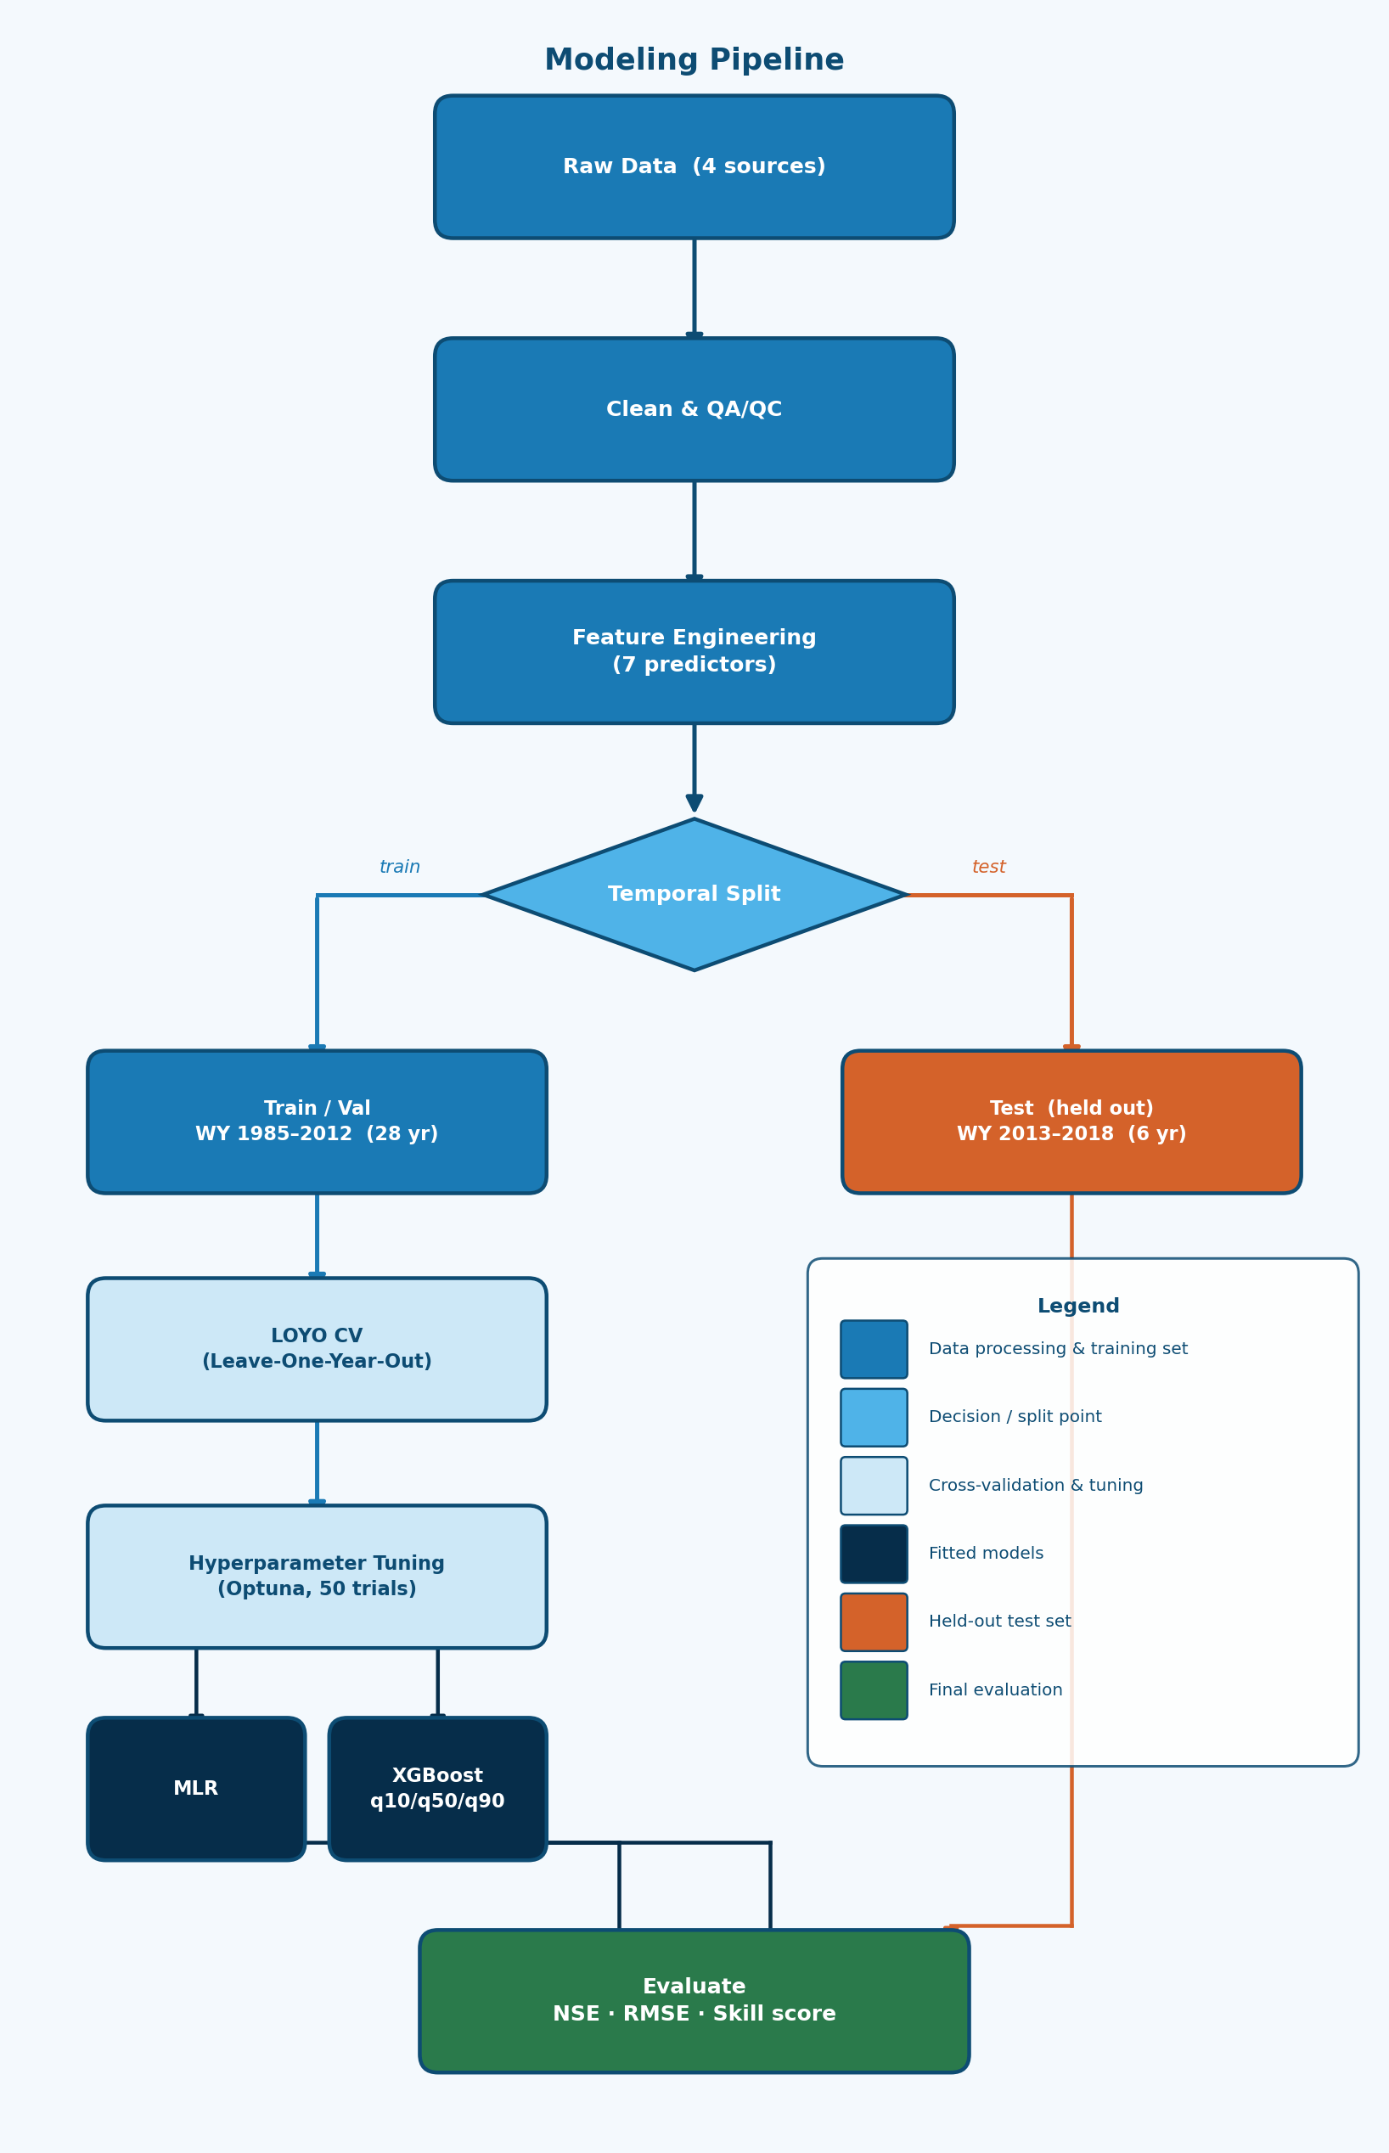
Methodology
Leakage prevention: hyperparameter tuning inside LOYO folds only — test set never touched during development.
Notes:
The temporal split is the key design decision. LOYO CV means hyperparameters were tuned without ever seeing the 6 test years — mirrors how operational April 1 forecasts work.

Slide 5
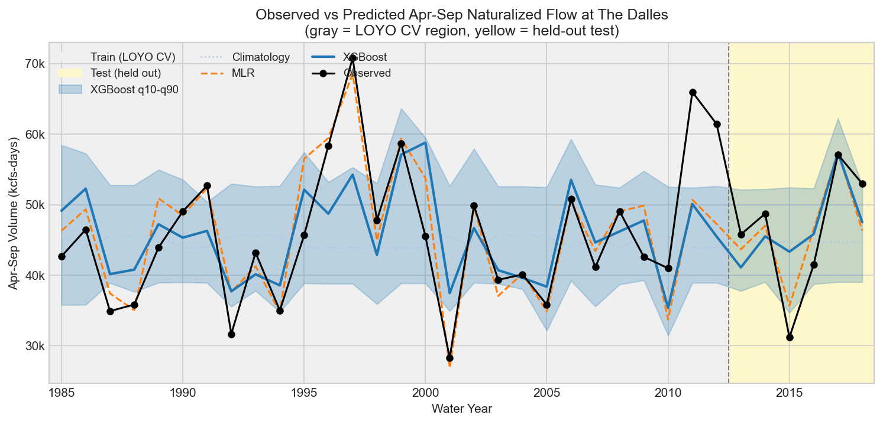
ML Results
Test set (WY 2013–2018)
MLR wins — at n=34, linear relationships dominate. LOYO CV consistent: MLR 0.69, XGB 0.44.
MLR tracks closely; XGBoost PI (blue) undercovers at ~67% vs 80% target.
Model | NSE | RMSE
Climatology | −0.03 | 8,488
MLR | 0.77 | 4,034
XGBoost | 0.46 | 6,170
Notes:
Simple linear model won. Apr 1 SWE is linearly correlated with spring runoff (r = 0.79), so linearity is physically correct. XGBoost would likely close the gap with a longer training record.

Slide 6
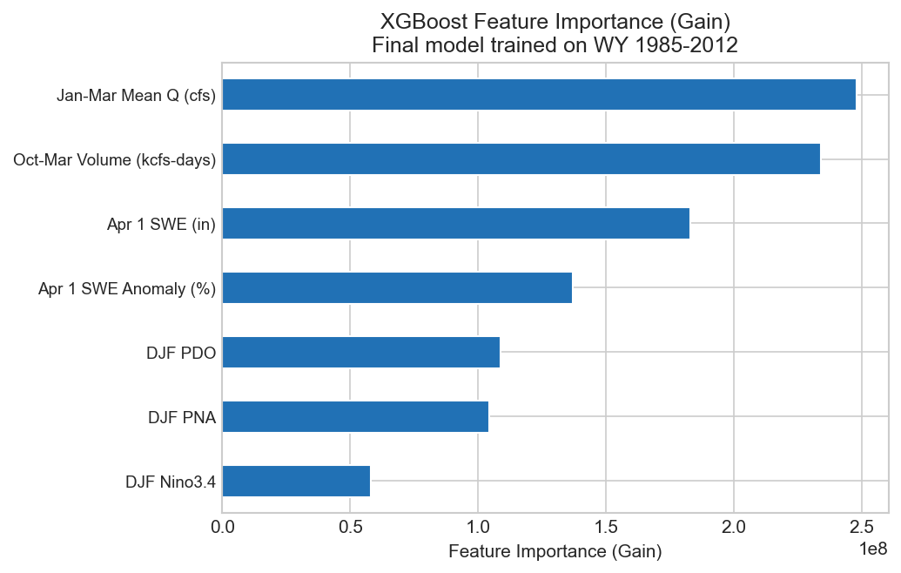
Interpretability
Antecedent flow (Jan–Mar, Oct–Mar) ranked highest — integrates current-season melt signal
Apr 1 SWE central — raw inches and anomaly % both matter
Climate indices secondary — modulate but don’t dominate
Rankings match operational forecaster intuition
Antecedent flow tops the ranking — integrates temp, precip, and melt that SWE alone misses.
Notes:
By Jan–Mar, antecedent flow integrates more current information than the Oct–Mar volume. NRCS forecasters independently prioritize snowpack + antecedent flow — our model reproduced that hierarchy without being told to.

Slide 7
LLM Benchmarking
Can a general-purpose LLM predict streamflow from a text description of conditions?
You are a hydrologist forecasting seasonal water supply. Water year 2013: Apr 1 SWE: 25.2 in (−12% vs median) DJF Nino3.4: −0.43 (La Niña) Jan–Mar flow: 103,131 cfs ... Return ONLY: {"prediction_kcfs_days": <number>}
v1: Zero-shot · v2: 3-example few-shot
Parse success: 100%
Model | Params
Phi-3.5-mini | ~3.8B
Phi-mini-MoE | ~7B
gemma-3-12b | 12B
Notes:
We adapted a classification tutorial to a regression task. Strict JSON output gave 100% parse success. Tested zero-shot and few-shot, using the better-performing version per model in the benchmark.

Slide 8
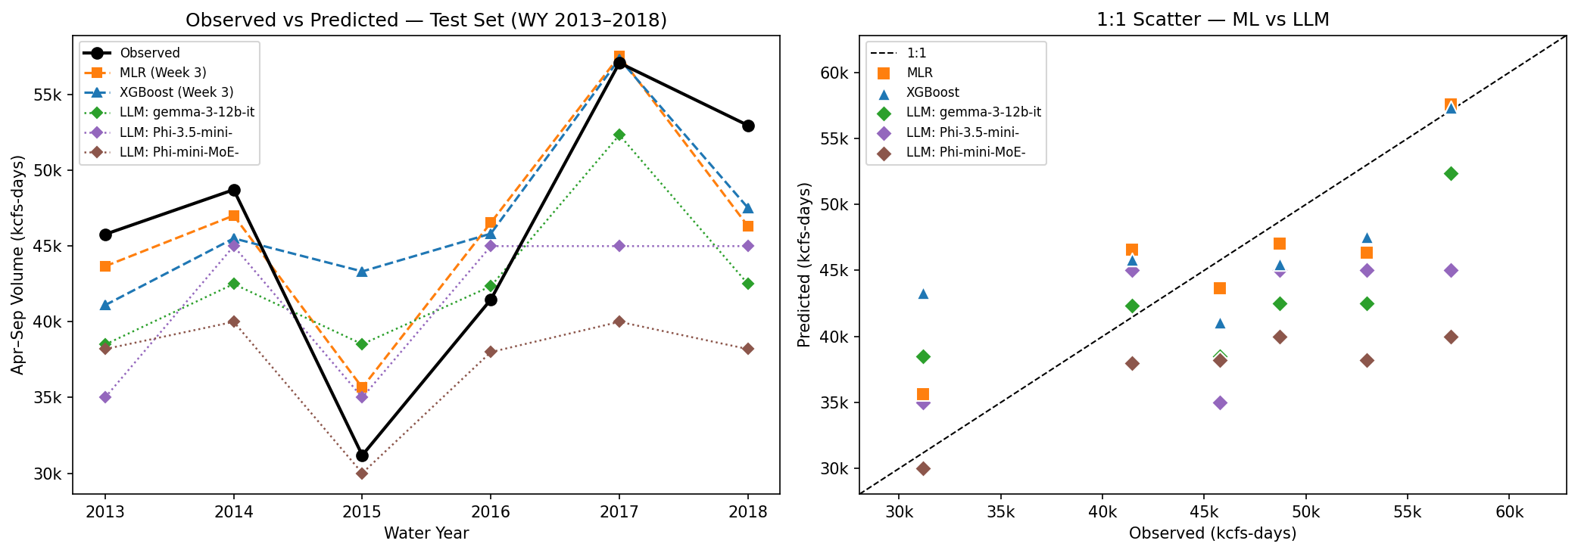
ML vs LLM: Results
Notes:
Note the flat lines for the Phi models — anchoring near climatology regardless of inputs. Gemma (12B) tracks the signal much better. Scale matters more than prompt engineering here.

Slide 9
ML vs LLM: Performance
Model | Type | NSE | RMSE
MLR | ML | 0.77 | 4,034
XGBoost | ML | 0.46 | 6,170
gemma-3-12b | LLM | 0.33 | 6,817
Phi-3.5-mini | LLM | 0.12 | 7,824
Phi-mini-MoE | LLM | −0.57 | 10,472
LLMs regress to the mean — Phi-3.5-mini returned 45,000 on 4 of 6 years
Only Phi-mini-MoE worse than climatology
Scale > prompt engineering
Numbers are tokens, not quantities — extremes unreliable
Notes:
WY 2017 wet year: MLR predicted 57,557 ✓, Phi-mini-MoE predicted 40,000 ✗. Even gemma partially competes with tuned XGBoost — a fine-tuned domain LLM would likely do better.

Slide 10
Limitations & Risks
ML
Small training set (n=28) limits XGBoost
Short test window (n=6) — one year swings NSE ±0.15
PI undercoverage (~67% vs 80% target)
Stationarity assumption — climate change may shift SWE–runoff relationships
LLM
Compressed variance — anchors near mean regardless of inputs
Structural numeric reasoning limitation — not a prompt problem
Not domain-fine-tuned
WY 2015 — worst miss: −51% SWE, strong El Niño. All models predicted 30–44k; observed: 31k. NRCS also missed this year.
Notes:
WY 2015 is the most important failure operationally. The LLM limitation is structural. Fine-tuning on BPA/SNOTEL data would likely close the gap significantly.

Slide 11
What We Learned
Modeling — Simple beats complex at small n; match model complexity to data volume
Data — Naturalized flow + domain-driven feature engineering were the foundation
ML vs LLM — Parse reliability: perfect. Prediction accuracy: not. Scale > prompt design.
From mistakes — CV score ≠ robustness to extremes; WY 2015 humbled every model
As a team — Weekly git branches + reproducible environments + domain review at every step
Next steps: Extend training to WY 1929 · Fine-tune LLM on domain data · Sub-basin forecasts
Notes:
All three — go around for one bullet each. Stefan: data/modeling. Cameron: ML results. Amanda: LLM. The most valuable learning was building a reproducible, defensible pipeline and being honest about where it failed.

