Slide 1
TRACK: Extreme Weather and Data Center Siting
Tea
TRACK
Thomas Benson, Rajiv Prasad, Anastasia Bernat, Cole Woodford, and Kevin Atkinson
Notes:
Hi everyone, we’re Team TRACK, and today we’ll be presenting our AI solution for bringing together extreme weather data to inform data center siting. We’ll walk through our approach, results, and key insights from comparing machine learning and LLM methods.

Slide 2
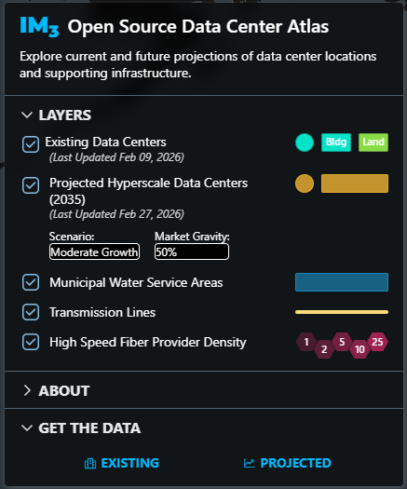
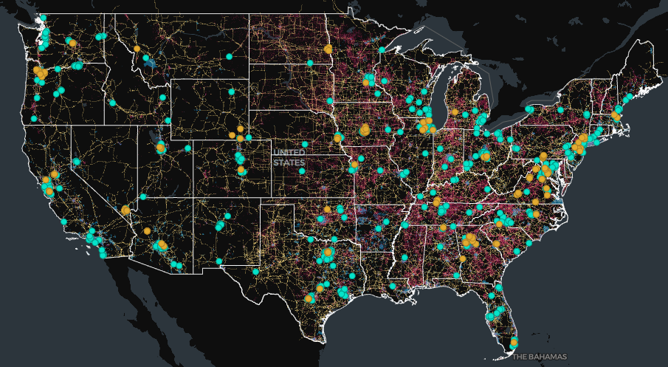
Problem
Current and planned data centers – siting process does not account for extreme weather risks and doing so could help improve climate resiliency, mitigate energy supply disruptions, and reduce cooling costs.
New features from the dataset -> inform data center siting with this new information.
Goal
Build a model to turn extreme weather data into a geospatial layer with projected variables (e.g., future heatwaves) and integrate into PNNL’s IM3 Data Center Atlas and use this new layer to assess current and planned data center sites against these risks.
Success Criteria
The Atlas should reliably communicate whether current and planned data centers would be or are climate-resilient.
Consistent and reliable projections.
F1 and AUC as key metrics.
Screenshots from the IM3 Data Center Atlas – layers and map visualization tool.
Notes:
The problem that we set out to address was that the data for current and planned data centers doesn’t account for extreme weather risks, such as very high or low temperatures. We argued that by accounting for extreme weather, data centers can be sited more strategically in a way that doesn’t threaten to disrupt energy supply, would ensure climate resilience, and would theoretically help to achieve lower cooling costs for the data centers.
Our goal was to build a model that could turn this extreme weather data into a geospatial layer with projected variables and integrate it with an existing tool owned by PNNL, which is the IM3 Data Center Atlas, and use this new layer to essentially assess current and planned data center sites against these risks.
We defined success as the Atlas reliably communicating whether current and planned data centers would be or are climate-resilient and we wanted projections to be reliable and consistent. Our F1 and AUC later become our key metrics of success, which we’ll talk about.
Having said all of that, we went through a learning process as a team here. We ultimately discovered that we were constrained by time and skill and in our understanding of what ML and LLM approaches could do, so we refined our approach to focus more on creating new features from the dataset that could, in future, help to inform data center siting, which we’ll discuss in later slides.

Slide 3
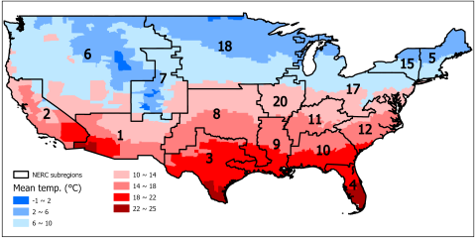
Data Overview & Challenges
Dataset
Source: Heatwave and Cold Snap Event Library (1980-2024).
Size: 163,451 records.
Features: event start date, end date, centroid date, duration, highest/lowest temperature, North American Electric Reliability Corporation (NERC) subregion ID, and spatial coverage.
Challenges
Spatial aggregation bias.
Simulated temperatures.
Selection bias.
Original dataset image (a map of NERC subregions with county-level mean temperatures).
Notes:
We used the heatwave and cold snap event library dataset, which includes event data, the duration, highest and lowest temperatures, NERC subregion IDs, and spatial coverage data.
However, we found that there were some limitations and potential biases in the data, such as spatial aggregation bias (where the data are summarized at the NERC level, which could obscure within-region variability), the lack of purely observed temperatures (the dataset relies on simulated temperatures, so localized extremes may be missed), and possible selection bias (where only the events that meet specific “definition” thresholds are included, so event counts depend on the chosen definition).
These issues influenced how we prepared the data and ultimately selected our models.

Slide 4

Approach Overview
Cleaned and standardized .zip archives into consistent CSVs
Remove junk/non-data rows
Convert columns to appropriate data types
Drop duplicates
Filters miscategorized data (heat events in cold-snap files)
Features added
Inter-event recovery interval days
Gap in days between the current event end date and the next event start date within the same region
Cumulative heat stress index
Running cumulative stress index within each region-year, based on event temperature multiplied by duration
Yearly max heat wave intensity
Maximum event temperature observed for the region in that calendar year
Yearly max heat wave duration
Maximum event duration observed for the region in that calendar year
Yearly max heat wave intensity trend
Year-over-year change in yearly maximum intensity within each region
Yearly max heat wave duration trend
Year-over-year change in yearly maximum duration within each region
Model Selection
Logistical Regression (Scikit-learn)
Continuous data set
XGBoost (Classifier)
Classification – High risk event
Suited to tabular, numeric records
Split
Train 70% / Validation 15% / Testing 15%
Hyperparameter combinations
Multiple sets
F1 score for selection criterion

Slide 5
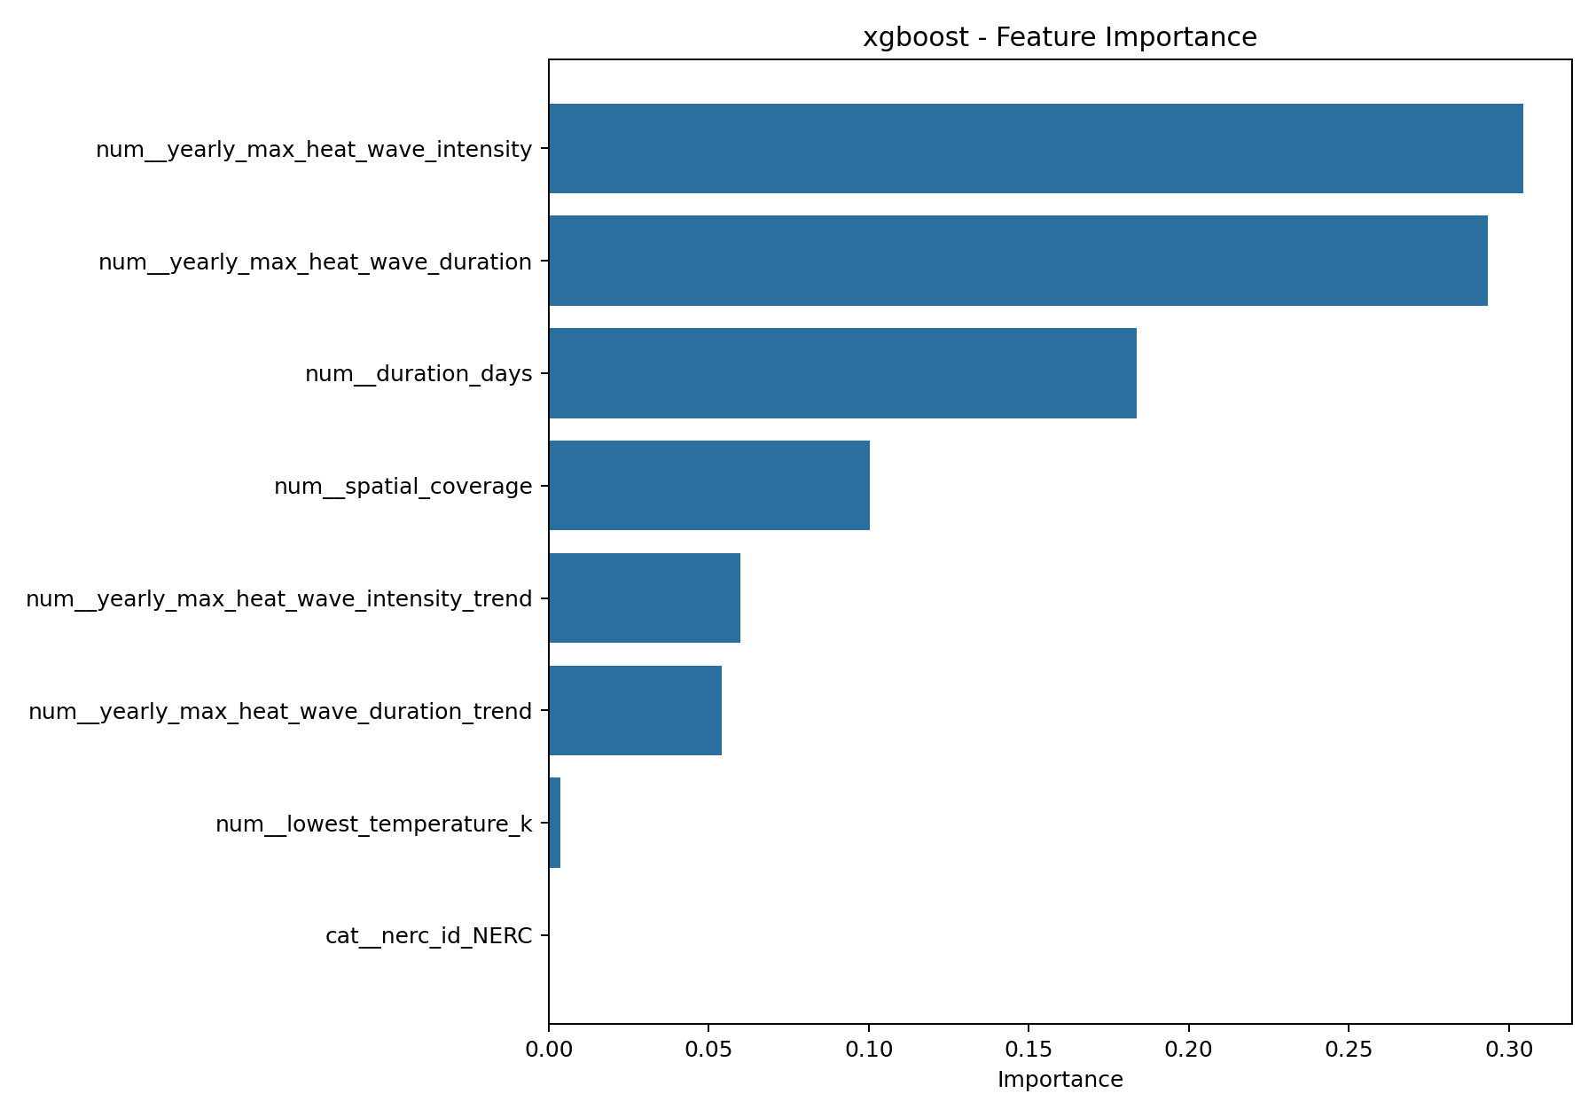
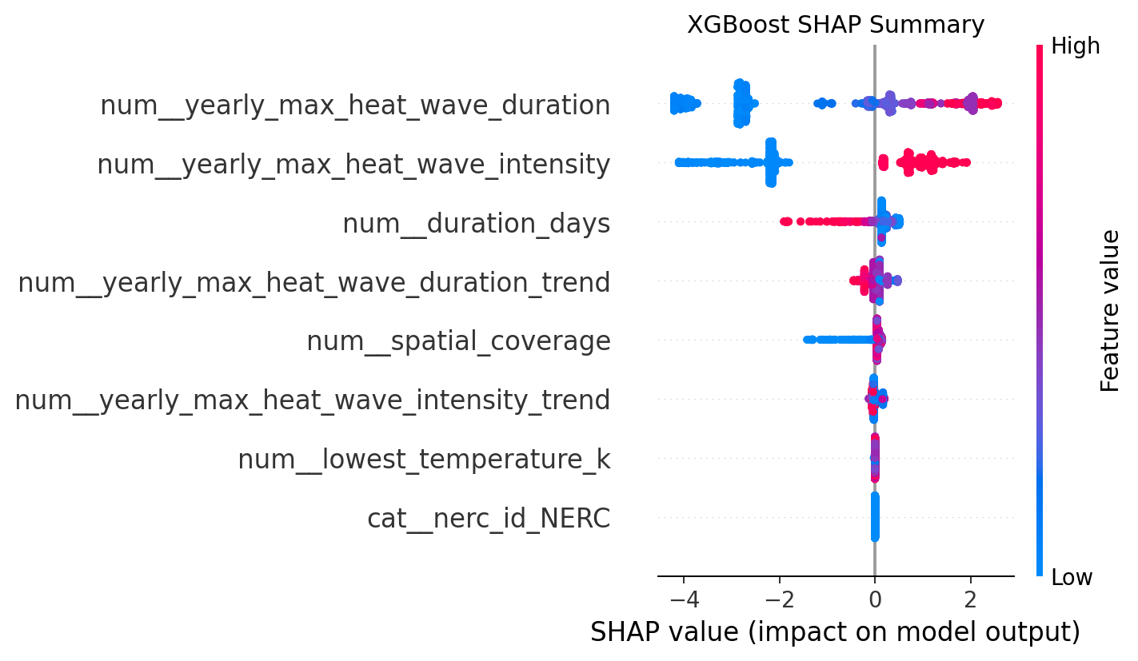
ML Results & Insights
Performance
Logistic Regression F1: 0.766
Logistic Regression AUC-ROC: 0.916
Logistic Regression performs better at the operating threshold
XGBoost has better overall ranking ability
Weak on: “Borderline events” for both models produced high false negative
XGBoost F1: 0.750
XGBoost AUC-ROC: 0.943
Insights
False negatives of 24,517 (6,846 truly high risk) records:
XGBoost: 2,566 (37.5% miss rate)
Logistic Regression: 1,007 (14.7% miss rate)
Notes:
F1 = how good the yes/no decisions are at your chosen threshold.
AUC = how good the overall ranking is before threshold choice.
Ranking ability means to put events in order from most ‘Risky’ to least.
SHAP value represents how much a variable affected ranking – positive SHAP means the value was used to determine a high-risk event – negative SHAP means the value was used to determine a low-risk event.

Slide 6
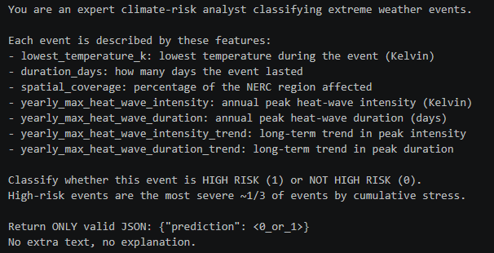
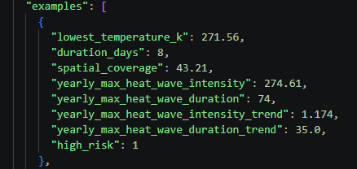
LLM Approach & Results
Prompt
Gave it a role
Description of Data Fields
Simple Assignment
Approach / Strategy
Create prompts for LLMs, by LLMs
Structured output (JSON, 1 or 0)
Few-shot examples provided
Results
Gemma 3 – 67% of events correctly categorized
Phi 3.5 mini – 63 % of events correctly categorized
Phi mini moe – 24 % of events correctly categorized
Issues
Hallucinations (Gemini 2.5 pro hallucinated the percentage to be 56% vs 67% actual)
Our “high risk” events are only 11.6% of data, prompt indicates 1/3
Notes:
Notes: We then used an LLM to perform the same task. We designed prompts with structured outputs and used few-shot examples to improve consistency. The LLM achieved [metric] of [value].It handled flexible inputs well, but we observed issues like inconsistent formatting and hallucinations.

Slide 7
ML vs LLM Comparison
Criteria | ML Model | LLM Approach
Accuracy (test data) | 88% (XGBoost) | 67% (Gemma 3)
Speed (run test) | Fast (minutes) | Slower (Hours)
Effort | Medium setup (LLM generated scripts) | Medium setup (LLM generated notebook)
Flexibility | Low (Code/Training) | High (Natural Lang.)
Notes:
Notes: This slide highlights the key tradeoffs.
The ML model achieved higher accuracy and consistency, making it more reliable for structured predictions. The LLM is more flexible and faster to prototype, but less consistent.
So the key takeaway is: ML is better for control and reliability, while LLM is better for flexibility and rapid development.

Slide 8
Insights & Closing
System Flow
Cold Snap / Heat wave data → train models → judge output accuracy
Key Insights
Feature design impacts model accuracy
ML more accurate than LLMs
LLMs were slower even with less data
Limitations
Data has inherent spatial structure that we did not explicitly account for
ML produced significant number of false positives
LLMs may require structured, stepwise model development
Future Work
Improve data features to explicitly account for spatial structure in data using domain knowledge; leverage additional spatial data (i.e., data center sites)
Think through developing mutistep LLM-based models
Notes:
Notes:
Here’s a quick look at our system.
Our ML modeling was simple – we developed a set of simple, obvious features; split the dataset into training, validation, and test sets; and trained the ML model. The test revealed the model did reasonably well on predicting high risk events, although it did produce false positives.
From this project, we learned that feature engineering is critical, ML models are more reliable for structured tasks, and LLM performance is limited by context size.
Some limitations include limited feature engineering and limited leveraging of spatial structure inherent in the data.
In the future, we would improve this by better developing engineering features; correlating existing dataset with other relevant spatial data, such as data center sites; and thinking how to leverage the strength of LLMs to develop multistage models.
Thank you—happy to take questions.

Slide 9
Key Learning Milestones
Thomas: Learned how to more effectively prompt an LLM, improved understanding of how to clean datasets with the help of AI, and developed a basic awareness of ML models and algorithms and their different applications.
Rajiv: Learned that ML models can produce reasonably good predictions even with limited specificity in features.
Anastasia: Learned how LLMs may only marginally improve with strong prompting when using multimodal data.
Cole: Learned that building a baseline classification model can be surprisingly quick using libraries like XGBoost.
Kevin: Learned differences between the use of ML models and LLMs and how to better utilize LLMs to complete tasks that have data involved.

