Slide 1
ESSD AI Competition
Final Presentation
Evergreen Analyzers

Slide 2

AI disclaimer
AI was used in drafting of this presentation

Slide 3
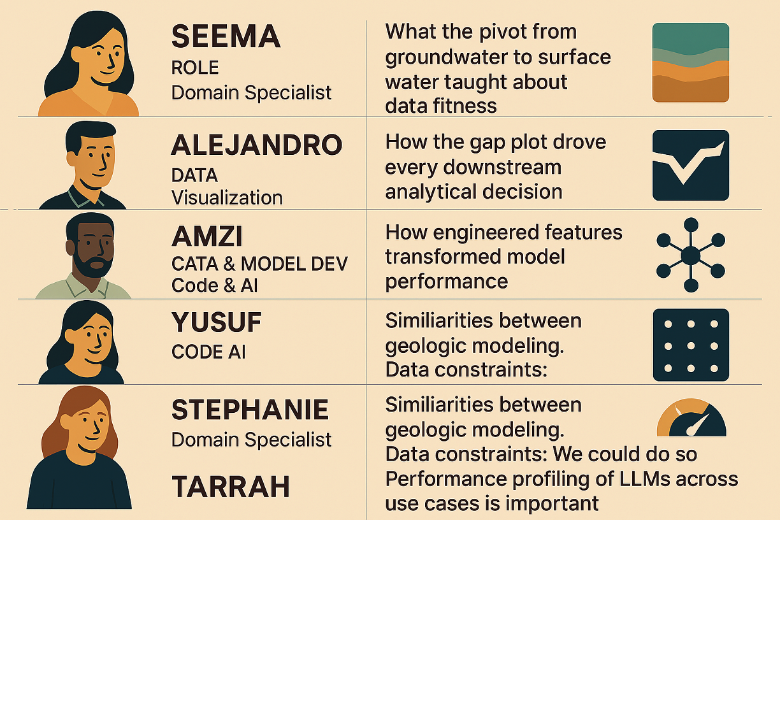




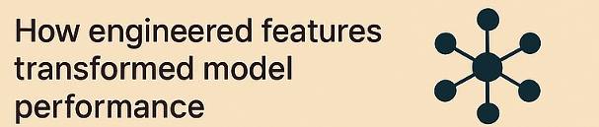



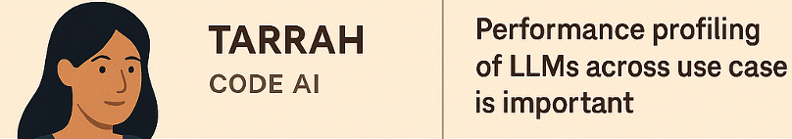




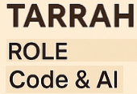

Evergreen Analyzers – Intro & Team Reflections
Data Discovery workflow,
pivot from GW to SW, and
data fitness
Exploring the intersection of LLM analysis
and data workflows, collaborating across
AI and engineering teams to build
understanding and sharpen insights.
Analysis Reflection
Choosing the right overall model
and setup is key —
ARIMA vs ARIMAX, feature
engineering, … think it through!
Similarities between
geologic modeling.
Data constraints: We could do more
with complete geologic metadata
Notes:
Why did you do this to us - LLMs are not designed to crunch large datasets!!!!

Slide 4
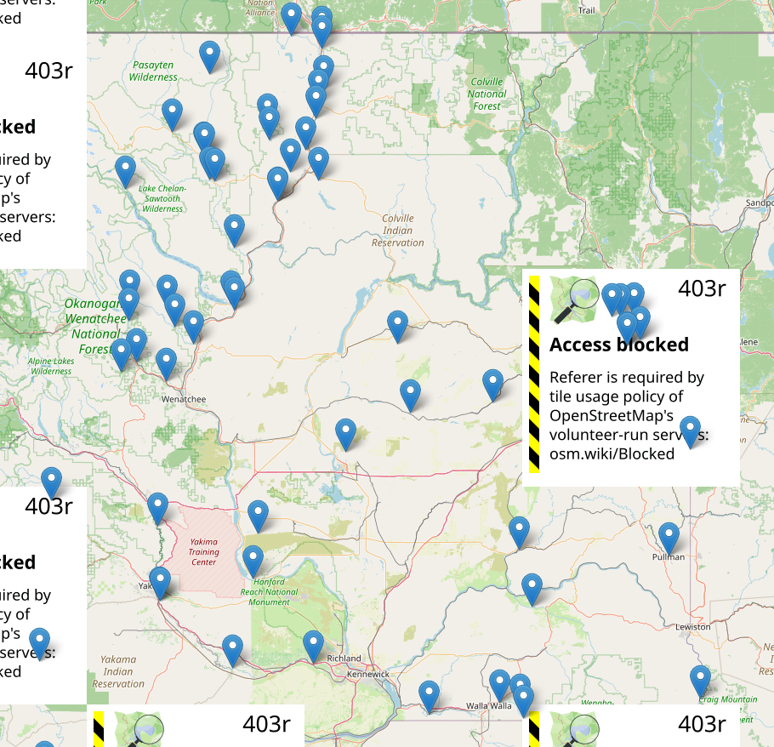
Intro - Problem Framing & Goal
Problem
Columbia River Basalt Group (CRBG) aquifers are under stress, declining ~2 ft per year. The solution? Drill deeper wells
Goal
AI prototype that detects anomalies, forecasts water levels 1 year ahead, and classifies sites as Normal / Watch / Warning
Dataset
USGS Water Data API — 74 monitoring sites, records back to the 1950s, ~1.2M data points
Limitations
Uneven spatial coverage, multi-year gaps, variable record lengths
Asked Gemini to make us a monitoring locations map…

Slide 5
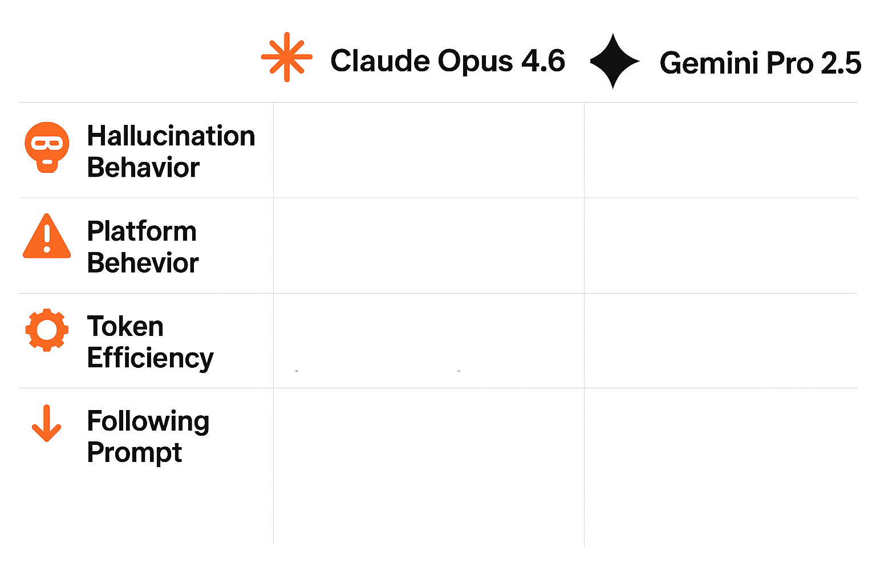
Week 1 - LLM Benchmarking & Discovery
Method: Run Claude Opus 4.6 and Gemini Pro 2.5 in parallel with identical prompts
Plausible, but nonexistent
data.
Included unrelated, invented information regarding pet neutering.
Attempted “escape-the-box”
by instructing user to run
scripts.
Stayed within platform
constraints.
~45,750 tokens
~24,150 tokens
Ignored clear instructions to
use data provided and
specific date range.
Ignored specific details in
prompt.
Takeaways: 1.2M+ points exceeded feasible LLM processing — dataset better suited for ML/neural
network approach; LLMs useful as copilots, not unsupervised analysts

Slide 6
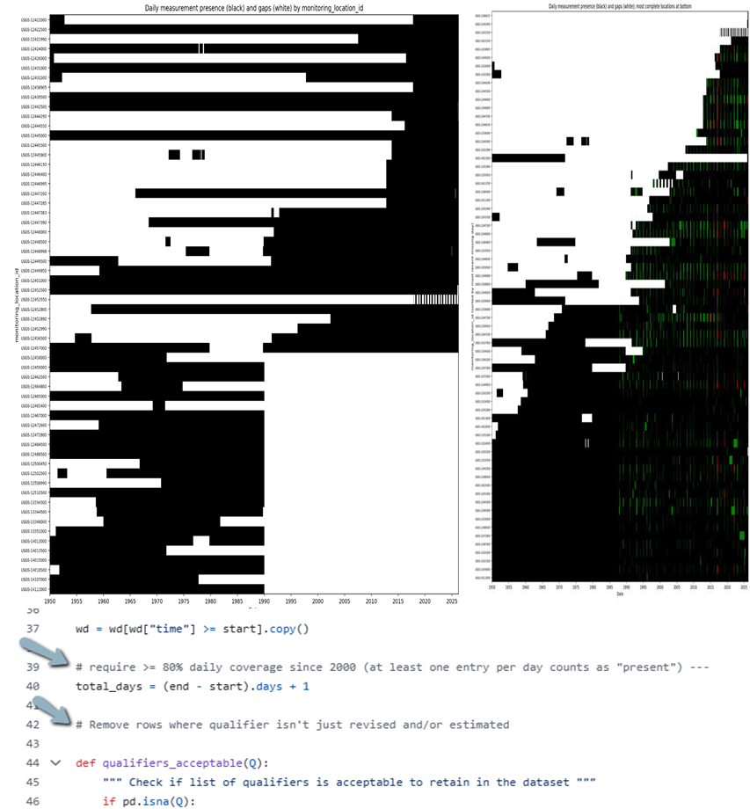
Week 2 - Data Cleaning & The Pivot
Our Original Goal: -
- Forecast groundwater levels for Washington’s CRBG aquifer using USGS data.
Why the Groundwater Data Didn’t Work- The Pivot Decision:
Well data was missing key background information- we had water-level readings from individual wells. But the dataset lacked reliable aquifer identifiers
Well comparisons became apples‑to‑oranges
Surface water flow rates offered a physically consistent and directly comparable measurement across all sites
Gap Analysis as a Data Fitness Diagnostic:
ChatGPT-generated gap plot showing daily measurements (black) and missing (white) data-
data before 2000 was too incomplete
Refined plot highlights qualifier data: green for estimated/revised, red for all other qualifiers (ice, debris )
ChatGPT was used to refine the Python code. We kept data from 2000 onward and retained only stations (50 sites) with ≥80% daily coverage
Surface Water Brought New Data Fitness Lessons
Switching to surface water solved the comparability issue but introduced new challenges. Over to Stephanie

Slide 7
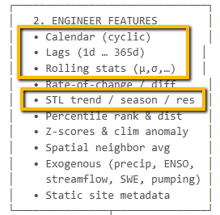
Week 2 - Feature Engineering & Split Strategy
Methodology
Engineered Features
Split Strategy
Assess which features make sense for this dataset (Asked Claude)
Have Claude generate code for input into Pandas (Python package) to generate engineered features
Objective: hold back some data
80/10/10 random split by monitoring location
Leakage prevention: backward-looking calculations only
Seasonal Encoding: Captures cyclical seasonal position without discontinuity
Lag & Rolling Window
Short lags (1–7d) = storm response Long lags (90–365d) = baseflow memory & year-over-year trends
STL Decomposition
Separates flow into trend (climate shift), seasonal (annual cycle), and residual (anomalies & noise)

Slide 8
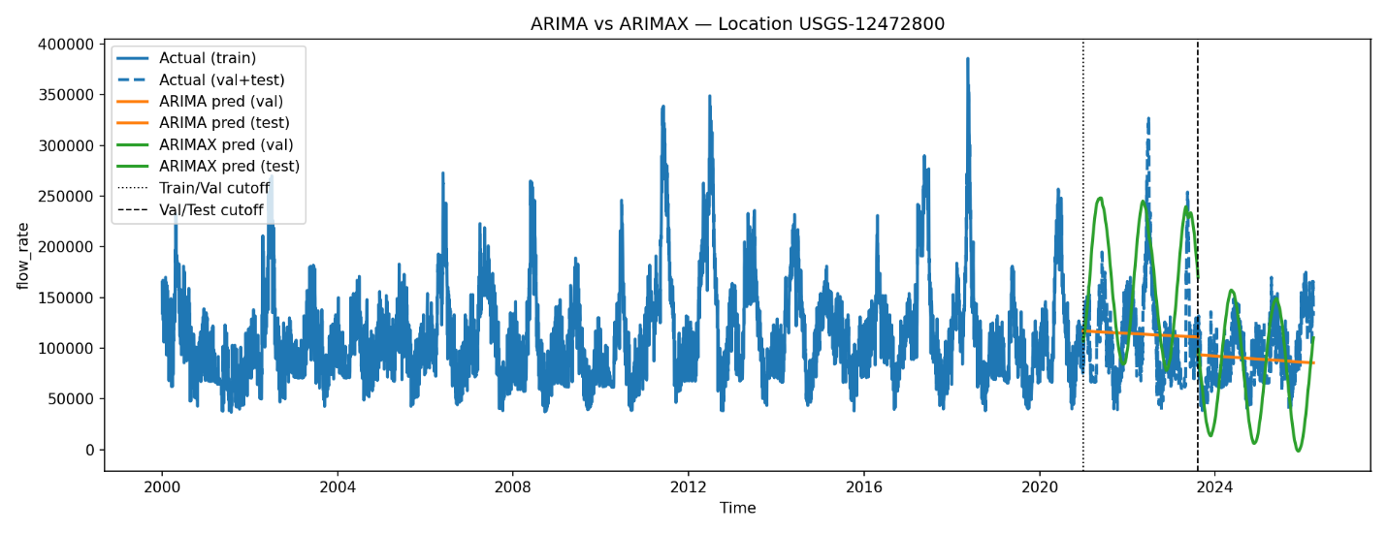
Week 3 - Model Showdown
Split: 80/10/10 temporal split at each site to prevent leakage
ARIMA: near-linear forecasts that missed seasonal cycles and underfit daily variability
ARIMAX: sinusoidal predictions tracking seasonal structure — noticeably better, though amplitude/timing mismatches remain
Stationarity failures at some sites — likely driven by unobserved external factors (usage, inflow) not in the outflow-only dataset
Notes:
Figure 1. Monitoring location from the Columbia River showing time series flow rates (cubic feet per second), that the actual flow‑rate data has strong seasonal cycles with noisy daily variation. ARIMA produces almost linear forecasts that fail to follow these cycles, underfitting both validation and test periods. ARIMAX models the seasonal pattern more effectively with a sinusoidal shape, but its predictions still show amplitude and timing mismatches compared to the actual data. Overall, ARIMAX captures the structure better than ARIMA.

Slide 9
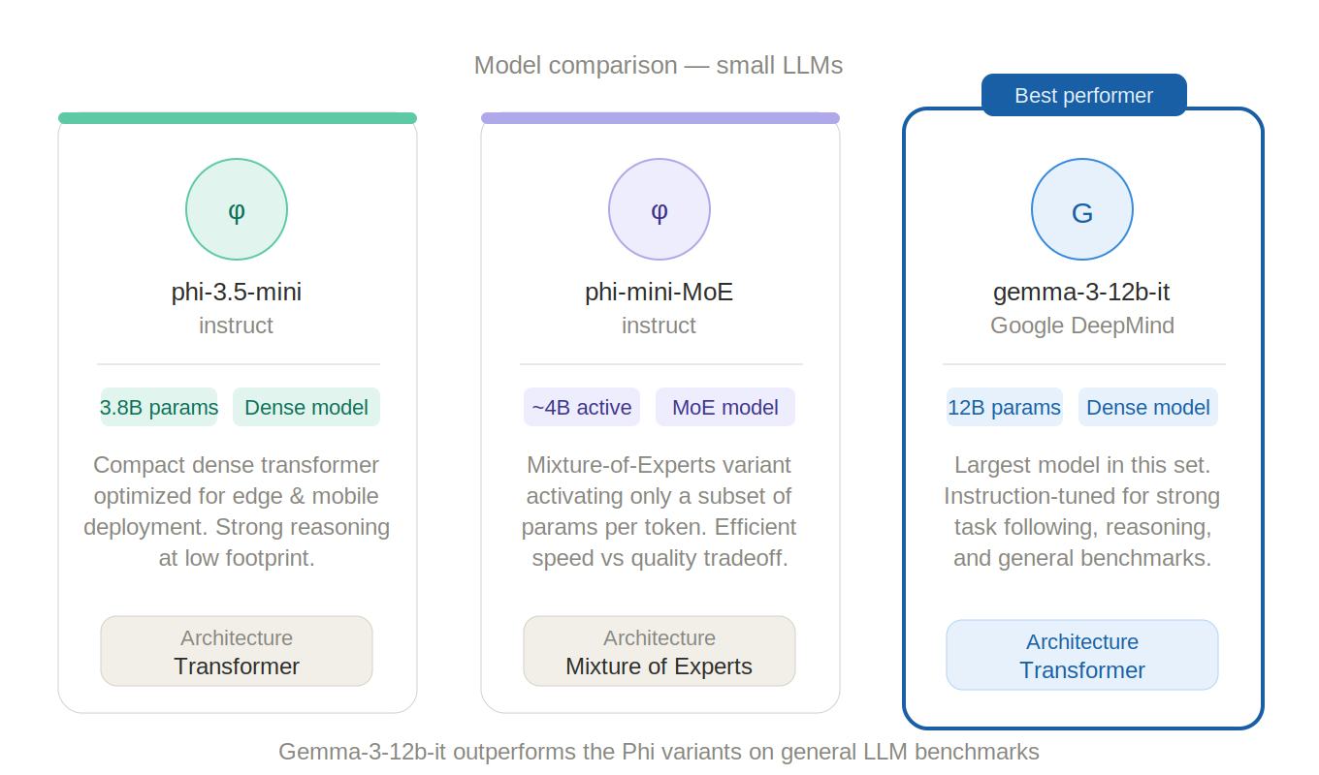
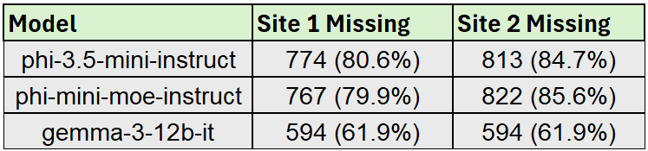
Week 4 - LLM Benchmarking vs. ML Model
Three LLMs Tested
phi-3.5-mini-instruct
phi-mini-moe-instruct
gemma-3-12b-it ← best LLM performer
Prompt Strategy
Fed 1 year (366 days) of daily flow rates as comma-separated values
Asked to predict next 960 days to match ARIMAX test set
Forced strict output: floating-point numbers only, no text
Ran on 2 monitoring locations
Key Findings
Even the best LLM (gemma) missed 62% of dates
ARIMAX produced 100% coverage across all test dates
LLM predictions lacked seasonal structure — regressed toward the mean
RMSE not directly comparable due to massive gaps in LLM output

Slide 10

Summary and Next Steps
Lessons Learned
Next Steps
Git & collaboration from scratch
Branching, PRs, version control as a team
Validate your data before modeling
Gap analysis drove the groundwater-to-surface-water pivot
Feature engineering is make-or-break
Seasonal encodings: 0 to 11 stations with positive R²
LLMs are copilots, not replacements
Great for code help, weak at numerical prediction
Aquifer mapping
Link depth interpretations to water table heights
GIS heat maps
Visualize predicted flow rates across stations
Anomaly flagging
Highlight stations with unusual trends on a map
Model improvements
SARIMA, climate indices (ENSO, PDO), ensembles

