Slide 1

AI-Based Evaluation of Deep Geothermal Reservoir Potential
Team ByteMe
Notes:
Image: Abstract Data Visualization – Stock Photo

Slide 2
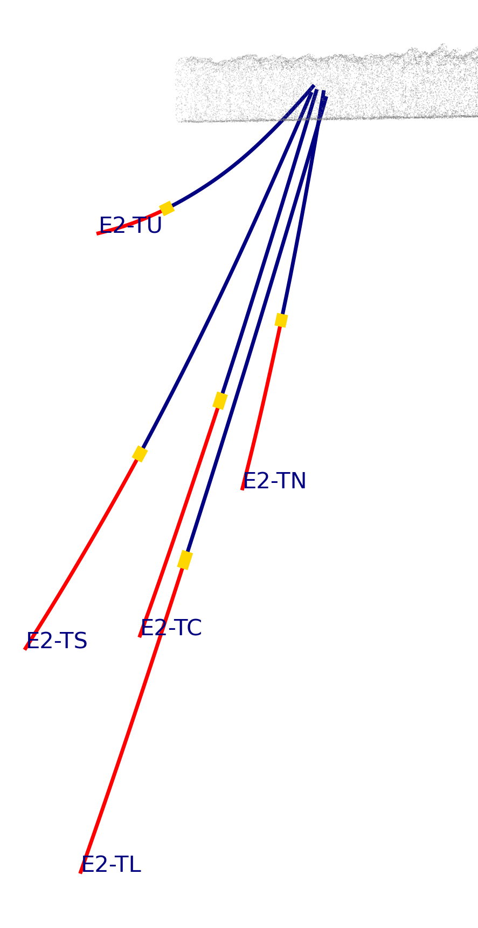
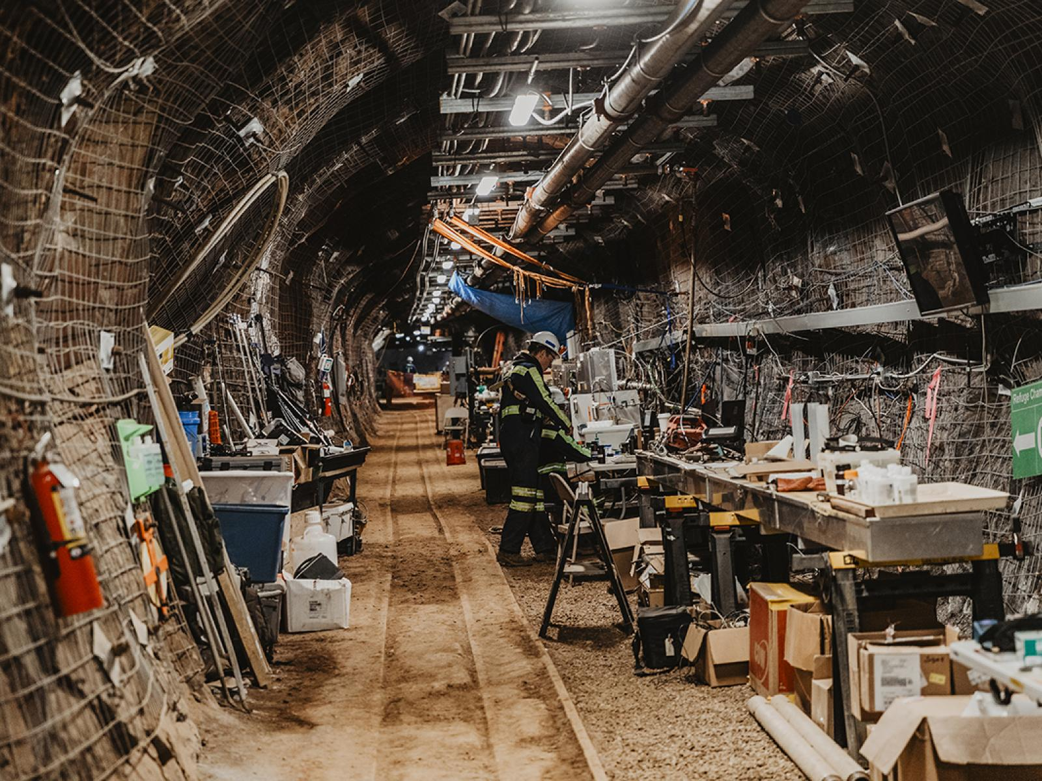
Predict the temporal evolution of temperature and flow in a multi-well fracture thermal energy storage (FTES)
Problem
Aim to predict the temporal evolution for different injection rates, time spans, or hot water temperatures.
Goal
Train models to determine where and how water flows as a proxy of the fracture network.
Success Criteria
Comparing to the persistence model
Fair ML vs LLM comparison
Allows for a more efficient FTES injection design for extracting heat from deep underground in similar, metamorphic geologic settings.
Predict production well temperatures based on injection conditions and historical thermal response.
(R2 to be higher than persistence model)
https://www.pnnl.gov/news-media/surfing-underground-test-geothermal-energy-potential
Notes:
Notes: The problem we addressed is [problem], which leads to [impact]. Our goal was to build a model that can [task]. We defined success using [metric], while also ensuring results were consistent and comparable across ML and LLM approaches.

Slide 3
Data Overview & Challenges
Source: DEMO Fractured-rock Thermal Energy Storage (FTES) Test 1 in the Sanford Underground Research Facility (SURF), from Dec 2024 – Feb 2025 (hot water injection)
Dataset
Size: ≈2k hourly records; ≈100K 1-minute records resampled from 6.3 GB 1-second dataset
Features: Temperature, pressure, flow rate & electrical conductivity across 5 boreholes (TC = injection well | TL, TN = production wells | TU, TS = monitor wells), and engineered ML features
Challenges
Missing / inconsistent values: 116 duplicate timestamps removed; pressure sensors >99% null after cleaning (injection-side instruments operating outside rated range were dropped)
Limited edge-case coverage: Single 72-day test with one injection well and two producers, ∴ model generalization is constrained to similar fracture geometry and injection conditions
Zero-value artifact: Zeros in 1-second temperature data were not caught by the original TEMP_MIN = –5 °C threshold and were included in 1-minute averages, pulling down means and creating false downward temperature spikes. Fix: TEMP_MIN updated to 0 °C (identified in team meeting April 10 and resolved shortly after.)
Column name | Plain name | What it tells the model
elapsed_injection_min | Minutes since injection start | How many minutes have passed since hot-water injection began on Dec 13? Early in the experiment the rock is cold and far from equilibrium; later it has been charged with heat and behaves differently. This feature gives the model a sense of "where we are" in the experiment.
cumulative_heat_input | Running total of heat delivered | A running sum of (flow rate × injection temperature × time step) since injection began. Think of it as the odometer of heat delivered. Units are °C·L·s. This is more physically correct than just counting liters pumped, because 60 °C water carries more thermal energy than 40 °C water at the same flow rate.
Exemplar engineered features based on thermal state of system
Notes:
Notes: We used [dataset], which includes [key features]. However, we encountered challenges such as missing values and potential bias in [area]. These issues directly influenced how we prepared the data and selected our models.

Slide 4
ML approach overview
Data Preparation
Engineered features: cumulative heat input, elapsed injection time, rolling net flow, thermal gradient and temperature-difference features, cyclical hour features, and lagged target/flow variables at 15, 30, and 60 steps.
Targets were framed as multi-horizon forecasts of temperature change (delta) at 15, 60, 240, and 1440 steps ahead.
Workflow
Time-based train / validation / test split to preserve sequence structure
Hyperparameter tuning was performed with a 10-iteration random search over model-specific settings such as tree depth, estimators, learning rate, hidden size, number of layers, and transformer heads.
Multiple model families combining interpretable ML models and DL sequence models:
Multi-output Random Forest, Multi-output XGBoost, MLP, LSTM, and Transformer.

Slide 5
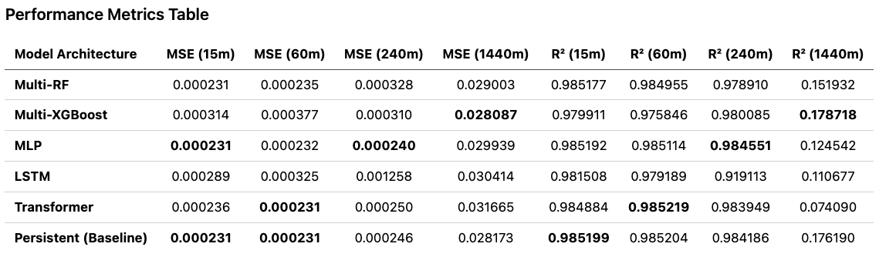
Short horizon (15m): The Persistent baseline and MLP are effectively tied for best performance, with MSE near 0.000231 and R² near 0.9852.
Medium horizon (60m): The Transformer delivers the best overall result, but only by a very small margin over the Persistent baseline and MLP.
Intermediate horizon (240m): The MLP is the strongest model, with the best MSE (0.000240) and best R² (0.9846).
Long horizon (1440m): Multi-XGBoost performs best, reaching the lowest MSE (0.028087) and highest R² (0.1787), though the Persistent baseline remains very competitive.
LSTM: Performs well at short horizons but degrades noticeably at 240m relative to the other models.
Overall takeaway: All methods perform strongly through 240m, but 1440m forecasting remains substantially harder and only slightly better than the naive persistence baseline.

Slide 6
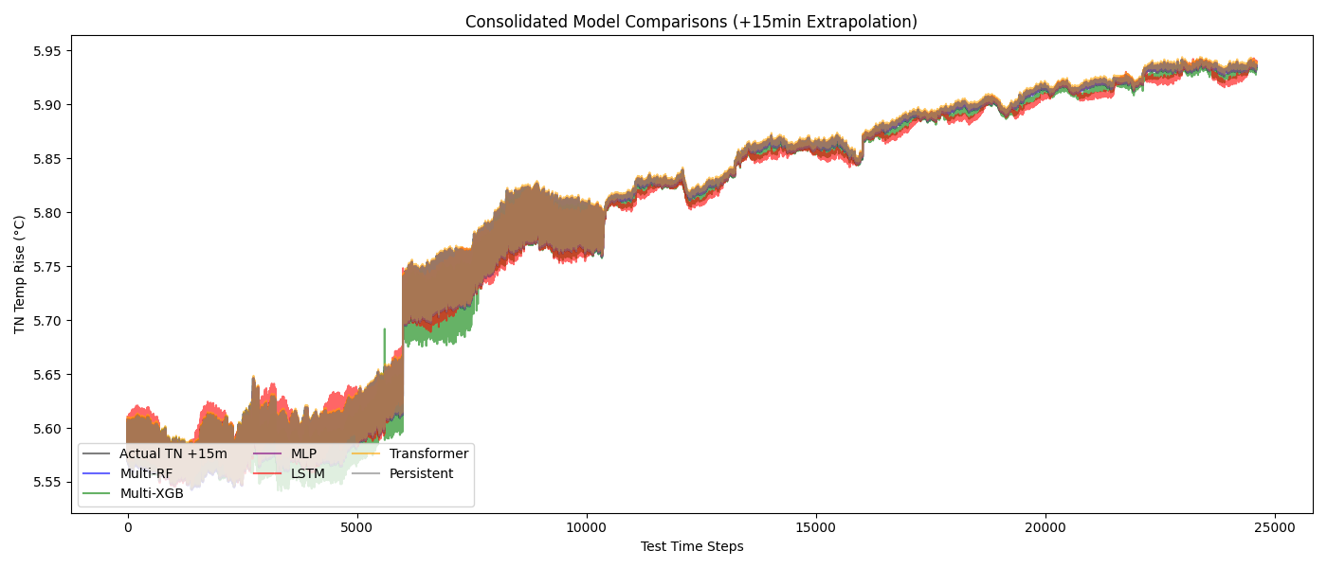
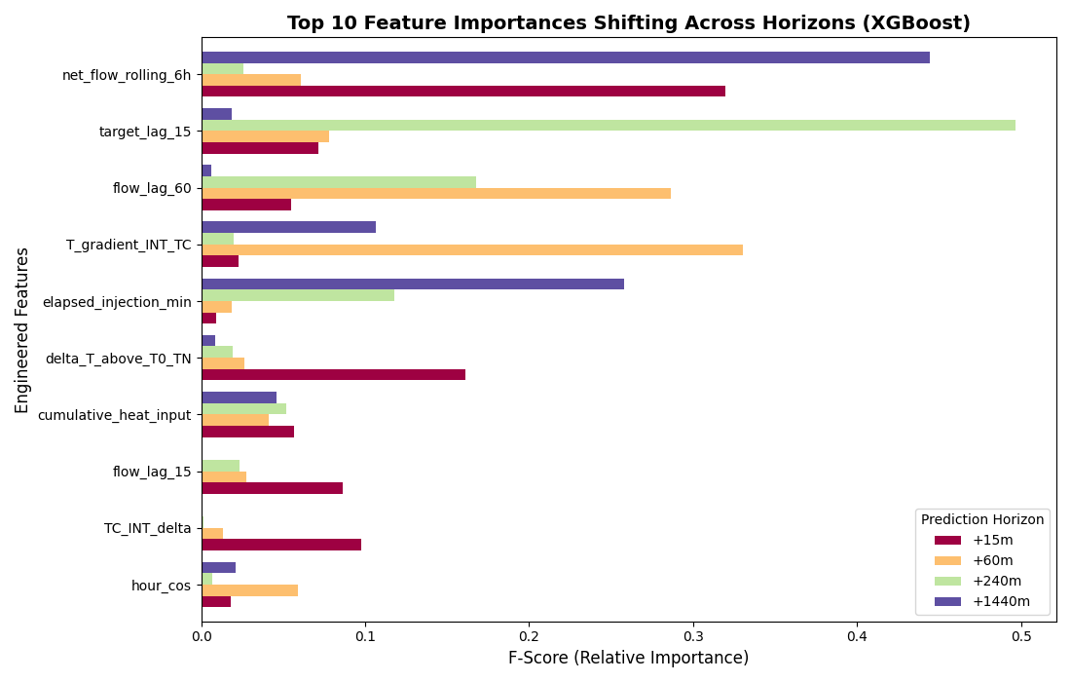
Visuals and insights
Prediction error for 15min horizon; All models are tracking with each other well.
Predicting temperature change (delta) addresses out of distribution issue in this data with trend.
Shift of importance in features for predicting different time horizon
Notes:
Talking points:
Target_lag_15 has a very high feature importance for the +240 prediction horizon; I am not sure physically why this would be the case and this relationship is suspect.
Probably needs more investigating to tease out what is happening and review of other engineered features.
The fact that net_flow_rolling_6h has a high feature importance is suspect because cumulative_heat_input (which also includes flow) has the same feature importance across each prediction horizon – this shows that the prediction horizon doesn’t matter at the injector to predict what is happening at the producing wells.
Probably needs more investigating and refinement to tease out what is happening here.

Slide 7
LLM Approach & Results
Approach
Prompt-based predictions
Structured outputs (JSON)
Strategy
Manual prompt construction
Verbose vs. compact style
Zero-shot, few-shot (1, 5, 10, 20)
Agentic auto prompt design loop
Each model designs its own prompting strategy and iterates with feedback from the previous round
Results
Best setup overall: gemma-3-12b-it + verbose_10
Manual prompts outperformed auto prompts
MSE: 0.0002 – 0.0013
R2: 0.897 – 0.986
Issues
Inconsistent formatting
Hallucinations -> wild predictions
Long prompts may cause model to lose track and degrade
Indeterministic, even with temperature and seed set to 0
Rank | gemma-3-12b-it | Phi-3.5-mini-instruct | Phi-mini-MoE-instruct
High | | | V Low | verbose_10 | verbose_1 | compact_20
 | compact_10 | compact_1 | verbose_1
 | compact_20 | verbose_zeroshot | compact_10
 | compact_5 | compact_5 | verbose_10
 | verbose_5 | compact_zeroshot | verbose_5
 | verbose_1 | verbose_5 | compact_5
 | compact_zeroshot | compact_10 | compact_1
 | compact_1 | verbose_10 | verbose_zeroshot
 | verbose_zeroshot | compact_20 | compact_zeroshot
Notes:
Notes: We then used an LLM to perform the same task. We designed prompts with structured outputs and used few-shot examples to improve consistency. The LLM achieved [metric] of [value].It handled flexible inputs well, but we observed issues like inconsistent formatting and hallucinations.

Slide 8
ML vs LLM Comparison
100 sample test
Model | Horizon | MSE_Manual | R2_Manual | MSE_ML | R2_ML | MSE_Persist | R2_Persist | MSE_Auto | R2_Auto | Best_R2
gemma-3-12b-it | 15 | 0.000255 | 0.981689 | 0.001511 | 0.891559 | 0.000338 | 0.97573 | 1.024761 | -72.530774 | Manual LLM
 | 60 | 0.000194 | 0.985994 | 0.001105 | 0.920094 | 0.000281 | 0.979662 | 1.025754 | -73.203785 | Manual LLM
 | 240 | 0.000443 | 0.966926 | 0.001568 | 0.882855 | 0.000313 | 0.976638 | 1.025949 | -75.672262 | Persistence
 | 1440 | 0.001345 | 0.896565 | 0.001111 | 0.914574 | 0.00109 | 0.91622 | 1.034243 | -78.523336 | Persistence
phi-3.5-mini-instruct | 15 | 0.00039 | 0.972003 | 0.001511 | 0.891559 | 0.000338 | 0.97573 | 0.002691 | 0.837785 | Persistence
 | 60 | 0.000346 | 0.974972 | 0.001105 | 0.920094 | 0.000281 | 0.979662 | 0.003307 | 0.79904 | Persistence
 | 240 | 0.000611 | 0.954322 | 0.001568 | 0.882855 | 0.000313 | 0.976638 | 0.005315 | 0.666334 | Persistence
 | 1440 | 0.001527 | 0.88259 | 0.001111 | 0.914574 | 0.00109 | 0.91622 | 0.011031 | 0.287542 | Persistence
phi-mini-moe-instruct | 15 | 0.00025 | 0.982062 | 0.001511 | 0.891559 | 0.000338 | 0.97573 | 0.000282 | 0.979747 | Manual LLM
 | 60 | 0.000225 | 0.983693 | 0.001105 | 0.920094 | 0.000281 | 0.979662 | 0.000252 | 0.981776 | Manual LLM
 | 240 | 0.000297 | 0.9778 | 0.001568 | 0.882855 | 0.000313 | 0.976638 | 0.000614 | 0.954134 | Manual LLM
 | 1440 | 0.001471 | 0.886932 | 0.001111 | 0.914574 | 0.00109 | 0.91622 | 0.001695 | 0.869675 | Persistence
Manual LLMs outperform ML on every horizon except 1440m.
Neither LLMs nor ML consistently beat the persistence baseline.
LLM accuracy and consistency vary a lot depending on the model and prompt.
LLM setup effort is lower than ML, takes longer to run, and may achieve surprisingly good accuracy.
Notes:
Notes: This slide highlights the key tradeoffs.
The ML model achieved higher accuracy and consistency, making it more reliable for structured predictions. The LLM is more flexible and faster to prototype, but less consistent.
So the key takeaway is: ML is better for control and reliability, while LLM is better for flexibility and rapid development.

Slide 9
Demo, Insights & Closing
Demo / System Flow
Input → Model → Output
Key Insights
Data quality strongly impacts results
ML is more reliable for structured tasks
LLM performance depends on prompt design
Limitations
Data bias / size
Model generalization
LLM variability
Future Work
Improve features and data
Refine prompts / models
Notes:
Notes:
Here’s a quick look at our system.
[Walk through demo briefly]
From this project, we learned that data quality is critical, ML models are more reliable for structured tasks, and LLM performance depends heavily on prompt design.
Some limitations include [bias, data size, variability].
In the future, we would improve this by [next steps].
Overall, this project demonstrates how AI can be applied to [real-world impact].
Thank you—happy to take questions.

Slide 10





Team ByteMe
Team Member | Lessons Learned
Judy Robinson Geophysicist, PM | Some of the F-scores in the ML feature importance were not expected and need more investigation, especially the relationship between the lagged variables and the prediction horizons.
Heather Sabella Systems Engineer | Garbage in, garbage out! Poor quality input data will inevitably produce poor model results. V&V are crucial steps!
Tse-Chun Chen Data Scientist | Persistence (analog prediction) is always a good baseline to examine. More inputs/features/complexity does not necessarily yield better results.
(Xue) Michelle Li Geospatial & Earth Scientist | Each LLM has its own “personality”, so getting the best results may require tailoring our prompts to the specific model.
Dana Vesty Terrestrial Ecologist | Ai is a useful tool but expertise is critical to understanding the data and the content created.

