Slide 1

Fractrue Thermal Energy Storage (FTSE)
Tea
Team 1: SubSignal
Juan Barajas
Stephen Ferencz
Rebecka Iveson
Kyle Weiss
Nino Zuljevic
Notes:
Notes: Hi, we’re Team [Name], and today we’ll present our AI solution for [problem].We’ll walk through our approach, results, and key insights from comparing machine learning and LLM methods.

Slide 2
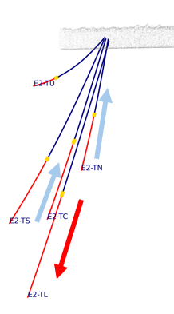
Problem
FTES stores excess heat in hydraulically created fractures and monitors conditions through multiparameter data from several boreholes. A major challenge is determining if and when fracture connectivity changes during pressurized injections or recovery.
Understanding changes in fracture connectivity can help understand long-term heat-storage performance and inform operational decisions.
Goal
Build an AI/ML model to automatically clean and process multi-resolution time-series data to quantify system behavior and build a technically defensible measured digital twin of the FTES system.
Success Criteria
Automated, accurate data processing achieved.
Temporal evolution of edge-weighting that is consistent with observed measurement differences at the wells in the given dataset.
Geothermal Test Site Data
Notes:
Notes: The problem we addressed is [problem], which leads to [impact]. Our goal was to build a model that can [task]. We defined success using [metric], while also ensuring results were consistent and comparable across ML and LLM approaches.

Slide 3
Data Overview & Challenges
Dataset
Source: Geothermal Data Repository
Size: 2,609 hourly time steps
Features: 68 + 4 Engineered
Challenges
Minor: Small # of missing values
Short observational time period and limited variety of operational conditions not well suited for system characterization for predicting future behavior
The data set was hourly time steps of features like temperature, pressure, etc from the Sanford Underground Research Facility between 12/10/24 to 3/24/25.
Notes:
Notes: We used [dataset], which includes [key features]. However, we encountered challenges such as missing values and potential bias in [area]. These issues directly influenced how we prepared the data and selected our models.

Slide 4
Approach Overview
Data Preparation: We cleaned and normalized the time-series data by removing faulty sensor channels, correcting duplicate time stamps and applying an appropriate scaling.
Model Selection: We evaluated available ML options and selected a spatio-temporal graph neural network (ST-GNN) because it can simultaneously learn spatial coupling between wells.
Workflow: We integrated datast cleaning, feature engineering, scaling, model selection, training and evaluation into reproducible end-to-end workflow documenting each step and ensurse ourputs align with desired deliverables.
Cleaned, reduced, engineered, and scaled multi-resolution time-series dataset.
Implemented and justified a spatio-temporal GNN for subsurface connectivity.
Integrated preprocessing, modeling, validation, and analysis into one pipeline.
Notes:
Notes: We cleaned and standardized the data, then engineered features like [A, B, C].We selected [model] because it fits the problem and balances performance with interpretability.We used a train-validation-test split and tuned hyperparameters before final evaluation.

Slide 5
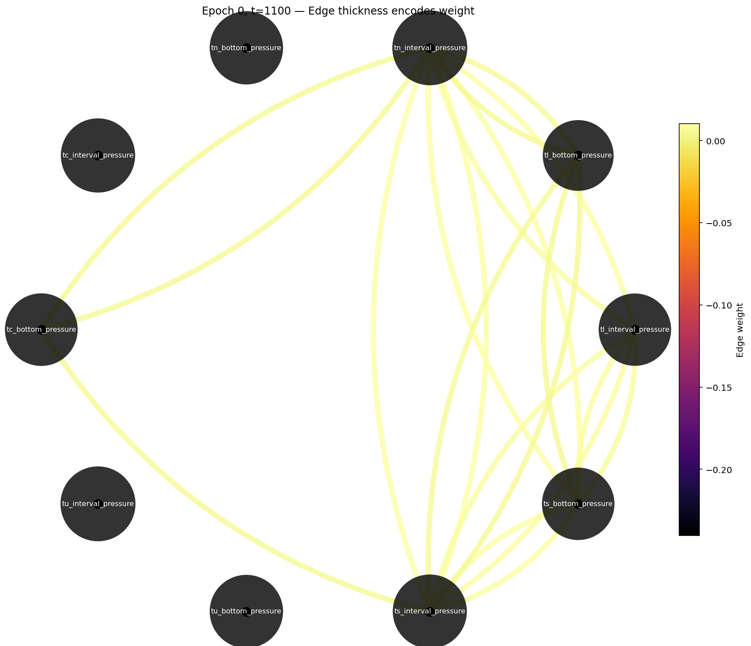
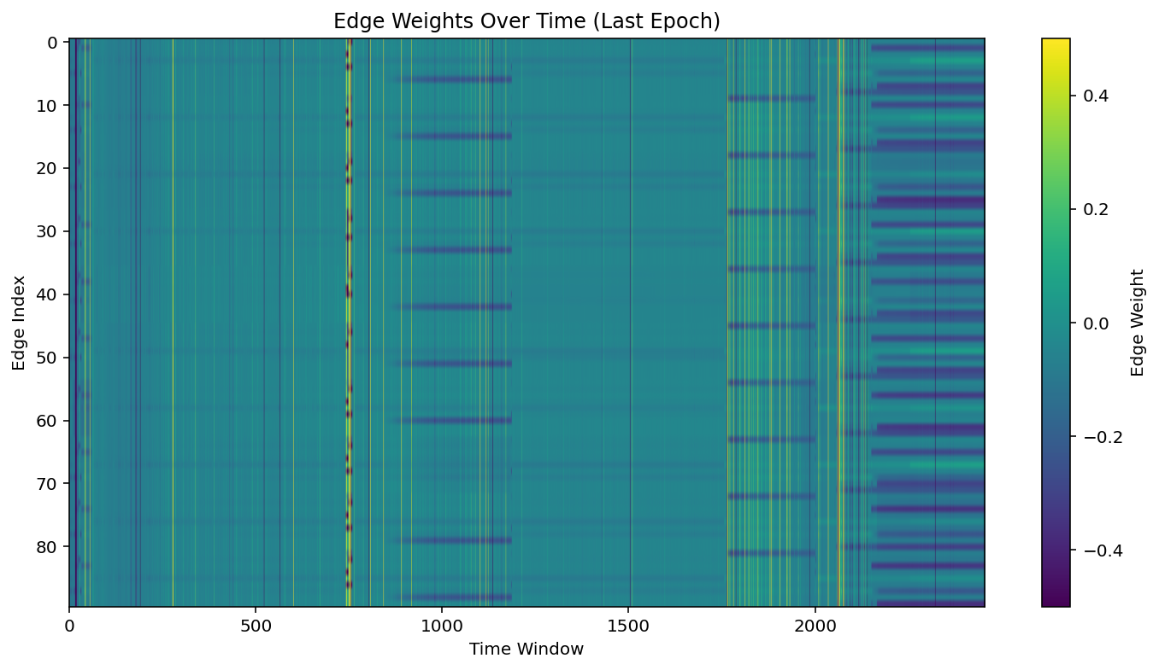
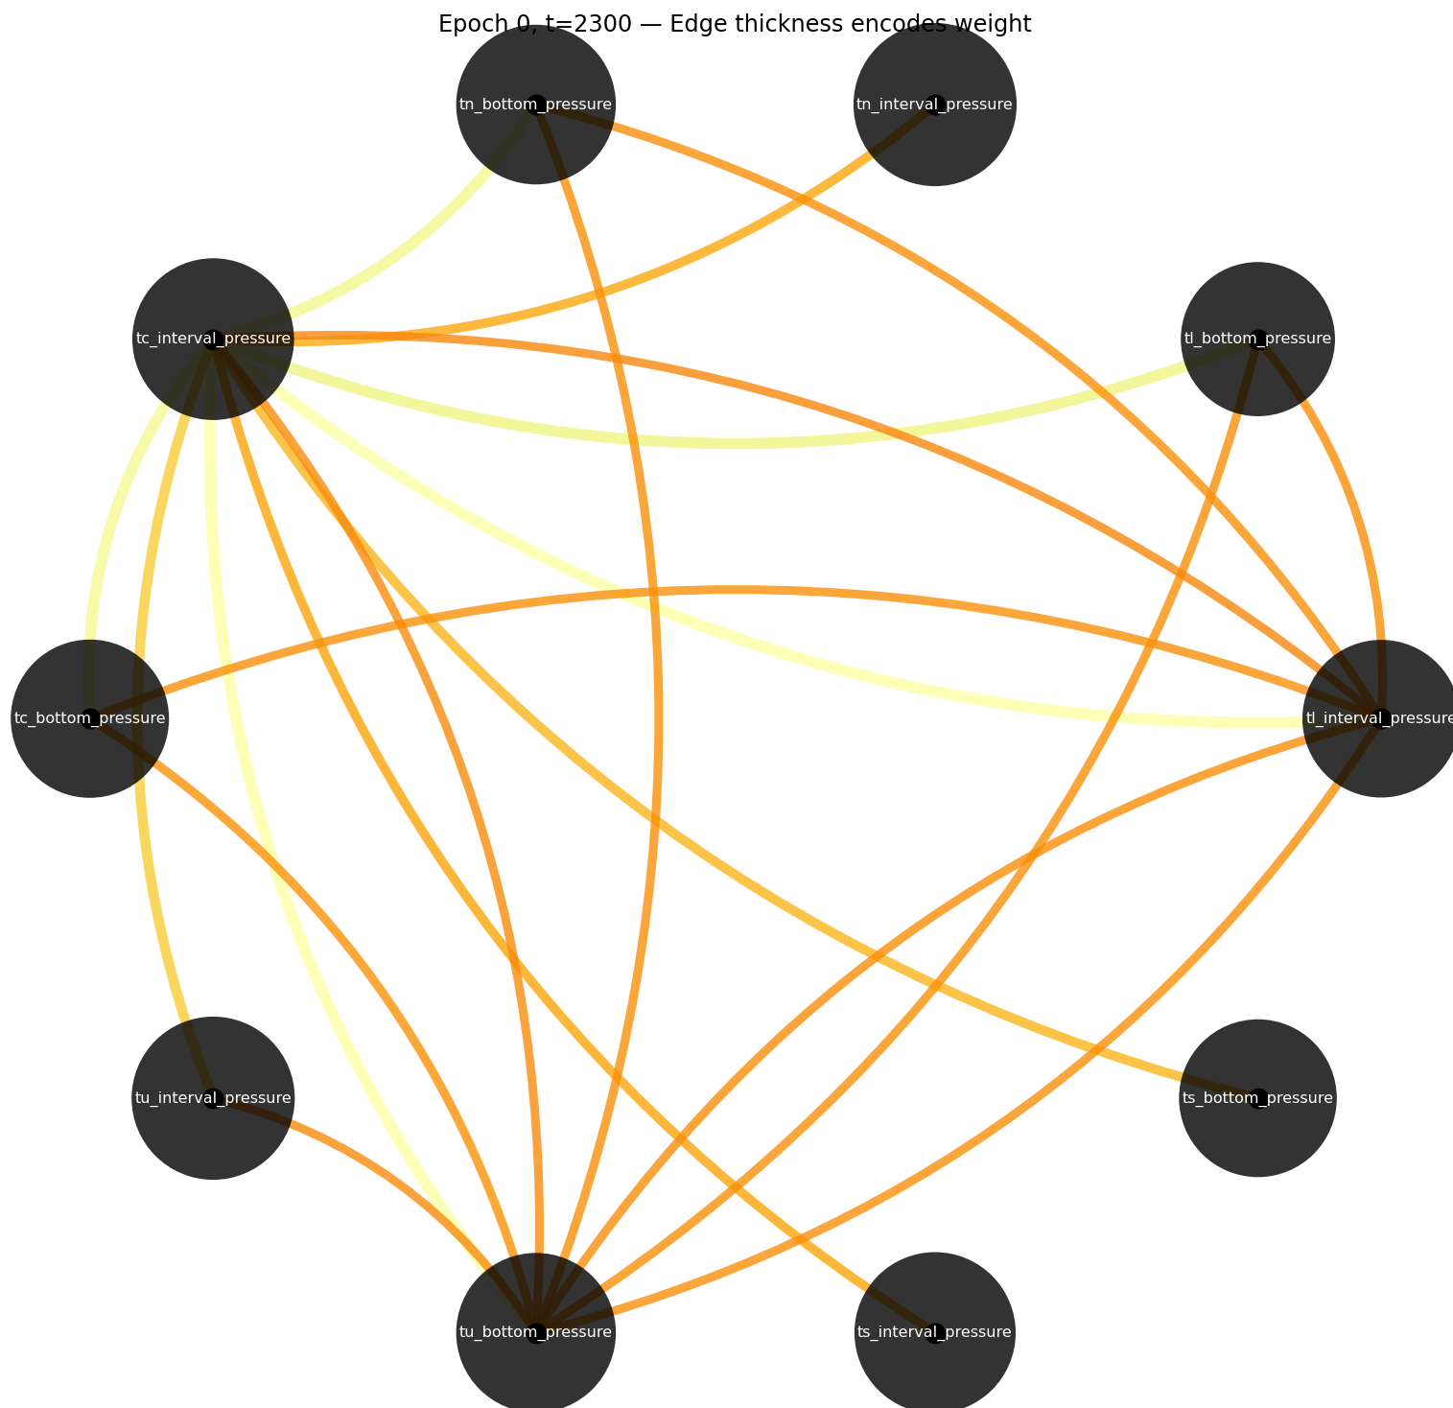
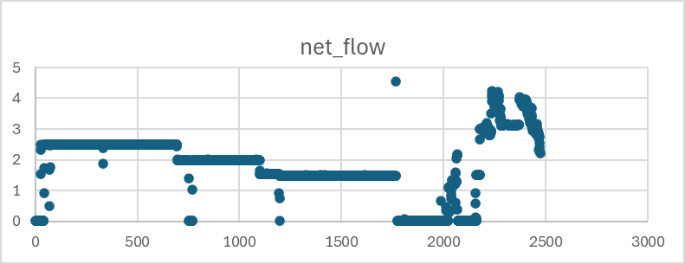
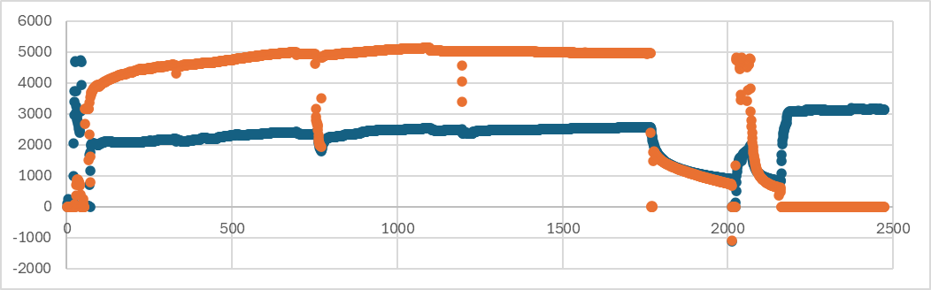
ML Results & Insights
Main takeaway: Temporal evolution of edge weights matches well with geothermal operations
T = 1,100
pumping
Edge Weights Between Well Nodes
injecting
Well combinations
T = 1,100
T = 2,300
furthest away
Snapshots of Graph Network
T = 2,300
pumping
Flow L/min
injecting
Pressure PSI
Notes:
Notes: This slide shows how our ML model performed.We achieved [metric] of [value], indicating [interpretation].The model performs well on [pattern], but struggles with [edge case].From our visualization, we can see that [explain briefly], which suggests that [insight].Overall, this tells us the model is [reliable / limited in specific ways].

Slide 6
LLM Approach & Results
Aspect | Notebook 1 (Amateur) | Notebook 2 (Software Engineer) | Notebook 3 (AI / Data Expert)
Task type | Regression (predict 10 continuous pressures) | Classification (risk labels) | Ranking/retrieval (top-3 node pairs)
ML Baseline | Ridge regression via normal equations (did not use Week 3 ML results) | Week 3 ML predictions loaded from CSV | GNN edge-weight tensor (ground truth derived from Week 3)
LLM(s) used | Phi-3.5-mini-instruct (single model, loaded locally via transformers) | Phi-3.5-mini, Phi-mini-MoE, Gemma-3-12b (three models via OpenAI-compatible API) | Gemma3:12b-it-qat (single model via Ollama)
LLM interface | Local HuggingFace model with model.generate() | Remote OpenAI-compatible endpoints (localhost ports 8000–8002) | Ollama with OpenAI-compatible API wrapper
Prompt style | Simple: summary stats + trend, asks for 10 comma-separated numbers | Strict JSON schema with prediction + confidence fields | Templated prompt with few-shot examples loaded from external files, strict JSON schema
Metrics | Standard regression error metrics to measure how close the LLM's predicted continuous pressure values are to the true values, plus latency timing per inference | Classification accuracy to check if the LLM's predicted risk label exactly matches the ground-truth label, alongside parse success rate to track how often each model returns valid structured JSON | Uses set-overlap and ranking metrics to measure how well the LLM identifies the same highest-connectivity node pairs as the GNN ground truth
Train/test split | No split — trains and evaluates Ridge on same windows (quick mode: 15 windows) | All samples sent to all models (no temporal split) | Formal temporal split: prompt_dev / purge / validation / purge / test
Notes:
Notes: We then used an LLM to perform the same task.We designed prompts with structured outputs and used few-shot examples to improve consistency.The LLM achieved [metric] of [value].It handled flexible inputs well, but we observed issues like inconsistent formatting and hallucinations.
Approach
Prompt-base predictions using 3 different LLMs, structured by 3 different team members
Structured outputs (JSON/table)
Strategy
Clear instructions + constraints
Few-shot examples
Results
[Metric]:[value]
Issues
Inconsistent formatting
Hallucinations

Slide 7
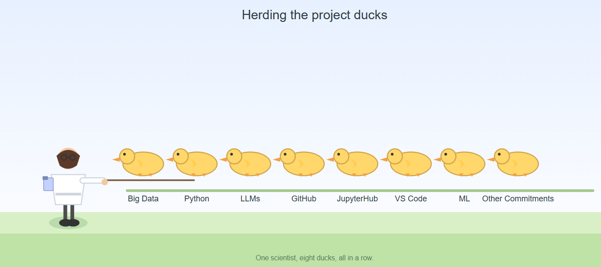
LLM Issues and Insights
Using integrated LLM added learning curve beyond just the data problem, so depending on experience, time deflected from actual problem
Notebook 1 simplified to building its own ML from scratch (ridge regression), due to coding and prompt issues.
No matplotlib in Jupyter Notebook environment – would have been a good way to visually validate results to ML method
Generated with GPT-5

Slide 8
ML vs LLM Comparison
Criteria | ML Model | LLM Approach
Physical Accuracy | High – grounded in numeric edge weights and temporal physics. | Mid- depends on narrative and prompt interpretation.
Consistency | High – deterministic, repeatable predicitons. | Low-Mid – varies with promts and model randomness.
Speed | Faster – batch interferance across all windows. | Slower – pre-record LLM queries add latency.
Effort | Higher Upfront – data prep + model training. | Lower Up front, higher ongoing – prompt tuning + parsing fixes.
Flexibility | Mid - limited to engineered features and GNN structure. | High – can interpret diverse narratives and contexts.
Time Invested | 8+ hours to setup | 1-4 hours depending on team member
Notes:
Notes: Our model is evaluated slightly differently, we won’t predicting heatwaves or temperatures, but we were looking to see how well the model recreated the physical system.
Notes: This slide highlights the key tradeoffs.
The ML model achieved higher accuracy and consistency, making it more reliable for structured predictions. The LLM is more flexible and faster to prototype, but less consistent.
So the key takeaway is: ML is better for control and reliability, while LLM is better for flexibility and rapid development.

Slide 9
Demo, Insights & Closing
Demo / System Flow
Observational well data→ Graph NN → Edge weights over time
Key Insights
The tools people use in their day to day make a big difference – if we could have more easily combined our 6 personnas into 1, we would have been unstoppable
ML is more reliable for structured tasks
LLM performance depends on prompt design but can potentially get you answers quicker. Need to balance the risk vs. desired outcome.
Limitations
ML approach has steeper learning curve to setup and troubleshoot
LLM variability – what you have access to (free vs. paid; integrated vs. AI incubator), makes a difference for speed and quality of output
Future Work
Continue to learn to use these tools, so that when you need to apply them, the learning curve is less steep
Stay up to date on latest models, agents, skills, etc.
Notes:
Notes:
Here’s a quick look at our system.
[Walk through demo briefly]
From this project, we learned that data quality is critical, ML models are more reliable for structured tasks, and LLM performance depends heavily on prompt design.
Some limitations include [bias, data size, variability].
In the future, we would improve this by [next steps].
Overall, this project demonstrates how AI can be applied to [real-world impact].
Thank you—happy to take questions.

Slide 10
Key Learning Milestones
Stephen: Chat-assisted coding, ST-GNN ML modeling
Kyle: ST-GNN ML modeling, increased familiarity with GitHub, and using a variety of chat agents.
Becka: Introduction to GitHub, reintroduction to Jupyter Notebooks/Hub, learned to use basic VS code and CoPilot set up for ask, plan, do actions, ST-GNN ML modeling introduction
Nino: Learned how to run notebooks in Jupyter Hub, introduction to ST-GNN ML modelling
Juan: Introduced to ST-GNN ML modeling, increased knowledge around data prep for ML, tangent on prediction ML and auto research style LLM enabled ML repositories.
Notes:
Note: could also break this up by phase, but want each person discussing unique aspects they learned about or from in this project (e.g., how to prompt an LLM, what hyperparameters do for a model, etc.)

