Slide 1
GRID · COMPOUND RISK
■
ESSD AI CHALLENGE · FINAL PRESENTATION · APR 27, 2026
TEAM ZERO SHOT HOPEFULS
Compound Hazard Forecasting.
A location-aware, one-week-ahead model for co-occurring heatwaves and droughts across the contiguous U.S. — benchmarked head-to-head against three small LLMs.
TEAM
DATA
Avi Joshi
Sarah Saslow Leah Hare Carolyn Pearce
PNNL AI-Ready Benchmark US Fires, Heatwaves, Droughts 2001 – 2020 · CONUS
Notes:
Hi everyone, we're Team Zero Shot Hopefuls, and over the next ten minutes we'll walk you through how we built a one-week-ahead forecast for compound hazards — heatwaves and droughts occurring together — across the contiguous U.S. We'll cover the problem, the data, our methodology, results, how machine learning stacked up against LLMs on the same task, and what we learned along the way.

Slide 2
■
ZERO SHOT HOPEFULS
/
ESSD AI CHALLENGE
PROBLEM
Compound hazards demand compound forecasts.
CLIMATE
SYSTEMS
PEOPLE
Heatwaves, droughts, and wildfires increasingly co-occur across the U.S. — and their joint severity is greater than the sum of parts.
Traditional forecasting treats each hazard independently, missing the compounding effect where one hazard primes the next.
Emergency managers lack the lead time to shift from reactive response to proactive preparation, staging, and communication.
COMPOUND HAZARD FORECASTING · APR 2026
02
/ 13
Notes:
Let's start with why this matters. Climate change is making heatwaves, droughts, and wildfires co-occur more often, and the joint severity is worse than the sum of parts. But most forecasting systems still treat each hazard independently. The result: emergency managers get late, siloed signals and stay stuck in reactive mode. A compound forecast gives them lead time to pre-position resources and communicate risk before it lands.

Slide 3
■
ZERO SHOT HOPEFULS
/
ESSD AI CHALLENGE
TASK · GOAL · SUCCESS CRITERIA
Forecast one week ahead, with a calibrated AUC ≥ 0.95.
THE TASK, FORMALLY
SUCCESS CRITERIA
TARGET(t + 1 wk) =
01
AUC-ROC ≥ 0.95
HI02 == 1ANDPDSI.cat ≤ 3
on held-out 2018–2020 test set
02
Calibrated probabilities
// per weekly grid cell, CONUS
low Brier score, reliable ranking of risk
// probability output, 0.0 – 1.0
03
Fair ML vs LLM comparison
same features, same test set, same metrics
COMPOUND HAZARD FORECASTING · APR 2026
03
/ 13
Notes:
Our task, formally: predict the probability of a compound heatwave-and-drought event one week ahead, at weekly resolution, per grid cell across CONUS. The label combines HI02 — a heatwave flag — with a PDSI drought category of 3 or lower. We set three success criteria up front: AUC-ROC of at least 0.95 on the held-out test set, well-calibrated probabilities, and a fair head-to-head with LLMs on exactly the same features and metrics.

Slide 4
■
ZERO SHOT HOPEFULS
/
ESSD AI CHALLENGE
DATASET · METHODOLOGY
Twenty years of grid-cell climate data — four percent of it dangerous.
314K
26
CHALLENGES WE HAD TO DESIGN AROUND
Severe class imbalance.
WEEKLY GRID-CELL ROWS
FEATURES (19 RAW + 7 ENGINEERED)
Only ~4% of weeks are compound events.
20
~4%
Missing values.
Meteorological + fire variables, uneven by cell.
YEARS · 2001 – 2020
COMPOUND EVENTS (POSITIVE CLASS)
Dataset cut-off at 2020.
Recent climate regime shifts are not represented.
Daily → weekly aggregation.
Source: PNNL "AI-Ready Benchmark Data for US Fires, Heatwaves, and Droughts"
Binary and continuous features need separate logic.
COMPOUND HAZARD FORECASTING · APR 2026
04
/ 13
Notes:
We used the PNNL AI-Ready benchmark — about 314,000 weekly grid-cell rows from 2001 to 2020, with 19 raw features covering temperature, drought indices, fire, and meteorology, plus 7 features we engineered. The hard part isn't size, it's the shape: only about 4% of weeks are compound events. So we're a rare-event problem with missing values, daily-to-weekly aggregation choices, and a dataset that cuts off before the extreme seasons of the last few years.

Slide 5
■
ZERO SHOT HOPEFULS
/
ESSD AI CHALLENGE
METHODOLOGY
Clean, aggregate, engineer, split — in that order.
01 · CLEAN
02 · ENGINEER
03 · SPLIT
04 · MODEL
Daily → weekly
Seven added features
Chronological, no leakage
Two models, different jobs
Logistic Regression as an interpretable baseline · LightGBM for non-linear interactions, with SHAP for explanation.
Aggregate NetCDF rasters; handle binary vs continuous features separately; zero-fill fire NaNs where semantically valid.
wind_speed · seasonal_sin/cos · tmean_7d_avg · drought_trend_14d · fwi_7d_max · pdsi_category.
Train 2001–2015 · Validate 2016–2017 · Test 2018–2020. Hyperparameters tuned on val only.
↳
Threshold tuned on validation (0.65 vs default 0.50) to prioritise recall for a rare-event early warning.
COMPOUND HAZARD FORECASTING · APR 2026
05
/ 13
Notes:
Our pipeline is four steps. One: clean and aggregate daily NetCDF data to weekly, handling binary and continuous features separately. Two: engineer seven features — wind speed, seasonal sine and cosine, a 7-day mean temperature, a 14-day drought trend, a 7-day max fire weather index, and a PDSI category. Three: a strictly chronological split — train on 2001 through 2015, validate on 2016 and 2017, test on 2018 through 2020 — so no future information ever leaks backward. Four: two models, chosen for what they each reveal. Logistic regression as an interpretable baseline, and LightGBM for non-linear interactions, explained with SHAP. And one operational choice: we tuned the decision threshold on validation up to 0.65 to prioritise recall.

Slide 6
■
ZERO SHOT HOPEFULS
/
ESSD AI CHALLENGE
RESULTS · HELD-OUT TEST SET (2018–2020)
LightGBM excels at discrimination; logistic regression offers a clear baseline for comparison.
LIGHTGBM · AUC-ROC
THE HEADLINE
Both models clear the AUC ≥ 0.95 bar. LightGBM wins on F1, recall, and calibration.
0.989
Near-perfect ranking of compound-event weeks vs. non-event weeks.
WHY IT MATTERS
LightGBM catches 1,189 more true compound events than the logistic baseline on the same test set.
F1
RECALL
BRIER
PRECISION
0.643
80%
0.020
0.59
CAVEAT
0.579
66%
0.042
0.54
Absolute precision is capped by the ~4% base rate. Even a perfect model will return some false alarms.
■ LightGBM
■ Logistic Regression
COMPOUND HAZARD FORECASTING · APR 2026
06
/ 13
Notes:
Here are the results on the held-out test set. LightGBM lands at an AUC of 0.989 — it's almost perfectly ranking compound-event weeks above non-event weeks. Both models clear the 0.95 bar we set. LightGBM wins on F1 at 0.643 versus 0.579, on recall at 80% versus 66%, and on calibration — a Brier score of 0.020. Concretely, LightGBM catches 1,189 more real compound events than the logistic baseline on the same data. The one honest caveat: because only 4% of weeks are positive, absolute precision is capped — even a perfect model returns some false alarms at this base rate.

Slide 7
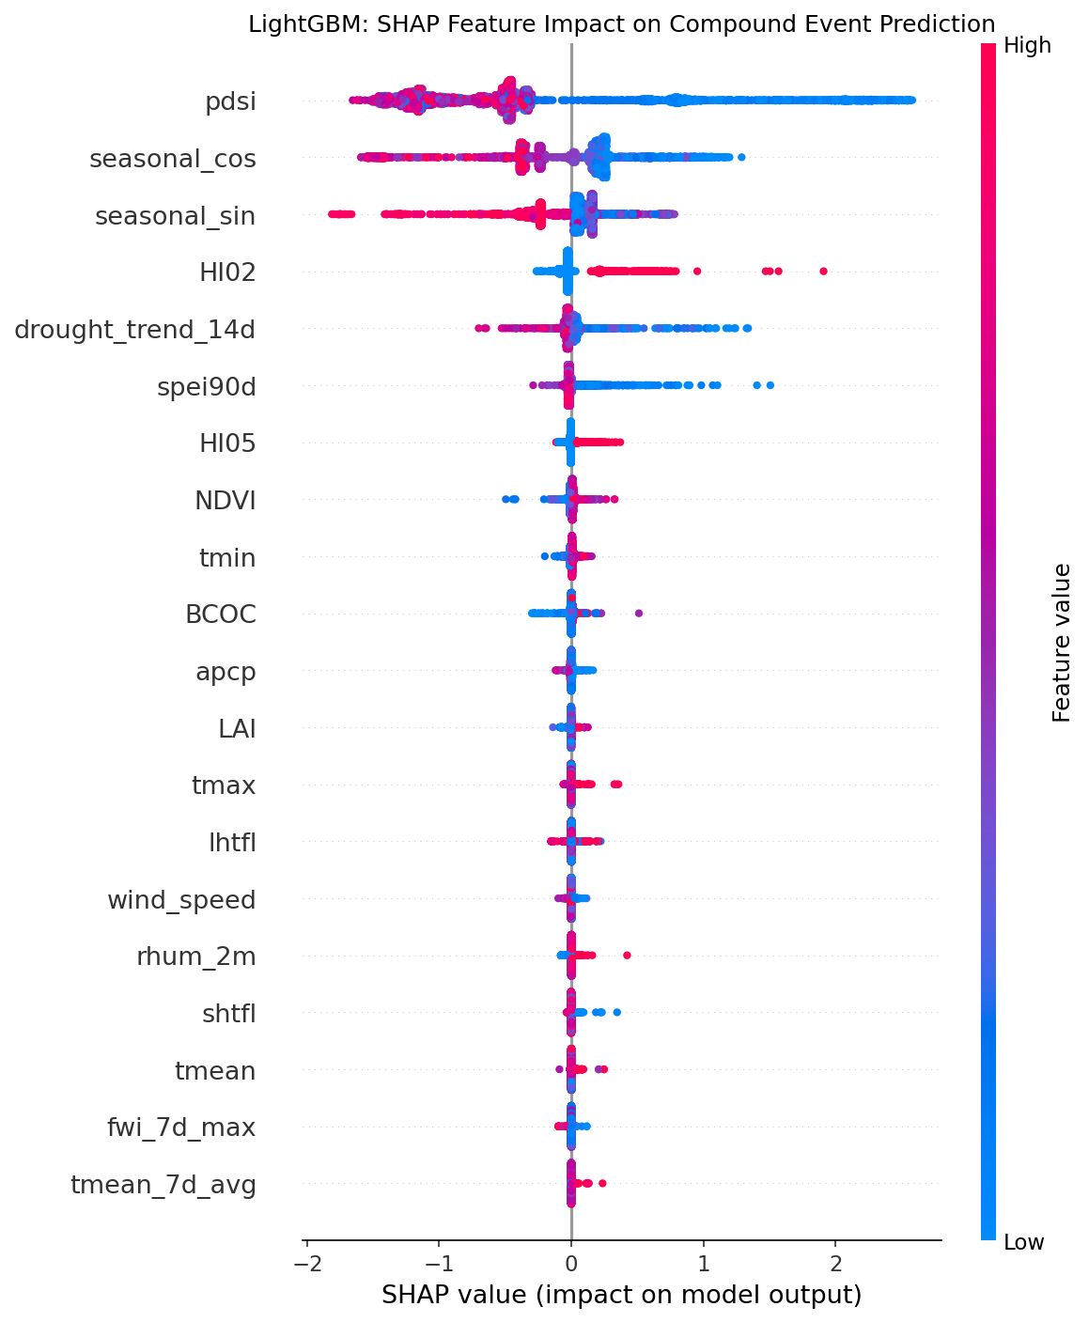
■
ZERO SHOT HOPEFULS
/
ESSD AI CHALLENGE
INTERPRETABILITY · SHAP
Drought severity and seasonal timing drive the predictions.
LIGHTGBM · SHAP FEATURE IMPACT
01
PDSI
Palmer Drought Severity Index — single strongest predictor.
02
seasonal_cos / seasonal_sin
Calendar timing: late-summer weeks carry elevated risk.
03
HI02
Heatwave indicator — heat and drought must co-occur.
04
drought_trend_14d
Two-week drying trajectory matters more than a snapshot.
05
spei90d
90-day standardised precipitation evapotranspiration.
COMPOUND HAZARD FORECASTING · APR 2026
07
/ 13
Notes:
On interpretability: we ran SHAP on the LightGBM model, and the top drivers are exactly what a climate scientist would hope to see. PDSI — Palmer Drought Severity Index — is the single strongest predictor. Then seasonal cosine and sine, which encode calendar timing; HI02, the heatwave flag; the 14-day drought trend; and SPEI. The direction also matches physical intuition: more negative PDSI pushes the SHAP value up, meaning the model has learned that deeper drought raises compound-event probability. It's not picking up spurious correlations.

Slide 8
■
ZERO SHOT HOPEFULS
/
ESSD AI CHALLENGE
LLM BENCHMARK · THREE LOCALLY-HOSTED MODELS
Small LLMs can parse the task, but not the numbers.
HOW WE RAN IT
THREE MODELS ON THE SAME 1,000-ROW TEST SAMPLE
// prompt each row with 26 features
Phi-3.5-mini-instruct
0.464
0.832
BEST LLM
// name, value, units, domain range
Phi-mini-MoE-instruct
0.225
0.794
OVER-PREDICTS
output
=
{
"prediction": 0 | 1, "confidence": 0.0 – 1.0
gemma-3-12b-it
0.279
0.388
BELOW RANDOM
}
// 4 prompt variants tested:
THE FAILURE MODE
v1 · zero-shot, all 26 features
Confidence calibration is inverted — models report higher confidence when wrong than when right. Their self-assessment is unusable.
v2 · few-shot, all 26 features
v3 · zero-shot, top-8 SHAP
v3_few · few-shot, top-8 SHAP
Run on PNNL JupyterHub. Few-shot examples drawn exclusively from training set (2001–2015) to prevent leakage.
08
/ 13
Notes:
Now the LLM side. We ran three locally-hosted models — Phi-3.5-mini, Phi-mini-MoE, and gemma-3-12b — on the same 1,000-row stratified test sample. We presented each feature with a name, value, units, and a domain range, and constrained output to strict JSON. We tested four prompt variants: zero-shot and few-shot, with all 26 features and with just the top-8 SHAP features. Parse success was 100% across the board. But the content broke down. The best LLM — Phi-3.5-mini — got to F1 0.464 and AUC 0.832. The other two over-predicted positives so aggressively that 85% of their alarms were false. And across all three, confidence calibration was inverted — they were more confident when wrong than when right. Their self-reported confidence is not a usable signal.

Slide 9
■
ZERO SHOT HOPEFULS
/
ESSD AI CHALLENGE
ML VS LLM · HEAD-TO-HEAD
For operational forecasting, ML wins on every axis that matters.
CRITERION
LIGHTGBM
BEST LLM · PHI-3.5-MINI
ML WINS
Accuracy (F1)
0.644
0.464
✓
Discrimination (AUC)
0.987
0.832
✓
Calibration (Brier ↓)
0.020
0.149
✓
Consistency
High · deterministic
Medium · prompt-sensitive
✓
Speed / row
Milliseconds
Seconds
✓
Setup effort
High · features + tuning
Low · prompt only
—
Labeled data needed
Yes
No
—
Interpretability
SHAP, coefficients
Natural language · unreliable
✓
TAKEAWAY
WHERE LLMs STILL HELP
LightGBM beats the best LLM by ~39%
on F1 with the same features, data, and metrics.
Rapid prototyping when no labeled data exists yet — Phi-3.5-mini reaches F1 0.46 with zero training.
09
/ 13
Notes:
Head-to-head, on the same features, same data, same metrics: LightGBM beats the best LLM by about 39% on F1. It's faster per prediction, deterministic, better-calibrated, and explainable through SHAP. The only axes where LLMs win are setup effort and the fact that they need zero training data. So the honest framing is: for operational compound-hazard forecasting, ML is the clear choice. LLMs are useful for rapid prototyping when labeled data doesn't exist yet — Phi-3.5-mini reaching 0.46 F1 from prompts alone is a useful baseline.

Slide 10
■
ZERO SHOT HOPEFULS
/
ESSD AI CHALLENGE
LIMITATIONS · RISKS · FUTURE WORK
What the model doesn't know.
DATA
CLASS IMBALANCE
SCOPE
Training window ends in 2020
~4% base rate caps precision
LLM comparison is small-model only
Even with balanced weighting, false alarms are inherent to rare-event forecasting. The 0.65 threshold favours recall — an operational choice.
2021–2025 brought record heat, drought, and fire seasons. The model has not seen them. Recent climate regimes may be out-of-distribution.
7–12B models only, run locally on JupyterHub. Frontier models (70B+) or climate-domain fine-tunes may narrow the gap we found.
COMPOUND HAZARD FORECASTING · APR 2026
10
/ 13
Notes:
A few things the model doesn't know, that we want to be upfront about. First, training ends in 2020 — the extreme fire and heat seasons since then are out-of-distribution. Second, the 4% base rate fundamentally caps precision, and our 0.65 threshold is an operational choice trading precision for recall. Third, our LLM comparison was constrained to 7-to-12-billion-parameter models running locally. Frontier models or a climate-domain fine-tune might narrow the gap. Next steps: add spatial features — latitude, longitude, elevation, land cover — test larger or fine-tuned LLMs, and explore a hybrid that pairs ML probabilities with LLM-generated risk narratives for emergency managers.

Slide 11
■
ZERO SHOT HOPEFULS
/
ESSD AI CHALLENGE
KEY INSIGHTS
Three things we learned about the problem itself.
01
Drought severity is the single strongest signal.
PDSI dominates SHAP rankings. When PDSI drops below ~-2, compound-event probability climbs sharply — matching physical intuition.
02
Threshold choice changes the story.
Moving the decision threshold from 0.50 → 0.65 lifted recall from ~60% to 80% — critical for a rare-event early warning.
03
For structured numeric prediction, purpose-built ML still wins.
Feature engineering and calibration compound in value; prompt engineering alone does not substitute for training data.
COMPOUND HAZARD FORECASTING · APR 2026
11
/ 13
Notes:
Zooming out, three insights about the problem itself. One: drought severity is the dominant signal — once PDSI drops below about -2, compound-event probability climbs sharply. Two: threshold choice reframes the product. Moving from 0.50 to 0.65 lifted recall from around 60% to 80%, which for a rare-event early warning is the difference between useful and not. Three: for structured numeric prediction, purpose-built ML still wins. Feature engineering and calibration compound in value; prompt engineering alone does not substitute for training data.

Slide 12
■
ZERO SHOT HOPEFULS
/
ESSD AI CHALLENGE
LEARNING OUTCOMES
Four people, four lessons.
AJ
Avi Joshi
SS
Sarah Saslow
LLM LEAD
GITHUB APPRENTICE
“ LLMs can be delusional, always verify their work. ”
“Start small and build from there. You don't have to complete your entire task in one ask. ”
LH
Leah Hare
CP
Carolyn Pearce
WORKFLOW & DOCS
ANALYSIS & EVALUATION
“ Don't be afraid to try. Keep notes of what worked and what didn't. ”
“ Learning about AI is much more fun as a team (especially if you have a spirit guide). ”
COMPOUND HAZARD FORECASTING · APR 2026
12
/ 13
Notes:
Finally, what each of us took away.

Slide 13
■ ZERO SHOT HOPEFULS
Q & A
Thank you.
Notes:
Thank you. We're happy to dig into the methodology, the ML vs LLM tradeoffs, or where this pipeline would go next. Questions?

